Slide 1
Science & Education Report

Slide 2
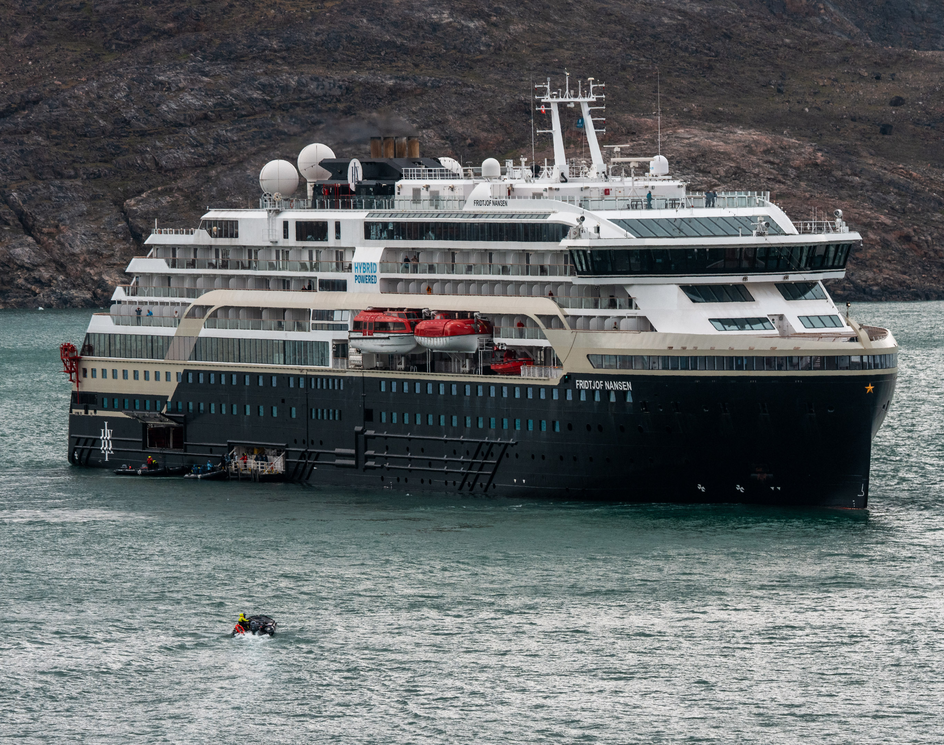
Grand Greenland – Mythical Lands of the North
MS Fridtjof Nansen
18 July – 1 August 2026
Notes:
Add Ship name, dates and voyage name

Slide 3
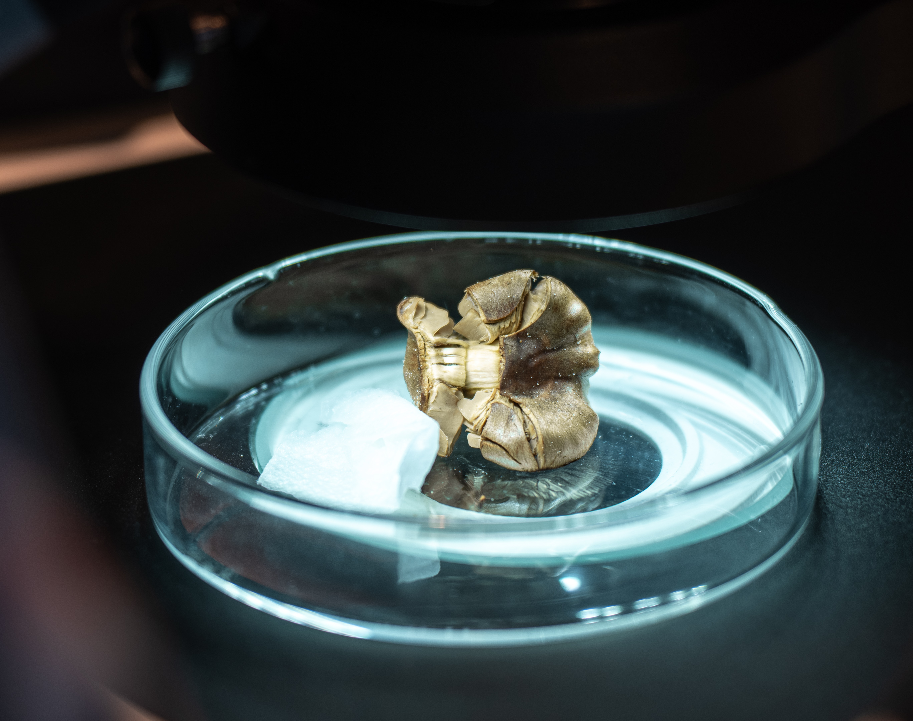
Science & Education Programme
As we sailed along the Greenland coast, we journeyed together through landscapes shaped by sea, weather, wildlife, history, and time.
Through lectures, workshops, time on deck, and moments ashore, we explored coastlines, fjords, islands, seabirds, whales, plants, clouds, and the forces shaping this polar route, while contributing to Citizen Science along the way.
We hope these shared experiences helped deepen your connection to the places we visited and inspired you to keep observing, recording, and caring for the natural world beyond this voyage.
Notes:
Add brief summary of the Science & Education Program over the whole voyage

Slide 4
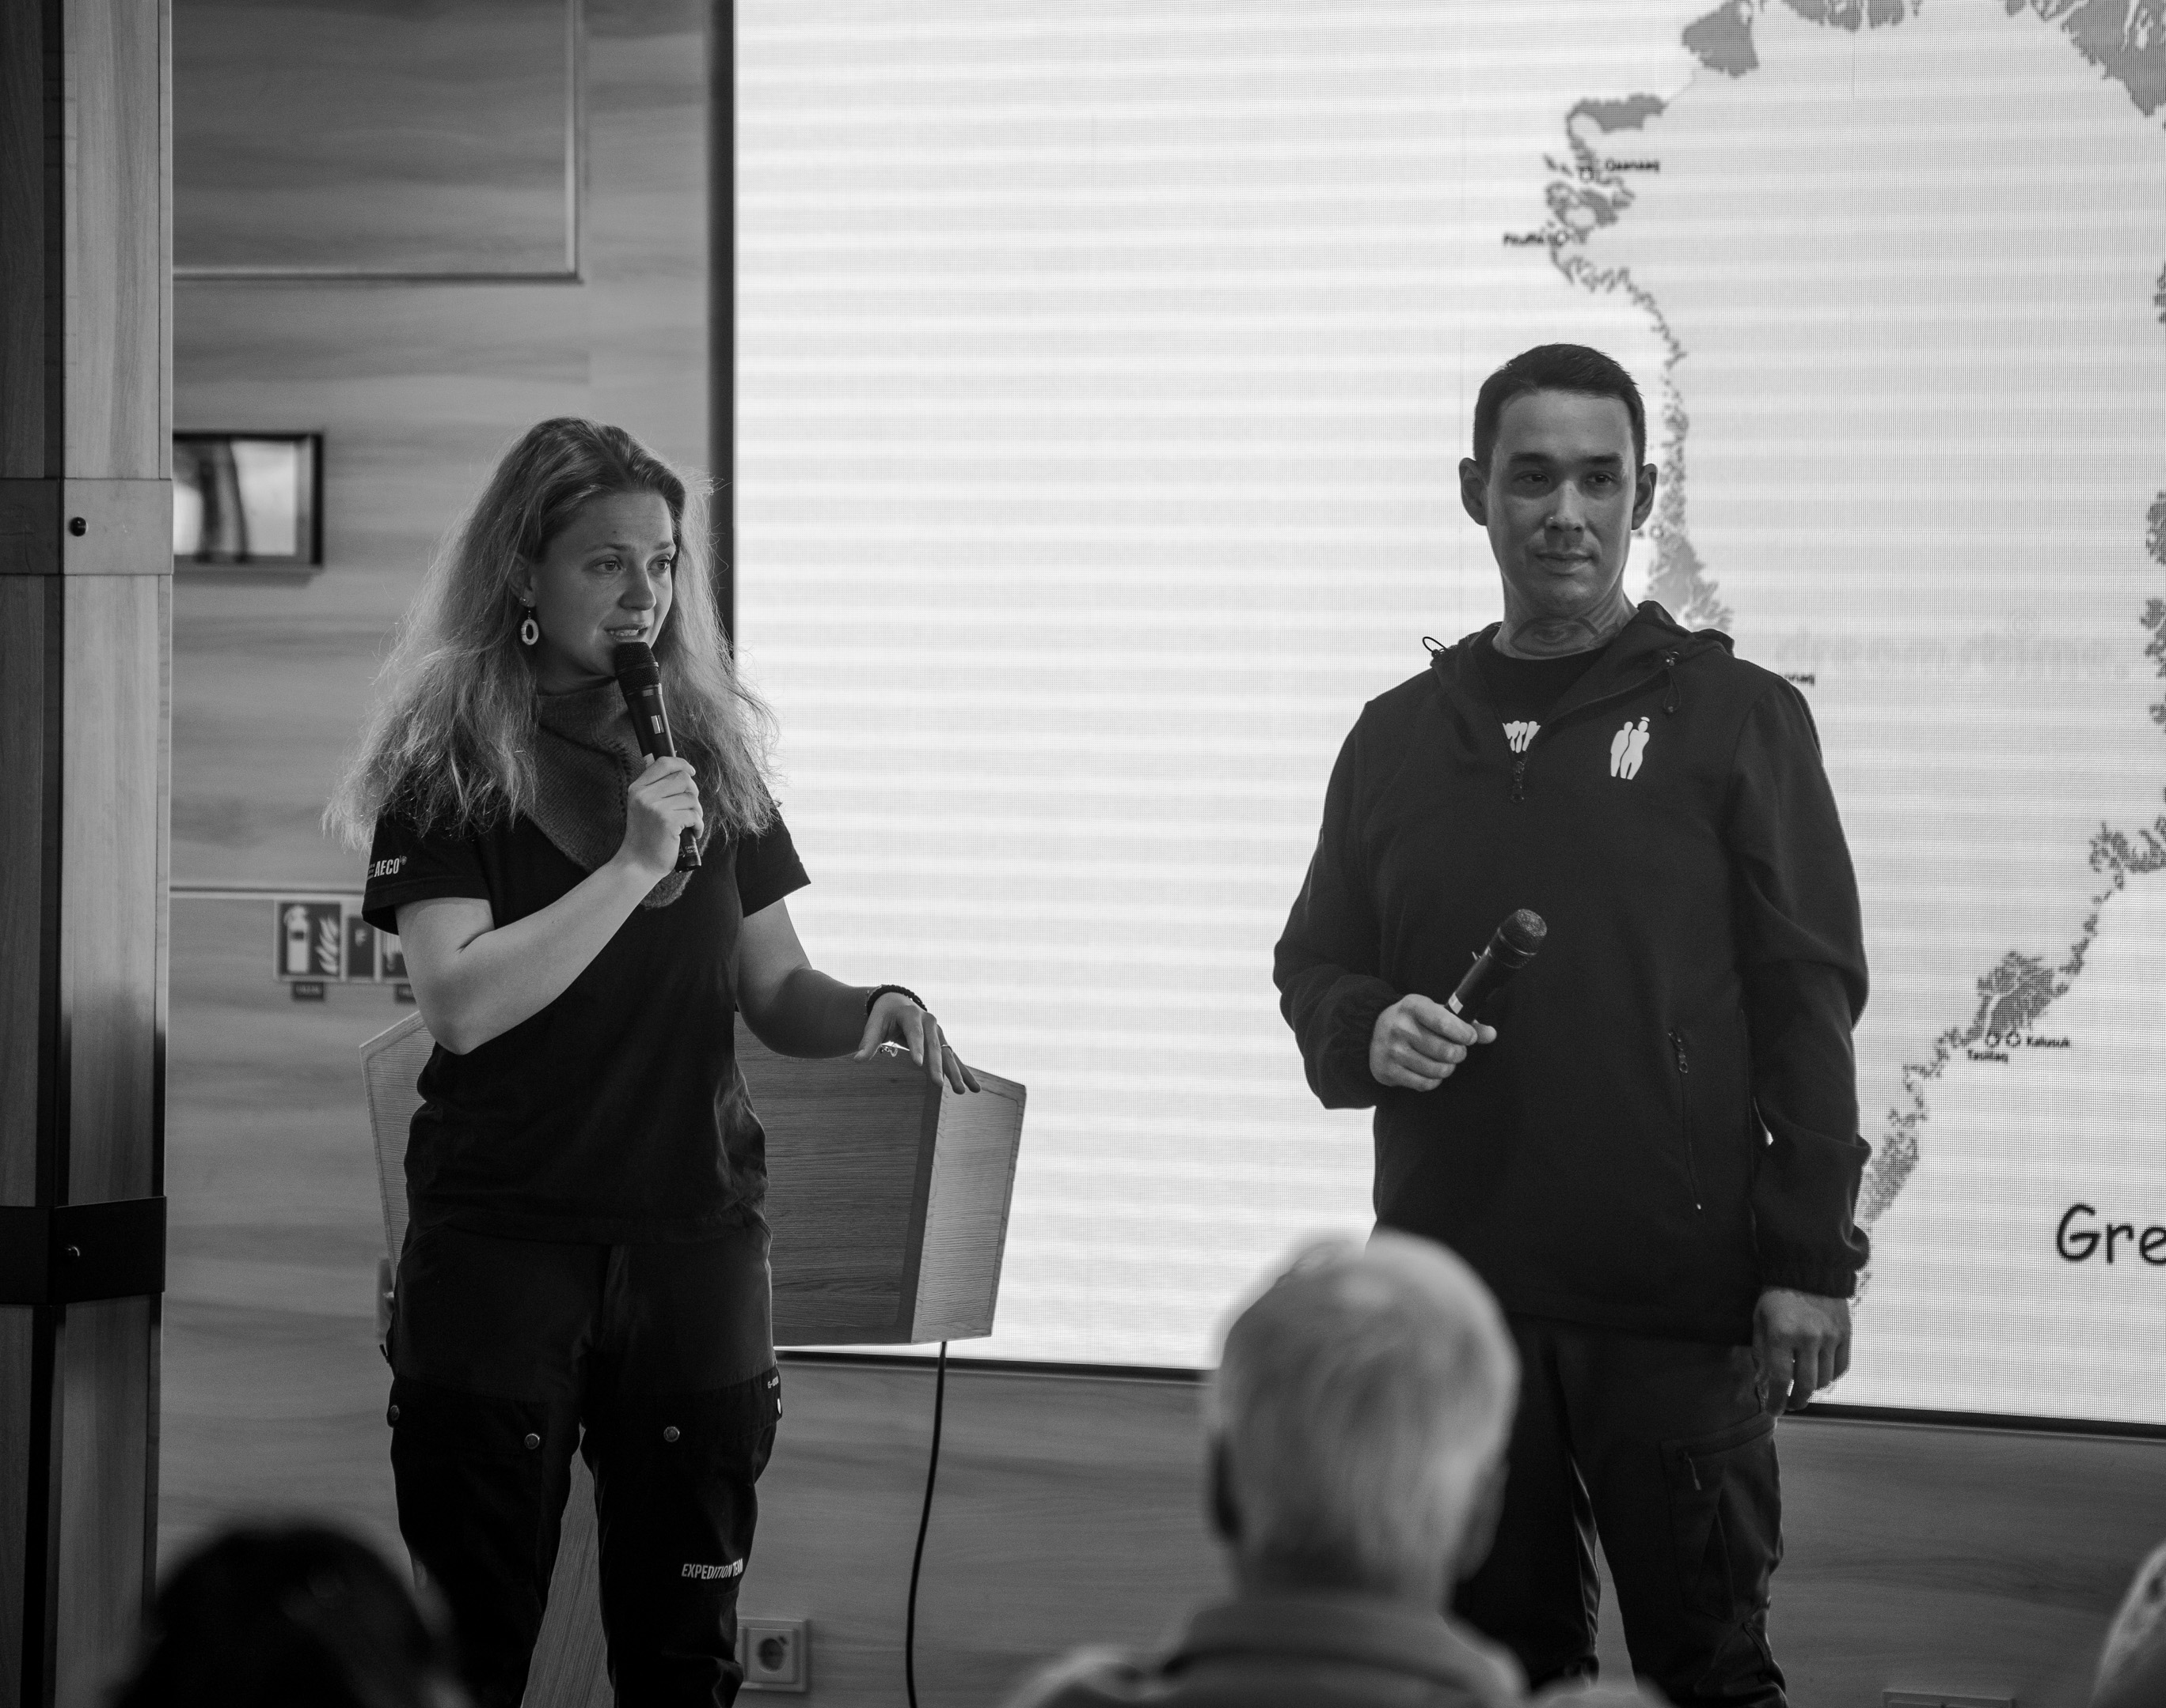
History & Culture
You discovered Greenlandic settlements and received a warm welcome from every community we visited. Through lectures and discussions with Sidsel and Chef Laasi, we gained a deeper understanding of Greenlandic traditions, cuisine, daily life, and the deep connection between people and nature. You also learned about the challenges and opportunities of living in the Arctic and picked up some basic Greenlandic words, deepening your sense of Greenland's culture and way of life.
Notes:
Add summary of history workshops or hikes undertaken

Slide 5
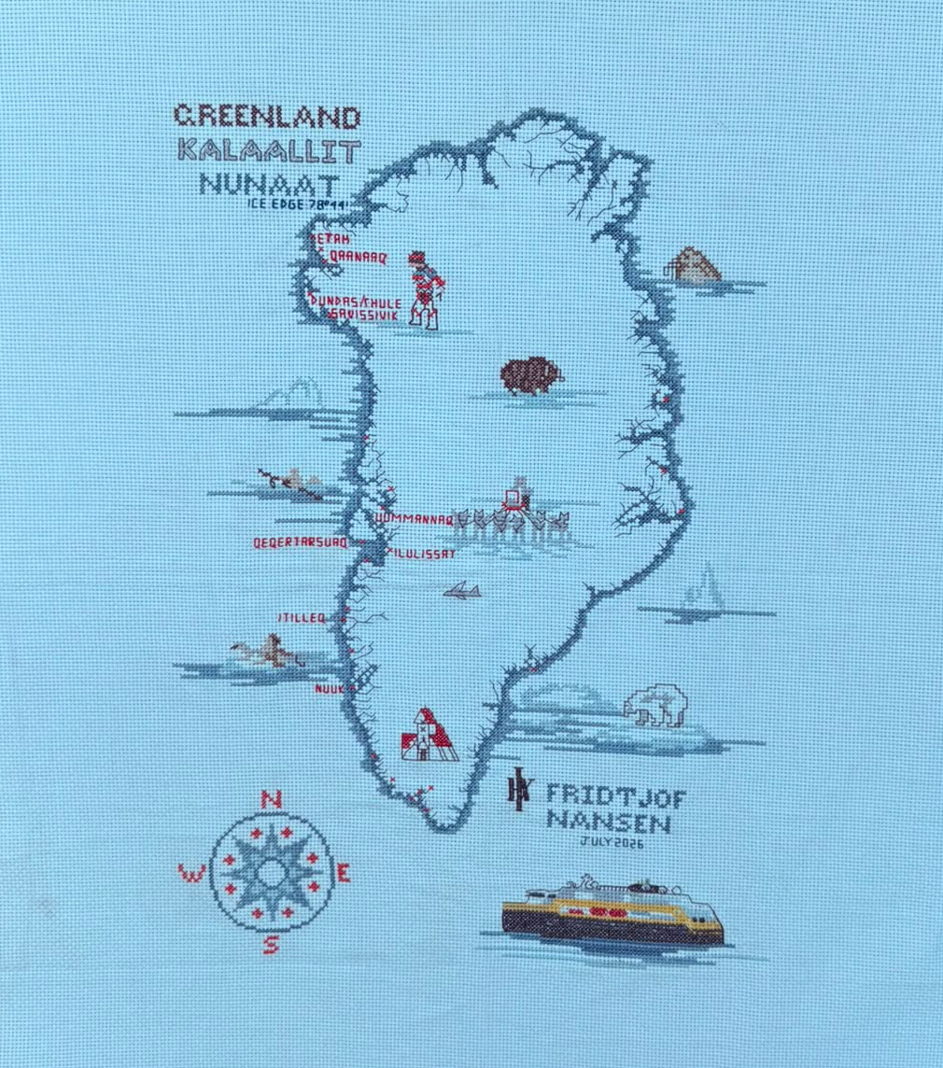
Arts & Crafts
We were honoured to accept this donation of a cross-stitch of our journey for the HX Foundation Charity Auction. Completed by hand in over 20 hours of work by one of our guests, Niamh, this unique piece of art represents the journey we took and the wildlife and landscapes we saw. Guests and crew alike were in awe of this one-of-a-kind piece and grateful for the money it raised for the HX Foundation.
Notes:
Add summary of workshops and activities – i.e. knitting, local crafts (with cultural interpreter), painting, scientific drawing

Slide 6
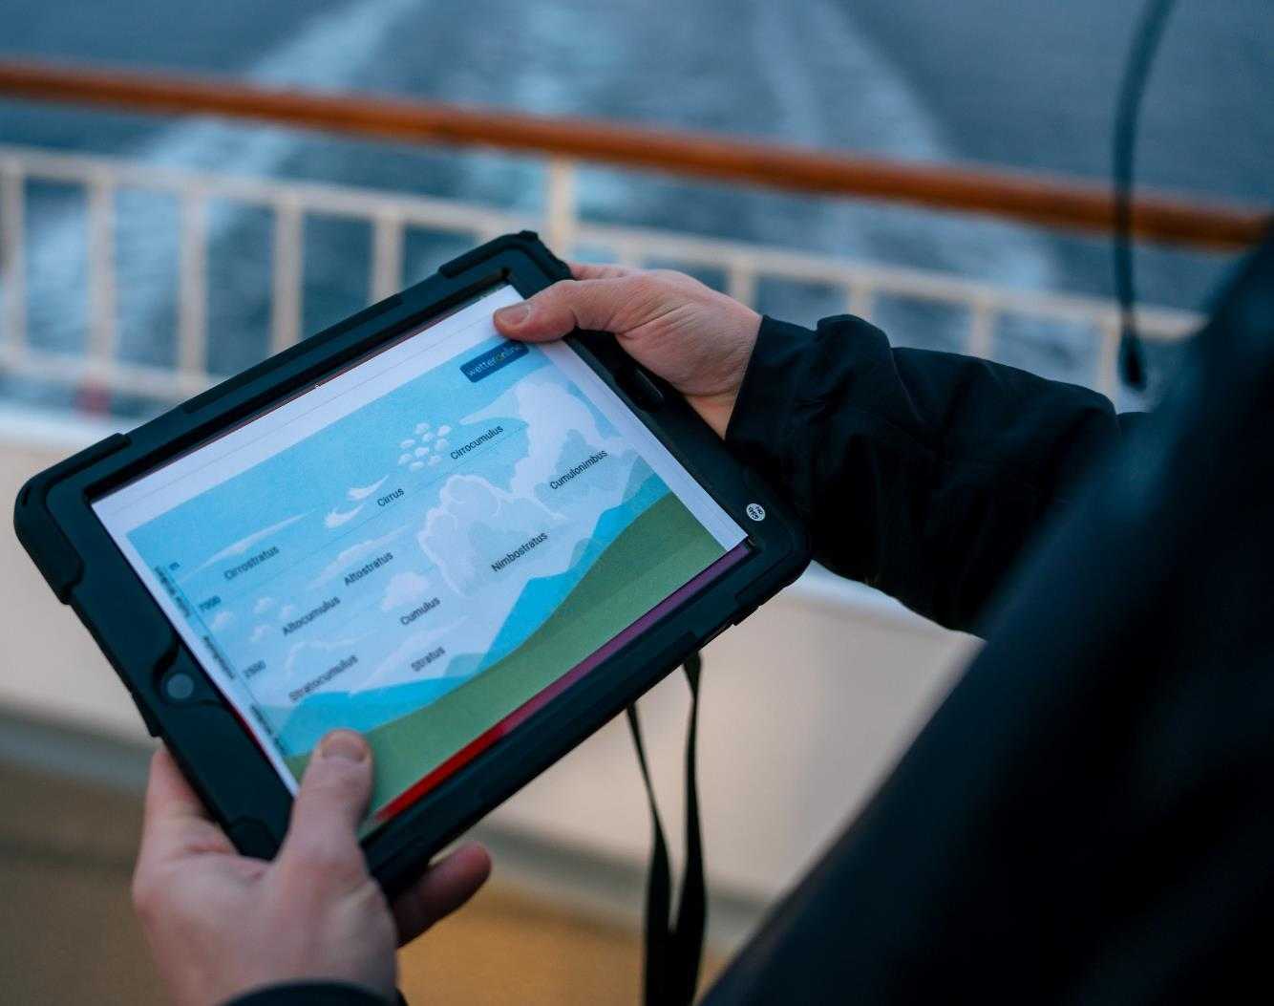
NASA's GLOBE Cloud Observer
During our voyage, we conducted five Cloud Observation sessions.
By comparing our observations with satellite data, scientists can improve cloud classification, weather forecasting, and climate models.
You can continue contributing from home using the GLOBE Observer app.
View our data on the global map
Notes:
Add summary of number of sessions and observations submitted, any special observations and add specific link to NASA Cloud observations if possible

Slide 7
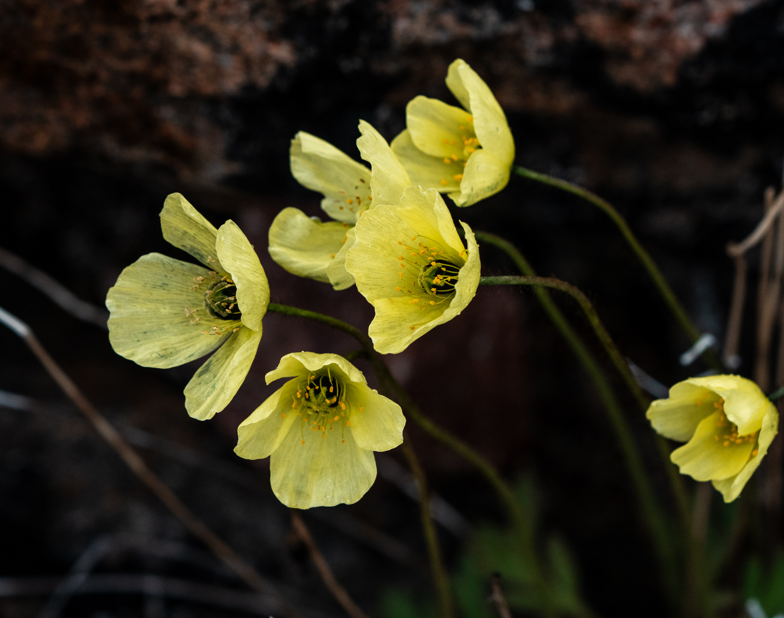
iNaturalist
Throughout this voyage, you played a vital role in documenting the biodiversity of Greenland.
Together, we gathered:
1,340 Observations
242 Species Identified
9 Observers Participating
Each observation helps scientists build a clearer picture of biodiversity in Arctic regions.
Ready to explore our findings?
View our data submitted on our iNaturalist project
Notes:
Claire

Slide 8
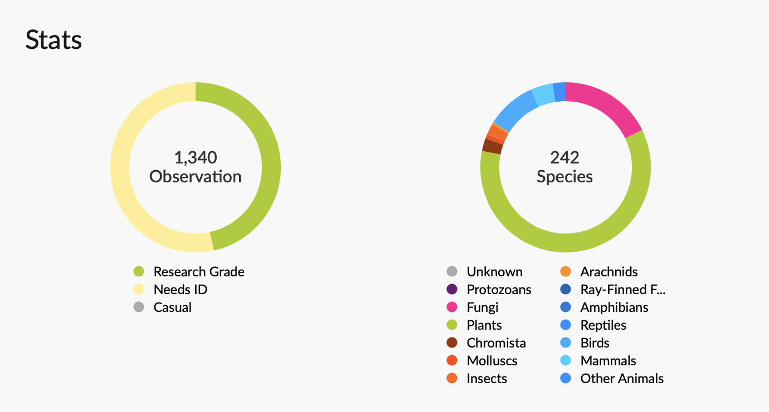
Notes:
Claire

Slide 9
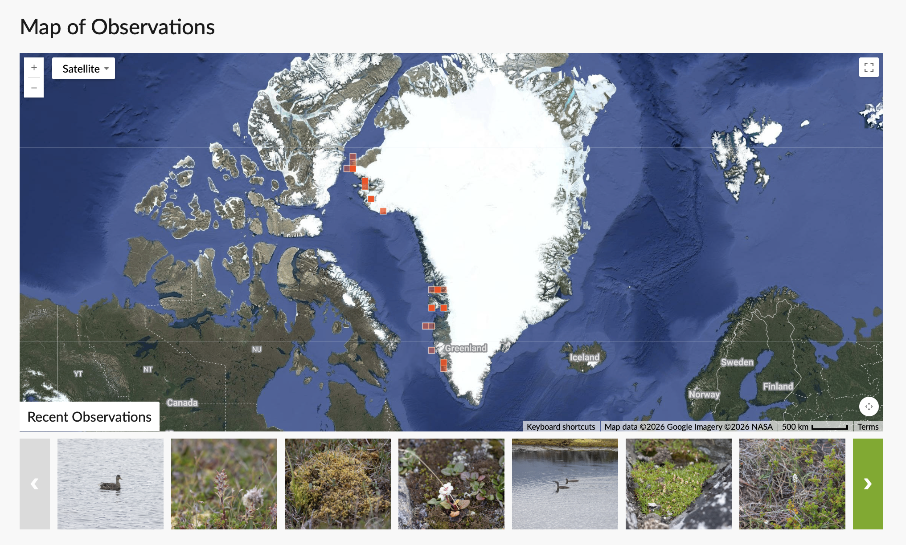

Slide 10
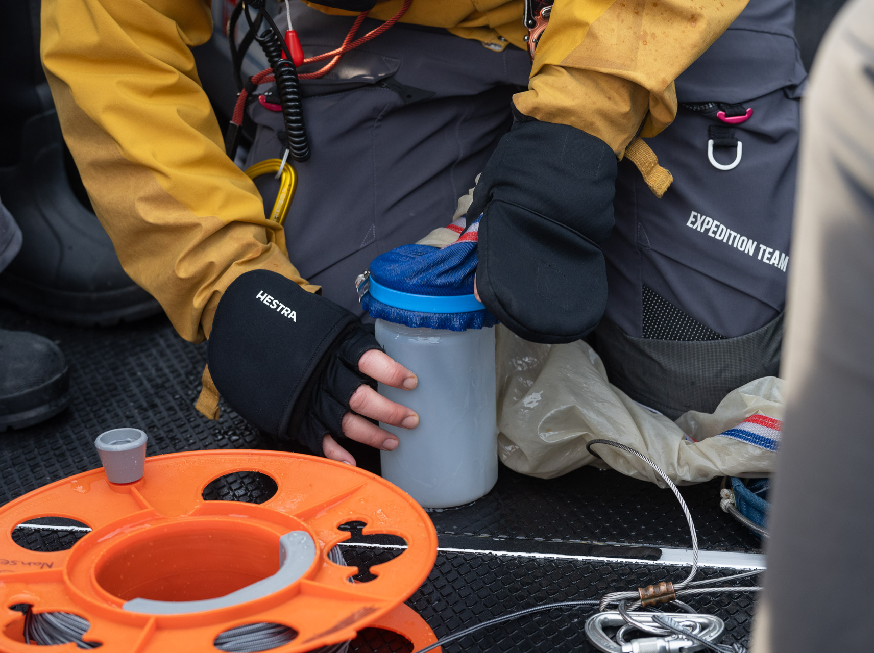
Science Boat
Over 16 science boat sessions, you moved beyond observation and took part in hands-on exploration of the waters along our route.
Using the plankton net, CTD, and Secchi Disk, you collected samples and measurements to better understand the hidden world beneath the surface, from tiny drifting organisms to water conditions and clarity.
Together with our Guest Scientist Rick, you also collected various data including water samples for the Iceberg Ecosystems project. These samples will help understand how increasing meltwater and the presence of icebergs impact the ecosystems.
View our data submitted to the Secchi Disk Project
Notes:
Add highlights of what science boat activities and sampling were undertaken – update secchi link to specific voyage if possible

Slide 11
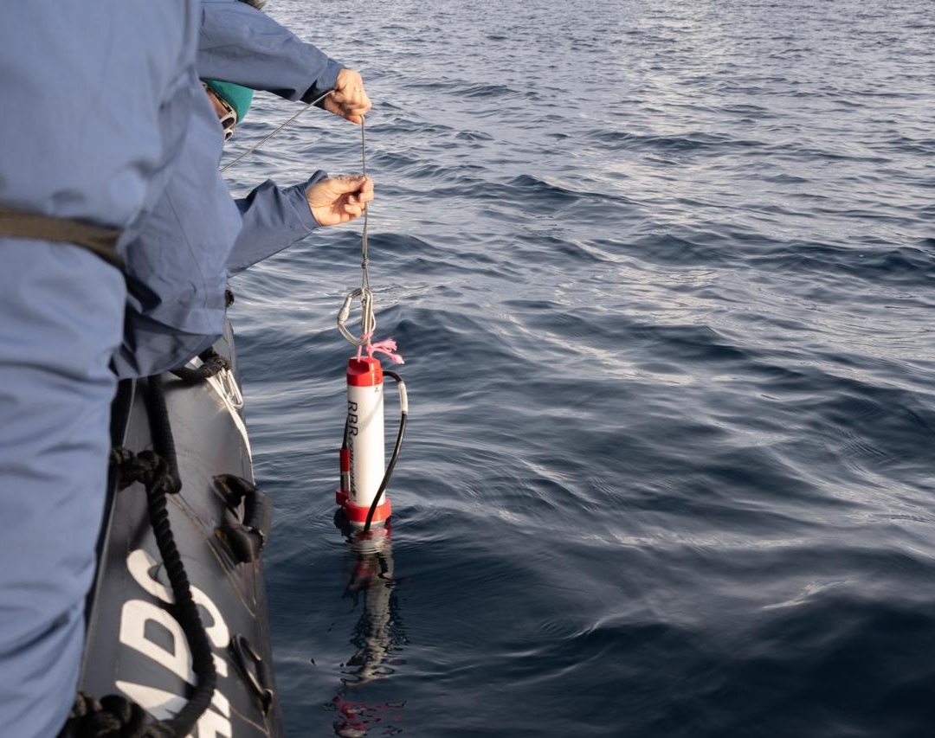
CTD
Beneath the surface, the ocean holds important clues about change.
With the CTD, you measured temperature, salinity, and depth, helping us better understand water conditions along our route.
Each profile added useful data on how freshwater, currents, and ocean layers shape these waters, one measurement at a time.
We downloaded all the CTD data you collected to the European Marine Observation and Data Network (EMODnet)

Slide 12
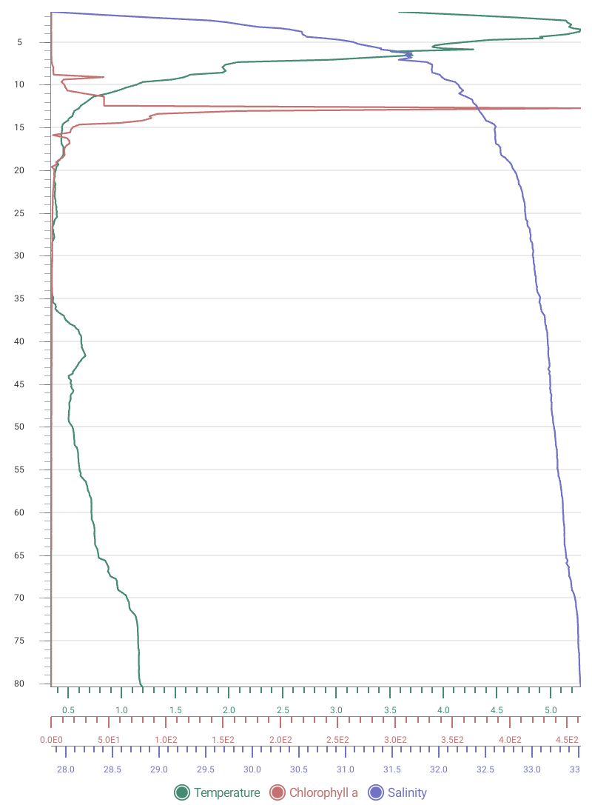
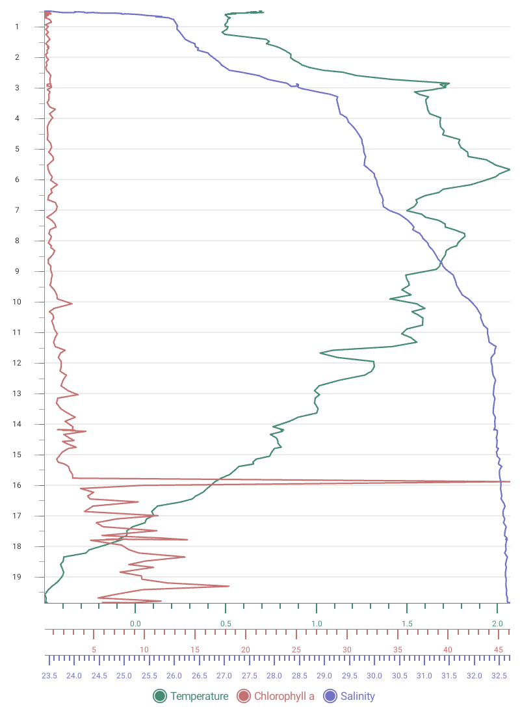
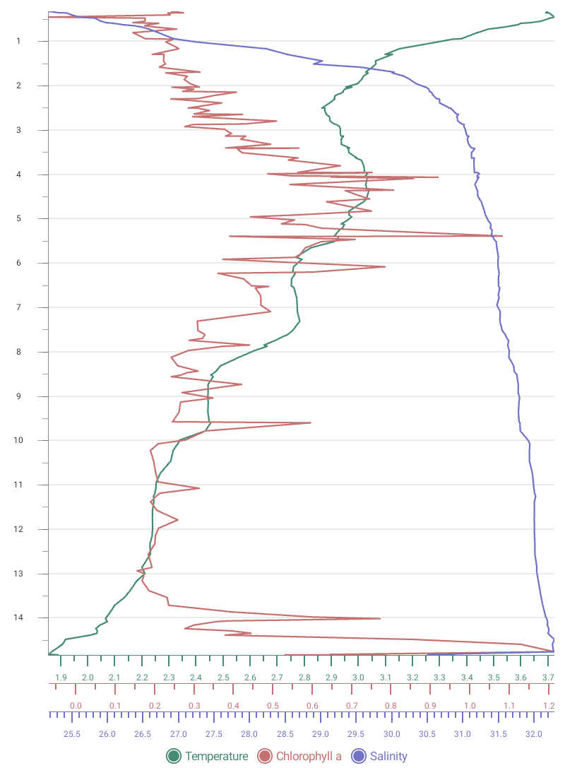
CTD
Uummannaq
Savissivik
Dundas
Temperature (°C)
Chlorophyll (µg/l)
Salinity (PSU)
Temperature (°C)
Chlorophyll (µg/L)
Salinity (PSU)
Notes:
While the Secchi Disk gave us a simple way to measure water clarity, the CTD device allowed us to take a deeper look at the ocean itself—measuring salinity, temperature, and depth to better understand how these waters are structured and how they influence marine life.

Slide 13
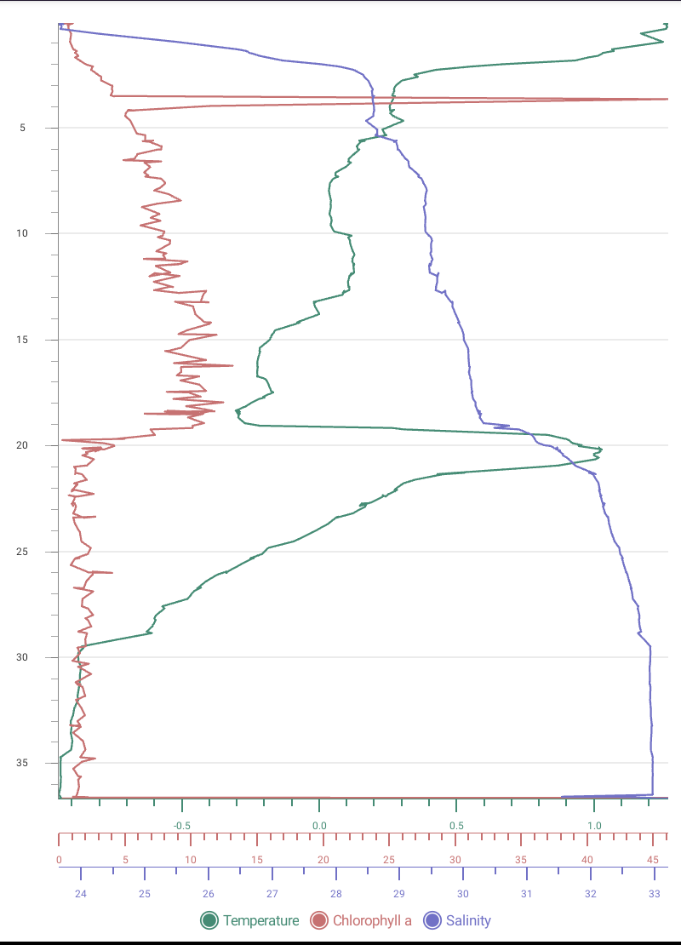
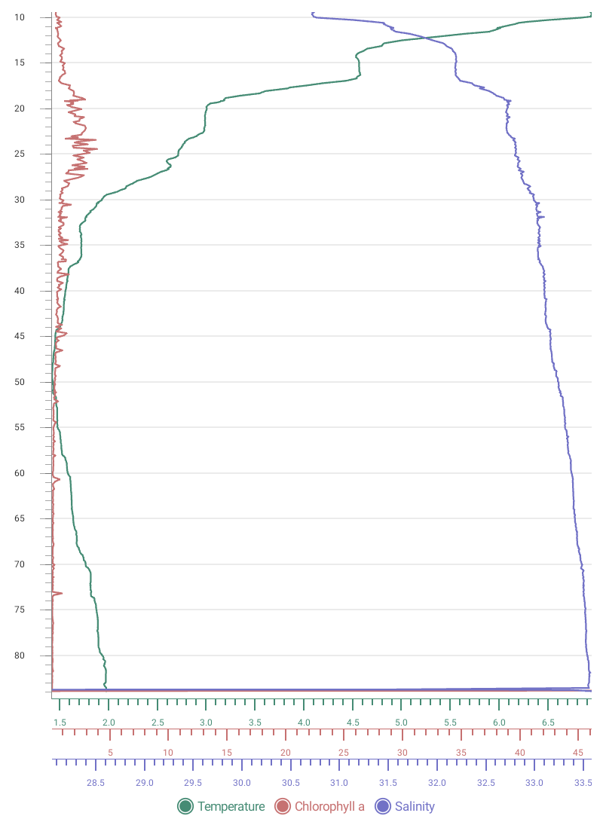
CTD
Etah
Qeqertarsuaq
Temperature (°C)
Chlorophyll (µg/l)
Salinity (PSU)

Slide 14
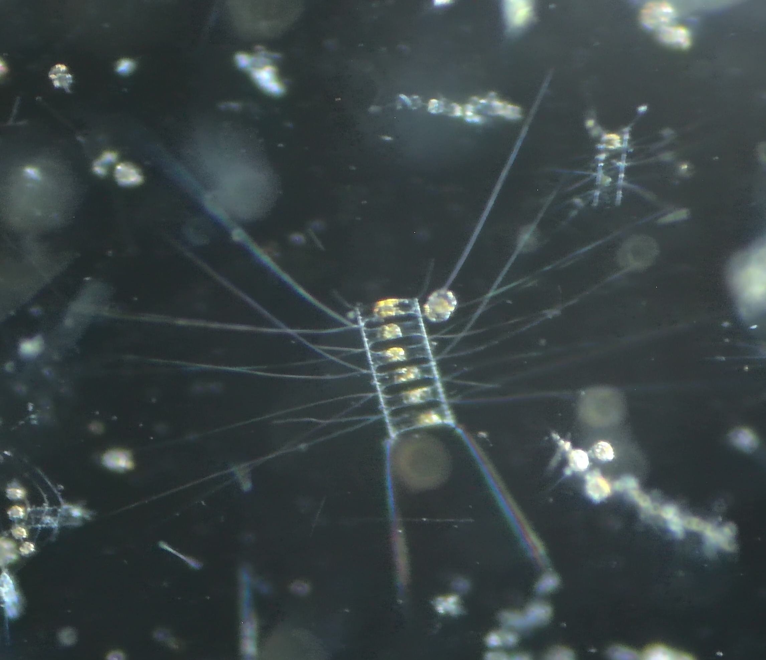
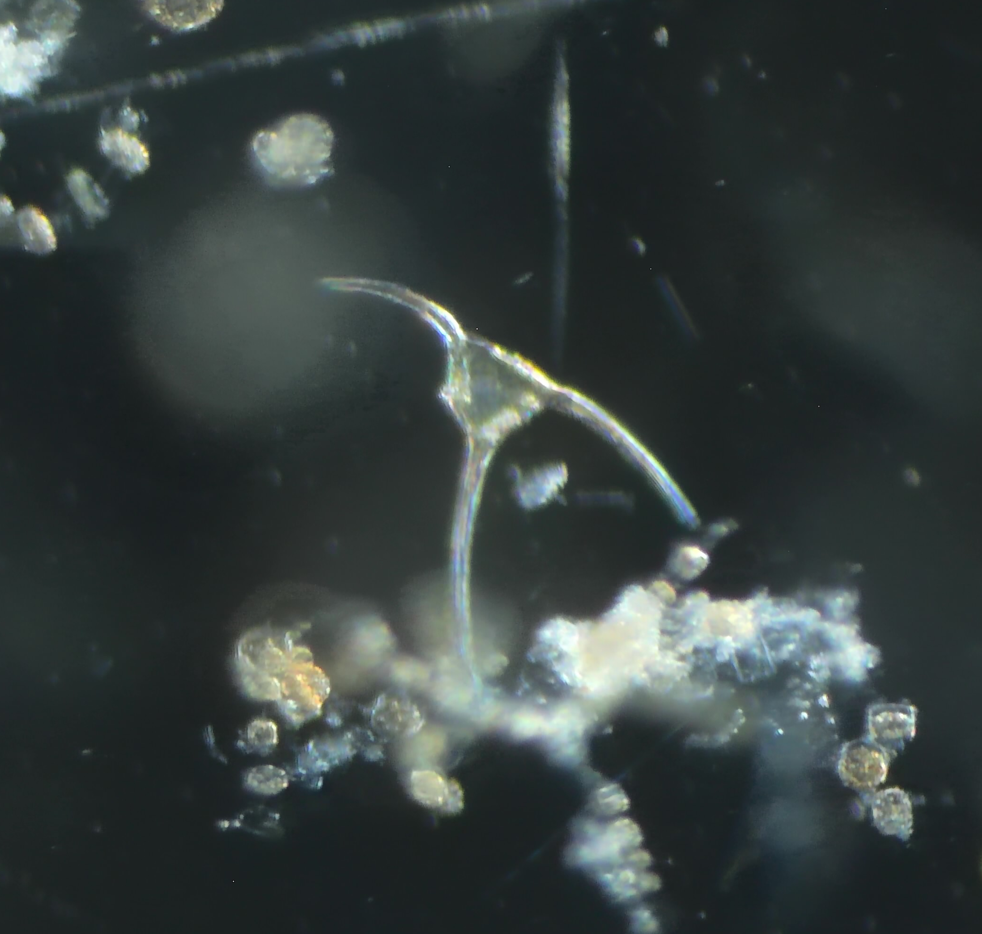
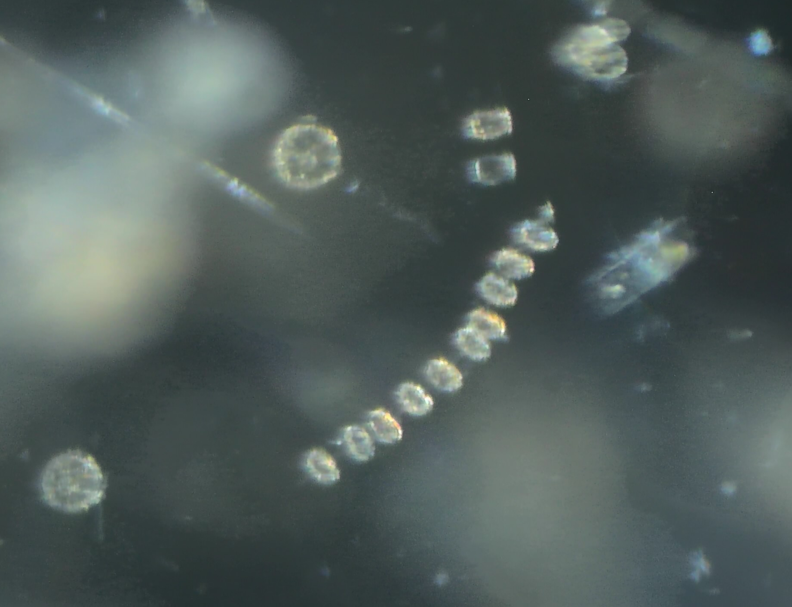
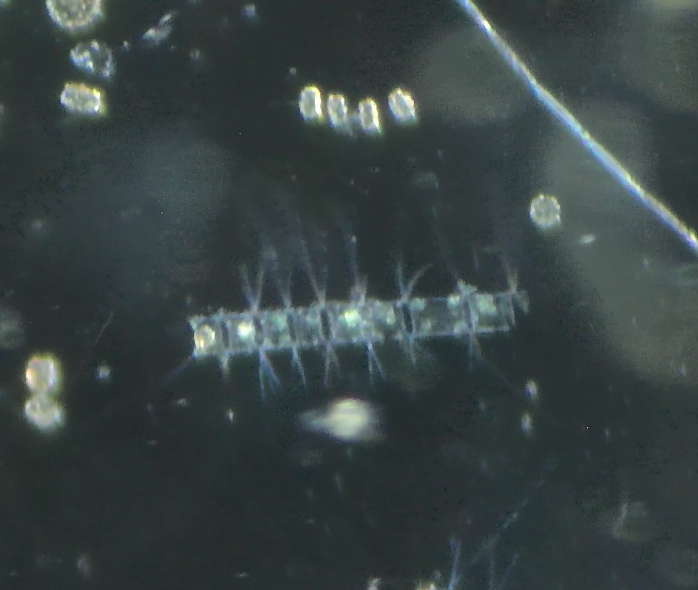
Plankton Samples
Diatom Chaetoceros spp.
Dinoflagellate – Tripos longipes
Back in the Science Centre, we brought our samples into focus under the microscope, revealing a hidden world of plankton.
Using the main screen and smaller microscopes, you could explore each drop of water up close.
What appeared invisible to the naked eye quickly became a vivid reminder that these tiny organisms form the foundation of the rich ecosystems we have been travelling through.
Diatoms chain
Diatom Chaetoceros spp.
Notes:
Add any interesting finds in the plankton samples and pictures taken down the microscopes

Slide 15
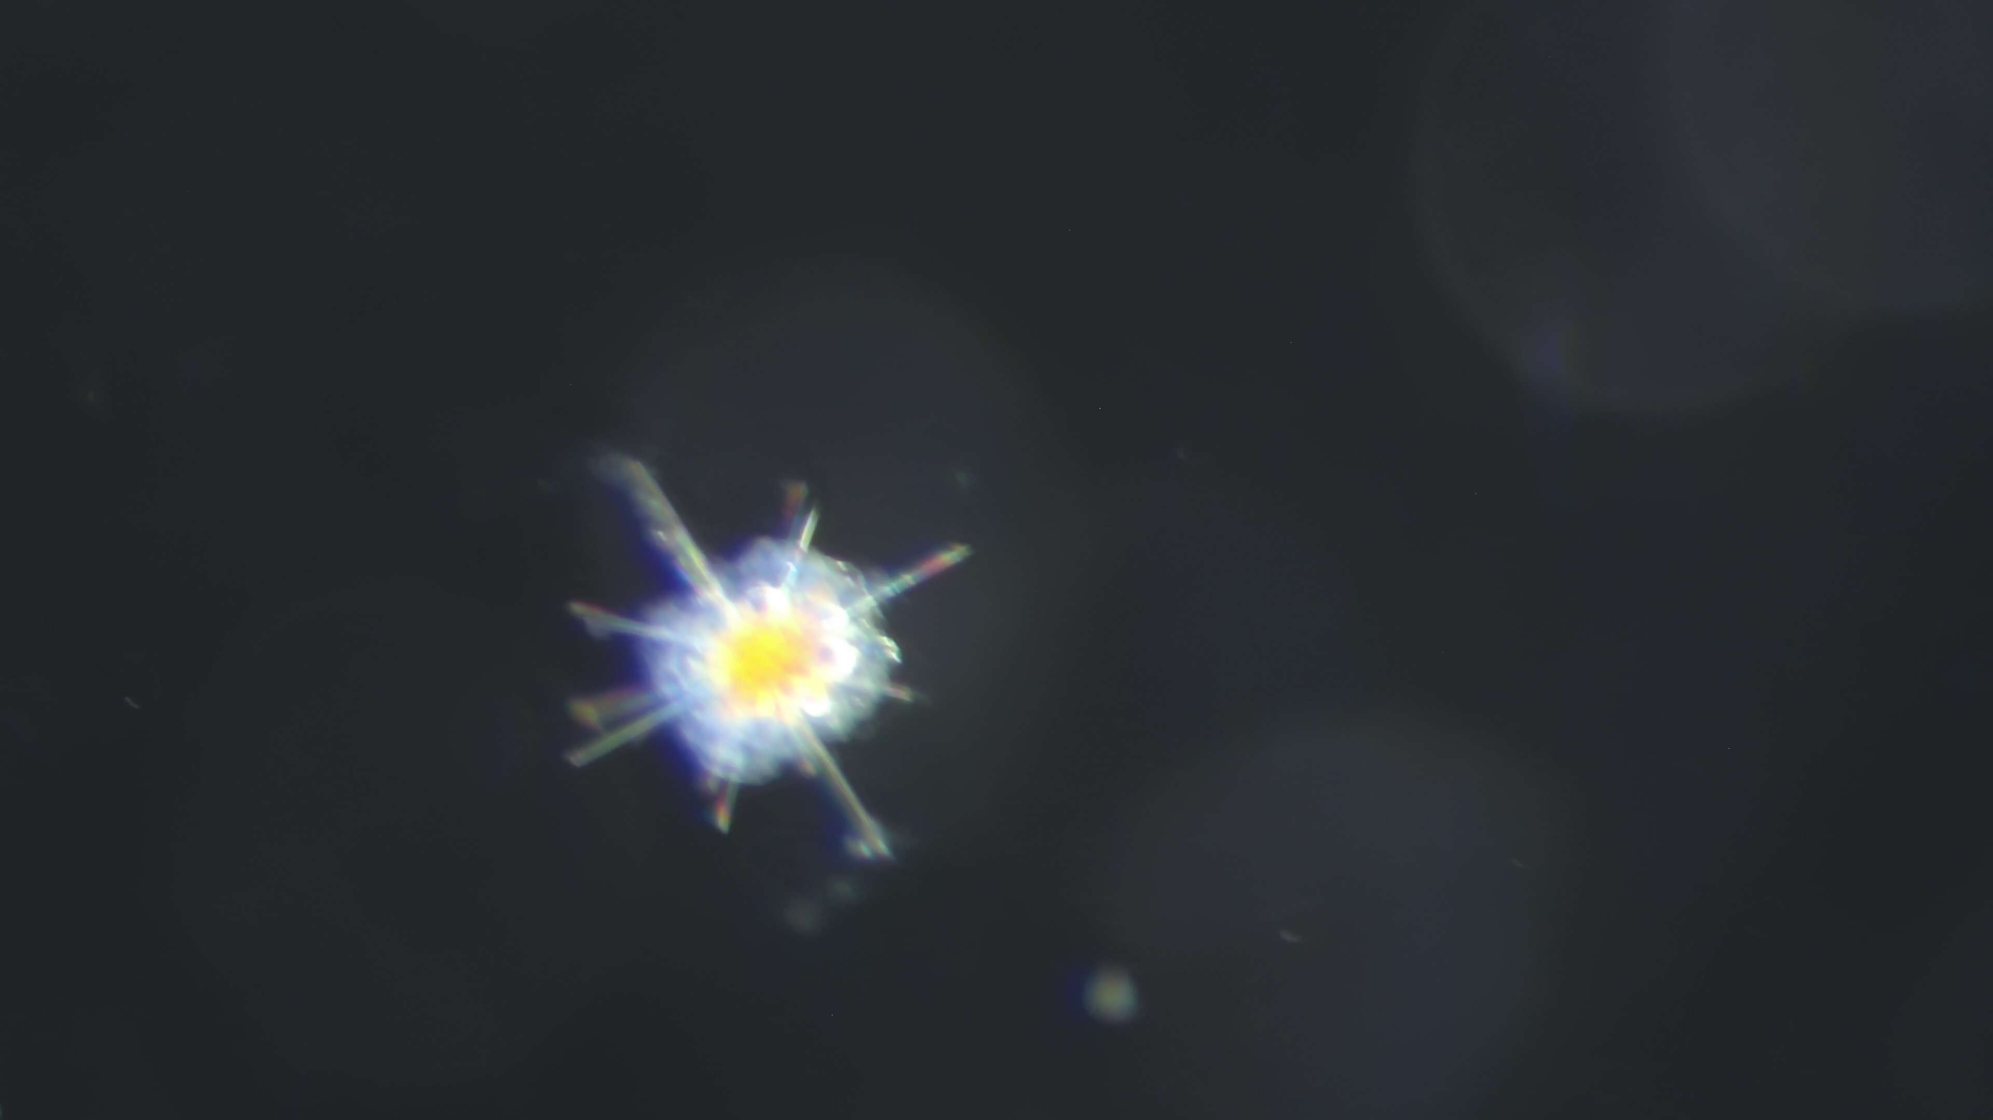
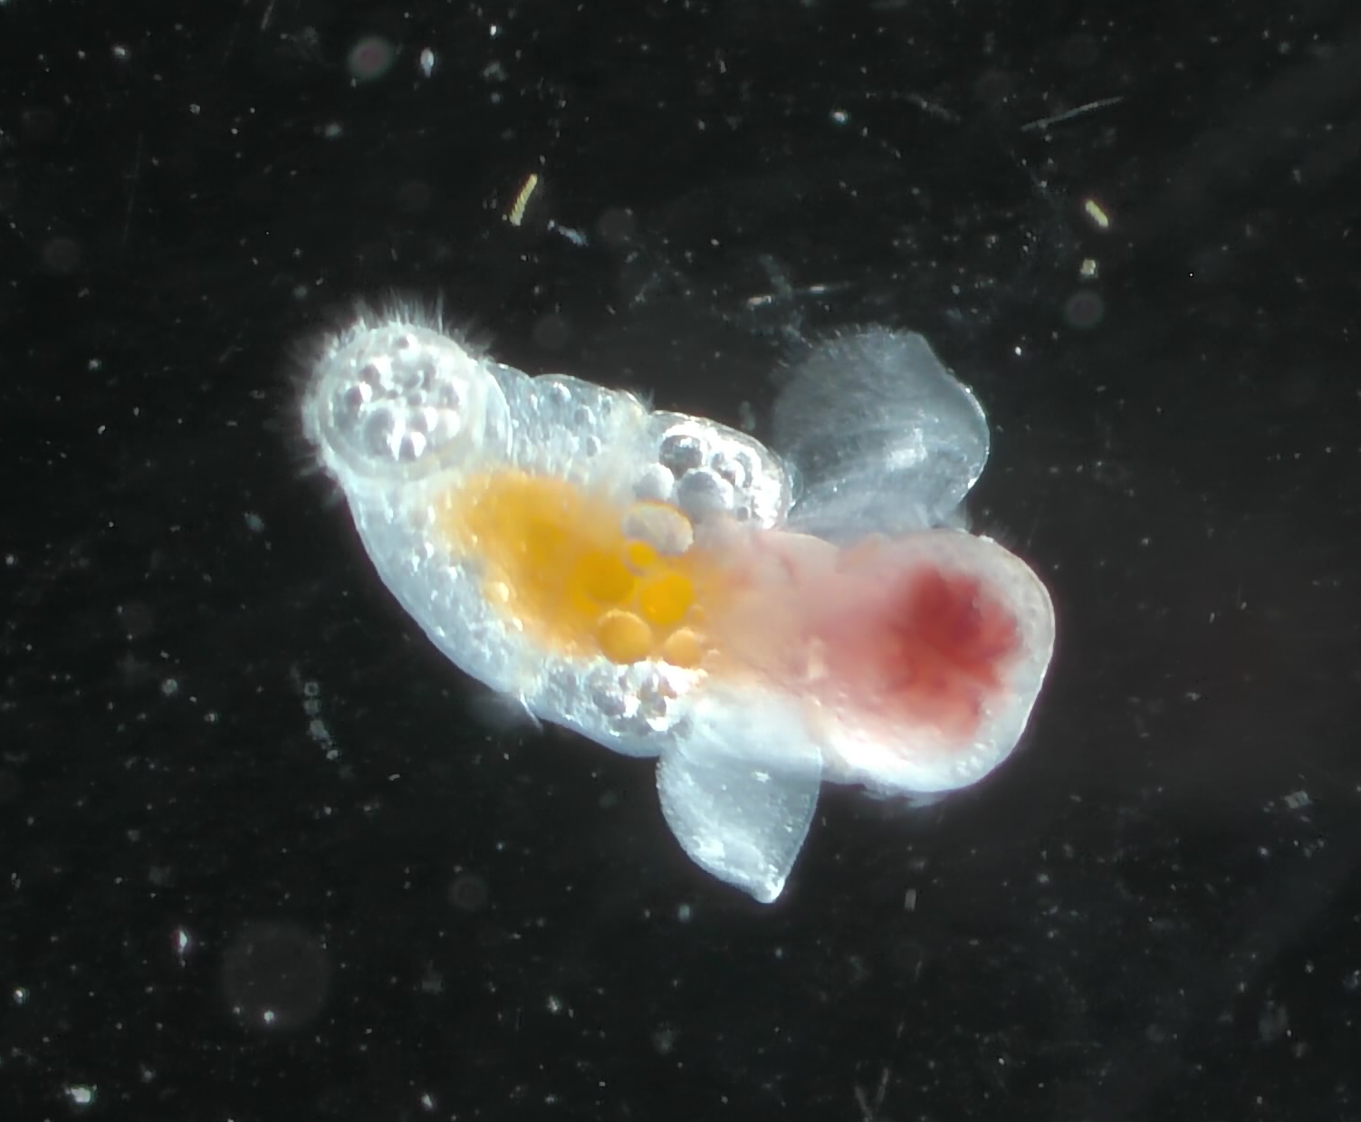
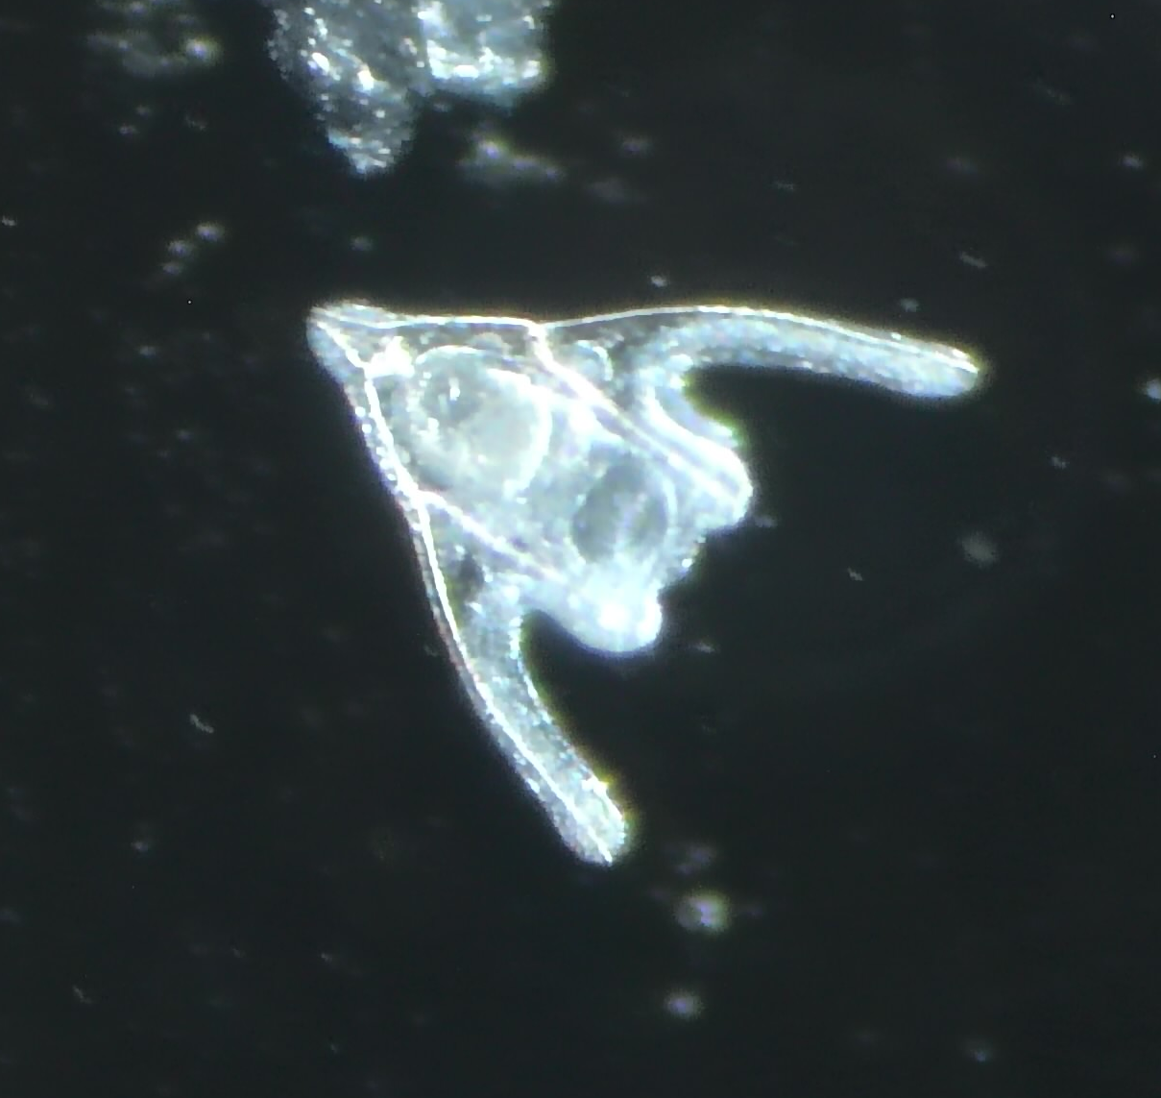
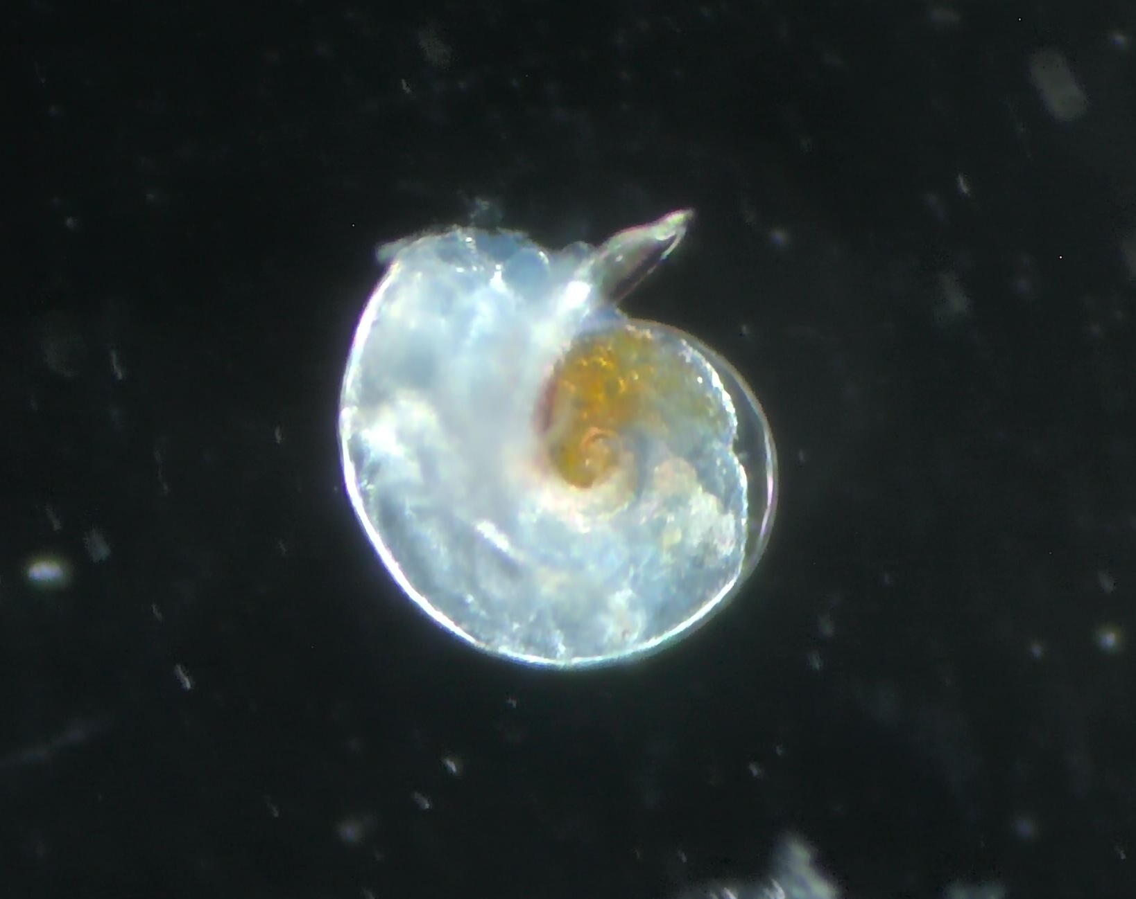
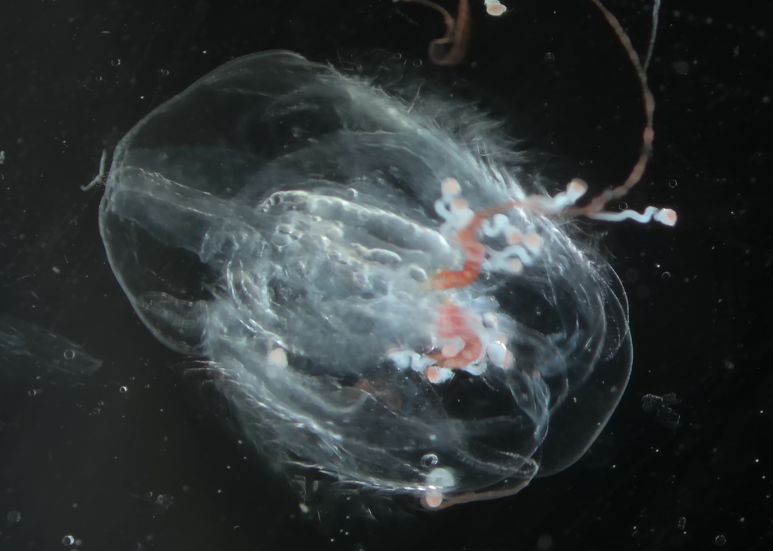
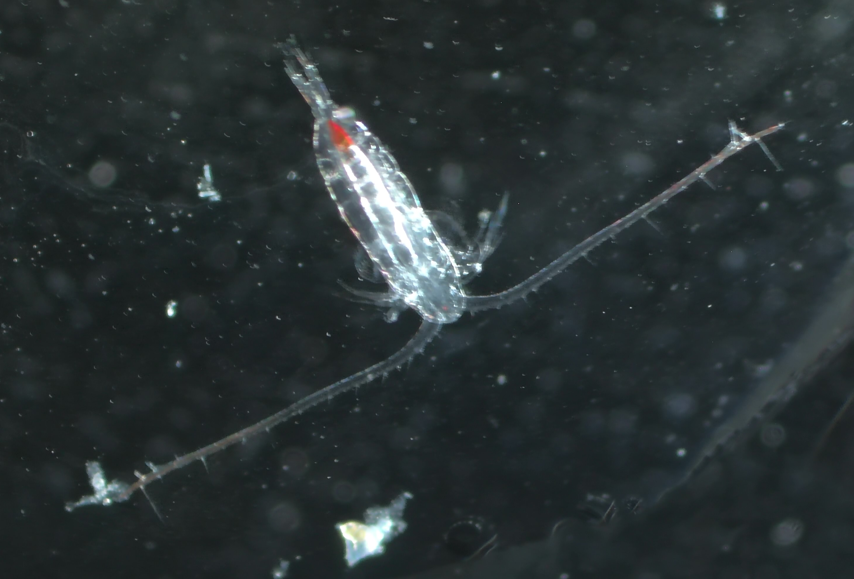
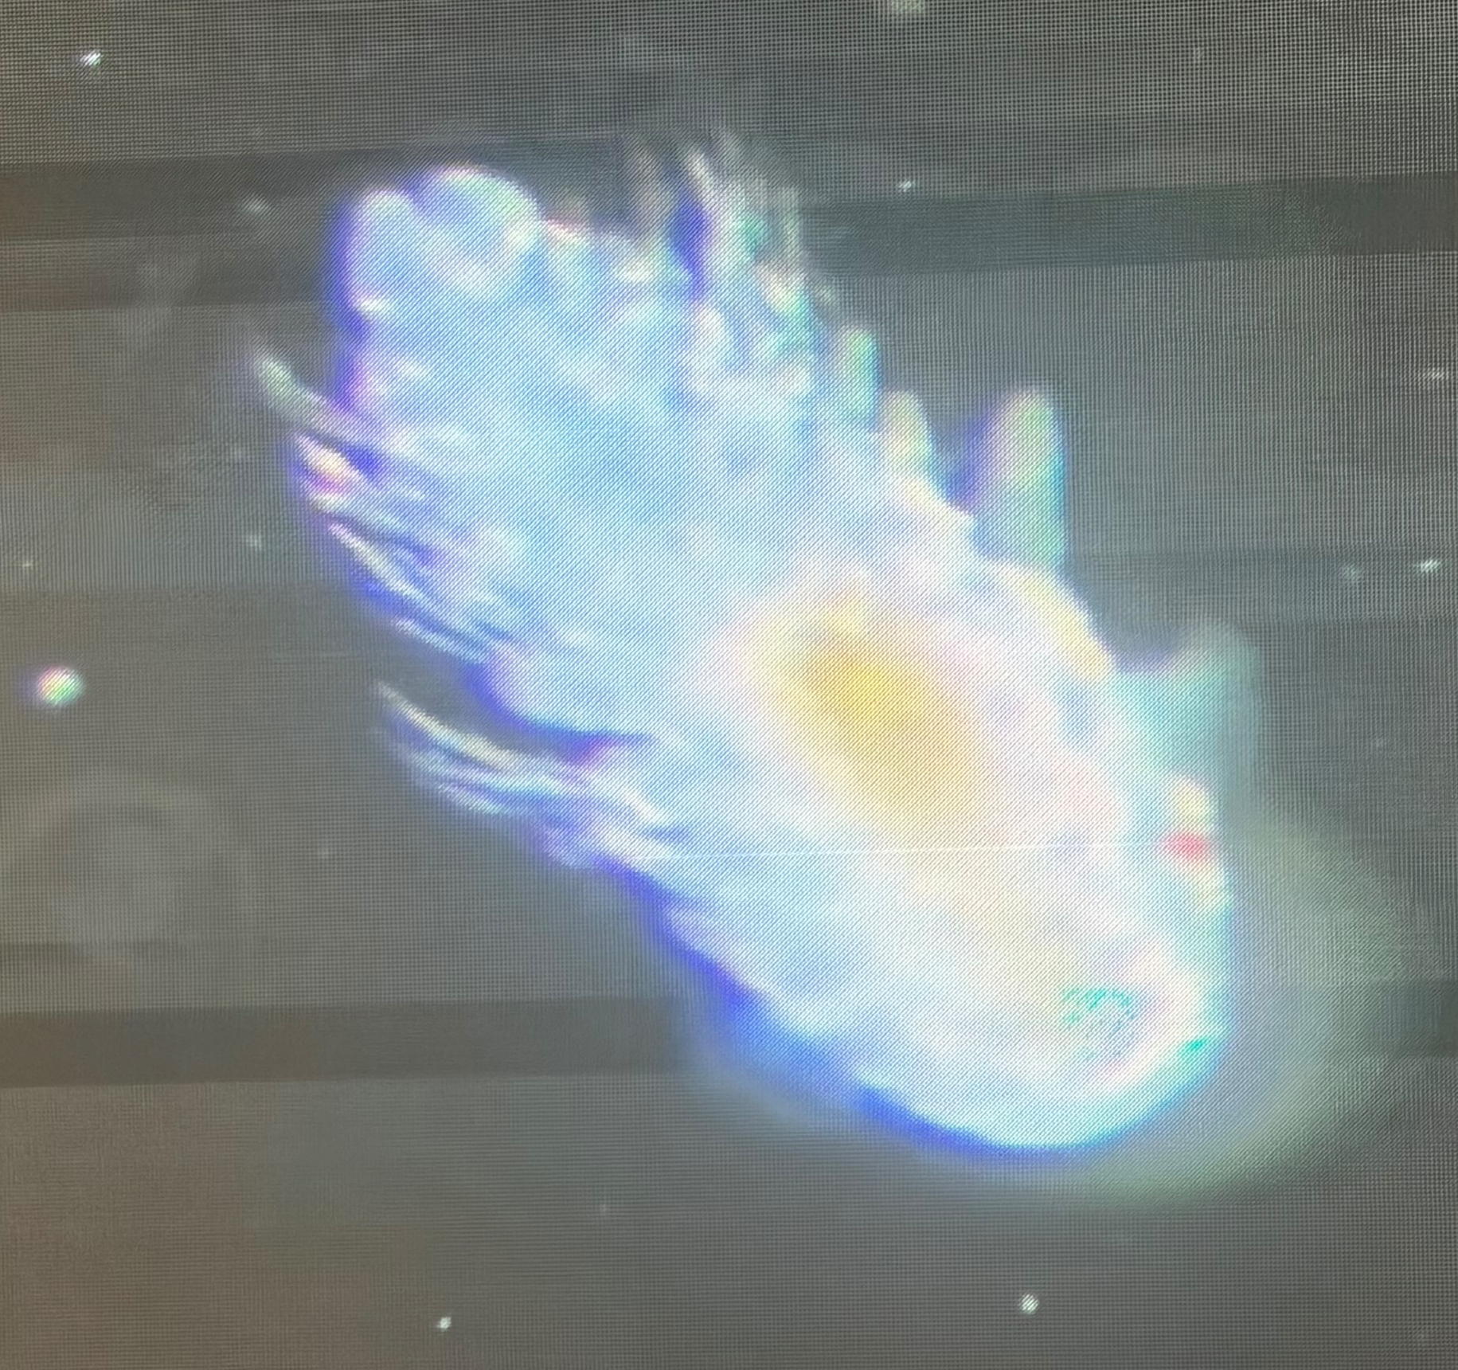
Zooplankton
Radiolarian
Naked sea butterfly – Clione limacina
Sea urchin larvae
Pteropod - Sea snail
Polychaete larva
Jelly fish
Copepod –Calanus spp

Slide 16
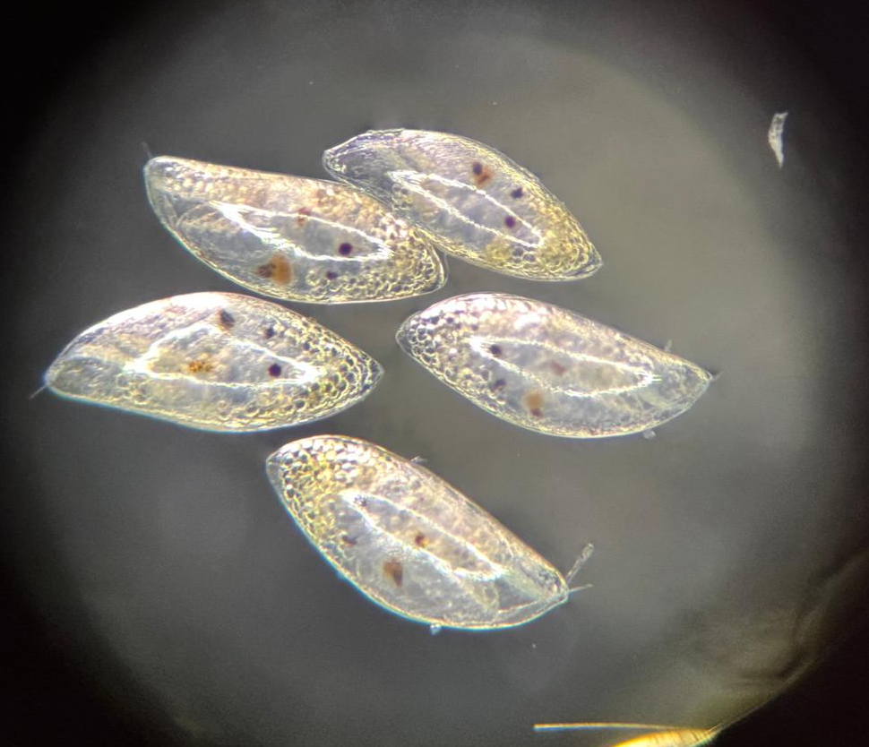
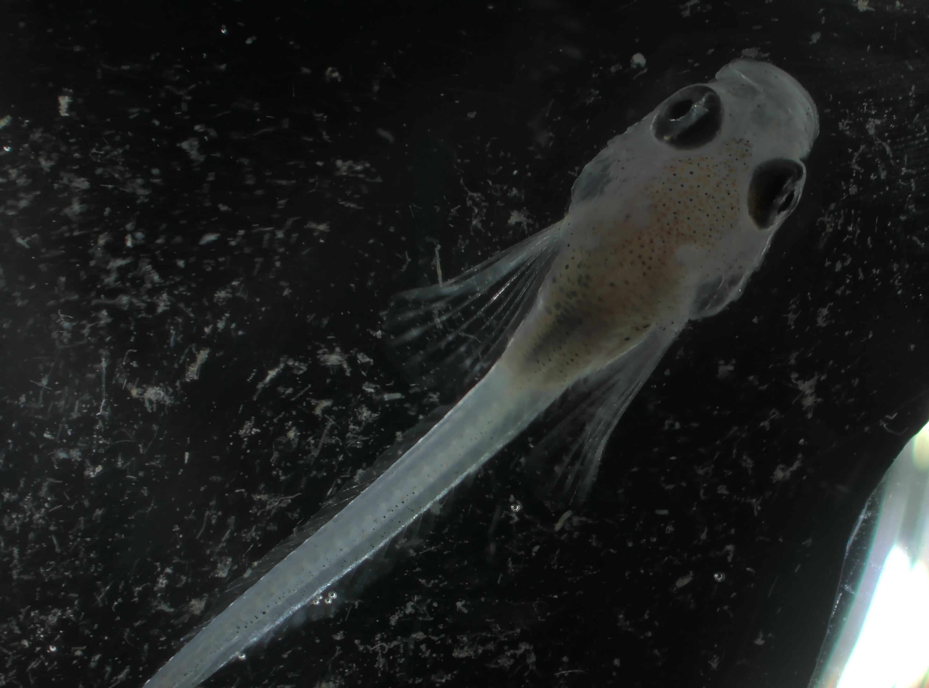
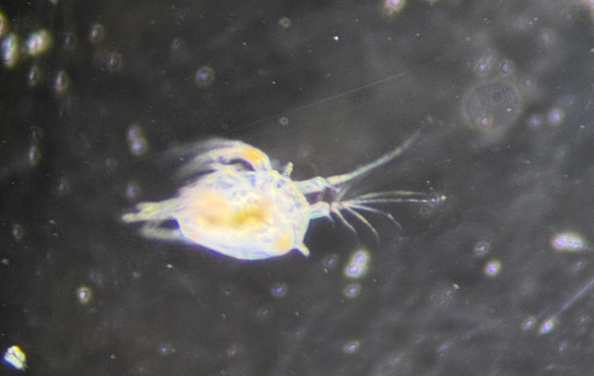
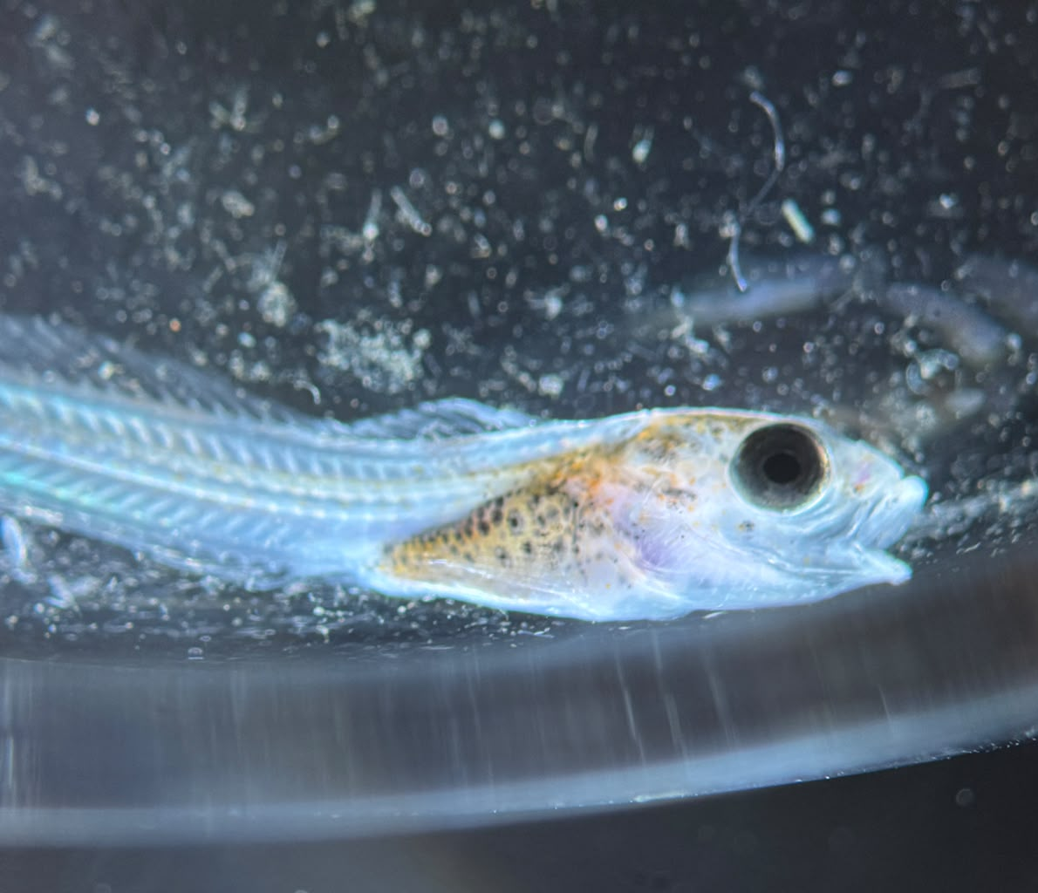
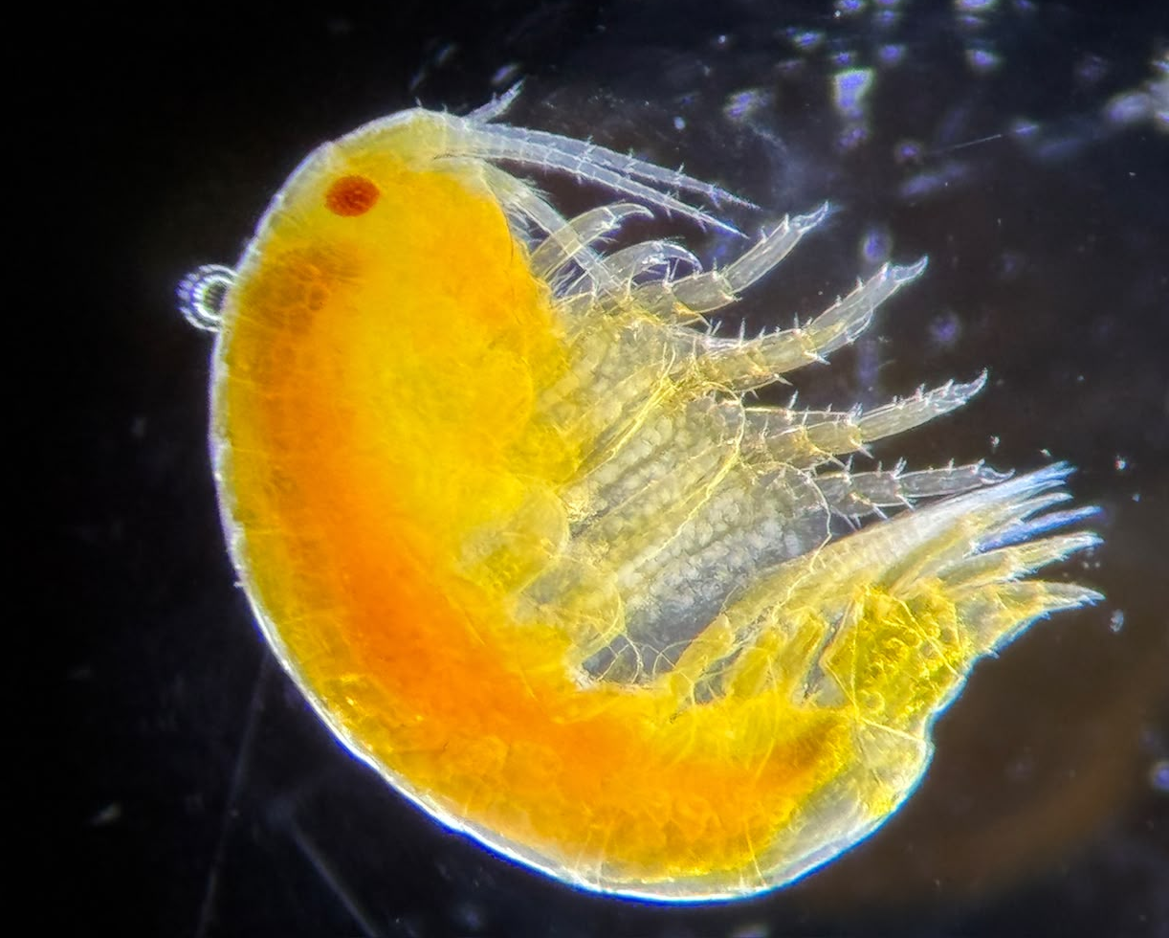
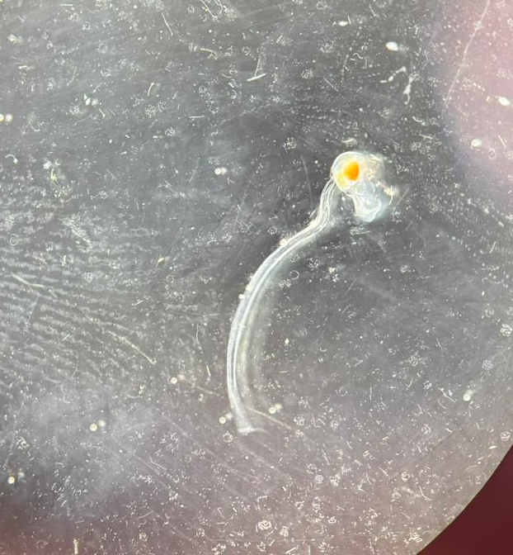
Zooplankton
Nauplii larvae
Ostracods
Amphipod
Larvacean
Fish larvae

Slide 17
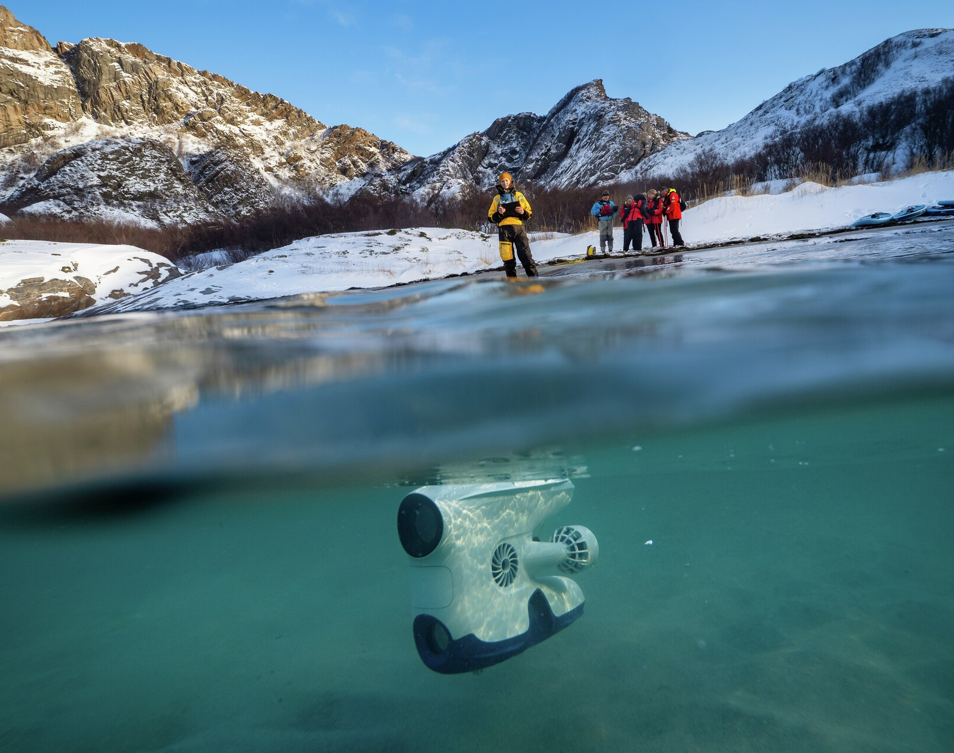
Underwater drone
View the highlights from our underwater drone footage on YouTube
Notes:
Add location, date and highlights of what was found – specific link to drone video can be added if uploaded at point of writing

Slide 18
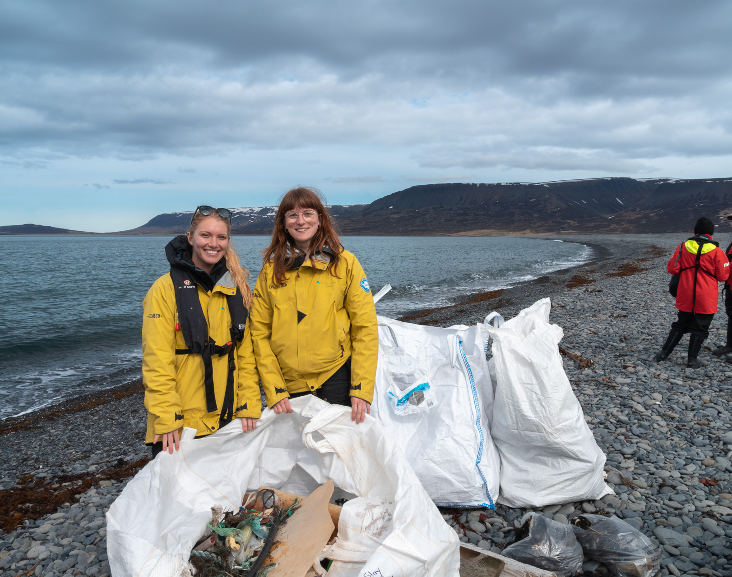
Beach clean-up
Notes:
Add location, date and weight of litter collected

Slide 19
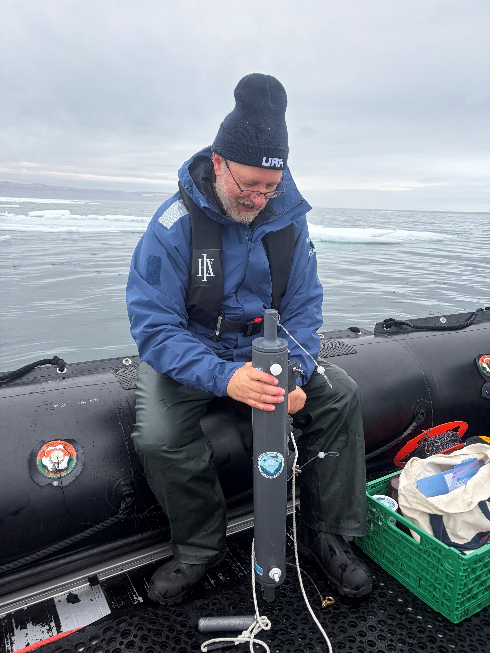
Guest Scientist
Dr Rick Reynolds was on board for the project Iceberg Ecosystems from the Scripps Institution of Oceanography. The project aims to understand how iceberg abundance and meltwater impact the ecosystems in Greenland.
During six science boat sessions, you collected with Rick:
Bird, ocean colour, and iceberg data.
12 meltwater samples (% freshwater)
24 phytoplankton samples (identification and abundance)
12 samples for nutrient analysis
Read more about the IceECo project
Visit our Science & Education Hub online to find out more
Notes:
Overview of project and link(s) to find out more (preferably on our website, otherwise theirs) – Hide if not relevant

Slide 20
Wildlife
List – Birds
Notes:
Use the following pages to highlight some of the key bird species identified – and/or use the final page of the bird section to highlight the complete bird list on the e-Bird trip report

Slide 21

Wildlife List – Seabirds
SCIENTIFIC NAME | ENGLISH | DEUTSCH
Alle alle | dovekie | Krabbentaucher
Calidris alba | sanderling | Sanderling
Calidris alpina | dunlin | Alpenstrandläufer
Cepphus grille | black guillemot | Gryllteiste
Charadrius hiaticula | common ringed plover | Sandregenpfeifer
Clangula hyemalis | long-tailed duck | Eisente
Fratercula arctica | Atlantic puffin | Papageitaucher
Fulmarus glacialis | Northern fulmar | Eissturmvogel
Gavia immer | common loon | Eistaucher
Gavia stellata | red-throated loon | Sterntaucher
Larus fuscus | lesser black-backed gull | Heringsmöwe
Larus glaucoides | Iceland gull | Polarmöwe
Larus hyperboreus | glaucous gull | Eismöwe
Larus marinus | great black-backed gull | Mantelmöwe
Phalaropus lobatus | red-necked phalarope | Odinshühnchen
Notes:
Copy and paste water birds observed – make sure scientific name is in italics

Slide 22
Wildlife List – Seabirds
SCIENTIFIC NAME | ENGLISH | DEUTSCH
Rissa tridactyla | black-legged kittiwake | Dreizehenmöwe
Somateria mollissima | common eider | Eiderente
Somateria spectabilis | king eider | Prachteiderente
Stercorarius longicaudus | long-tailed jaeger | Falkenraubmöwe
Sterna paradisaea | Arctic tern | Küstenseeschwalbe
Uria lomvia | thick-billed murre | Dickschnabellumme
Xema sabini | Sabine's gull | Schwalbenmöwe
Notes:
Copy and paste water birds observed – make sure scientific name is in italics

Slide 23
Wildlife List – Water birds
SCIENTIFIC NAME | ENGLISH | DEUTSCH
Anas platyrhynchos | mallard | Stockente
Anser caerulescens | snow goose | Schneegans
Branta canadensis | Canada Goose | Kanadagans
Notes:
Copy and paste water birds observed – make sure scientific name is in italics

Slide 24
Wildlife List – Land birds
SCIENTIFIC NAME | ENGLISH | DEUTSCH
Acanthis flammea | redpoll | Birkenzeisig
Calcarius lapponicus | Lapland longspur | Spornammer
Corvus corax | common raven | Kolkrabe
Lagopus muta | rock ptarmigan | Alpenschneehuhn
Mergus serrator | red-breasted merganser | Mittelsäger
Oenanthe oenanthe | Northern wheatear | Steinschmätzer
Plectrophenax nivalis | snow bunting | Schneeammer
Turdus iliacus | redwing | Rotdrossel
Notes:
Copy and paste land birds observed – make sure scientific name is in italics

Slide 25
eBird
Bird-watching is not just a hobby. It is a powerful tool for science. eBird, a global Citizen Science platform, allows bird enthusiasts to record and share sightings, contributing valuable data for research and conservation.
During our voyage, our onboard Ornithologist completed 37 checklists and recorded 33 bird species along the way.
Every entry adds to a growing database that helps scientists track migration patterns, monitor populations, and understand bird behaviour in Greenland.
View our data on our e-Bird trip report
Notes:
Give overview of the number of bird species found, number of observations etc. and add link to the e-Bird trip report

Slide 26
Wildlife
List – Marine Mammals

Slide 27

Wildlife List – marine mammals
SCIENTIFIC NAME | ENGLISH | DEUTSCH
Balaenoptera physalus | fin whale | Finnwal
Balaenoptera musculus | blue whale | Blauwal
Megaptera novaeangliae | humpback whale | Buckelwal
Balaenoptera borealis | sei whale | Seiwal
Balaenoptera acutorostrata | minke whale | Zwegwal
Erignathus barbatus | bearded seal | Bartrobbe
Pagophilus groenlandicus | harp/Greenland seal | Sattelrobbe
Pusa hispida | ringed seal | Ringelrobbe
 | unidentified seal
Ursus maritimus | polar bear | Eisbär
Notes:
Copy and paste marine mammals observed – make sure scientific name is in italics

Slide 28
ORCA
While on your journey around West and North Greenland you were joined by ORCA Ocean Conservationist, Taz, who was collecting data on whales, dolphins, and porpoises. We collected this data using the ORCA OceanWatchers App and sent it back to ORCA, making it available to many organisations interested in cetacean conservation. It will also appear on the ORCA website's interactive map, giving an overview of what you might encounter where.
On this journey we collected a total of 12 hours and 34 minutes of data, spanning 212.4 km. We recorded five species of marine mammal during these surveys, with a total of 20 individuals, plus more during wildlife watching outside the surveys.
Notes:
Please update
Add more slide if you need to. Keep the same font and format pls. screenshots of the surveys conducted, whale species seen could be interesting.

Slide 29
Wildlife
List – Land Mammals

Slide 30
Wildlife List – Land mammals
SCIENTIFIC NAME | ENGLISH | DEUTSCH
Equus ferus caballus | musk ox | Moschusochse
Leptus arcticus | Arctic hare | Schneehase
Vulpes lagopus | Arctic fox | Polarfuchs
Notes:
Copy and paste land mammals observed – make sure scientific name is in italics

Slide 31
Thanks for your participation!

