Slide 1
Science & Education Report
MS Fridtjof Nansen 2026
Notes:
Welcome, everyone!

Slide 2
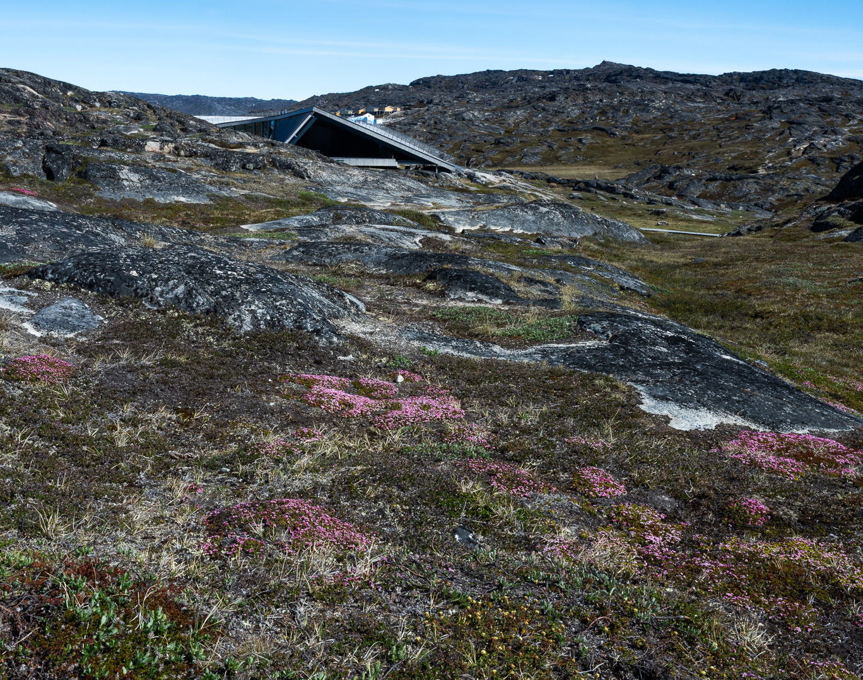
MS Fridtjof Nansen
Grand Greenland: The Icy Giants of Disko Bay
Nuuk - Nuuk
14 June 2026 – 24 June 2026
Notes:
Over the past days, we’ve explored Antarctica not just as travellers, but as active participants in science. Through citizen science projects, hands-on research, and field observations, we’ve contributed to a global effort to better understand and protect this unique environment. This presentation is a recap of the work we’ve done together—your role in it, the discoveries made, and how you can continue to be part of these efforts beyond this voyage.

Slide 3
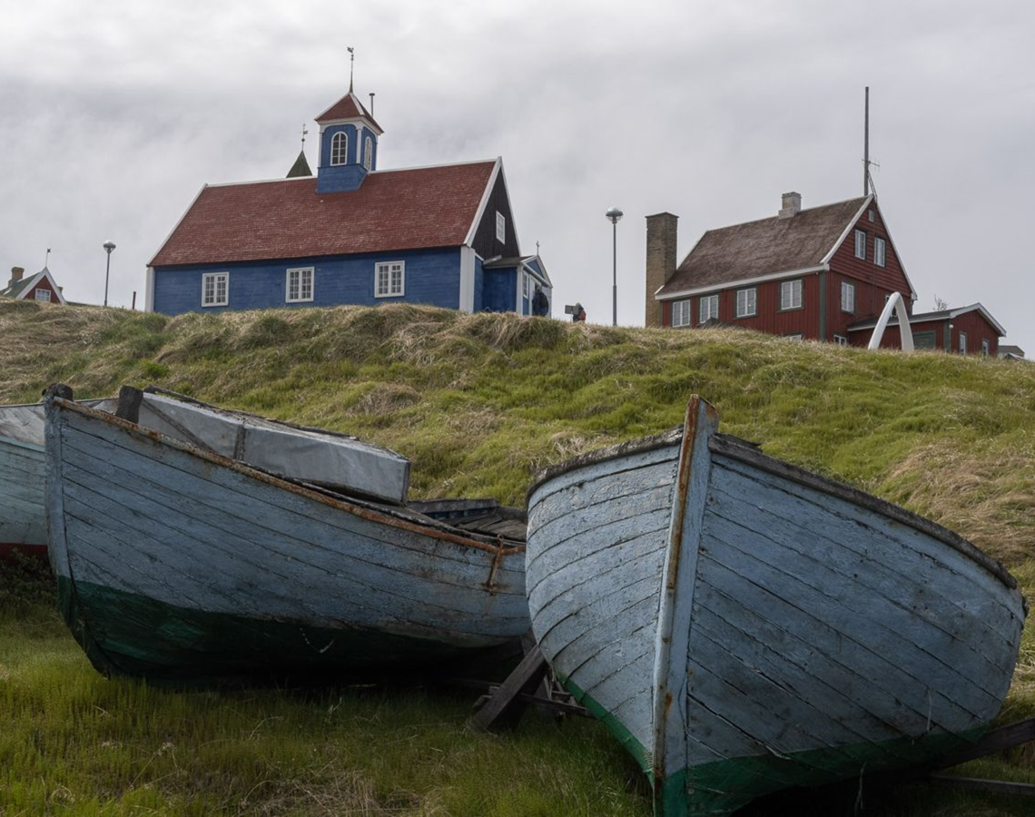
History & Culture
On this voyage, we visited several museums that represent and celebrate the culture of Greenland. In Qeqertarsuaq, we witnessed how the people of Greenland celebrate their national day.
On board, our Cultural Interpreter, Aleq, gave us insight into life in Greenland. Through a series of storytelling sessions, we also learned about the explorers who ventured into this part of the Arctic.

Slide 4
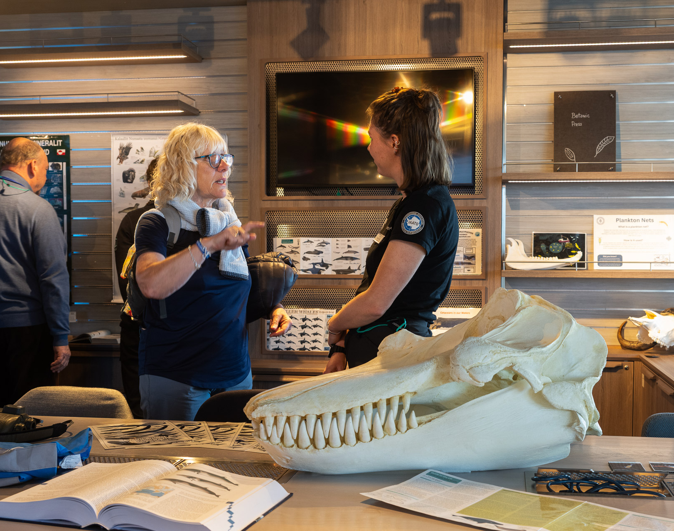
Science & Education Program
As we sailed along the Greenland coast, we travelled together through landscapes shaped by sea, weather, wildlife, history, and time.
Through lectures, workshops, time on deck, and moments ashore, we explored coastlines, fjords, islands, seabirds, whales, plants, clouds, and the forces shaping this polar route, while contributing to Citizen Science along the way.
We hope these shared experiences deepened your connection to the places we visited and inspired you to keep observing, recording, and caring for the natural world beyond this voyage.
Notes:
Introduction:
"As we set sail from Ushuaia, we embarked on more than just a voyage—we stepped into a world of discovery. Through towering glaciers, sculpted icebergs, and thriving wildlife, we weren’t just visitors; we became active participants in understanding this incredible environment."
Exploration & Connection:
"Every day brought new insights—through lectures, hands-on workshops, and quiet moments observing Antarctica’s wild beauty. We traced the journeys of past explorers, marvelled at the resilience of wildlife, and witnessed the powerful forces shaping this frozen continent."

Slide 5
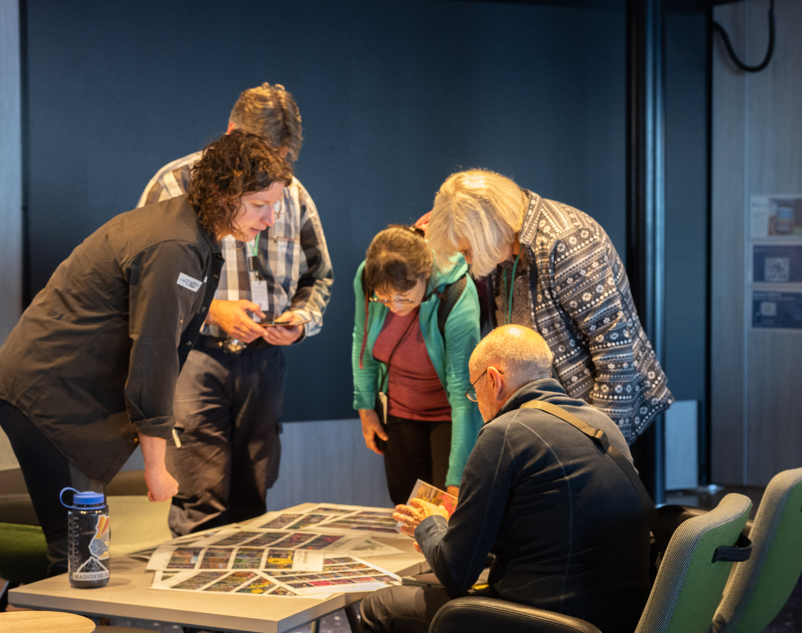
Science & Education Program
board HX vessels, we are guests in the places we visit, but through Citizen Science, you became part of something bigger.
By observing, recording, and sharing data, you contributed to global research and drew closer to the natural world.
This journey does not end here. Keep exploring, documenting, and caring for nature wherever you go.
Notes:
Citizen Science & Action:
"But our role here was more than just observation. Through citizen science, we contributed real data to global research—whether it was documenting biodiversity, collecting water samples, or tracking whale movements. Science is not just for scientists; it’s for everyone. It happens everywhere, every day, and we all have a role to play."
Bringing Antarctica Home:
"As we leave these icy waters behind, our connection to Antarctica doesn’t end here. The tools to observe, document, and contribute are in your hands. Every small action—every photo, every piece of data—adds to a greater understanding of our planet."
Closing Thought:
"May this experience inspire you to stay curious, to keep exploring, and to protect the fragile beauty of the natural world—because what we do, no matter where we are, truly makes a difference."

Slide 6
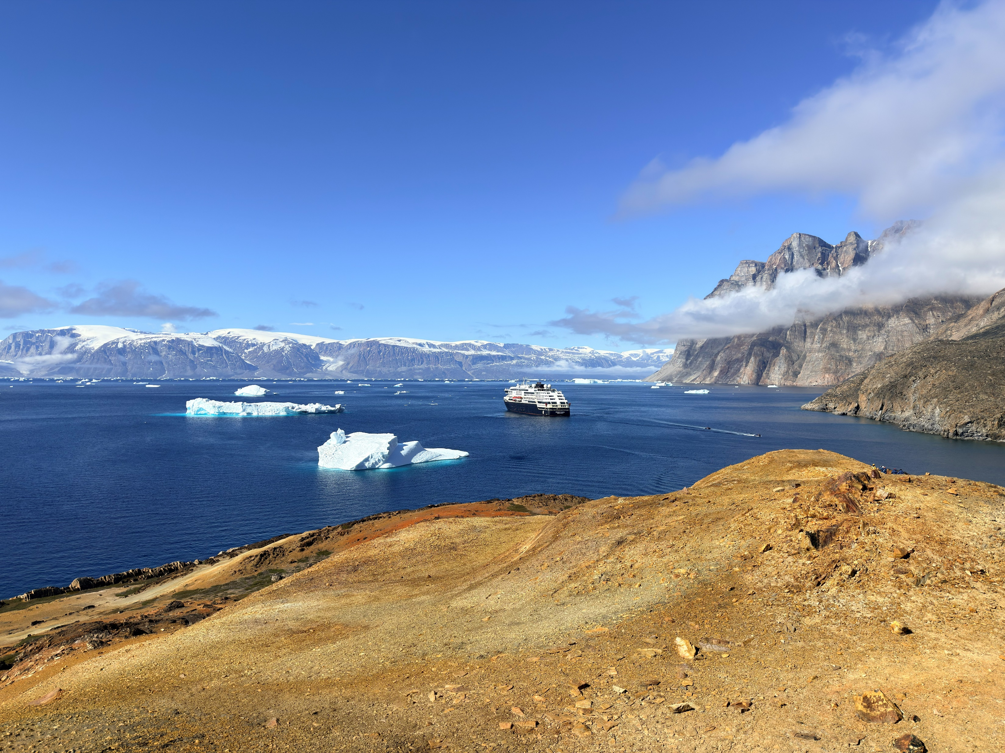
Geology
From some of the oldest rocks in the world — the Amîtsoq gneiss, 3.8 billion years old, found near Nuuk — to the plateau basalts of Qeqertarsuaq and Storøen's uniquely weathered rocks, Greenland is a geological treasury.
Greenland today may be geologically stable, but its roots reach back to the joining of crustal segments and megacontinents over billions of years. These rocks, formed at great depths, have travelled around 7,000 km through continental drift.
We traversed many of the fjords carved out during the Quaternary period through repeated glacial cycles, then flooded by the sea after the ice melted. They formed along cracks and faults left behind by those ancient continental collisions.
The geology of Greenland puts Earth's age into perspective and demonstrates the great erosive power of ice.
Storøen‘s gossan. Credit: Linda Skinner
Notes:
Please update for this voyage

Slide 7
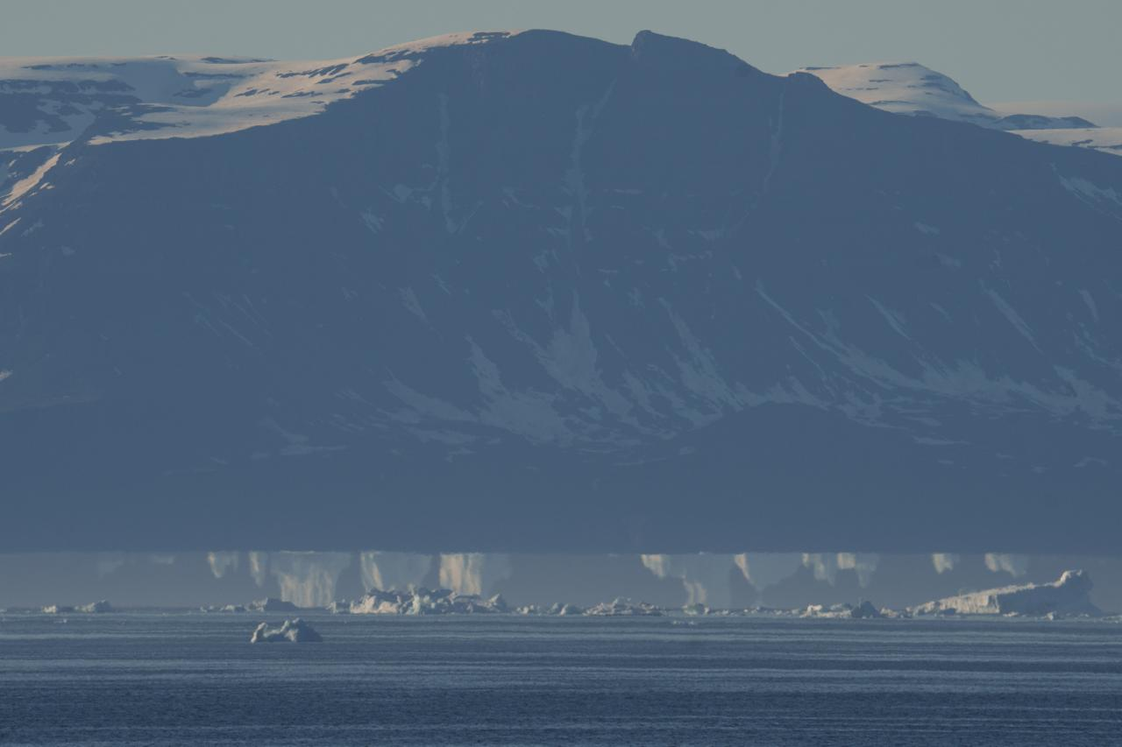
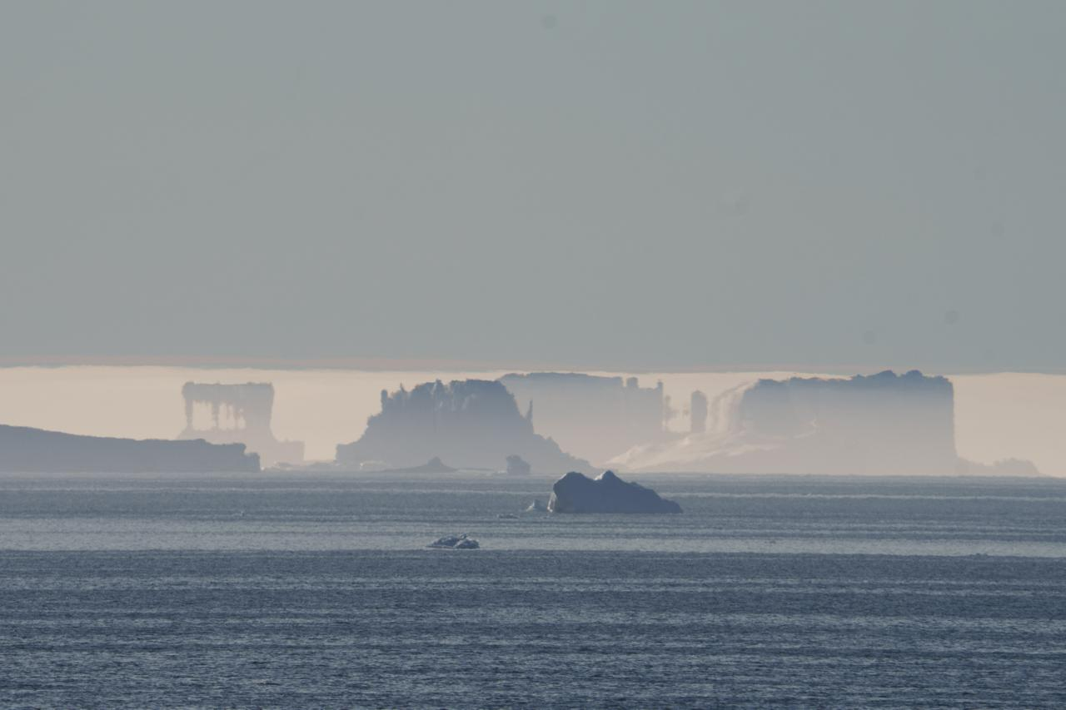
Fata Morgana
Fata Morgana is a mirage created when light bends through layers of air at different temperatures. It usually occurs when cold air is trapped near the sea or ice while warmer air sits above. This temperature inversion bends light upward or downward and distorts the image of distant objects.
In polar regions such as west Greenland, the contrast between very cold ice and slightly warmer air often produces this effect. We were fortunate to observe these remarkable mirages as we left Ilulissat, where distant icebergs, coastlines, and ships appeared stretched, lifted, doubled, flattened, or turned into strange floating shapes. What looked like a huge 'ice castle' or a hovering iceberg was in fact a real object, seen through a distorted path of light.
Leaving Ilulissat, 16.06.2026. Credit: Katrin Schmidt

Slide 8
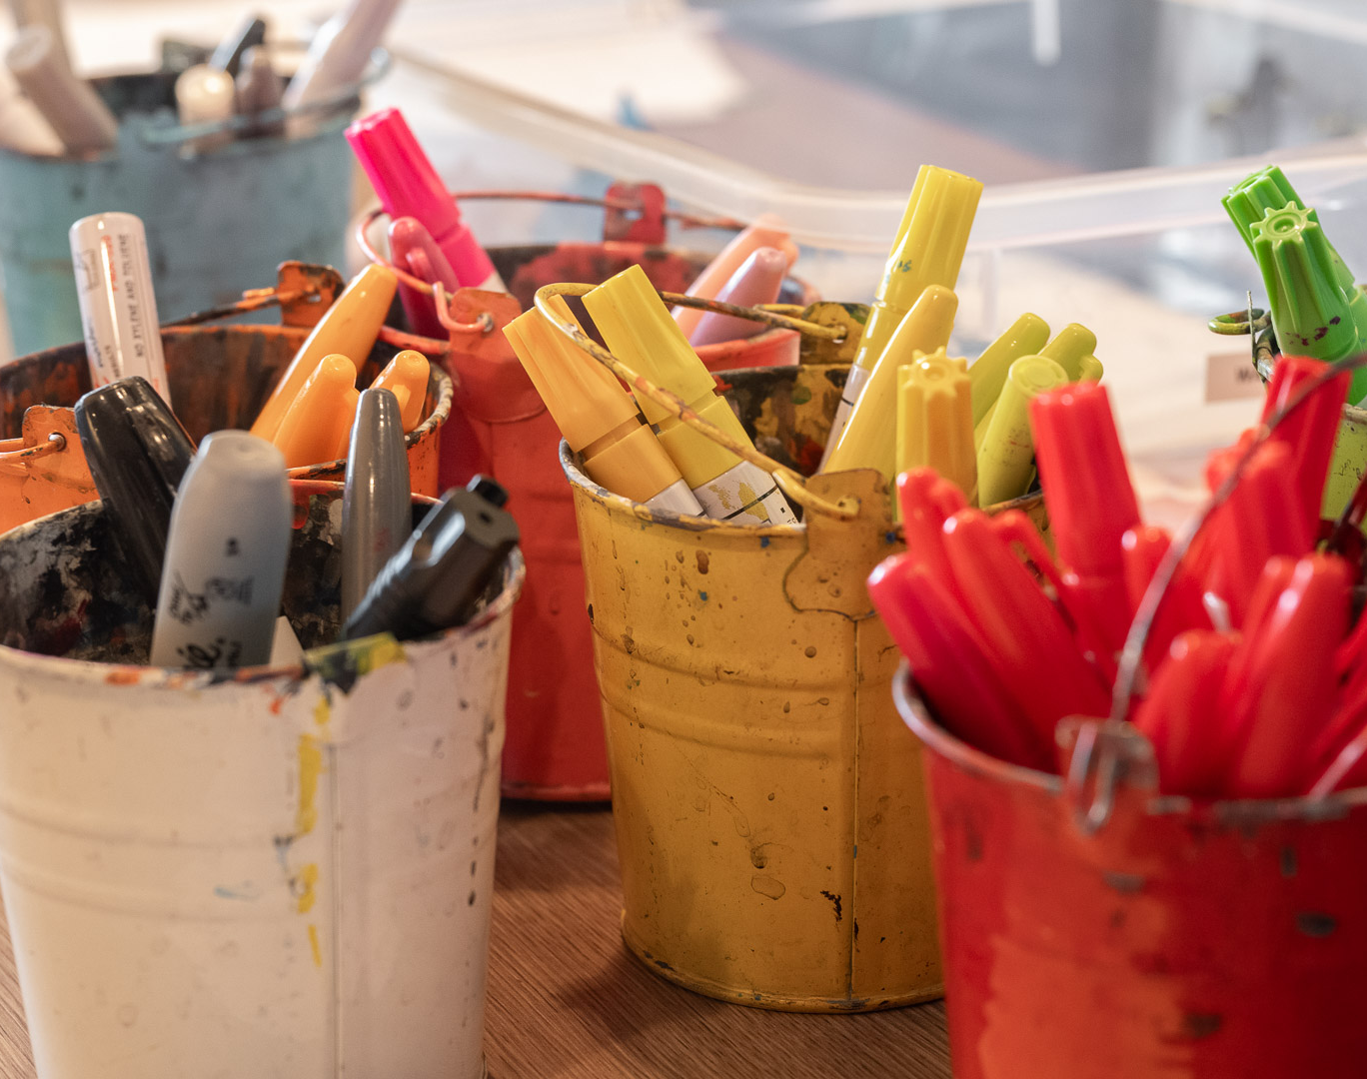
Arts, Crafts & Creativity
Through bottle painting and watercolours, we explored creativity as another way to connect with the places we visited.
No experience was needed — only curiosity and a willingness to try something new. Each creation became a personal reminder of the landscapes, wildlife, and shared moments from this voyage.
Credit: Emily Gregory
Notes:
Just like science and history help us connect with Antarctica, so does creativity. Throughout the voyage, we had the chance to express our experiences in a different way—through bottle, watercolour, and species painting, and clay modelling. Whether it was capturing the icy landscapes in watercolour or shaping wildlife out of clay, these moments allowed us to slow down, reflect, and bring a piece of Antarctica to life in our own unique way. Let’s take a look at some of the creative moments we shared onboard

Slide 9
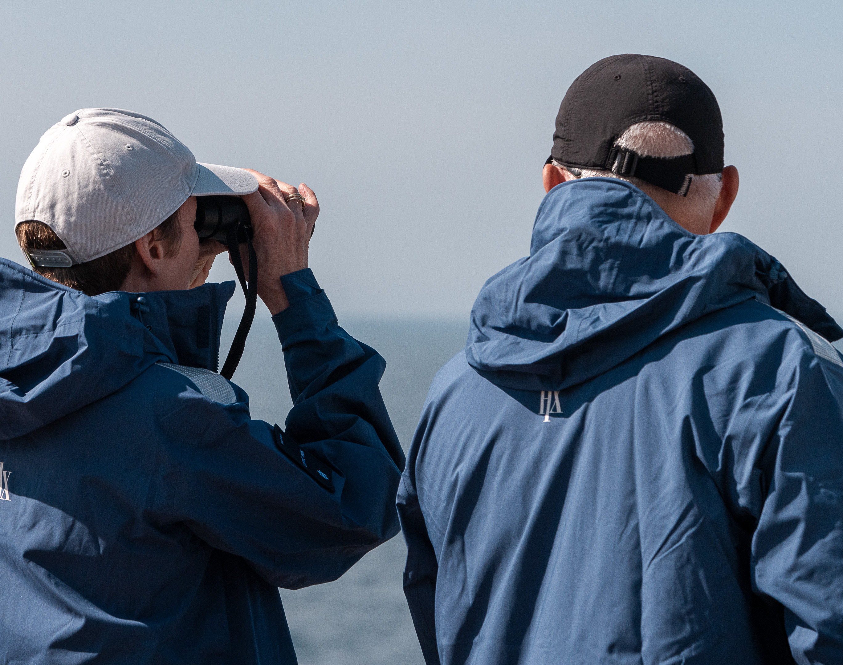
Wildlife Watch
As we travelled through Greenland, time on deck gave us the chance to take in the changing landscapes, weather, and wildlife around us.
Together, we searched for life at sea and along the coast — from seabirds riding the wind, to whales and other wildlife appearing around the ship. Each sighting deepened our appreciation of this northern route and the connections between land, sea, and sky.
These moments reminded us that the voyage was not only about the places we visited, but also about what we observed along the way.
Credit: Oscar Farrera/HX
Diatoms (St. Matthew, Alaska)
Photo: Oscar Farrera
Notes:
Creativity was just one way we engaged with this incredible environment, but another was through direct observation.
Whether standing on deck or out in the zodiacs, we spent time scanning the horizon, watching seabirds glide past, and spotting whales as they surfaced. Every wildlife sighting was a reminder that Antarctica is anything but empty—it’s full of life, adapted to thrive in the harshest conditions.

Slide 10
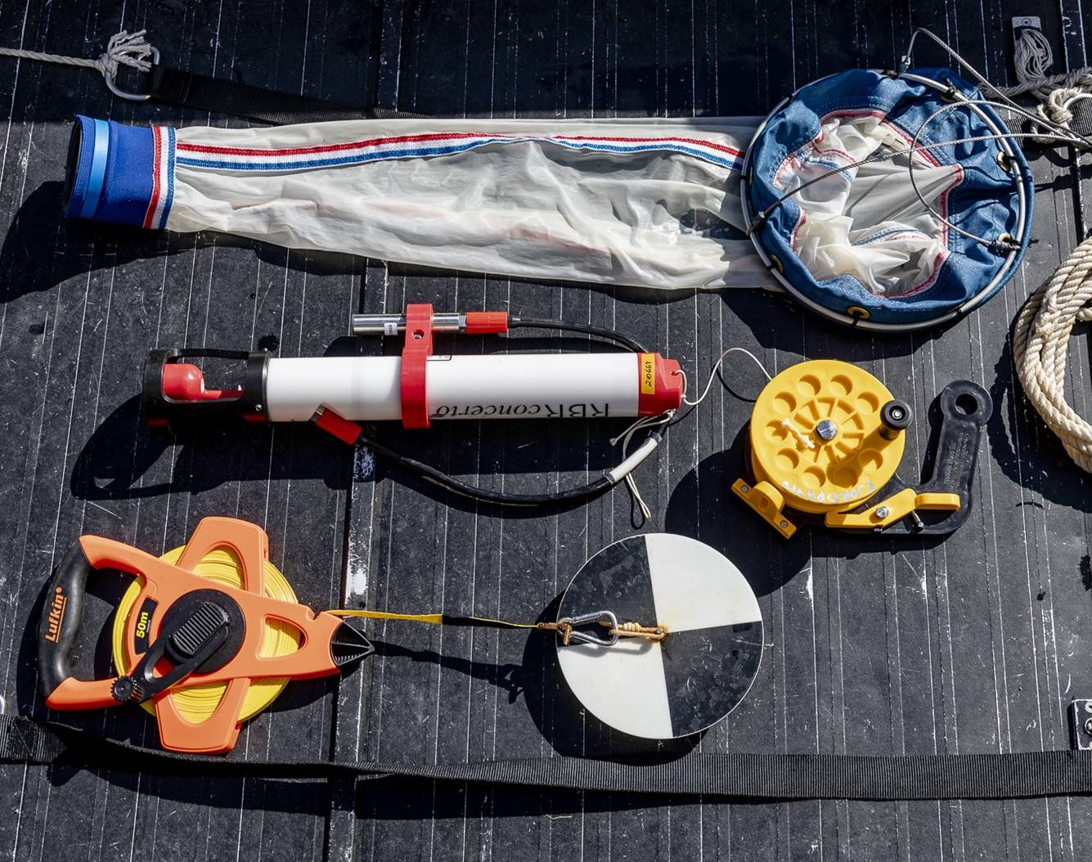
Science Boat
Over three science boat sessions, we moved beyond observation and took part in hands-on exploration of the waters along our route.
Using the plankton net, CTD, and Secchi Disk, we collected samples and measurements to better understand the hidden world beneath the surface — from tiny drifting organisms to water conditions and clarity.
These sessions were a reminder that science begins with curiosity, careful observation, and a willingness to ask questions about the world around us.
Notes:
We also took a deeper dive into Antarctica’s marine world through hands-on science. Out on the science boat, we weren’t just observing—we were actively collecting data, contributing to real research on this fragile ecosystem.

Slide 11
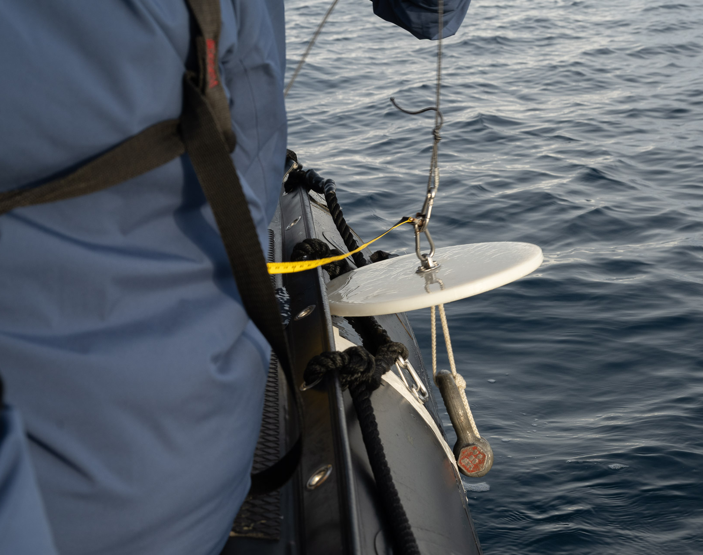
Secchi Disk
Looking into the water, it is easy to forget how much hidden life lies beneath the surface.
With the Secchi Disk, we measured water clarity by lowering the disk until it disappeared from view, offering clues about plankton abundance and ocean conditions.
On some days, currents made measurements impossible, reminding us that nature sets the terms. Each reading contributed to a better understanding of our changing ocean.
Photo: Matthew Gladhill
Notes:
To explore the health of these waters even further, we used a Secchi Disk to measure water clarity—a simple but powerful way to understand plankton abundance and ocean conditions.

Slide 12
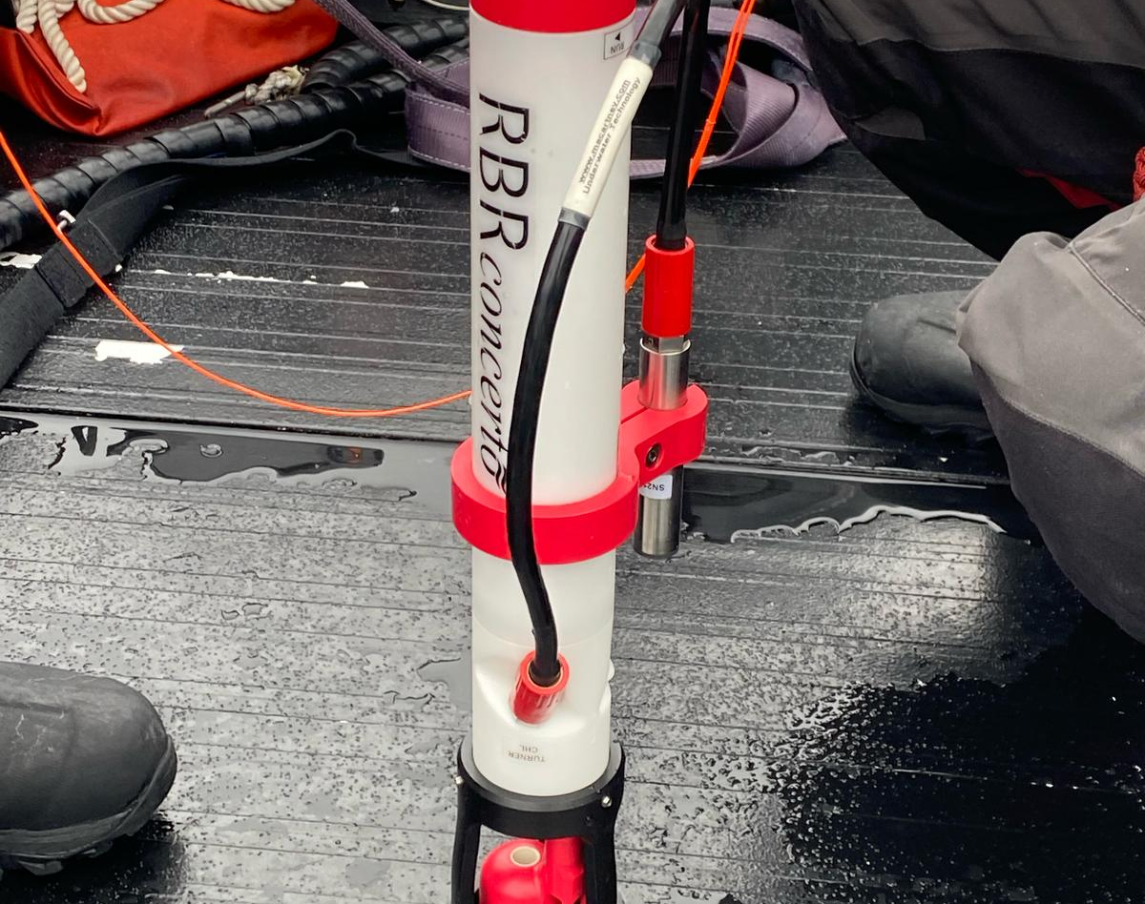
CTD
Beneath the surface, the ocean holds important clues about change.
With the CTD, we measured temperature, salinity, and depth, helping us better understand water conditions along our route.
Each profile added useful data on how freshwater, currents, and ocean layers shape these waters — one measurement at a time.
Photo: Matthew Gladhill
Notes:
While the Secchi Disk gave us a simple way to measure water clarity, the CTD device allowed us to take a deeper look at the ocean itself—measuring salinity, temperature, and depth to better understand how these waters are structured and how they influence marine life.

Slide 13
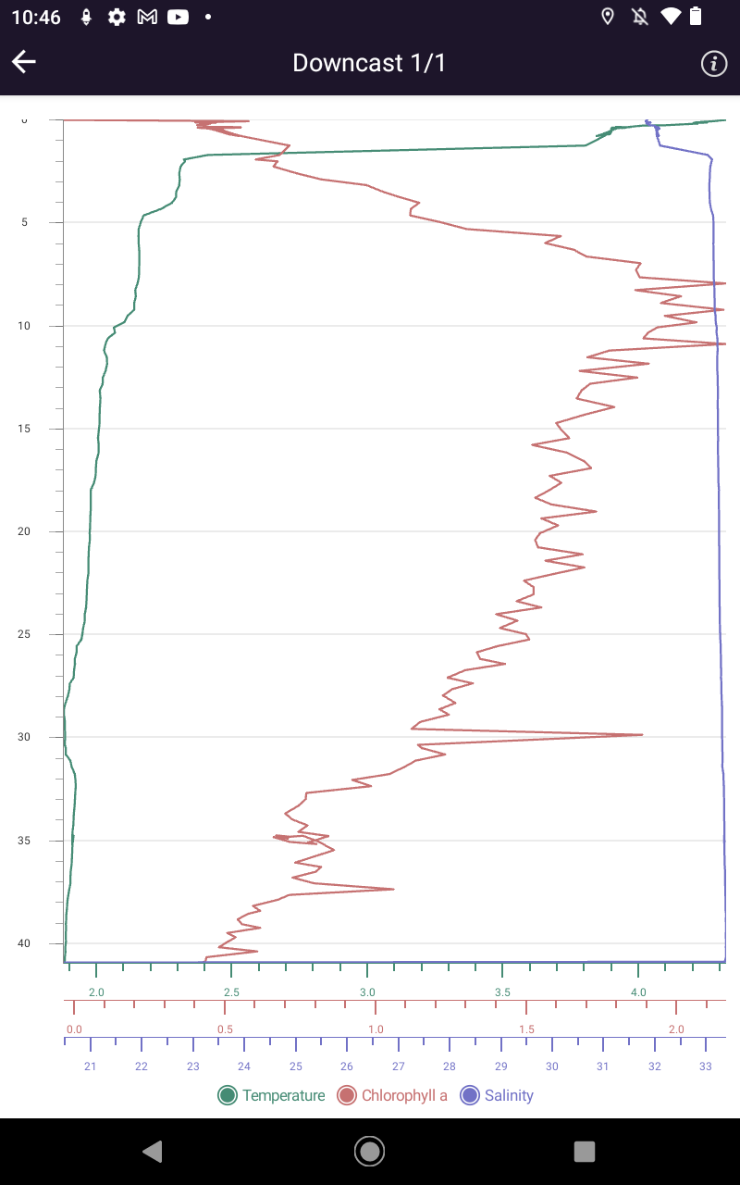
Depth Profile:
Our CTD profile from Vaigat shows a 2.4°C difference in temperature between the surface and 40 m depth, with the surface slightly warmer than the water below. Sun and atmosphere likely warmed the surface layer, while cold Arctic currents shape the deeper layers.
Phytoplankton, measured here as chlorophyll a (µg/l), was elevated at 10 m and 30 m depth. Below that, values were much lower.
Our plankton samples across the voyage contained plenty of zooplankton after a vertical tow and fewer after a surface tow — likely because zooplankton descend through the water column during the brightest hours of the day to avoid predation.
Depth (m)
Temperature (°C)
Chlorophyll
Salinity
Notes:
Updated 25/05

Slide 14
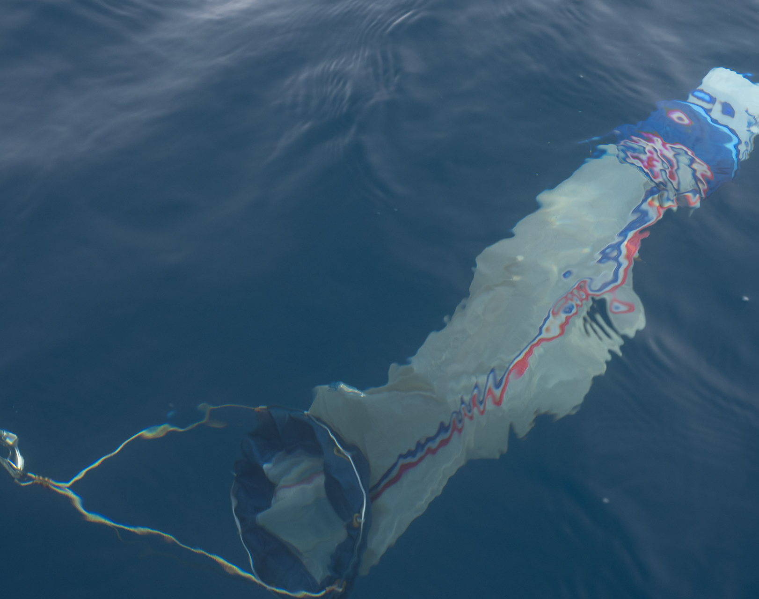
Water Sampling
During our expedition, we collected water samples from Uummannaq, Vaigat Sound, and Evighedsfjord.
From the science boat, we deployed plankton nets, towing them through the water to capture these drifting life forms. The phytoplankton net (20 µm mesh) collected microscopic plant-like organisms — the base of the marine food web in these fjord and coastal systems.
Each tow offered a glimpse into the hidden world beneath the surface, helping us understand how these tiny organisms support life along the Greenland coast.
Photo: Matthew Gladhill
Notes:
And with plankton net tows, we captured some of the smallest yet most important life forms in the ocean, the foundation of the entire Antarctic food chain. By taking part in these studies, we weren’t just passengers; we were citizen scientists, contributing to a better understanding of this ever-changing environment."

Slide 15
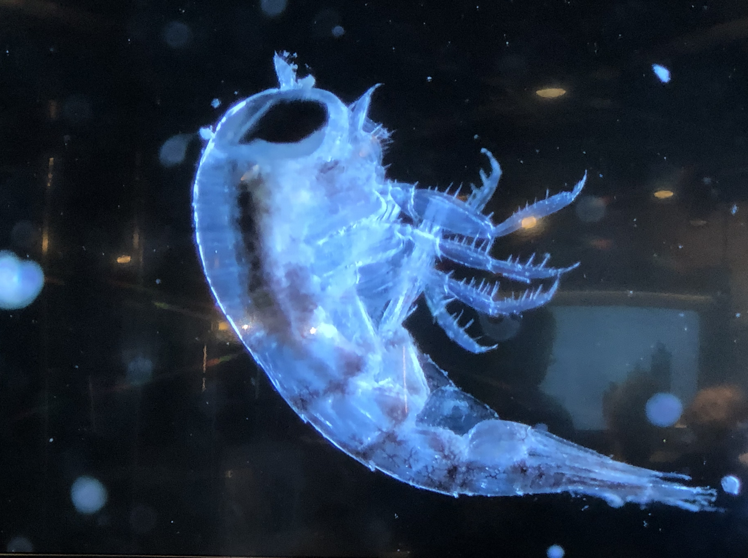
Plankton Samples
Back in the Science Centre, we brought our Vaigat Sound and Storøen surface and vertical tow samples into focus under the microscope, revealing a hidden world of plankton.
Using the main screen and smaller microscopes, we explored each drop of water up close.
What appeared invisible to the naked eye quickly became a vivid reminder that these tiny organisms form the foundation of the rich ecosystems we travelled through.
Notes:
Updated 25-05

Slide 16
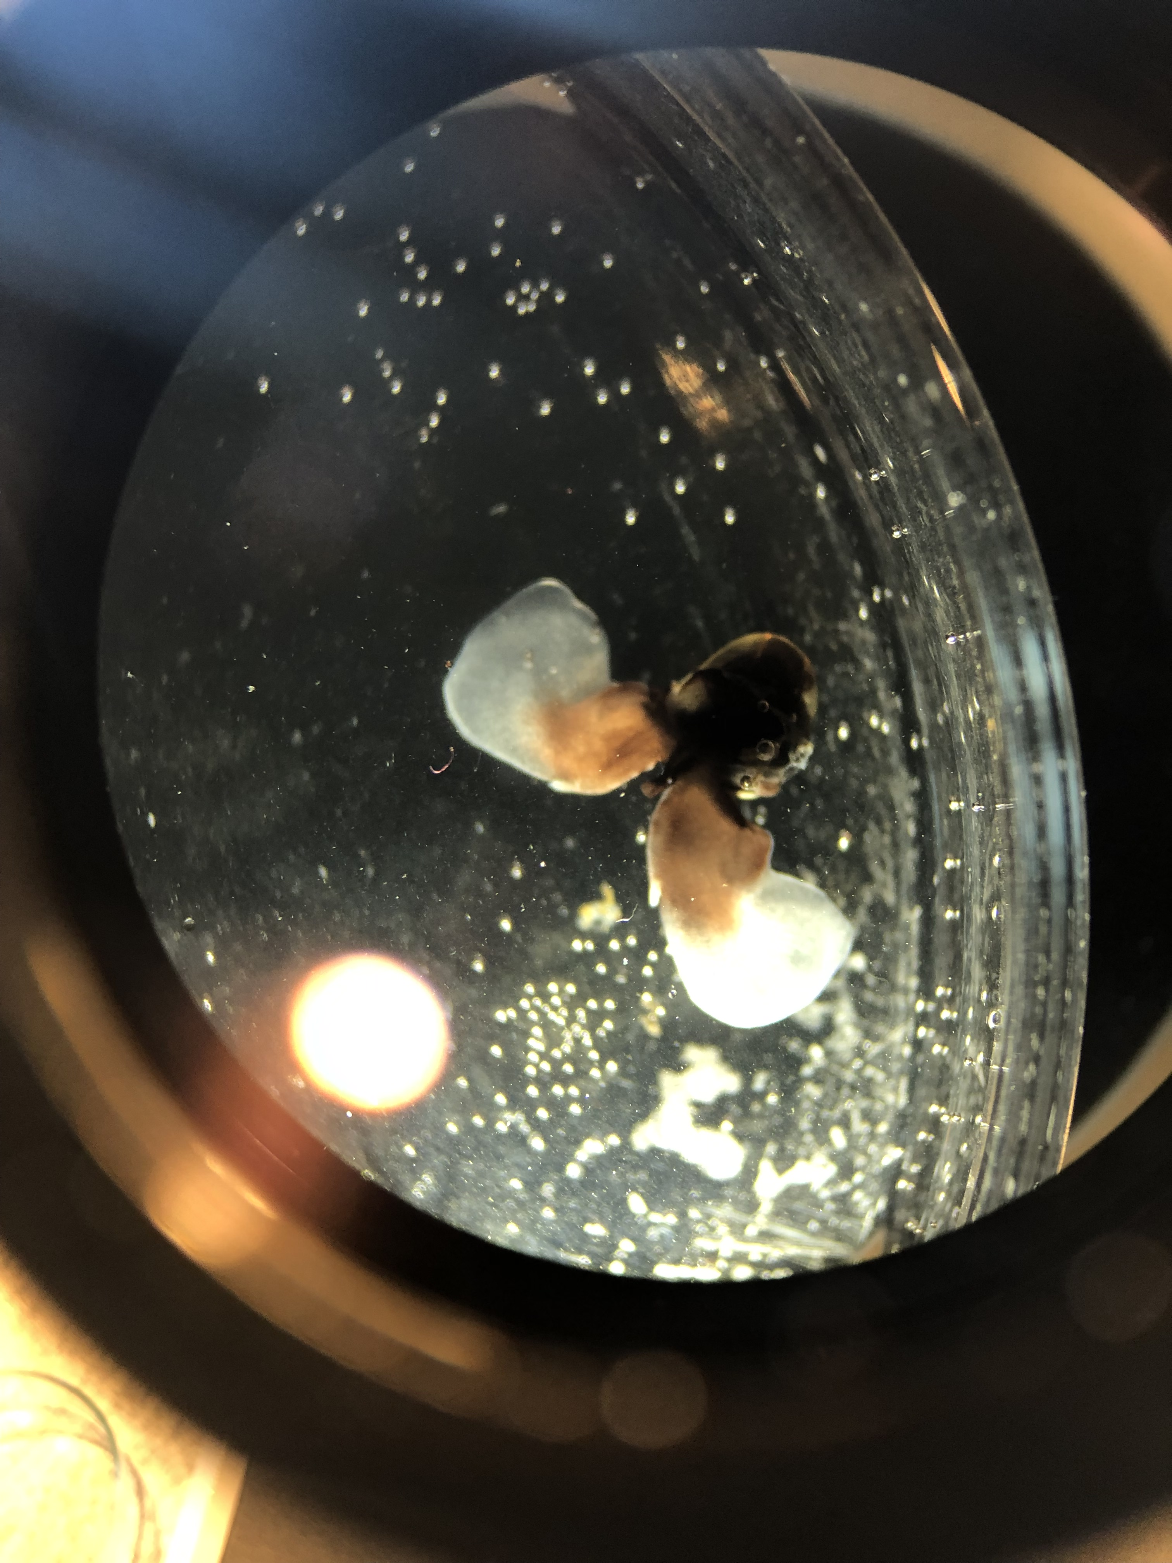
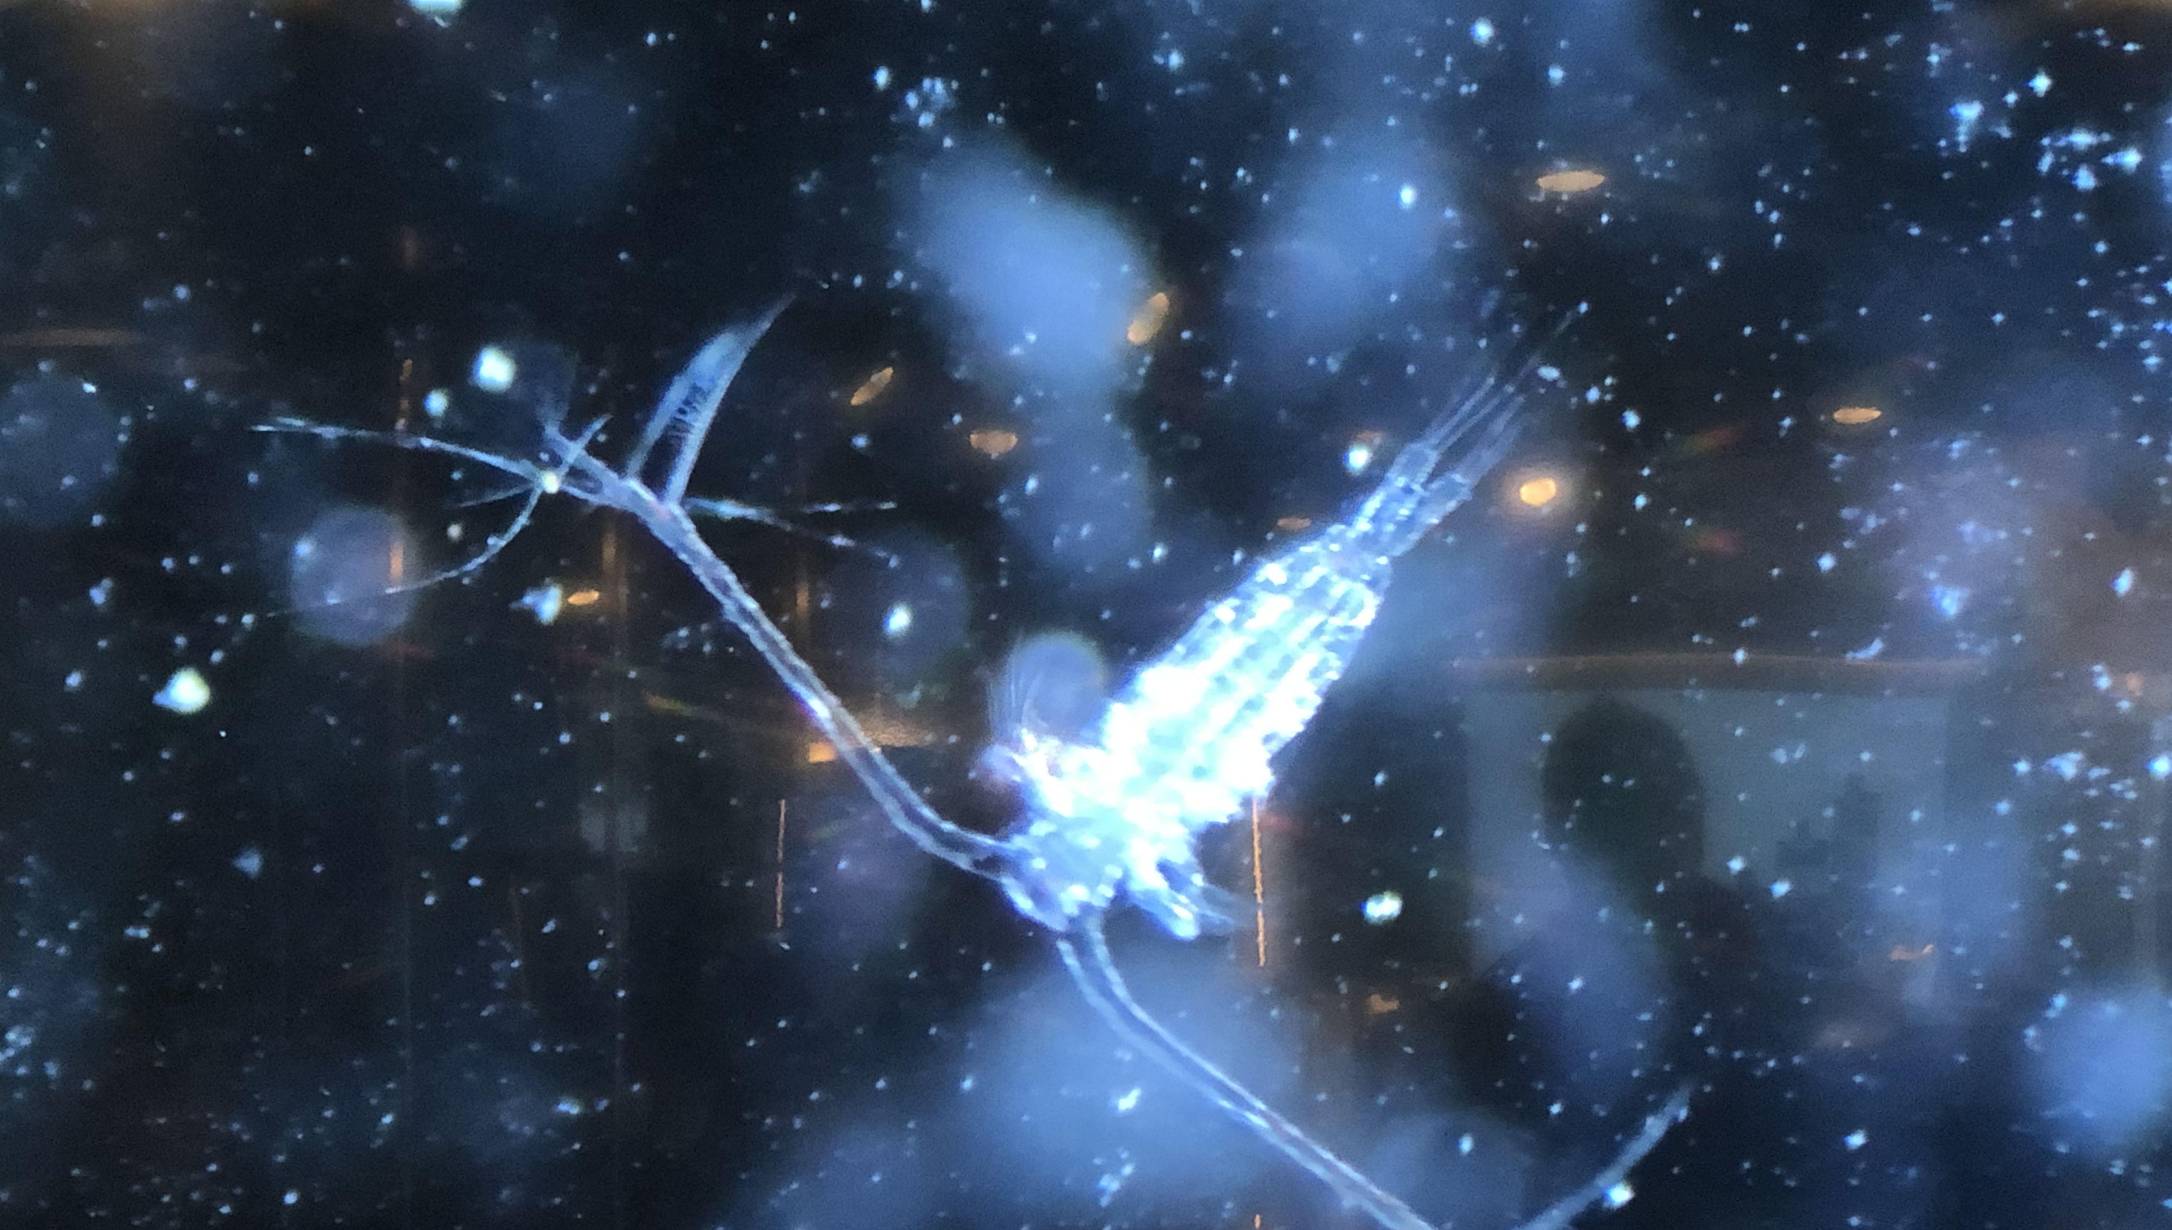
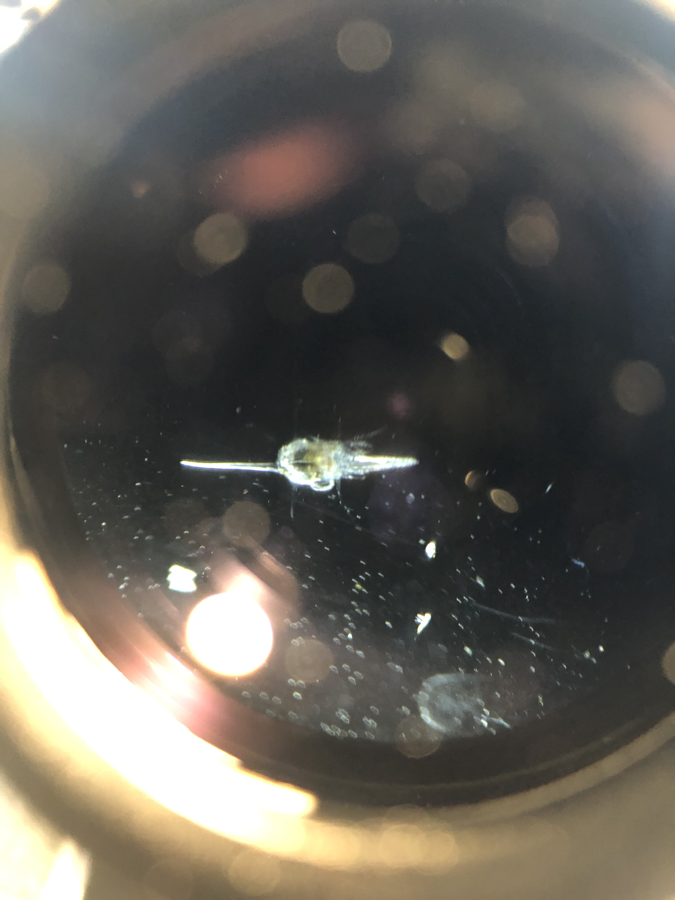
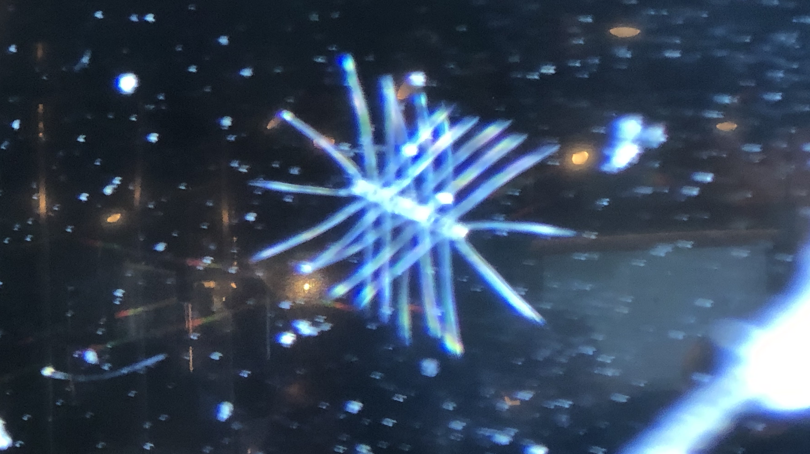
A) Sea butterfly - zooplankton
B) Copepod – Calanus sp. - zooplankton
C) Diaton sp. - phytoplankton
D) Spider crab larvae - zooplankton
Notes:
Updated 25-05

Slide 17
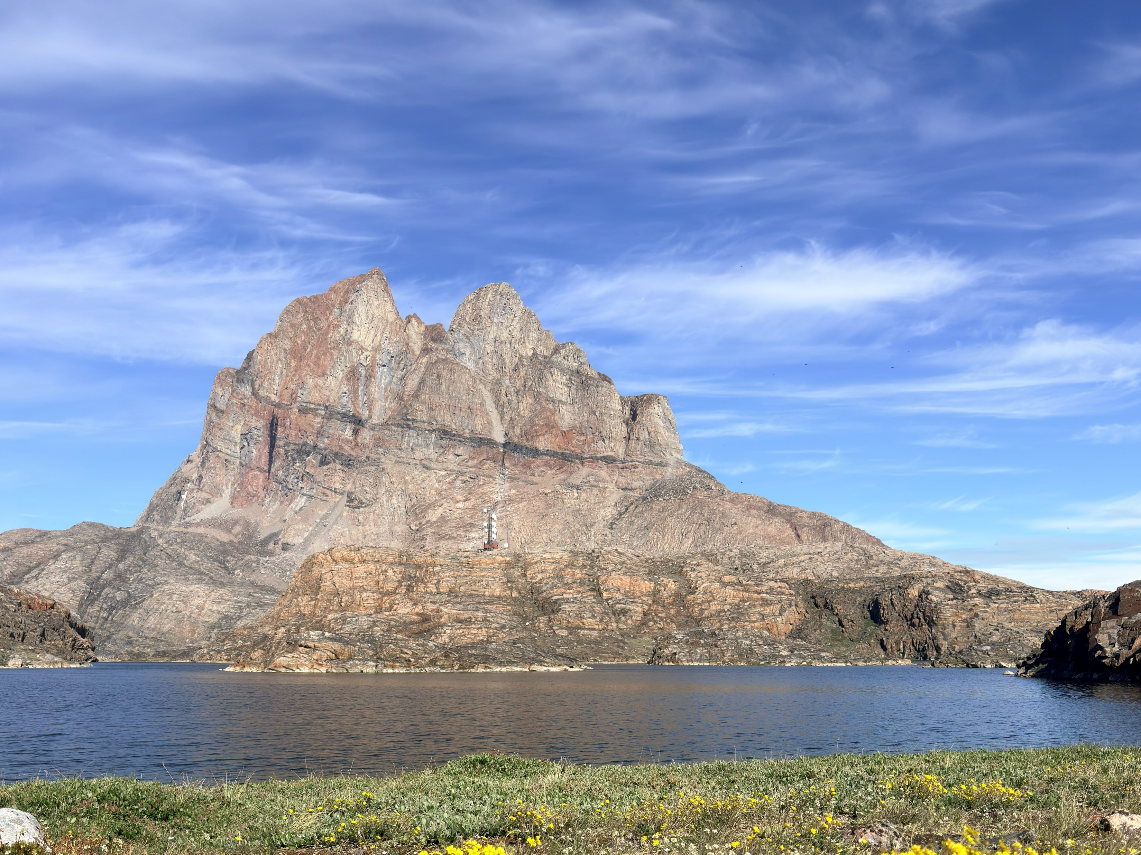
NASA's GLOBE Cloud Observer
Cirrus in Uummannaq. Credit: Linda Skinner
During our voyage, we contributed to NASA's GLOBE Cloud Observations, collecting data on:
17 June (Uummannaq)
18 June (Storøen)
19 June (Vaigat Sound)
By comparing our observations with satellite data, scientists can improve cloud classification, weather forecasting, and climate models.
You can continue contributing from home using the GLOBE Observer app.
View our data on the global map
Photo: Oscar Farrera
Notes:
Linda
Just as plankton play a key role in the marine ecosystem, clouds influence the climate—affecting temperature, weather patterns, and even how much sunlight reaches the ocean’s surface.
To tell us more about the GLOBE Cloud Project and how our observations contribute to climate research

Slide 18
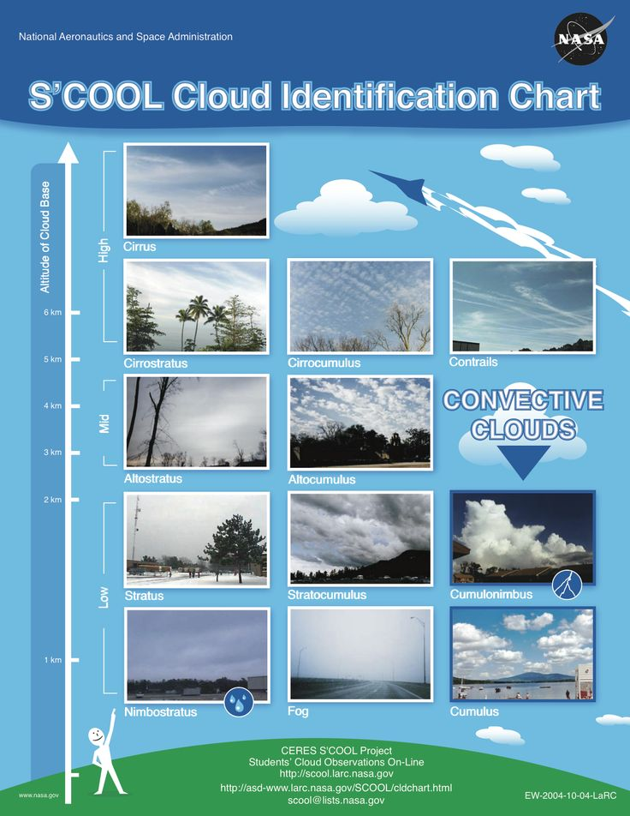
NASA Cloud Observer
High clouds (base above 6,000 metres):
Cirrus: thin, wispy clouds composed of ice crystals, often appearing as delicate streaks or feathery wisps high in the sky.
Cirrostratus: thin, sheet-like clouds that cover large portions of the sky, sometimes creating a halo around the sun or moon.
Cirrocumulus: small, fluffy clouds in a regular pattern, resembling fish scales or ripples.
Medium clouds (base between 2,000 and 6,000 metres):
Altocumulus: puffy, greyish-white clouds with rounded edges, often forming parallel rows or patches.
Altostratus: thick, greyish clouds that partially obscure the sun or moon, lacking the distinct features of cirrostratus.
Low clouds (base below 2,000 metres):
Stratus: uniform, greyish clouds that cover the sky like a blanket, sometimes bringing drizzle or light rain.
Stratocumulus: low, lumpy clouds with defined edges, often appearing in rows or patches.
Nimbostratus: thick, dark grey clouds associated with steady rain or snow.
These cloud types vary in appearance and behaviour, but this basic classification helps meteorologists interpret weather patterns and atmospheric conditions. For more examples, explore NASA's On-Line Cloud Chart.
6
5
4
3
2
1
View our data on the global map
Notes:
Linda

Slide 19
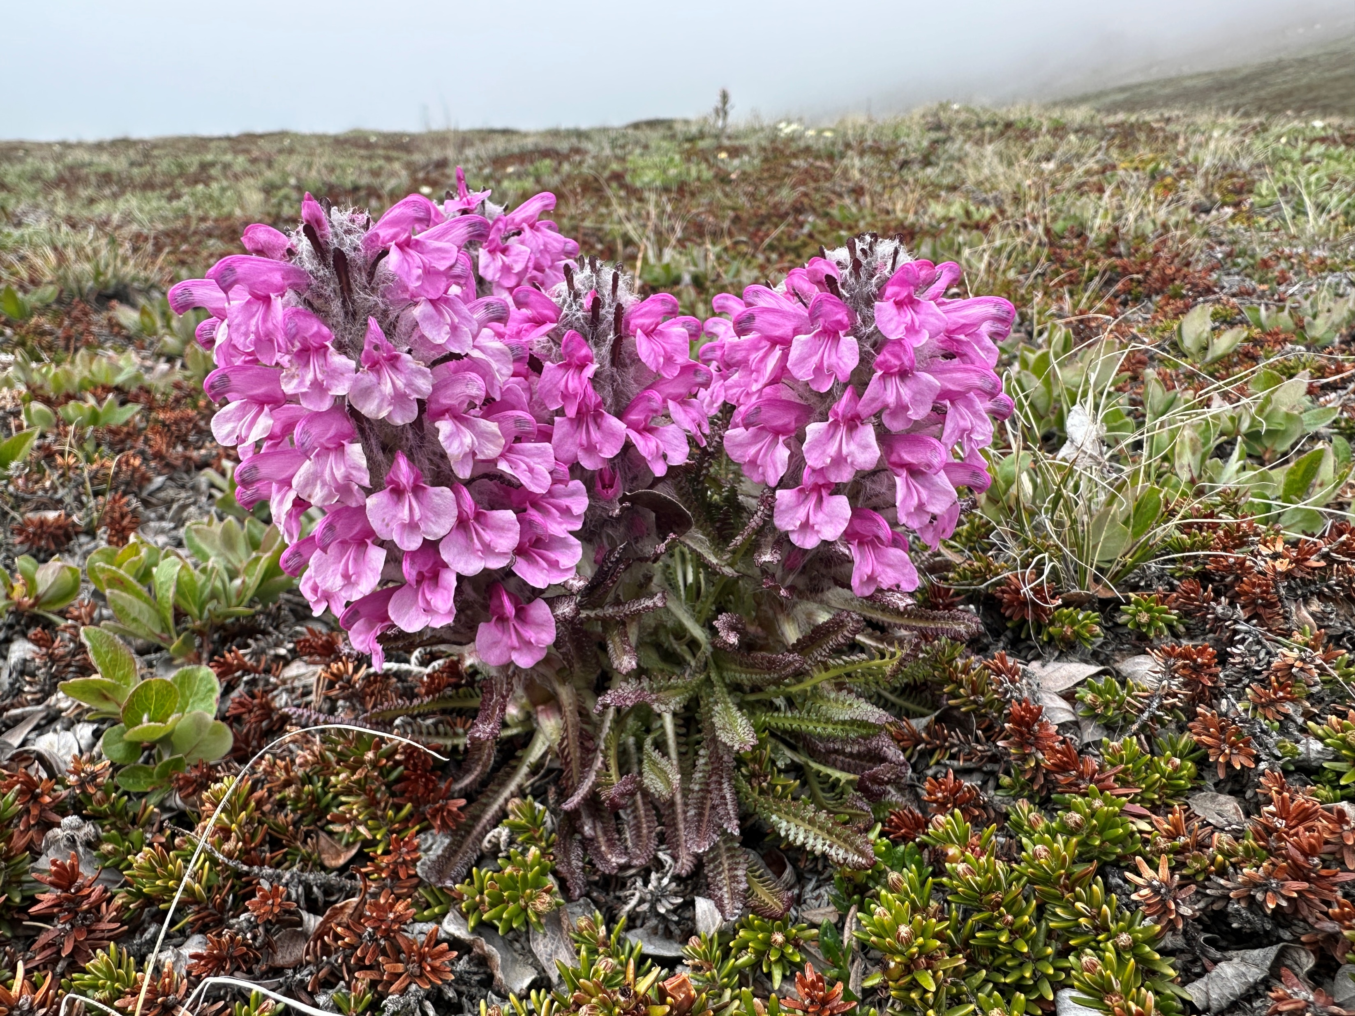
iNaturalist
Throughout this voyage, you played a vital role in documenting the biodiversity of Greenland.
Together, we gathered:
1,094 observations
181 species identified
11 observers participating
Each observation helps scientists build a clearer picture of biodiversity in Arctic and sub-Arctic regions.
Ready to explore our findings? Follow the link below to view our collective data and see the impact of your contributions:
2026 June 14 – 24: Grand Greenland: The Icy Giants of Disko Bay — MS Fridtjof Nansen · iNaturalist
Notes:
Claire

Slide 20
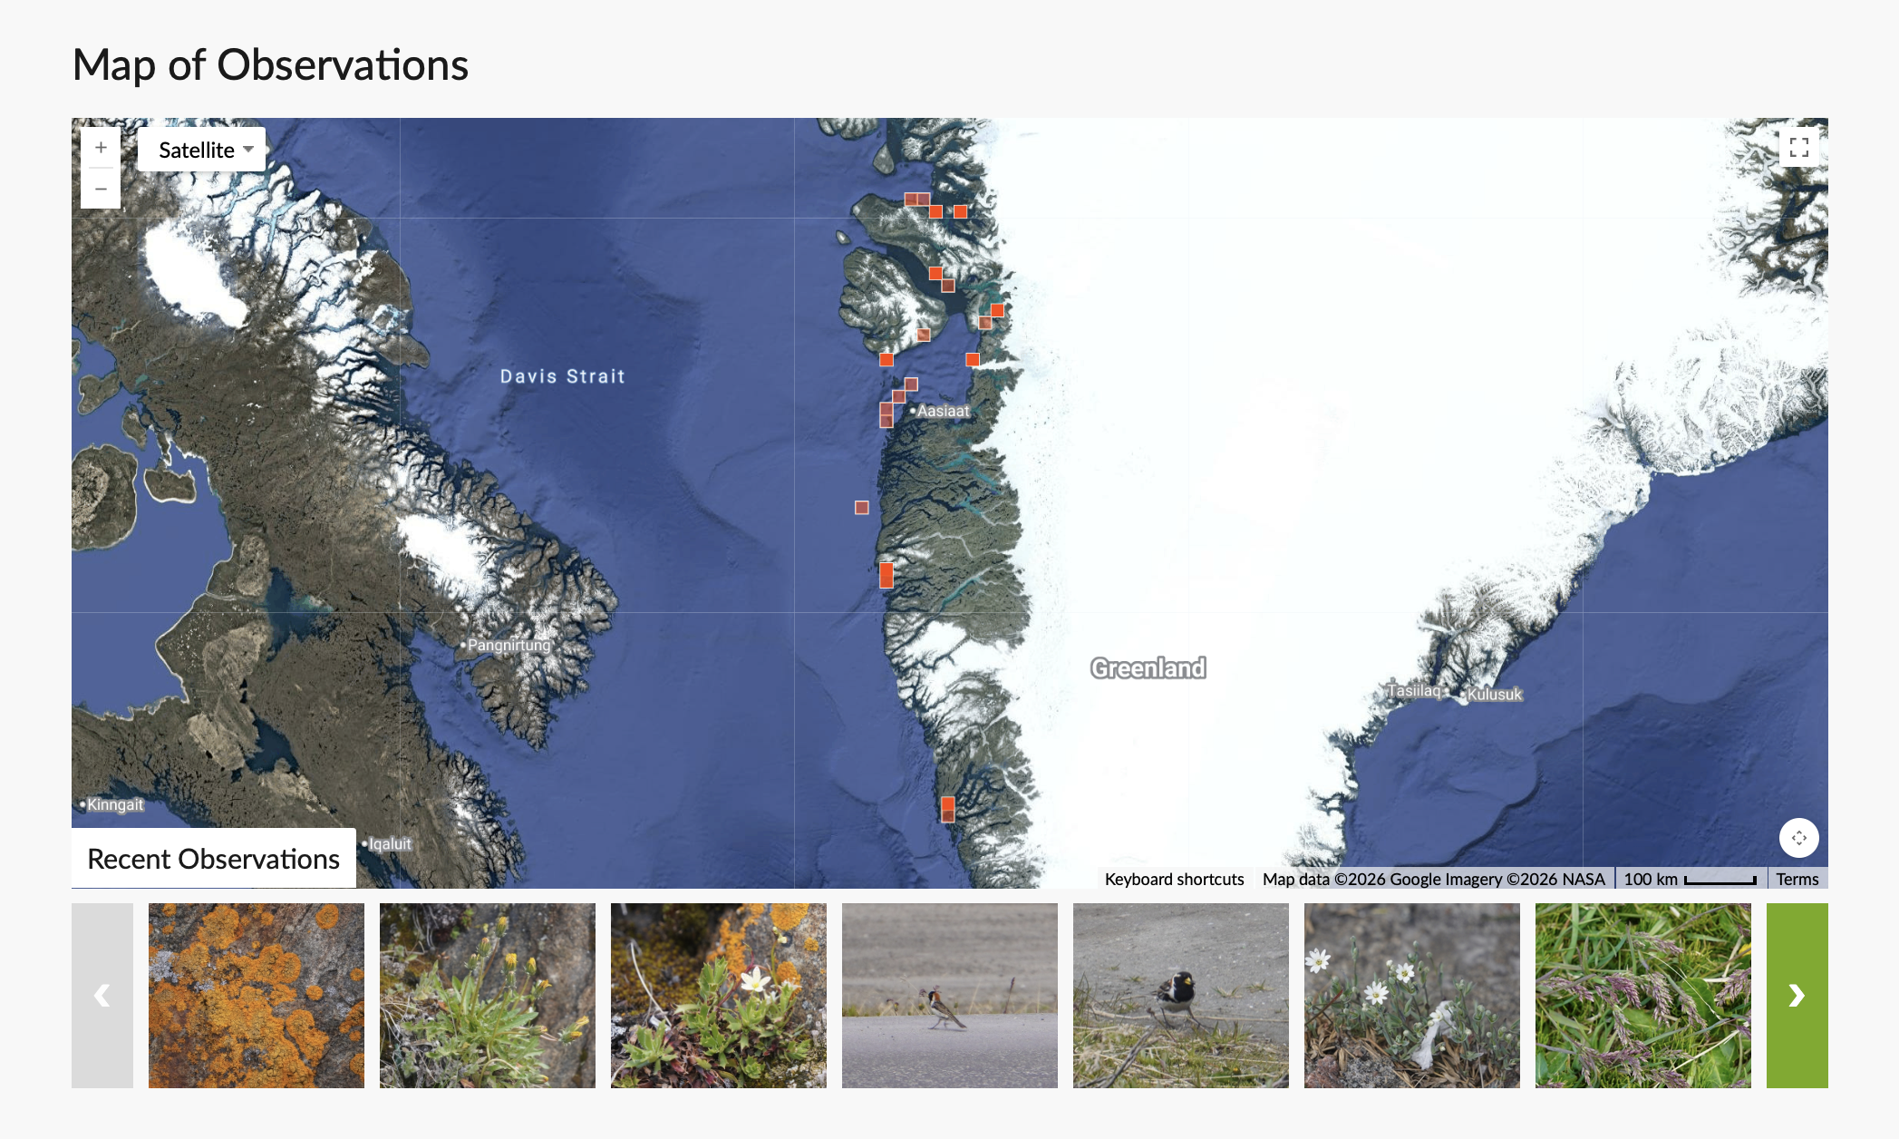
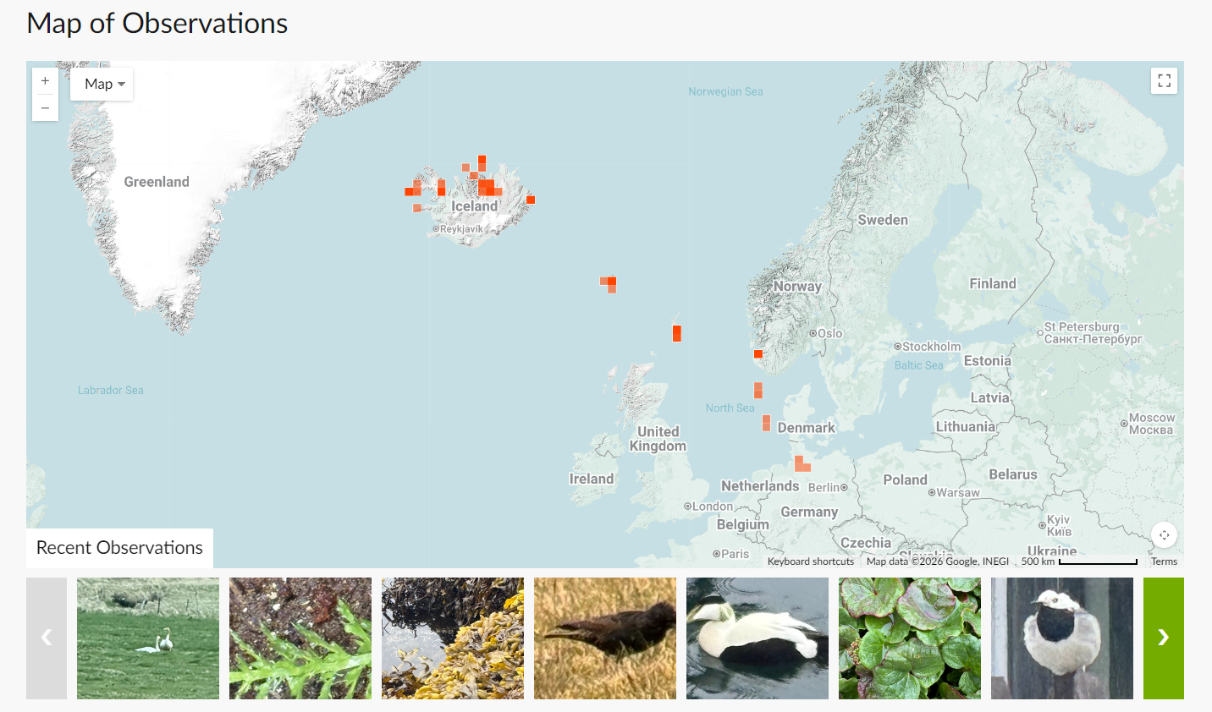
Notes:
Claire

Slide 21
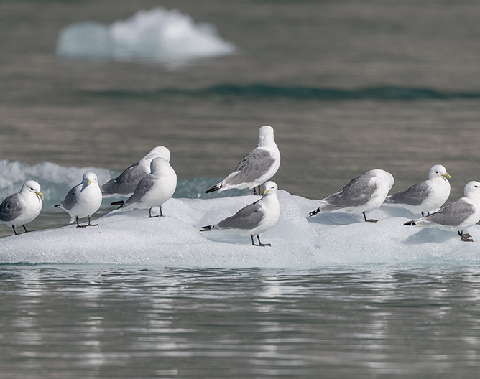
eBird
Bird-watching is not just a hobby — it is a powerful tool for science. eBird, a global Citizen Science platform, allows bird enthusiasts to record and share sightings, contributing valuable data for research and conservation.
During our voyage, our onboard Ornithologist conducted seven wildlife watches, completing 26 checklists and recording 27 bird species along the way.
Every entry adds to a growing database that helps scientists track migration patterns, monitor populations, and understand bird behaviour in Greenland.
Follow the link below to explore our data and see how your observations contribute to a global effort in avian research:
https://ebird.org/tripreport/538831
Credit: Oscar Farrera/HX
Notes:
CHIARA

Slide 22
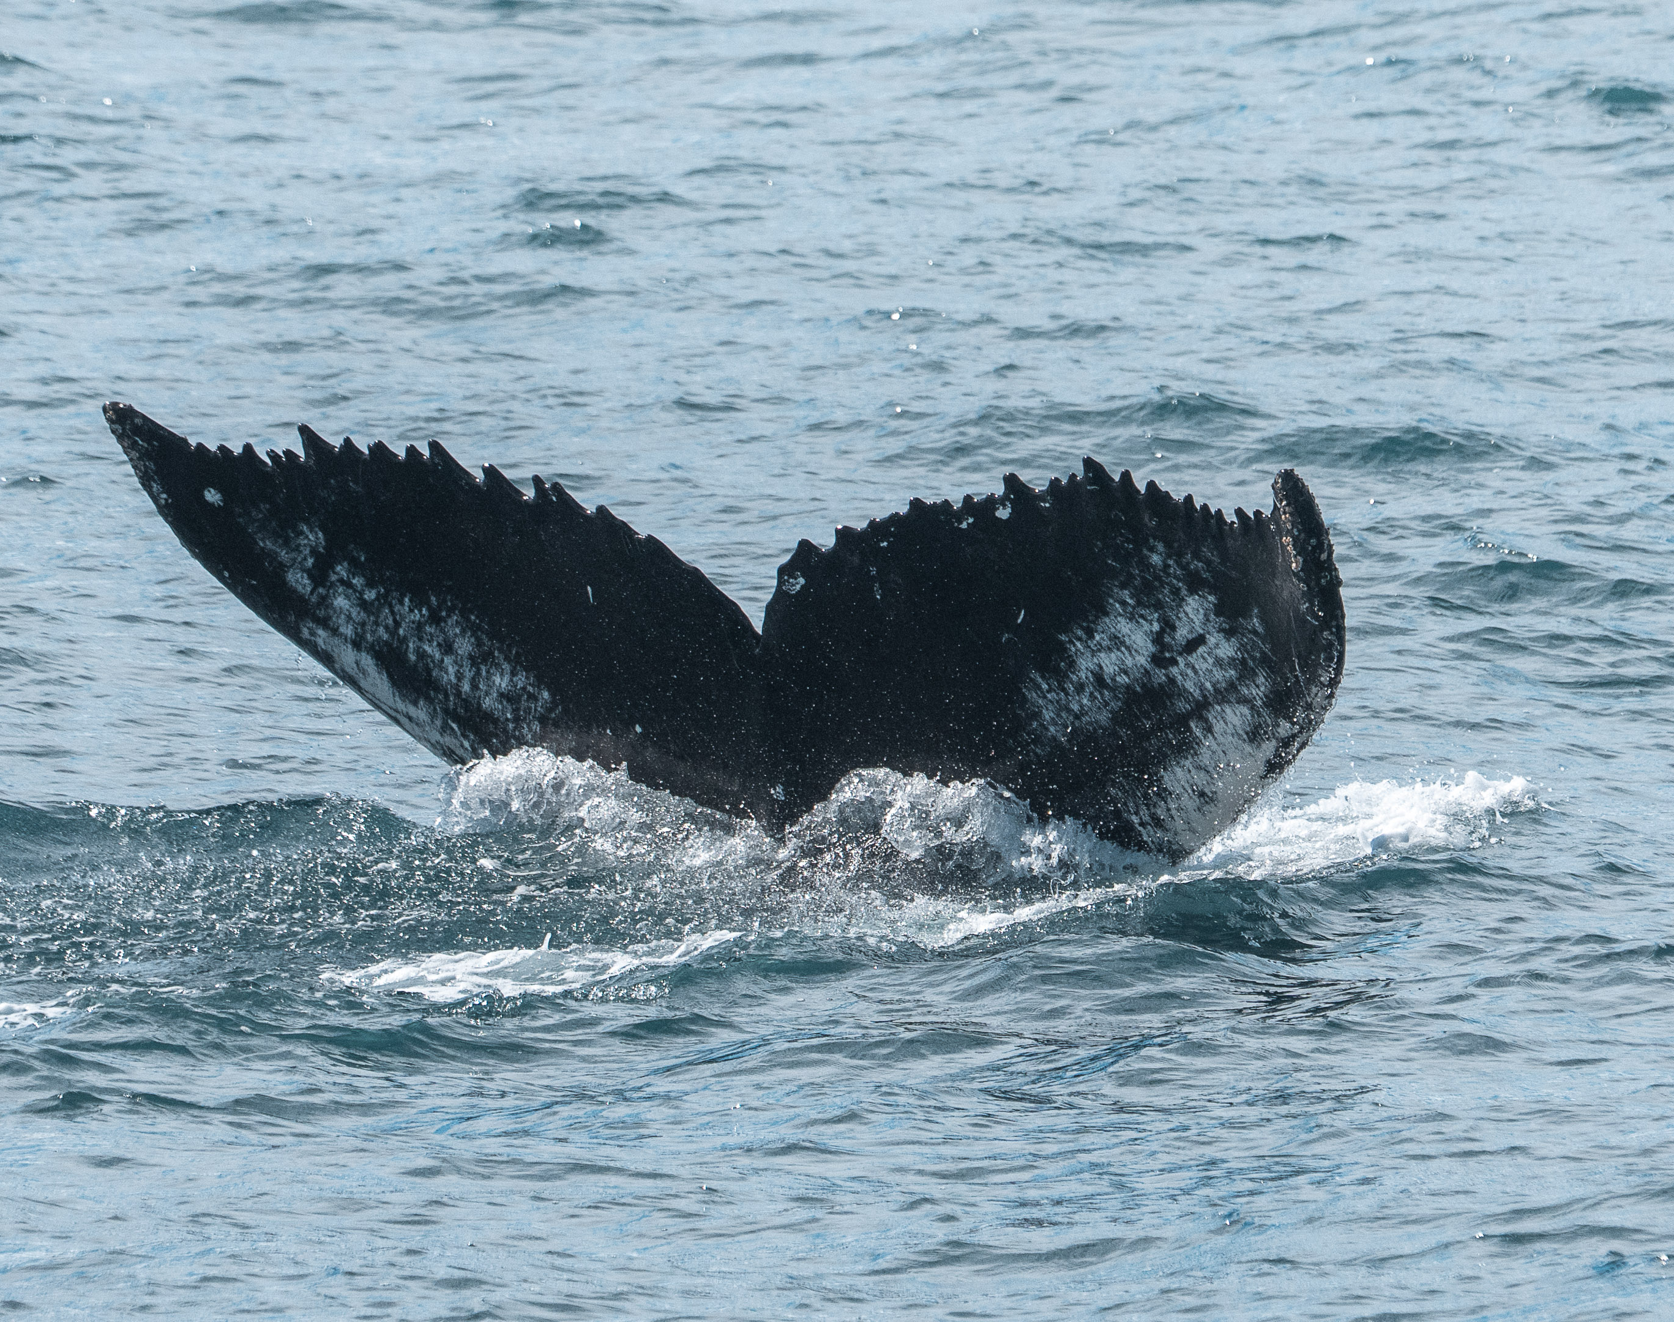
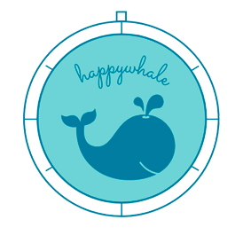
Happywhale
Cetaceans — whales, dolphins, and porpoises — always capture our attention. By submitting photos to Happywhale, we help scientists track individual animals through their lives and movements.
During this voyage, the Expedition Team and guests uploaded observations of humpback whales. We now wait to see whether they can be matched to known or new individuals.
You can view MS Fridtjof Nansen's Happywhale submissions, follow individual whales for future updates, or upload your own photos from this voyage or past encounters.
Credit: Timo Heinz
Notes:
Update

Slide 23
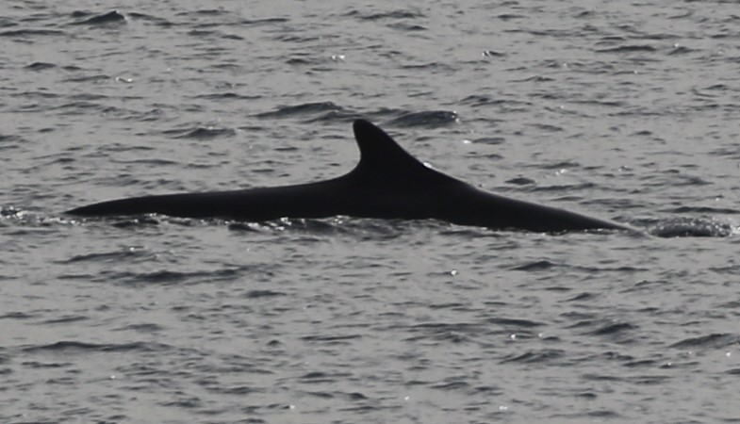
Fin whale – Finwal - Rorqual commun
Notes:
PETE

Slide 24
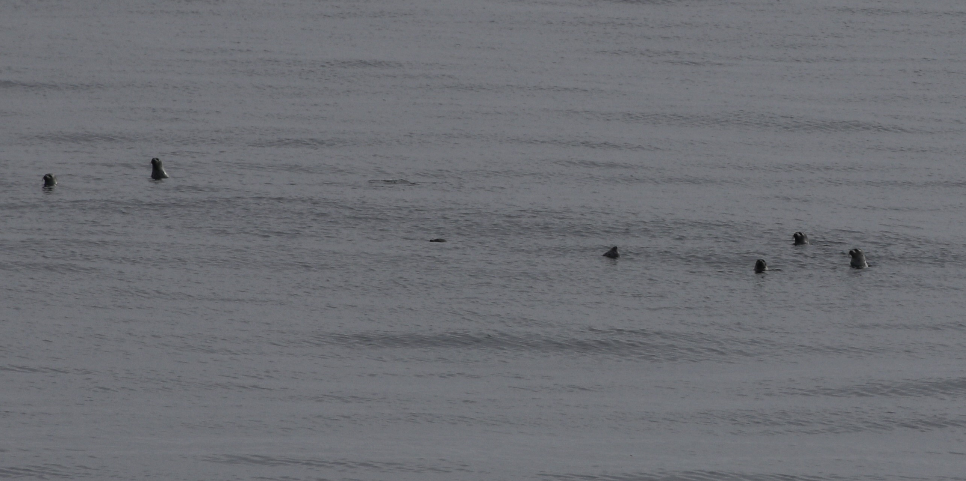
Harp seals – Sattelrobbe - Phoque du Groenland
Notes:
PETE

Slide 25
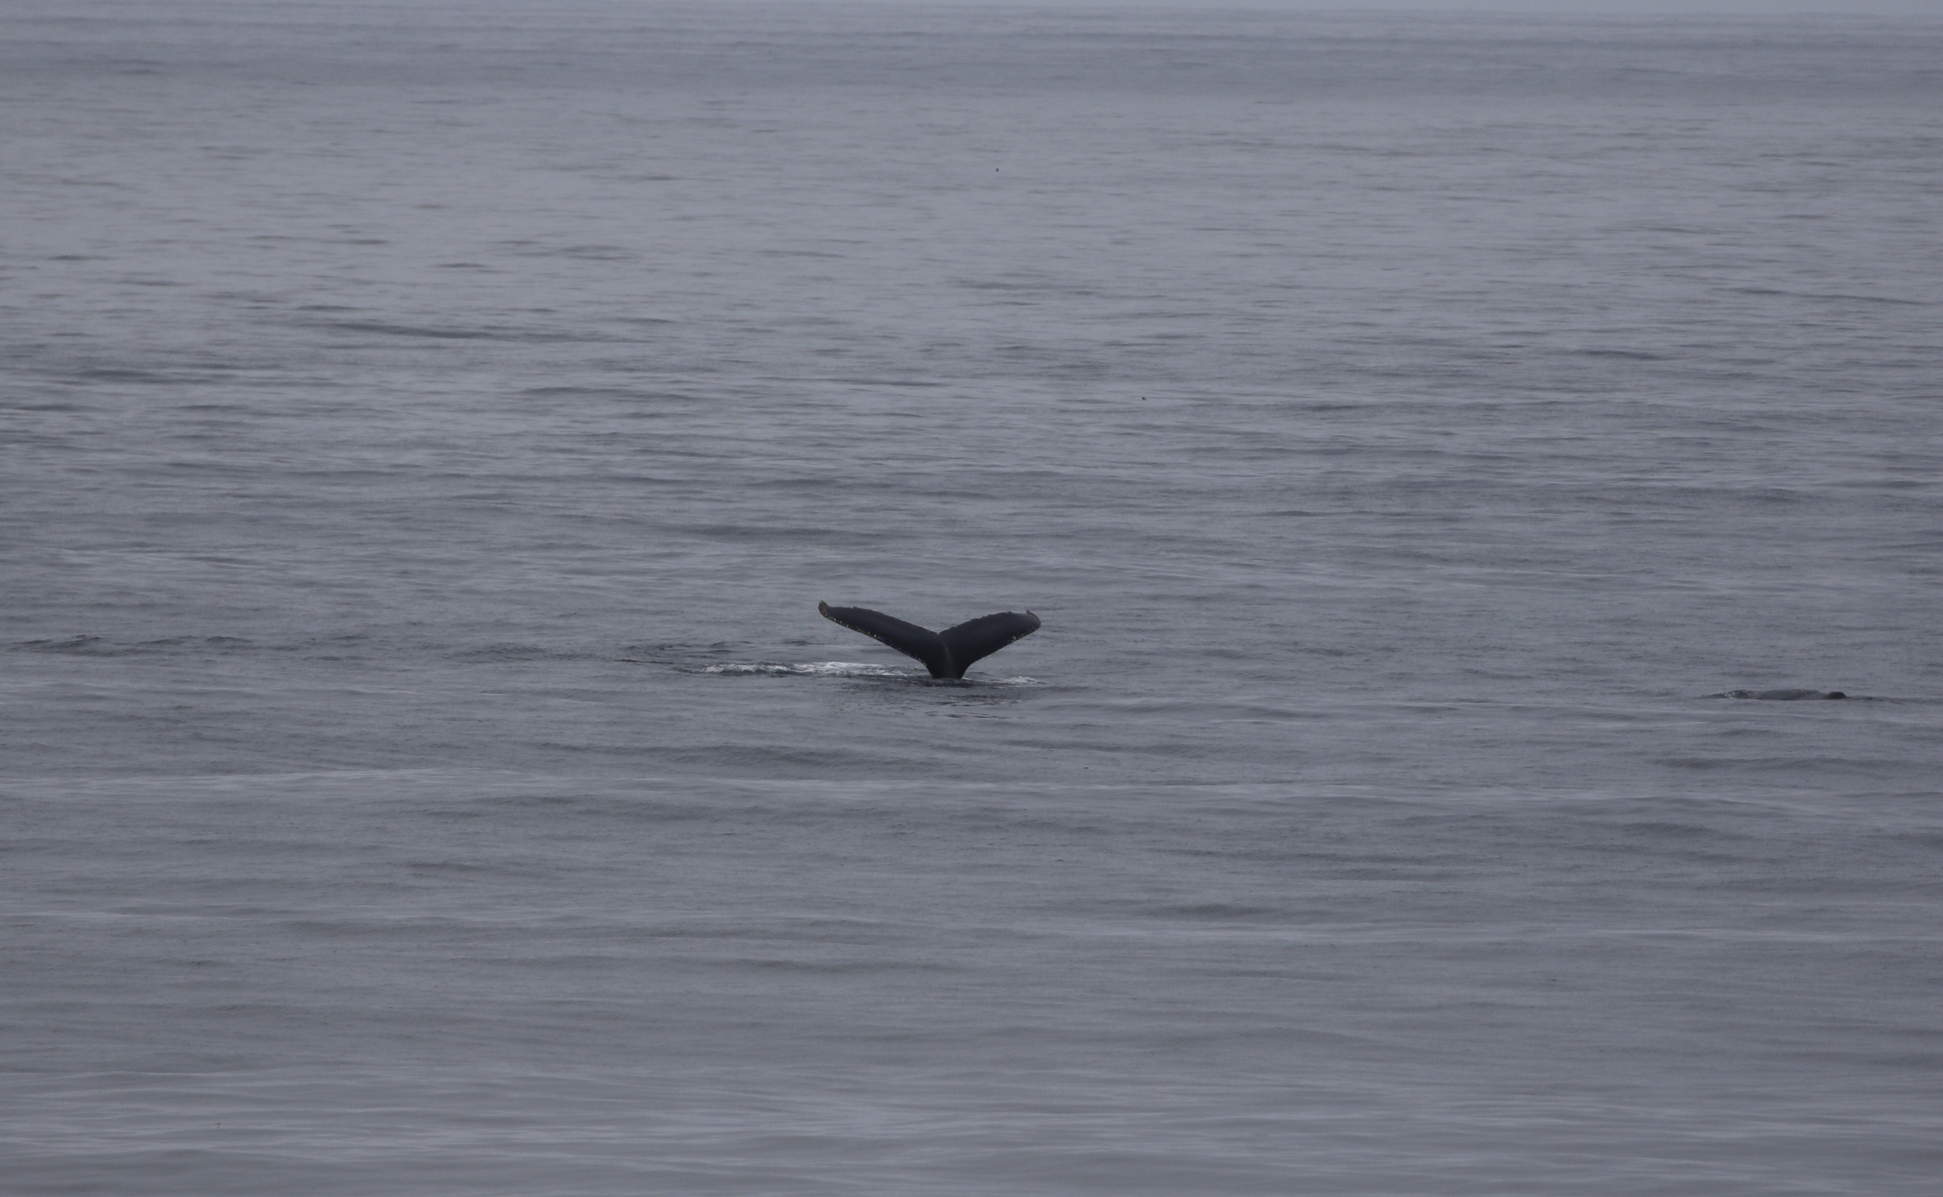
Humpback whale – Buckelwal - Baleine à bosse
Notes:
PETE

Slide 26
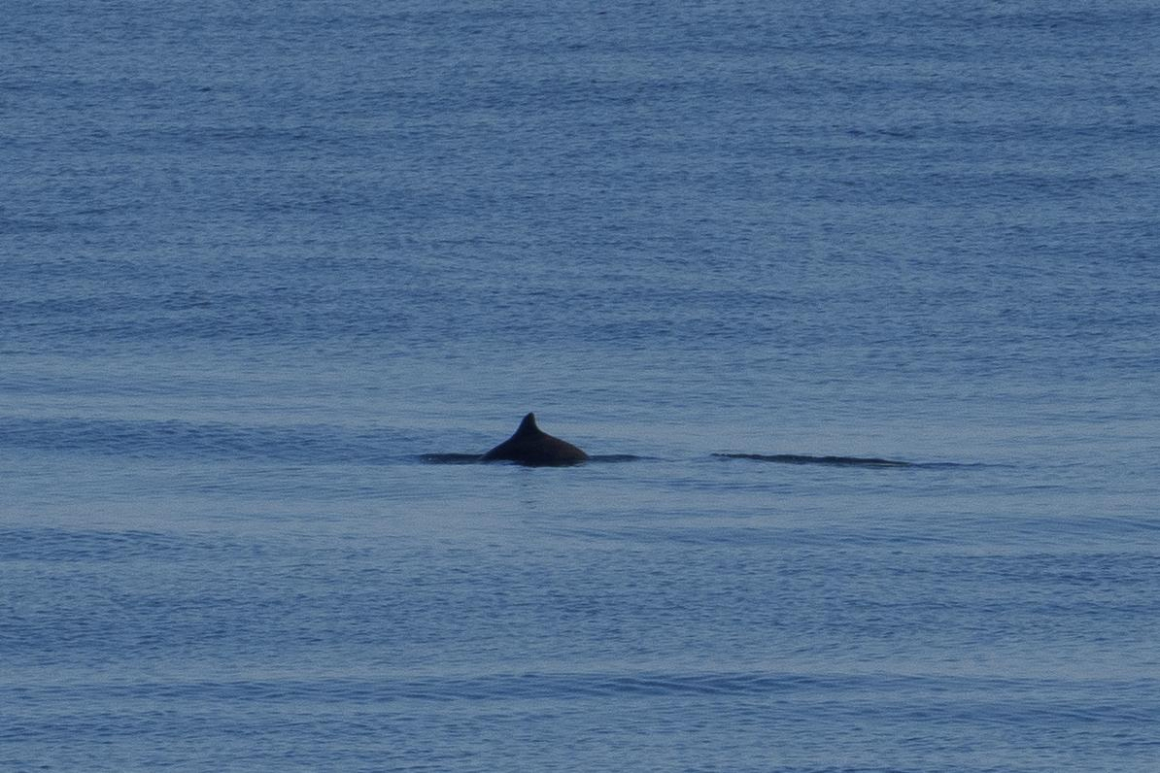
Harbour porpoise – Schweinswal - Marsouin
Notes:
PETE

Slide 27
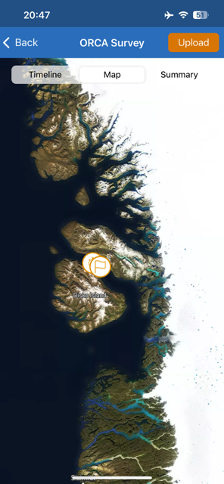
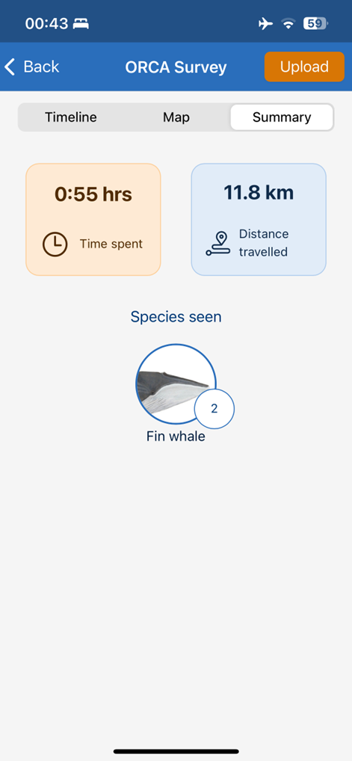
ORCA
During your journey, you were joined by ORCA Ocean Conservationist Taz, who collected data on whales, dolphins, and porpoises using the ORCA OceanWatchers app. The data is sent back to ORCA and made available to organisations working in cetacean conservation. It is also published on the ORCA interactive map for anyone interested in what has been seen and where.
On this voyage, we collected 8 hours and 32 minutes of data, spanning 112 km. Four marine mammal species were recorded across these surveys, with a total of 106 individuals logged.
Notes:
Add more slide if you need to. Keep the same font and format pls. screenshots of the surveys conducted, whale species seen could be interesting.

Slide 28
Sightings
Species | Number of individuals seen
Humpback whale (Megaptera novaeangliae) | 15
Fin whale (Balenoptera Physalus) | 5
Unidentified baleen whale | 2
Harp Seal (Pagophilus groenlandicus) | 84
Notes:
Unidentified baleen whale-

Slide 29
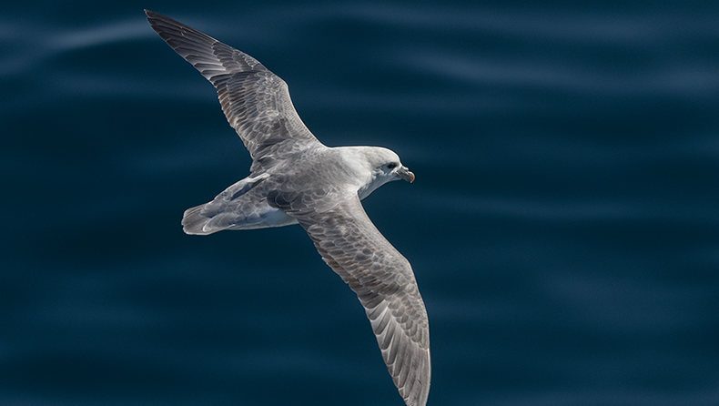
Wildlife
List - Birds

Slide 30
Wildlife List – Birds
Scientific Name | English | Deutsch | Français
Fulmarus glacialis | Northern Fulmar | Eissturmvogel | Fulmar boréal
Ardenna gravis | Great Shearwater | Großer Sturmtaucher | Puffin majeur
Morus bassanus | Northern Gannet | Basstölpel | Fou de Bassan
Stercorarius parasiticus | Arctic Skua | Schmarotzerraubmöwe | Labbe parasite
Larus fuscus | Lesser Black-backed Gull | Heringsmöwe | Goéland brun
Larus glaucoides | Iceland Gull | Polarmöwe | Goéland arctique
Larus hyperboreus | Glaucous Gull | Eismöwe | Goéland bourgmestre
Larus marinus | Great Black-backed Gull | Mantelmöwe | Goéland marin
Rissa tridactyla | Black-legged Kittiwake | Dreizehenmöwe | Mouette tridactyle
Sterna paradisaea | Arctic Tern | Küstenseeschwalbe | Sterne arctique
Uria aalge | Common Guillemot | Trottellumme | Guillemot marmette
Uria lomvia | Brünnich's Guillemot | Dickschnabellumme | Guillemot de Brünnich
Alca torda | Razorbill | Tordalk | Pingouin torda
Cepphus grylle | Black Guillemot | Gryllteiste | Guillemot à miroir
Notes:
Copy and paste water birds observed – make sure scientific name is in italics

Slide 31
Wildlife List – Birds
Scientific Name | English | Deutsch | Français
Haliaeetus albicilla | White-tailed Eagle | Seeadler | Pygargue à queue blanche
Motacilla alba | White Wagtail | Bachstelze | Bergeronnette grise
Oenanthe oenanthe | Northern Wheatear | Steinschmätzer | Traquet motteux
Corvus corax | Common Raven | Kolkrabe | Grand Corbeau
Acanthis flammea | Redpoll | Birkenzeisig | Sizerin flammé
Plectrophenax nivalis | Snow Bunting | Schneeammer | Plectrophane des neiges
Calcarius lapponicus | Lapland Longspur | Spornammer | Plectrophane lapon
Scientific Name | English | Deutsch | Français
Anas platyrhynchos | Mallard | Stockente | Canard colvert
Somateria mollissima | Common Eider | Eiderente | Eider à duvet
Mergus serrator | Red-breasted Merganser | Mittelsäger | Harle huppé
Gavia immer | Great Northern Diver | Eistaucher | Plongeon imbrin
Arenaria interpres | Ruddy Turnstone | Steinwälzer | Tournepierre à collier
Notes:
Copy and paste water birds observed – make sure scientific name is in italics

Slide 32
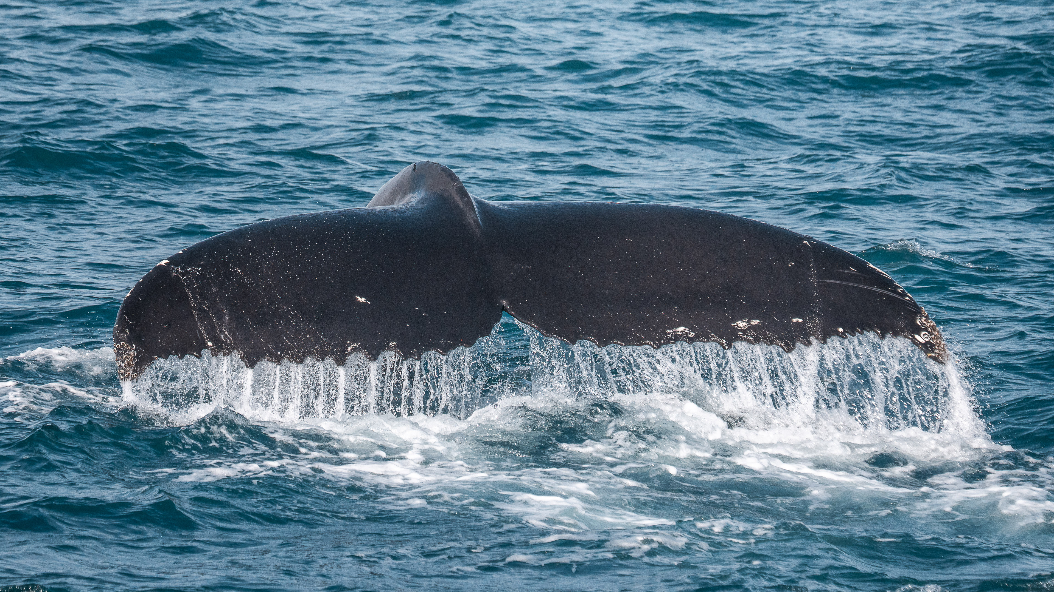
Wildlife
List - Marine Mammals
Credit: Timo Heinz
Notes:
Updated 11.02.25

Slide 33

Wildlife List – Mammals
Scientific Name | English | Deutsch | French
Balaenoptera physalus | Fin whale | Finnwal | Rorqual commun
Megaptera novaeangliae | Humpback whale | Buckelwal | Baleine à bosse
Phocoena phocoena | Harbour porpoise | Schweinswal | Marsouin
Pagophilus groenlandicus | Harp Seal | Sattelrobbe | Phoque du Groenland
Vulpes lagopus | Arctic Fox | Polarfuchs | Renard arctique
Leptus arcticus | Arctic Hare | Schneehase | Lievre arctique
Notes:
Updated by Lilia - updated

Slide 34
Thanks for your participation!

