Slide 1
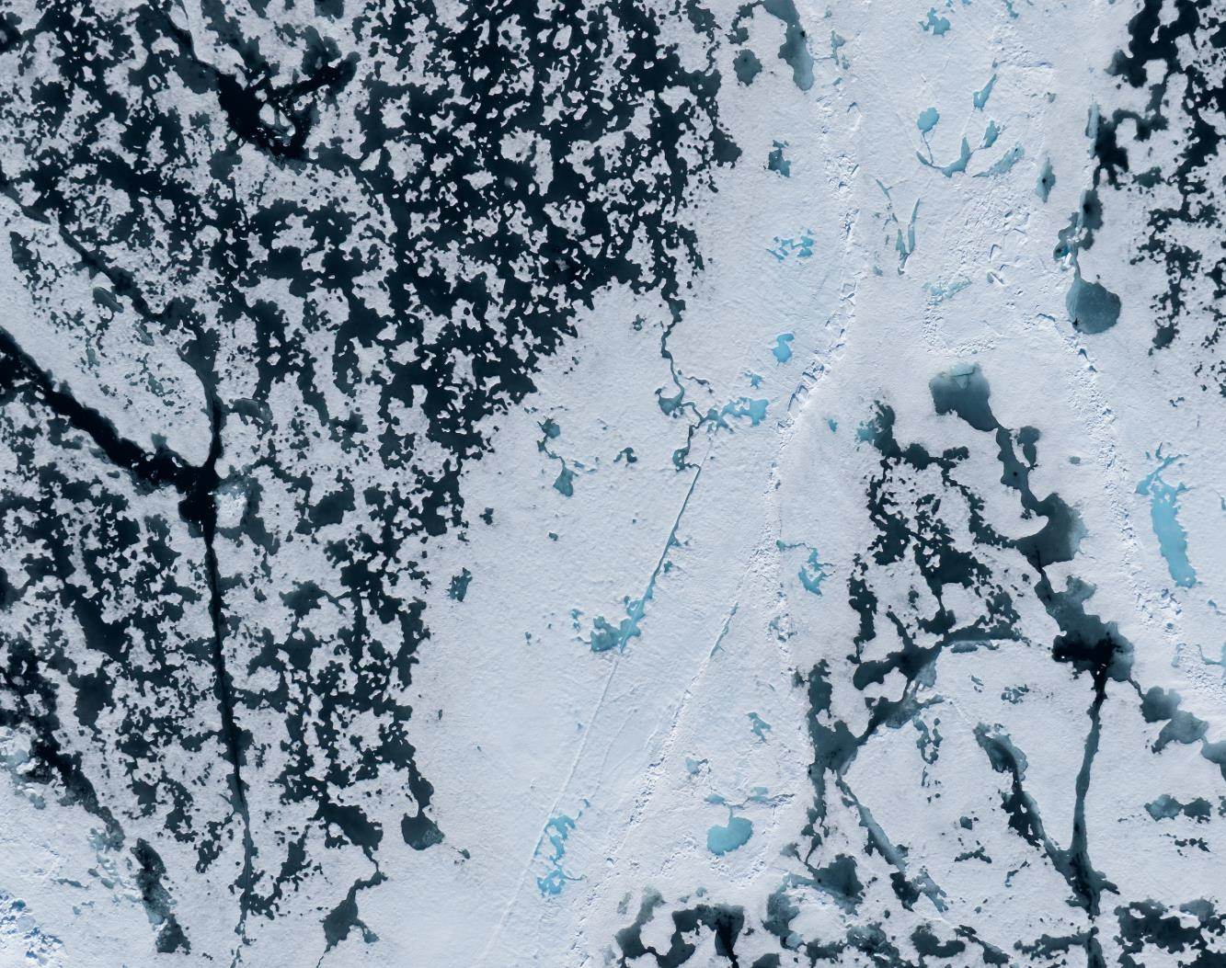
MS FRAM - June 21st – 30th 2026
Svalbard in Springtime, the Return of the Sun
Credit: Yuri Choufour/HX

Slide 2
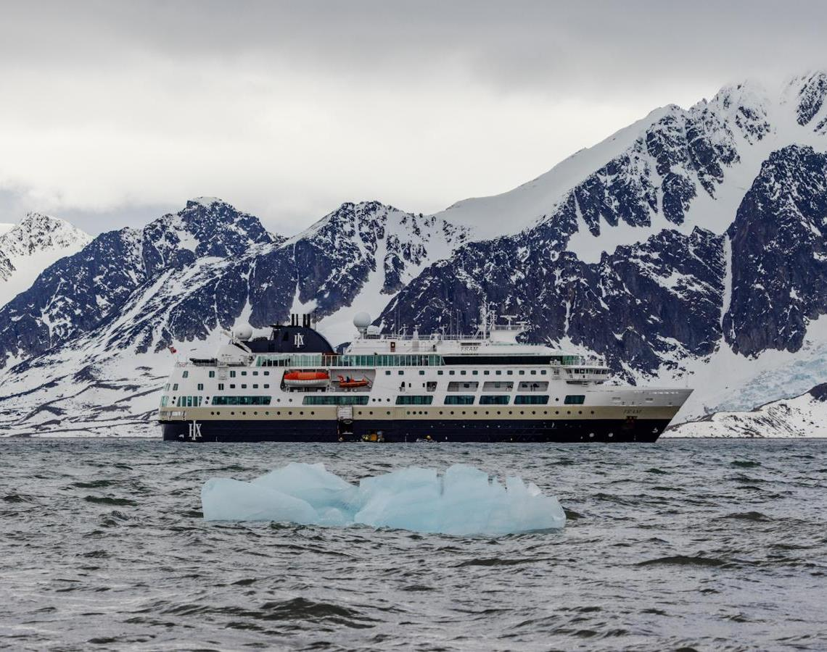
Science & Education Program
During this voyage, we helped collect data for three Citizen Science projects: eBird, iNaturalist, and the Secchi Disk project. Guests joined 12 lectures on subjects ranging from birds to rocks, and took part in six Discovery Sessions delivered by the Expedition Team.
We were also joined aboard by a Guest Scientist from the FRAM-PLANKTO project, who studied plankton communities across the fjords we visited.
Many of you were drawn to the scientific side of our voyage, and we thank you for your curiosity and enthusiasm. What follows is a summary of the science activities we ran together.
Credit: Rosie Barrett/HX
Notes:
Add brief summary of the Science & Education Program over the whole voyage

Slide 3
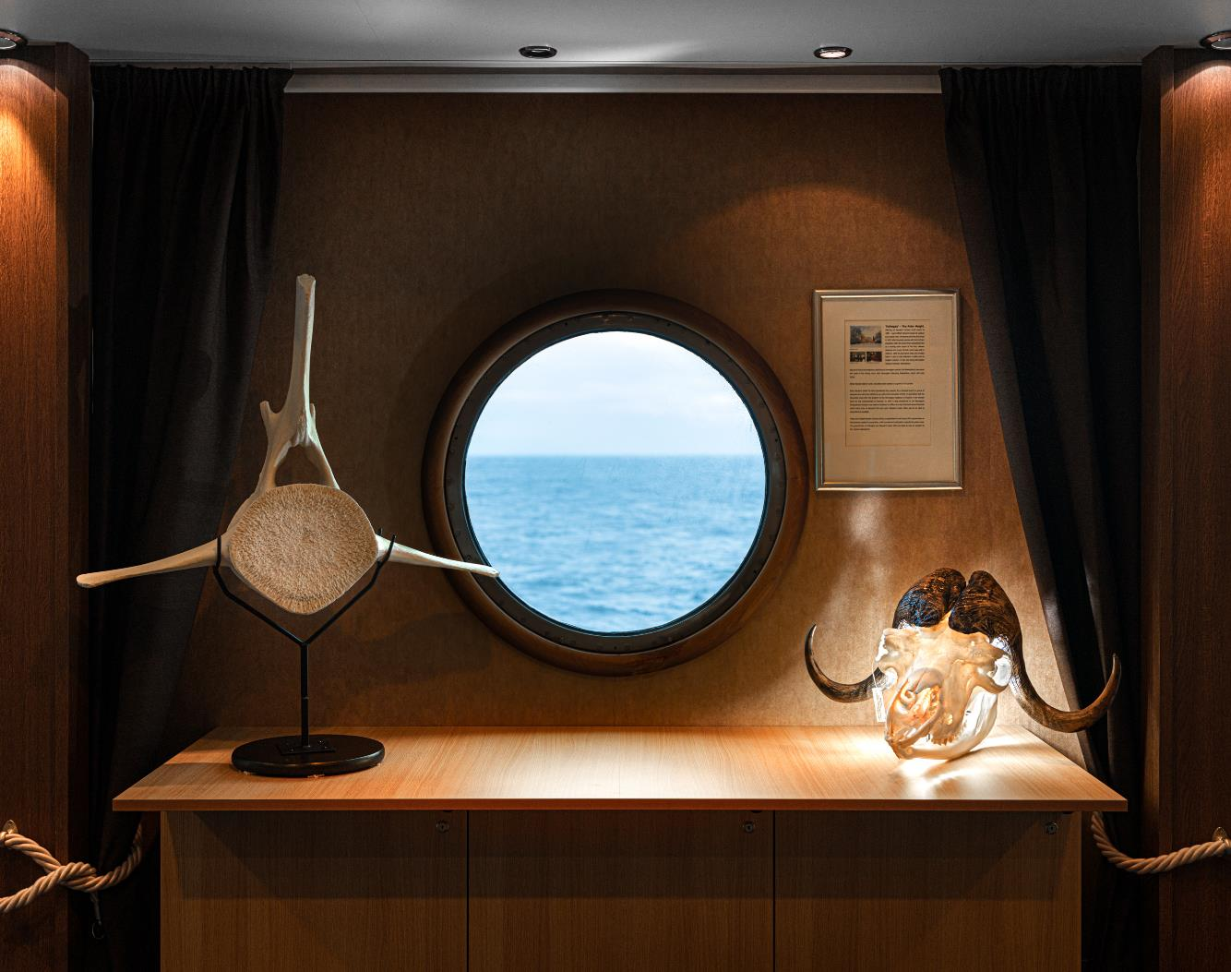
Lectures & Discovery Sessions
12 Lectures
6 Discovery sessions
3 Citizen science projects
6 Science boats
1 Guest Scientis projects
©Yuri Choufour

Slide 4
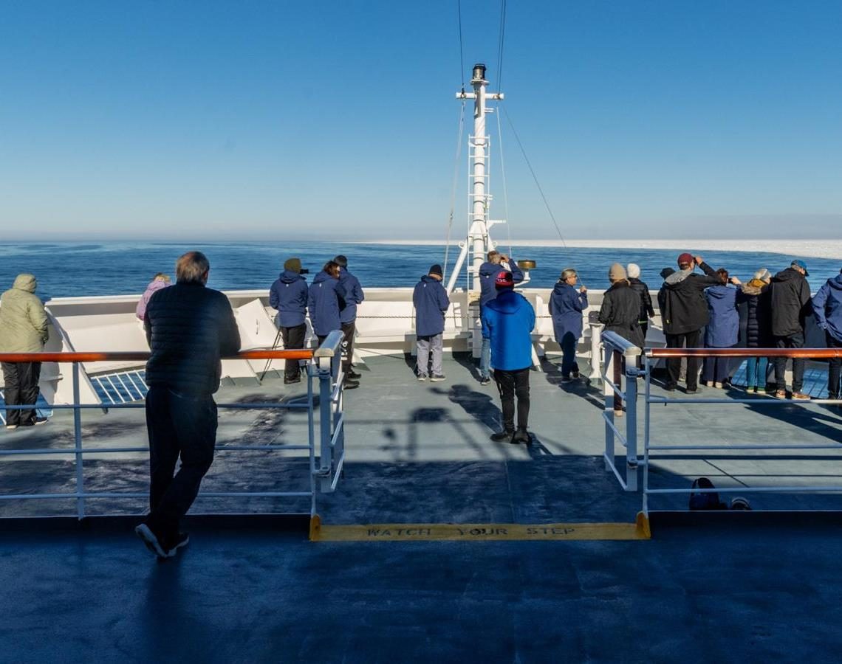
Wildlife Watch
28 Species:
8 Mammals
20 Birds

Slide 5
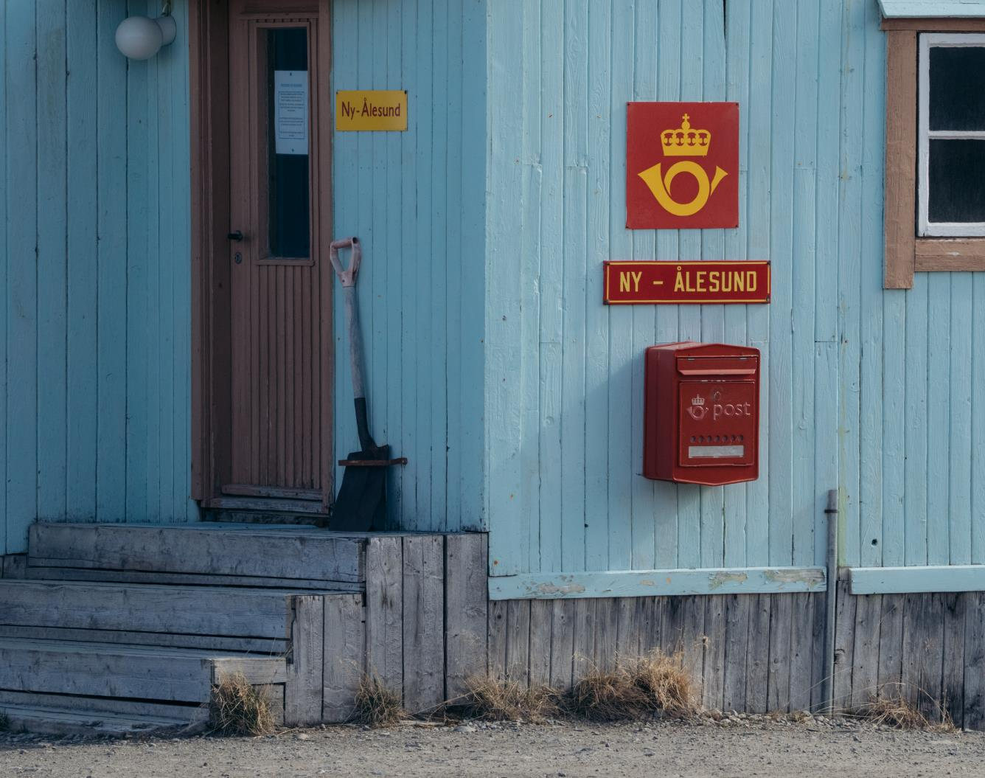
History & Culture
During this voyage, we learned not only about the remarkable history of Svalbard, but also about some of the most significant expeditions that set out to reach the North Pole — including Nansen's on board the original Fram.
At nearly 79°N, we visited Ny-Ålesund, the world's northernmost year-round research station — once a coal-mining outpost, now an international hub for Arctic science. In 1926, Roald Amundsen, the American Lincoln Ellsworth, and the Italian Umberto Nobile flew the airship Norge from here over the North Pole. Its mooring mast still stands, and a bronze bust of Amundsen honours Svalbard's exploration legacy.
Credit: Yuri Choufour/HX

Slide 6
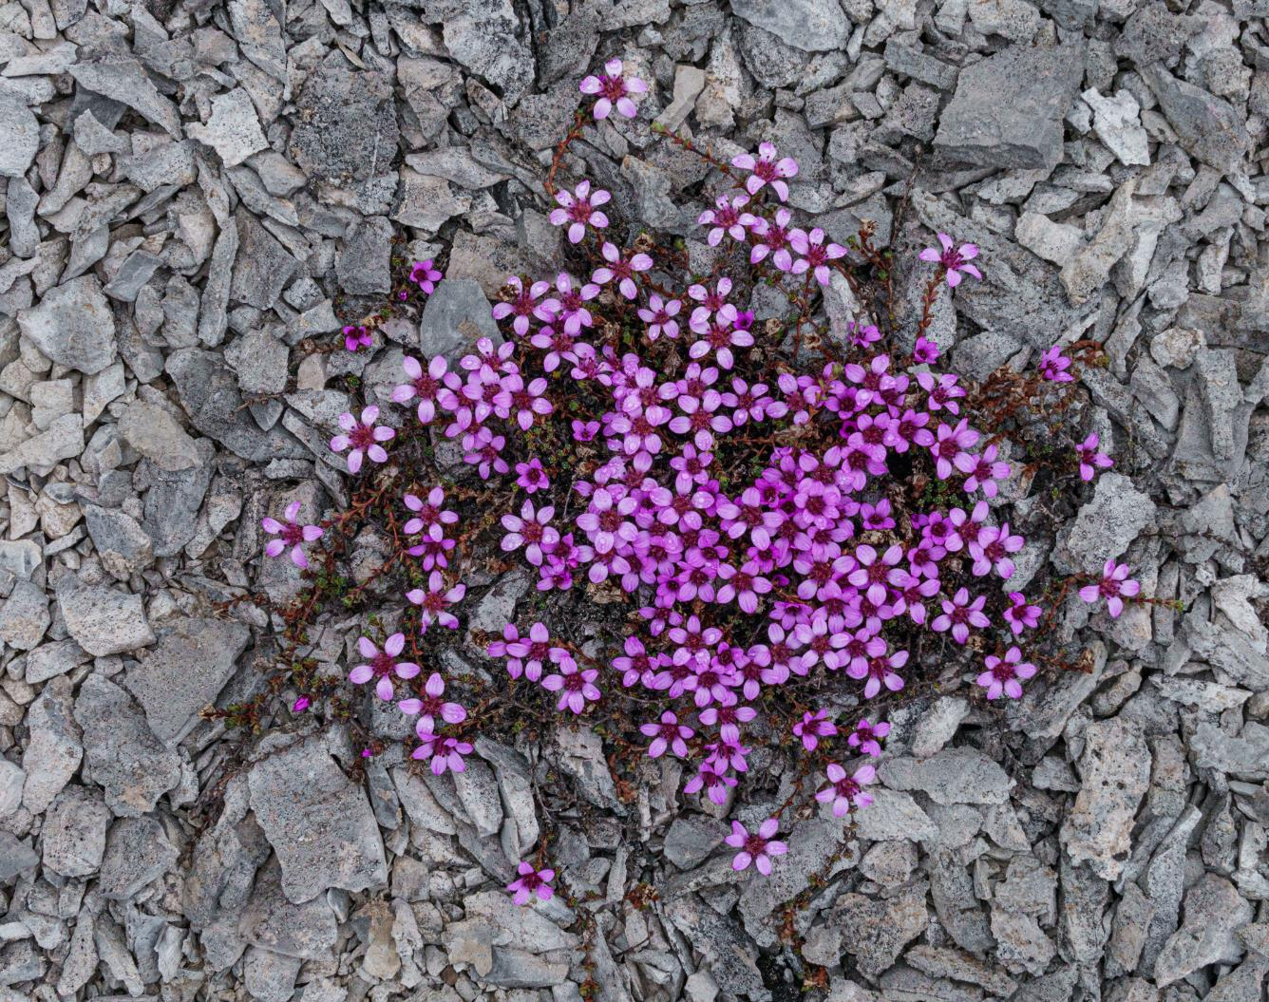
iNaturalist
Thanks to your efforts, we recorded 236 opportunistic observations representing nearly 58 different species — and the count is still growing as records are verified.
You can continue to upload your photographs to the iNaturalist website (inaturalist.org) or through the app, available on all platforms.
By sharing your data on iNaturalist, you contribute to a global, open-access database that supports scientific research and conservation monitoring. These records are valuable tools for researchers tracking species distribution and assessing ecosystem health.
To view the project and add your observations from this voyage by clicking here.
Fernandocrambus falklandicellus photographed by Vivi Bolin on New Island
Credit: Yuri Choufour/HX
Credit: Jan Hvizdal /HX
Yuri Choufour
Credit: Vivi Bolin/HX

Slide 7
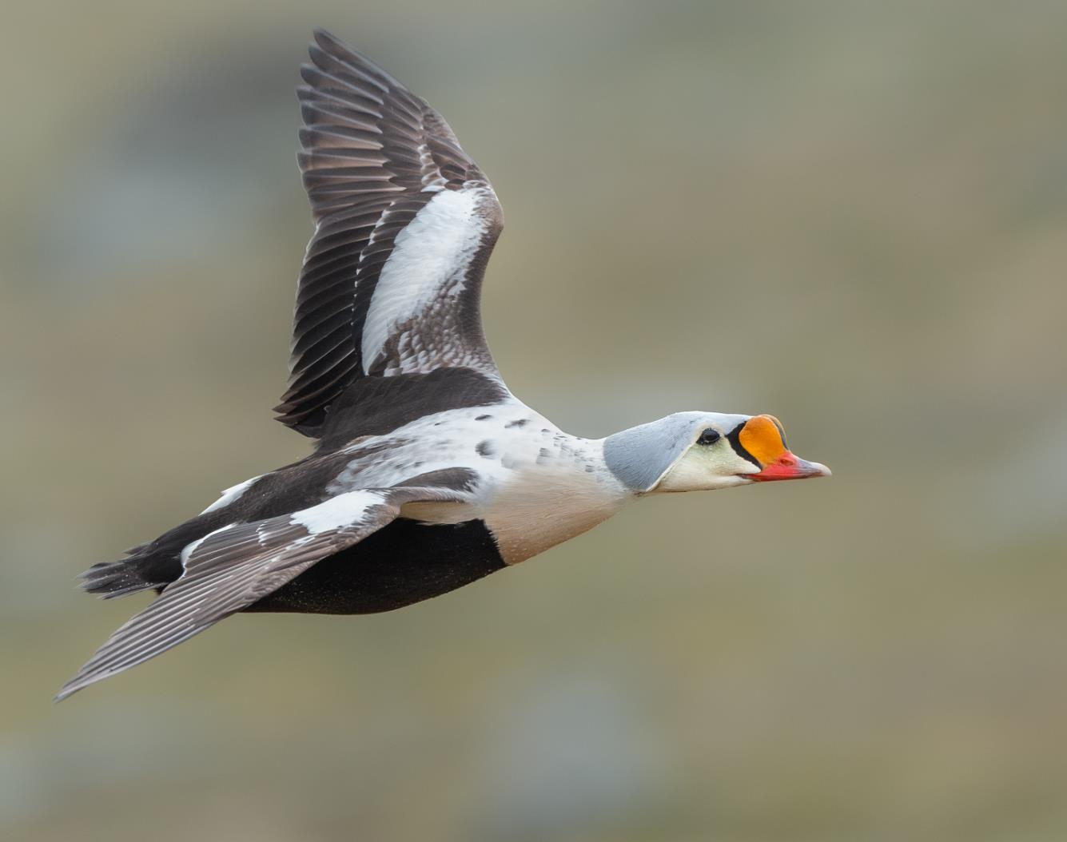
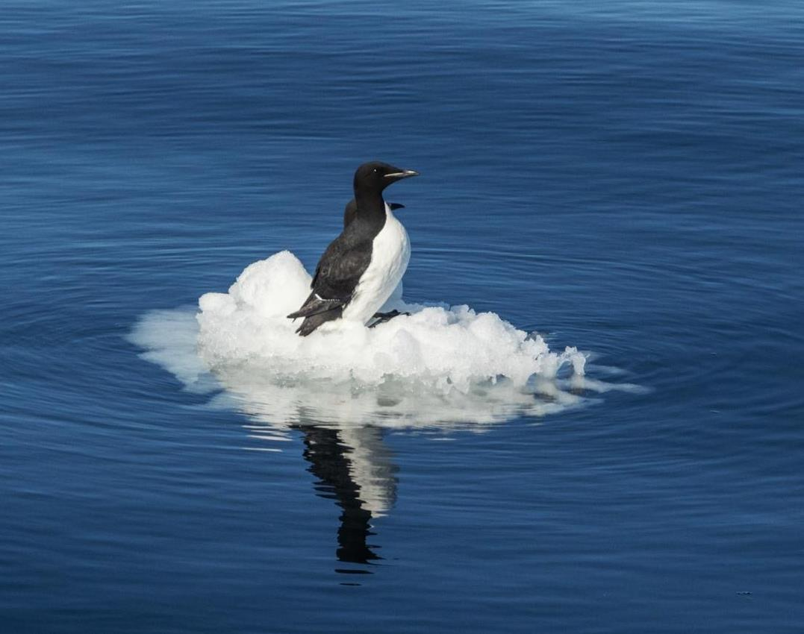
eBird
Our onboard Ornithologist Felix completed seven eBird checklists covering 15 different species during our 10-day voyage. The most abundant species was Brünnich's guillemot (thick-billed murre), followed by little auk (dovekie) and black-legged kittiwake. For the full survey details, please refer to the eBird trip report:
MS Fram: Circumnavigating Spitsbergen 21.06.2026 - 30.06.2026 - eBird Trip Report
Credit: Yuri Choufour/HX
Credit: Jan Hvizdal /HX
Notes:
UPDATE PLEASE

Slide 8
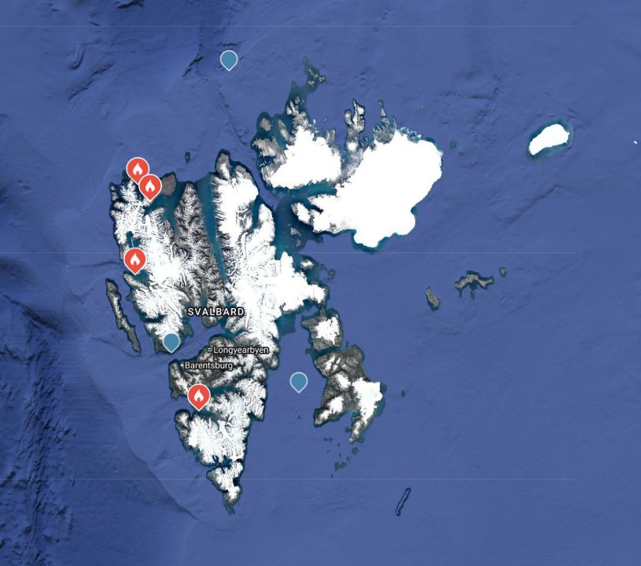
Locations of eBird Surveys

Slide 9
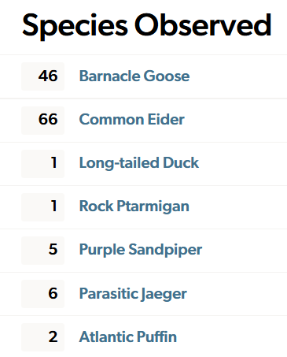
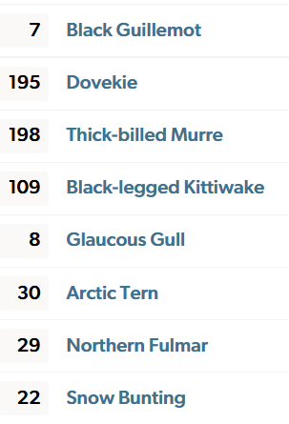
Species totals from eBird Surveys

Slide 10
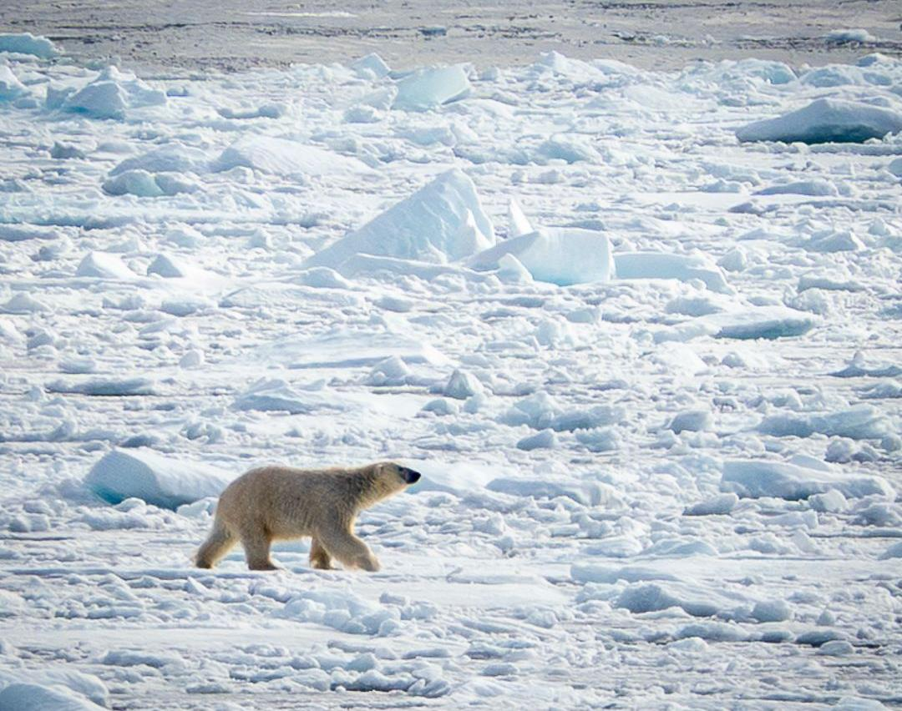
Mammals
Although we did not submit any photographs to the Happywhale project during this voyage, we were fortunate to see several marine mammals — bearded seals, ringed seals, and a pod of beluga whales. We also had a rare sighting of a blue whale. From the deck at Moffen, we watched walrus hauled out on the ice, and across the voyage we recorded six polar bear sightings.
We hope these encounters stay with you long after the voyage, and that they draw you back to the polar regions in future. Thank you for travelling with HX.
Notes:
UPDATE PLEASE

Slide 11
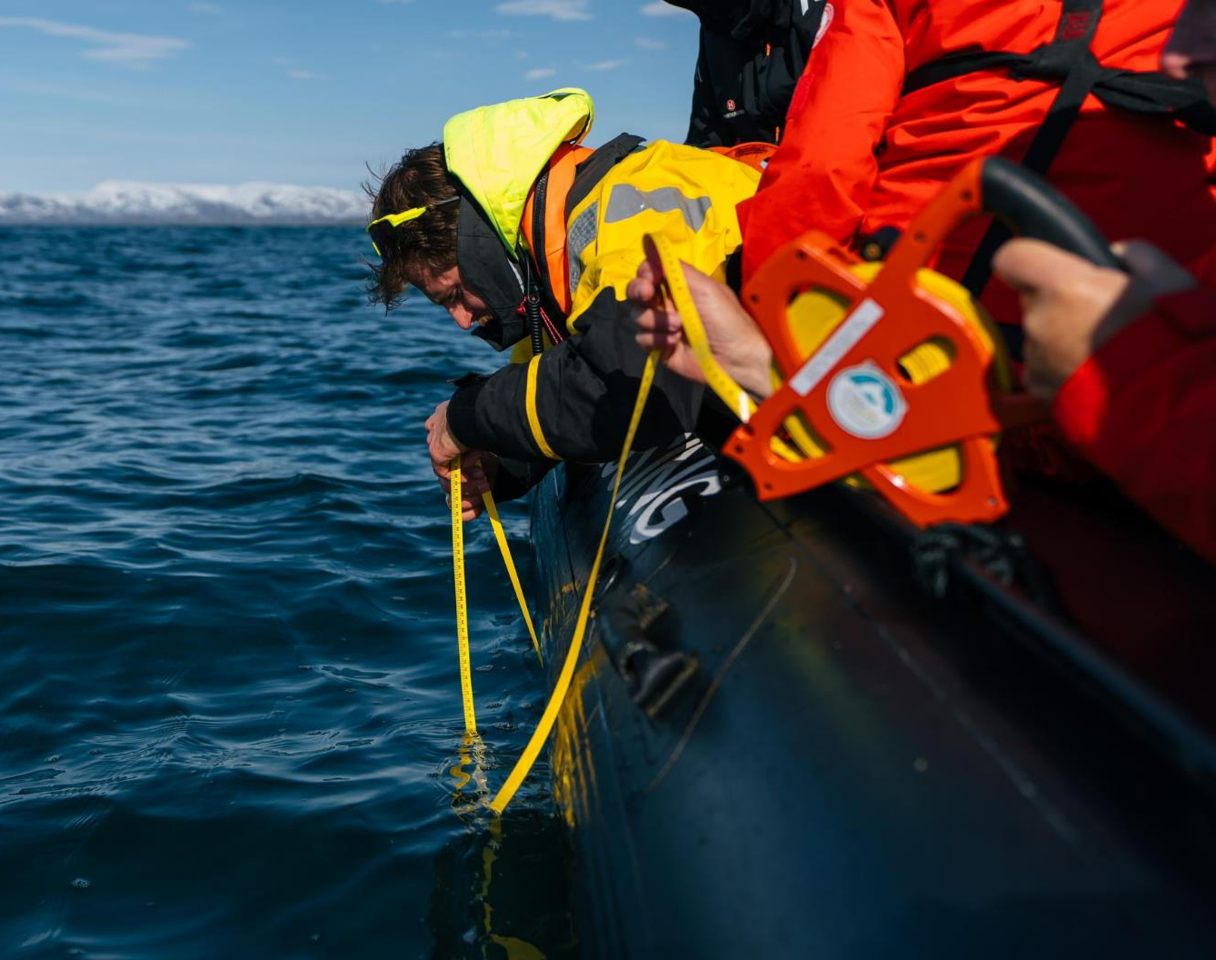
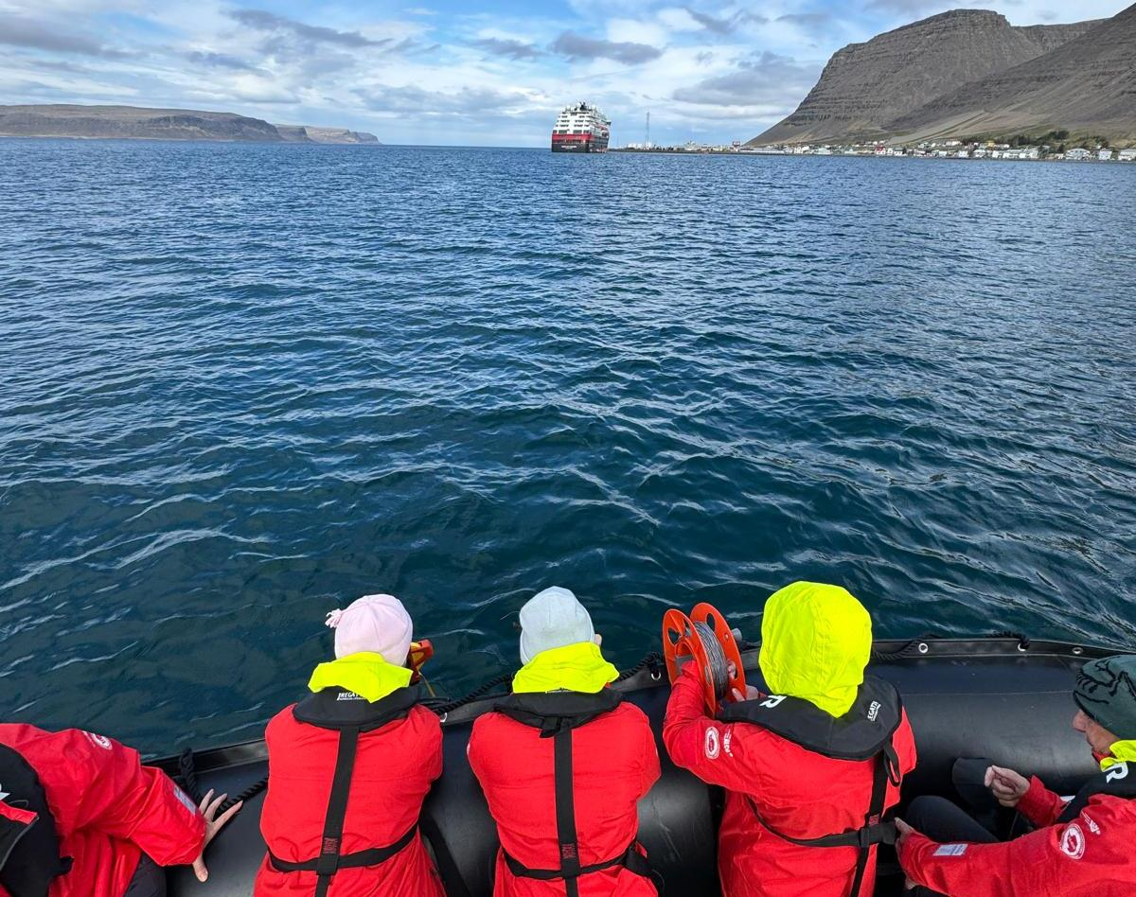
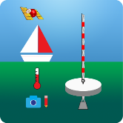
Science Boat
We ran six science boat sessions during this voyage: at Smeerenburg, Texas Bar, Torellneset, Sundneset, Burgerbukta, and Bamsebu.
View our data submitted to the Secchi Disk Project
Notes:
Add highlights of what science boat activities and sampling were undertaken – update secchi link to specific voyage if possible

Slide 12
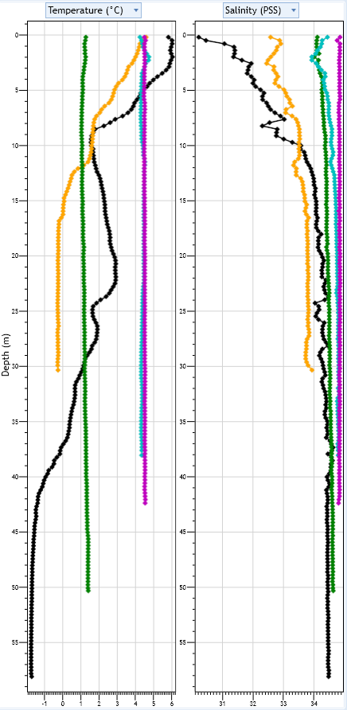
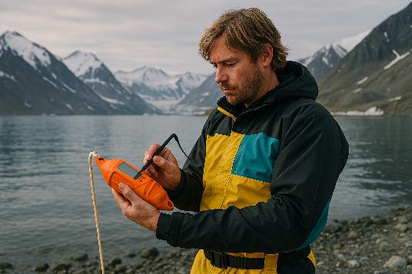
CTD Profiles
How to read the profiles:
The y-axis, running down the left side of each chart, shows depth. As you follow a line downward, you see how the water column changes with depth. The left chart shows temperature; the right chart shows salinity.
Each coloured line represents a separate CTD cast, plotted side by side for comparison. Pick one line, note the values at the surface, and follow how they shift as you move down the water column.
Purple line: 23 June — Smeerenburg
Turquoise line: 24 June — Texas Bar
Green line: 26 June — Torellneset
Yellow line: 27 June — Sundneset
Black line: 28 June — Burgerbukta
Notes:
Add any interesting finds in the plankton samples and pictures taken down the microscopes

Slide 13
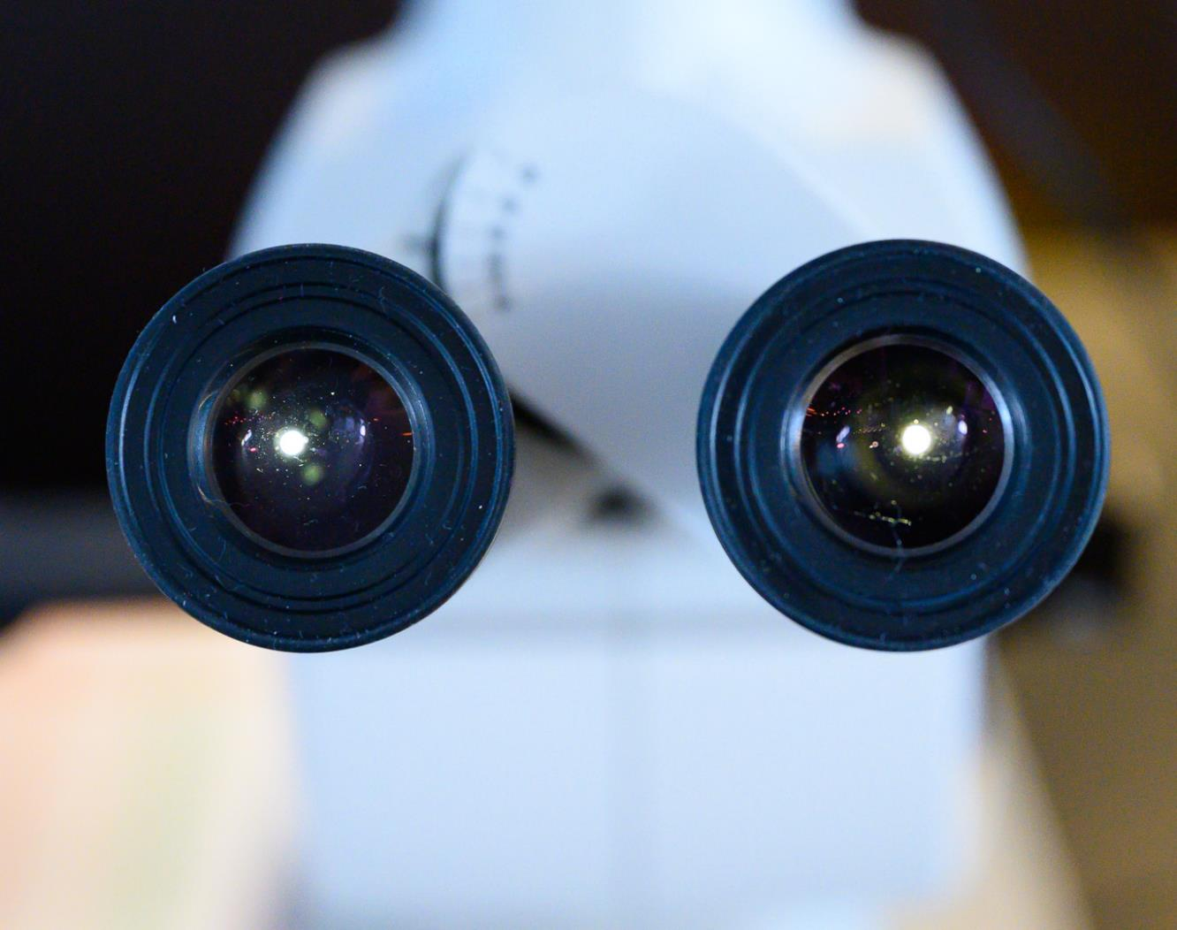
Plankton samples
©Martin Hain
Notes:
Add any interesting finds in the plankton samples and pictures taken down the microscopes

Slide 14
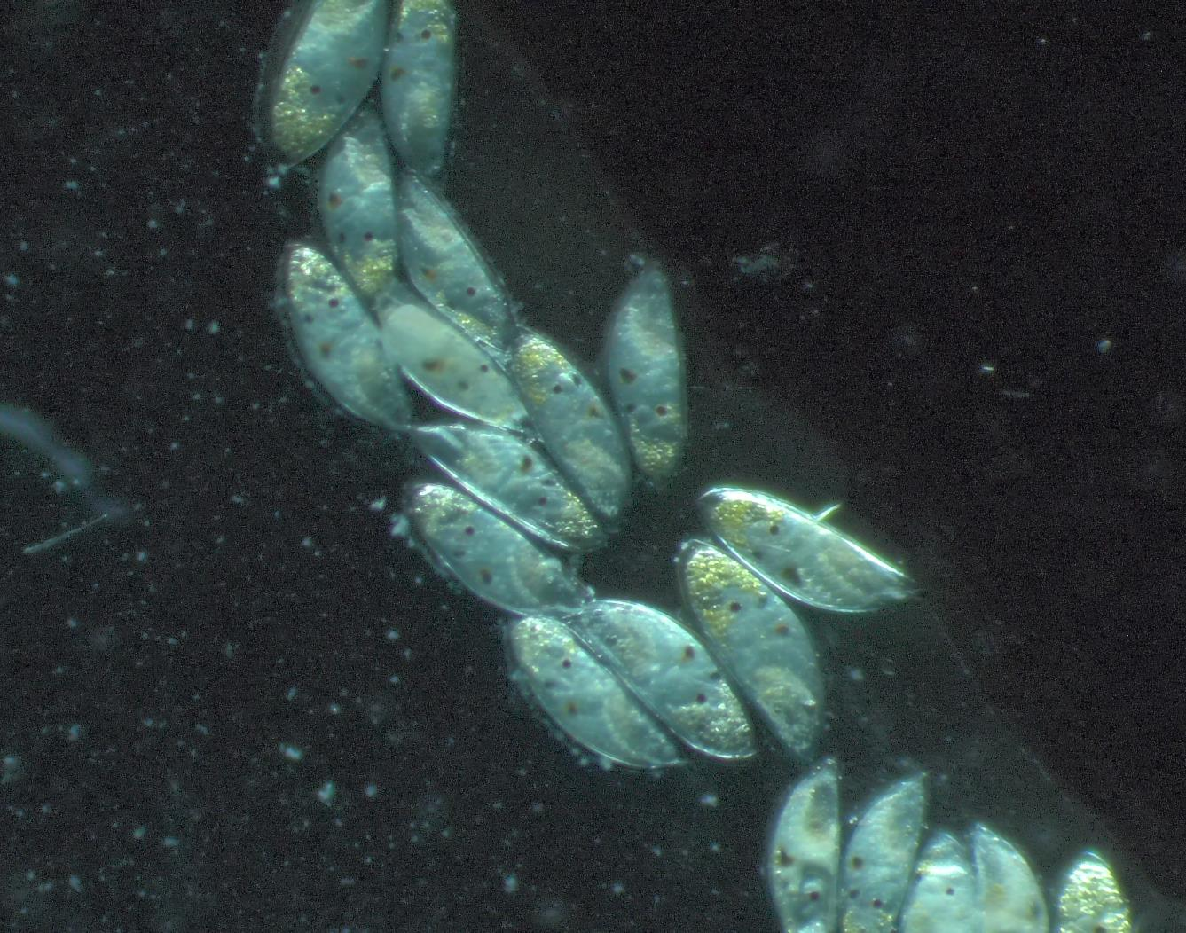
Plankton samples:
Barnacle Larvae
Notes:
Add any interesting finds in the plankton samples and pictures taken down the microscopes

Slide 15
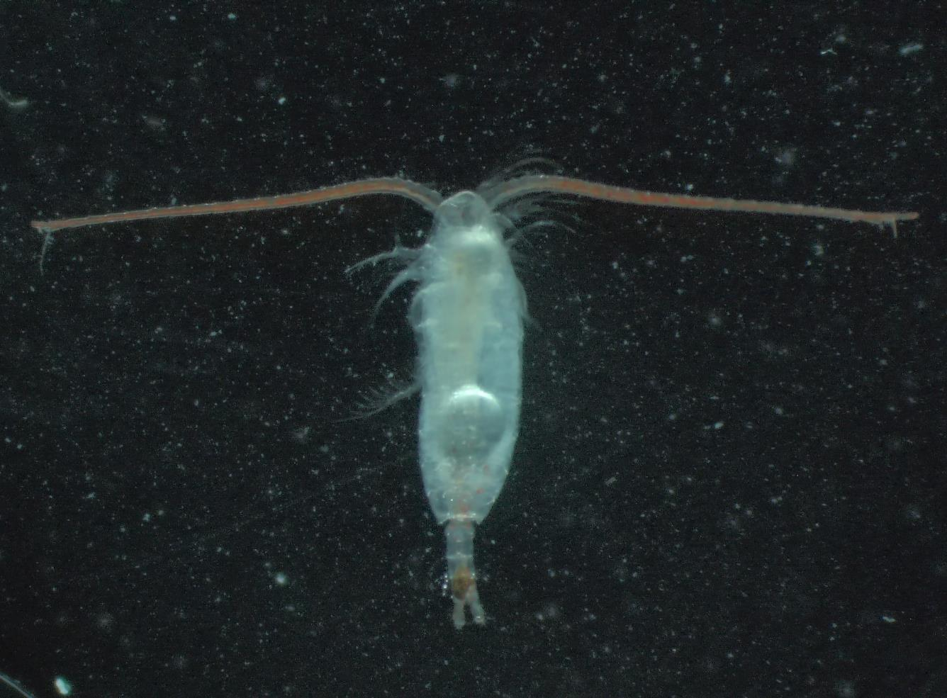
Plankton samples:
Copepod
Notes:
Add any interesting finds in the plankton samples and pictures taken down the microscopes

Slide 16
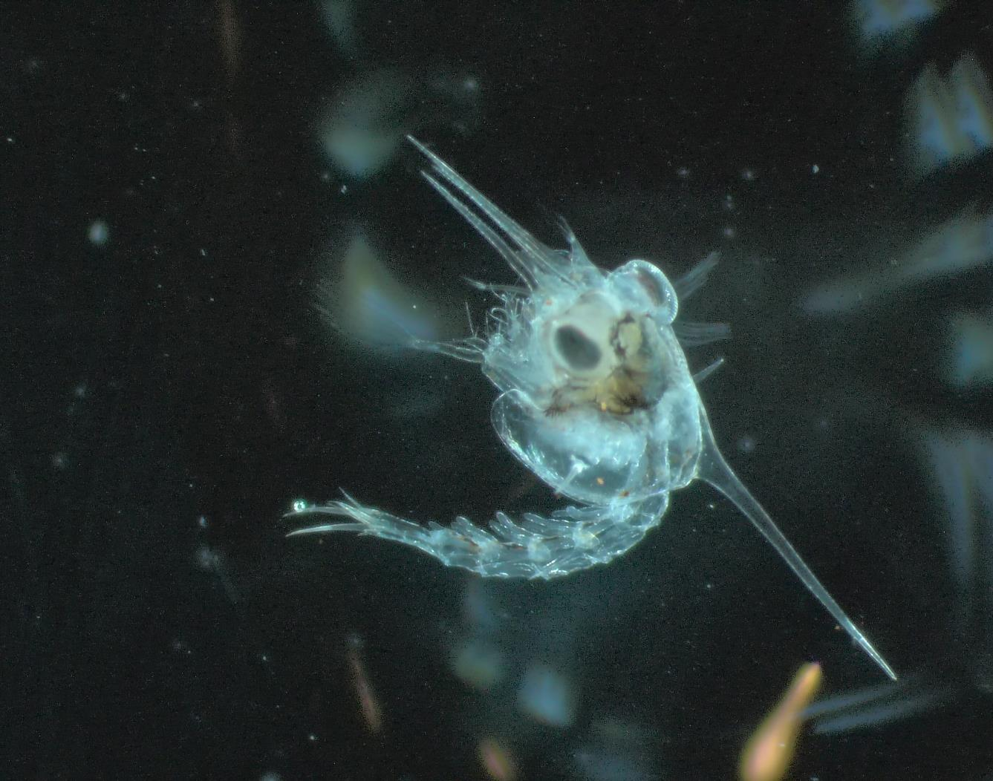
Plankton samples:
Crab Larvae
Notes:
Add any interesting finds in the plankton samples and pictures taken down the microscopes

Slide 17
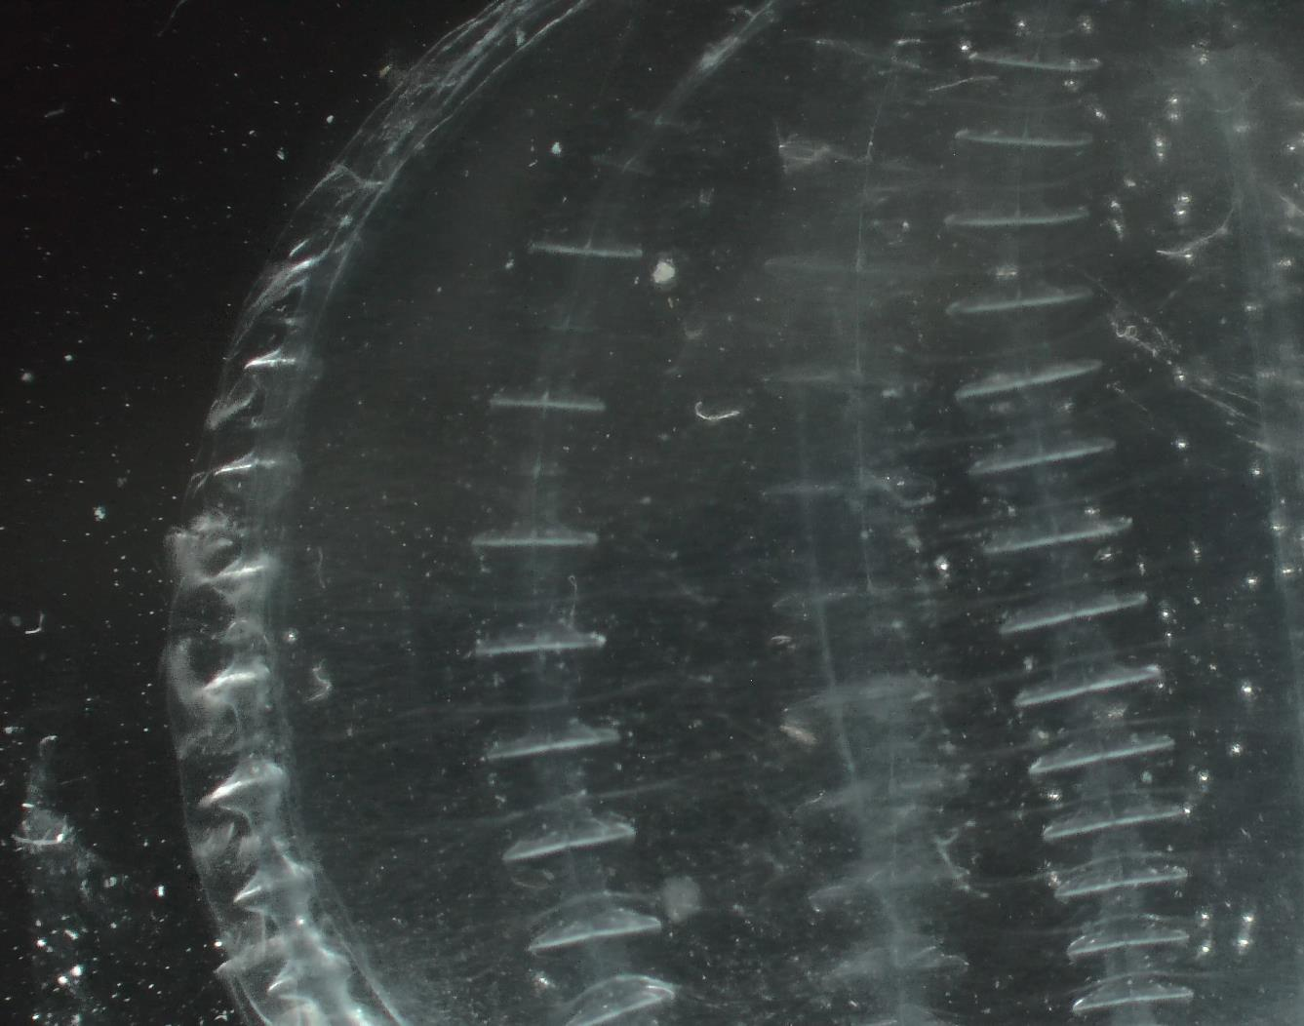
Plankton samples:
Comb Jelly
Notes:
Add any interesting finds in the plankton samples and pictures taken down the microscopes

Slide 18
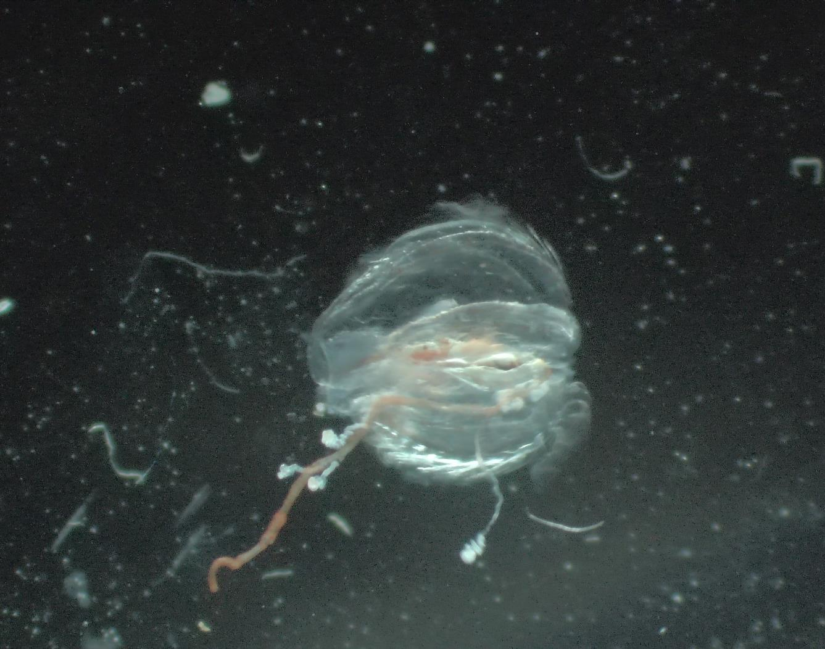
Plankton samples:
Comb Jelly
Notes:
Add any interesting finds in the plankton samples and pictures taken down the microscopes

Slide 19
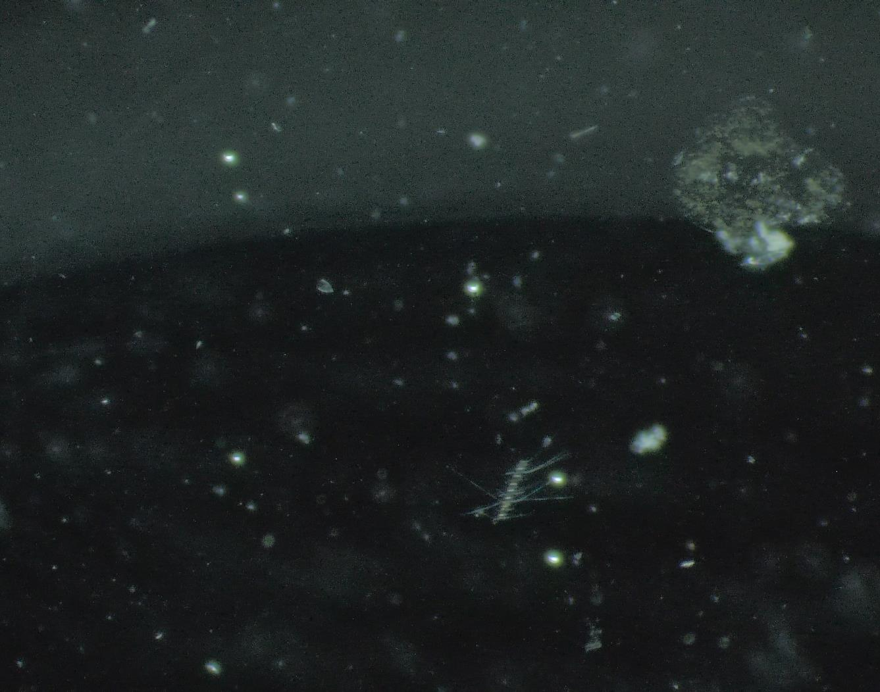
Plankton samples:
Phyto Plankton
Micro Algae
Siphonophores
Diatoms
Notes:
Add any interesting finds in the plankton samples and pictures taken down the microscopes

Slide 20
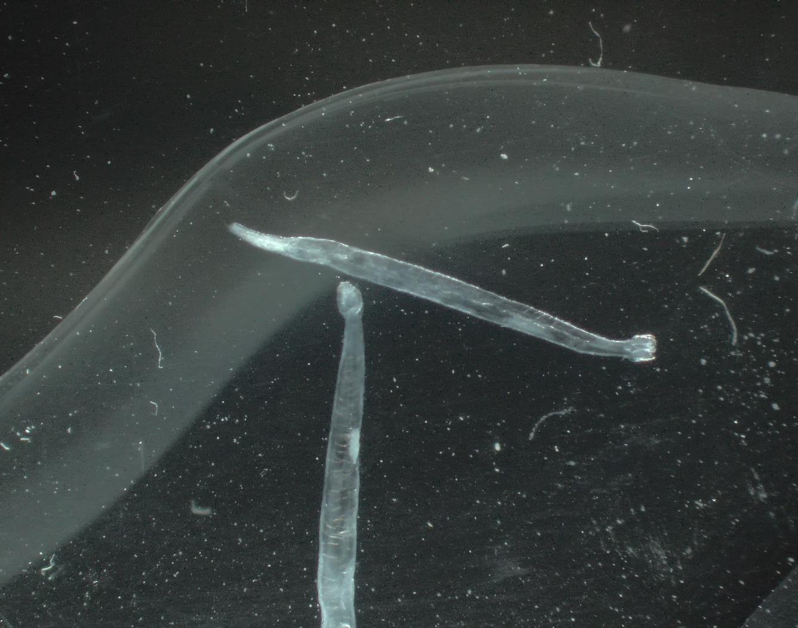
Plankton samples:
Arrow Worms
Notes:
Add any interesting finds in the plankton samples and pictures taken down the microscopes

Slide 21
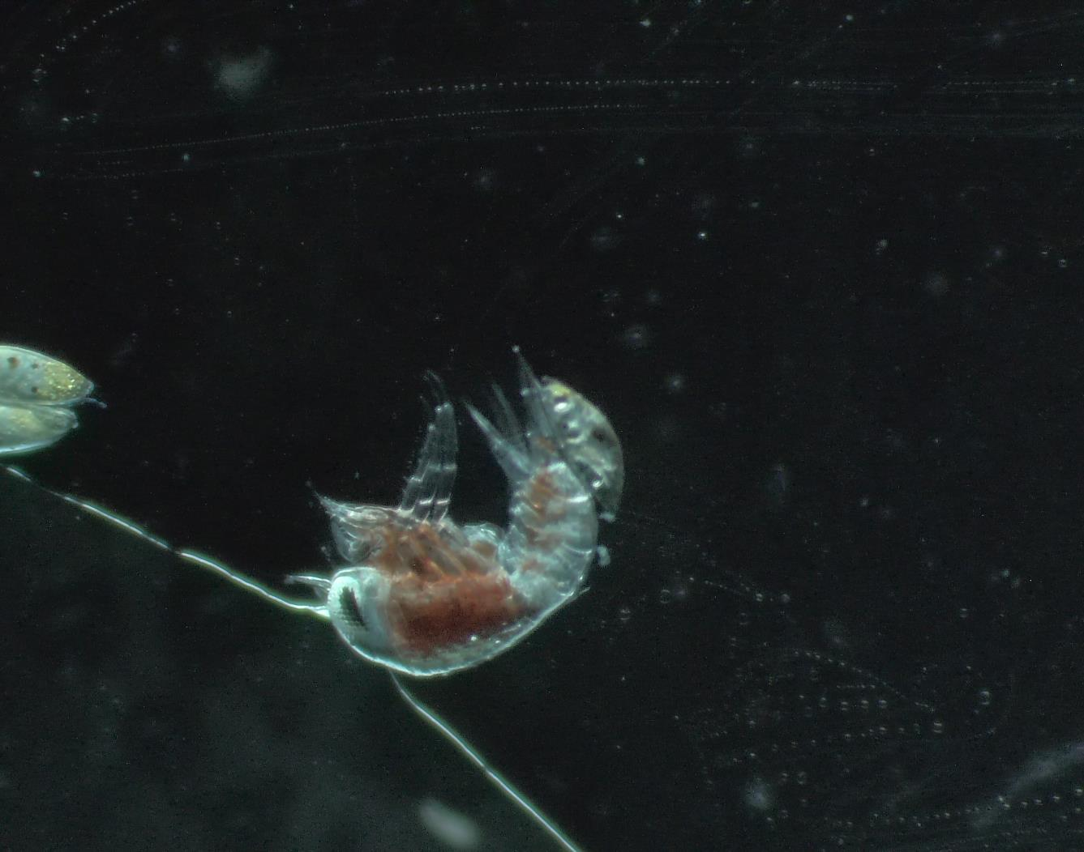
Plankton samples:
Hyperiid Amphipods
Notes:
Add any interesting finds in the plankton samples and pictures taken down the microscopes

Slide 22
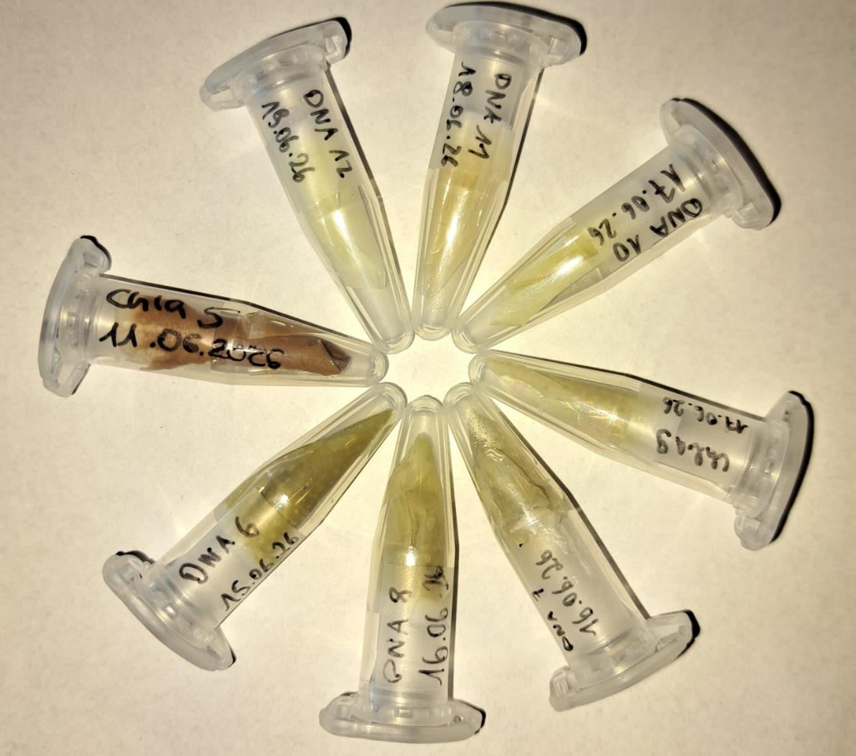
Guest Scientist's Project: FRAM-PLANKTO
The water samples collected across the fjords of Svalbard varied widely in microalgae biomass. This depended largely on the abundance of zooplankton in each sample — the more zooplankton grazing on microalgae, the lower the microalgae biomass we recorded.
That variability reflects the diversity of environmental conditions between the fjords, which in turn determines how microalgae grow. Understanding this variability is a cornerstone of Arctic research — it forms a baseline for tracking how Arctic ecosystems respond to global change, and it underpins sustainable ocean management.
www.awi.de
Notes:
Add info on how many images were submitted to happywhale, new whales were ID, matches etc. as appropriate plus link to ship account on Happywhale – update link to specific voyage

Slide 23

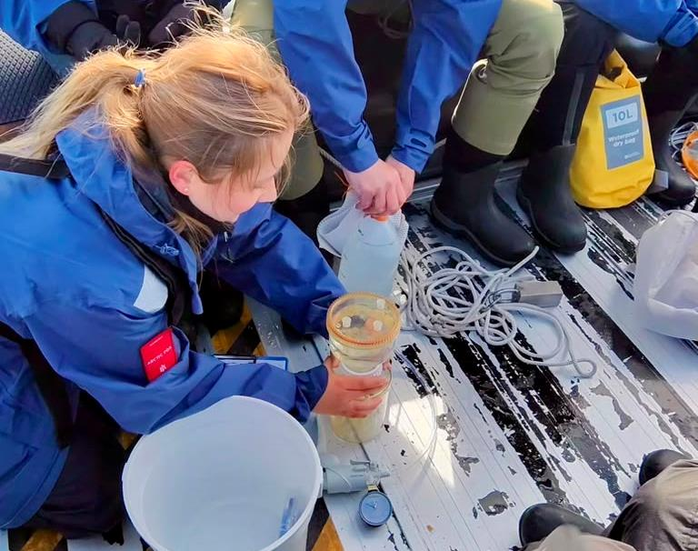

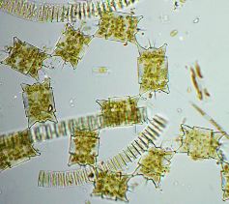
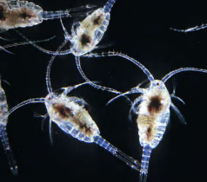
Guest Scientist's Project: FRAM-PLANKTO
The FRAM-PLANKTO project, run by the German Alfred Wegener Institute Helmholtz Centre for Polar and Marine Research, collected water samples in each of the fjords MS Fram visited over the past week. Inken Holthoff, a Master's student at AWI, is capturing the plankton composition that fuels the marine food chain — from microalgae and copepods all the way up to seals and whales.
Collected in collaboration with HX, these samples complement AWI's long-term observations in Fram Strait, which track how Arctic marine ecosystems respond to shifting environmental conditions.
Phytoplanton
(Microalgae)
Zooplankton
(Copepods)
Foto: Katja Metfies
Notes:
Add info on how many images were submitted to happywhale, new whales were ID, matches etc. as appropriate plus link to ship account on Happywhale – update link to specific voyage

Slide 24
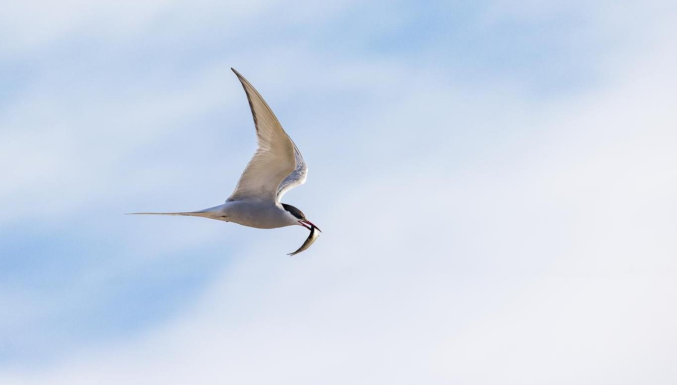
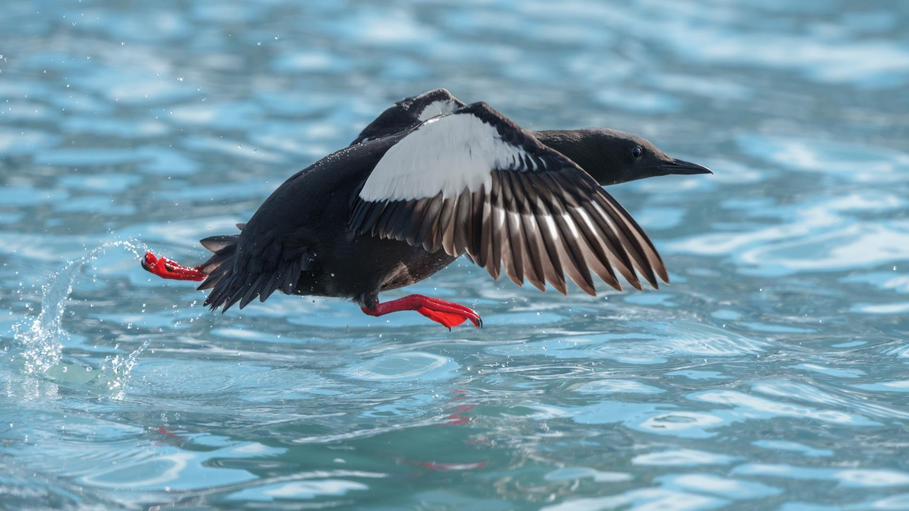
Wildlife
List - Birds
Credit: Rosie Barrett/HX
Notes:
Use the following pages to highlight some of the key bird species identified – and/or use the final page of the bird section to highlight the complete bird list on the e-Bird trip report
UPDATE PLEASE

Slide 25

Wildlife List – Seabirds
SCIENTIFIC NAME | ENGLISH | DEUTSCH
Alle alle | Little Auk/Dovekie | Krabbentaucher
Cepphus grylle | Black Guillemot | Gryllteiste
Fratercula arctica | Atlantic Puffin | Papageitaucher
Fulmarus glacialis | Northern Fulmar | Eissturmvogel
Larus canus | Lesser Black-backed Gull | Heringsmöwe
Larus hyperboreus | Glaucous Gull | Eismöwe
Pagophila eburnea | Ivory Gull | Elfenbeinmöwe
Rissa tridactyla | Black-legged Kittiwake | Dreizehenmöwe
Somateria mollissima | Common Eider | Eiderente
Stercorarius parasiticus | Arctic Skua/ Parasitic Jaeger | Schmarotzerraubmöwe
Stercorarius skua | Great Skua | Skua
Uria lomvia | Brünnich’s Guillemot / Thick-billed Murre | Dickschnabellumme
Notes:
Copy and paste water birds observed – make sure scientific name is in italics

Slide 26
Wildlife List – Waterbirds
SCIENTIFIC NAME | ENGLISH | DEUTSCH
Branta bernicla | Brant Goose | Ringelgans
Branta leucopsis | Barnacle Goose | Weißwangengans
Calidris maritima | Purple Sandpiper | Meerstrandläufer
Gavia stellata | Red-throated Diver/Loon | Sterntaucher
Somateria mollissima | Common Eider | Eiderente
Clangula hyemalis | Long-tailed Duck | Eisente
Notes:
Copy and paste water birds observed – make sure scientific name is in italics

Slide 27
Wildlife List – Landbirds
SCIENTIFIC NAME | ENGLISH | DEUTSCH
Lagopus mytus | Rock Ptarmigan | Alpenschneehuhn
Plectrophenax nivalis | Snow Bunting | Schneeammer
Notes:
Copy and paste water birds observed – make sure scientific name is in italics
15

Slide 28
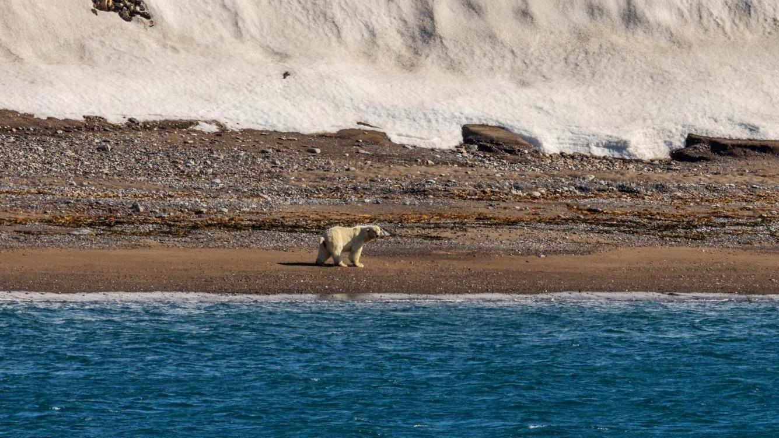
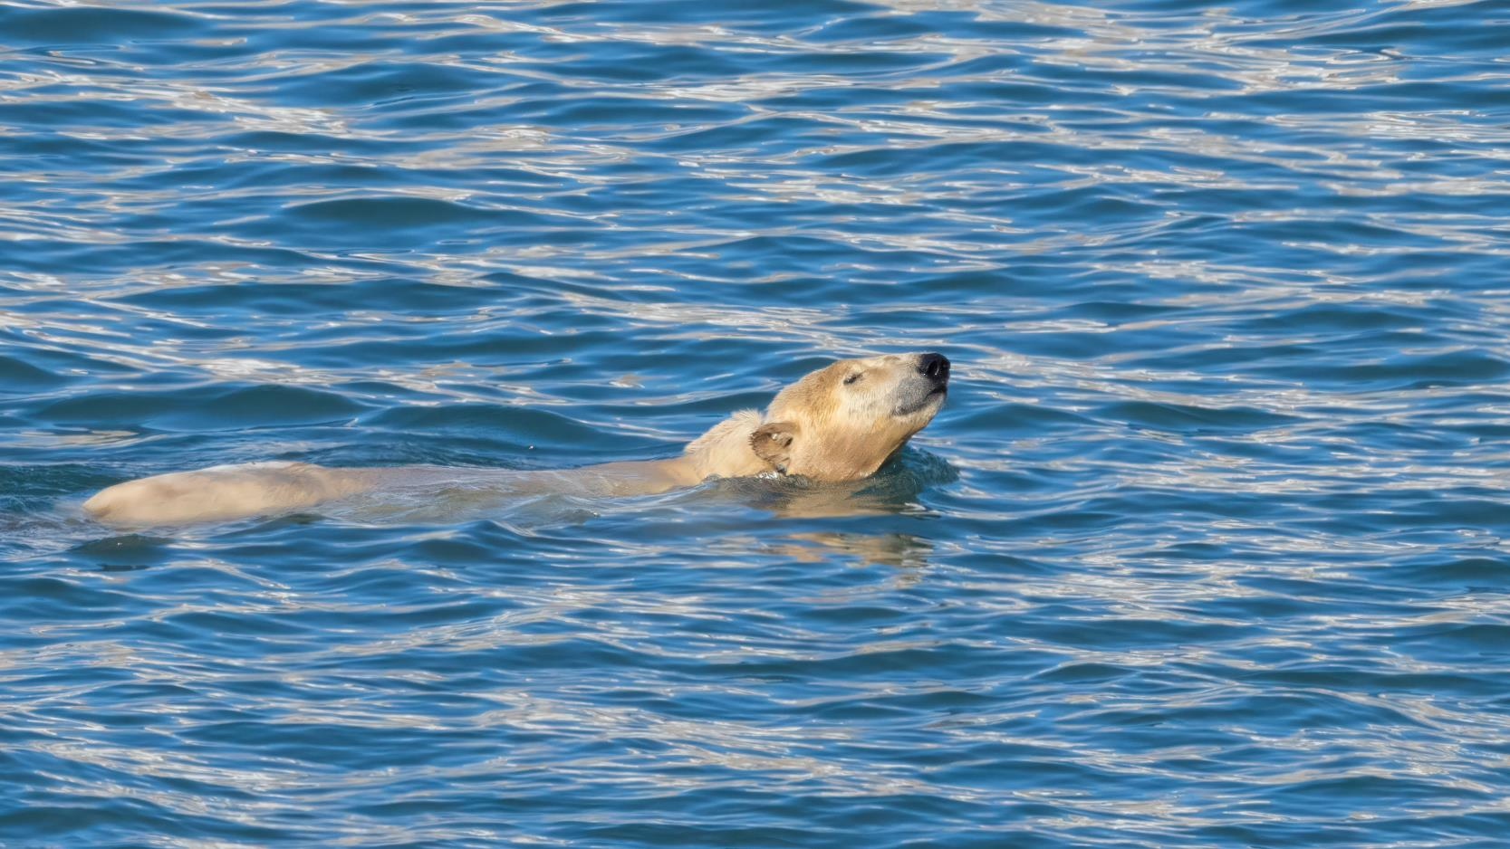
Wildlife
List - Marine Mammals
Credit: Rosie Barrett/HX

Slide 29

Wildlife List – Marine Mammals
SCIENTIFIC NAME | ENGLISH | DEUTSCH
Balaenotera acutorostrata | Minke Whale | Zwergal
Ursus maritimus | Polar Bear | Eisbär
Balaenoptra Musculus | Blue whale | Blauwal
Pusa hispida | Ringed Seal | Ringelrobbe
Odobenus rosmarus | Walrus | Walross
Erignathus Barbatus | Bearded Seal | Bartrobbe
Notes:
Copy and paste marine mammals observed – make sure scientific name is in italics

Slide 30
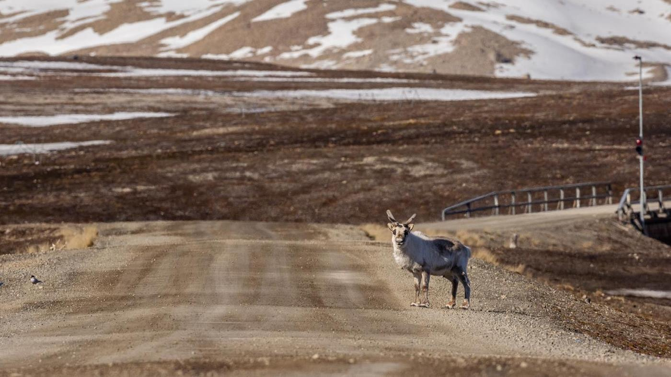
Wildlife
List - Land Mammals
Credit: Rosie Barrett/HX

Slide 31
Wildlife List – Land Mammals
SCIENTIFIC NAME | ENGLISH | DEUTSCH
Rangifer tarandus | Reindeer | Rentier
Alopex lagopus | Arctic Fox | Polarfuchs
Notes:
Copy and paste marine mammals observed – make sure scientific name is in italics

Slide 32
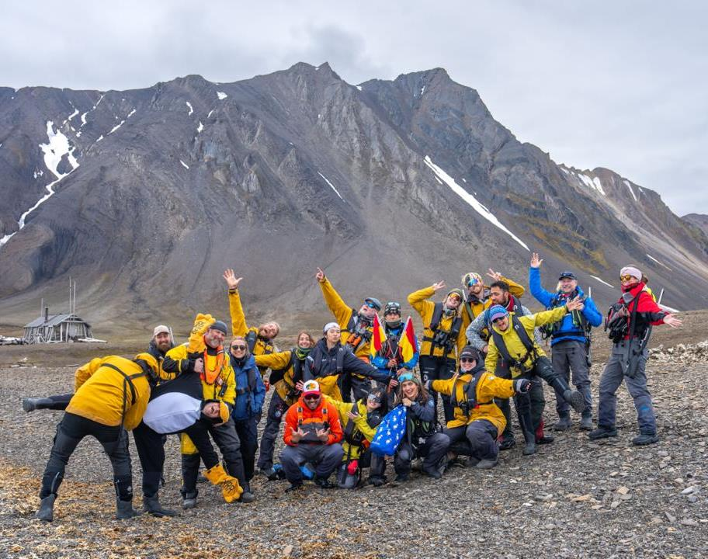
Thank you!
The FRAM Science and Education Team thanks you for choosing HX Expeditions to explore the western Svalbard archipelago in springtime. Your participation supports the ongoing work of researchers, and it makes it possible for them to join our voyages — carrying out meaningful studies and reaching field sites that are often difficult to access by any other route.
We are grateful for your curiosity and for the enthusiasm you brought to the natural world around us — from birds and marine mammals to the flowers, lichens, mosses, and the microscopic life we found in a single drop of water.
It was a pleasure to share ideas with you, to talk over history across a coffee, and to stand together in front of the ecosystems we encountered. We hope this voyage stays with you.
Credit: Jan Hvizdal /HX

Slide 33
Connect with your inner scientist

