Slide 1
Science & Education Report

Slide 2
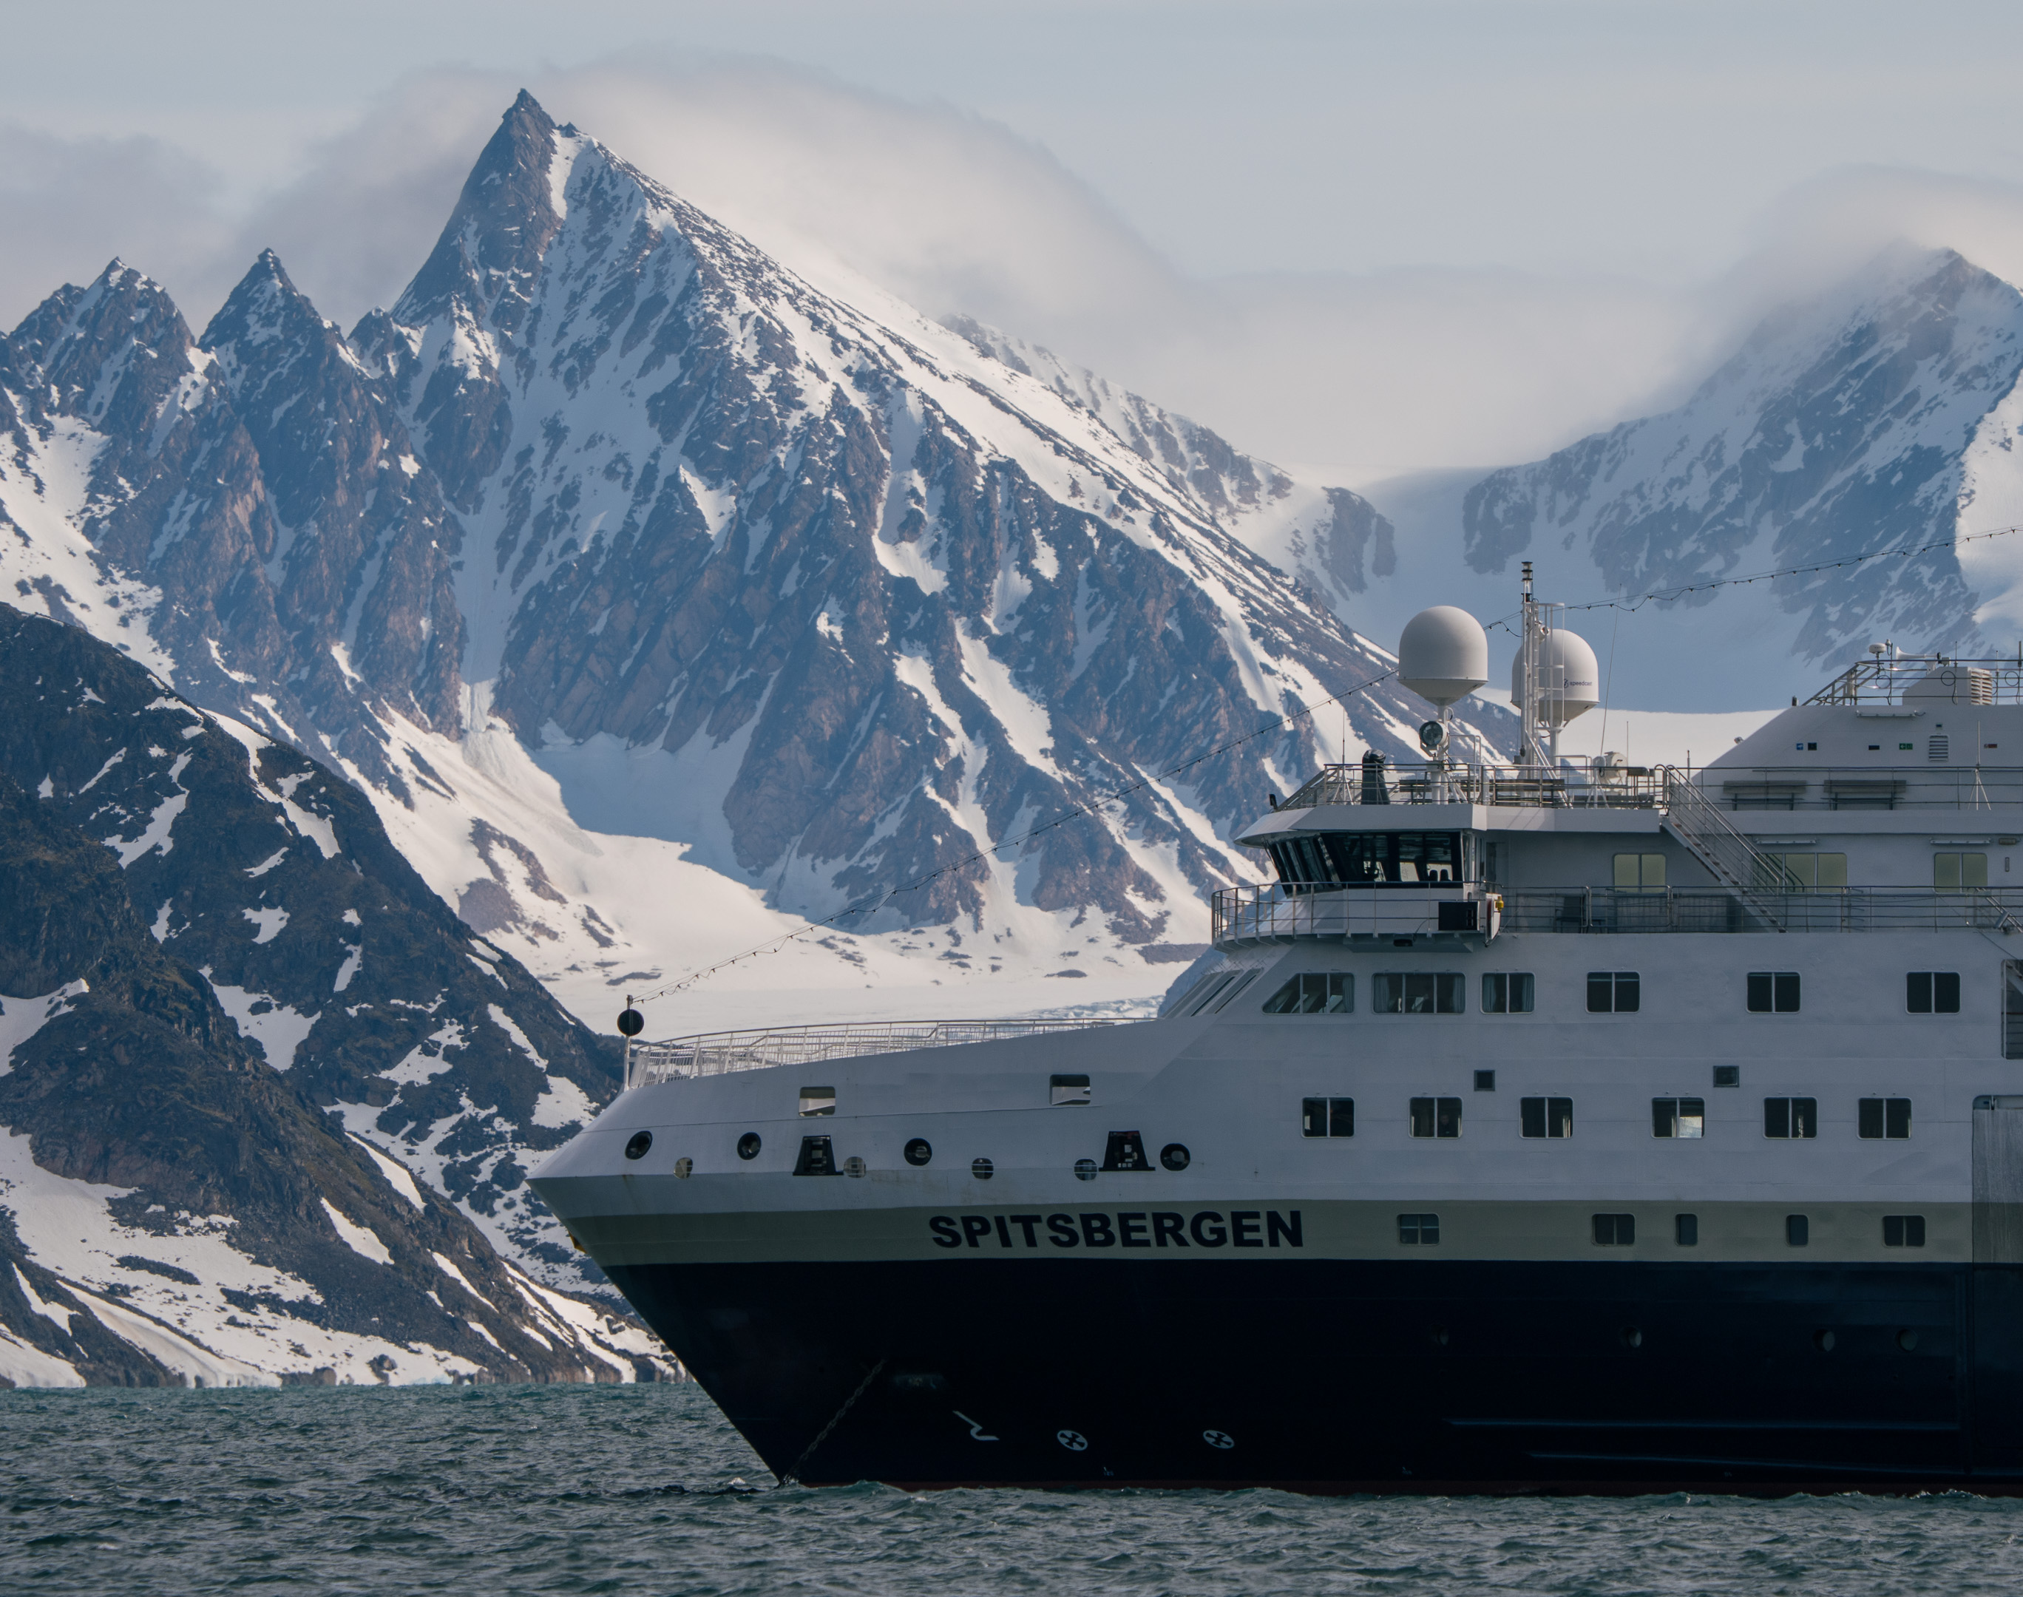
MS Spitsbergen
09.06. – 16.06.2026
Svalbard in Spring
The Return of the Sun
Notes:
in Spring
The Return of the Sun

Slide 3
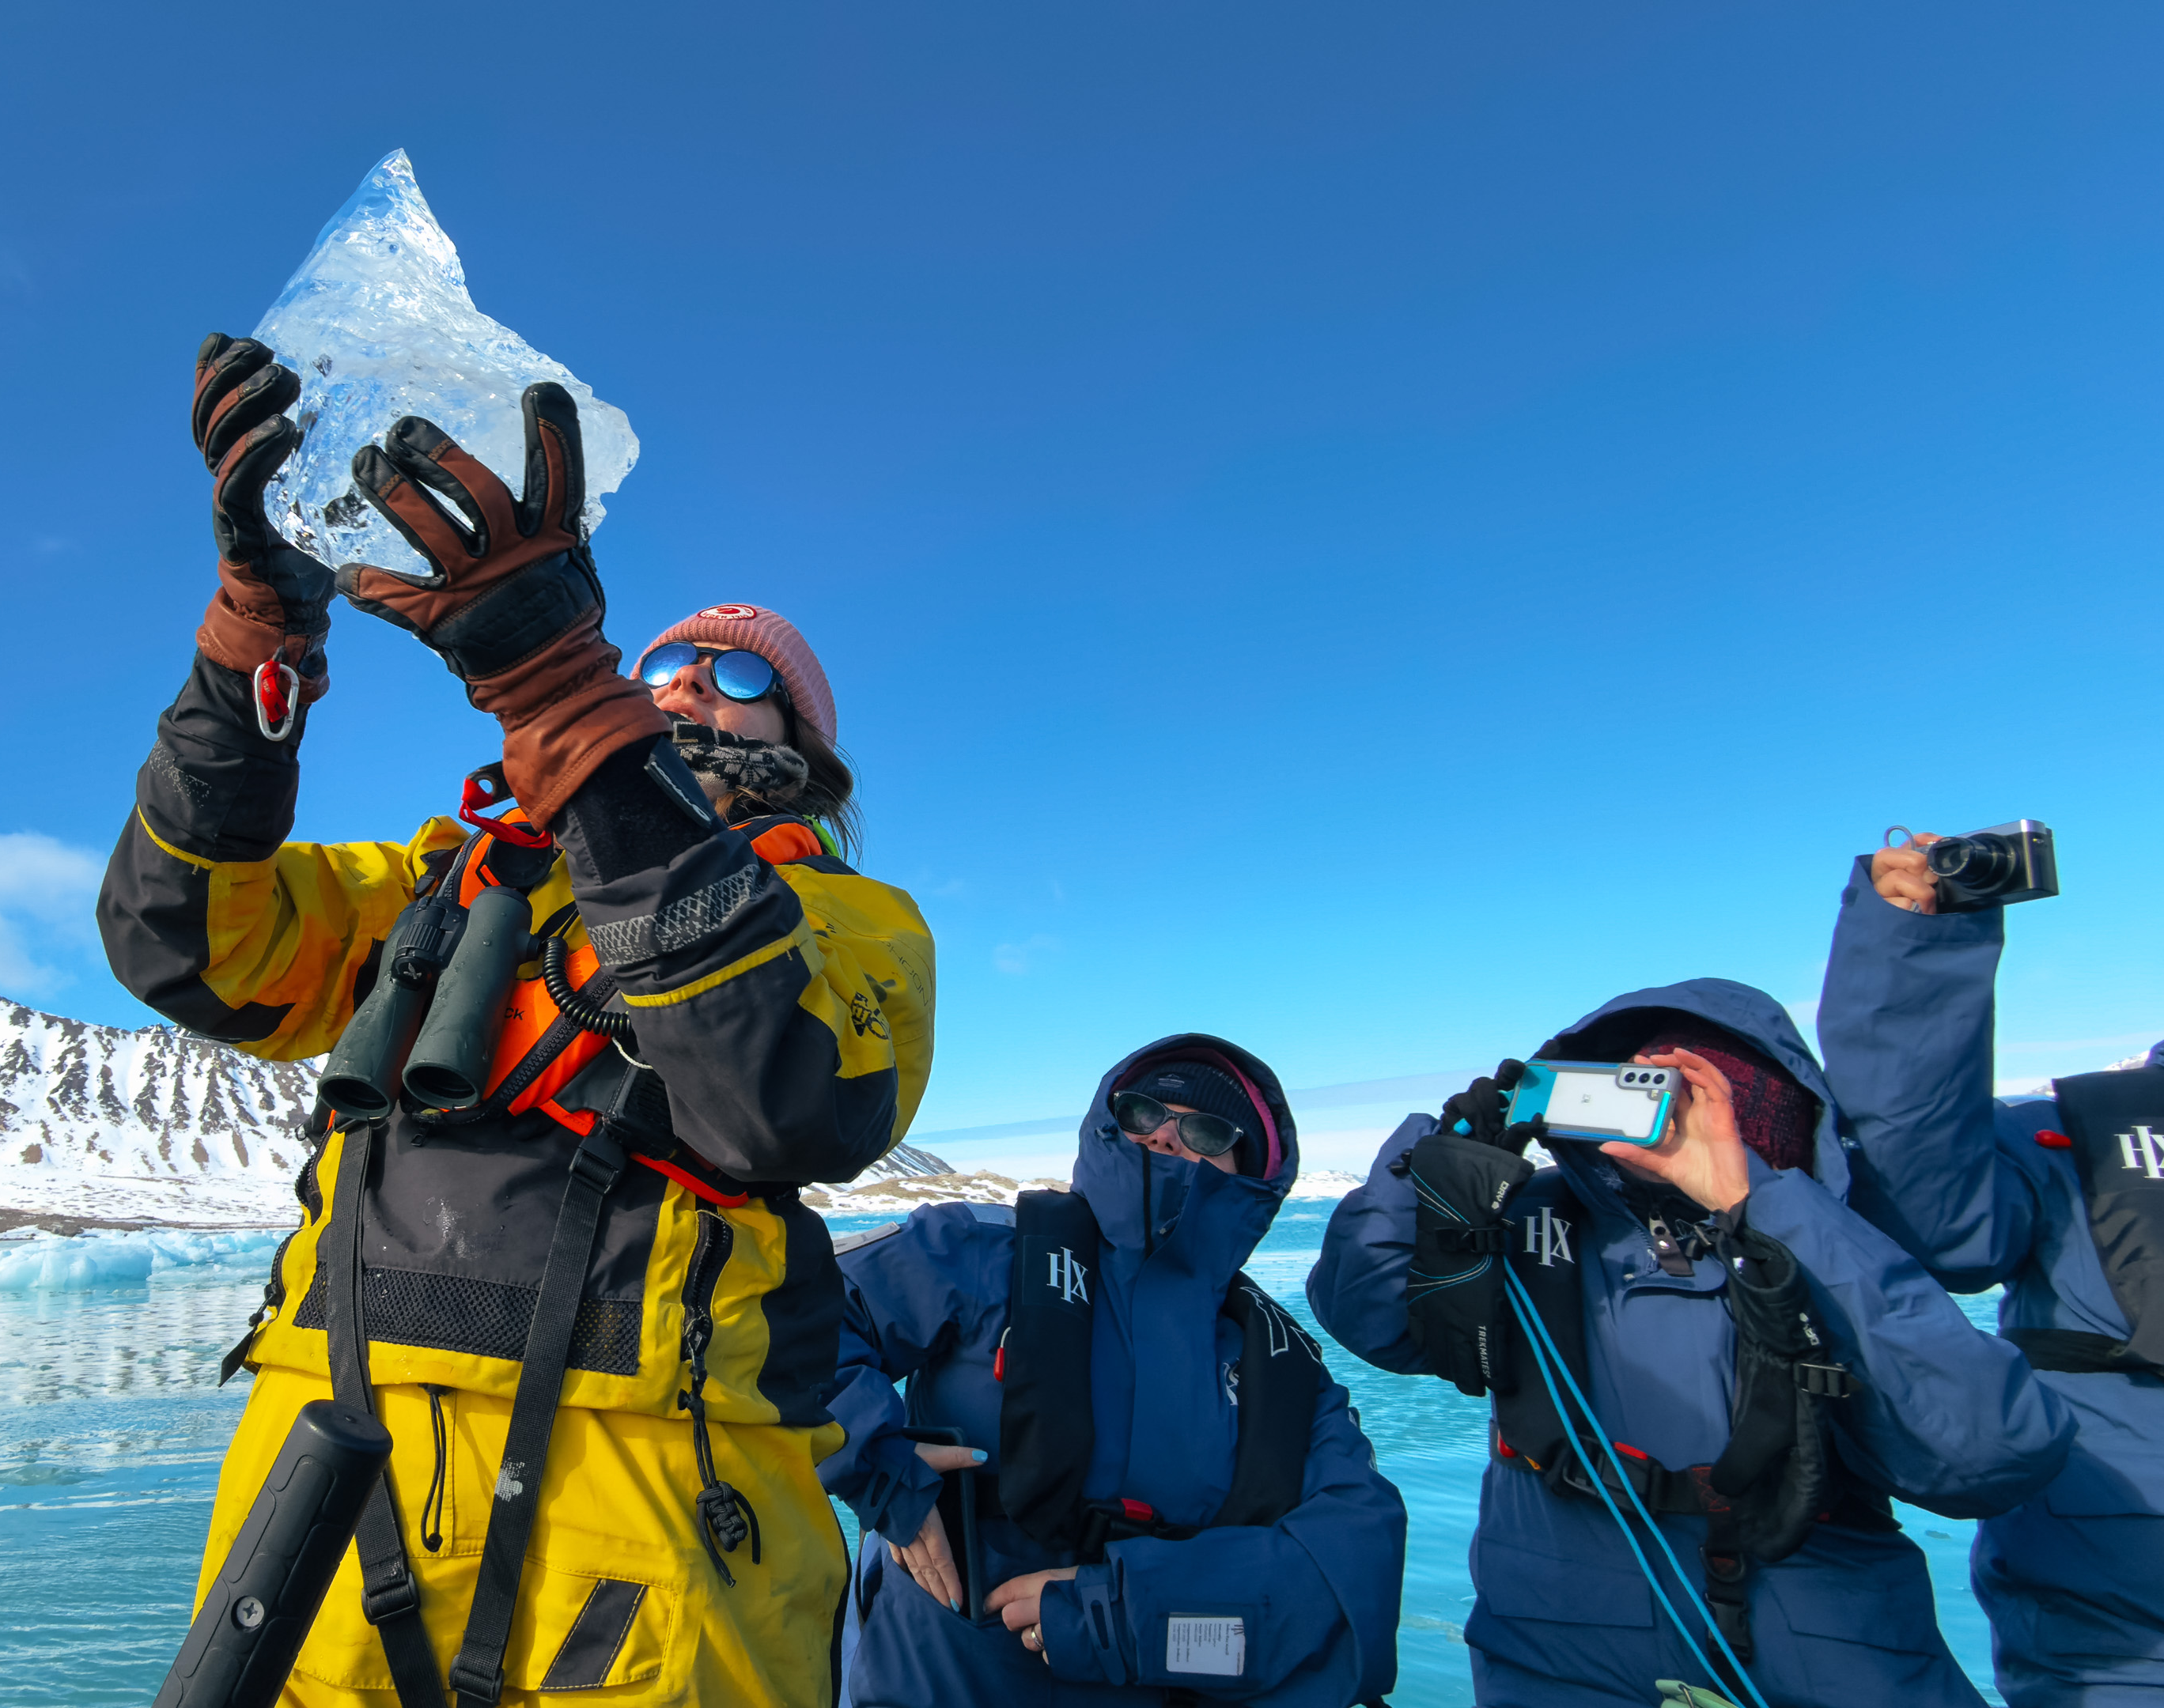
Science & Education Program
Our Science and Education Team accompanied you throughout your expedition into the remote nature of the Svalbard archipelago.
Together we explored the region's natural beauty, exceptional wildlife, and layered history. We ran lectures and interactive sessions on board, and took to the landscape during landings, nature walks, and outings on the water.
Notes:
Add brief summary of the Science & Education Program over the whole voyage

Slide 4
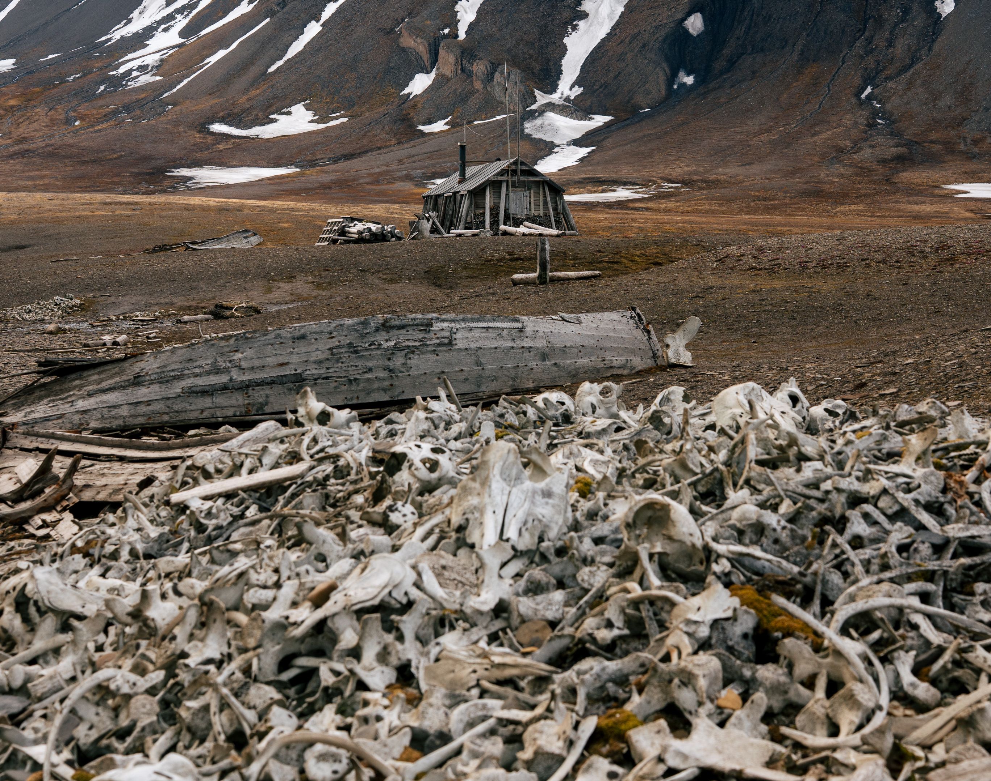
History & Culture
We sailed to remote shores with a short but complex human history.
We explored the unusual international and political status of Svalbard, shaped by the Svalbard Treaty signed in 1920.
Notes:
Add summary of history workshops or hikes undertaken

Slide 5
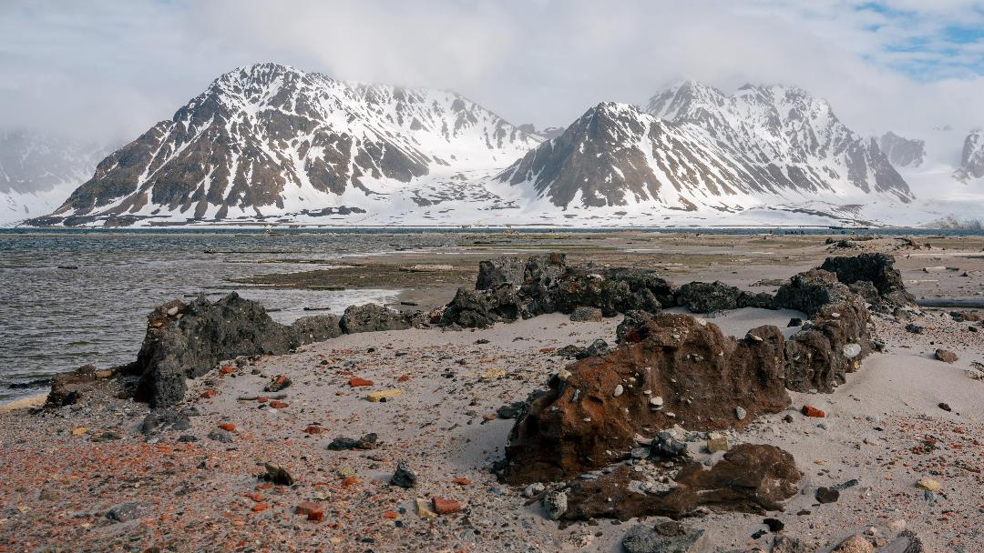
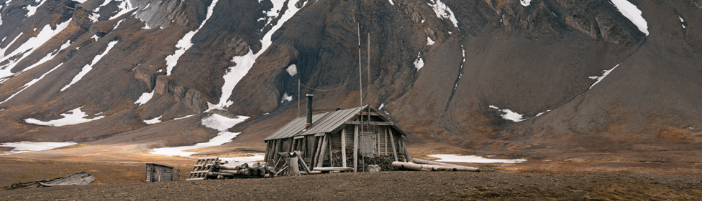
Svalbard
During our landings in Svalbard, we encountered traces of the region's early whaling era and of the more recent trapping period.
Scattered across the landscape were huts — some still maintained and in use — alongside abandoned traps and the crumbling remains of old whaling ovens. These relics offered vivid glimpses into the human history that once shaped these remote shores.

Slide 6
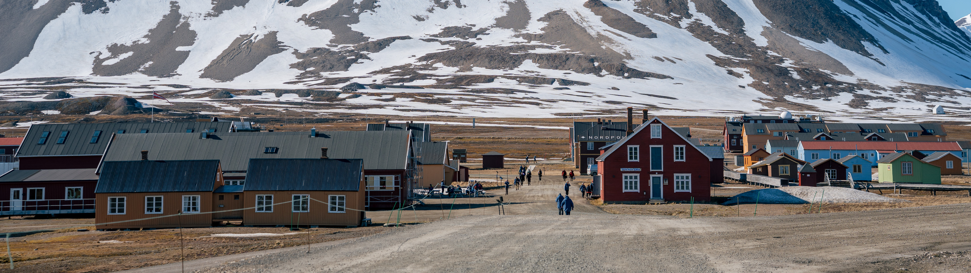
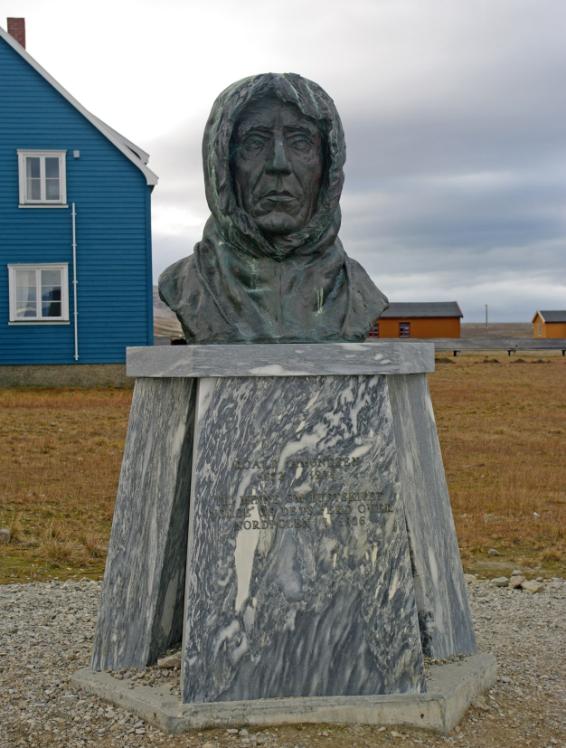

Ny-Ålesund
Our voyage included a stop that captures the scientific character of the Arctic.
Ny-Ålesund, the world's northernmost civilian settlement, is an international research hub where eleven nations work side by side under the Svalbard Treaty. Together with the other sites we visited, it shows how the High Arctic acts as a natural laboratory for understanding climate, ecosystems, and long-term environmental change.

Slide 7
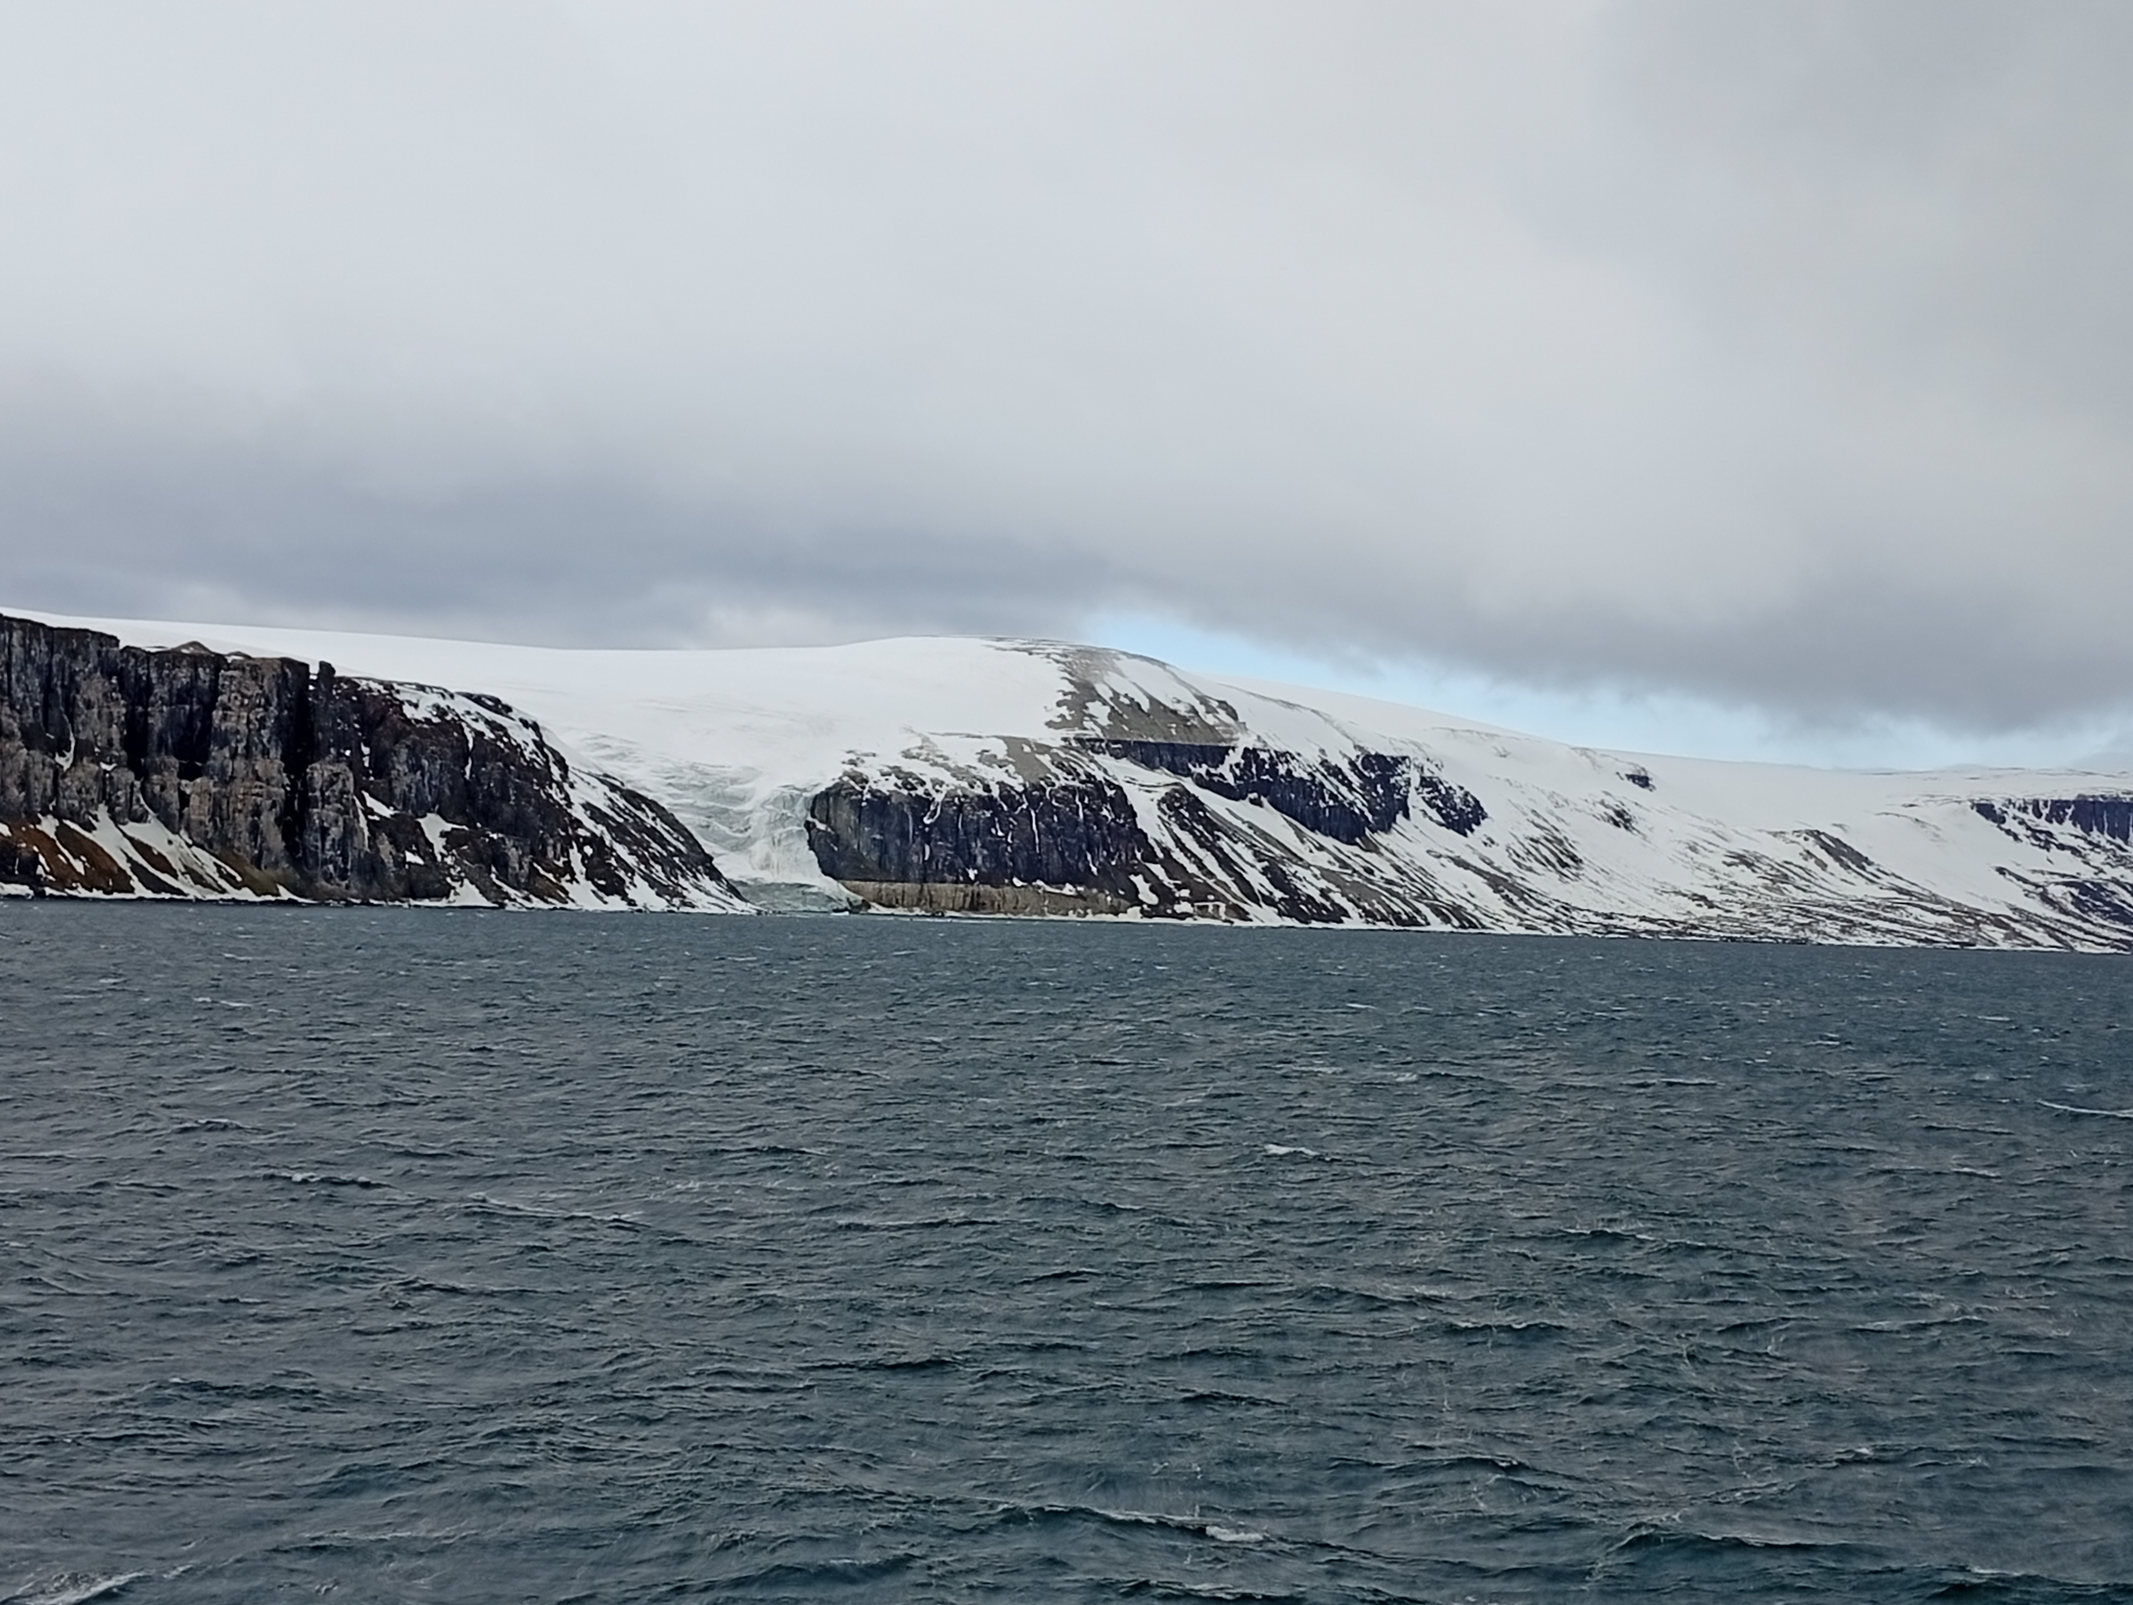
Geology
The Alkefjellet cliffs, formed of dark basalt and white limestone, rise up to 100 metres and reveal the region's ancient volcanic activity. The cliffs' geological structure, formed during the Jurassic or Early Cretaceous, features a dark dolerite intrusion. Erosion has since uncovered the intrusion, which is Jurassic to Lower Cretaceous in age. It sits within Permian limestone, metamorphosed into marble near the contact zone.

Slide 8
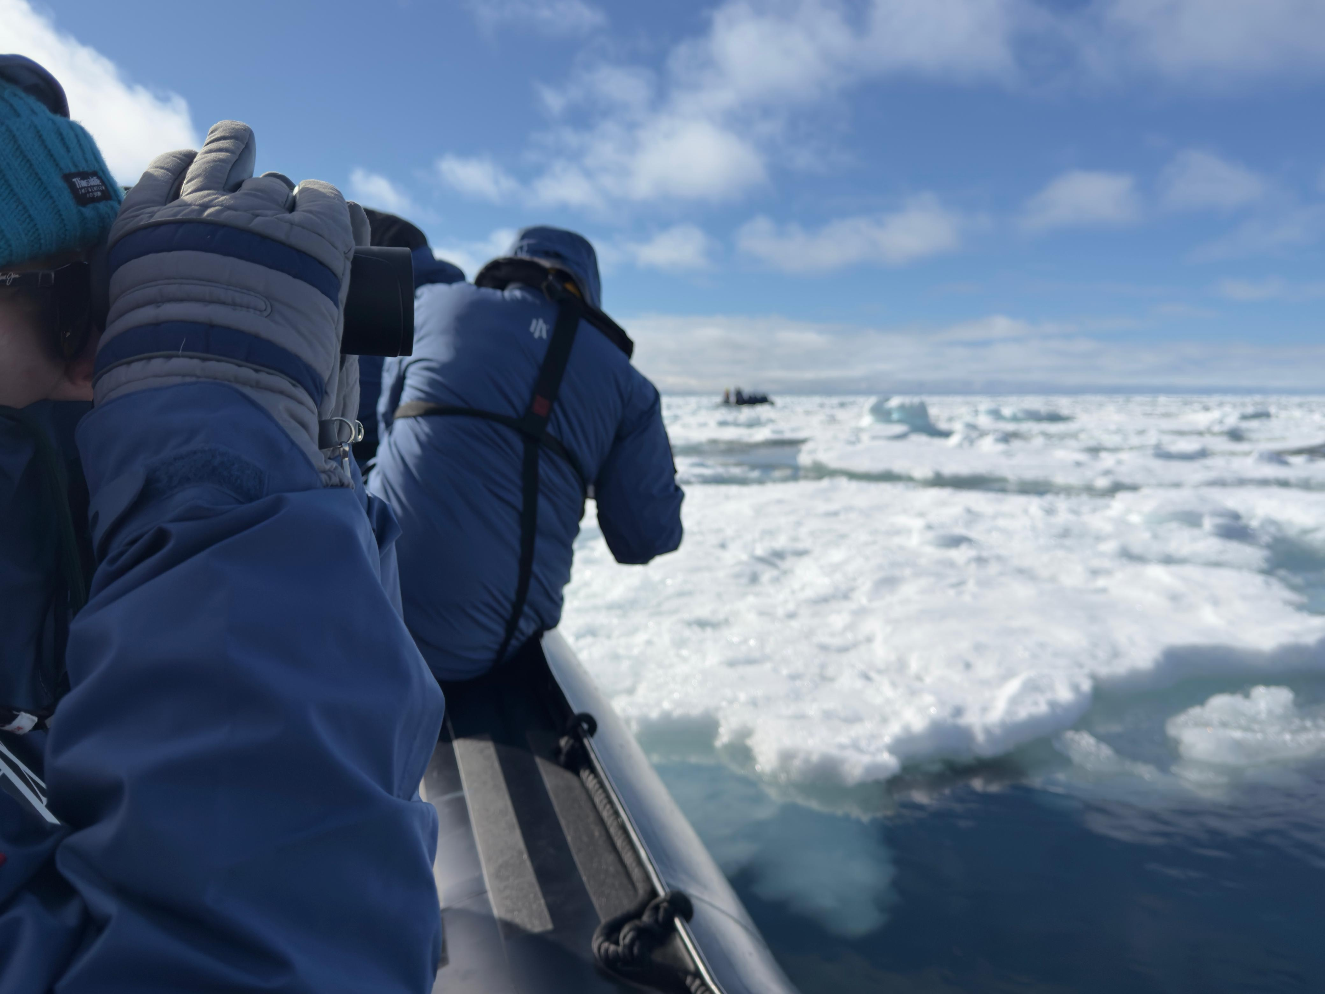
Sea Ice
Sea ice does quiet but vital work. It reflects sunlight back into space, helps cool the planet, and insulates the ocean below — shaping the climate of both polar regions and supporting the marine life that depends on it.
Both its extent and its thickness are declining as the climate warms. Monitoring sea ice matters more than ever, both for understanding what is changing and for managing the risks of growing human activity in the Arctic.

Slide 9
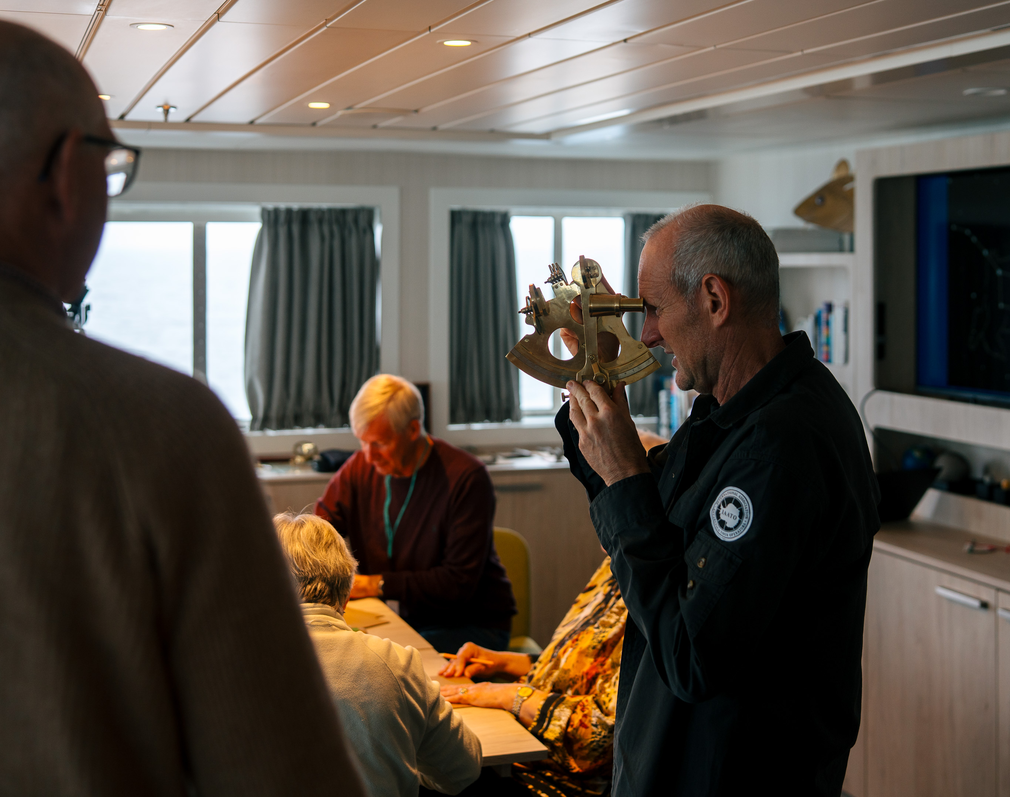
Workshops
Throughout the voyage we ran a series of practical workshops connecting seamanship with exploration skills. We built simple sextants to learn the principles of celestial navigation and ran a hands-on session on editing photographs using only a smartphone. Together these sessions gave a practical feel for the techniques, both traditional and modern, that support Arctic travel and documentation.
Notes:
Add summary of workshops and activities – i.e. knitting, local crafts (with cultural interpreter), painting, scientific drawing

Slide 10
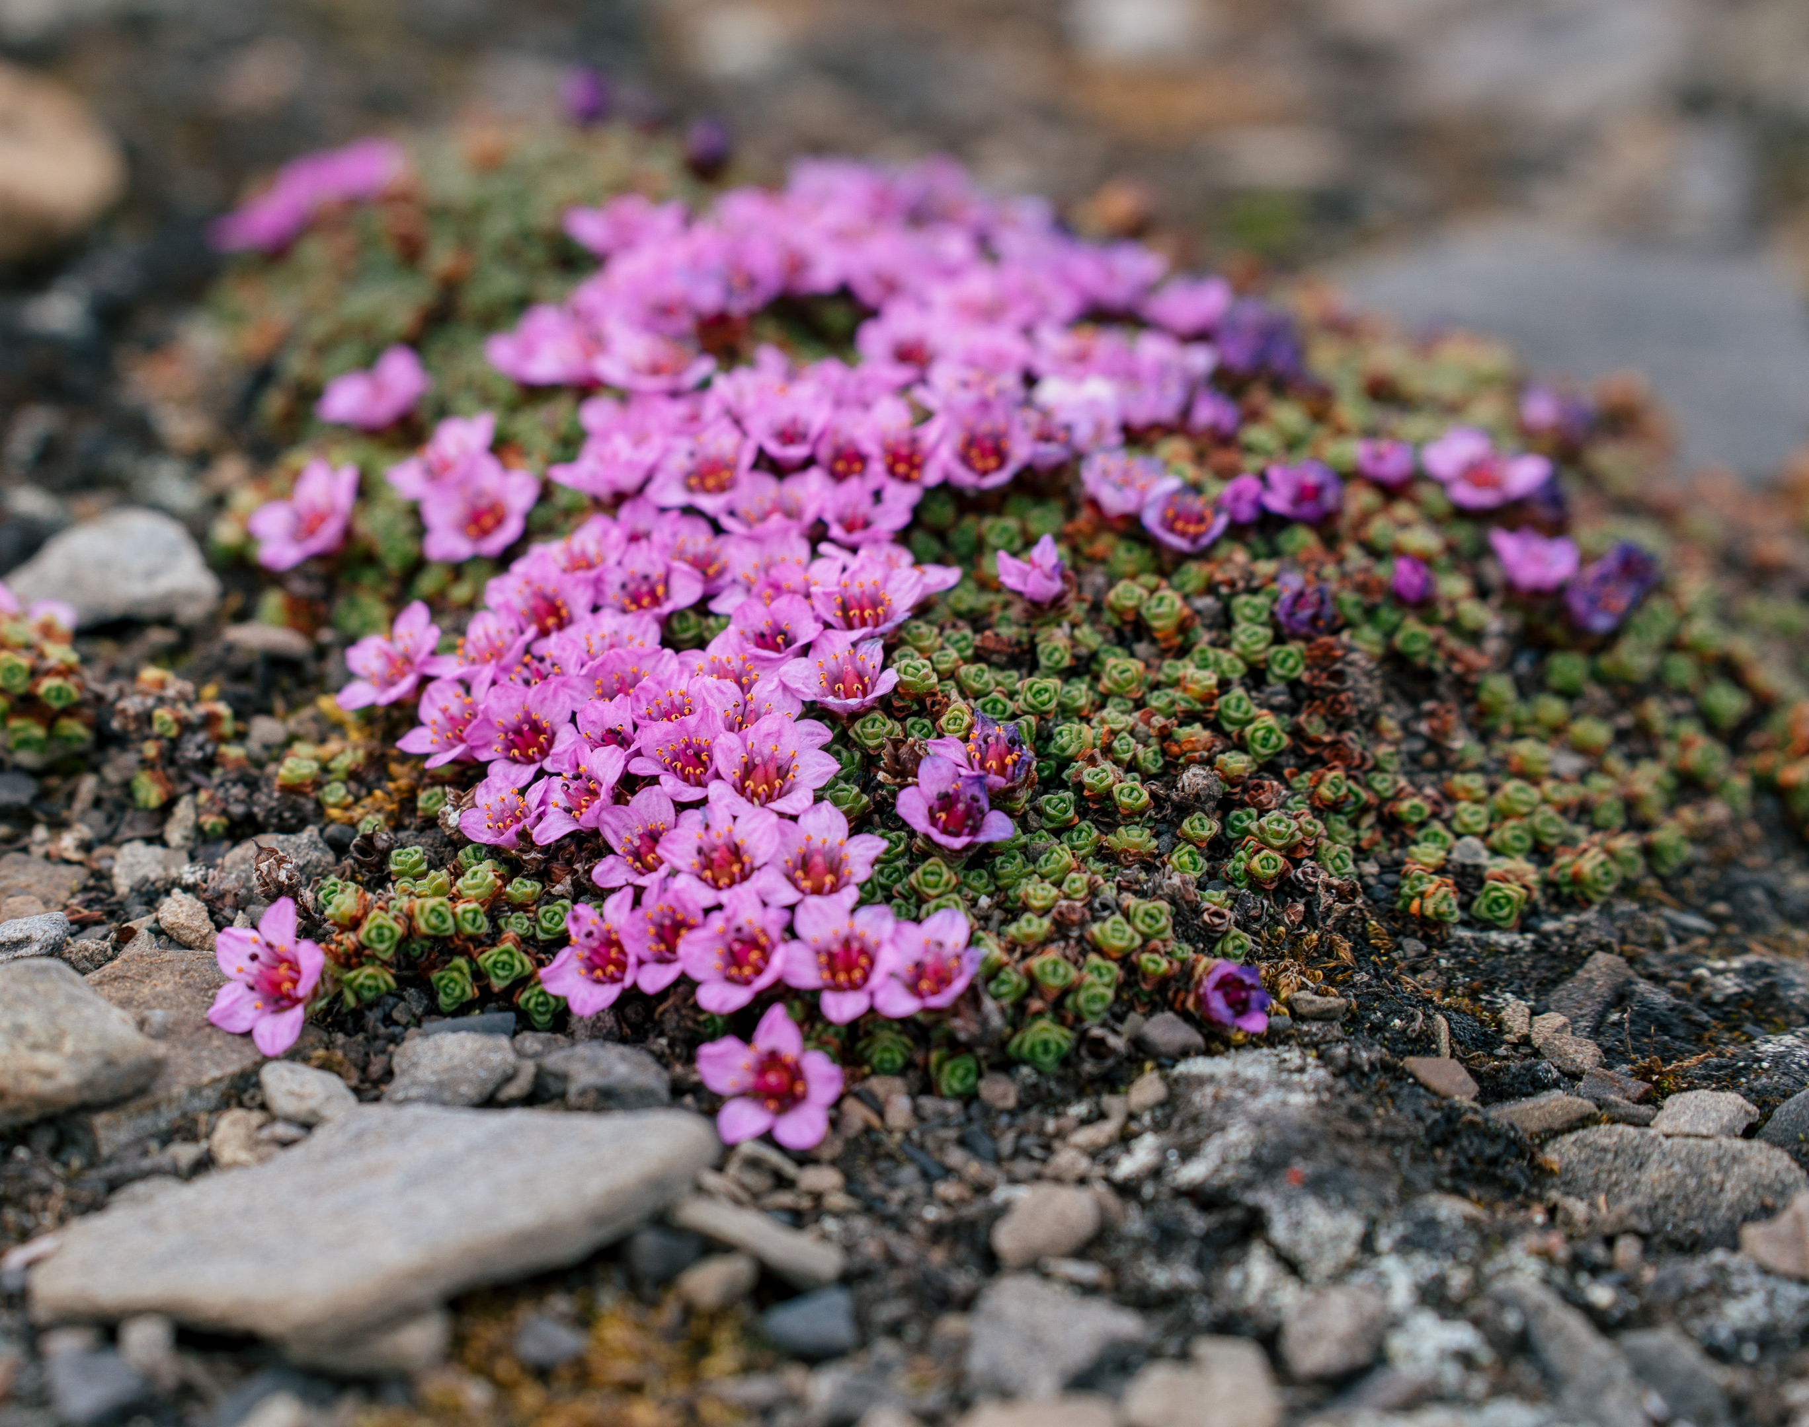
iNaturalist
Throughout the expedition, we documented the flora and fauna of Svalbard and uploaded our findings to the iNaturalist platform.
During the voyage, we submitted 100 observations covering 54 species. Each record helps build a clearer picture of how species are distributed across the archipelago, supporting researchers in their ongoing studies and conservation work.
View our data on the iNaturalist project page.
Notes:
Add summary of number of observations, number of species etc. and add link to the iNaturalist project for the specific trip

Slide 11
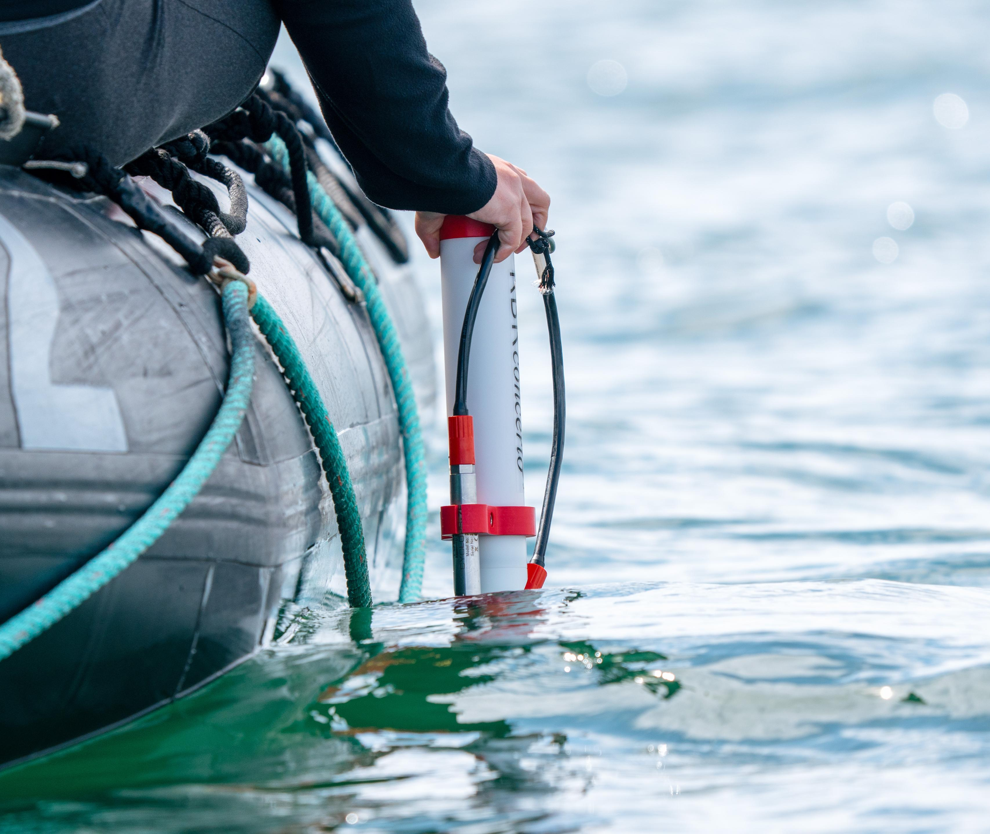
Science Boat
Twenty-four guests joined our three science boat outings in Signehamna, Faksevågen, and at the ice edge to study plankton and local hydrography.
Together we monitored ocean clarity for the Secchi Disk Citizen Science study, contributing to research on the distribution of phytoplankton blooms.
View our data submitted to the Secchi Disk Project
Notes:
Add highlights of what science boat activities and sampling were undertaken – update secchi link to specific voyage if possible

Slide 12
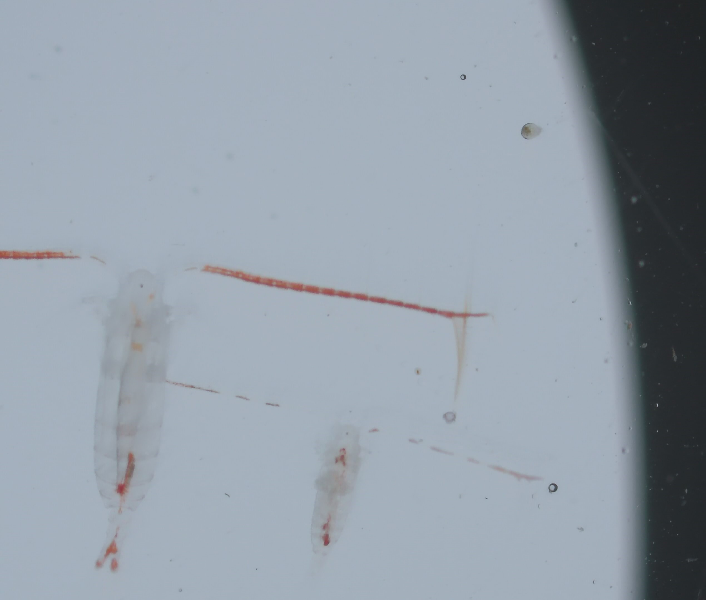
Plankton Samples
We explored the microscopic world of plankton — the tiny organisms that drift through the ocean.
In the samples collected at Signehamna, Faksevågen, and near the ice edge, we identified phytoplankton (Phaeocystis and diatoms), holozooplankton (copepods, comb jellies, ostracods, appendicularians, and sea butterflies), and merozooplankton (crab, barnacle, and anemone larvae).
Calanus copepods
Notes:
Add any interesting finds in the plankton samples and pictures taken down the microscopes
Diatoms: These microscopic algae are enclosed in shells made of silica and are one of the most important groups of phytoplankton. They play a vital role in aquatic ecosystems by contributing to the base of the food chain and oxygen production.
Dinoflagellates: These single-celled organisms possess two flagella for movement and are known for their ability to create bioluminescence in oceans, contributing significantly to marine biodiversity and nutrient cycling.
Copepods (Calanus sp.): These small crustaceans are crucial in marine food webs as primary consumers of phytoplankton, transferring energy to higher trophic levels and influencing nutrient cycling in the oceans.
Planktonic larvae: These larvae of various marine organisms, such as fish and mollusks, play a critical role in dispersal and population dynamics, contributing to the resilience and diversity of marine ecosystems.

Slide 13
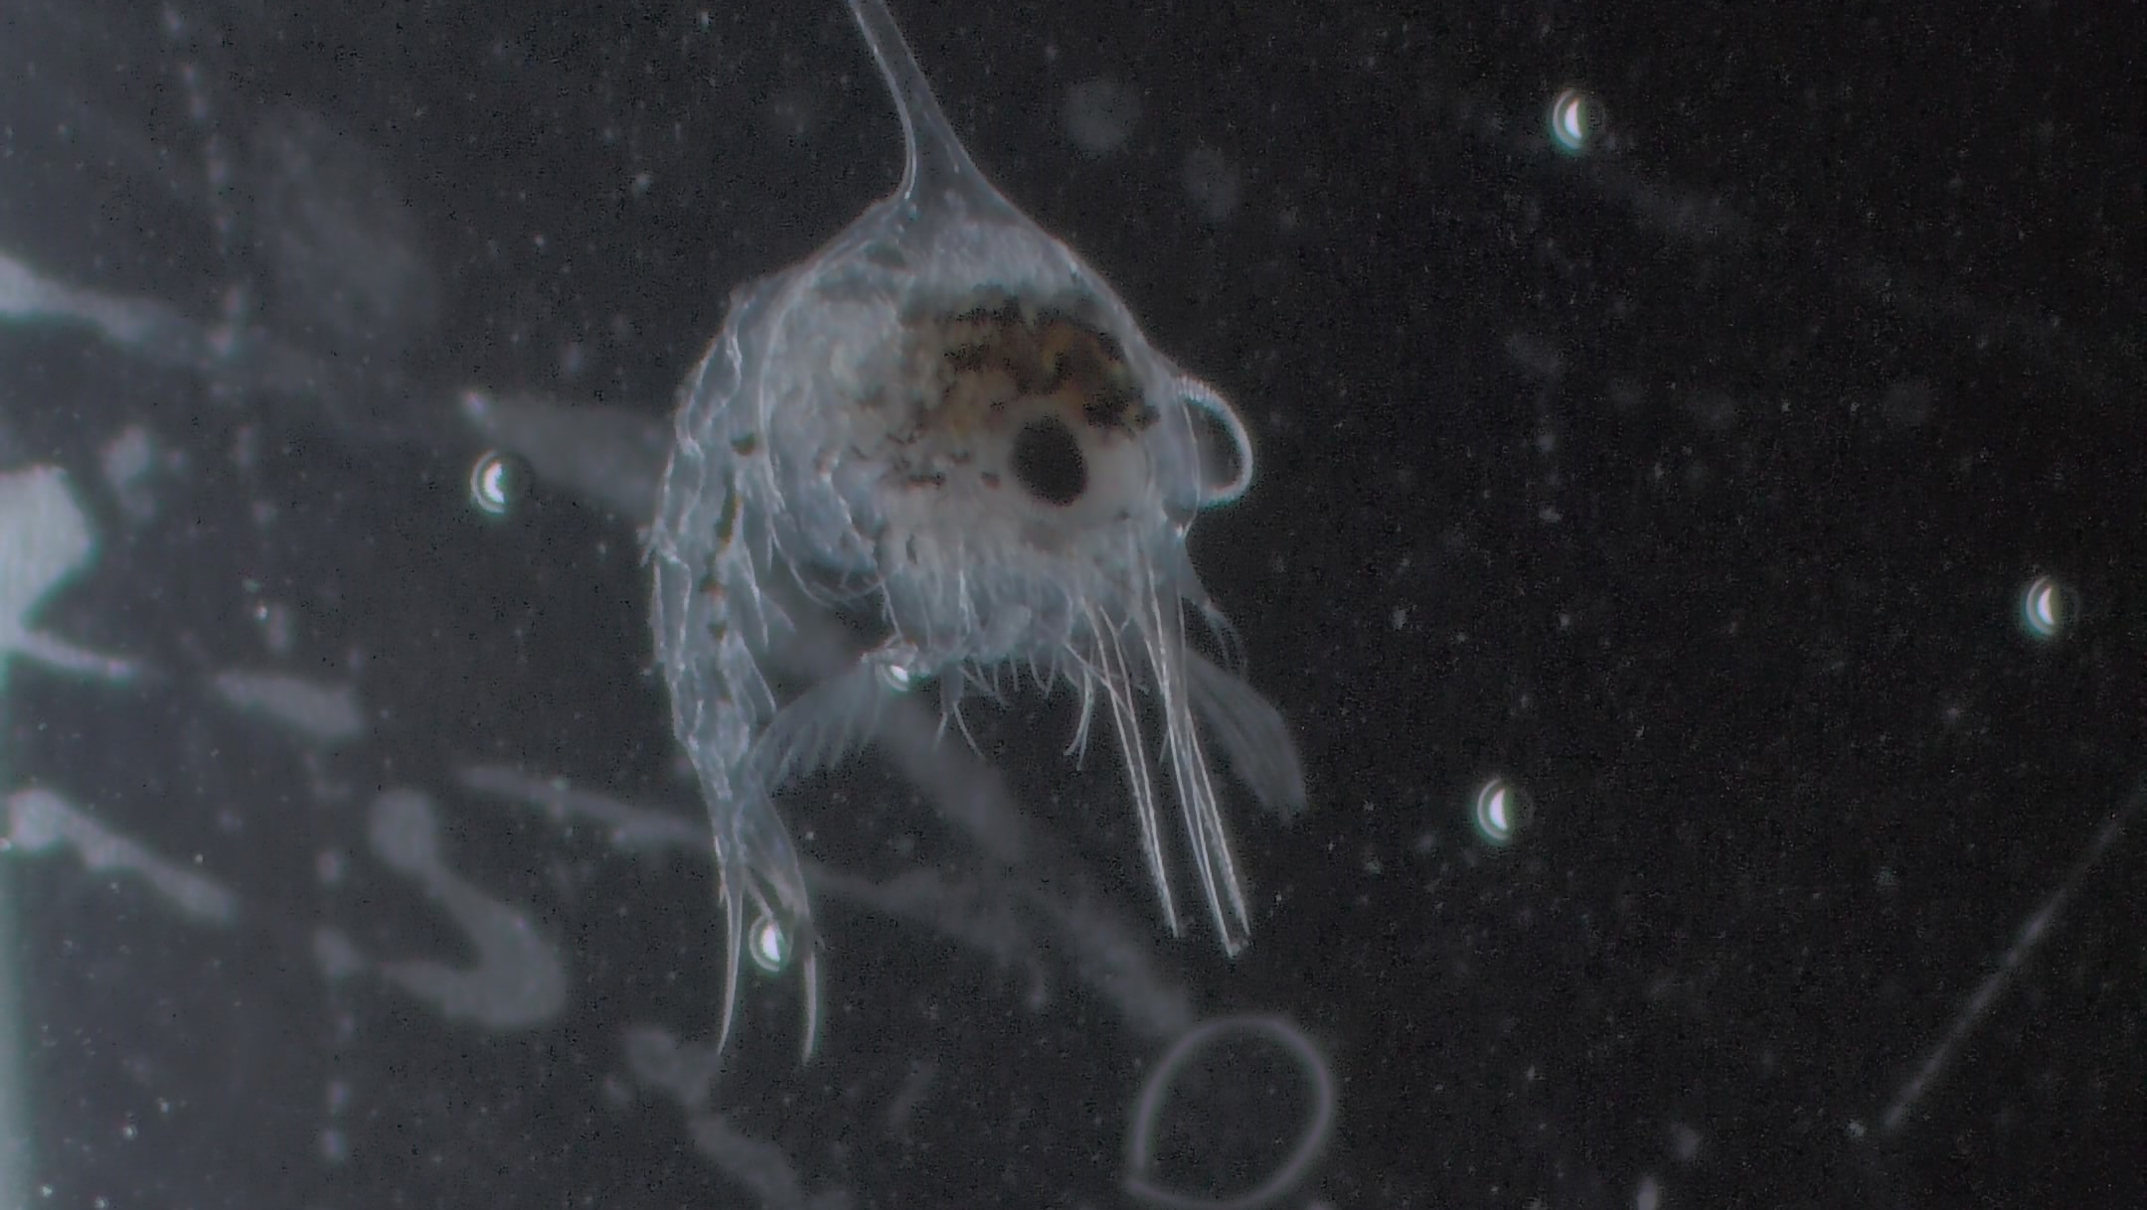
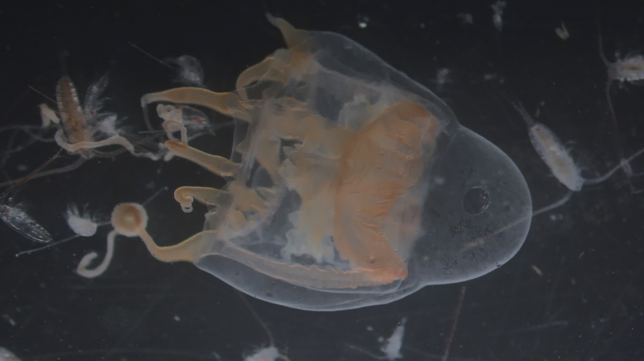
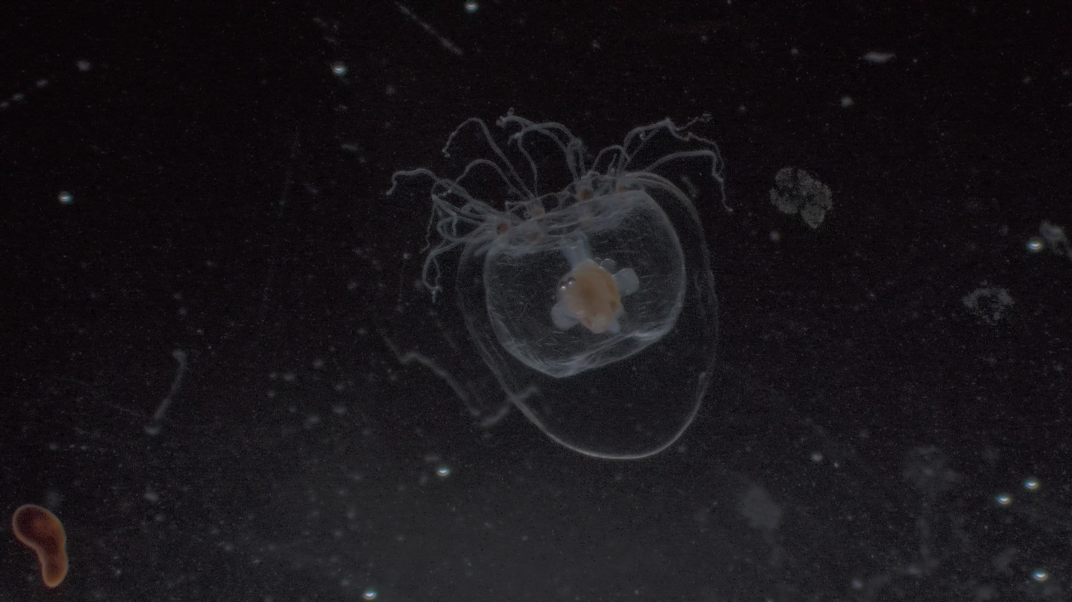
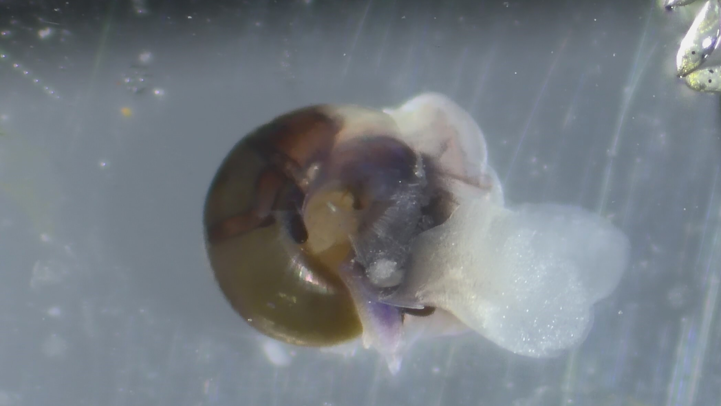
Crab larvae
Jellyfish
Jellyfish
Sea Butterfly

Slide 14
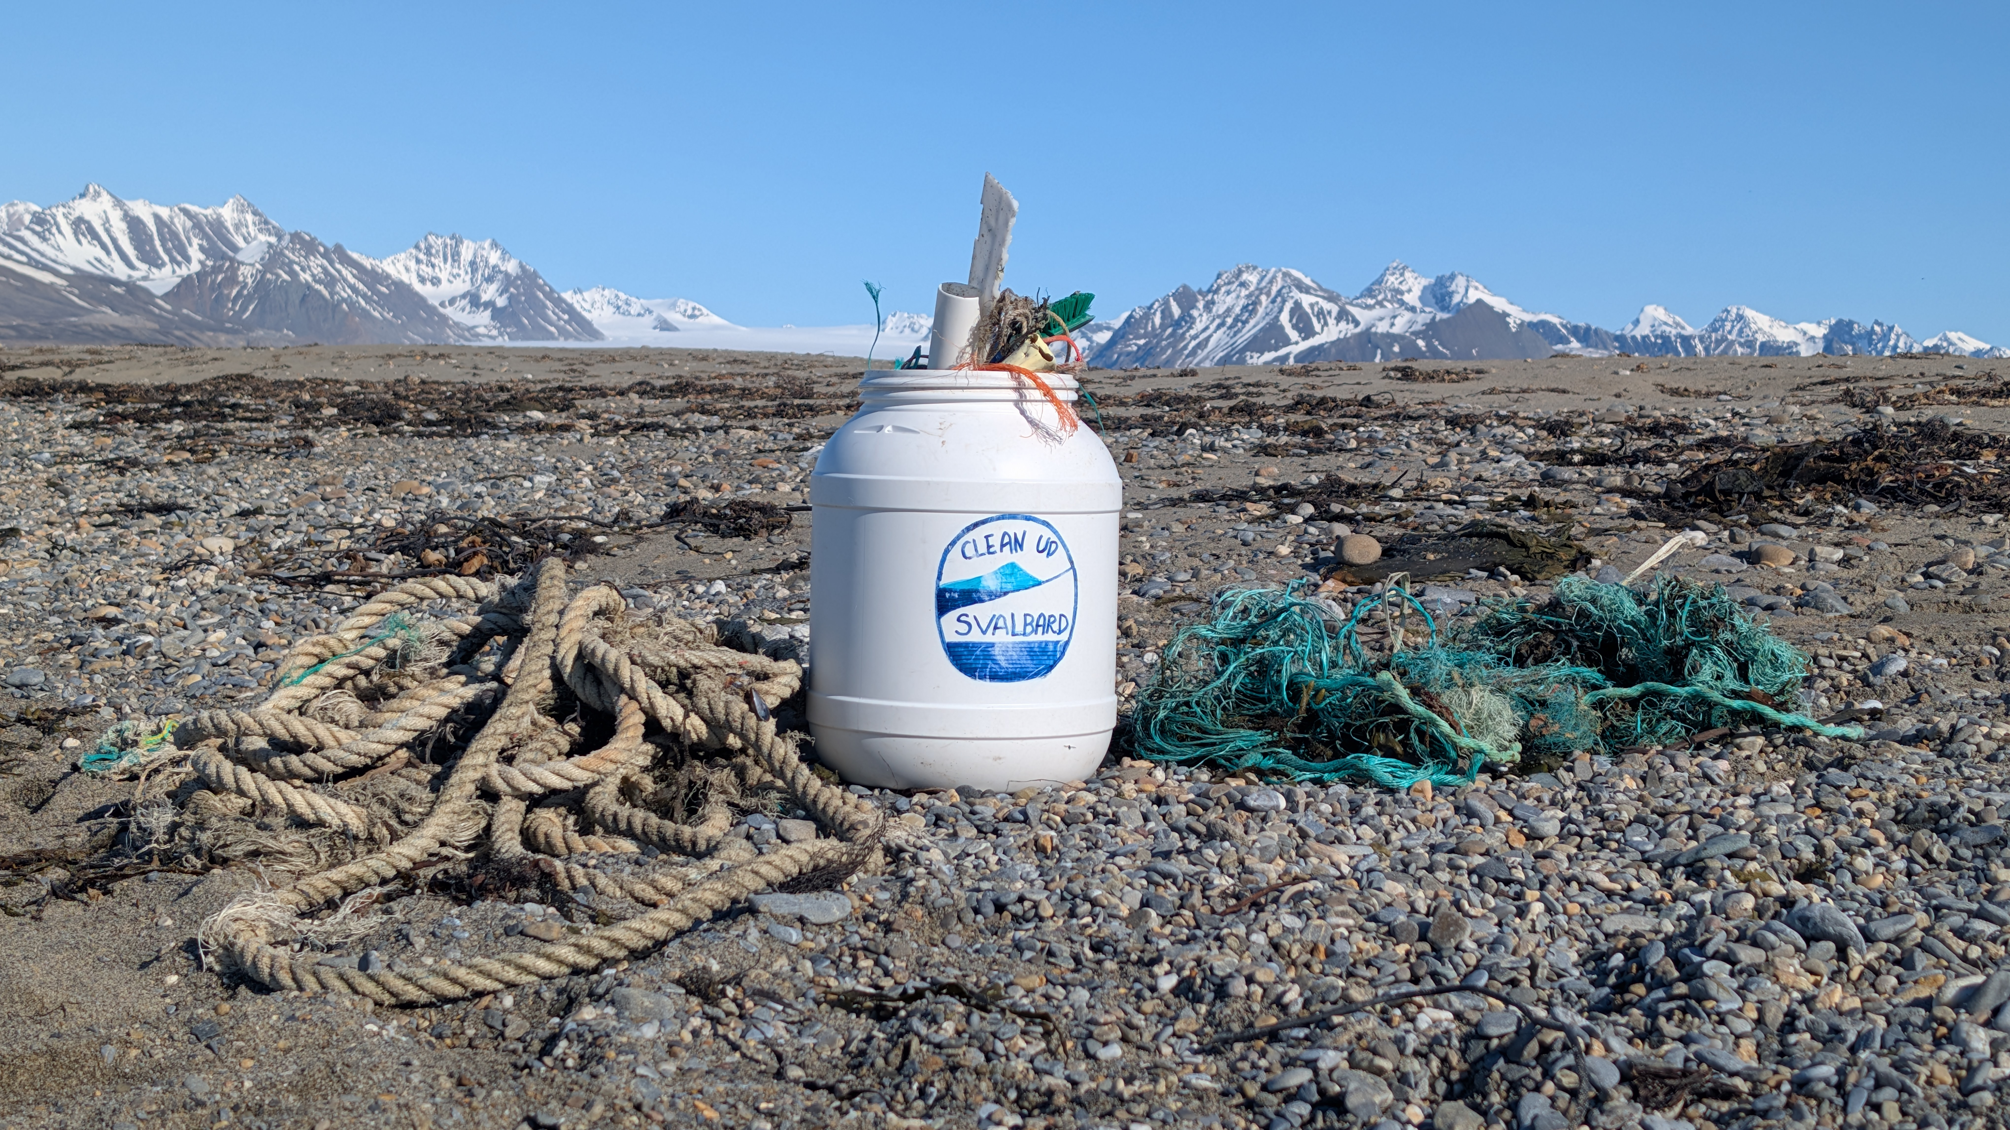
Beach
Clean-up
Over the course of the voyage, we took part in the Clean Up Svalbard initiative.
Between us we collected 20.7 kg of litter — bottles, fragments of netting and piping, a brush, and part of a hat.
Every piece carried off the shoreline helps protect the Arctic ecosystems we travel through. Thank you for taking the time to leave these beaches in better shape than we found them.
Notes:
Add location, date and weight of litter collected

Slide 15
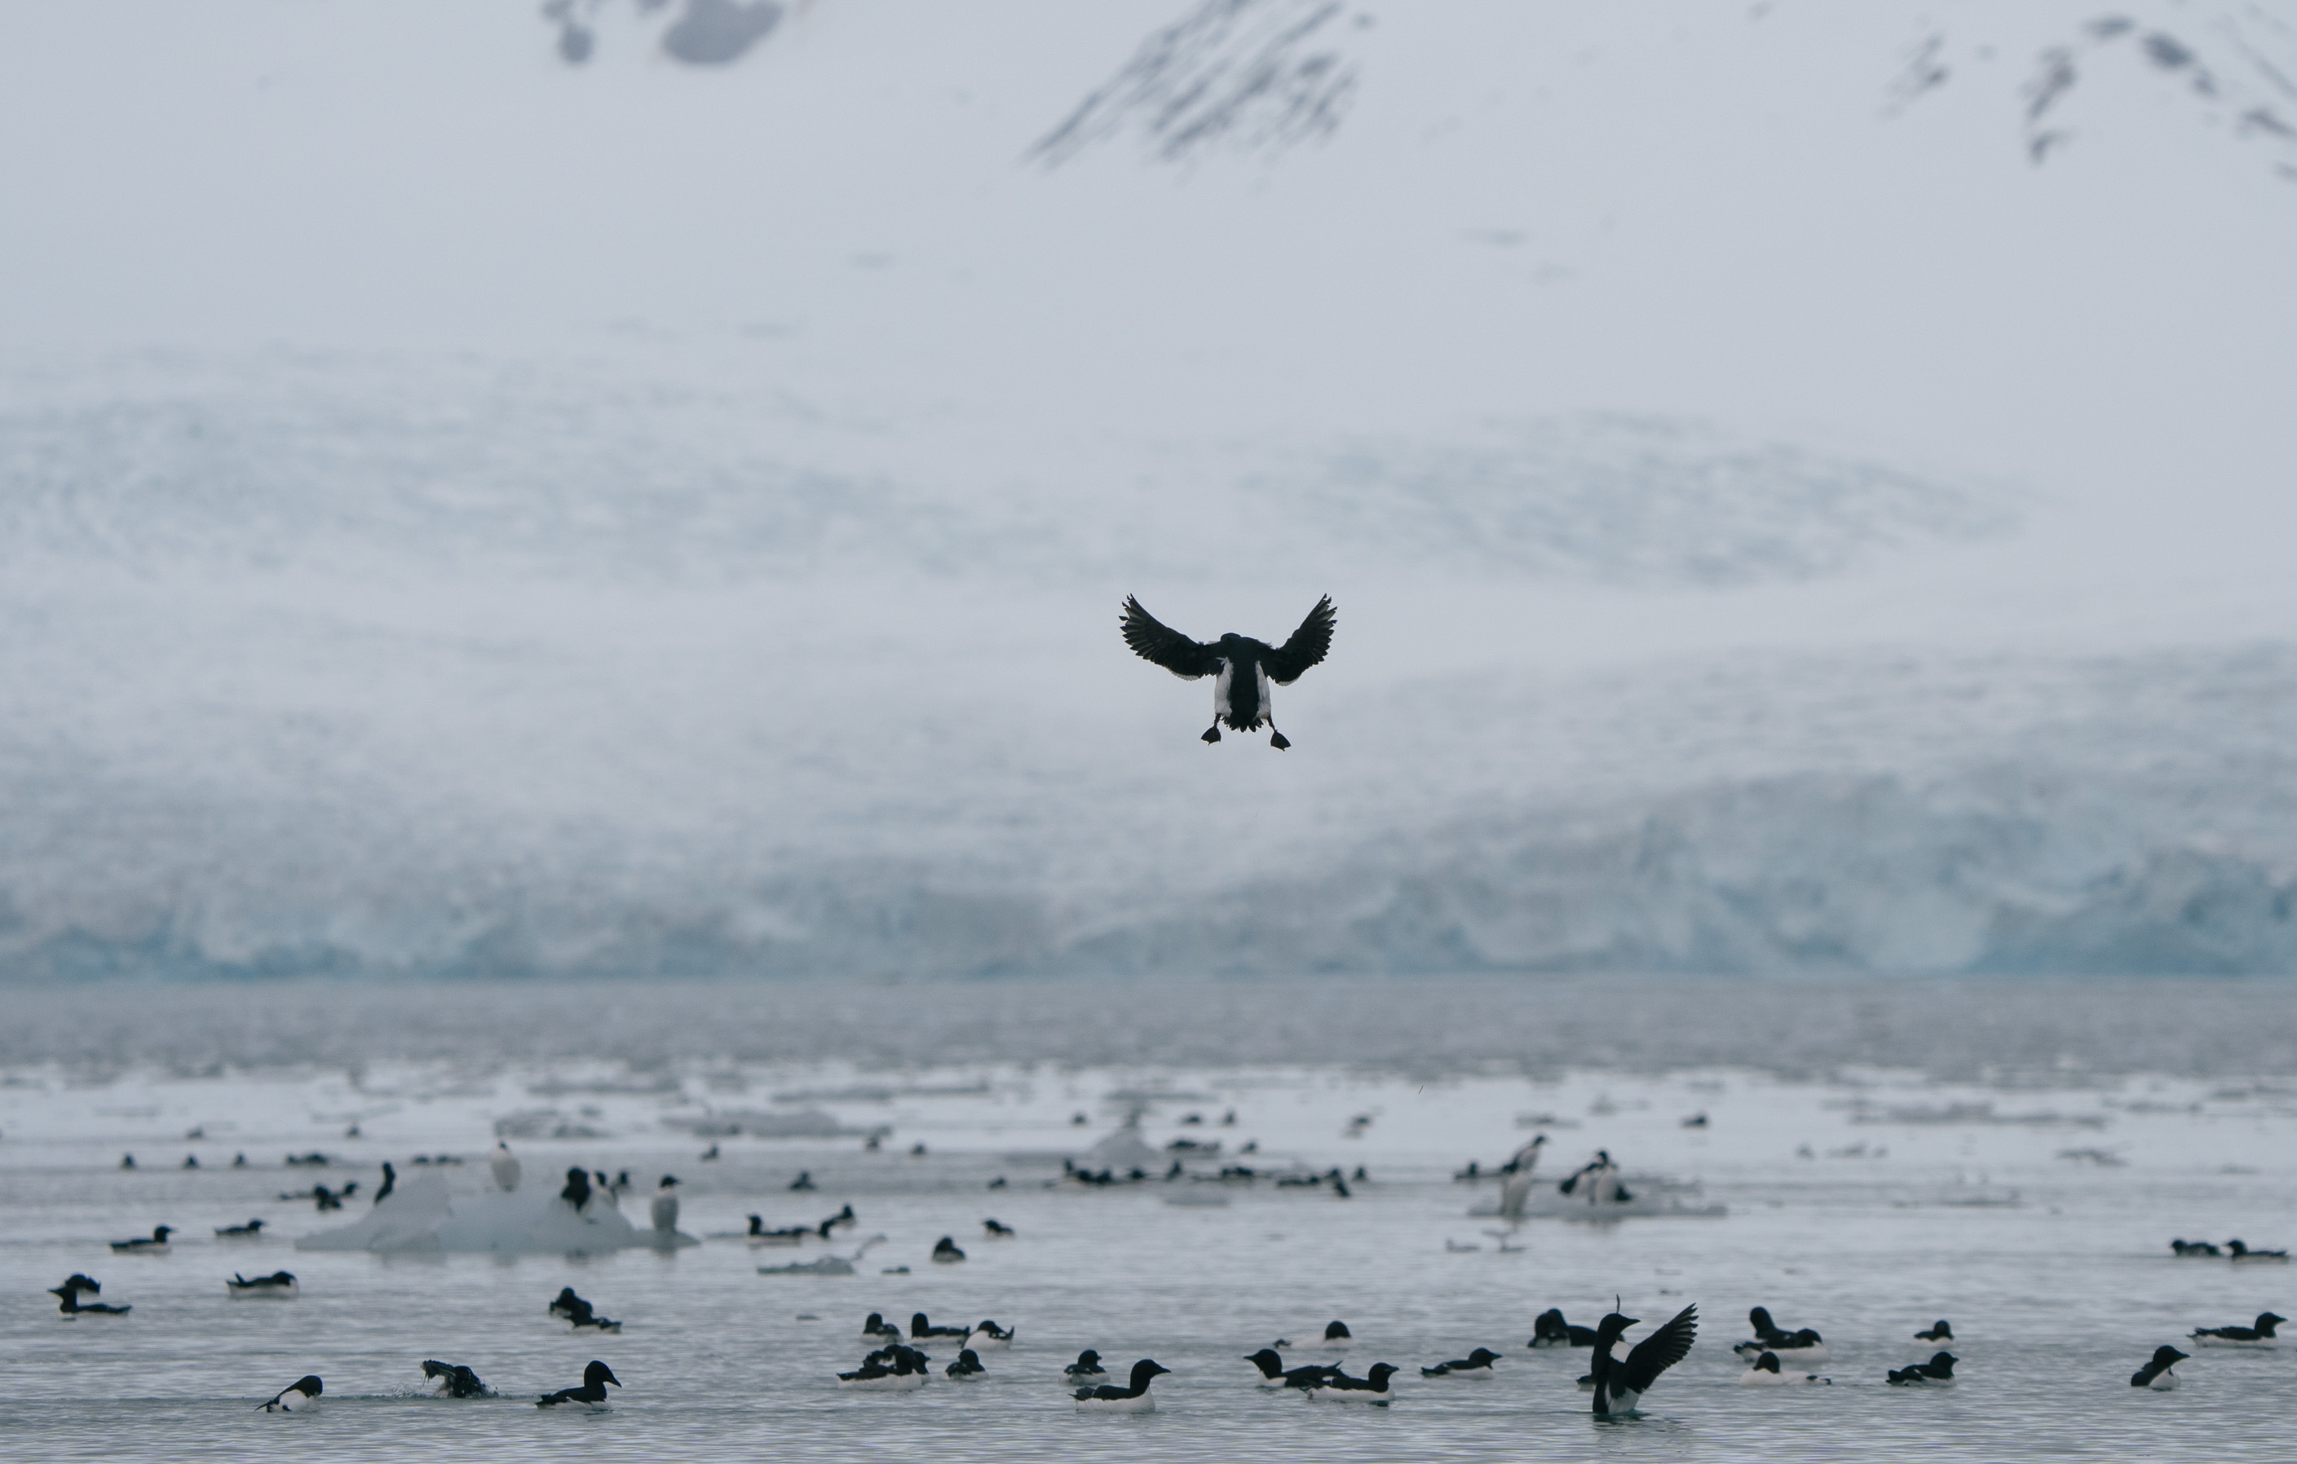
Wildlife
List - Birds
Notes:
Use the following pages to highlight some of the key bird species identified – and/or use the final page of the bird section to highlight the complete bird list on the e-Bird trip report

Slide 16

Wildlife List – Seabirds
SCIENTIFIC NAME | ENGLISH | DEUTSCH | FRANÇAIS
Fulmarus glacialis | Northern Fulmar | Eissturmvogel | Fulmar boréal
Stercorarius parasiticus | Arctic Skua (Parasitic Jaeger) | Schmarotzerraubmöwe | Labbe parasite
Stercorarius longicaudus | Long-tailed Jaeger | Falkenraubmöwe | Labbe à longue queue
Stercorarius skua | Great Skua | Große Raubmöwe | Grand Labbe
Larus hyperboreus | Glaucous Gull | Eismöwe | Goéland Bourgmestre
Pagophila eburnea | Ivory Gull | Elfenbeinmöwe | Mouette blanche
Xema sabini | Sabine's Gull | Schwalbenmöwe | Mouette de Sabine
Sterna paradisaea | Arctic Tern | Küstenseeschwalbe | Sterne Arctique
Rissa tridactyla | Black-legged Kittiwake | Dreizehenmöwe | Mouette tridactyle
Alle alle | Little Auk | Krabbentaucher | Mergule nain
Fratercula arctica | Atlantic Puffin | Papageitaucher | Macareux moine
Cepphus grylle | Black Guillemot | Gryllteiste | Guillemot à miroir
Uria lomvia | Brünnich's Guillemot (Thick-billed Murre) | Dickschnabellumme | Guillemot de Brünnich
Notes:
Copy and paste water birds observed – make sure scientific name is in italics

Slide 17
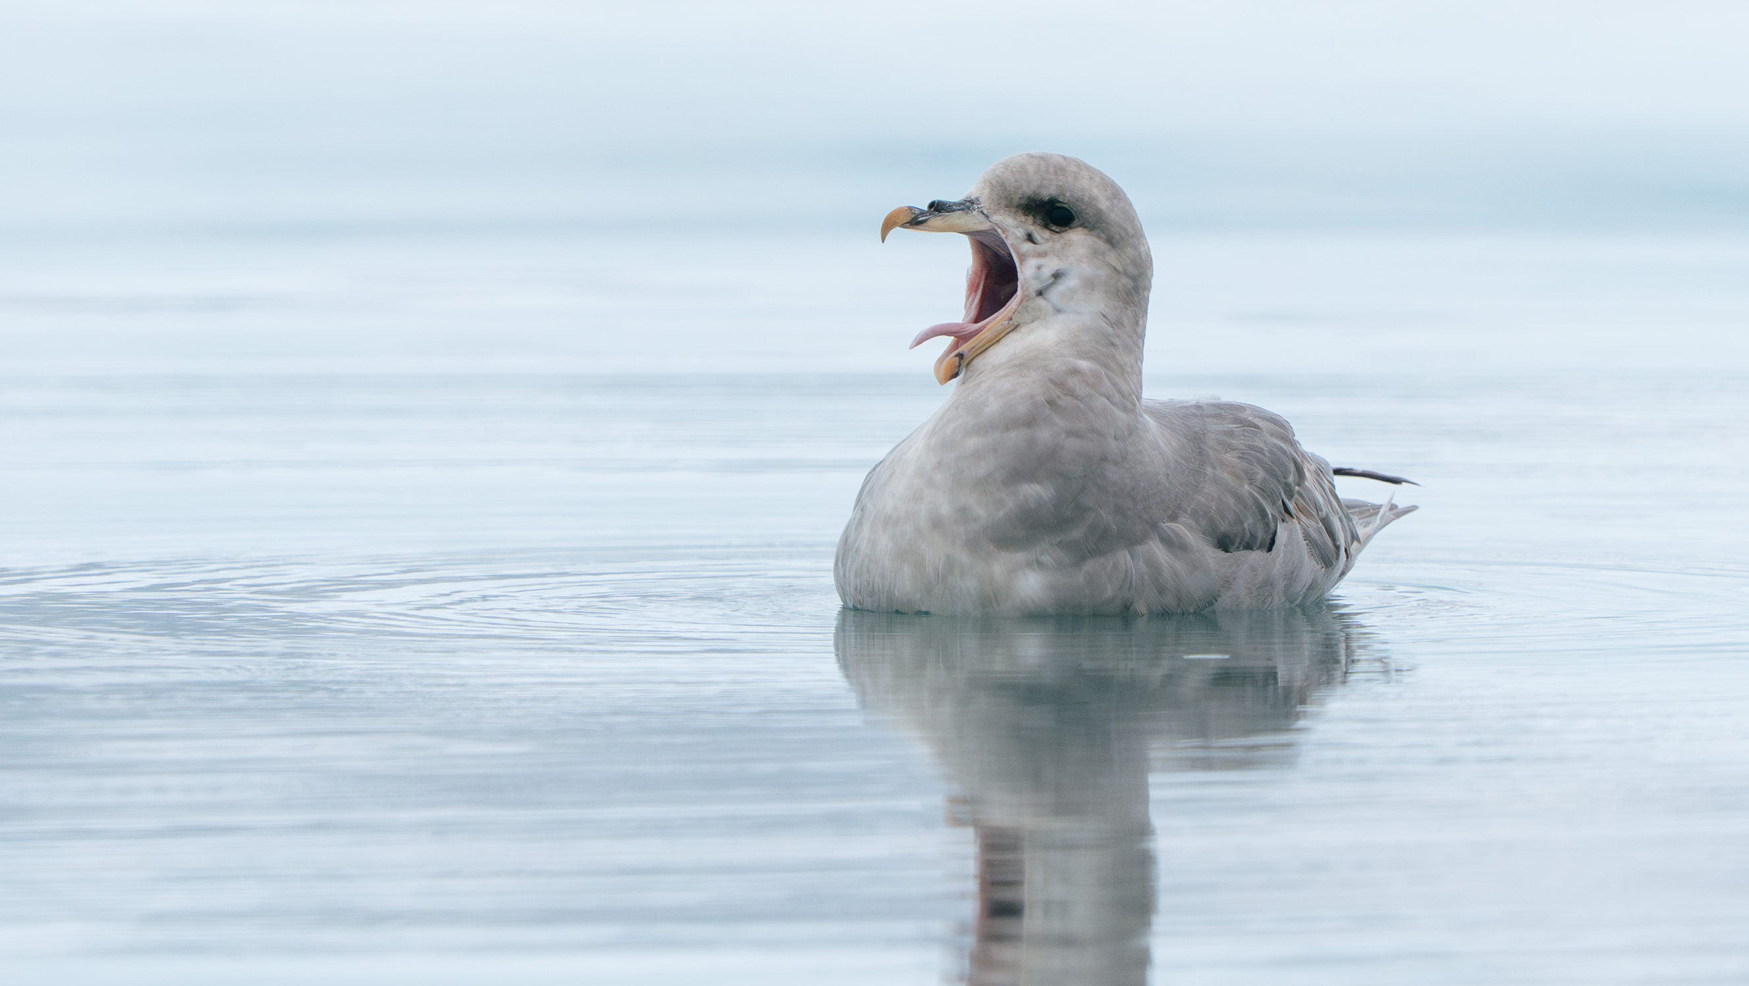
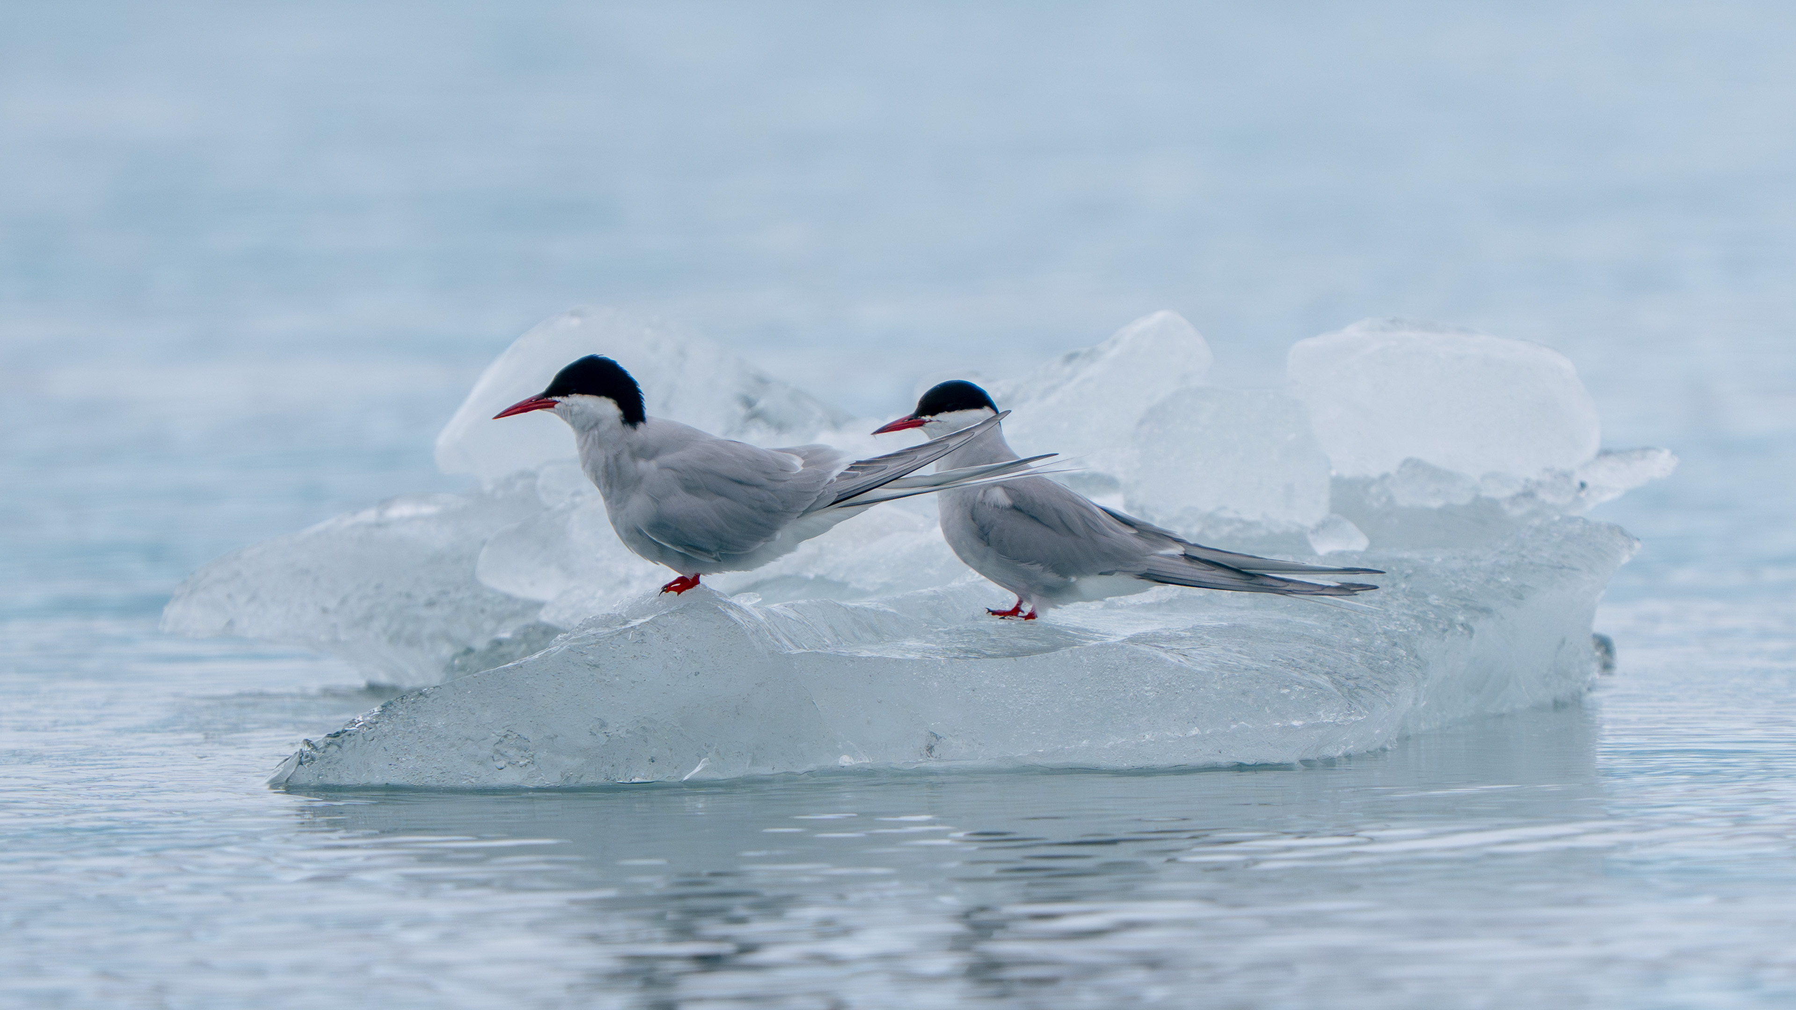
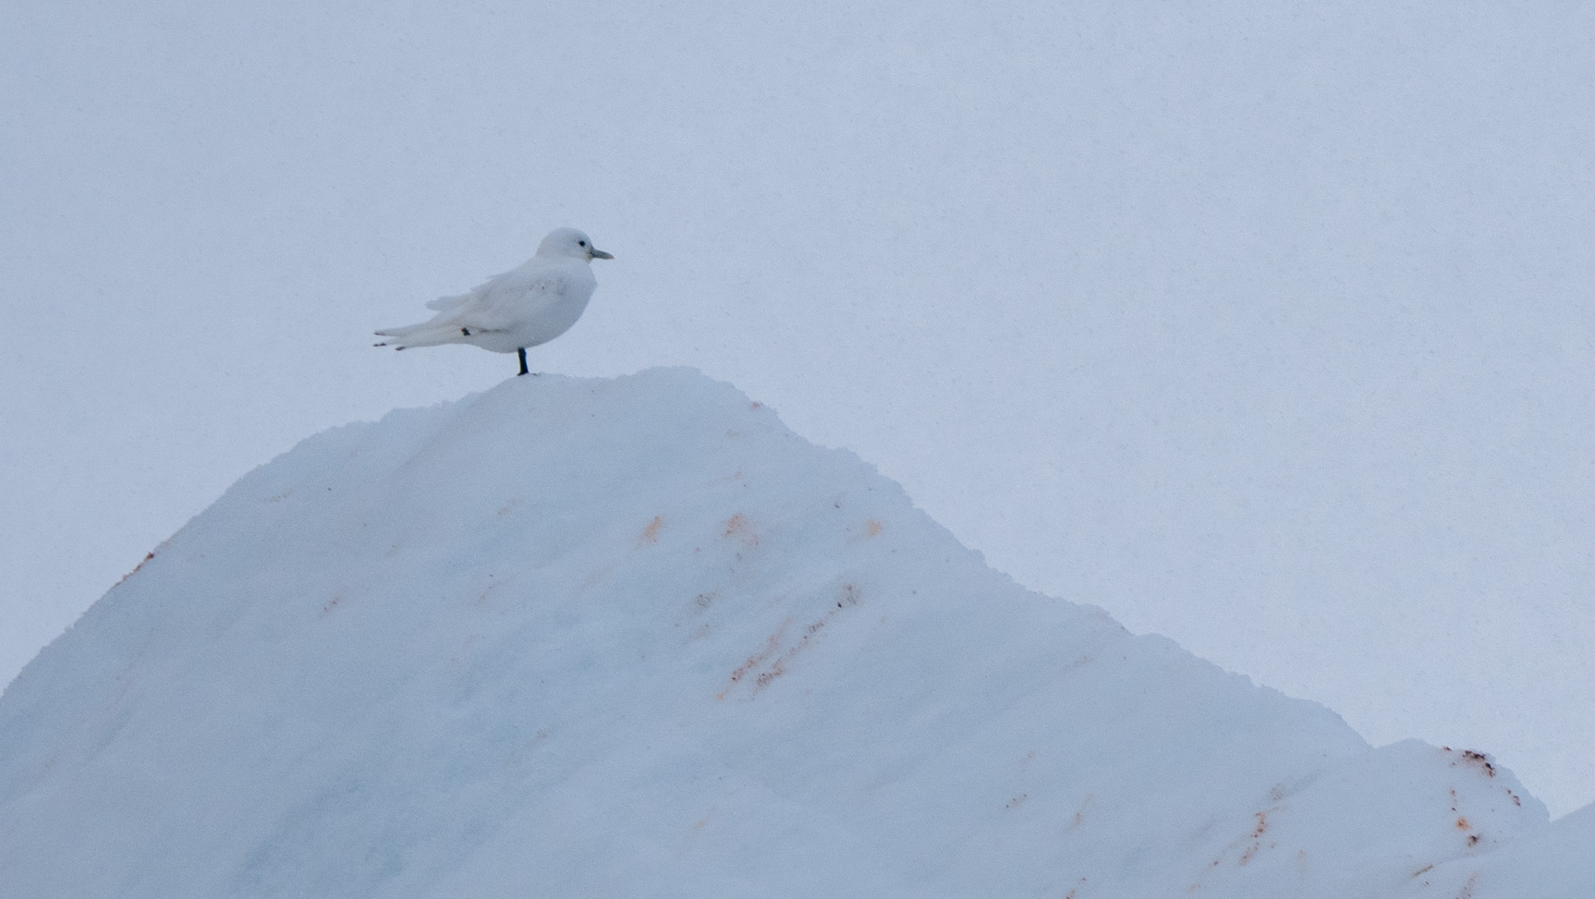
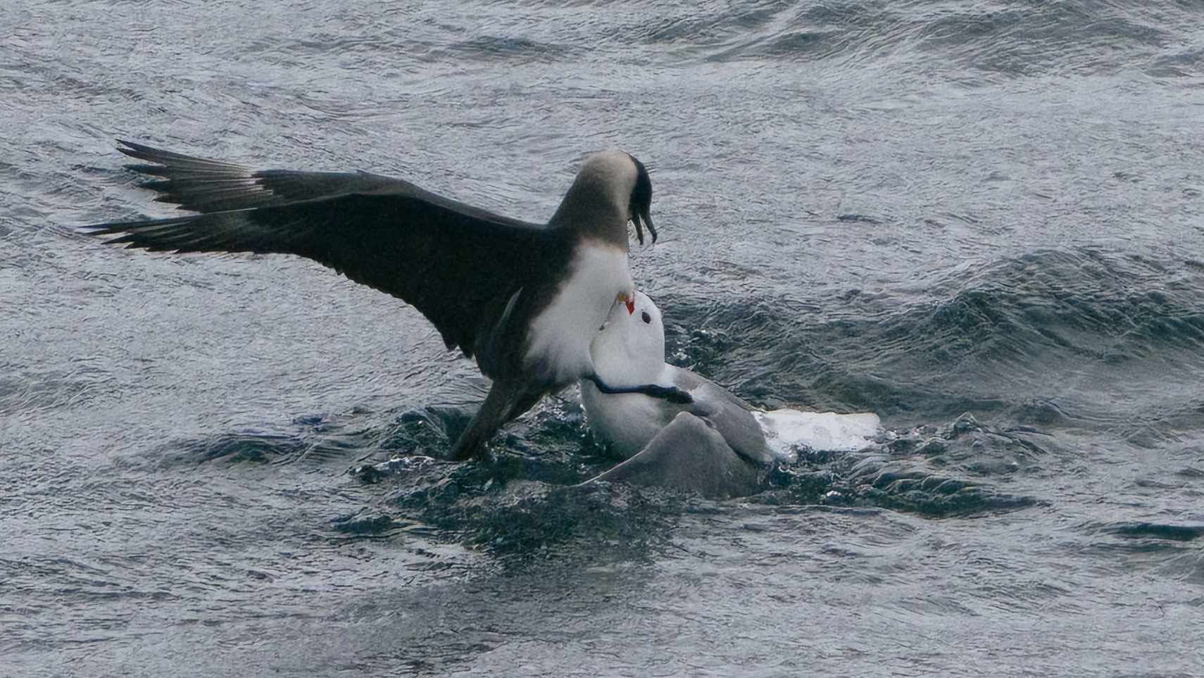

Slide 18
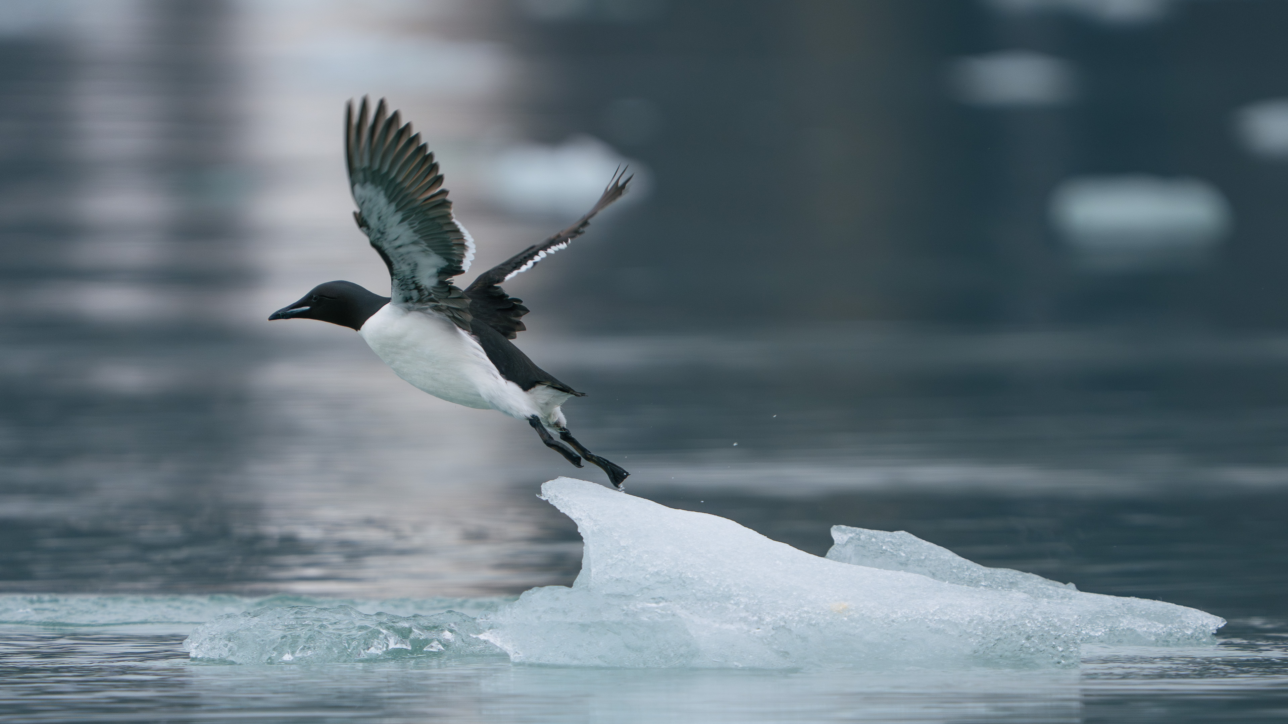
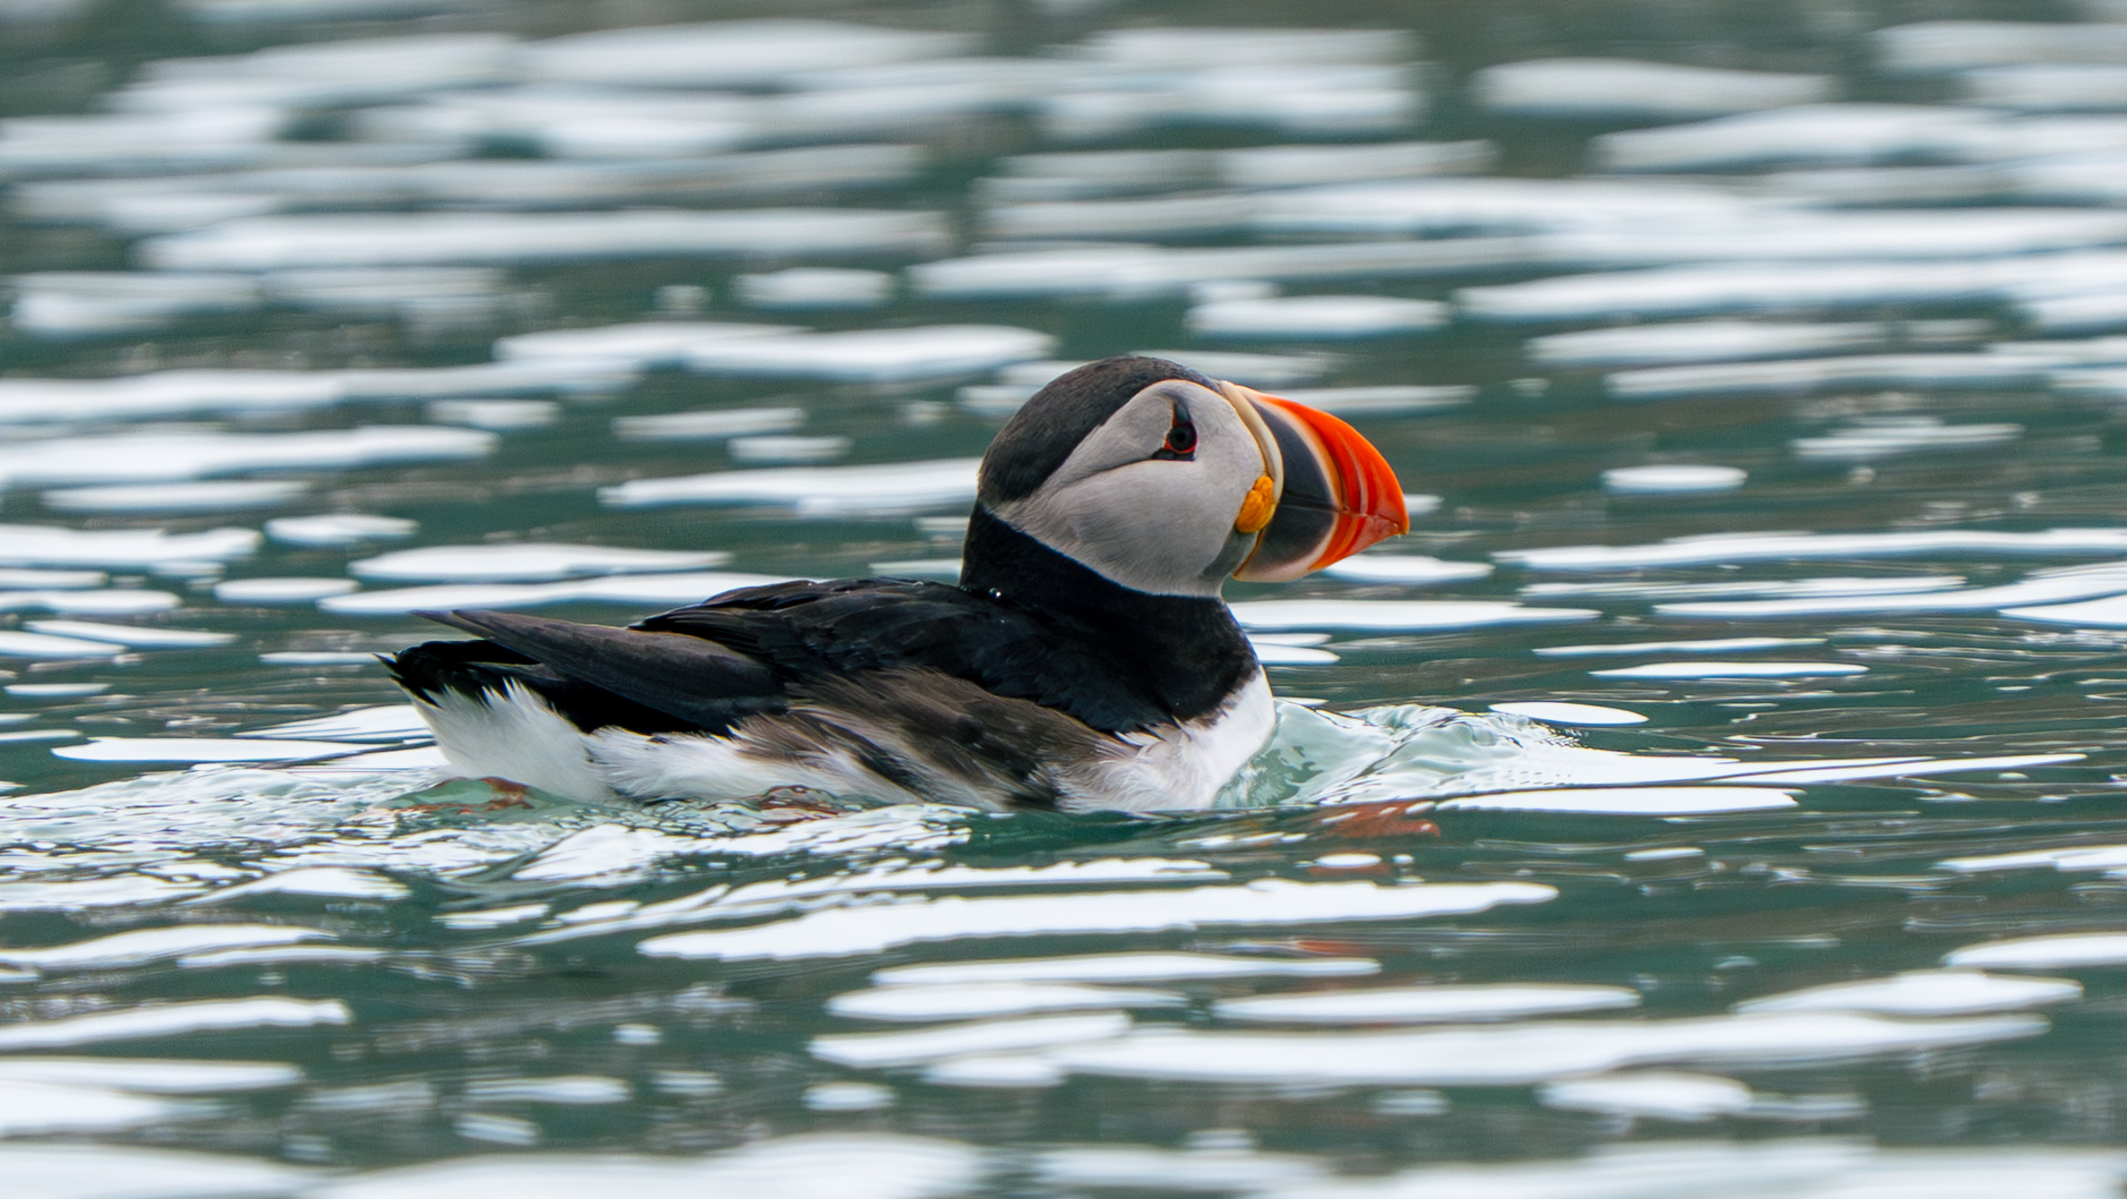
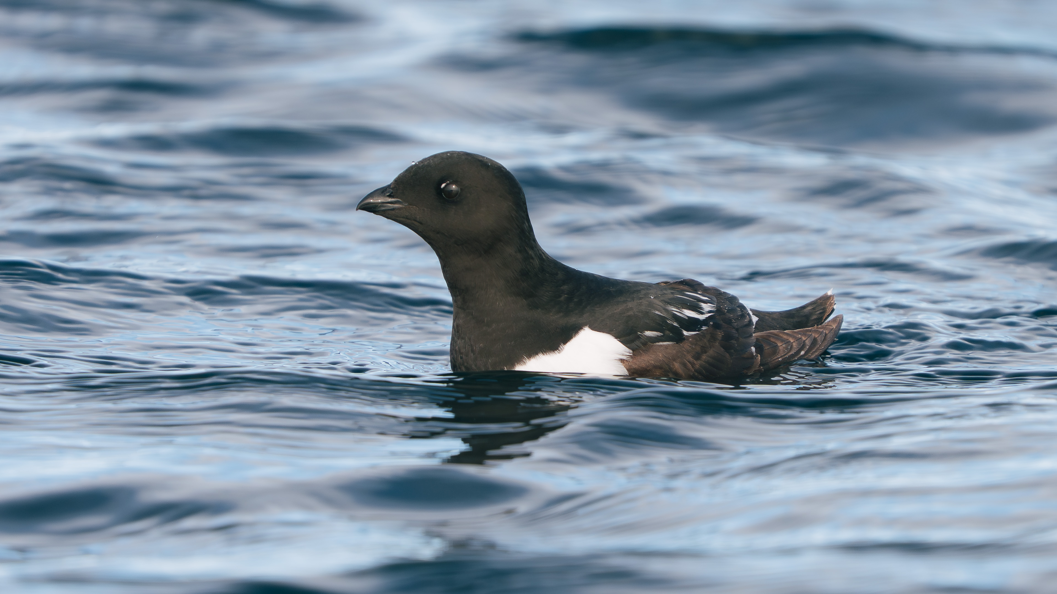
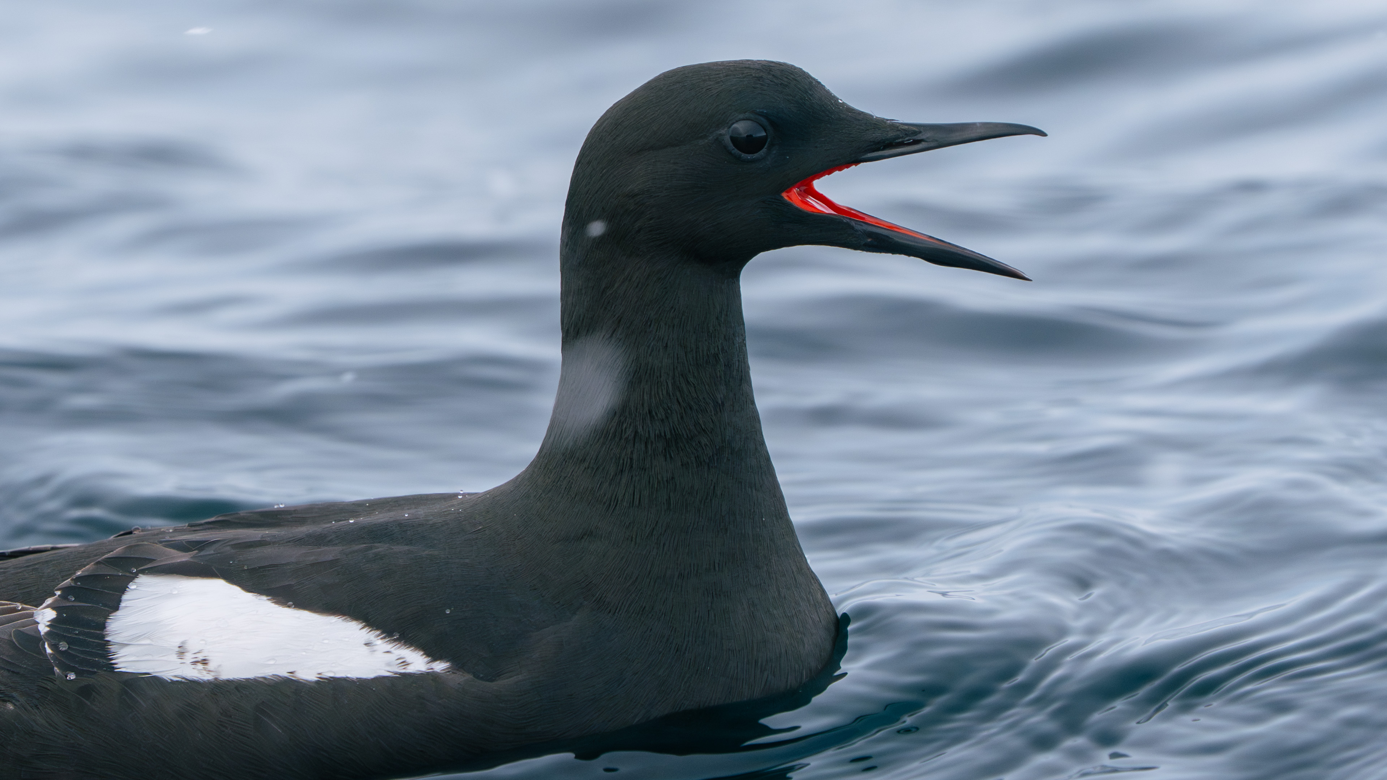

Slide 19
Wildlife List – Shorebirds
SCIENTIFIC NAME | ENGLISH | DEUTSCH | FRANÇAIS
Charadrius hiaticula | Common Ringed Plover | Sandregenpfeifer | Pluvier grand-gravelot
Calidris maritima | Purple Sandpiper | Meerstrandläufer | Bécasseau violet
Calidris canutus | Red Knot | Knutt | Polarsnipe
Calidris alba | Sanderling | Sanderling | Bécasseau sanderling
Phalaropus fulicarius | Red Phalarope (Grey Phalarope) | Thorshühnchen | Phalarope à bec large
Notes:
Copy and paste water birds observed – make sure scientific name is in italics

Slide 20
Wildlife List - Waterbirds
SCIENTIFIC NAME | ENGLISH | DEUTSCH | FRANÇAIS
Anser brachyrhynchus | Pink-footed Goose | Kurzschnabelgans | Oie à bec court
Branta leucopsis | Barnacle Goose | Weißwangengans | Bernache nonnette
Branta bernicla | Brent Goose | Ringelgans | Bernache cravant
Anas crecca | Eurasian Teal | Krickente | Sarcelle d’hiver
Somateria mollissima | Common Eider | Eiderente | Eider à duvet
Somateria spectabilis | King Eider | Prachteiderente | Eider à tête grise
Clangula hyemalis | Long-tailed Duck | Eisente | Harelde kakawi
Gavia stellata | Red-throated Diver (Red-throated Loon) | Sterntaucher | Plongeon catmarin
Notes:
Copy and paste water birds observed – make sure scientific name is in italics

Slide 21
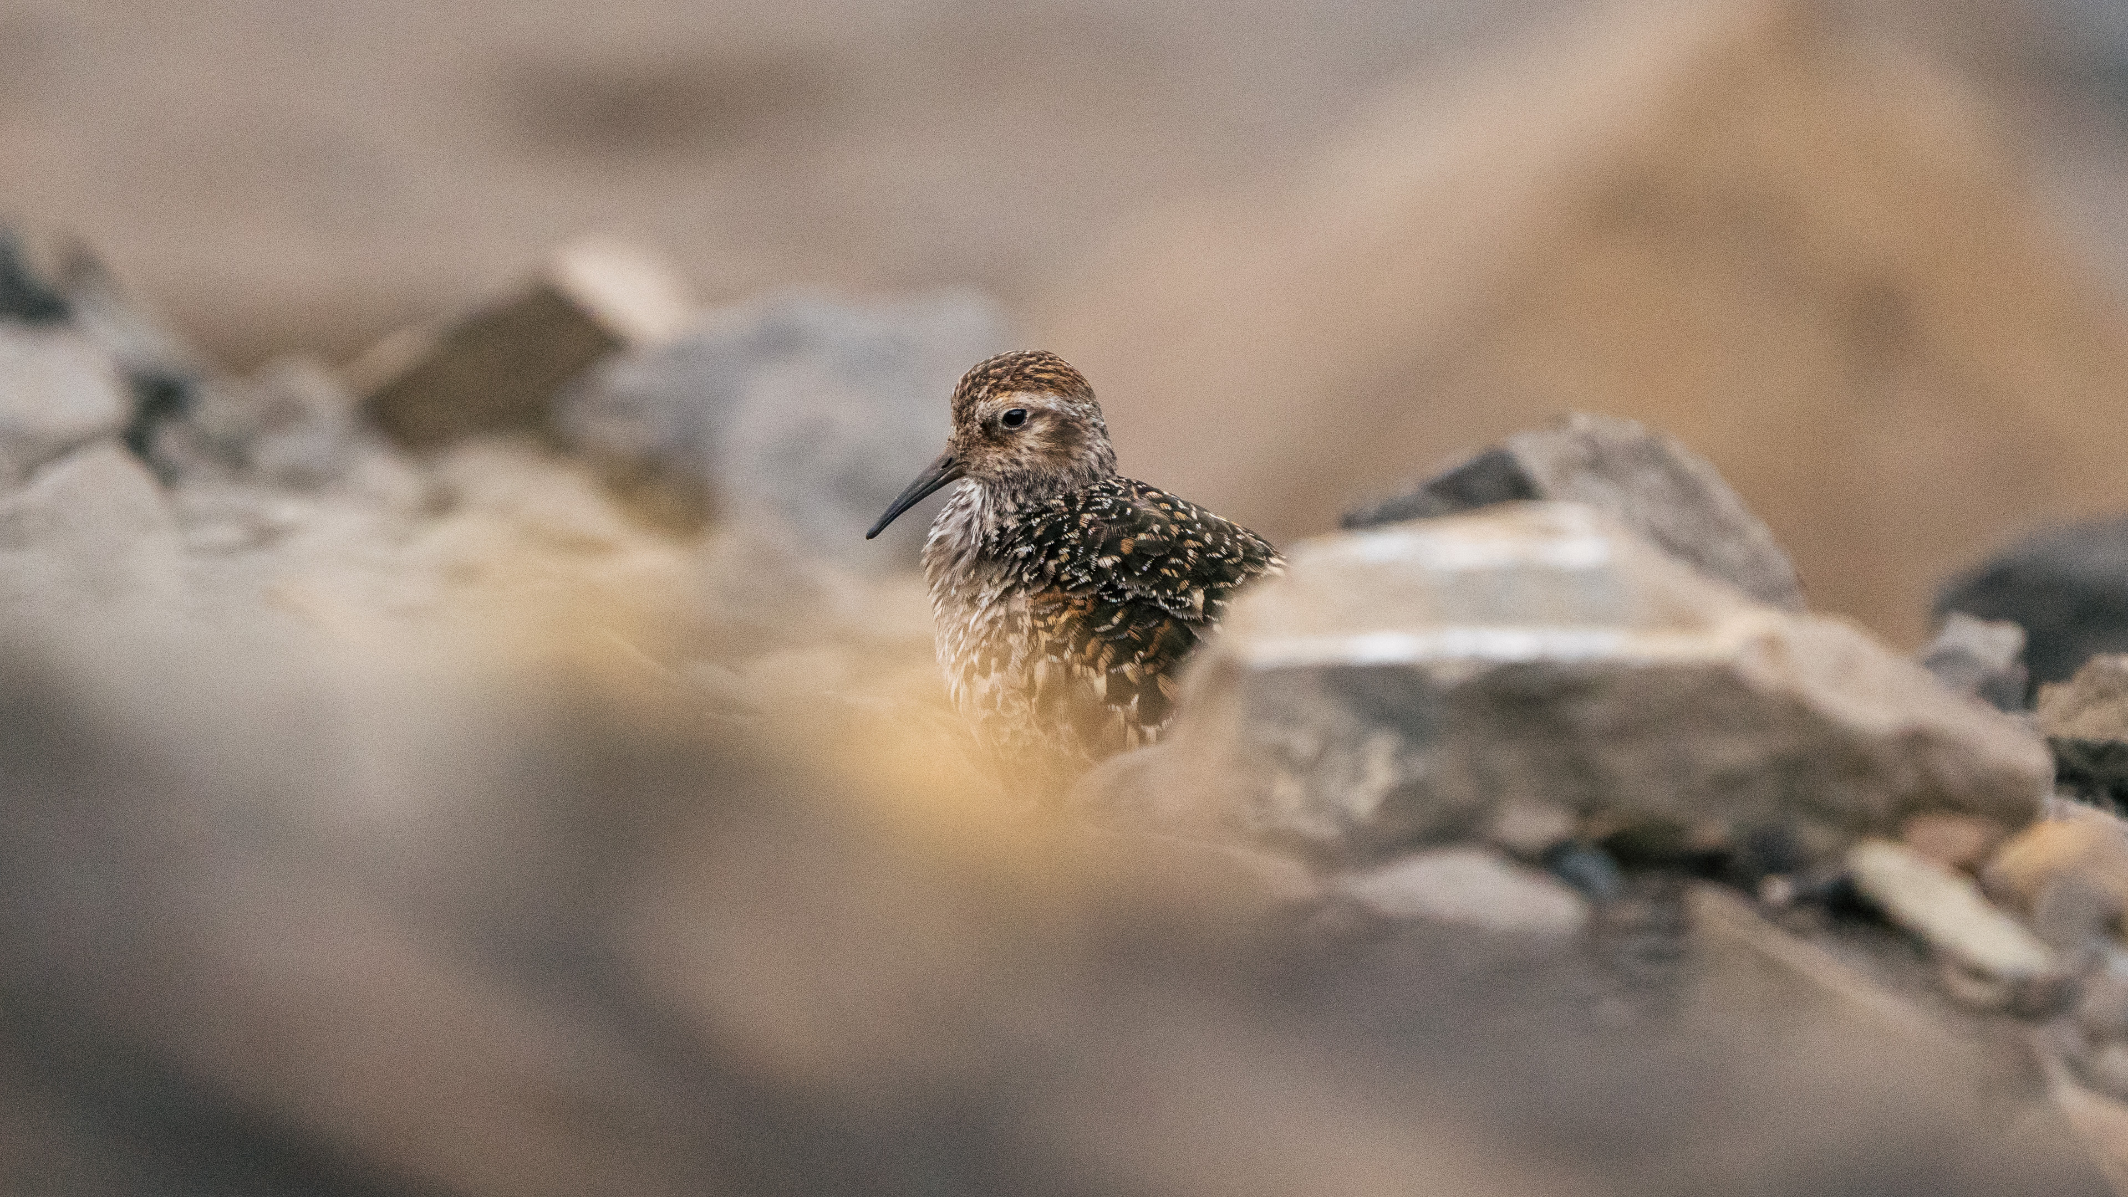
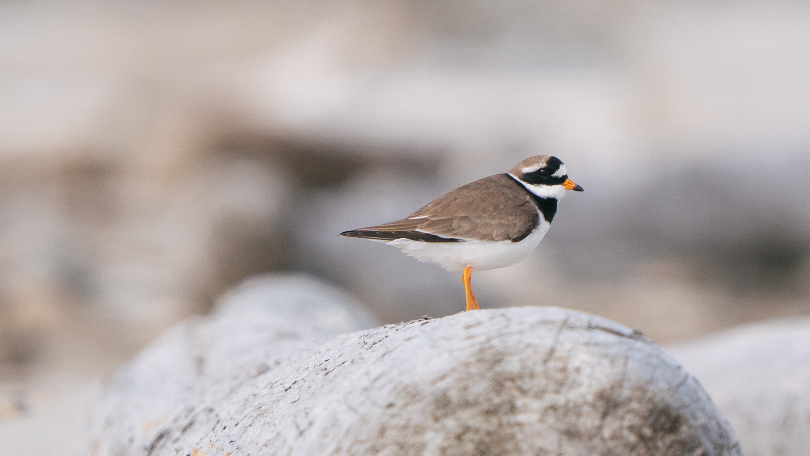
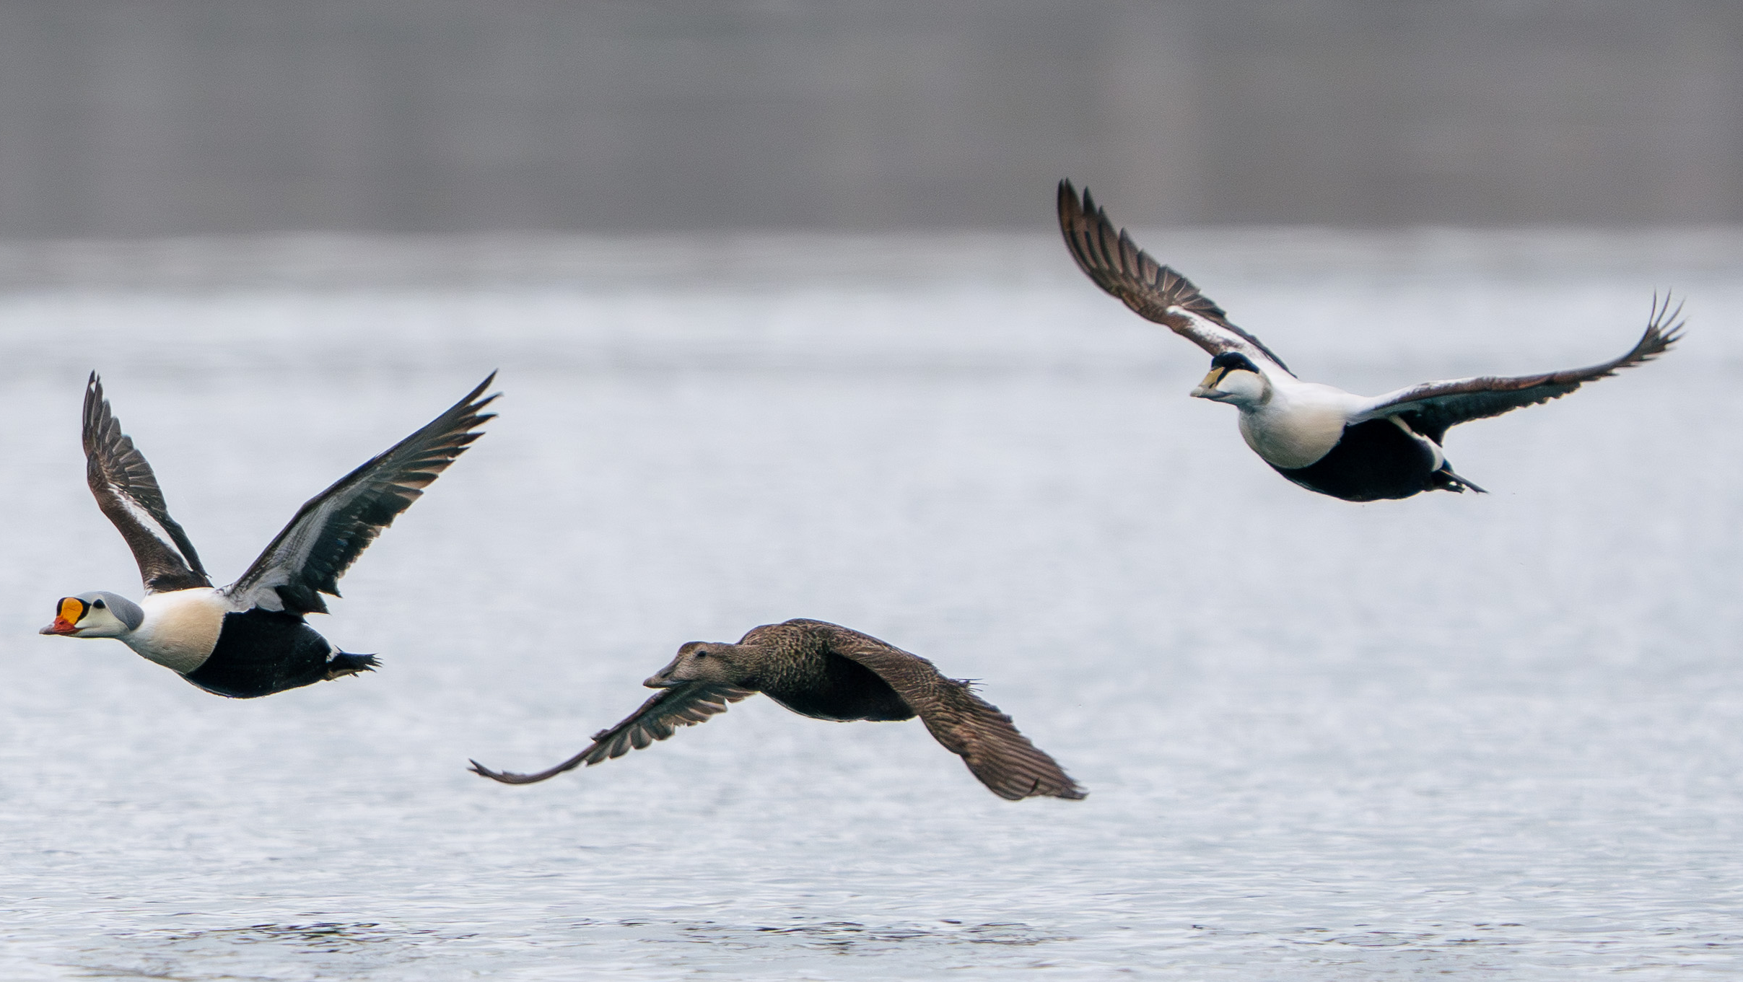
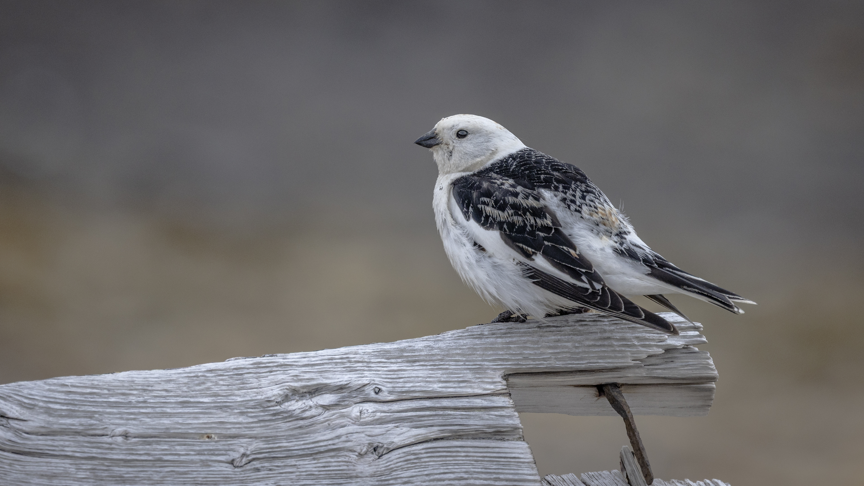

Slide 22
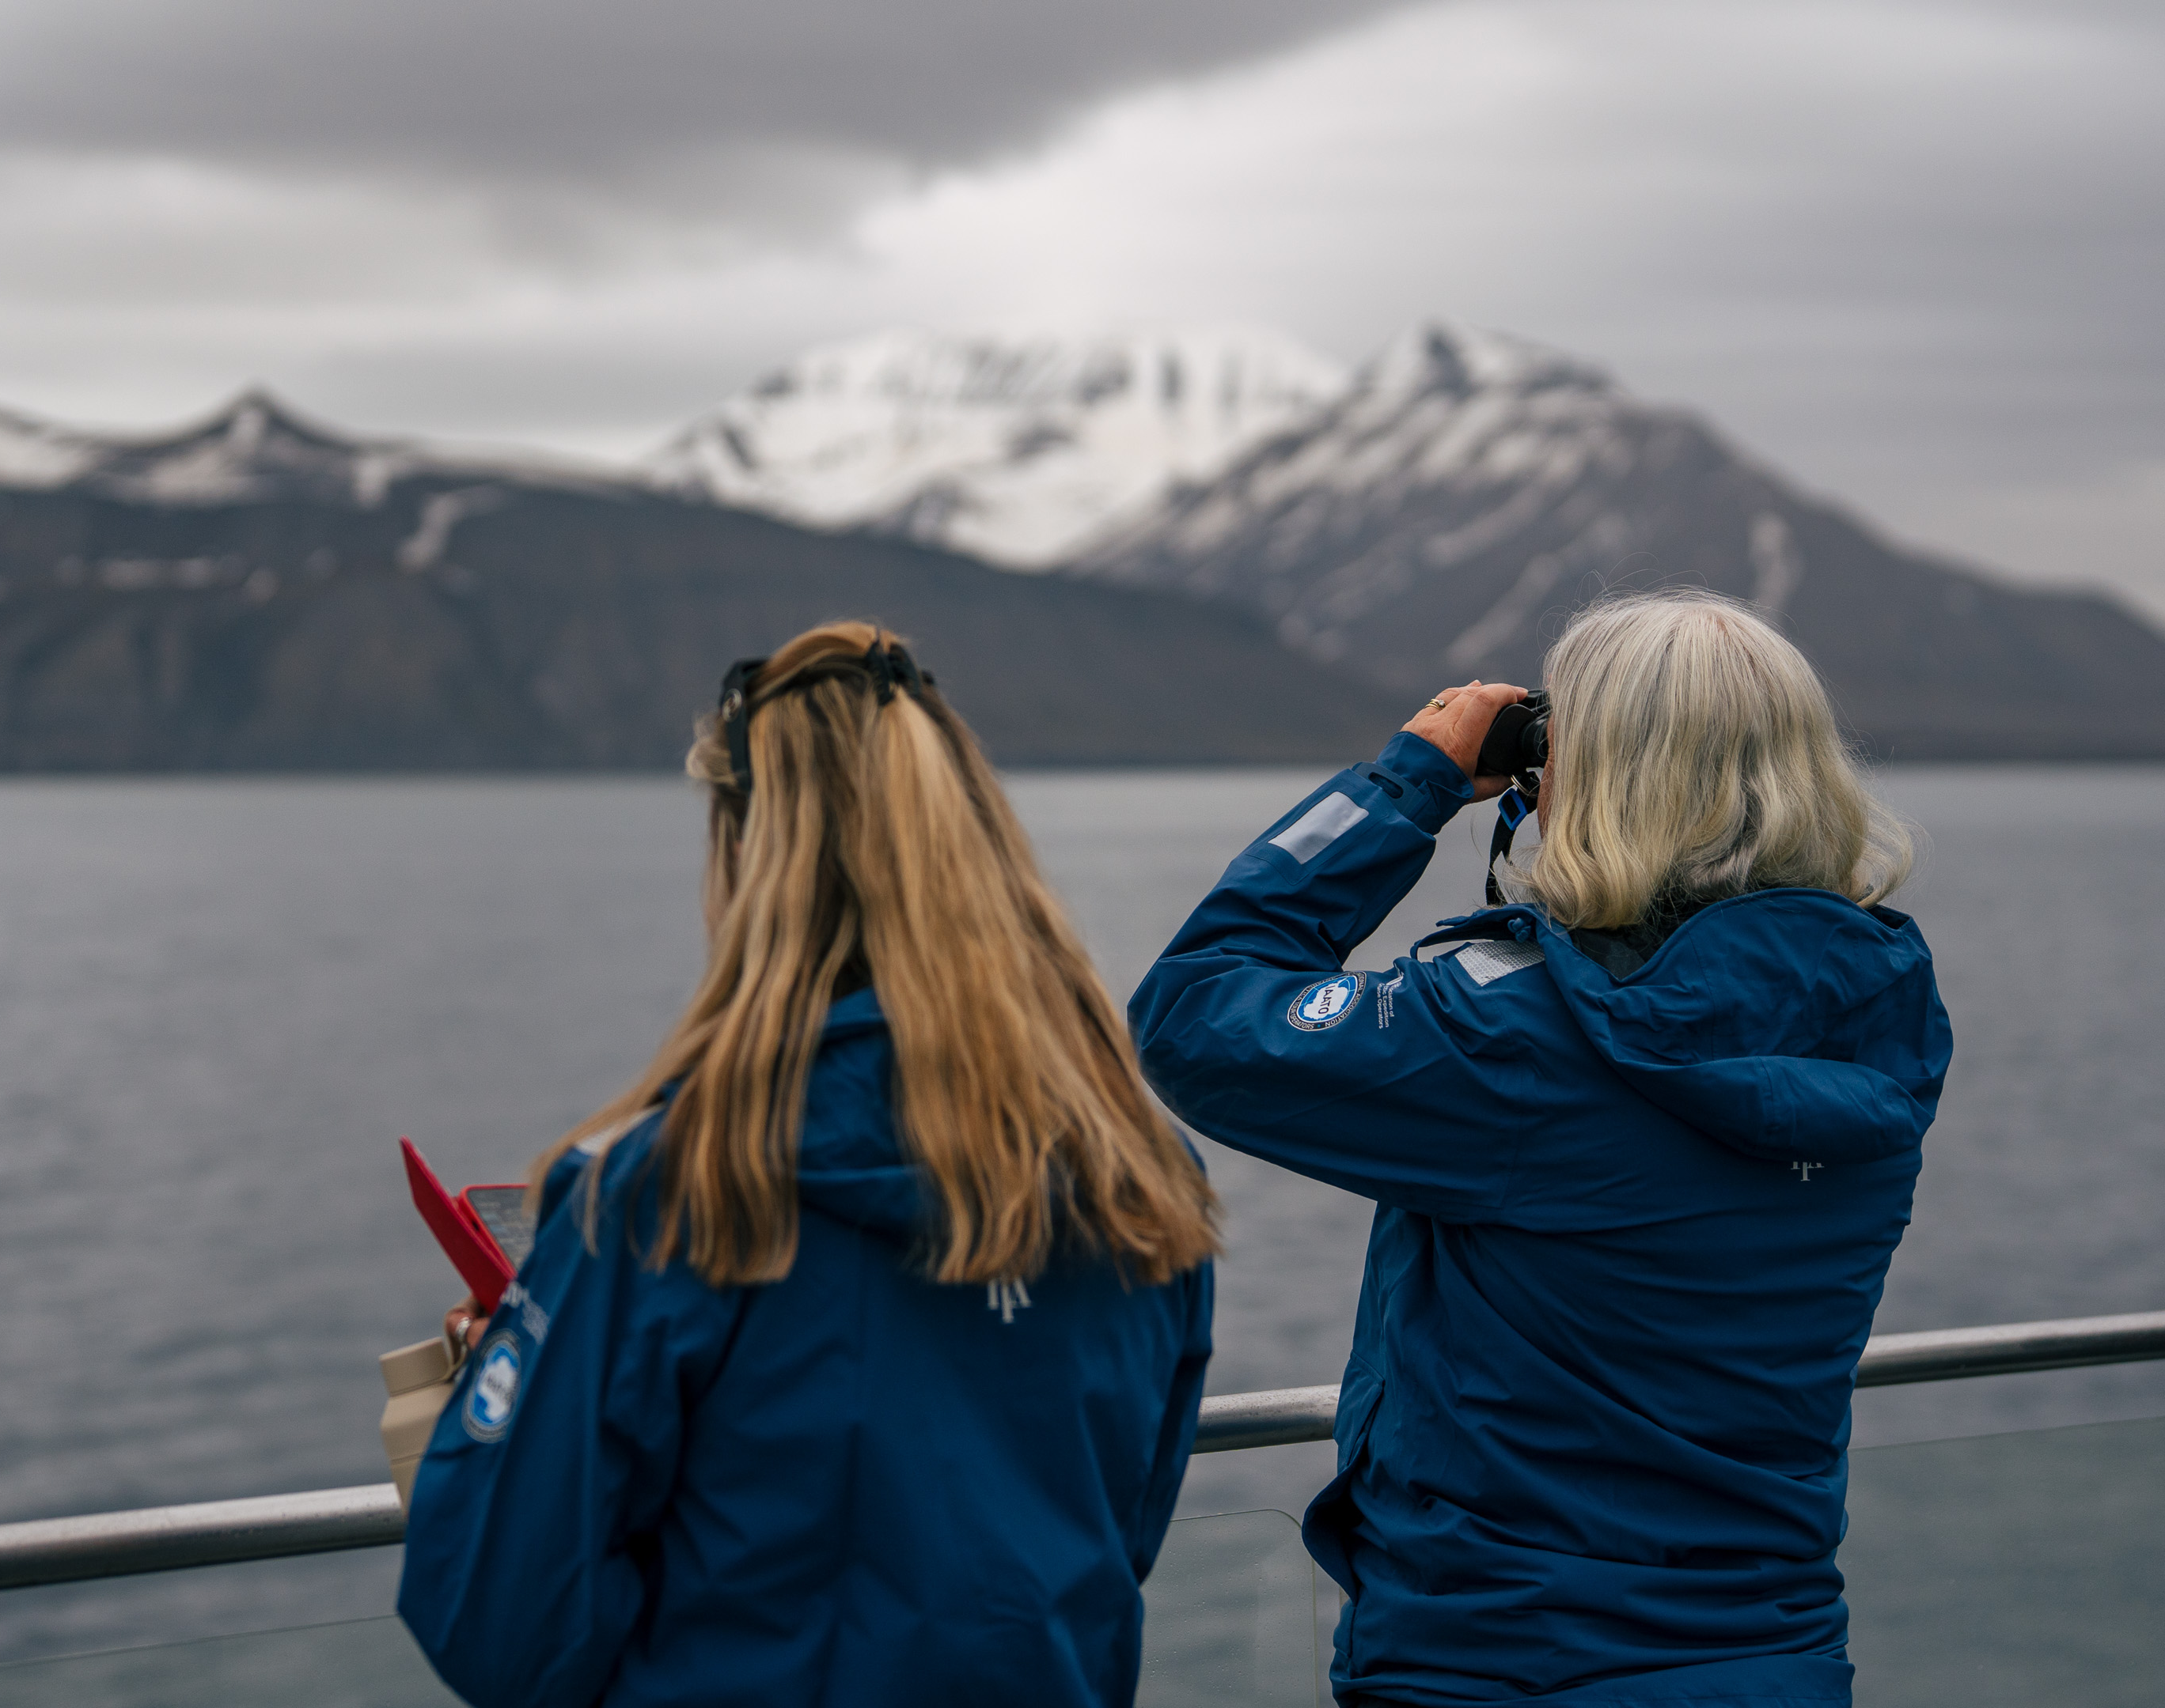
eBird
During our wildlife watches, our Ornithologist Julia and Expedition Leader Marcus carried out detailed seabird surveys, logging observations to the Citizen Science platform eBird. Across 16 checklists, we recorded 27 different bird species.
The data contributes directly to global bird conservation, deepening our shared understanding of seabird populations and the habitats they depend on.
View our data on our e-Bird trip report
Notes:
Give overview of the number of bird species found, number of observations etc. and add link to the e-Bird trip report

Slide 23
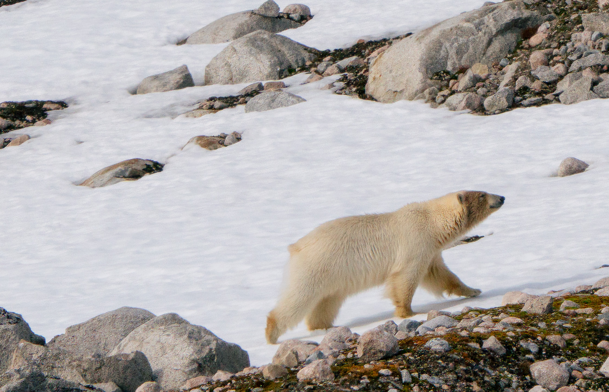
Wildlife
List - Mammals

Slide 24


Wildlife List – Marine Mammals
SCIENTIFIC NAME | ENGLISH | DEUTSCH | FRANÇAIS
Ursus maritimus | Polar Bear | Eisbär | Ours polaire
Balaenoptera acutorostrata | Common Minke whale | Zwergwal | Rorqual à museau pontu
Balaenoptera physalus | Fin whale | Finnwal | Rorqual commun
Phoca vitulina | Harbour seal, Common seal | Seehund | Phoque commún
Erignathus barbatus | Bearded Seal | Artrobbe | Phoque Barbu
Odobenus rosmarus | Walrus | Walross | Morse
Wildlife List – Land mammals
SCIENTIFIC NAME | ENGLISH | DEUTSCH | FRANÇAIS
Rangifer tarandus platyrhynchus | Svalbard Reindeer | Rentier | Renne du Spitzberg
Notes:
Copy and paste marine mammals observed – make sure scientific name is in italics

Slide 25
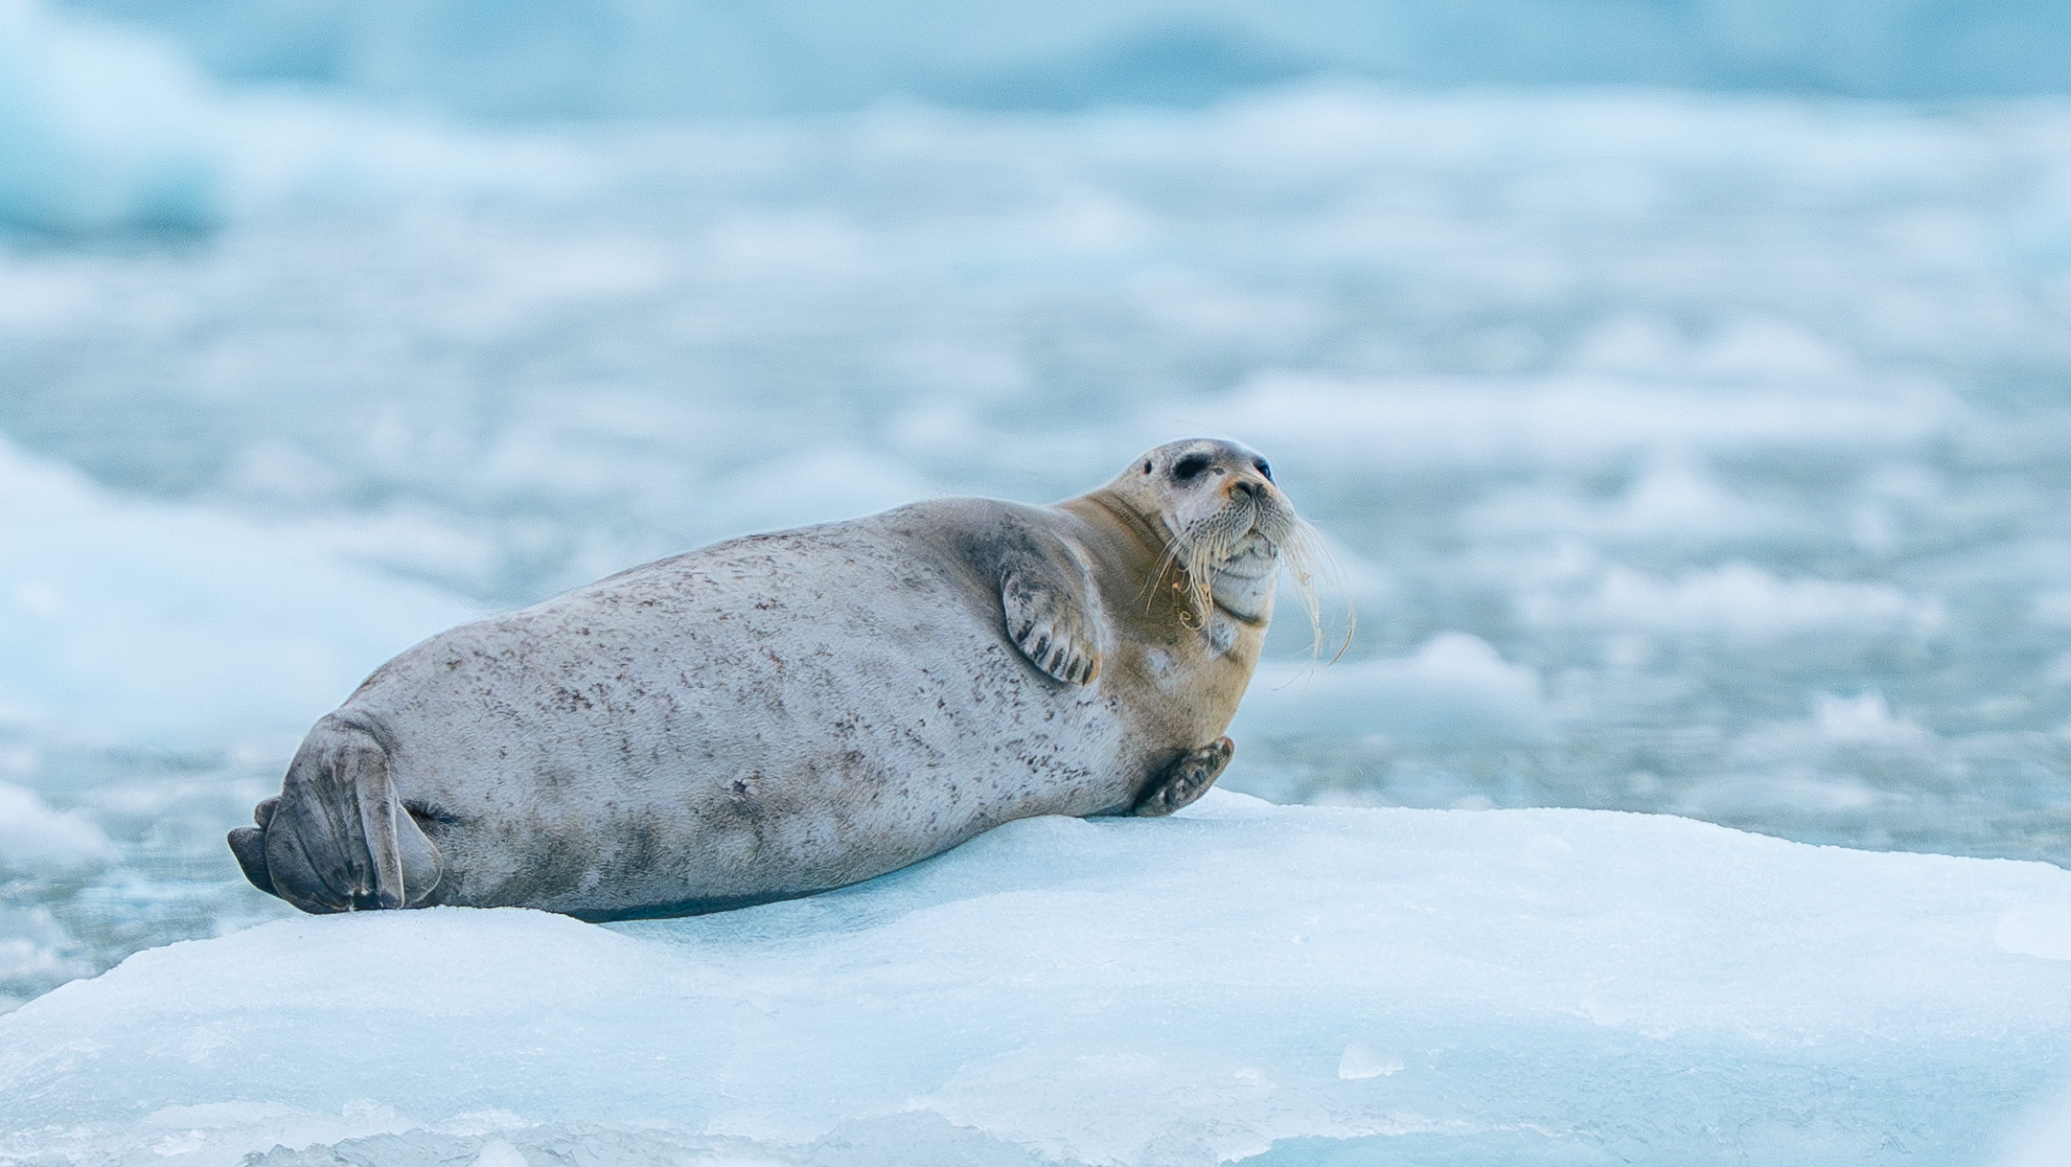
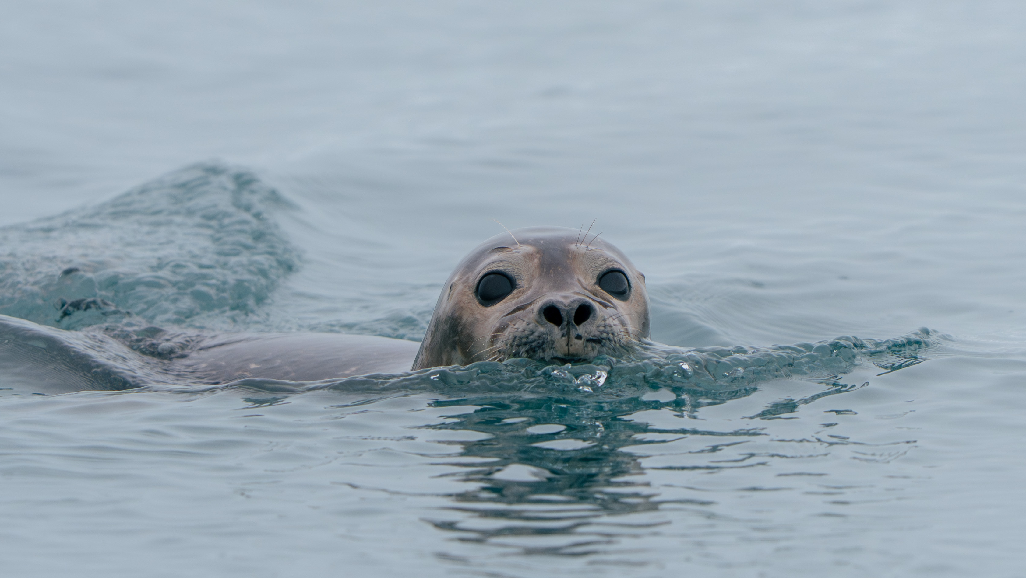
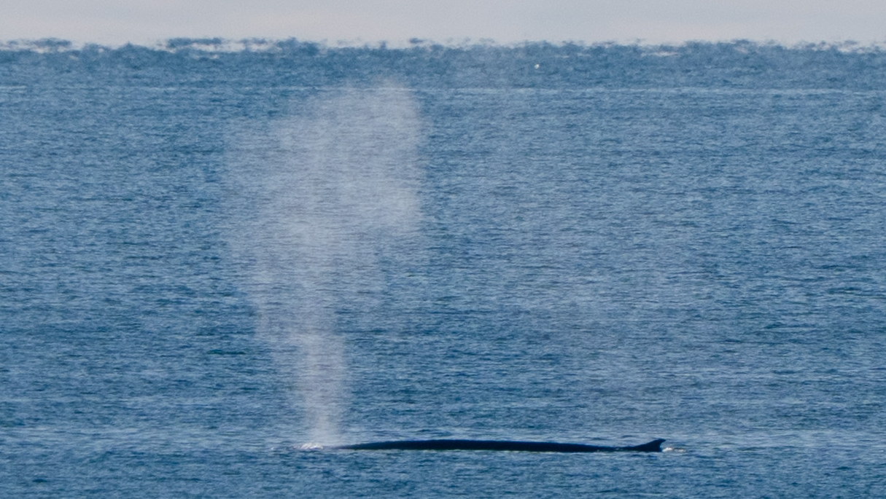
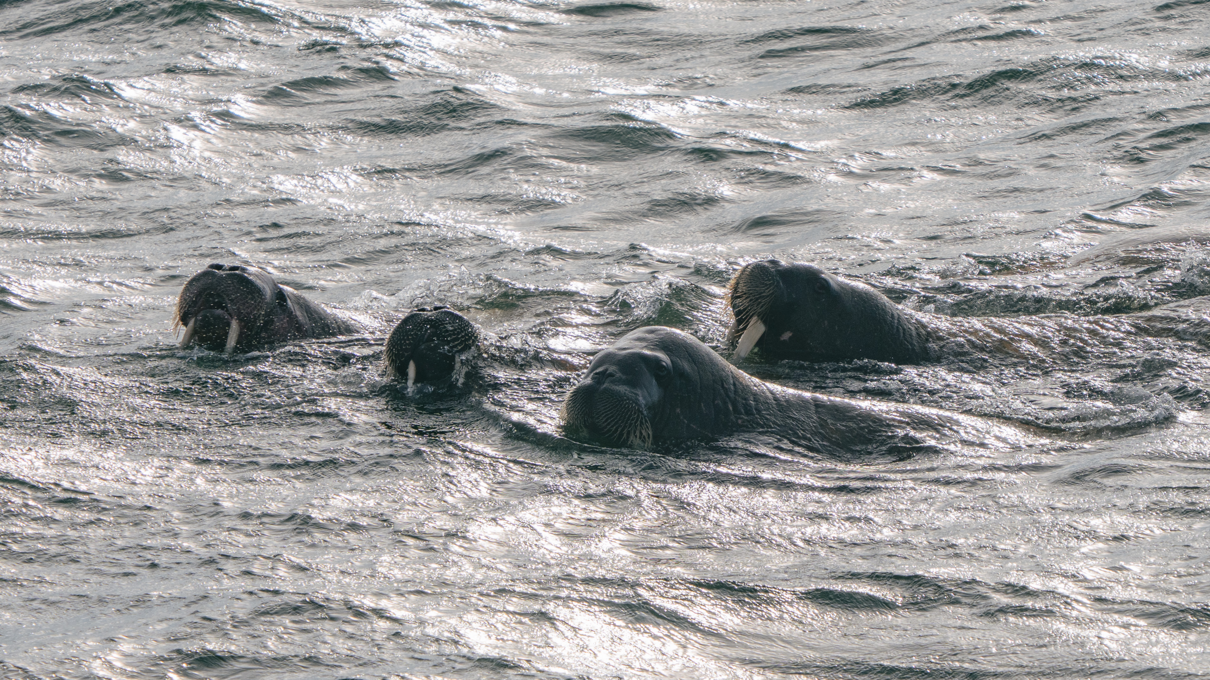

Slide 26
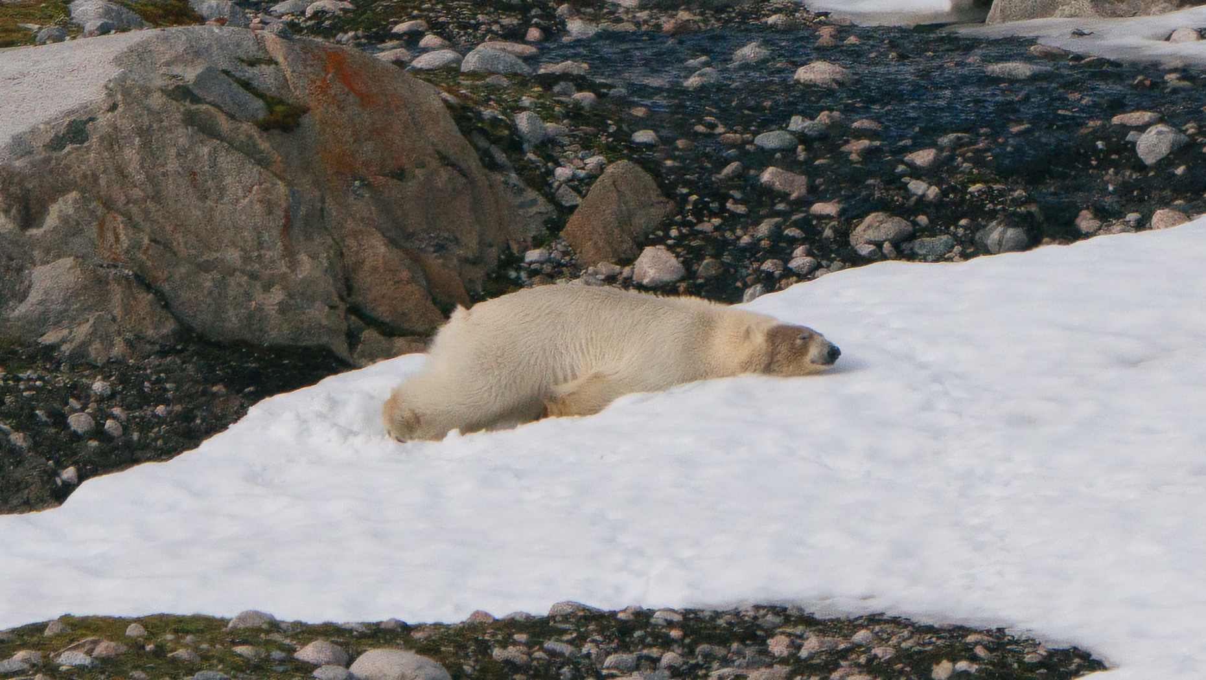
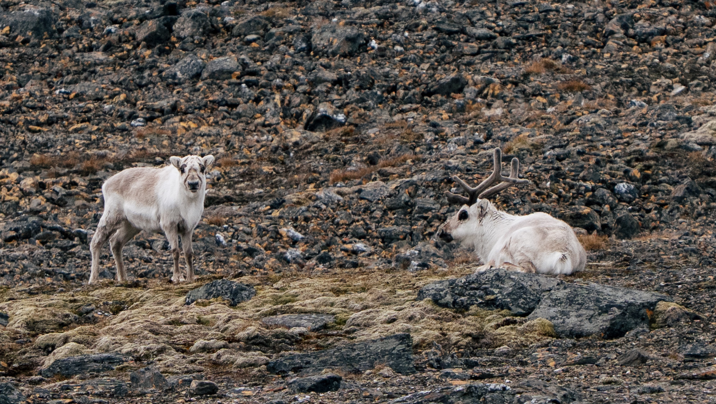
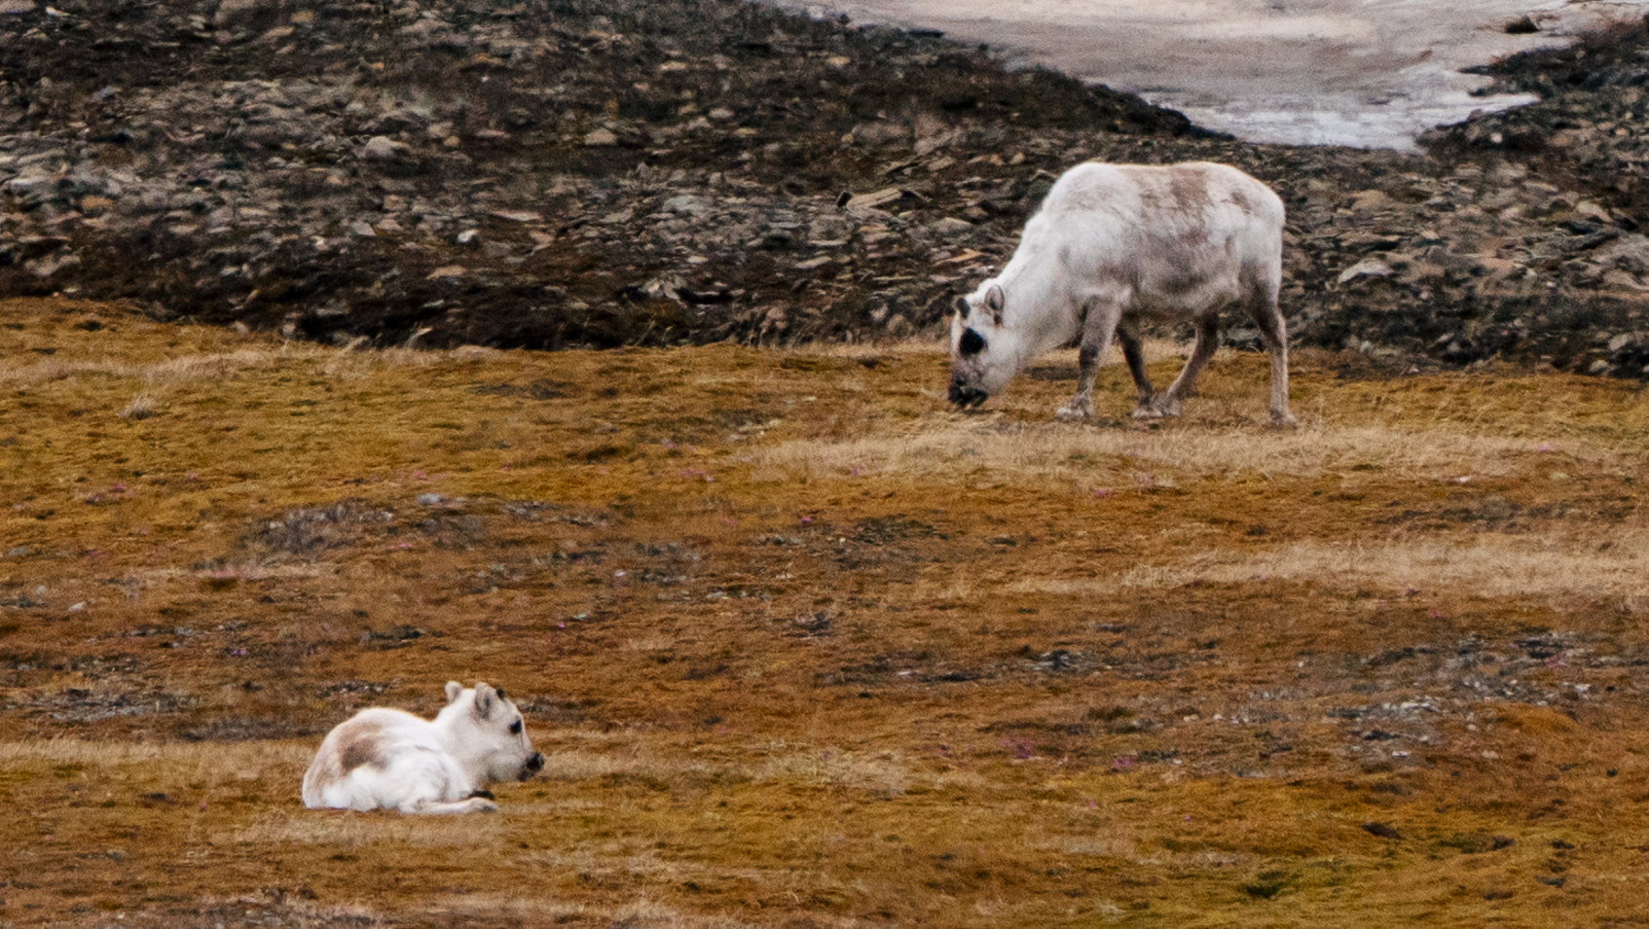
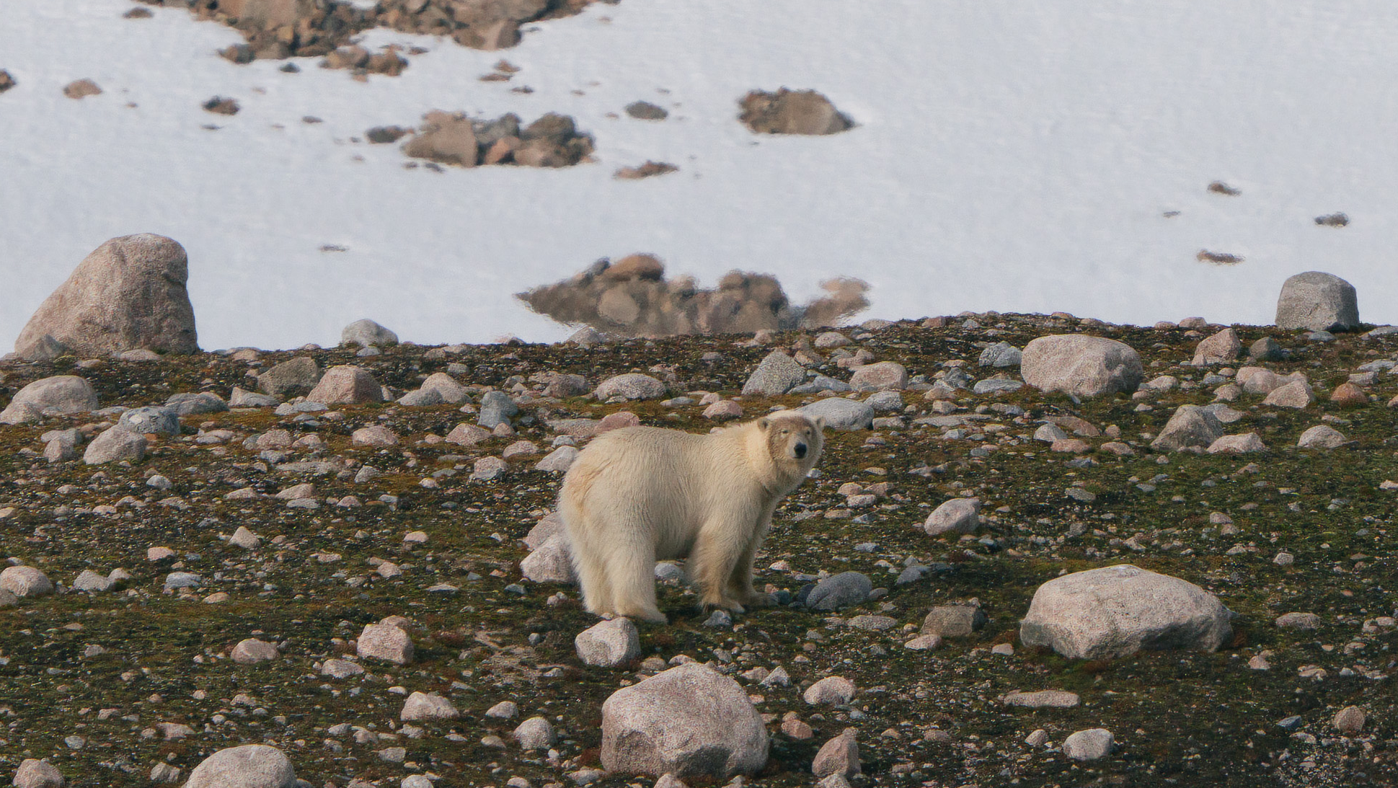

Slide 27
Connect with your inner scientist

Slide 28
NASA Globe Cloud Observer
Together with our Environmental Scientist Liam you observed the clouds and submitted your observations to NASA GLOBE Observer on X occasions.
These cloud observations can help NASA improve our understanding of Earth‘s atmosphere and climate by providing valuable data for scientific research and climate modelling.
View our data on the global map
Notes:
Add summary of number of sessions and observations submitted, any special observations and add specific link to NASA Cloud observations if possible

Slide 29
SCIENTIFIC NAME | ENGLISH | DEUTSCH | FRANÇAIS
Notes:
Copy and paste land birds observed – make sure scientific name is in italics

Slide 30
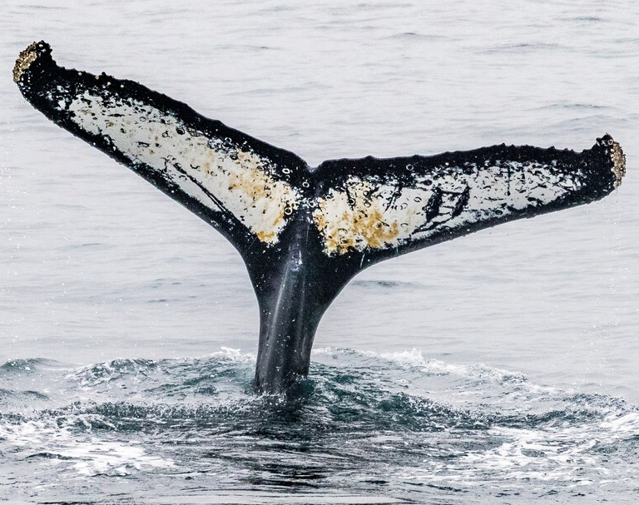
Happywhale
We submitted pictures of the identifying features of the marine mammals that we encountered to the citizen science platform, Happywhale. In total, XX observations were submitted and matched to individual specimens.
Happywhale allows us to follow individual whales and other marine mammals and learn about their life history and migratory routes. This helps us better understand these fascinating creatures and contributes to their conservation.
View our submissions to Happywhale
Notes:
Add info on how many images were submitted to happywhale, new whales were ID, matches etc. as appropriate plus link to ship account on Happywhale – update link to specific voyage

