Slide 1
Science & Education Report
MS Fridtjof Nansen 2026
Notes:
Welcome, everyone!

Slide 2
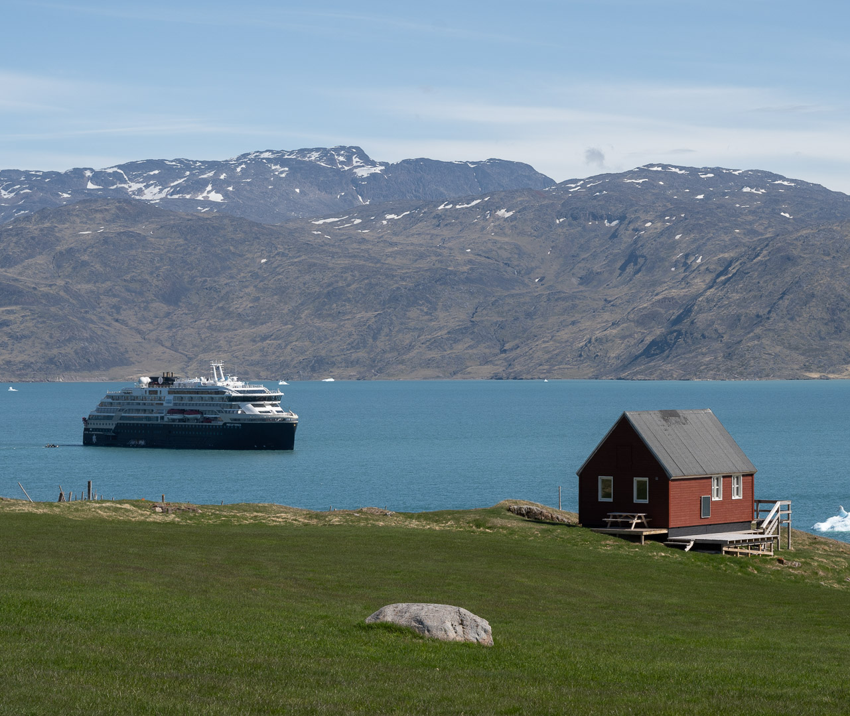
MS Fridtjof Nansen
Discovering Greenland
Reykjavik - Nuuk
2 June 2026 – 14 June 2026
Notes:
Over the past days, we’ve explored Antarctica not just as travellers, but as active participants in science. Through citizen science projects, hands-on research, and field observations, we’ve contributed to a global effort to better understand and protect this unique environment. This presentation is a recap of the work we’ve done together—your role in it, the discoveries made, and how you can continue to be part of these efforts beyond this voyage.

Slide 3
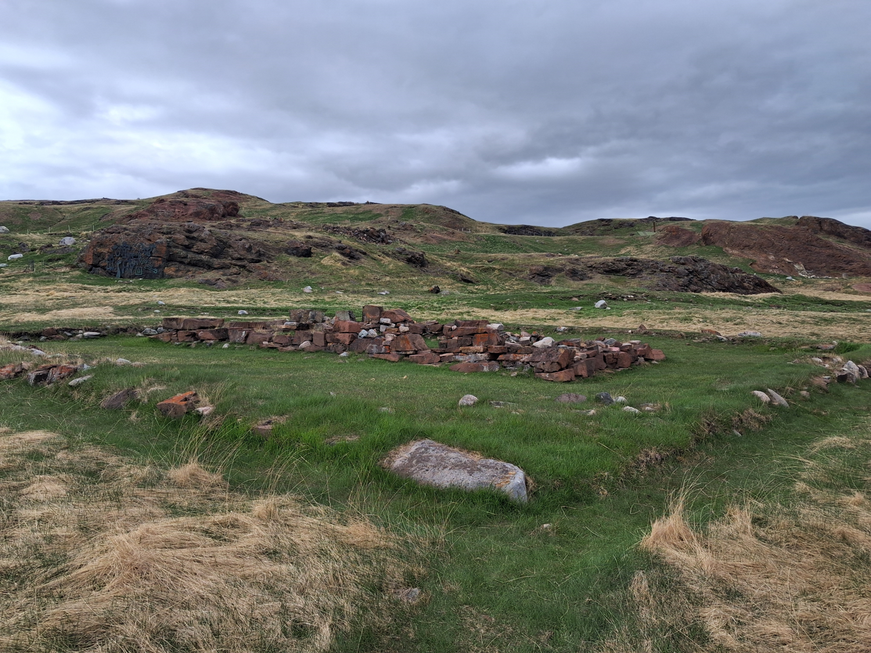
History & Culture
On this voyage we visited several cultural heritage sites. In Qassiarsuk we explored Brattahlíð — the farmstead of Erik the Red and his descendants. From the 900s, Norse settlers lived on Greenland for centuries before disappearing in the mid-1400s. This heritage was also evident for those of us who travelled to the church ruins at Hvalsey, where the last written record of the Norse settlement was made at a wedding in 1408.
We also investigated sites of Inuit heritage, particularly at Kvanefjord, where we looked at the gravesites connected to the Thule Inuit culture. The Thule Inuit graves had been given a commanding view of the ocean — the source of life for the early settlers on the Greenland coast.
At Ivittuut and Nordafar we saw the remains of Greenland's more recent history. The abandoned mine at Ivittuut and the fishing settlement at Nordafar both speak of the ambitions and failures to build modern industry in Greenland.

Slide 4
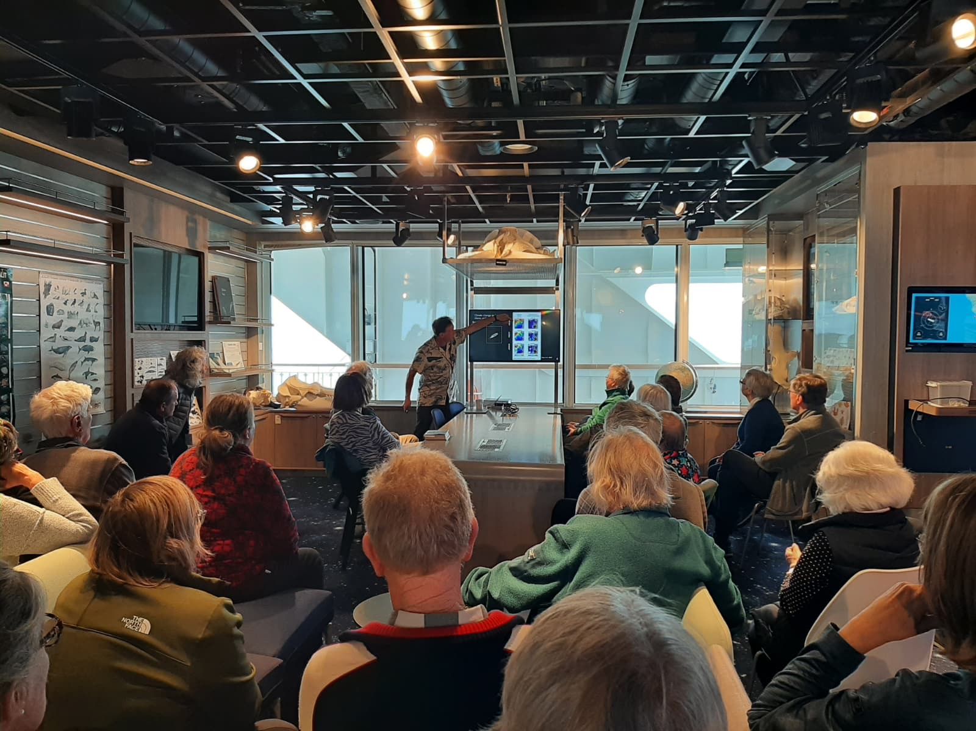
Science & Education Program
Crossing the Denmark Strait to Greenland, we journeyed together weather, wildlife, history, and time.
Through lectures, workshops, time on deck, and moments ashore, we explored coastlines, fjords, islands, seabirds, whales, plants, clouds, and the forces shaping this polar route, while contributing to citizen science along the way.
We hope these shared experiences deepened your connection to the places we visited, and that they inspire you to keep observing, recording, and caring for the natural world beyond this voyage.
Notes:
Introduction:
"As we set sail from Ushuaia, we embarked on more than just a voyage—we stepped into a world of discovery. Through towering glaciers, sculpted icebergs, and thriving wildlife, we weren’t just visitors; we became active participants in understanding this incredible environment."
Exploration & Connection:
"Every day brought new insights—through lectures, hands-on workshops, and quiet moments observing Antarctica’s wild beauty. We traced the journeys of past explorers, marvelled at the resilience of wildlife, and witnessed the powerful forces shaping this frozen continent."

Slide 5
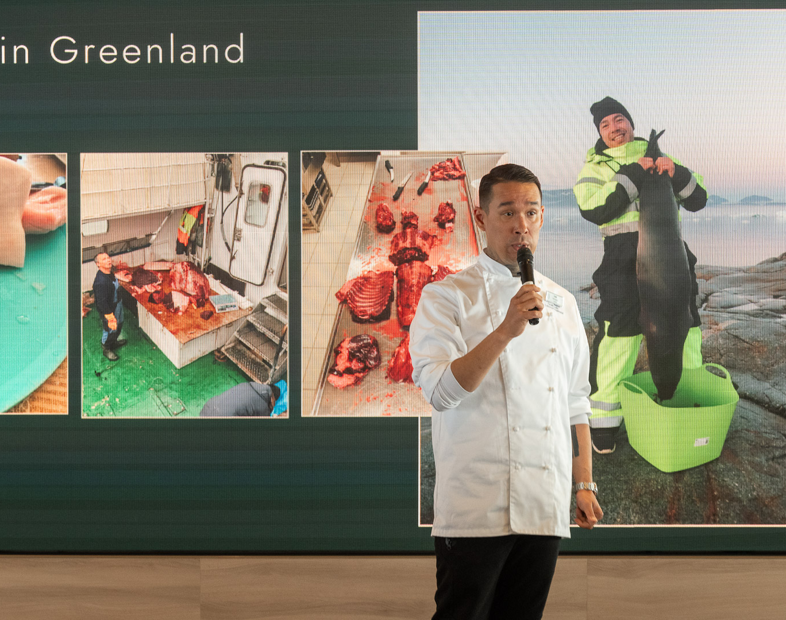
Science & Education Program
Aboard HX vessels, we are guests in the places we visit. through Citizen Science, you have become part of something bigger.
By observing, recording, and sharing data, you have helped contribute to global research and gained a closer connection to the natural world.
This journey does not end here. Keep exploring, documenting, and caring for nature wherever you go.
Notes:
Citizen Science & Action:
"But our role here was more than just observation. Through citizen science, we contributed real data to global research—whether it was documenting biodiversity, collecting water samples, or tracking whale movements. Science is not just for scientists; it’s for everyone. It happens everywhere, every day, and we all have a role to play."
Bringing Antarctica Home:
"As we leave these icy waters behind, our connection to Antarctica doesn’t end here. The tools to observe, document, and contribute are in your hands. Every small action—every photo, every piece of data—adds to a greater understanding of our planet."
Closing Thought:
"May this experience inspire you to stay curious, to keep exploring, and to protect the fragile beauty of the natural world—because what we do, no matter where we are, truly makes a difference."

Slide 6
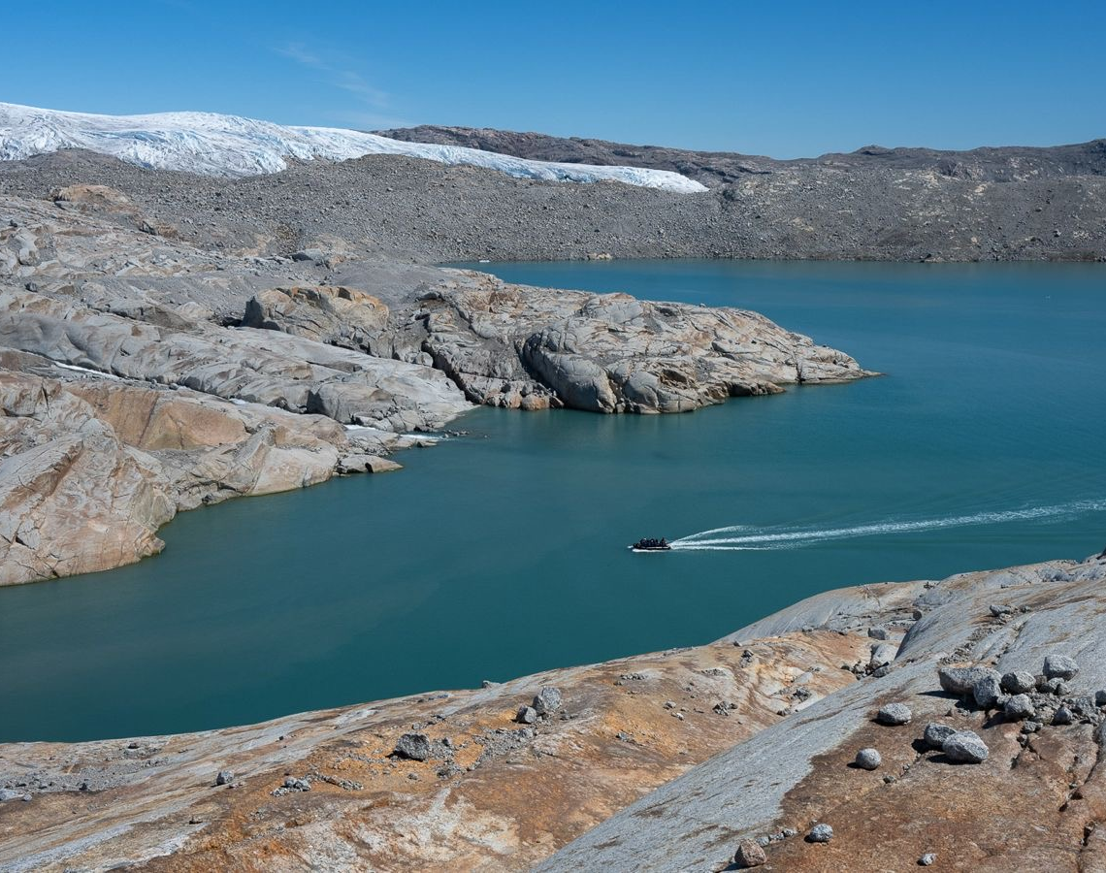
Geology
From the Amitsoq Gneiss near Nuuk — some of the oldest rocks on Earth at 3.8 billion years old — to the deep blue icebergs of Qaqertarsuup Fjord and the abandoned cryolite mine at Ivittuut, Greenland has hit the geological jackpot.
Greenland today may be geologically stable, but its roots reach back to the joining of crustal segments and megacontinents over billions of years. These rocks formed at great depths and have travelled around 7,000 km thanks to continental drift.
We traversed many of the fjords carved out in the Quaternary period through repeated glacial cycles, then flooded by the sea once the ice melted. The fjords have formed in areas where cracks and faults opened during those ancient continental collisions.
The geology of Greenland puts Earth's age into perspective and reveals the erosive power of ice.
Qaqertarsuup Fjord. Credit: Kim Rørmark
Notes:
Please update for this voyage

Slide 7
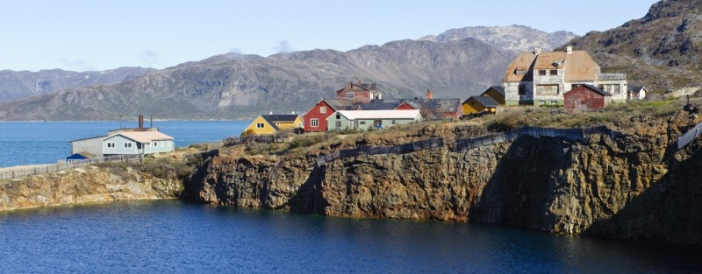
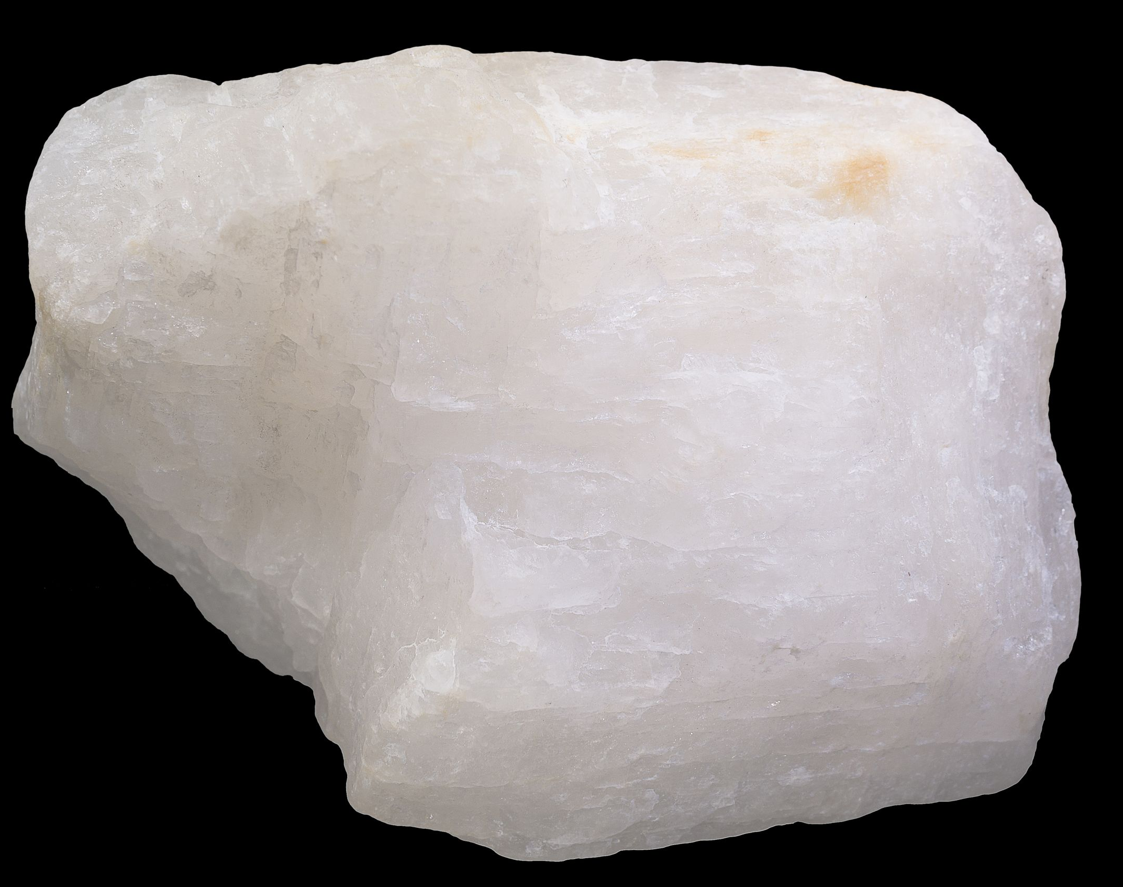

Geological Highlight: Ivittuut
Many natural resources have been used for industrial or military gain, but few have shaped history quite like this one. The inconspicuous white mineral found only in a single fjord in southwest Greenland had a profound impact on both World Wars: it made the large-scale production of aluminium possible in the first place. Because this new, lightweight metal was quickly adopted for aircraft, cryolite — the "ice-like stone" — became one of the most valuable minerals in the world. The mine at Ivittuut ran for a solid 130 years until synthetic cryolite replaced it in 1987. Today, only a 65-metre-deep, water-filled hole in the ghost town tells the tale.
Cryolite is sodium aluminium hexafluoride (Na₃AlF₆). It lowers the temperature required for the aluminium smelting process by more than 1,000°C. Before its discovery, aluminium was the most expensive metal in the world — twice as valuable as gold.

Slide 8
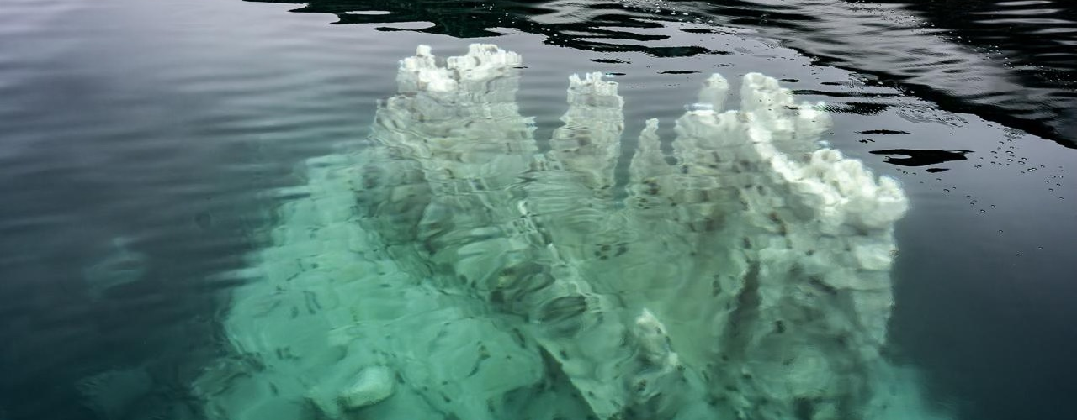
Geological Highlight: Ikka Fjord
Most stalagmites and stalactites occur in caves, where carbonate-rich water evaporates drop by drop and leaves behind its mineral load as calcite. So how can calcite columns grow under water? This is the enigma of ikaite.
The explanation is complex. Low temperatures, an influx of high-alkaline waters into the system, and the presence of chemical inhibitors that prevent ordinary calcite from forming are all required. A handful of other locations in the world show this phenomenon — tufa columns among them — but here in southwest Greenland we encountered the type locality of this extraordinary mineral.
Ikaite is a hydrated calcium carbonate (CaCO₃·6H₂O). It is only metastable: take it out of the cold-water environment and the columns begin to disintegrate, shedding their water in what looks like 'melting rock'.

Slide 9
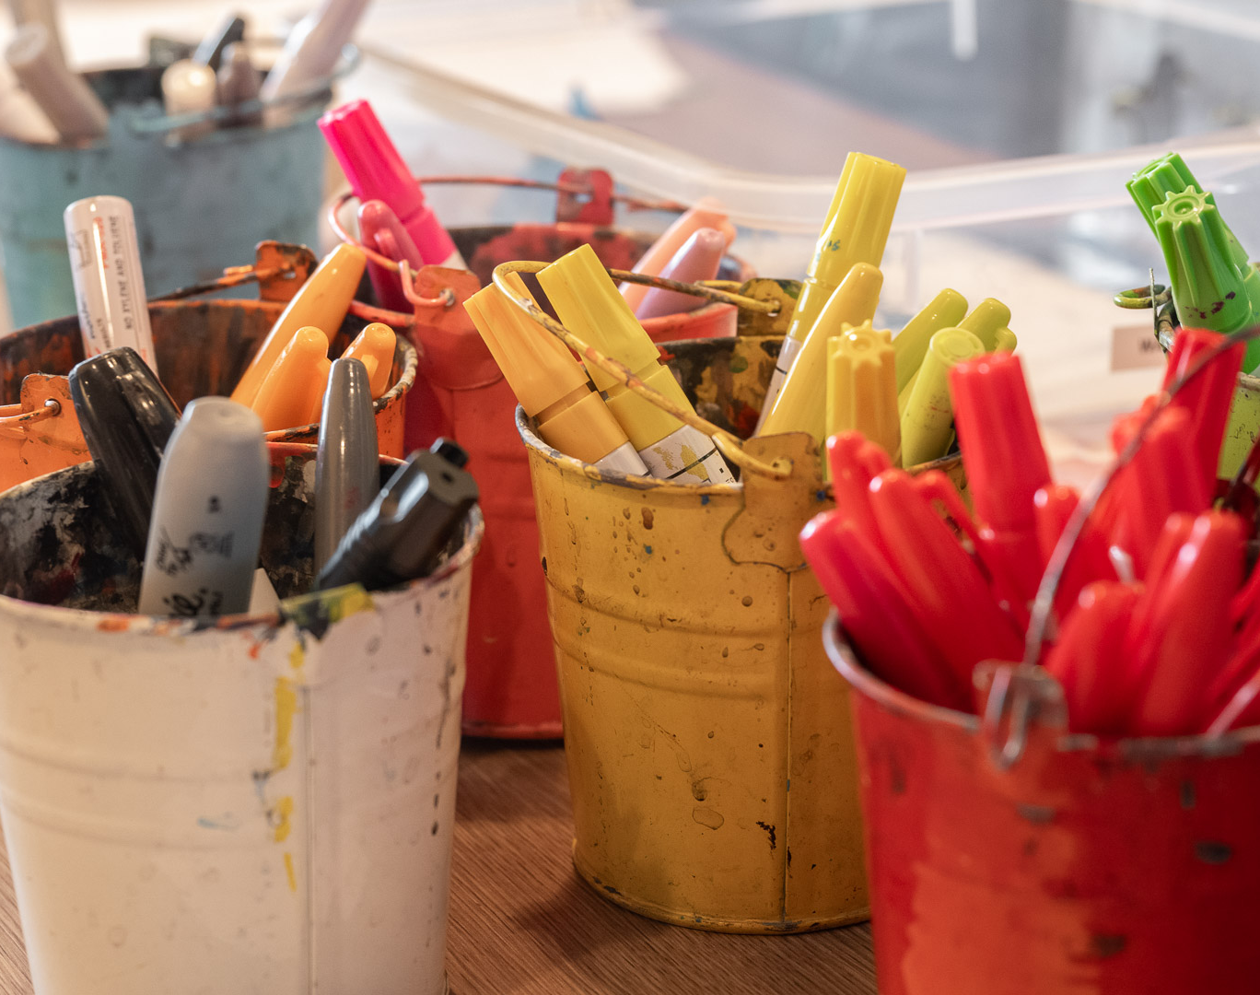
Arts, Crafts & Creativity
Through bottle painting, origami, and watercolours, we explored creativity as another way to connect with the places we visited.
No experience was needed, just curiosity and a willingness to try something new. Each creation became a small personal reminder of the landscapes, wildlife, and shared moments from this voyage.
Credit: Emily Gregory
Notes:
Just like science and history help us connect with Antarctica, so does creativity. Throughout the voyage, we had the chance to express our experiences in a different way—through bottle, watercolour, and species painting, and clay modelling. Whether it was capturing the icy landscapes in watercolour or shaping wildlife out of clay, these moments allowed us to slow down, reflect, and bring a piece of Antarctica to life in our own unique way. Let’s take a look at some of the creative moments we shared onboard

Slide 10
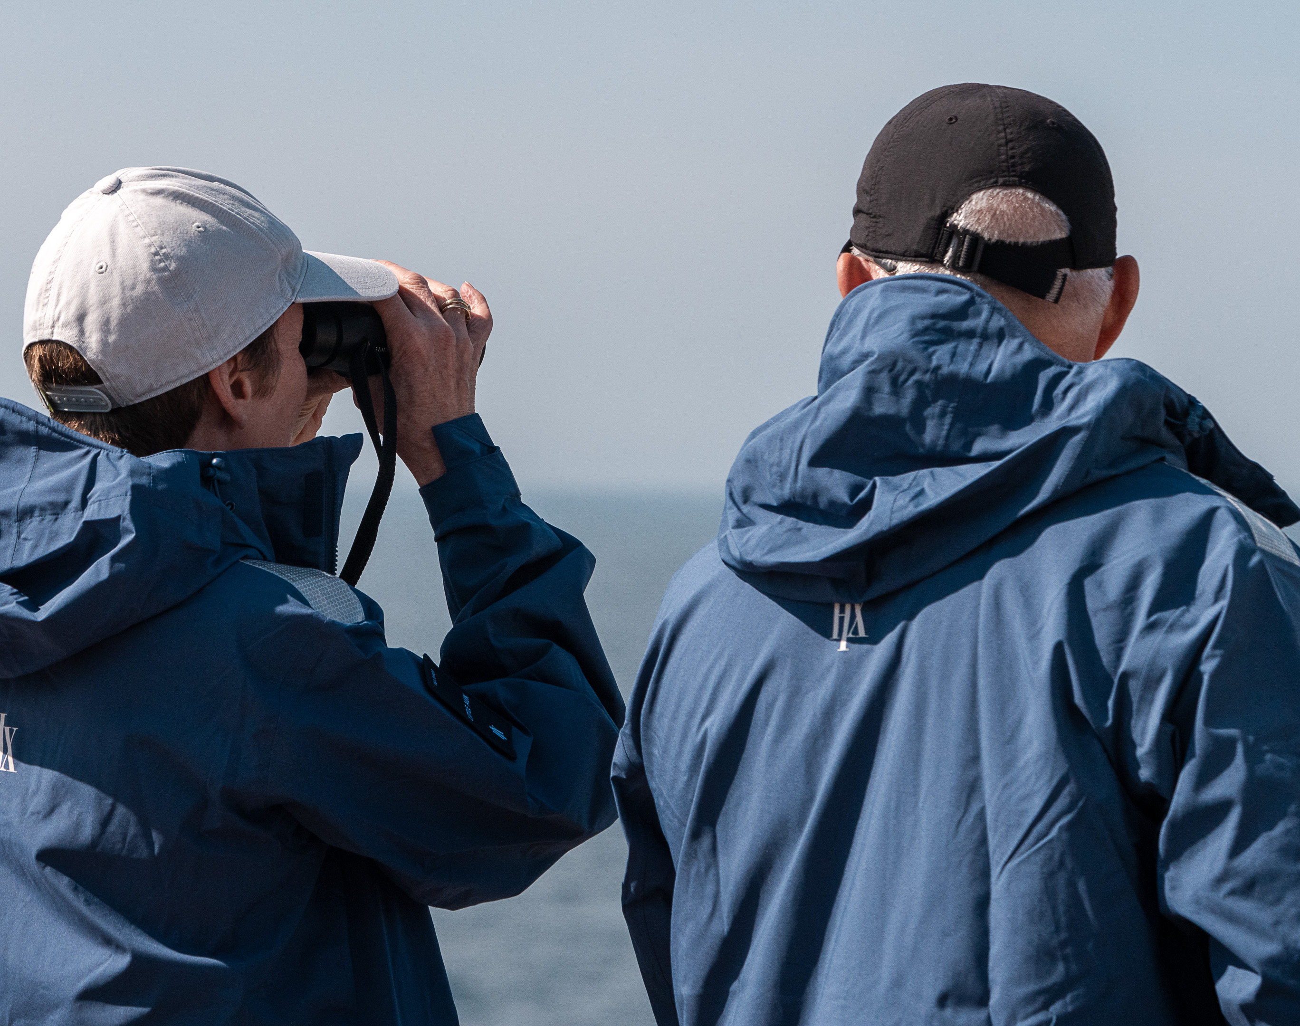
Wildlife Watch
As we travelled to Greenland, time on deck gave us the chance to take in the changing landscapes, weather, and wildlife around us.
Together, we searched for life at sea and along the coast — from seabirds riding the wind to whales and other wildlife appearing around the ship. Each sighting helped us better appreciate this northern route and the connections between land, sea, and sky.
These moments reminded us that the journey was not only about the places we visited, but about what we observed along the way.
Credit: Oscar Farrera/HX
Diatoms (St. Matthew, Alaska)
Photo: Oscar Farrera
Notes:
Creativity was just one way we engaged with this incredible environment, but another was through direct observation.
Whether standing on deck or out in the zodiacs, we spent time scanning the horizon, watching seabirds glide past, and spotting whales as they surfaced. Every wildlife sighting was a reminder that Antarctica is anything but empty—it’s full of life, adapted to thrive in the harshest conditions.

Slide 11
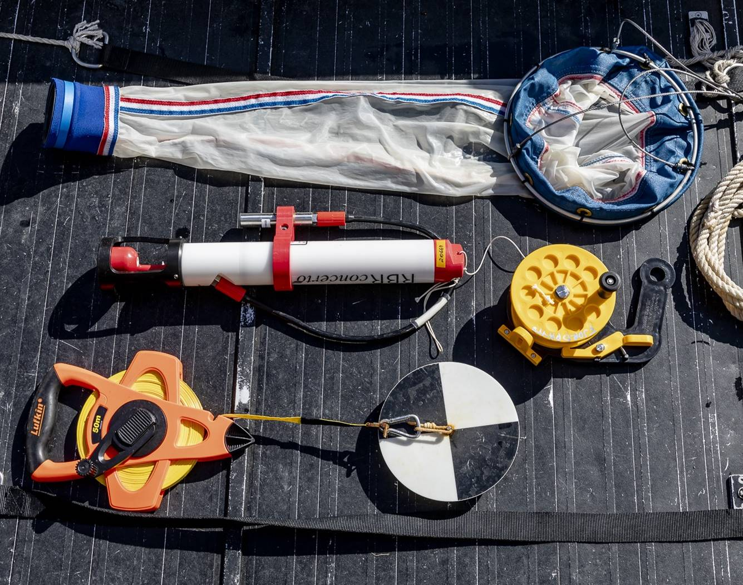
Science Boat
Over three science boat sessions, we moved beyond observation and took part in hands-on exploration of the waters along our route.
Using the plankton net, CTD, and Secchi Disk, we collected samples and measurements to better understand the hidden world beneath the surface
from tiny drifting organisms to water conditions and clarity.
These sessions were a reminder that science begins with curiosity, careful observation, and a willingness to ask questions about the world around us.
Notes:
We also took a deeper dive into Antarctica’s marine world through hands-on science. Out on the science boat, we weren’t just observing—we were actively collecting data, contributing to real research on this fragile ecosystem.

Slide 12
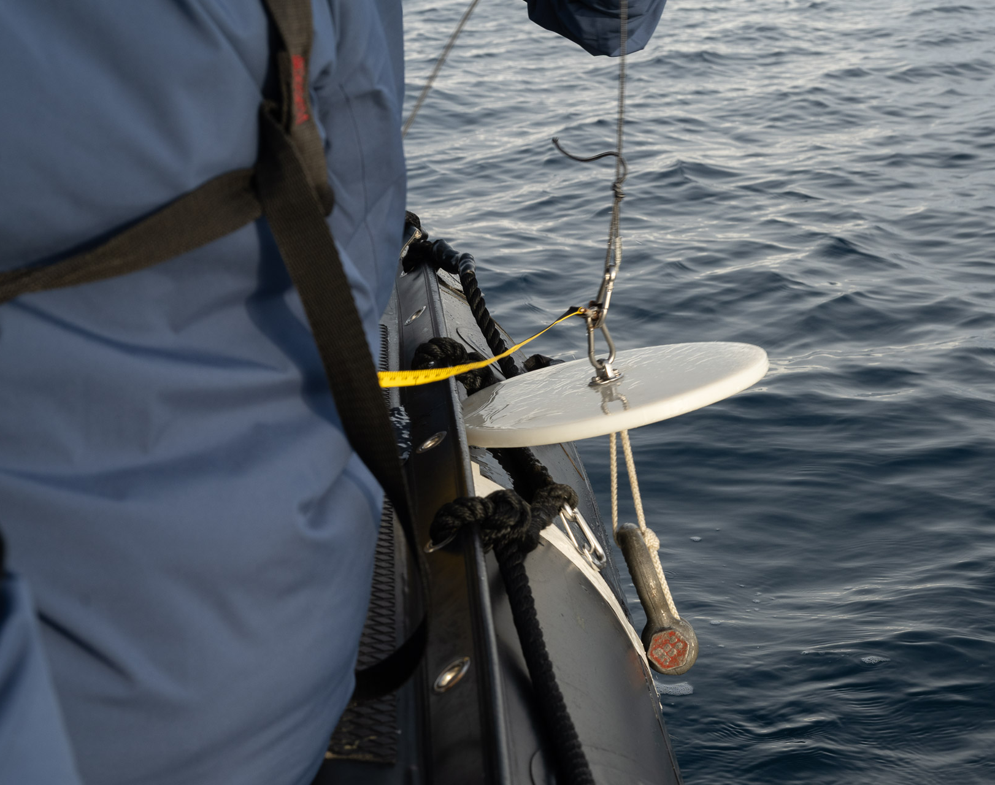
Secchi Disk
Looking into the water, it is easy to forget how much hidden life lies beneath the surface.
With the Secchi Disk, we measured water clarity by lowering it until it disappeared from view, offering clues about plankton abundance and ocean conditions.
On some days, currents made measurements impossible — a reminder that nature sets the terms. Each reading contributed to a better understanding of our changing ocean.
Photo: Matthew Gladhill
Notes:
To explore the health of these waters even further, we used a Secchi Disk to measure water clarity—a simple but powerful way to understand plankton abundance and ocean conditions.

Slide 13
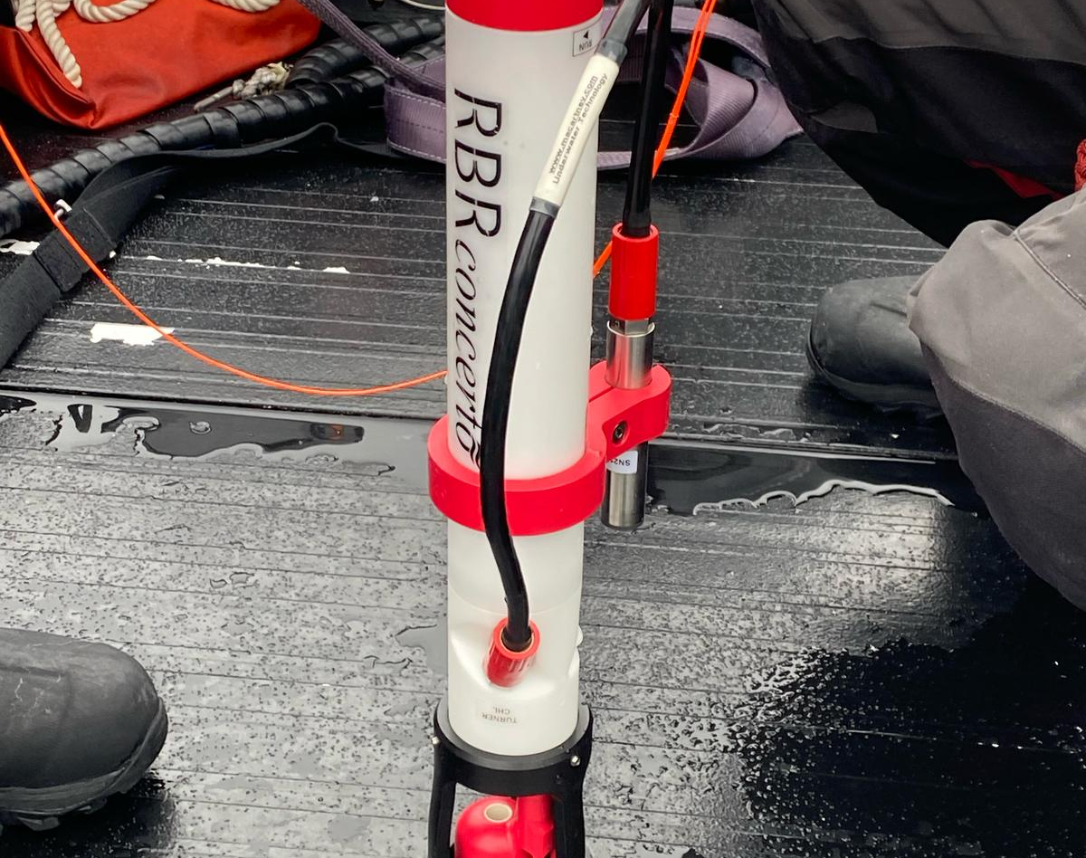
CTD
Beneath the surface, the ocean holds important clues about change.
With the CTD, we measured temperature, salinity, and depth, helping us better understand water conditions along our route.
Each profile added useful data on how freshwater, currents, and ocean layers shape these waters — one measurement at a time.
Photo: Matthew Gladhill
Notes:
While the Secchi Disk gave us a simple way to measure water clarity, the CTD device allowed us to take a deeper look at the ocean itself—measuring salinity, temperature, and depth to better understand how these waters are structured and how they influence marine life.

Slide 14
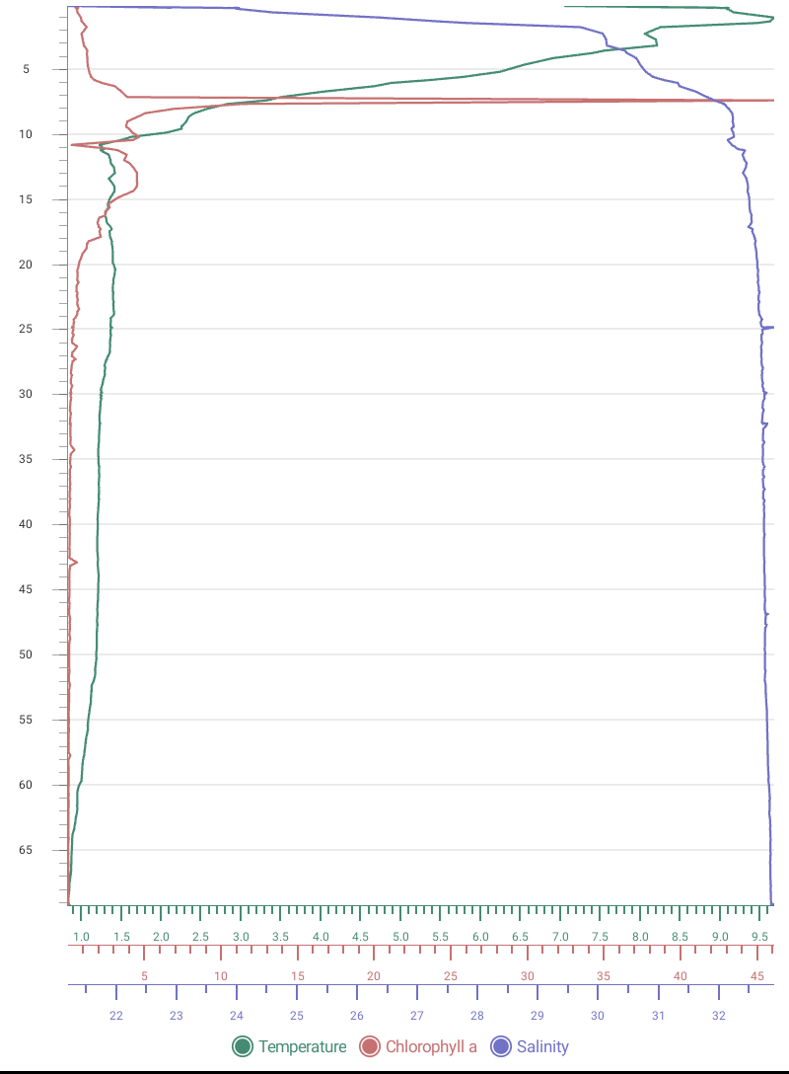
Depth Profile: Kvanefjord
Our CTD profile from Kvanefjord showed an 8°C difference between the surface and 70 m depth, with the surface significantly warmer. The surface layer was likely warmed by the sun and atmosphere, while deeper waters were more influenced by the cold input from Arctic currents.
Phytoplankton, shown here as a measure of chlorophyll a (µg/l), was elevated at around 8 m depth.
Our plankton samples throughout the voyage showed a higher abundance of zooplankton in vertical tows than in surface tows. This is likely because zooplankton descend through the water column during the brightest part of the day to avoid predation.
Depth (m)
Temperature (°C)
Chlorophyll a (ug/L)
Salinity
Notes:
Updated 25/05

Slide 15
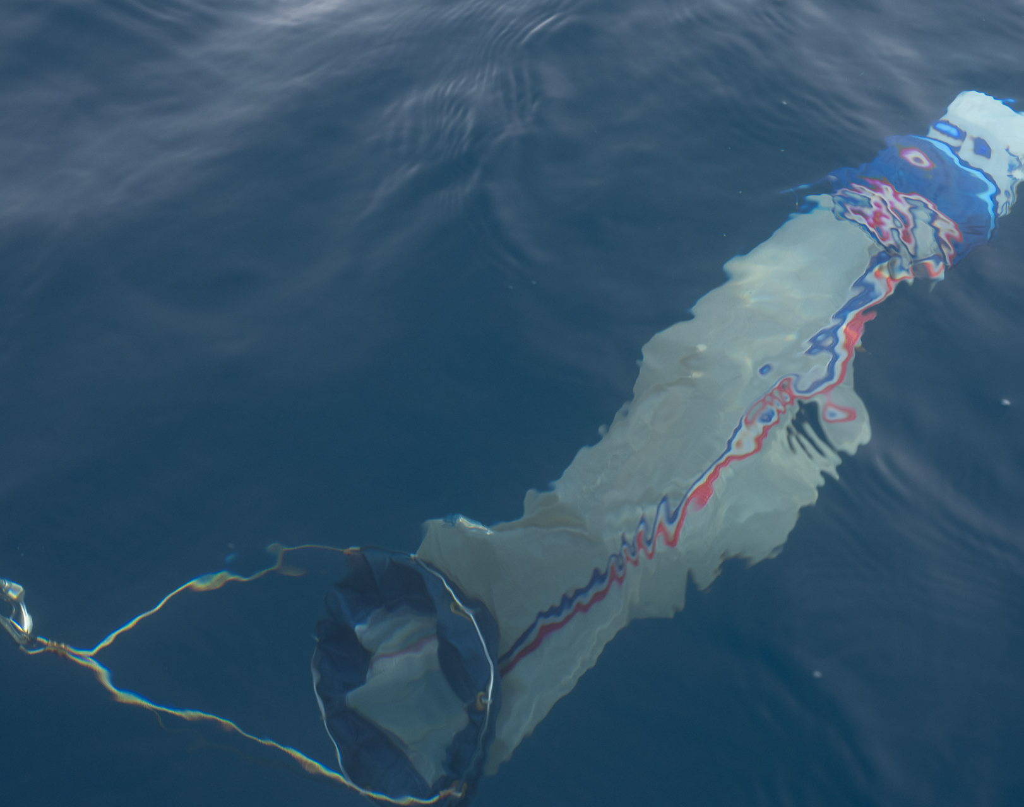
Water Sampling
During our expedition, we collected water samples from Kvanefjord, Qassiarsuk, and Narsarsuaq fjord.
From the science boat, we deployed plankton nets, towing them through the water to capture these drifting life forms. The phytoplankton net (20 µm mesh) collected microscopic plant-like organisms, forming the base of the marine food web in these fjord and coastal systems.
Each tow offered a glimpse into the hidden world beneath the surface, helping us understand how these tiny organisms support life along the Greenlandic coast
Photo: Matthew Gladhill
Notes:
And with plankton net tows, we captured some of the smallest yet most important life forms in the ocean, the foundation of the entire Antarctic food chain. By taking part in these studies, we weren’t just passengers; we were citizen scientists, contributing to a better understanding of this ever-changing environment."

Slide 16
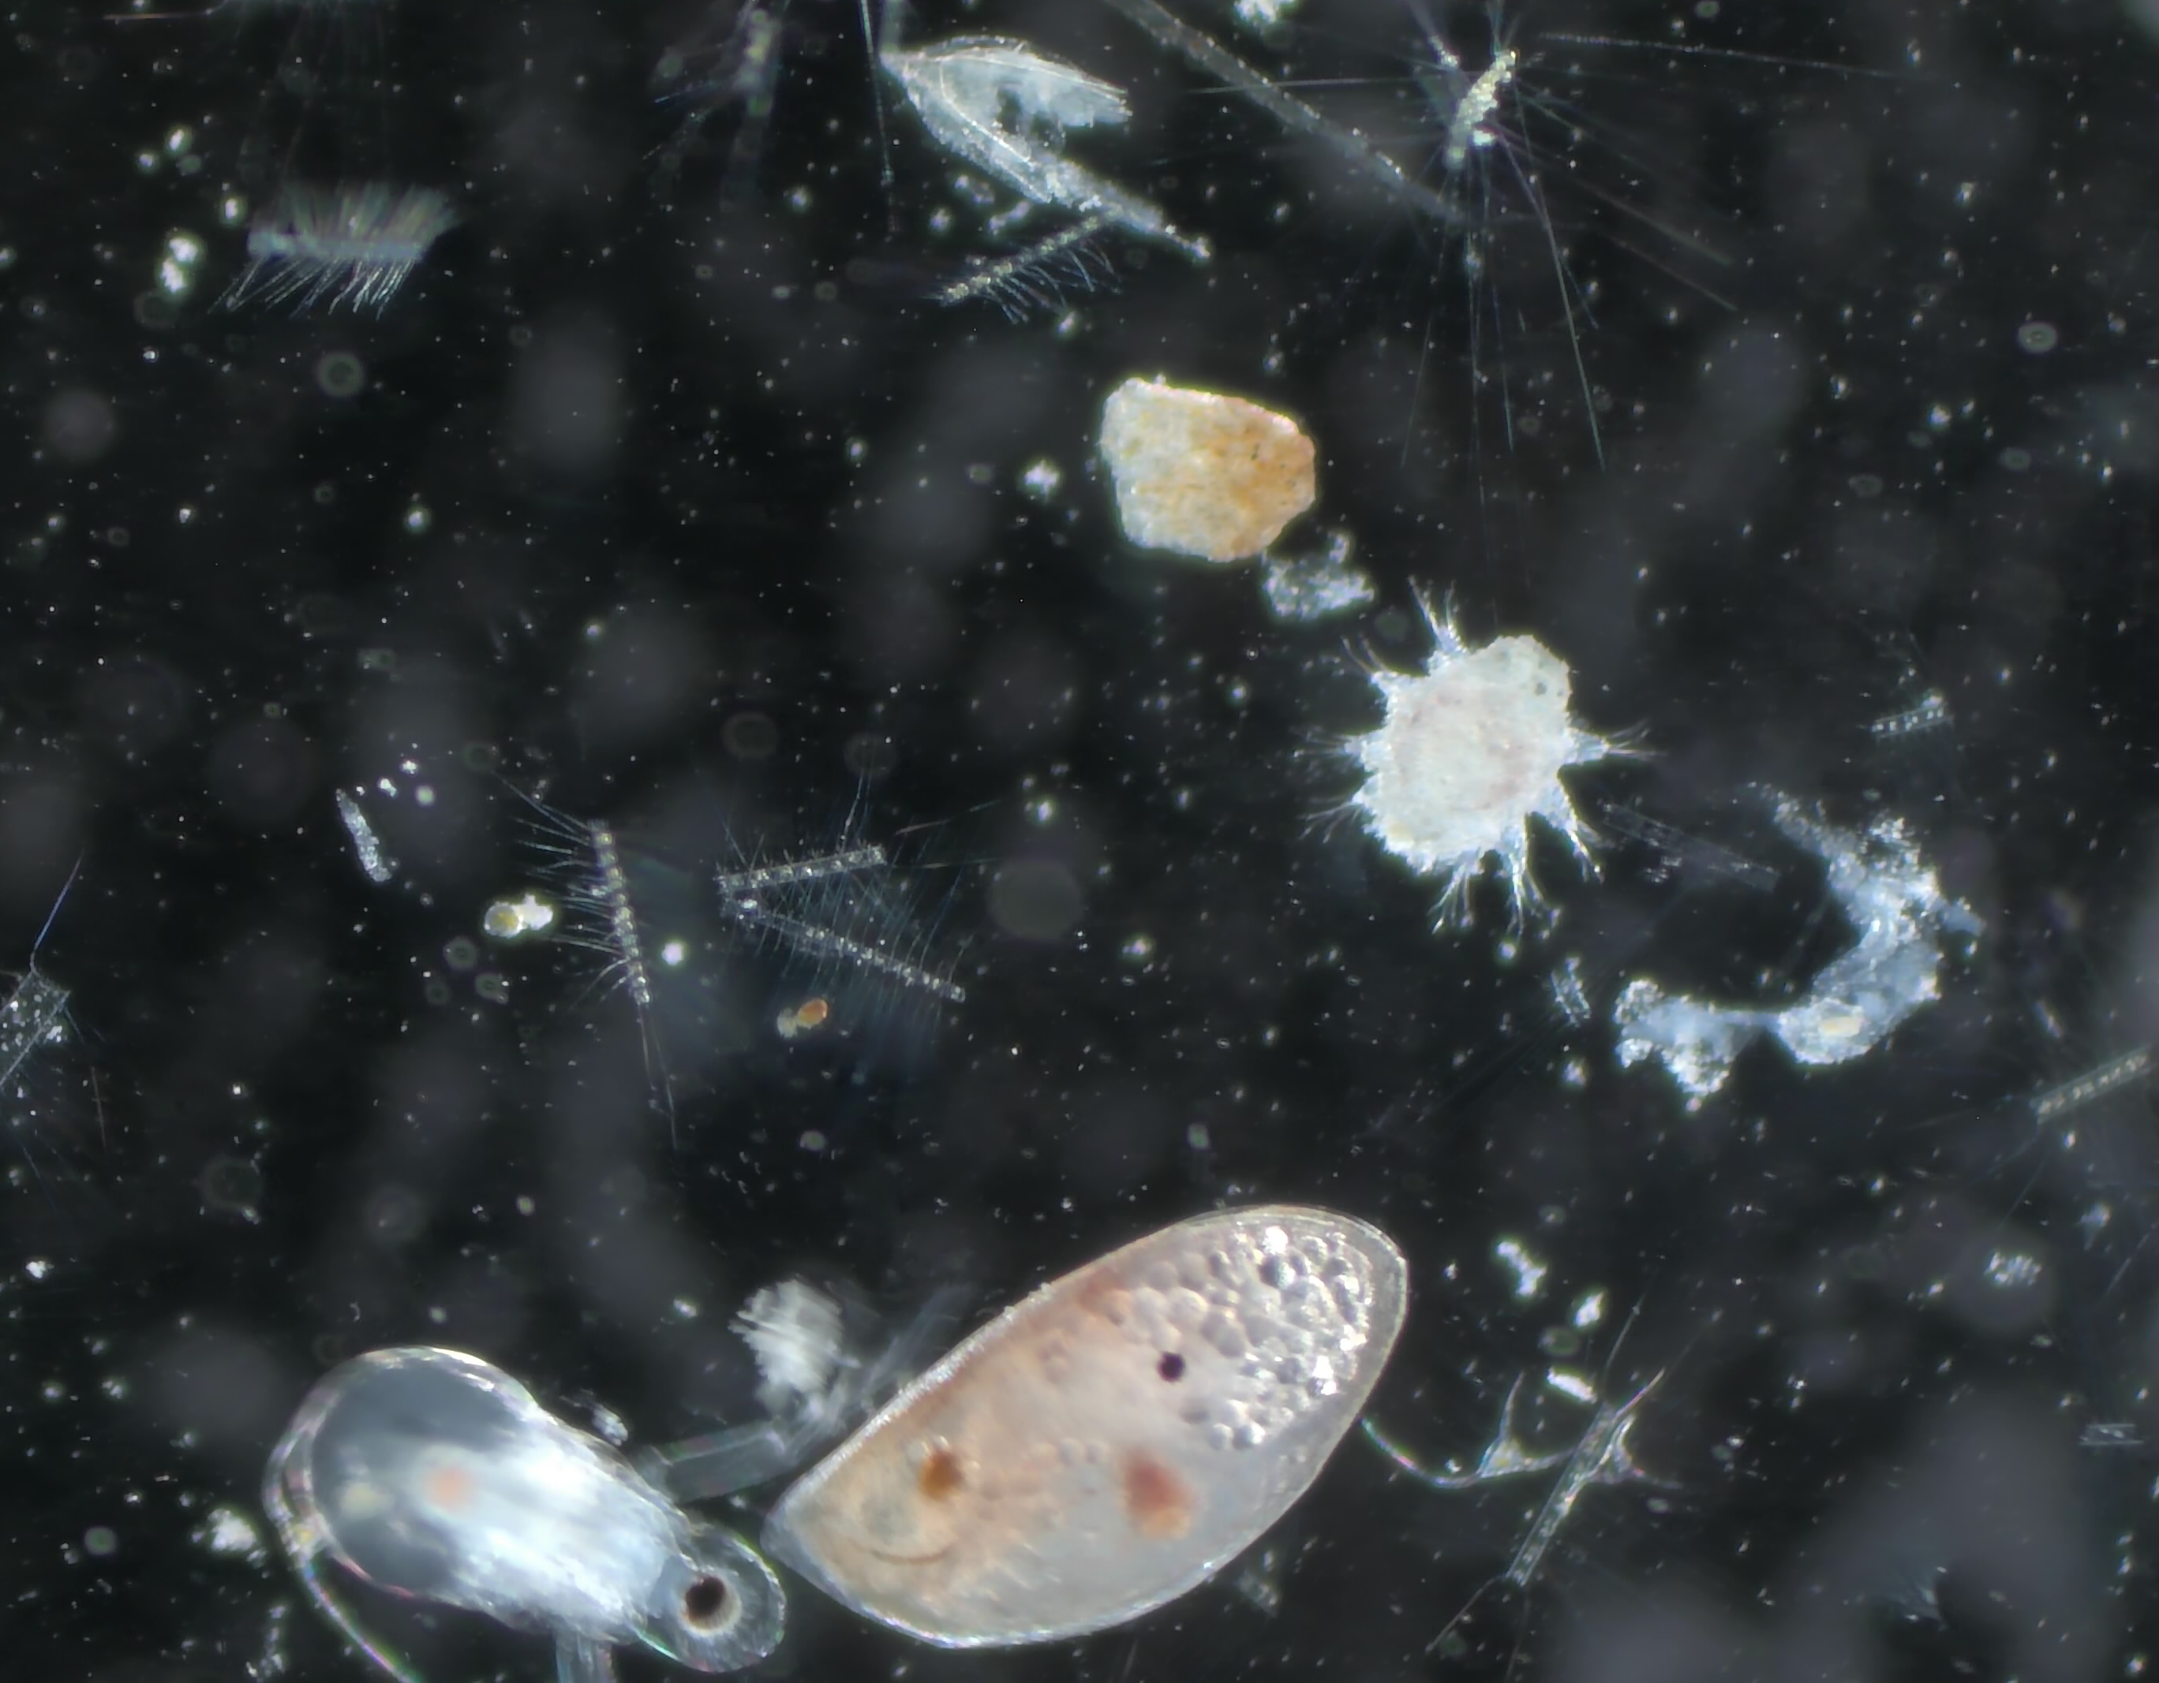
Plankton Samples
Back in the Science Centre, we brought our Qassiarsuk and Qaqertarsuup surface and vertical tow samples into focus under the microscope.
Using the main screen and smaller microscopes, guests could explore each drop of water up close.
What appeared invisible to the naked eye quickly became a vivid reminder that these tiny organisms form the foundation of the rich ecosystems we travelled through.
Notes:
Updated 25-05

Slide 17
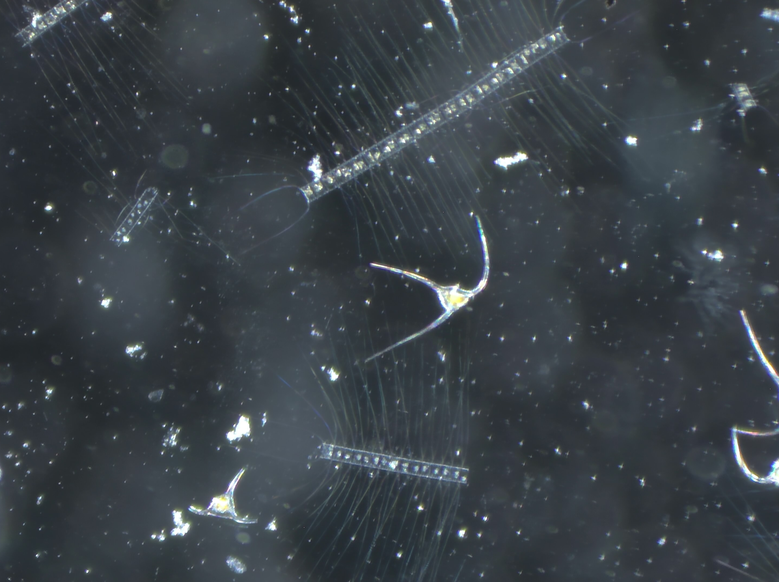
Diatoms and Dinoflagellates
Phytoplankton such as diatoms and dinoflagellates form the basis of the marine food web. Through primary production — photosynthesis — they support all the marine life we observed on this voyage.

Slide 18
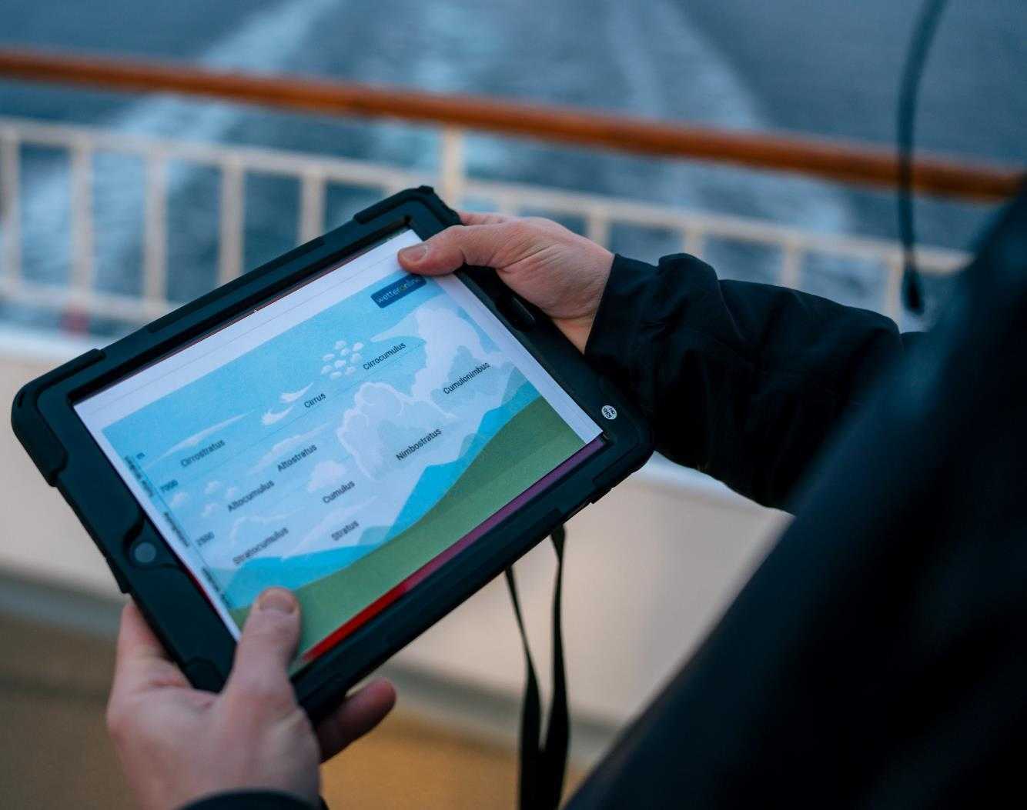
NASA's GLOBE Cloud Observer
During our voyage, we contributed to NASA’s GLOBE Cloud Observations, collecting data on:
5 June (Tasermiut Fjord)
10 June (Ikka Fjord)
By comparing our observations with satellite data, scientists can improve cloud classification, weather forecasting, and climate models.
You can continue contributing from home using the GLOBE Observer app.
View our data on the global map
Photo: Oscar Farrera
Notes:
CHIARA
Just as plankton play a key role in the marine ecosystem, clouds influence the climate—affecting temperature, weather patterns, and even how much sunlight reaches the ocean’s surface.
To tell us more about the GLOBE Cloud Project and how our observations contribute to climate research

Slide 19
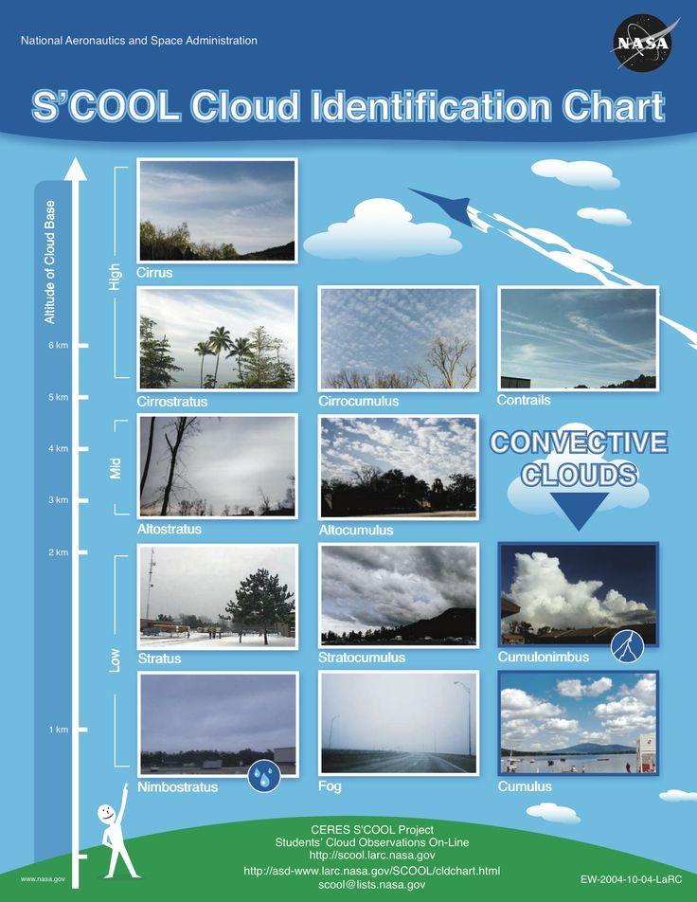
NASA's GLOBE Cloud Observer
High Clouds (base above 6,000 metres):
Cirrus: Thin, wispy clouds composed of ice crystals. They often appear as delicate streaks or feathery wisps high in the sky.
Cirrostratus: Thin, sheet-like clouds that cover large portions of the sky. They can create a halo around the sun or moon.
Cirrocumulus: Small, fluffy clouds in a regular pattern, resembling fish scales or ripples.
Medium Clouds (base between 2,000 and 6,000 metres):
Altocumulus: Puffy, greyish-white clouds with rounded edges. They often form parallel rows or patches.
Altostratus: Thick, greyish clouds that partially obscure the sun or moon. They lack the distinct features of cirrostratus.
Low Clouds (base below 2,000 metres):
Stratus: Uniform, greyish clouds that cover the sky like a blanket. They can bring drizzle or light rain.
Stratocumulus: Low, lumpy clouds with defined edges. They often appear in rows or patches.
Nimbostratus: Thick, dark grey clouds associated with steady rain or snow.
These cloud types vary in appearance and behaviour, but this basic classification helps meteorologists understand weather patterns and atmospheric conditions. To explore more examples, see NASA's On-Line Cloud Chart.
6
5
4
3
2
1
View our data on the global map
Notes:
CHIARA – slide DONE

Slide 20
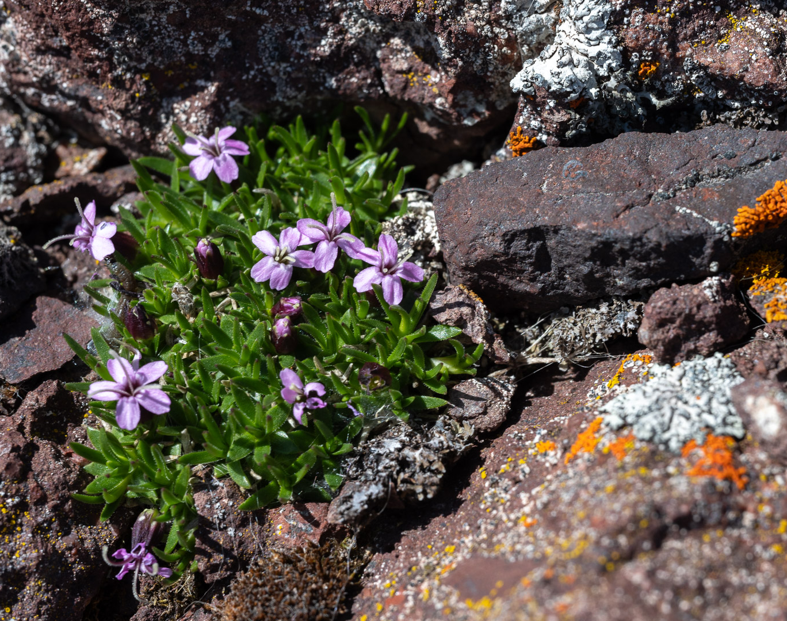
iNaturalist
Western Columbine
Aquilegia formosa
from Cordova, AK
Throughout this voyage, you played a vital role in documenting the biodiversity of Greenland.
Together, we gathered:
369 Observations
114 Species Identified
10 Observers Participating
Each observation helps scientists build a clearer picture of biodiversity in Arctic and sub-Arctic regions.
Ready to explore our findings? Use the link below to view our collective data and see the impact of your contributions.
2026 June 2 - 14: Discovering Greenland – From Reykjavík to Nuuk- MS Fridtjof Nansen · iNaturalist
Credit: Oscar Farrera/HX
Notes:
CHIARA

Slide 21
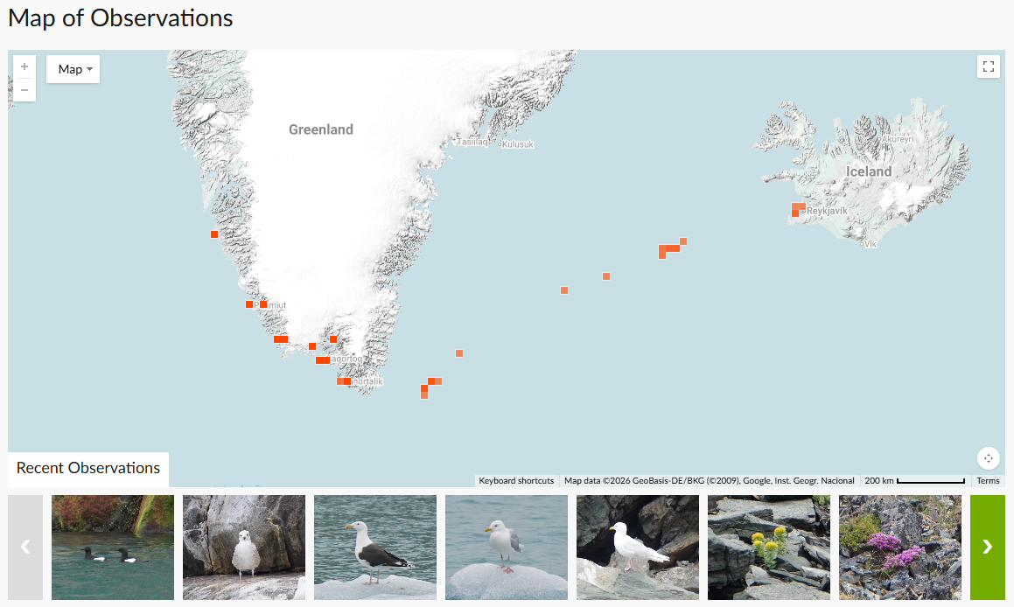
Notes:
Steffen

Slide 22
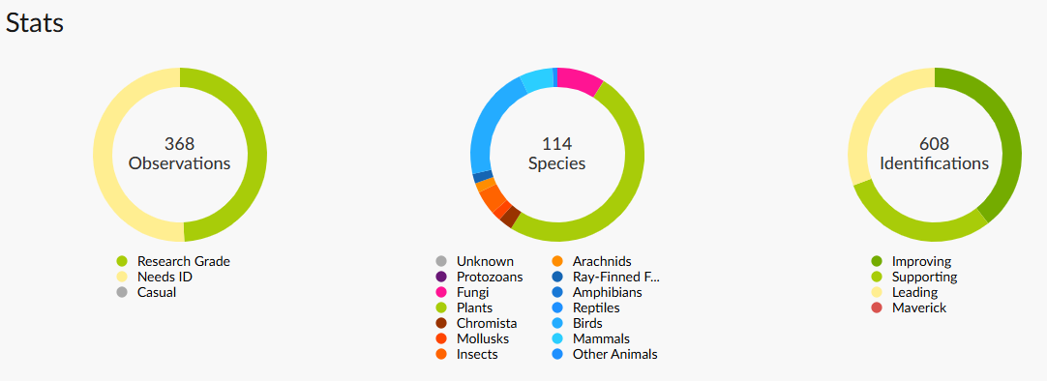
Notes:
Steffen
The observations covered 104 species, with plants making up the largest share of the identified records, alongside birds, mammals, fungi, insects, molluscs, and other coastal and marine life.

Slide 23
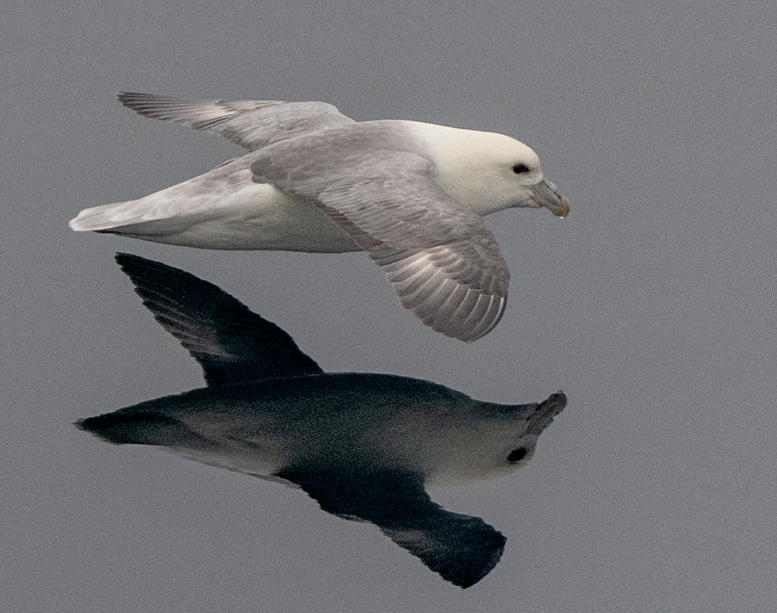
eBird
Bird-watching is more than a hobby — it is a powerful tool for science. eBird, a global Citizen Science platform, allows bird enthusiasts to record and share sightings, contributing valuable data for research and conservation.
During our voyage, our onboard Ornithologists conducted eight wildlife watches, completing 36 checklists and recording 34 bird species along the way. Every entry adds to a growing database that helps scientists track migration patterns, monitor populations, and understand bird behaviour in the North Atlantic.
Use the link below to explore our data and see how your observations contribute to a global effort in avian research.
https://ebird.org/tripreport/538265
Credit: Oscar Farrera/HX
Notes:
CHIARA

Slide 24
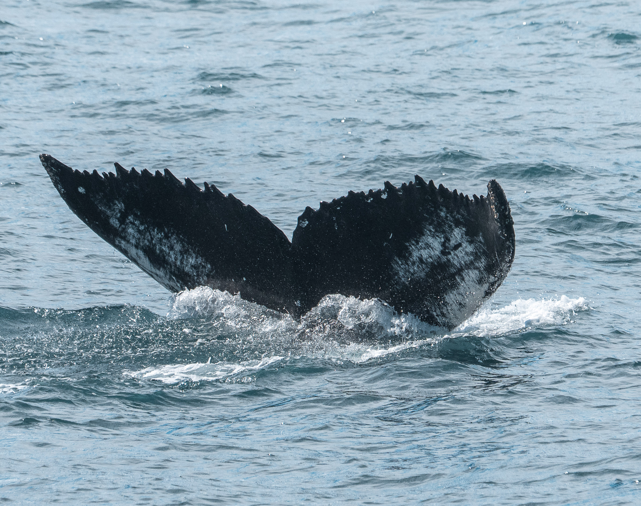
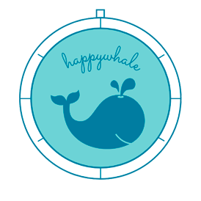
Happywhale
Cetaceans — whales, dolphins, and porpoises — always capture our attention. By submitting photos to Happywhale, we help scientists track individual animals through their lives and movements.
During this voyage, the Expedition Team and guests uploaded observations of humpback whales.
You can view MS Fridtjof Nansen’s Happywhale submissions, follow individual whales for future updates, or upload your own photos from this voyage or past encounters.
Credit: Timo Heinz
Notes:
Update

Slide 25

Minke whale — Denmark Strait
Notes:
PETE

Slide 26

Long finned pilot whale – Denmark Strait
Notes:
PETE

Slide 27
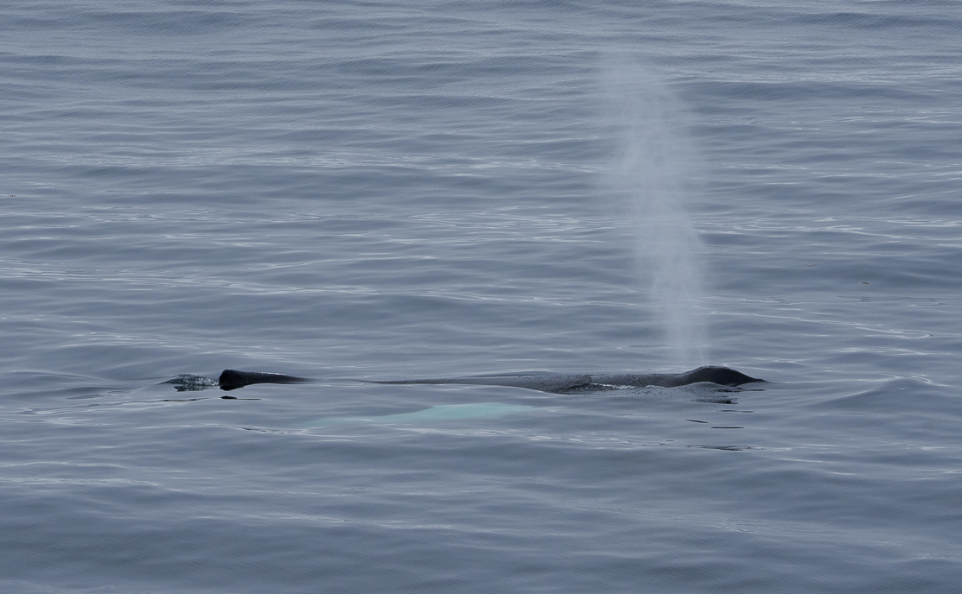
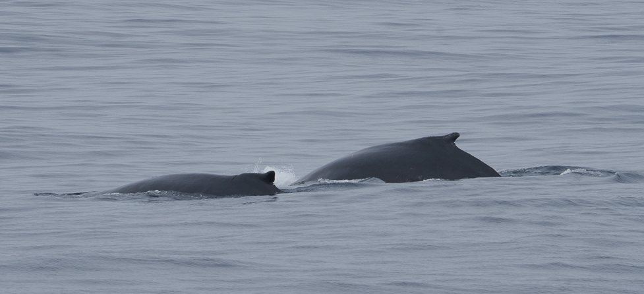
Humpback whales – Leaving Paamiut
Notes:
PETE

Slide 28
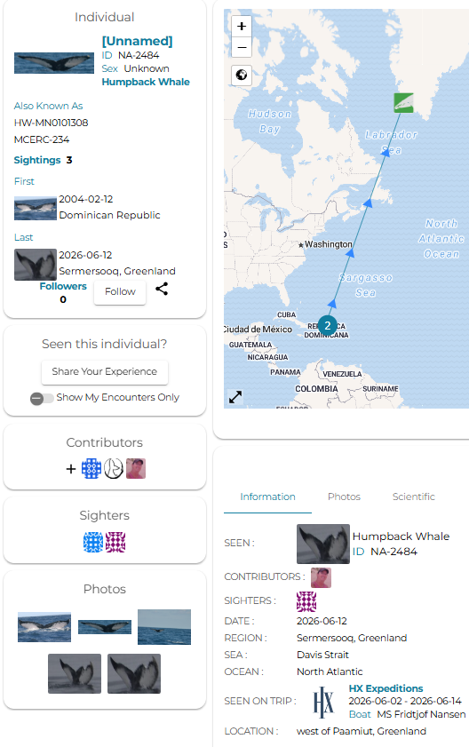
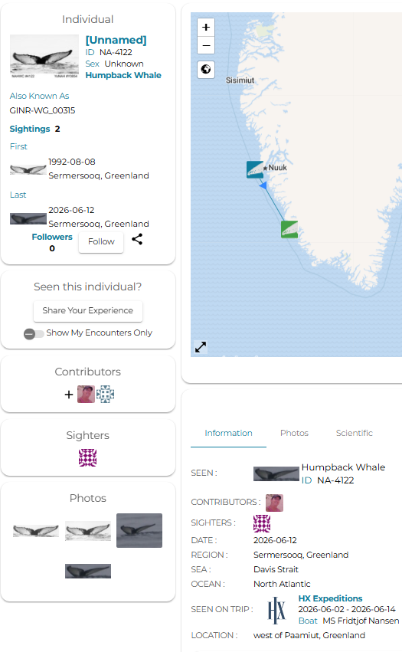
Happywhale
Matches
Towards the end of our voyage, we had an evening with more than 40 humpback whale encounters. Conditions were excellent for spotting, and we were lucky enough to see several whales fluking before their dives.
Several fluke photos were submitted, and we received two very interesting matches in return. Both whales had been sighted only a few times before, with long gaps in between. One individual in particular had not been observed in over 30 years. This highlights the power of Citizen Science: a single fluke photo can add important data on whale distribution, ecology, and behaviour.

Slide 29
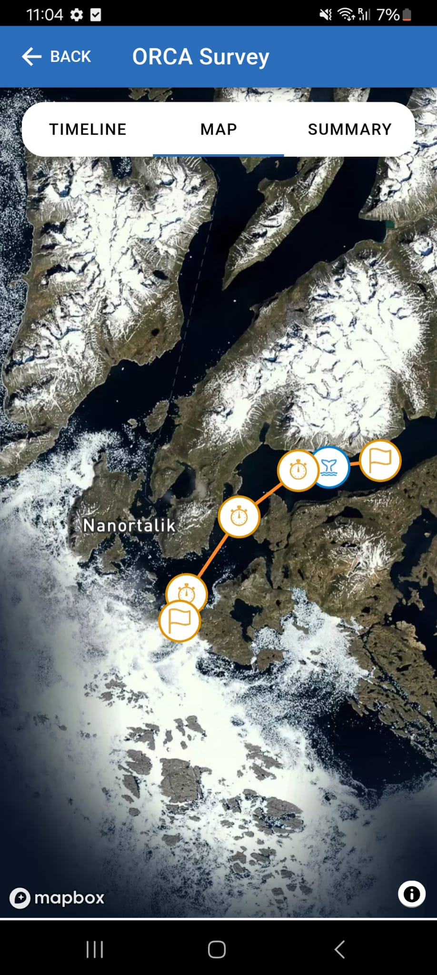
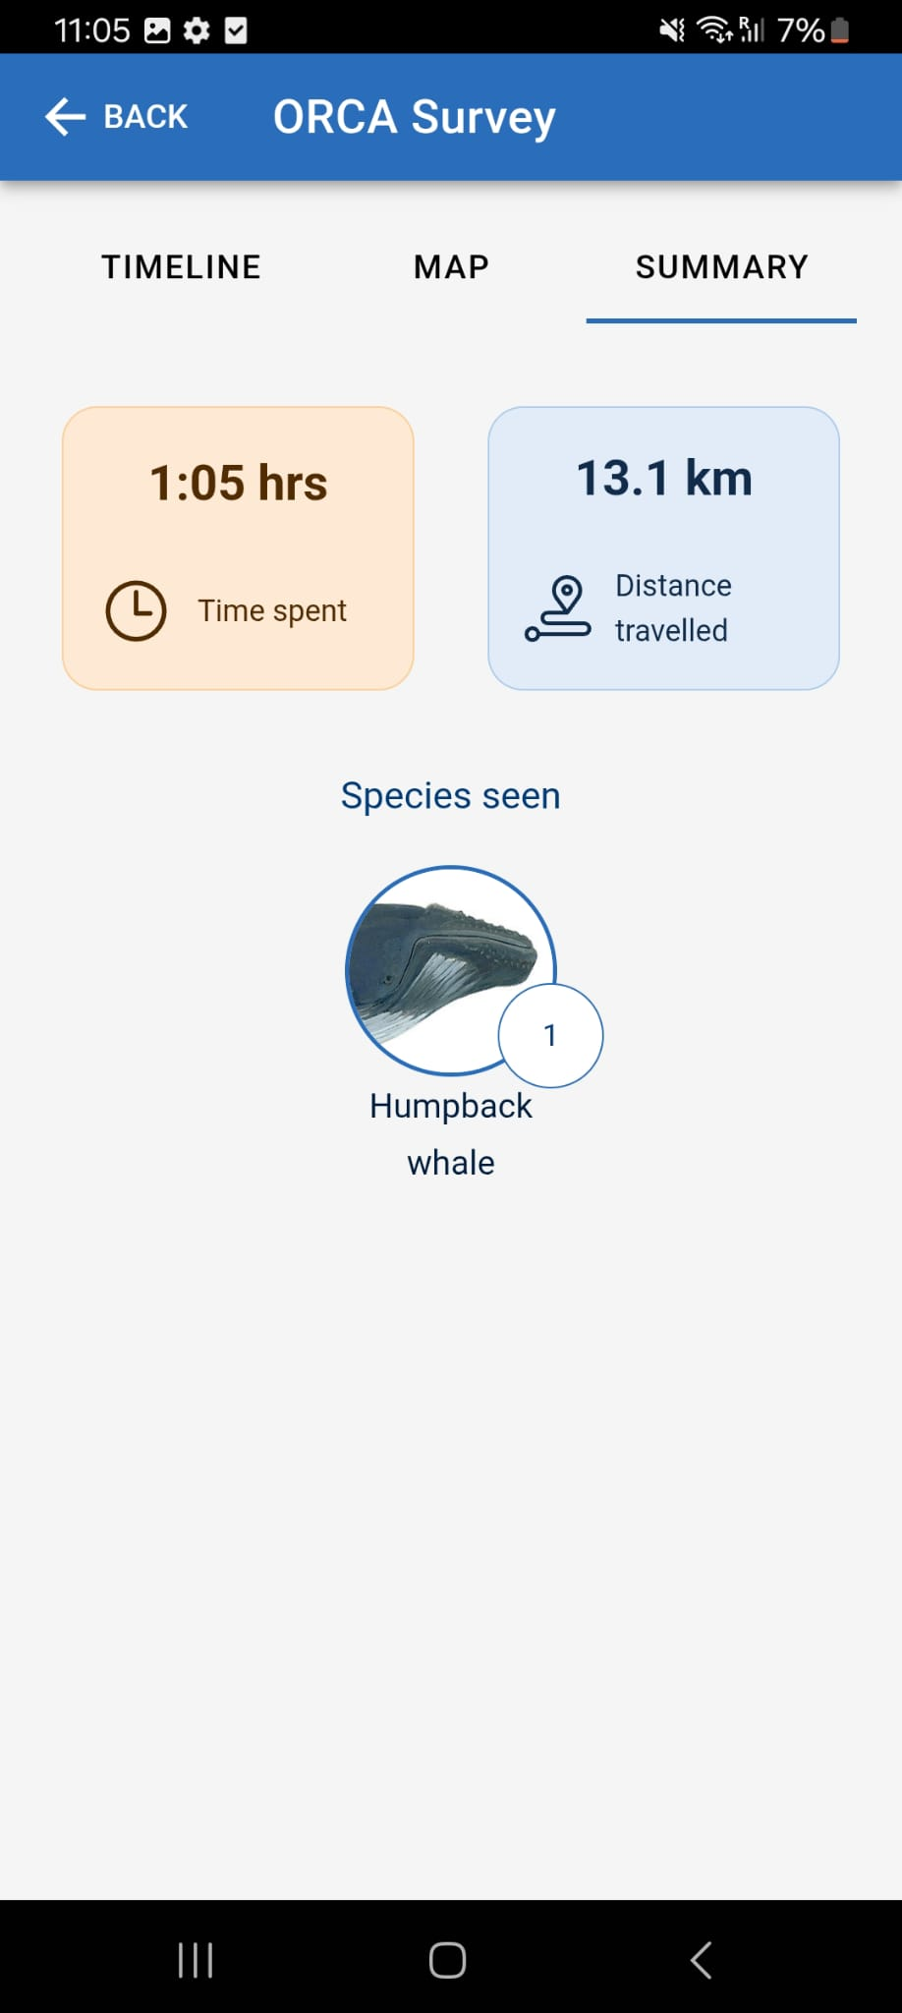
ORCA
On your journey across the North Atlantic, you were joined by ORCA Ocean Conservationist Pete, who collected data on whales, dolphins, and porpoises. This data was recorded using the ORCA OceanWatchers App and sent to ORCA, where it is made available to organisations interested in cetacean conservation. It is also published on the ORCA website's interactive map for anyone who wants to see what might be found and where.
On this voyage, a total of 16 hours and 31 minutes of survey data was collected, spanning a distance of 278 km. Four species of marine mammal were recorded, with 82 individuals observed in total.
Notes:
Add more slide if you need to. Keep the same font and format pls. screenshots of the surveys conducted, whale species seen could be interesting.

Slide 30
Sightings
Species | Number of individuals seen
humpback whale (Megaptera novaeangliae) | 21
minke whale (Balaenoptera acutorostrata) | 2
unidentified dolphin (Delphinidae sp.) | 7
harp seal (Pagophilus groenlandicus) | 52

Slide 31
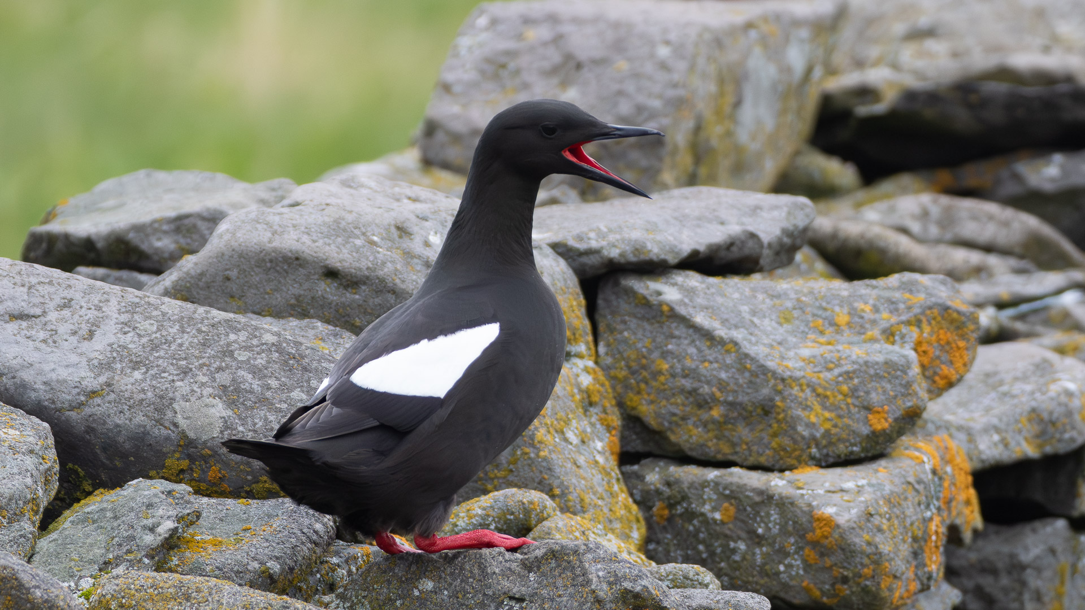
Wildlife List — Birds
Credit: Brendan Murtha

Slide 32
Wildlife List – Birds
Scientific Name | English | Deutsch | Français
Fulmarus glacialis | Northern Fulmar | Eissturmvogel | Fulmar boréal
Ardenna grisea | Sooty Shearwater | Dunkelsturmtaucher | Puffin fuligoneux
Ardenna gravis | Great Shearwater | Großer Sturmtaucher | Puffin majeur
Morus bassanus | Northern Gannet | Basstölpel | Fou de Bassan
Stercorarius parasiticus | Arctic Skua | Schmarotzerraubmöwe | Labbe parasite
Larus fuscus | Lesser Black-backed Gull | Heringsmöwe | Goéland brun
Larus glaucoides | Iceland Gull | Polarmöwe | Goéland arctique
Larus hyperboreus | Glaucous Gull | Eismöwe | Goéland bourgmestre
Larus marinus | Great Black-backed Gull | Mantelmöwe | Goéland marin
Rissa tridactyla | Black-legged Kittiwake | Dreizehenmöwe | Mouette tridactyle
Sterna paradisaea | Arctic Tern | Küstenseeschwalbe | Sterne arctique
Uria aalge | Common Guillemot | Trottellumme | Guillemot marmette
Uria lomvia | Brünnich's Guillemot | Dickschnabellumme | Guillemot de Brünnich
Alca torda | Razorbill | Tordalk | Pingouin torda
Cepphus grylle | Black Guillemot | Gryllteiste | Guillemot à miroir
Fratercula arctica | Atlantic Puffin | Papageitaucher | Macareux moine
Notes:
Copy and paste water birds observed – make sure scientific name is in italics

Slide 33
Wildlife List – Birds
Scientific Name | English | Deutsch | Français
Haliaeetus albicilla | White-tailed Eagle | Seeadler | Pygargue à queue blanche
Motacilla alba | White Wagtail | Bachstelze | Bergeronnette grise
Oenanthe oenanthe | Northern Wheatear | Steinschmätzer | Traquet motteux
Corvus corax | Common Raven | Kolkrabe | Grand Corbeau
Acanthis flammea | Redpoll | Birkenzeisig | Sizerin flammé
Plectrophenax nivalis | Snow Bunting | Schneeammer | Plectrophane des neiges
Calcarius lapponicus | Lapland Longspur | Spornammer | Plectrophane lapon
Scientific Name | English | Deutsch | Français
Anas platyrhynchos | Mallard | Stockente | Canard colvert
Somateria mollissima | Common Eider | Eiderente | Eider à duvet
Mergus serrator | Red-breasted Merganser | Mittelsäger | Harle huppé
Gavia immer | Great Northern Diver | Eistaucher | Plongeon imbrin
Arenaria interpres | Ruddy Turnstone | Steinwälzer | Tournepierre à collier
Notes:
Copy and paste water birds observed – make sure scientific name is in italics

Slide 34
Wildlife List – Birds
Scientific Name | English | Deutsch | Français
Anas platyrhynchos | Mallard | Stockente | Canard colvert
Somateria mollissima | Common Eider | Eiderente | Eider à duvet
Mergus serrator | Red-breasted Merganser | Mittelsäger | Harle huppé
Gavia immer | Great Northern Diver | Eistaucher | Plongeon imbrin
Arenaria interpres | Ruddy Turnstone | Steinwälzer | Tournepierre à collier
Notes:
Copy and paste water birds observed – make sure scientific name is in italics

Slide 35
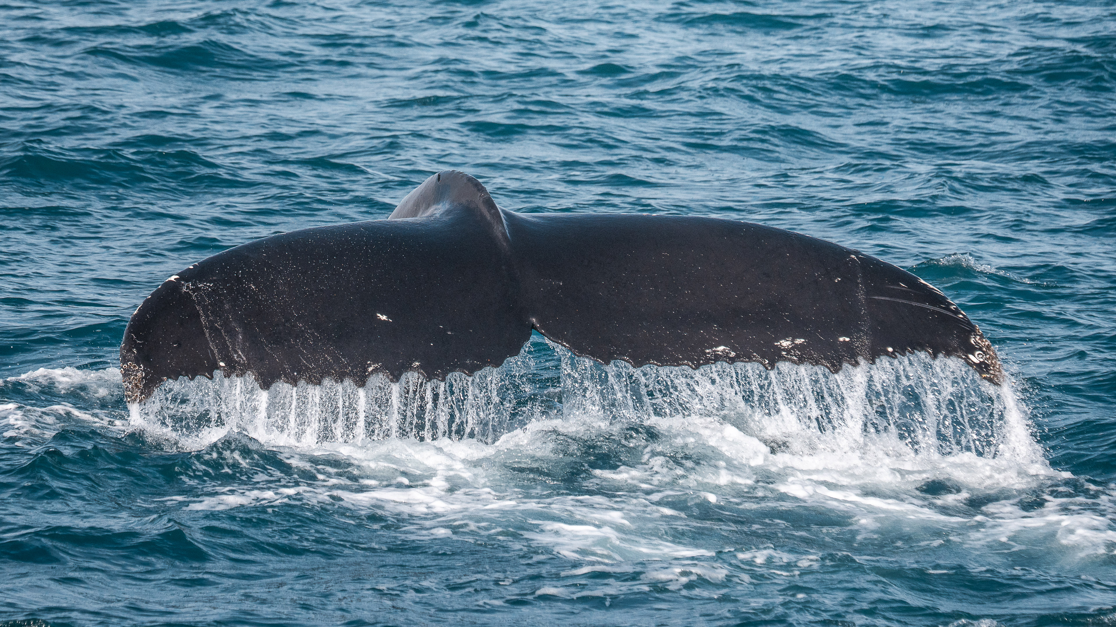
Wildlife
List - Marine Mammals
Credit: Timo Heinz
Notes:
Updated 11.02.25

Slide 36

Wildlife List – Mammals
Scientific Name | English | Deutsch | French
Balaenoptera acutorostrata | Minke whale | Zwergwal | Petit rorqual
Megaptera novaeangliae | Humpback whale | Buckelwal | Baleine à bosse
Globicephala melas | Long-finned pilot whale | Grindwal | Globicéphale
Pagophilus groenlandicus | Harp Seal | Sattelrobbe | Phoque du Groenland
Equus ferus caballus | Musk Ox | Moschusochse | Bœuf musqué
Rangifer tarandus | Reindeer | Rentier | Renne
Notes:
Updated by Lilia - updated

Slide 37
Connect With Your Inner Scientist

