Slide 1
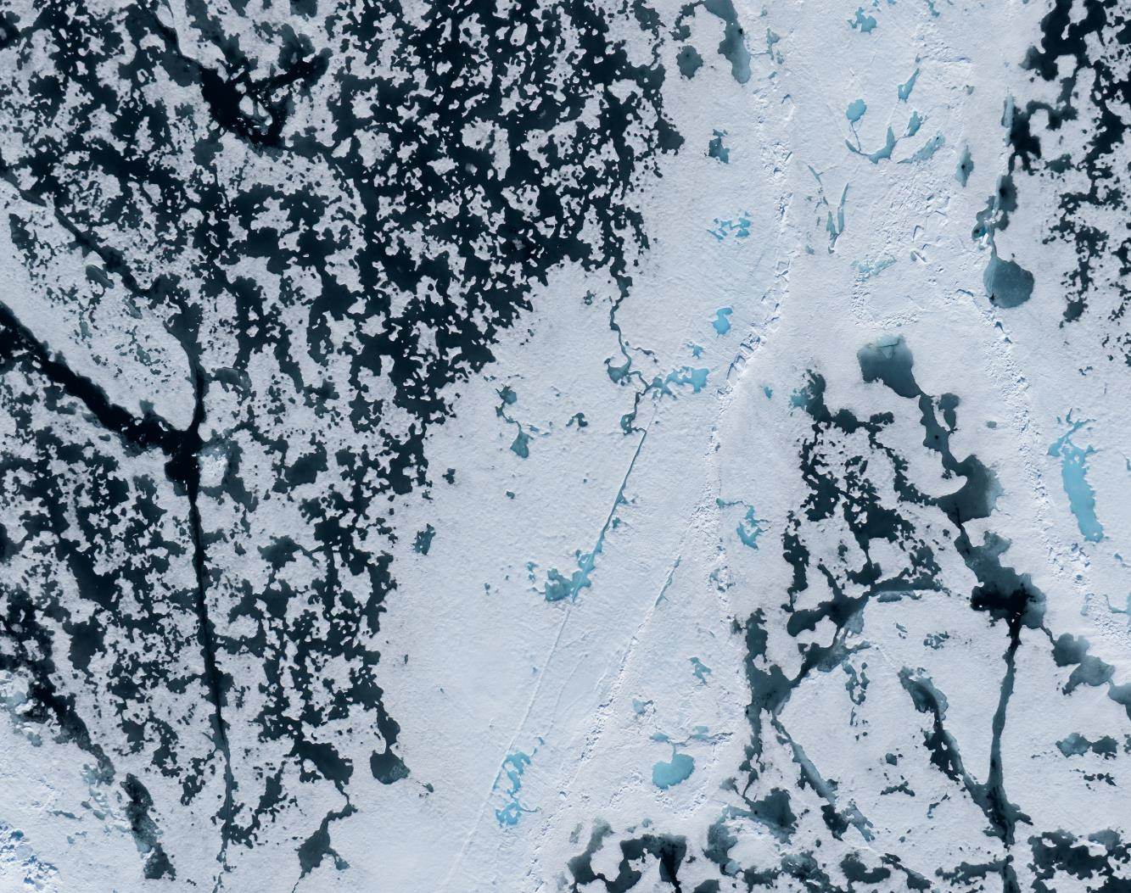
MS Fram
14 - 21 June 2026
Svalbard in Springtime, the Return of the Sun
Credit: Yuri Choufour/HX

Slide 2
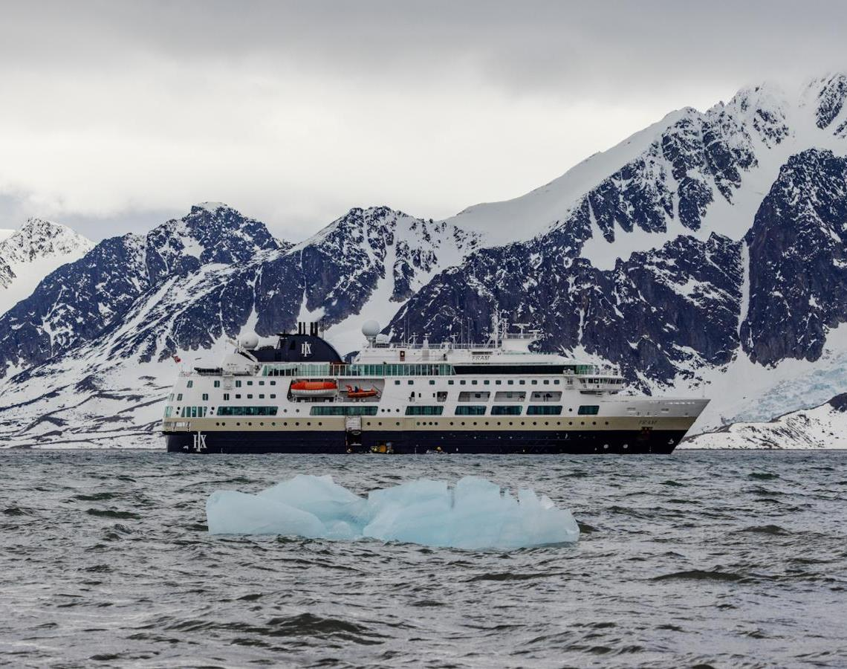
Science & education program
During this voyage, we helped by collecting data for 3 citizen science projects in total: eBird, Inaturalist & SecchiDisk project. You were able to enrich your mind with 6 lectures on different topics from birds to rocks. You also took part in the 2 discovery sessions we put on.
We had a guest scientist onboard from the FRAM-PLANKTO project who was studying plankton comunities in the different fjords.
A lot of you were very interested in the scientific aspect of our voyage and we thank you all for your enthusiasm. Here we provide a resume of our science activities.
Credit: Rosie Barrett/HX
Notes:
Add brief summary of the Science & Education Program over the whole voyage

Slide 3
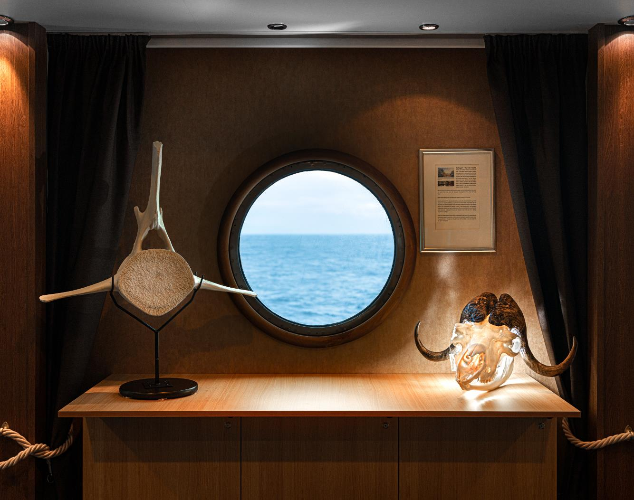
Lectures & Discovery Sessions
6 lectures
2 discovery sessions
3 Citizen Science projects
5 science boat sessions
1 Guest Scientist project
©Yuri Choufour/HX

Slide 4
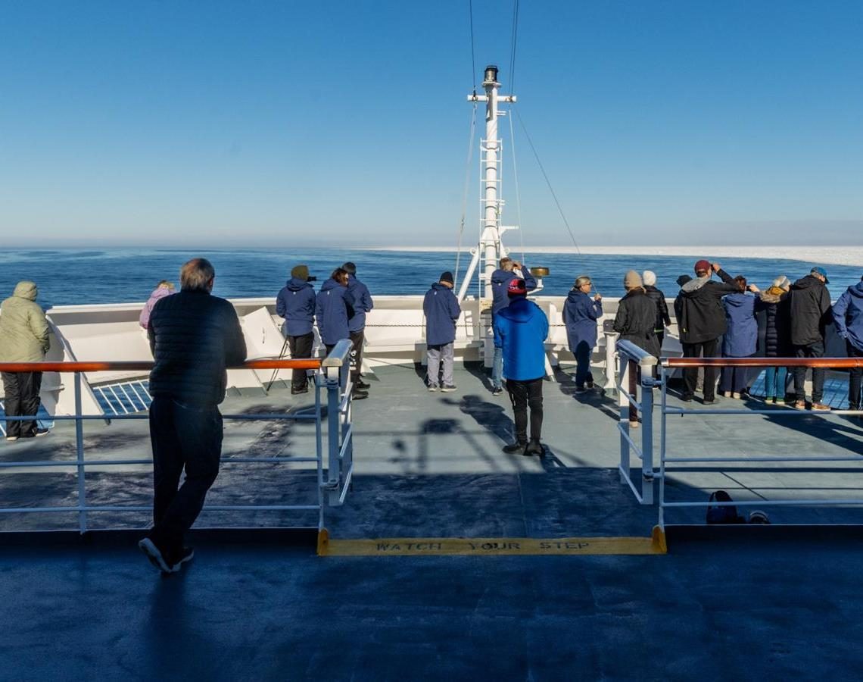
Wildlife Watch
30 species:
8 mammals
22 birds

Slide 5
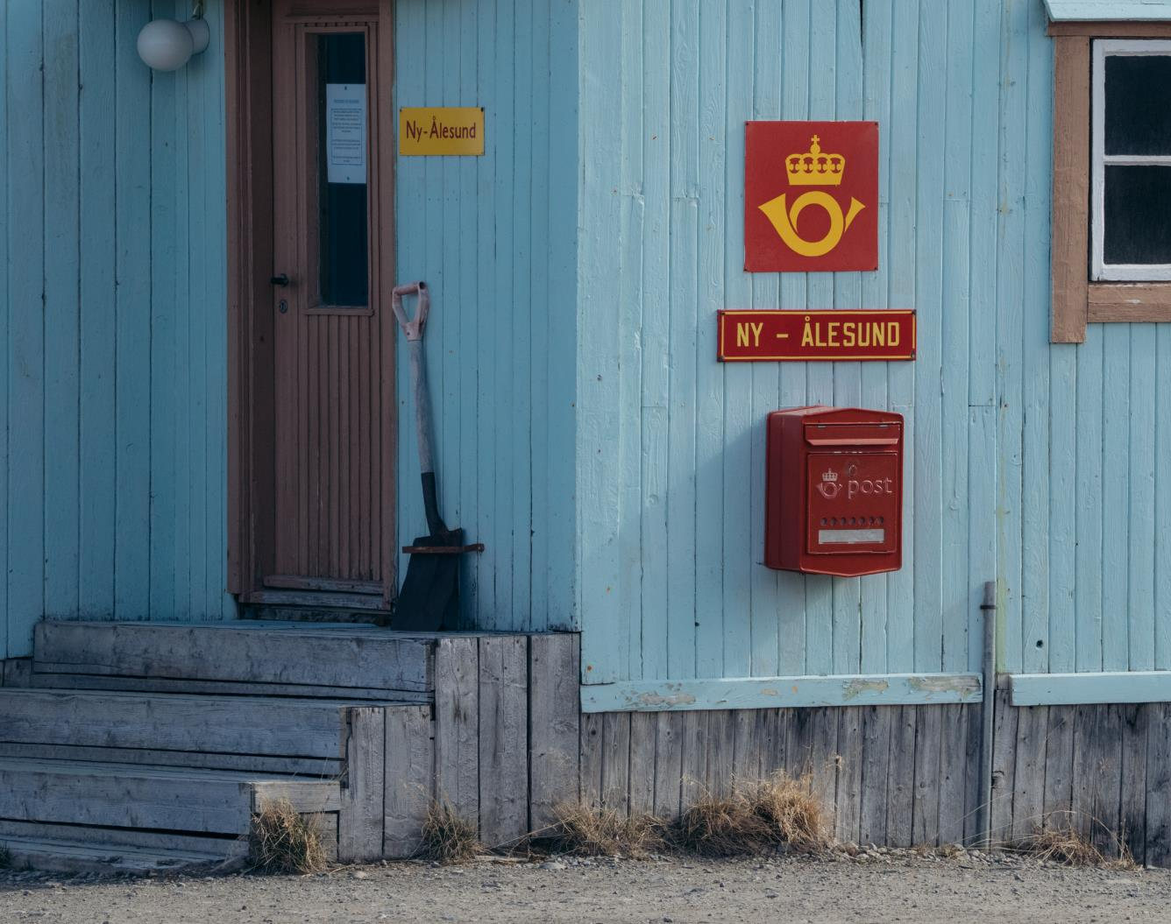
History & Culture
During this voyage, we explored the legacy of Fridtjof Nansen, his expedition across the Arctic Ocean aboard the Fram, and the remarkable history of Svalbard.
At nearly 79°N, we visited Ny-Ålesund, the world's northernmost year-round research station — once a coal-mining outpost, now an international hub for Arctic science. In 1926, Roald Amundsen, the American Lincoln Ellsworth, and the Italian Umberto Nobile took the airship Norge over the North Pole from here. Amundsen's mooring mast and bronze bust still honour Svalbard's exploration legacy.
Credit: Yuri Choufour/HX

Slide 6
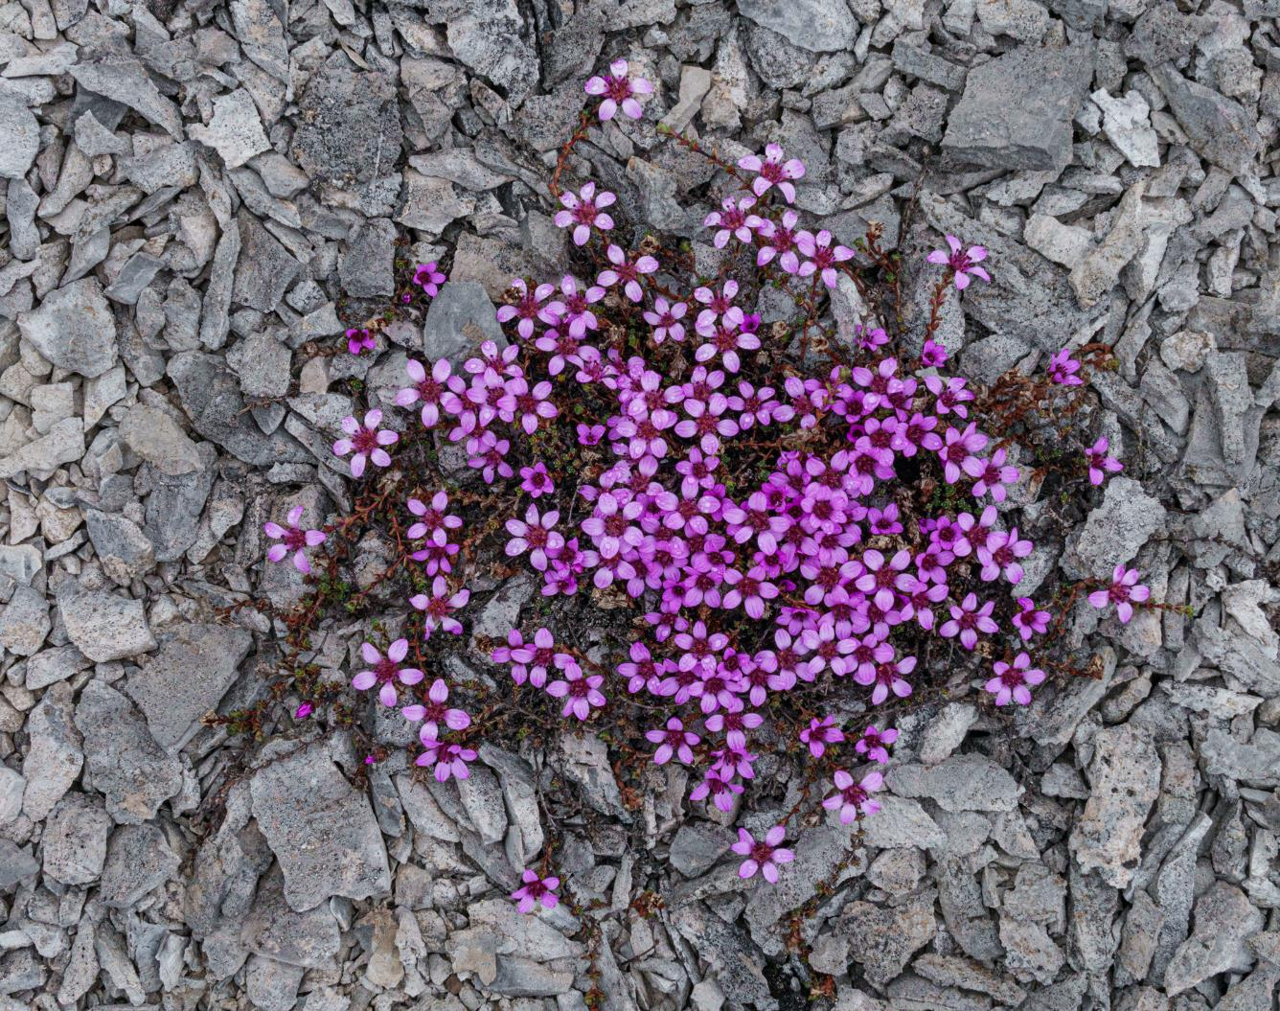
iNaturalist
Thanks to your efforts, we recorded 59 opportunistic observations representing nearly 31 different species - and the count is still rising.
You can upload further photographs to the iNaturalist website (inaturalist.org) or app on any platform. By sharing your data on iNaturalist, you contribute to a global, open-access database that fuels scientific research and conservation monitoring.
These records are vital for researchers tracking species distribution and assessing ecosystem health.
You can view the project and upload your observations from our voyage by clicking here.
Fernandocrambus falklandicellus photographed by Vivi Bolin on New Island
Credit: Yuri Choufour/HX
Credit: Jan Hvizdal /HX
Yuri Choufour
Credit: Vivi Bolin/HX

Slide 7
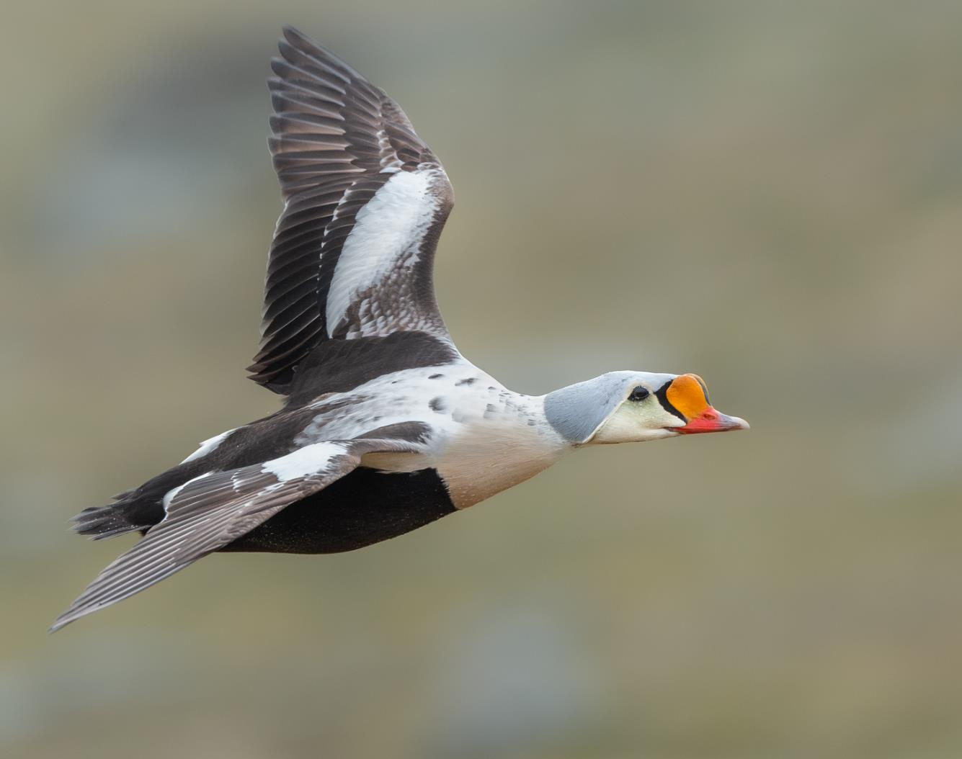
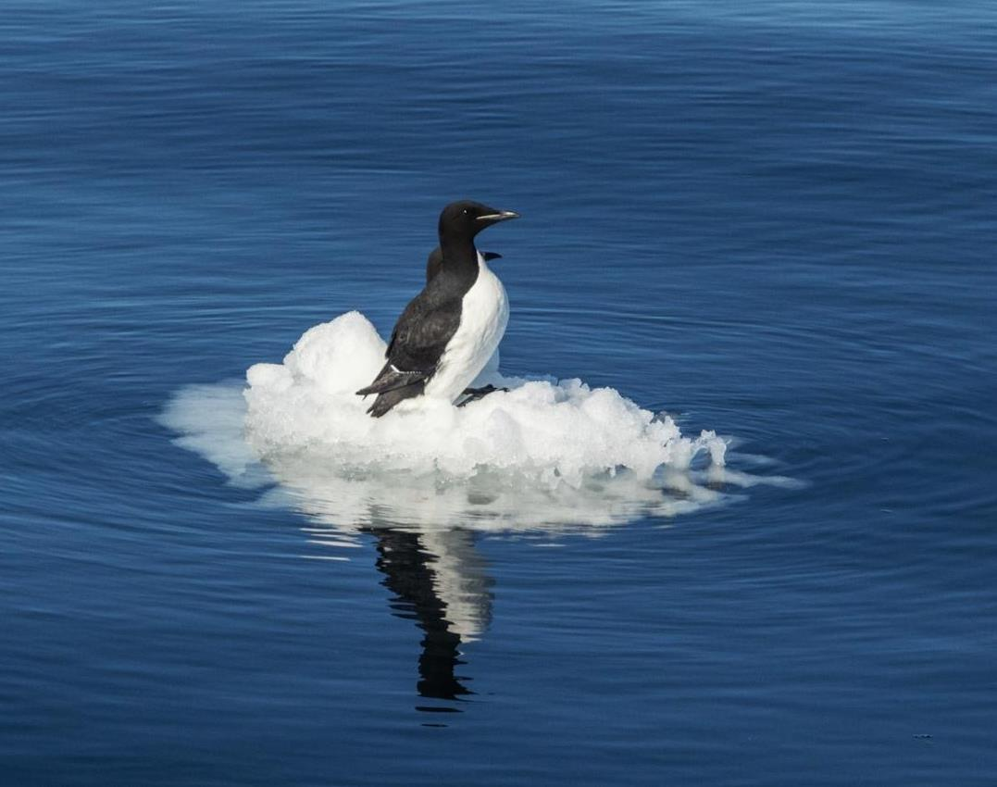
eBird
Our onboard Ornithologist Simon completed 14 eBird checklists, recording 21 species across our seven-day voyage. The most abundant species was the black-legged kittiwake, followed by Brünnich's guillemot (thick-billed murre) and the little auk (dovekie). For complete survey details, follow the link:
https://ebird.org/tripreport/538746
Credit: Yuri Choufour/HX
Credit: Jan Hvizdal /HX
Notes:
UPDATE PLEASE

Slide 8
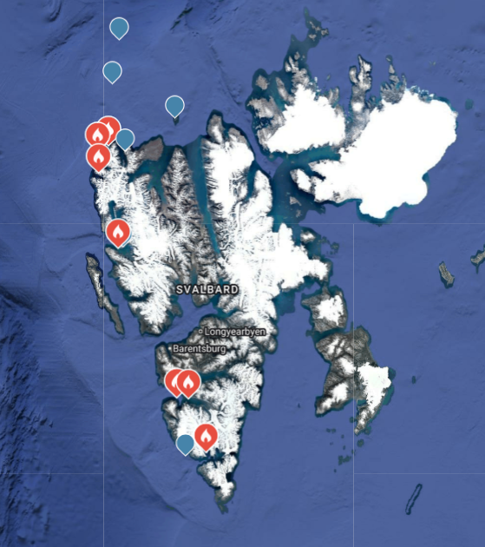
Locations of eBird Surveys

Slide 9
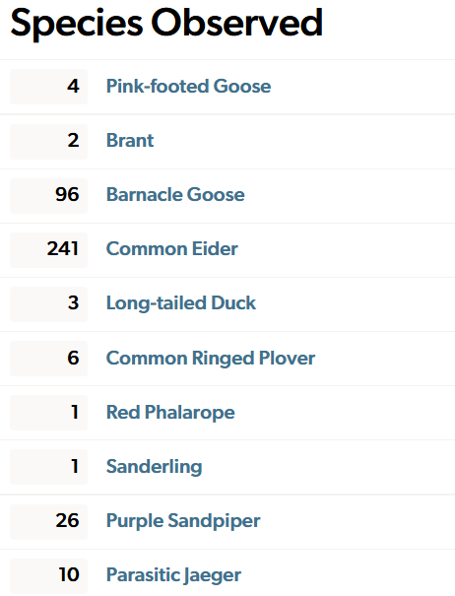
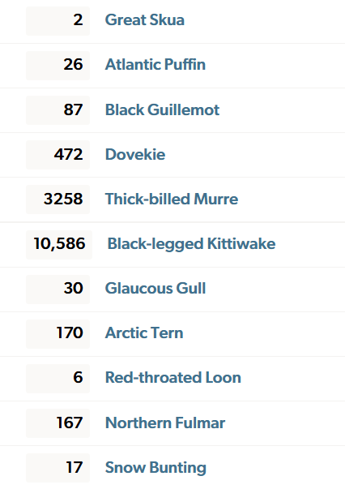
Species Totals from eBird Surveys

Slide 10
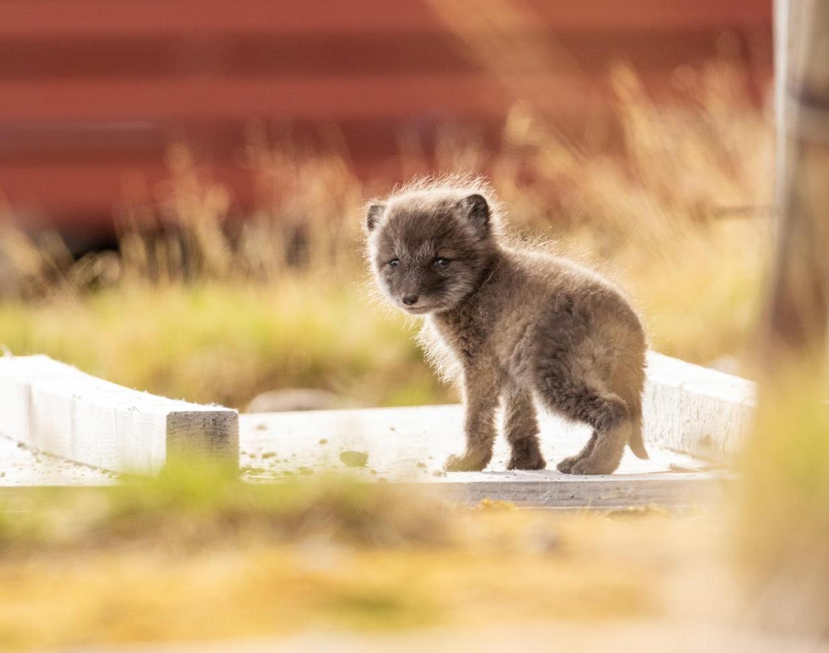
MAMMALS
Although we did not submit photographs to the Happywhale project during this voyage, we were fortunate to spot several marine mammals — harbour seals, ringed seals, and minke whales. From the deck we had clear views of walrus at Moffen, and on our final day a polar bear made a memorable appearance.
We hope you keep your eyes on the horizon for wildlife once you have returned home. Thank you for travelling with HX. We hope to welcome you on board again before long.
Notes:
UPDATE PLEASE

Slide 11
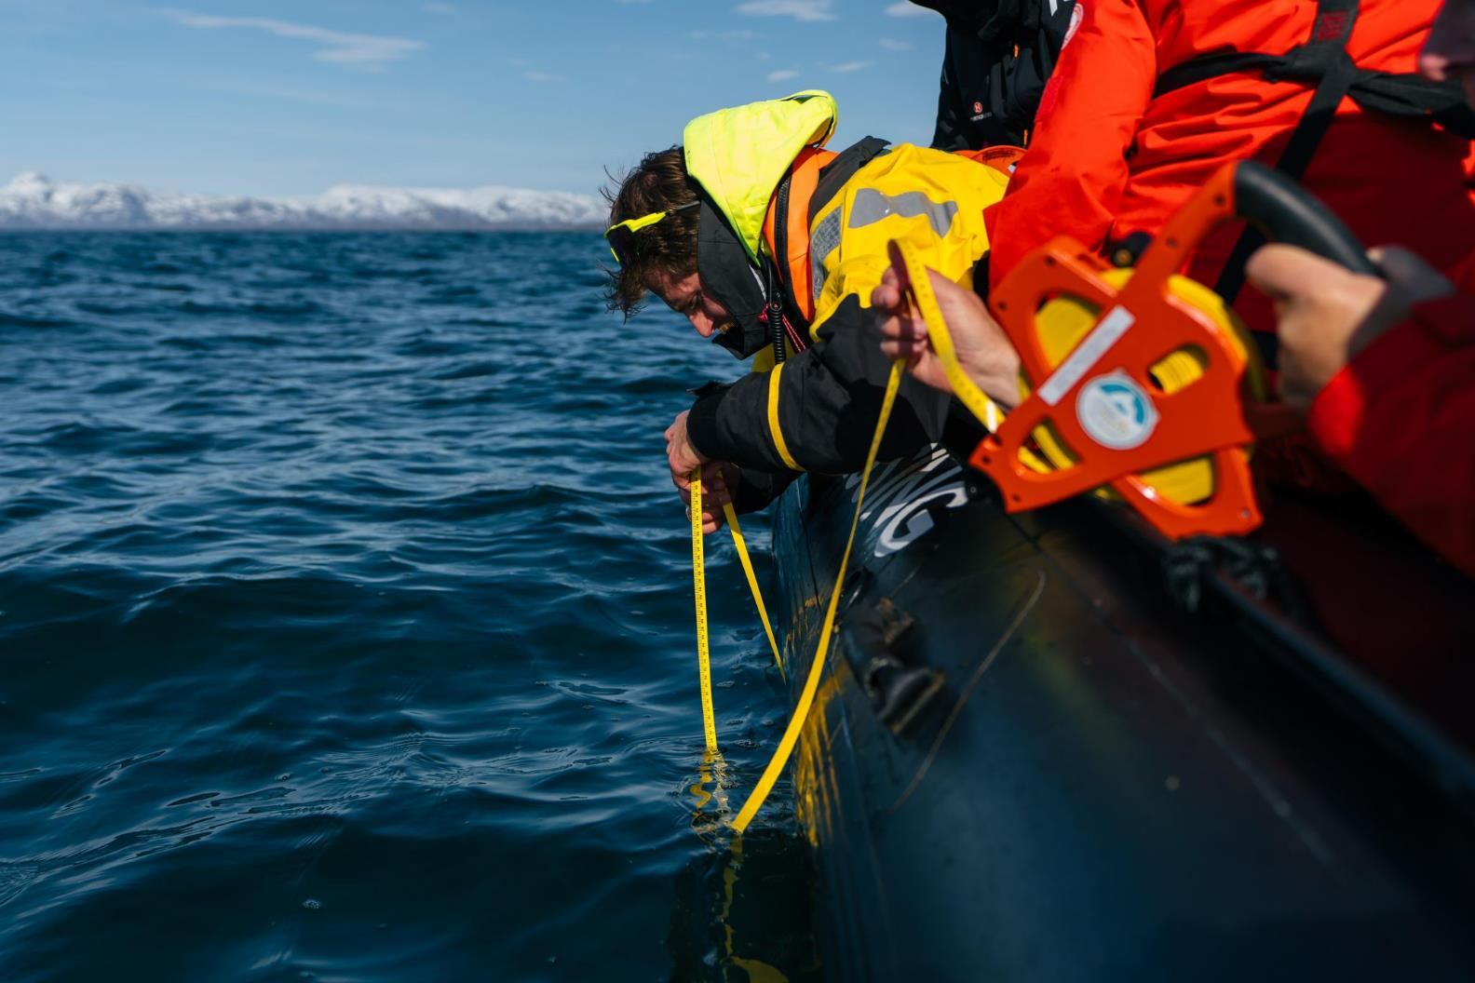
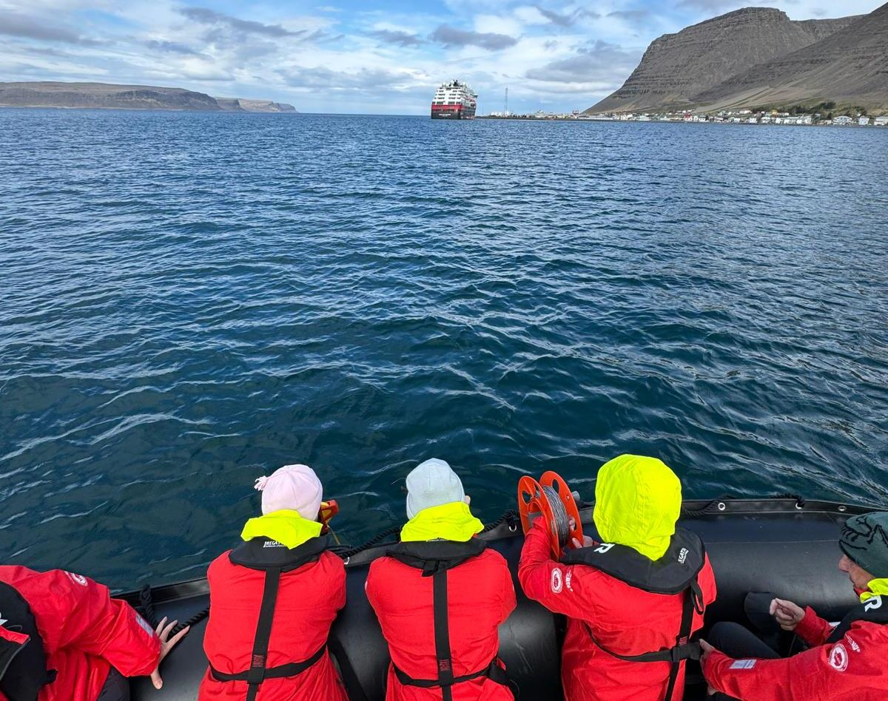
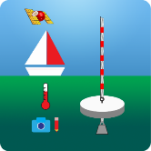
Science Boat
We ran 5 science boat sessions during this voyage, visiting Bamsebu, Gravnesodden, Smeerenburg, and Alicehamna. At each site we took Secchi Disk measurements to record the clarity of the water and to estimate the abundance of phytoplankton.
View our data submitted to the Secchi Disk Project.
Date | Location | Depth (m)
09.06.26 | Asbestodden | 9.3
12.06.26 | The Ice Edge | 12.0
View our data submitted to the Secchi Disk Project
Notes:
Add highlights of what science boat activities and sampling were undertaken – update secchi link to specific voyage if possible

Slide 12
Science Boat
We had 5 science boat sessions during this trip in: Bamsebu, Gravnesodden,
Smeerenburg & Alicehamna.
View our data submitted to the Secchi Disk Project
Notes:
Add highlights of what science boat activities and sampling were undertaken – update secchi link to specific voyage if possible

Slide 13
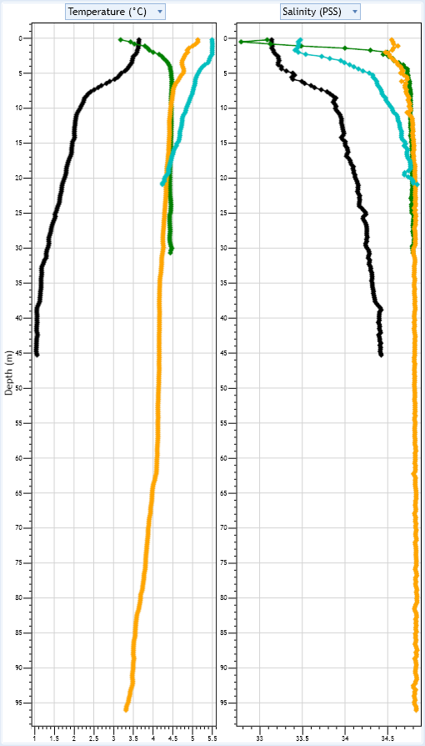
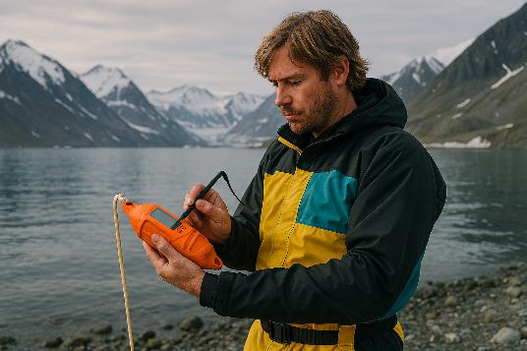
CTD Profiles
How to read the profiles: the y-axis on the left shows depth, increasing downward — values further down the graph correspond to deeper readings from the CTD. The left and right plots show temperature and salinity respectively. Each coloured line represents a separate cast, plotted together for direct comparison.
Pick a single line, note the value at the surface, and follow how it changes as you move down the water column.
Black line: 16 June, Bamsebu
Green line: 17 June, Gravnesodden
Yellow line: 17 June, Smeerenburg
Turquoise line: 18 June, Alicehamna
Black line: June 16th Bamsebu
Green line: June 17th Gravnesodden
Yellow line: June 17th Smeerenburg
Turqoise Line: 18th Alicehamna
Notes:
Add any interesting finds in the plankton samples and pictures taken down the microscopes

Slide 14
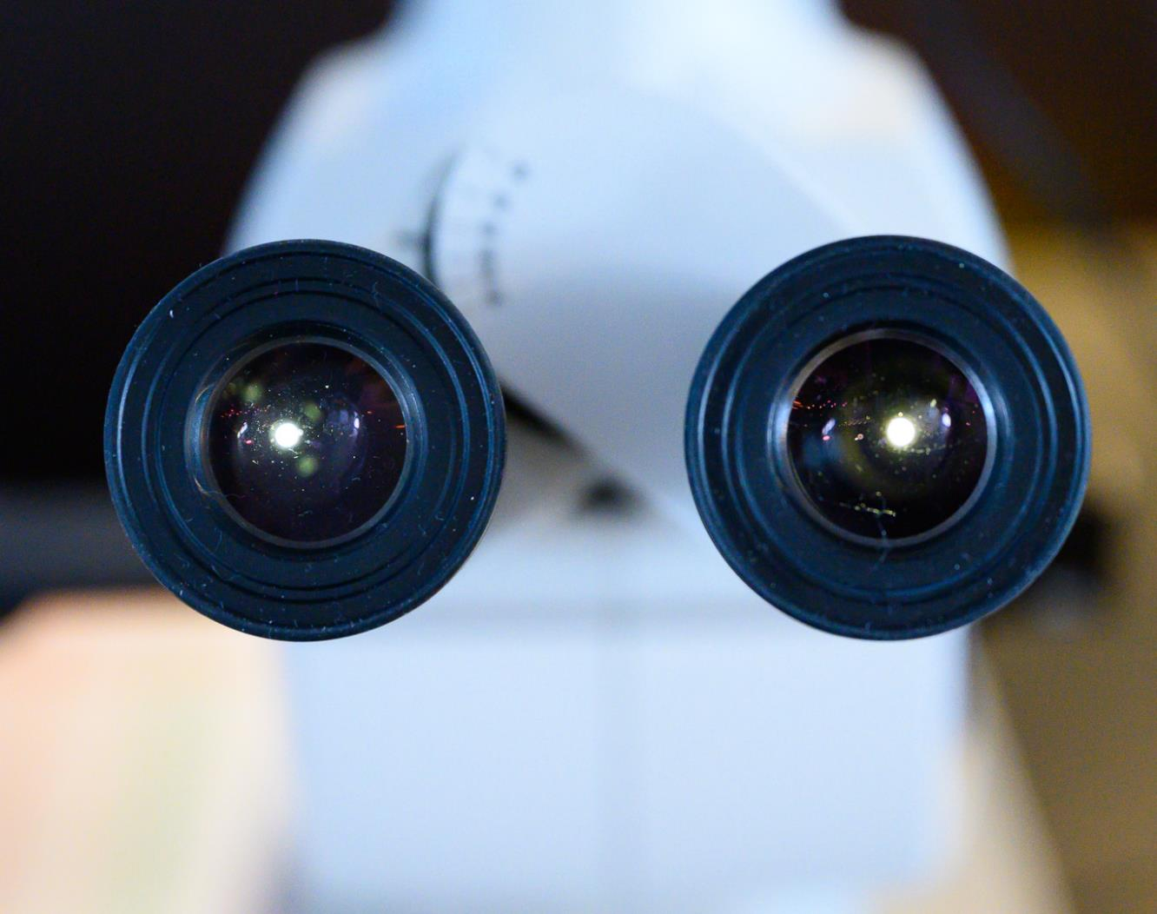
Plankton Samples
Credit: Martin Hain
Notes:
Add any interesting finds in the plankton samples and pictures taken down the microscopes

Slide 15
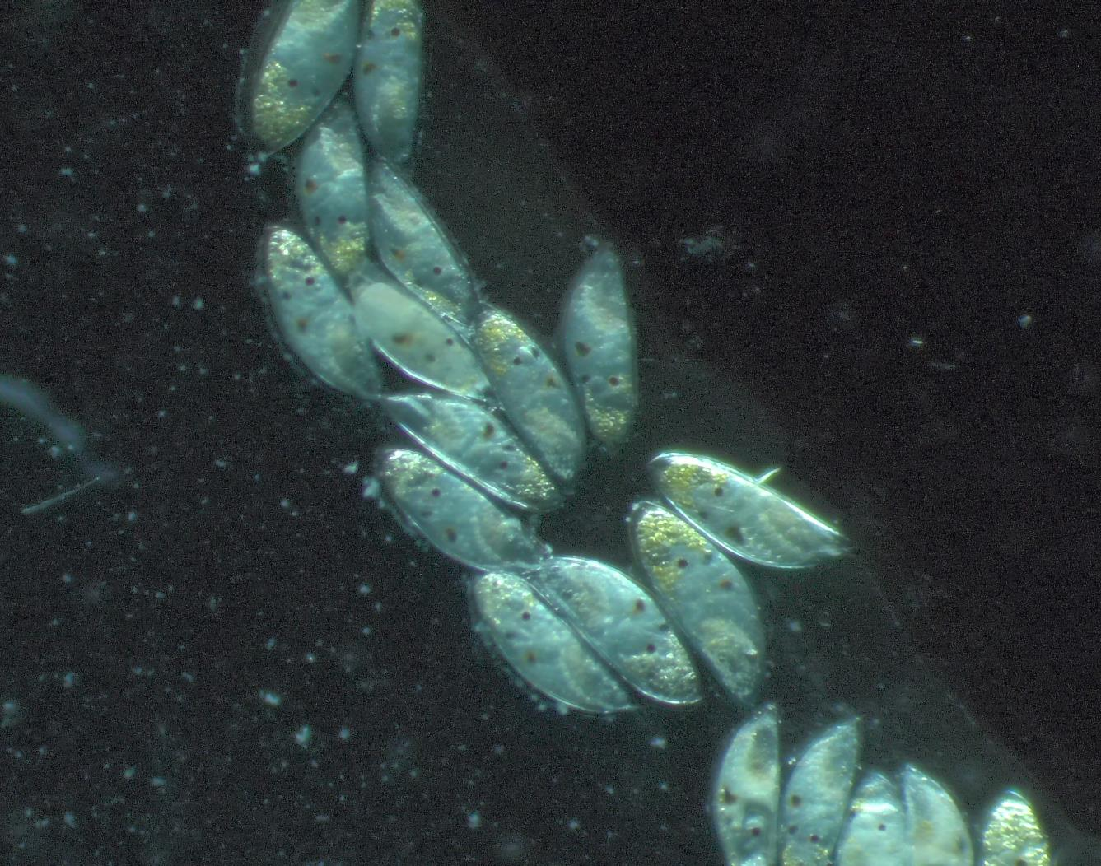
Plankton Samples: Barnacle Larvae
Notes:
Add any interesting finds in the plankton samples and pictures taken down the microscopes

Slide 16
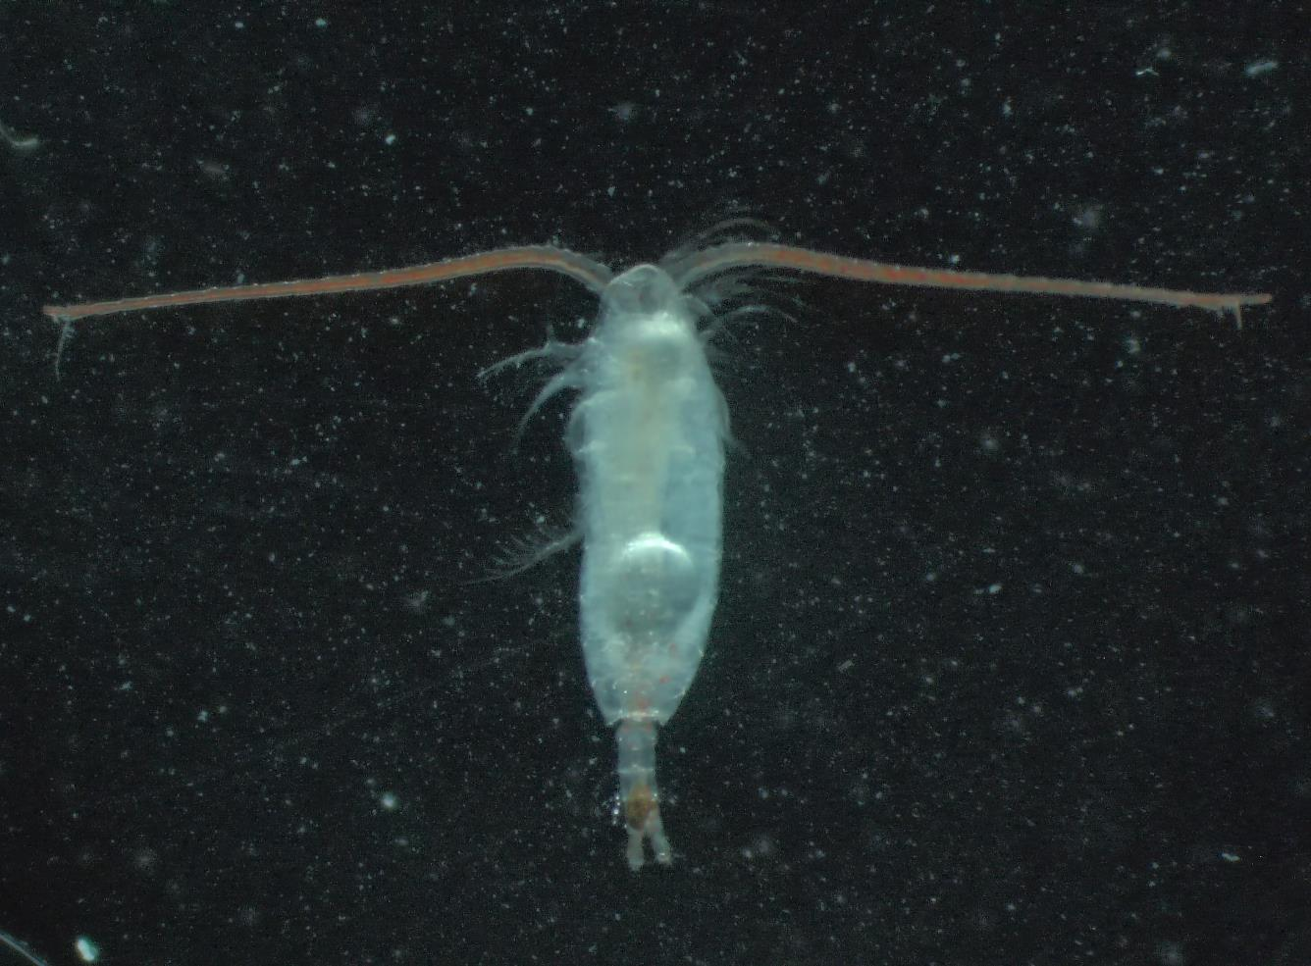
Plankton Samples: Copepod
Notes:
Add any interesting finds in the plankton samples and pictures taken down the microscopes

Slide 17
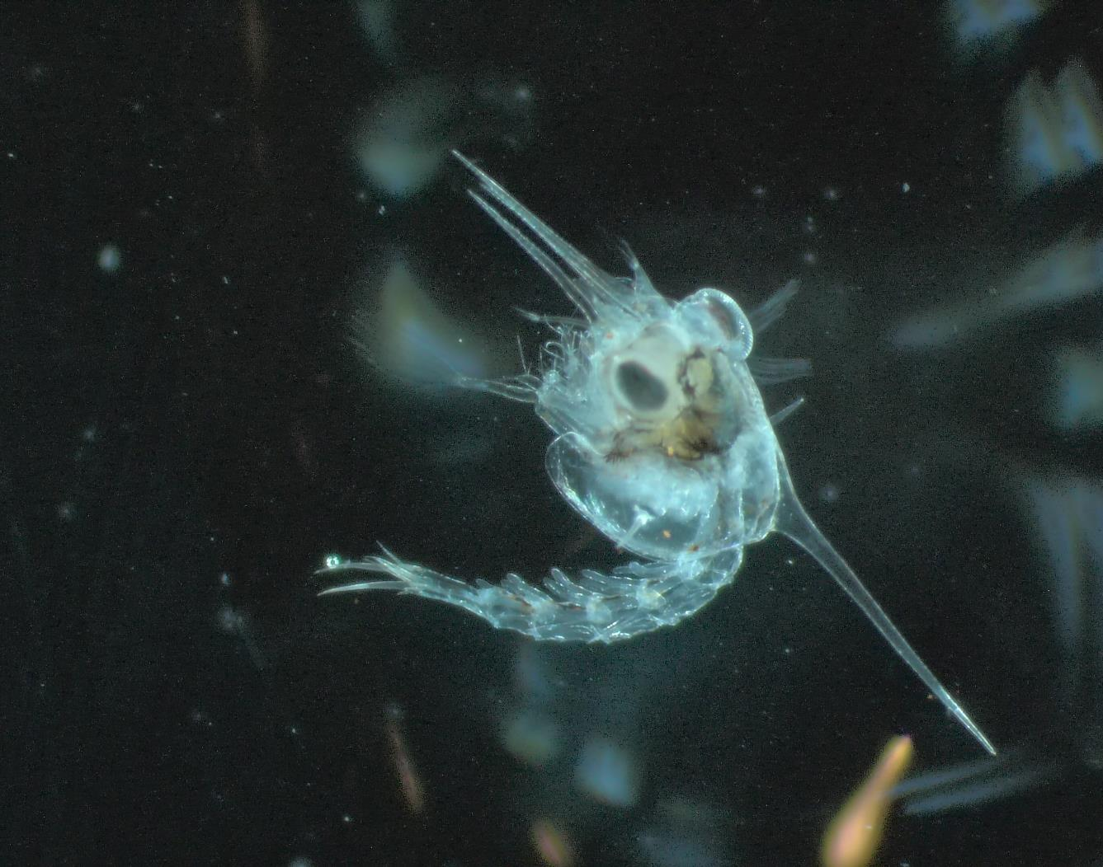
Plankton Samples: Crab Larvae
Notes:
Add any interesting finds in the plankton samples and pictures taken down the microscopes

Slide 18
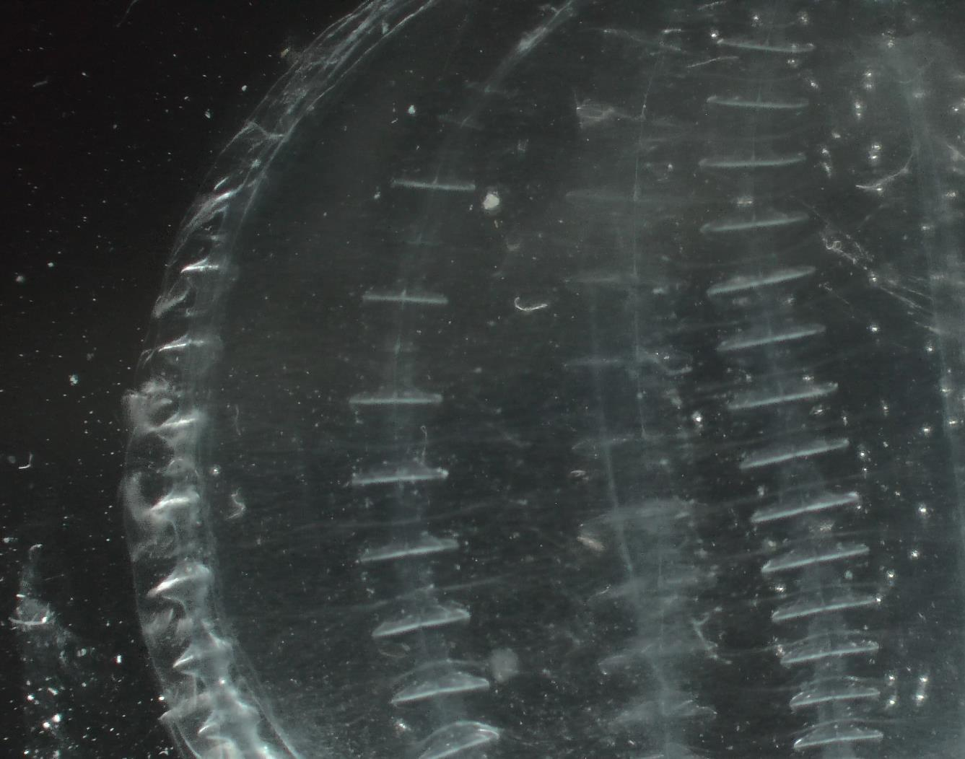
Plankton Samples: Comb Jelly
Notes:
Add any interesting finds in the plankton samples and pictures taken down the microscopes

Slide 19
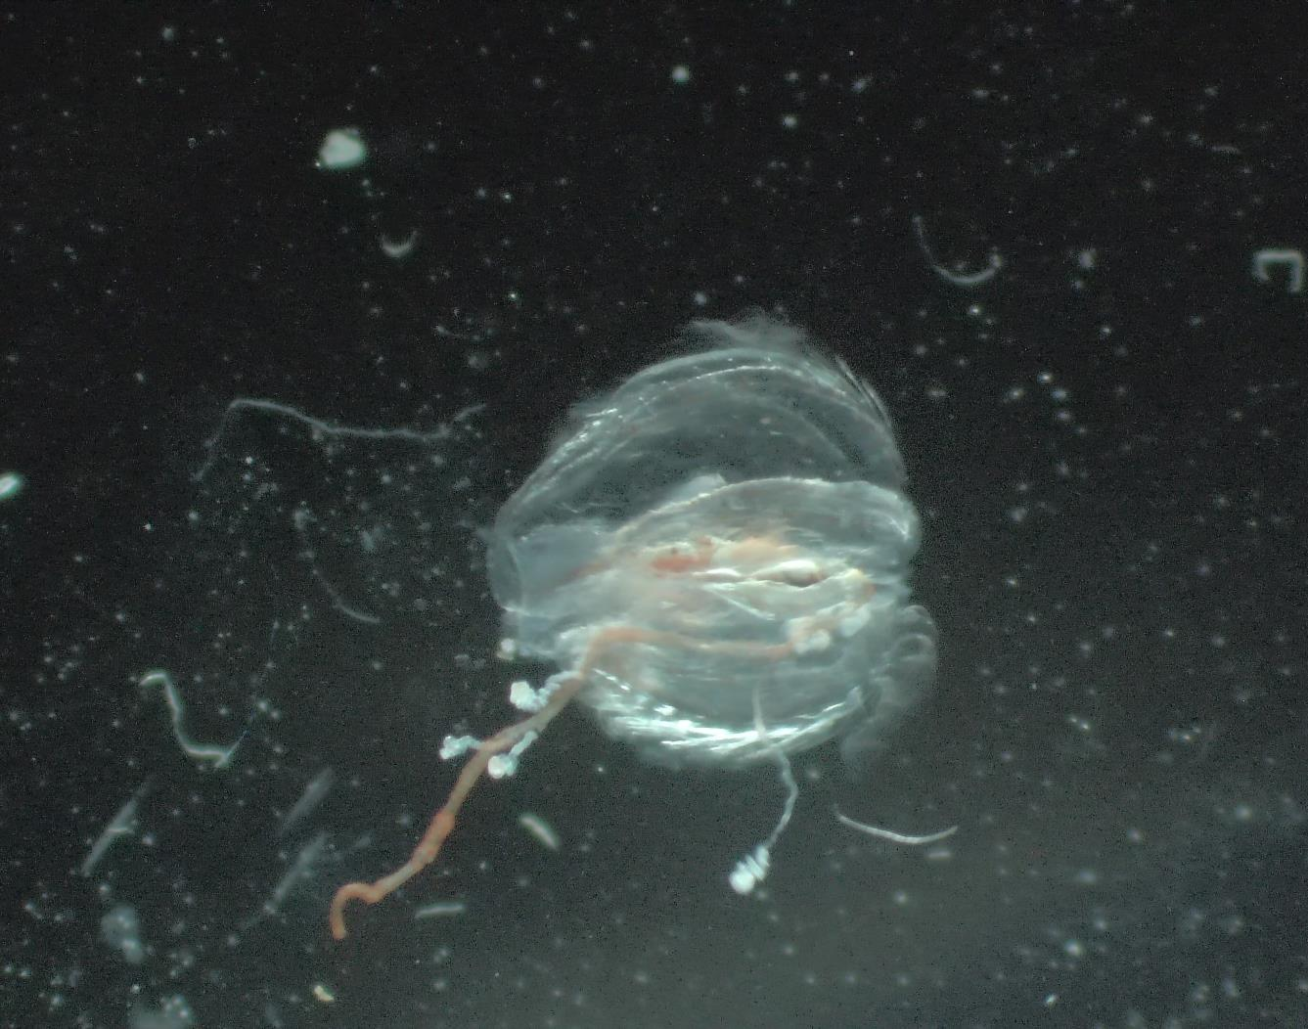
Plankton Samples: Comb Jelly
Notes:
Add any interesting finds in the plankton samples and pictures taken down the microscopes

Slide 20
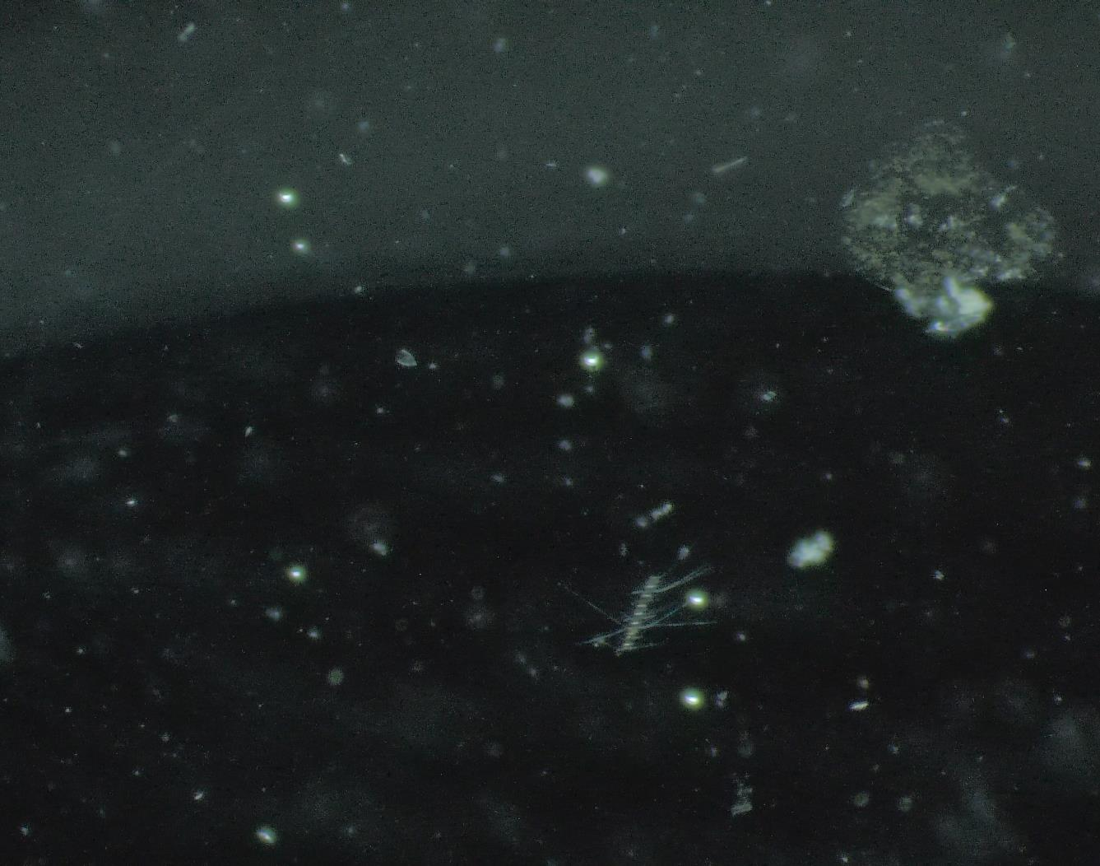
Plankton Samples:
Phyto Plankton
Micro Algae
Siphonophores
Diatoms
Notes:
Add any interesting finds in the plankton samples and pictures taken down the microscopes

Slide 21
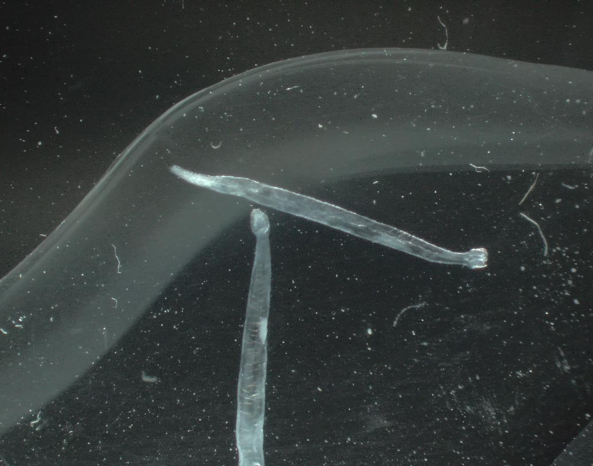
Plankton Samples: Arrow Worms
Notes:
Add any interesting finds in the plankton samples and pictures taken down the microscopes

Slide 22
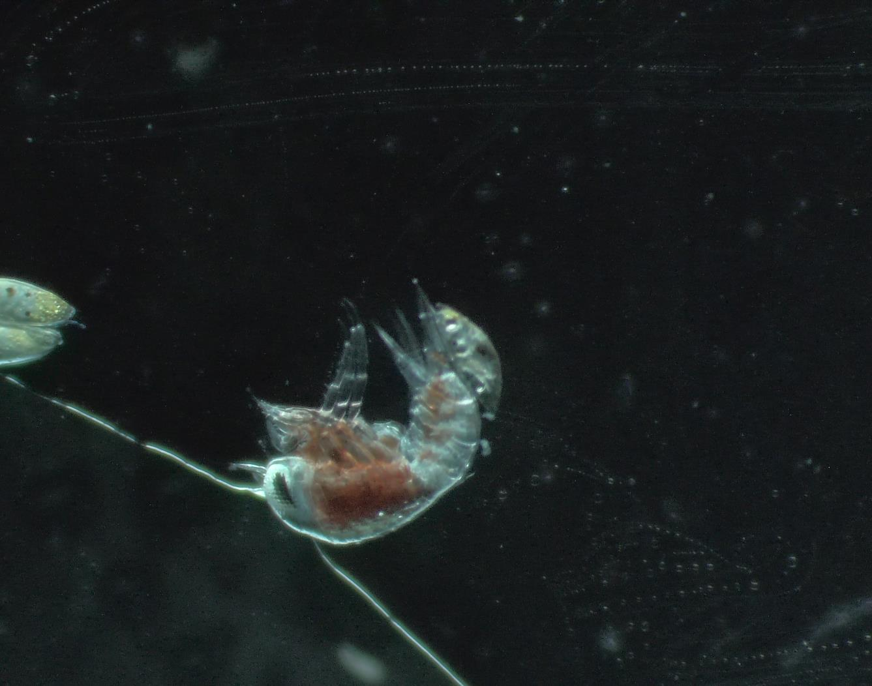
Plankton Samples: Hyperiid Amphipods
Notes:
Add any interesting finds in the plankton samples and pictures taken down the microscopes

Slide 23
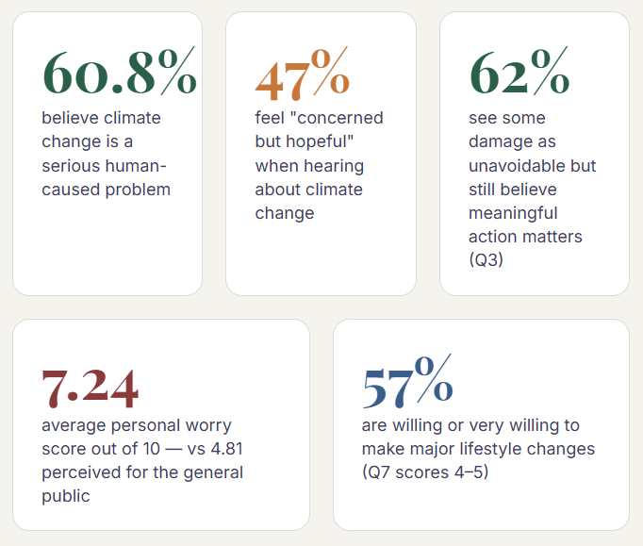
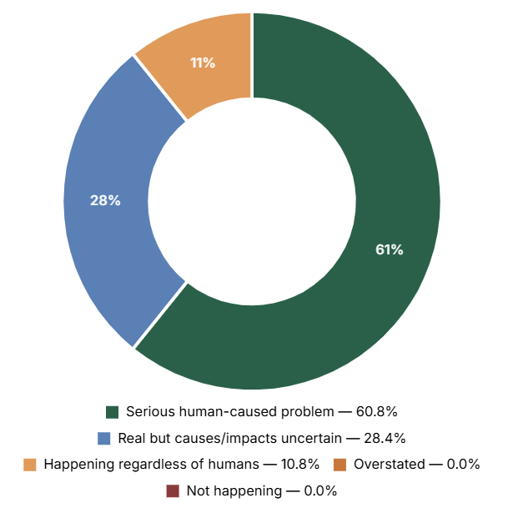
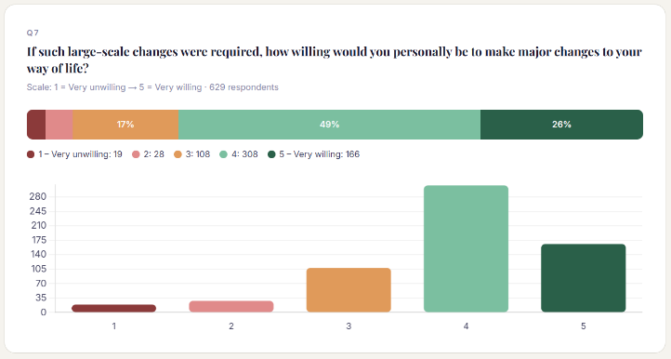
Climate Change Survey
When you hear about climate change, what best describes your reaction?
How do you feel about climate change?
As an experiment, we conducted a survey of guests' views and feelings on climate change. Over time, we hope to gather enough data to support a scientific statistical study within the microcosm of our ship.
Thanks to the 55 respondents who completed the survey - 44% of all guests on board. On this voyage, 61% of our guests consider climate change a serious problem caused by humans. You can view the results and interpretations on this link.
The results will continue to evolve as we collect more data.
Visit the IPCC website
Climate Change IPCC FAQ
IPCC Summary report
Visit the IPCC website
Climate Change IPCC FAQ
IPCC Summary report

Slide 24
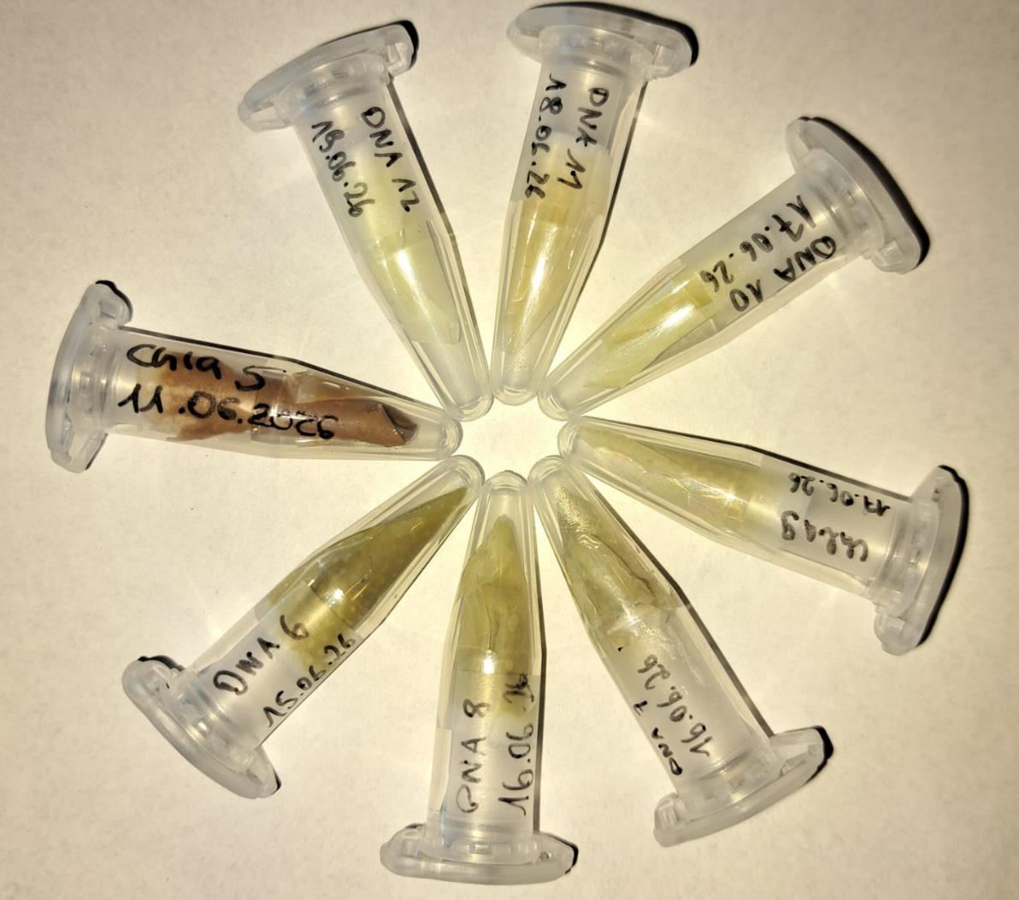
Guest Scientist's Project: FRAM-PLANKTO
The samples collected across the fjords of Svalbard varied considerably in microalgae biomass, depending on the abundance of zooplankton feeding on the microalgae. Low microalgae biomass correlated with high zooplankton abundance. This variability reflects the diversity of environmental settings between fjords, each shaping microalgae growth differently.
Understanding this variability is fundamental to mapping Arctic biodiversity and species distribution - a baseline against which we can measure the response of Arctic ecosystems to global environmental change, and a foundation for sustainable ocean management.
www.awi.de
Notes:
Add info on how many images were submitted to happywhale, new whales were ID, matches etc. as appropriate plus link to ship account on Happywhale – update link to specific voyage

Slide 25

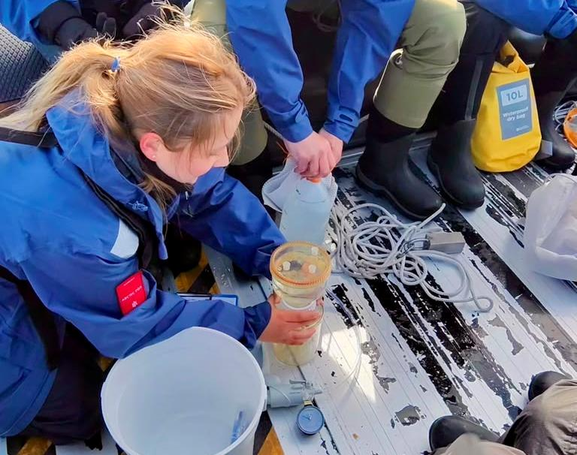

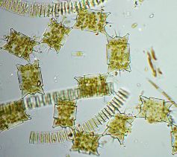
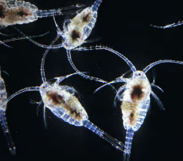
Guest Scientist's Project: FRAM-PLANKTO
The FRAM-PLANKTO project of the German Alfred Wegener Institute Helmholtz Centre for Polar Research collected water samples in each of the fjords MS Fram visited during the past week. Inken Holthoff, a master's student at AWI, set out to capture the plankton composition that fuels the marine food chain — from microalgae up to seals and whales. These samples, collected in collaboration with HX, complement AWI's long-term observations in the Fram Strait, which track the response of Arctic marine ecosystems to changing environmental conditions.
Phytoplanton
(Microalgae)
Zooplankton
(Copepods)
Foto: Katja Metfies
Notes:
Add info on how many images were submitted to happywhale, new whales were ID, matches etc. as appropriate plus link to ship account on Happywhale – update link to specific voyage

Slide 26
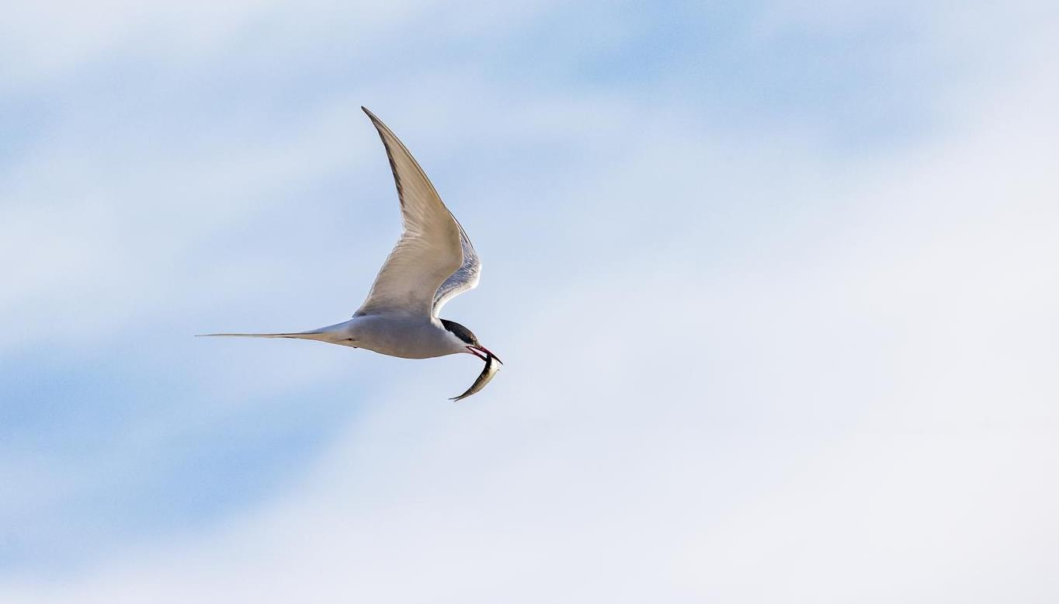
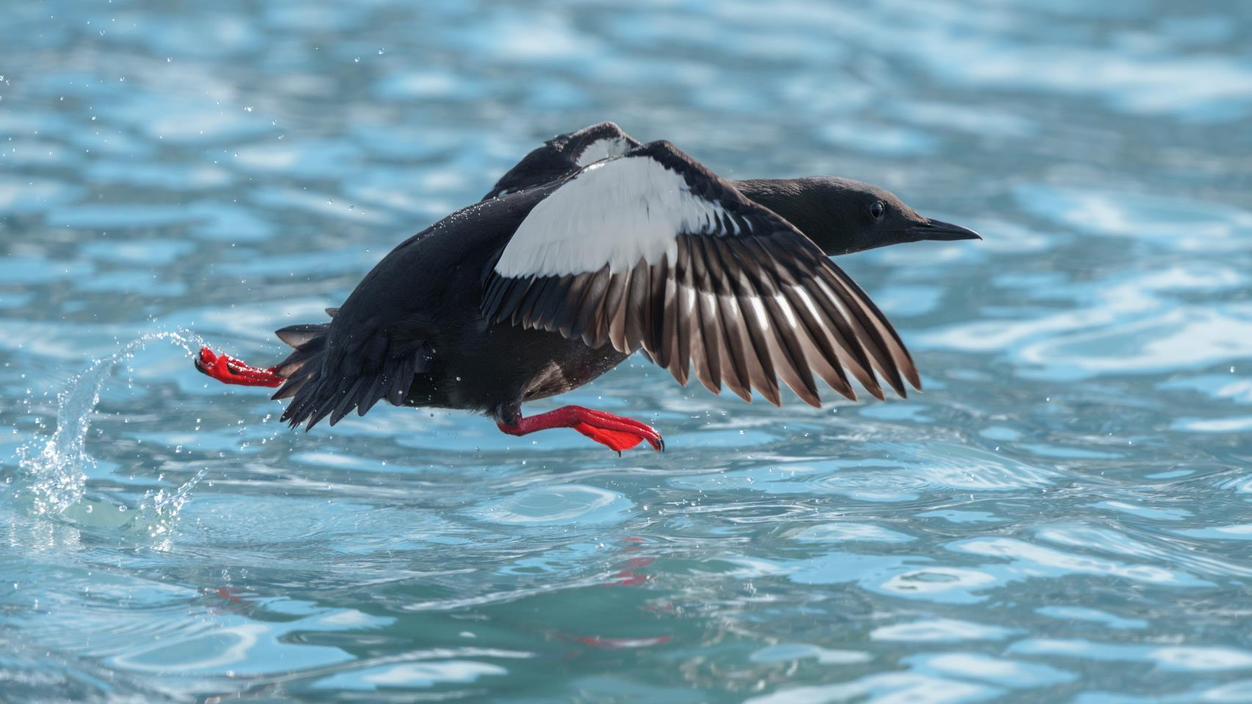
Wildlife
List - Birds
Credit: Rosie Barrett/HX
Notes:
Use the following pages to highlight some of the key bird species identified – and/or use the final page of the bird section to highlight the complete bird list on the e-Bird trip report
UPDATE PLEASE

Slide 27
Wildlife List — Seabirds
SCIENTIFIC NAME | ENGLISH | DEUTSCH
Alle alle | little auk / dovekie | Krabbentaucher
Cepphus grylle | black guillemot | Gryllteiste
Fratercula arctica | Atlantic puffin | Papageitaucher
Fulmarus glacialis | northern fulmar | Eissturmvogel
Larus canus | common gull | Sturmmöwe
Larus hyperboreus | glaucous gull | Eismöwe
Pagophila eburnea | ivory gull | Elfenbeinmöwe
Rissa tridactyla | black-legged kittiwake | Dreizehenmöwe
Somateria mollissima | common eider | Eiderente
Stercorarius parasiticus | Arctic skua / parasitic jaeger | Schmarotzerraubmöwe
Stercorarius skua | great skua | Skua
Uria lomvia | Brünnich's guillemot / thick-billed murre | Dickschnabellumme
Notes:
Copy and paste water birds observed – make sure scientific name is in italics

Slide 28
Wildlife List — Waterbirds
SCIENTIFIC NAME | ENGLISH | DEUTSCH
Anser brachyrhynchus | pink-footed goose | Kurzschnabelgans
Branta bernicla | brant goose | Ringelgans
Branta leucopsis | barnacle goose | Weißwangengans
Calidris maritima | purple sandpiper | Meerstrandläufer
Phalaropus fulicarius | red (grey) phalarope | Thorshühnchen
Gavia stellata | red-throated diver / loon | Sterntaucher
Somateria mollissima | common eider | Eiderente
Clangula hyemalis | long-tailed duck | Eisente
Notes:
Copy and paste water birds observed – make sure scientific name is in italics

Slide 29
Wildlife List — Landbirds
SCIENTIFIC NAME | ENGLISH | DEUTSCH
Lagopus muta | rock ptarmigan | Alpenschneehuhn
Plectrophenax nivalis | snow bunting | Schneeammer
Notes:
Copy and paste water birds observed – make sure scientific name is in italics
15

Slide 30
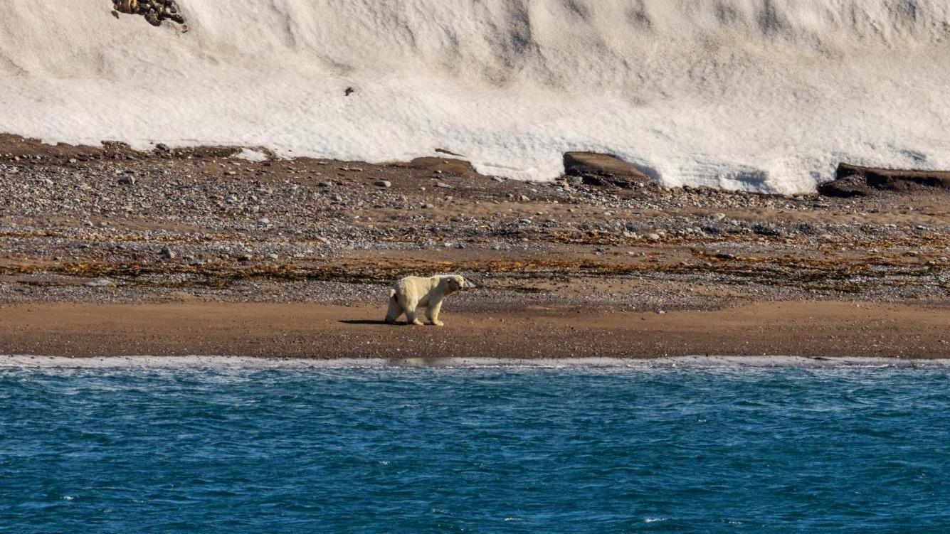
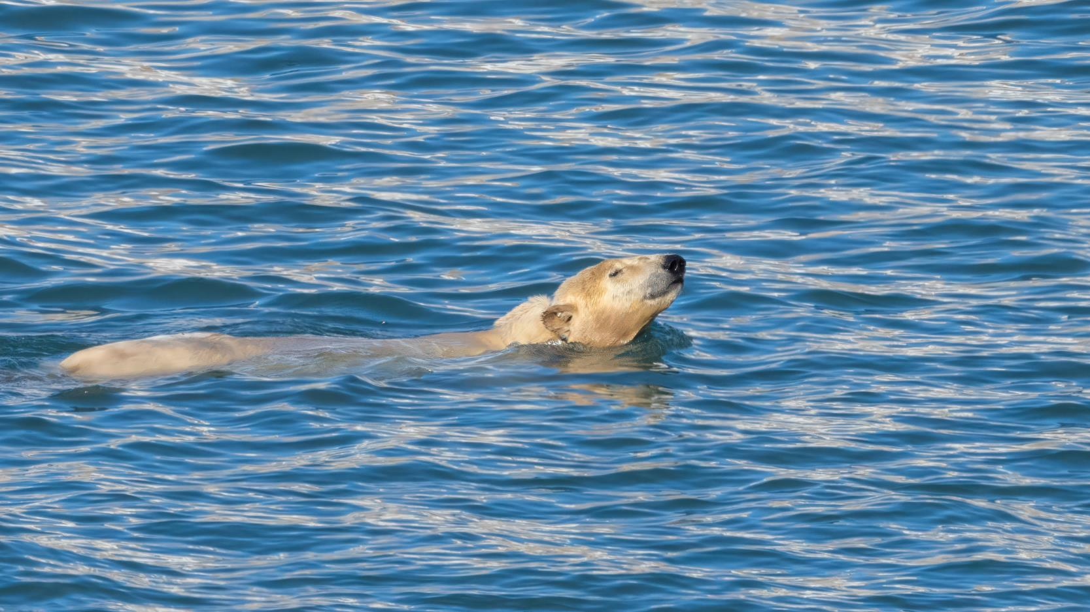
Wildlife List - Marine Mammals
Credit: Rosie Barrett/HX

Slide 31

Wildlife List — Marine Mammals
SCIENTIFIC NAME | ENGLISH | DEUTSCH
Balaenoptera acutorostrata | minke whale | Zwergwal
Ursus maritimus | polar bear | Eisbär
Phoca vitulina | harbour seal / common seal | Seehund
Pusa hispida | ringed seal | Ringelrobbe
Odobenus rosmarus | walrus | Walross
Notes:
Copy and paste marine mammals observed – make sure scientific name is in italics

Slide 32
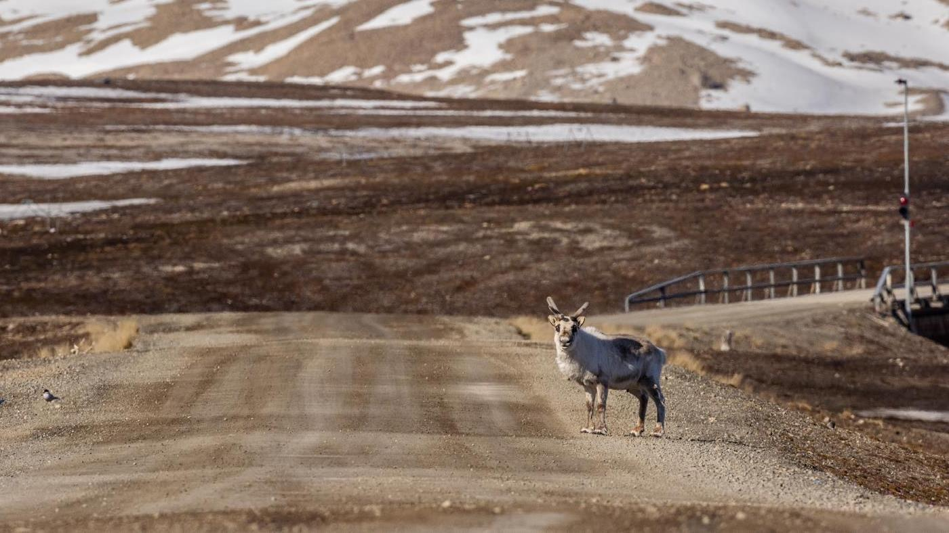
Wildlife
List - Land Mammals
Credit: Rosie Barrett/HX

Slide 33
Wildlife List – Land Mammals
SCIENTIFIC NAME | ENGLISH | DEUTSCH
Rangifer tarandus | reindeer | Rentier
Vulpes lagopus | Arctic fox | Polarfuchs
Notes:
Copy and paste marine mammals observed – make sure scientific name is in italics

Slide 34
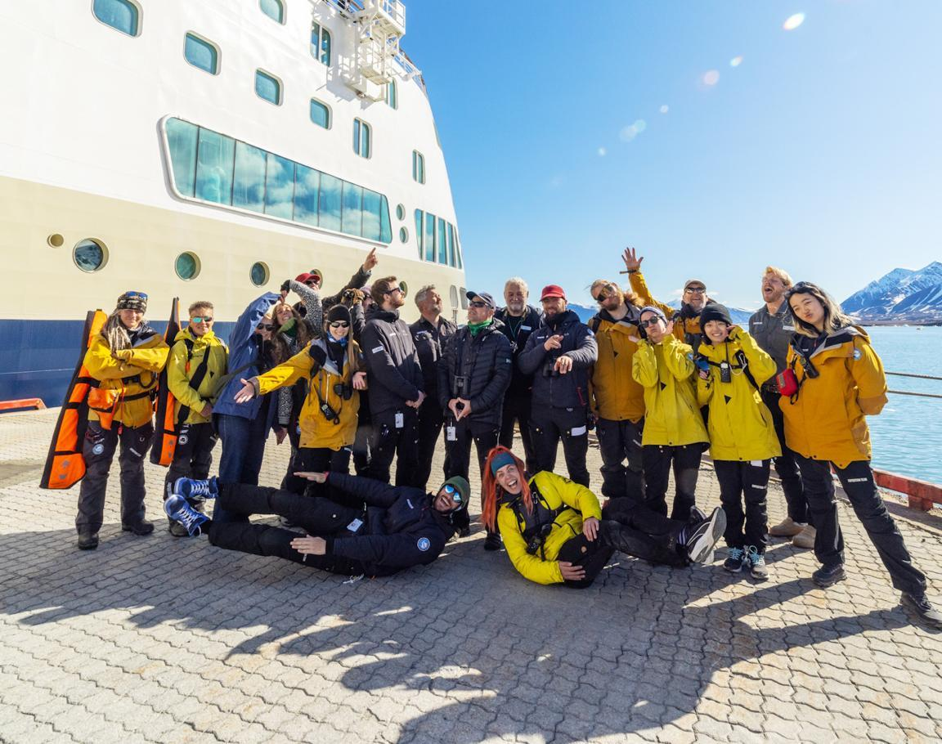
Thank you!
The Fram Science and Education Team extends warm thanks for choosing HX to explore the western Svalbard archipelago in springtime. Your participation supports the work of researchers and enables them to join our voyages, carry out meaningful studies, and access the logistical resources that are often hard to secure.
We are grateful for your genuine curiosity and shared enthusiasm for the natural world — from birds and marine mammals to flowers, lichens, mosses, and even the microscopic life found in a single drop of water.
It was a pleasure to exchange ideas, reflect on history over coffee, and observe together the diverse ecosystems we encountered. We hope this journey stays with you for a long time to come.
Credit: Rosie Barrett/HX
Credit: Yuri Choufour/HX
Credit: Jan Hvizdal /HX
Yuri Choufour

Slide 35
Connect with your inner scientist

