Slide 1
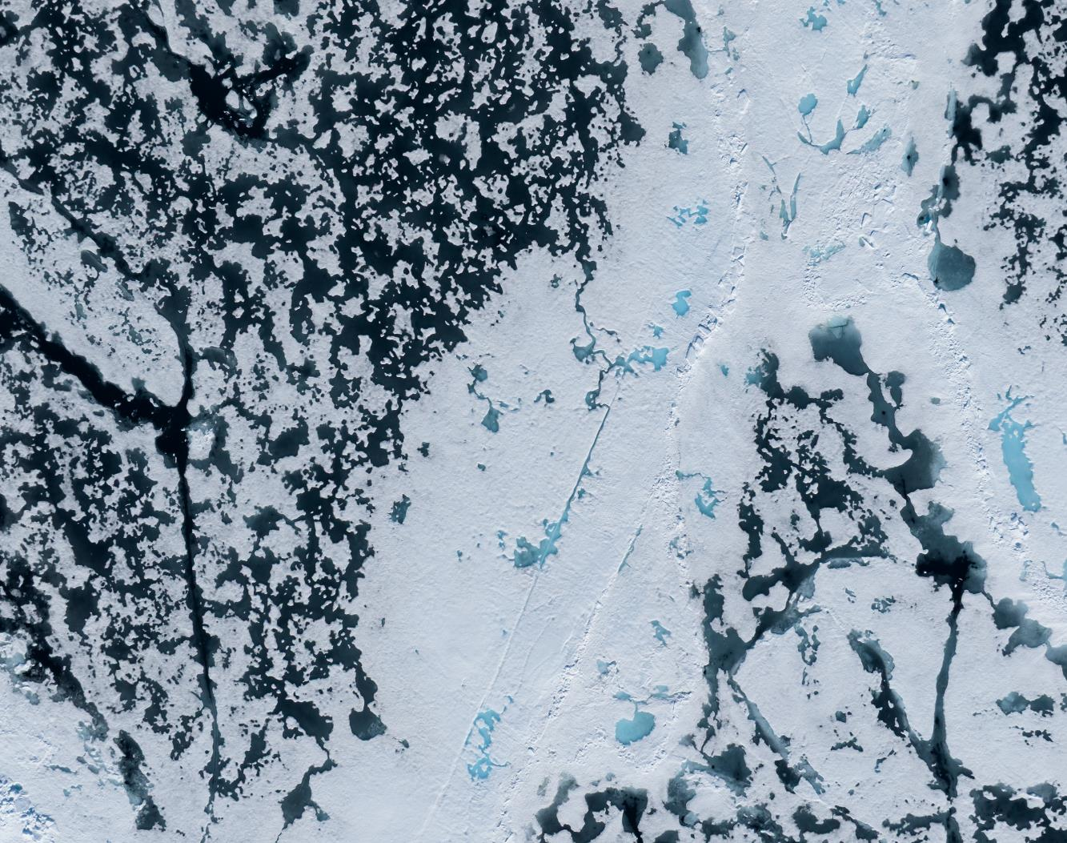
MS Fram — 7 – 14 June 2026
Svalbard in Springtime, the Return of the Sun
Credit: Yuri Choufour/HX

Slide 2
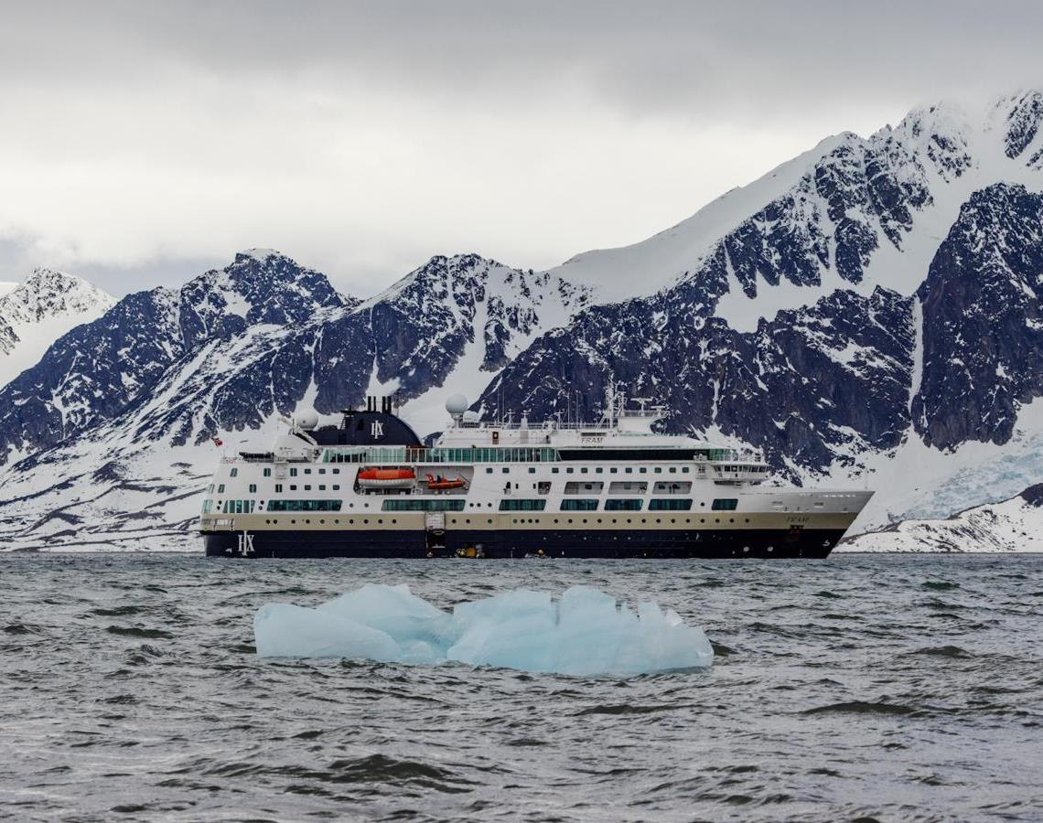
Science & Education Program
During this voyage, we helped by collecting data for 3 citizen science projects in total: eBird, iNaturalist & Secchi Disk project. You were able to enrich your mind with 8 lectures on different topics from birds to rocks. You also took part in the 3 discovery sessions we put on.
We had guest scientist on from two different projects that were collecting data whilst you were onboard. The wave project was tracking Arctic whale distribution and abundance, their research aims to minimize vessel impacts on marine life. And FRAM-PLANKTO project was studiying plankton comunities in the different fjords.
A lot of you were very interested in the scientific aspect of our voyage and we thank you all for your enthusiasm. Here we provide a resume of our science activities.
Credit: Rosie Barrett/HX
Notes:
Add brief summary of the Science & Education Program over the whole voyage

Slide 3
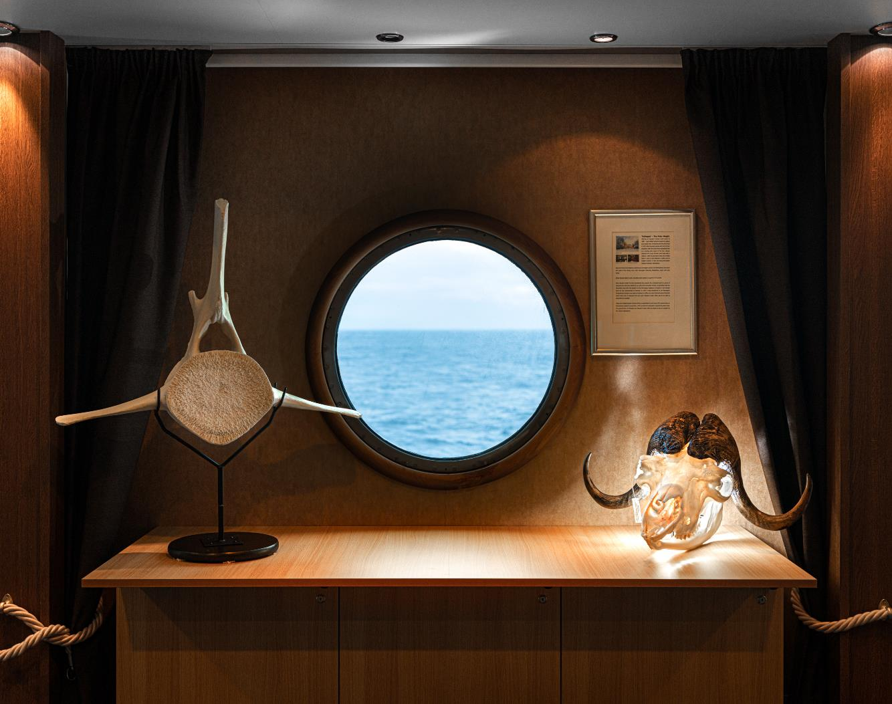
Lectures & Discovery Sessions
8 lectures
3 discovery sessions
3 Citizen Science projects
5 science boat sessions
2 Guest Scientist projects
©Yuri Choufour

Slide 4
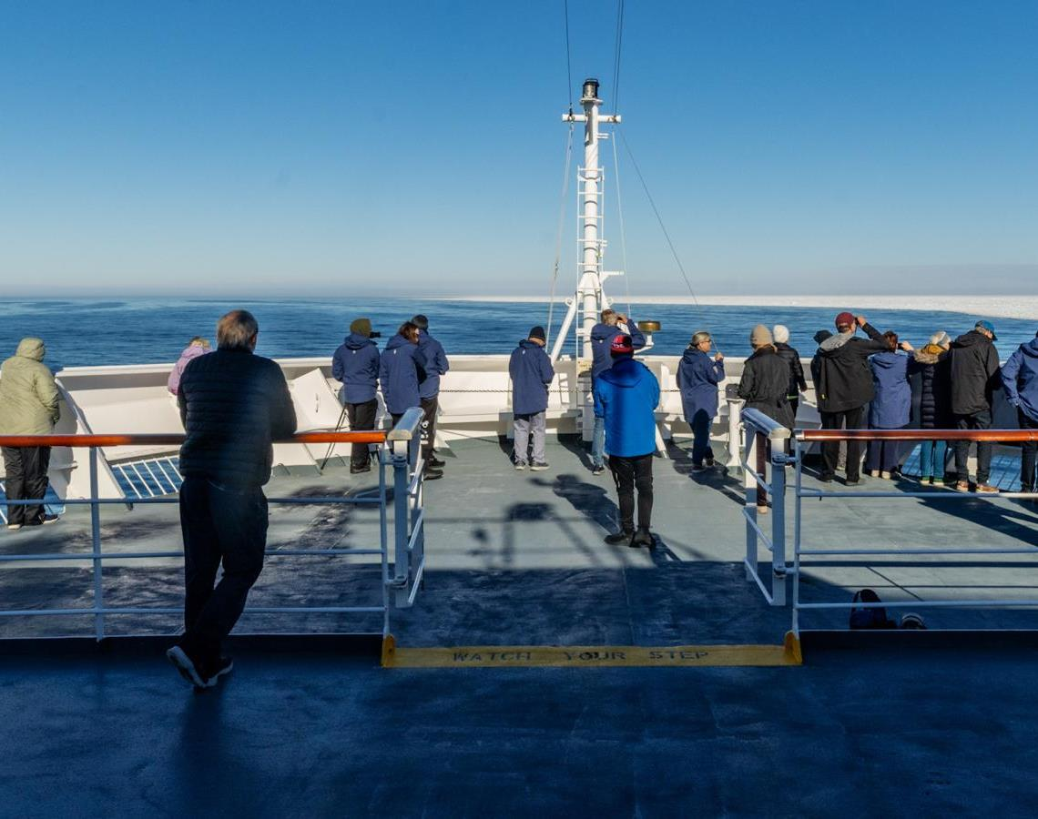
Wildlife Watch
30 species:
8 mammals
22 birds

Slide 5
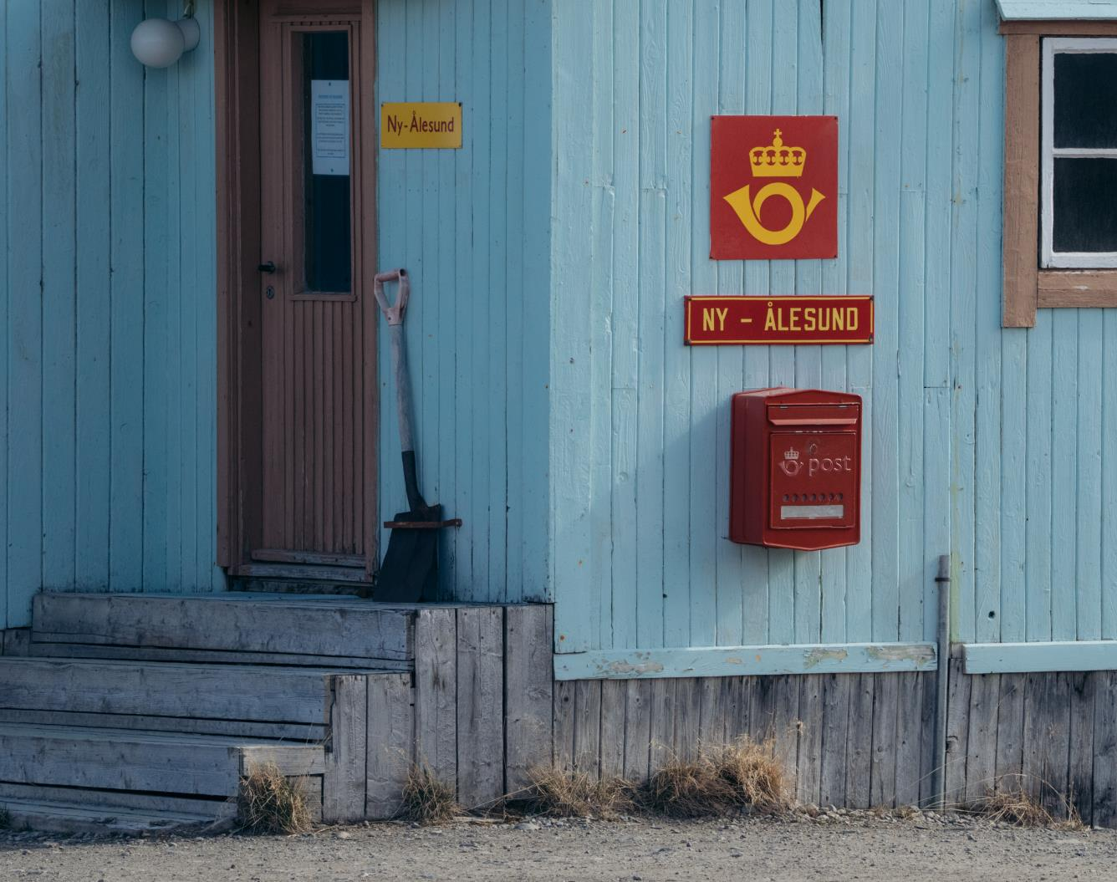
History & Culture
During this voyage, we learned about Fridtjof Nansen, his legendary expedition across the Arctic Ocean aboard the Fram, and the remarkable history of Svalbard.
At nearly 79°N, we visited Ny-Ålesund, the world's northernmost year-round research station — once a coal-mining outpost, now an international hub for Arctic science. In 1926, Roald Amundsen, Lincoln Ellsworth, and Umberto Nobile took the airship Norge over the North Pole from here. The mooring mast and a bronze bust of Amundsen still honour Svalbard's exploration legacy.
Credit: Yuri Choufour/HX

Slide 6
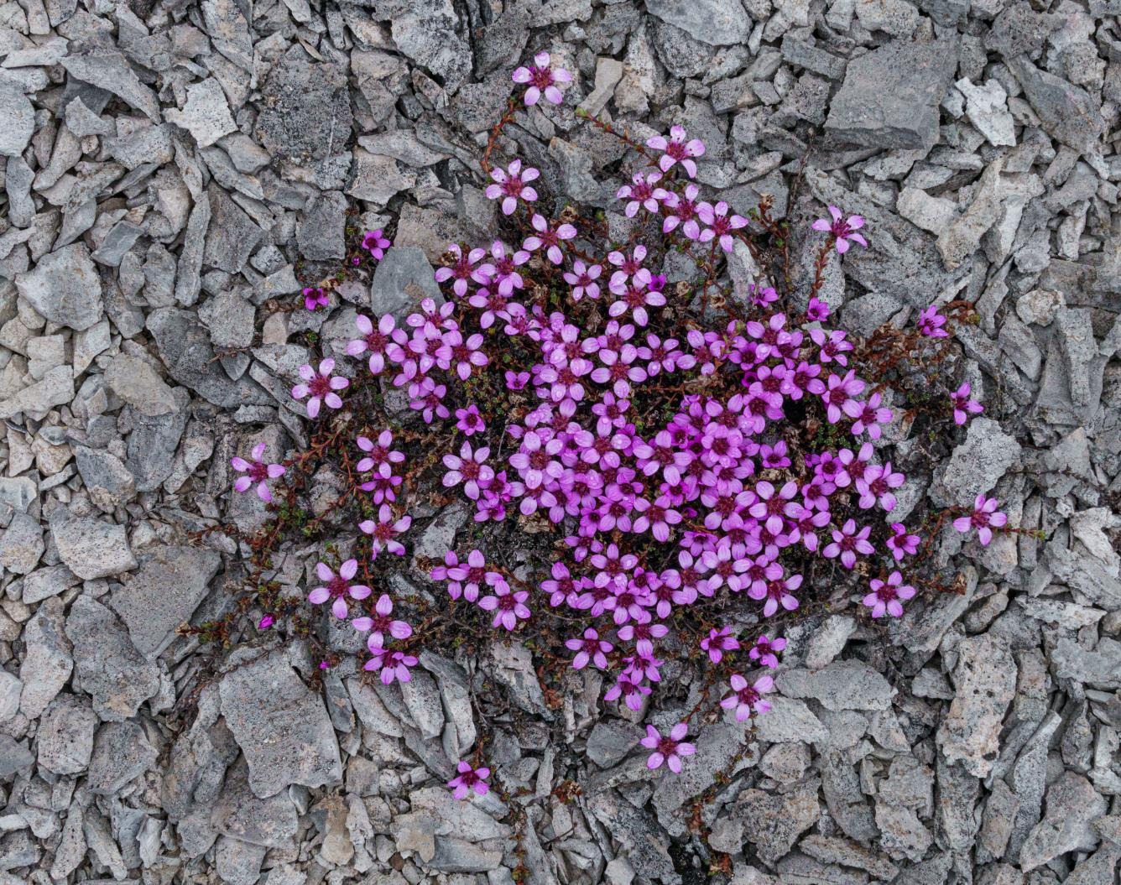
iNaturalist
Thanks to your efforts, we recorded 140 opportunistic observations representing nearly 47 different species.
By sharing your data on iNaturalist, you contributed to a global, open-access database that fuels scientific research and conservation monitoring. These records are vital tools for researchers tracking species distribution and assessing ecosystem health.
You can view the project — and upload your own observations from the voyage —by clicking here.
Fernandocrambus falklandicellus photographed by Vivi Bolin on New Island
Credit: Yuri Choufour/HX
Credit: Jan Hvizdal /HX
Yuri Choufour
Credit: Vivi Bolin/HX

Slide 7
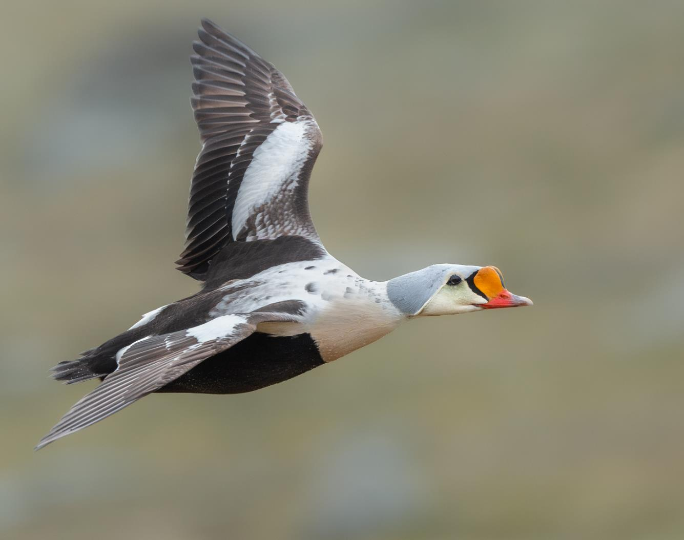
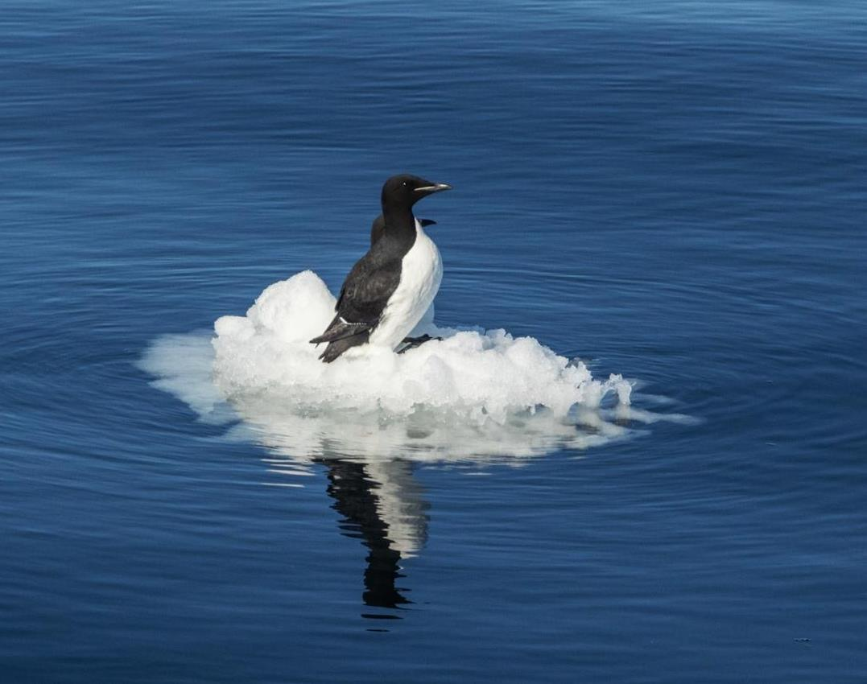
eBird
Our Ornithologist, Simon, completed 19 eBird checklists covering 22 different species during our seven-day voyage. The most abundant species was the little auk (also known as the dovekie), followed by Brünnich's guillemot (thick-billed murre) and the black-legged kittiwake.
For full survey details, visit:
https://ebird.org/tripreport/535187
Credit: Yuri Choufour/HX
Credit: Jan Hvizdal /HX
Notes:
UPDATE PLEASE

Slide 8
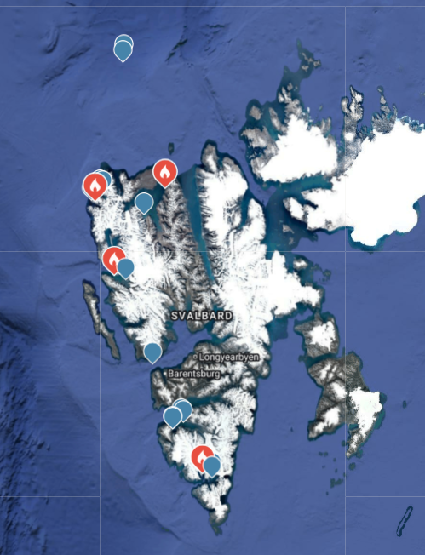
Locations of eBird Surveys

Slide 9
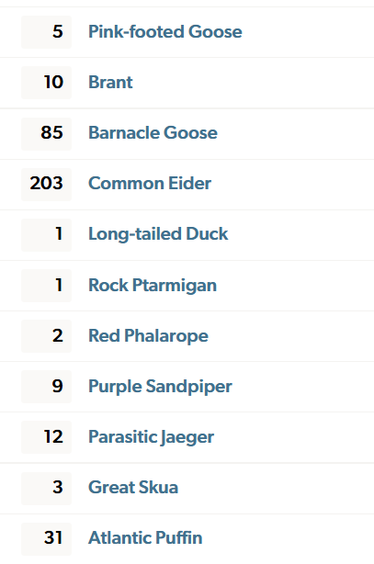
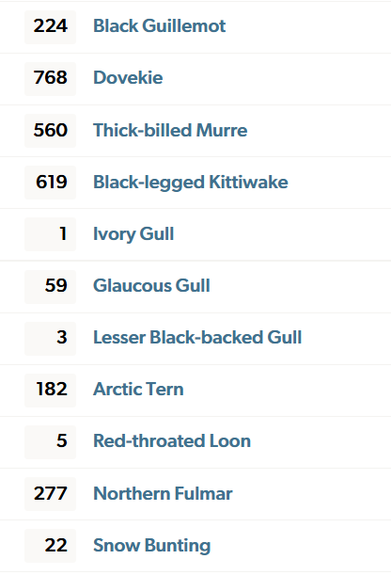
Species Totals from eBird Surveys

Slide 10
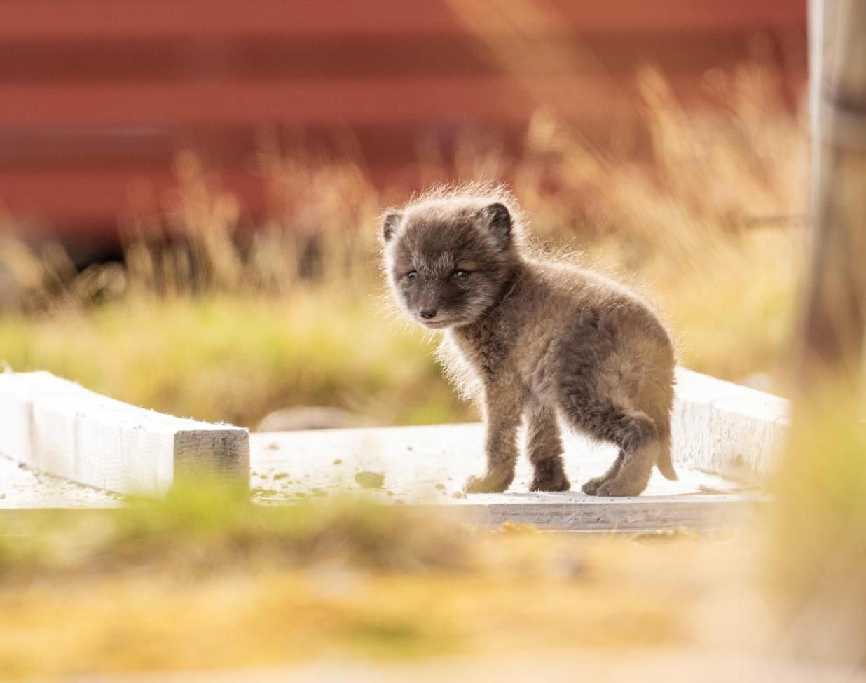
Mammals
Although we did not manage to submit any photos to the Happywhale project during this voyage, we were fortunate to spot several marine mammals — harbour seals, ringed seals, minke whales, and of course beluga whales. From the deck we had beautiful views of walrus at Moffen and, with real fortune on our side, a mother polar bear with her cub.
We hope you keep watching the horizon for wildlife long after your return. With any luck, we will see you on board again soon. Thank you for travelling with HX.
Credit: Yuri Choufour/HX
Notes:
UPDATE PLEASE

Slide 11
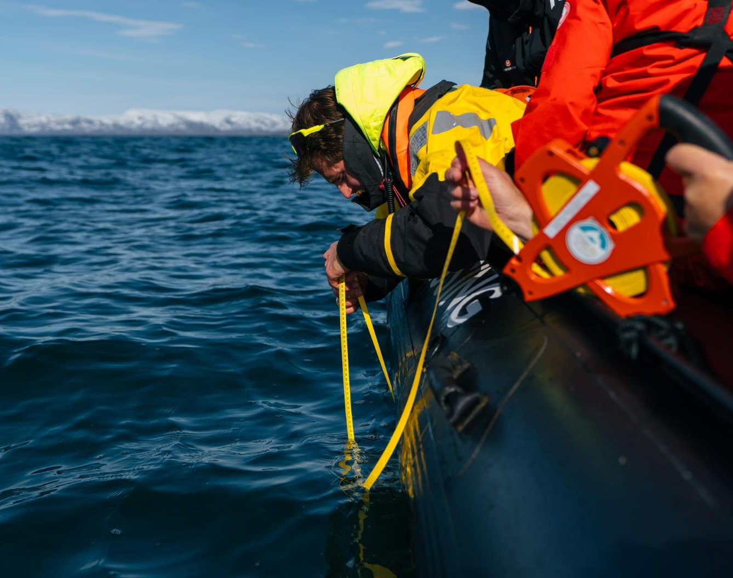
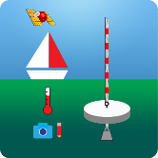
Science Boat
We ran five science boat sessions during this voyage at Asbestodden, Gravnesodden, Mushamna, and the Ice Edge. At each site, we took multiple Secchi Disk measurements to document the turbidity and clarity of the water and to assess the abundance of phytoplankton.
Date | Location | Depth (m)
9 June 2026 | Asbestodden | 9.3
12 June 2026 | The Ice Edge | 12.0
View our data submitted to the Secchi Disk Project
Notes:
Add highlights of what science boat activities and sampling were undertaken – update secchi link to specific voyage if possible

Slide 12
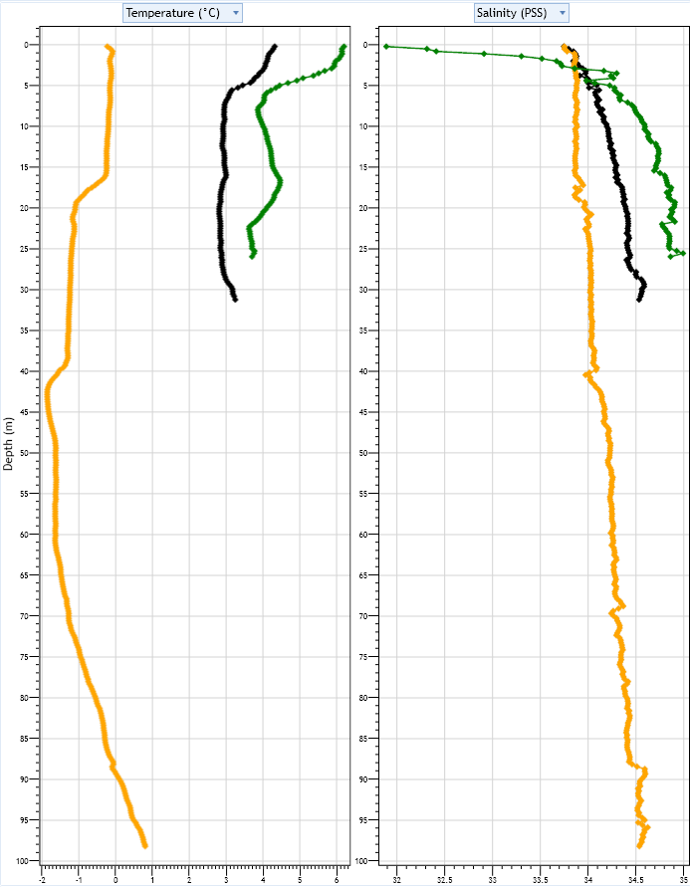
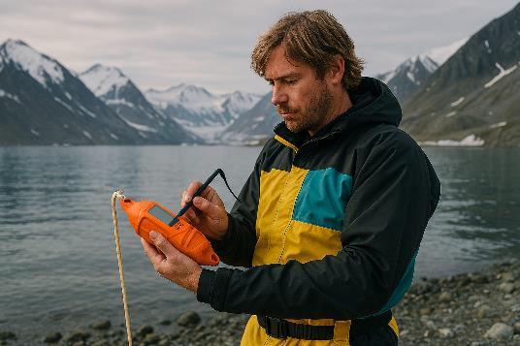
CTD Profiles
How to read the profiles:
The y-axis on the left shows depth, increasing downward. As you move down the graph, the values represent measurements taken deeper in the water column.
The left and right panels show temperature and salinity respectively. Each coloured line represents a separate CTD cast, plotted alongside the others for comparison.
To interpret the data, pick a single line, note the value at the surface, and follow how it changes with depth.
Black line: June 9th Asbestodden
Green line: June 11th Mushamna
Yellow line: June 12th Ice Edge
Notes:
Add any interesting finds in the plankton samples and pictures taken down the microscopes

Slide 13
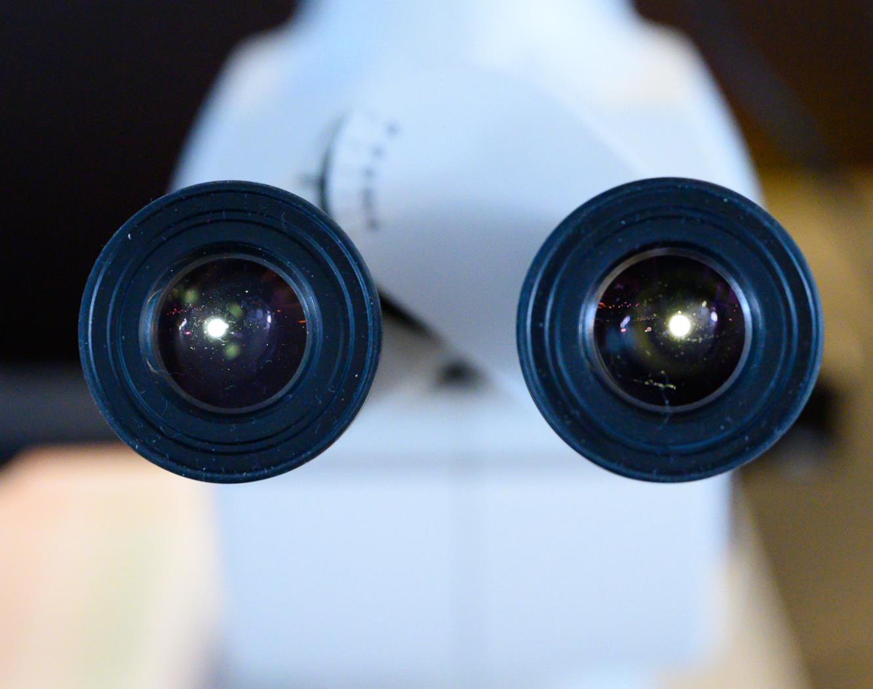
Plankton samples
©Martin Hain
Notes:
Add any interesting finds in the plankton samples and pictures taken down the microscopes

Slide 14
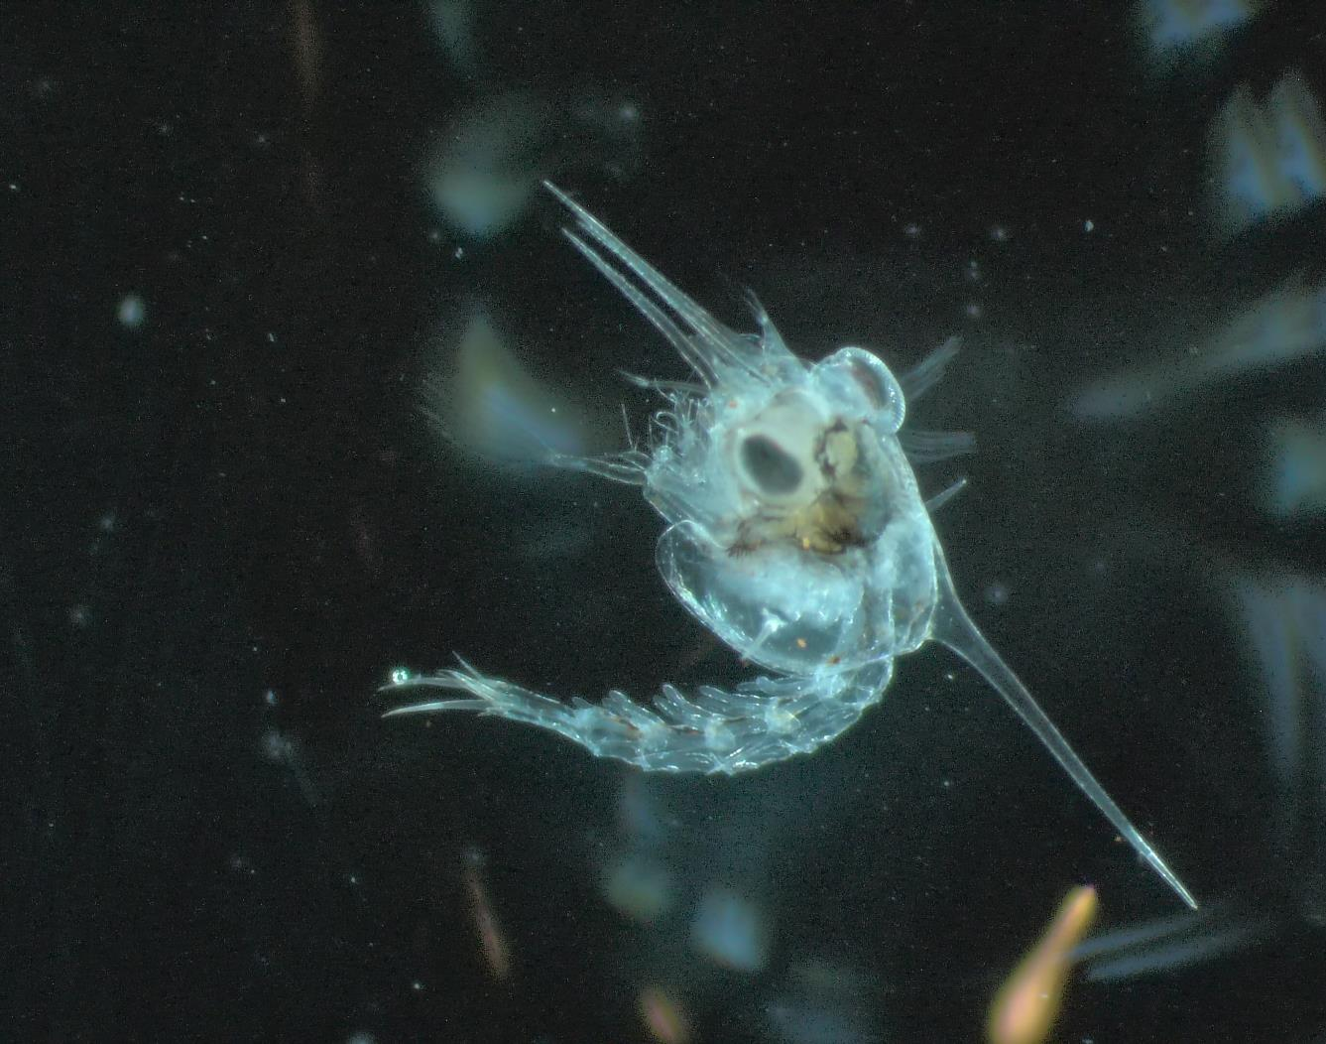
Plankton Samples: Crab Larvae
Notes:
Add any interesting finds in the plankton samples and pictures taken down the microscopes

Slide 15
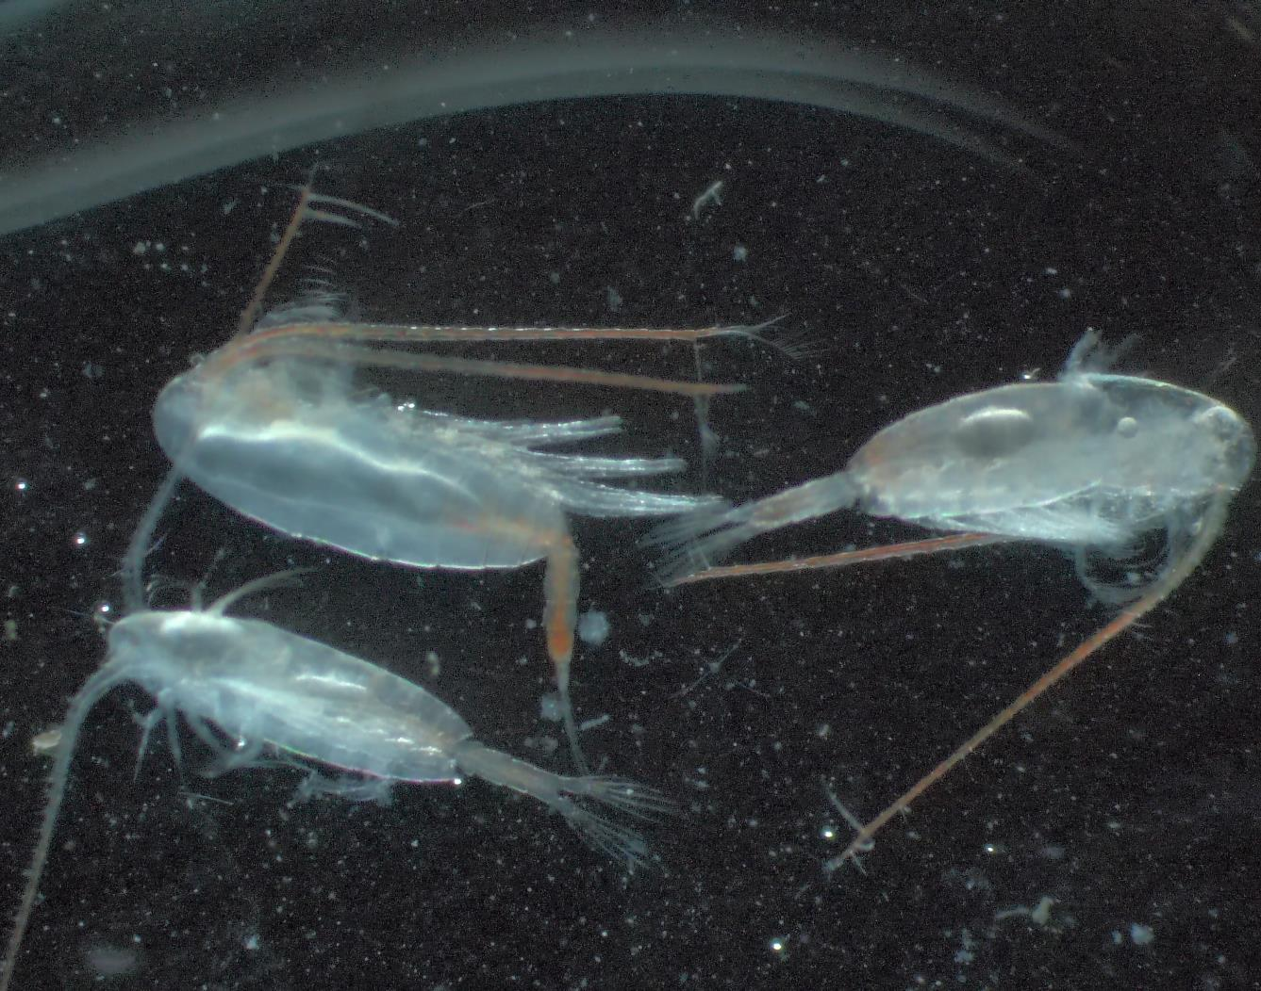
Plankton Samples: Copepods
Notes:
Add any interesting finds in the plankton samples and pictures taken down the microscopes

Slide 16
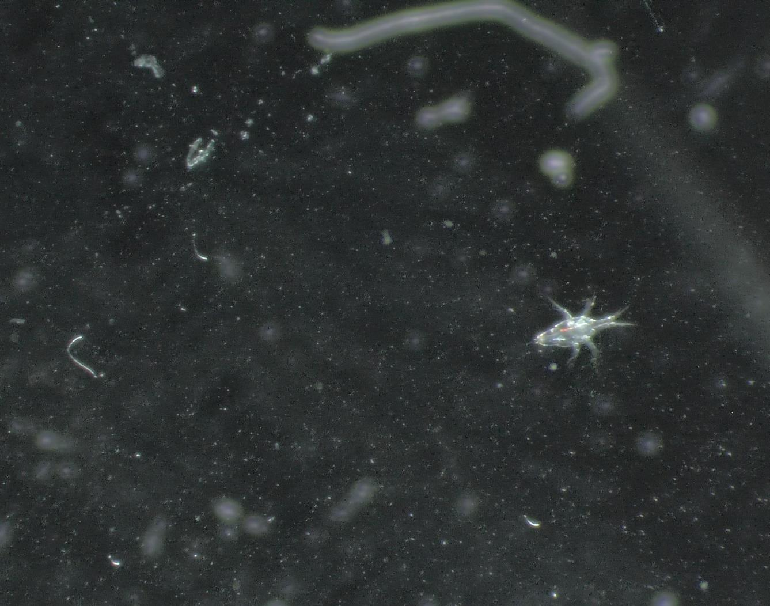
Plankton Samples: Copepod Larvae
Notes:
Add any interesting finds in the plankton samples and pictures taken down the microscopes

Slide 17
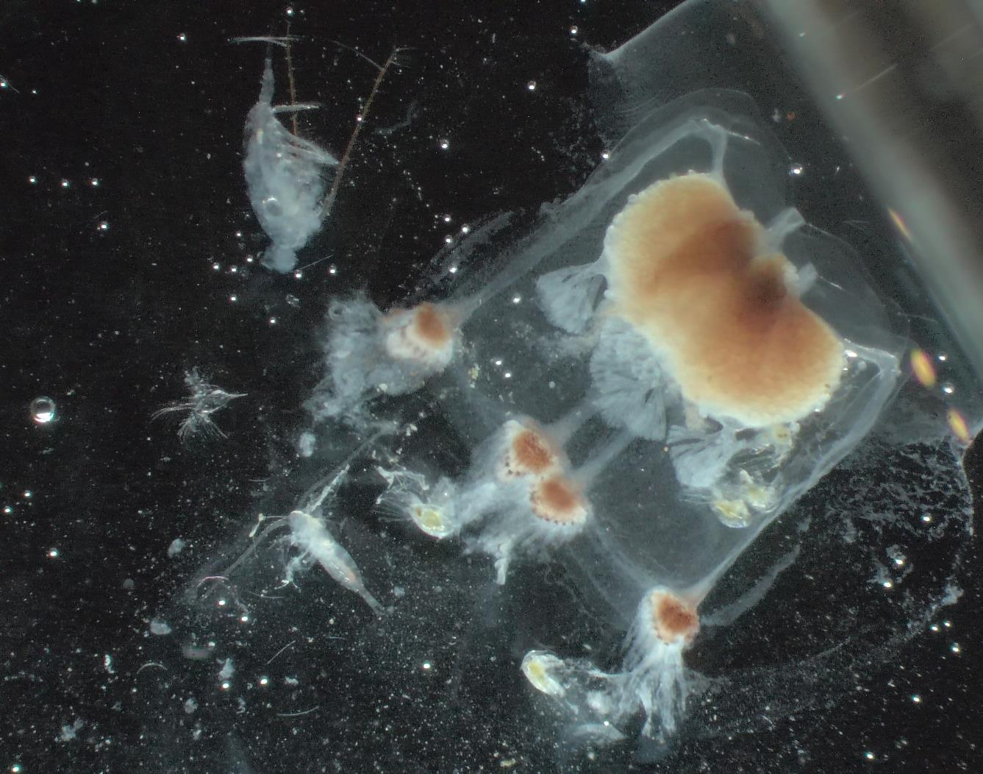
Plankton Samples: Jellyfish
Notes:
Add any interesting finds in the plankton samples and pictures taken down the microscopes

Slide 18
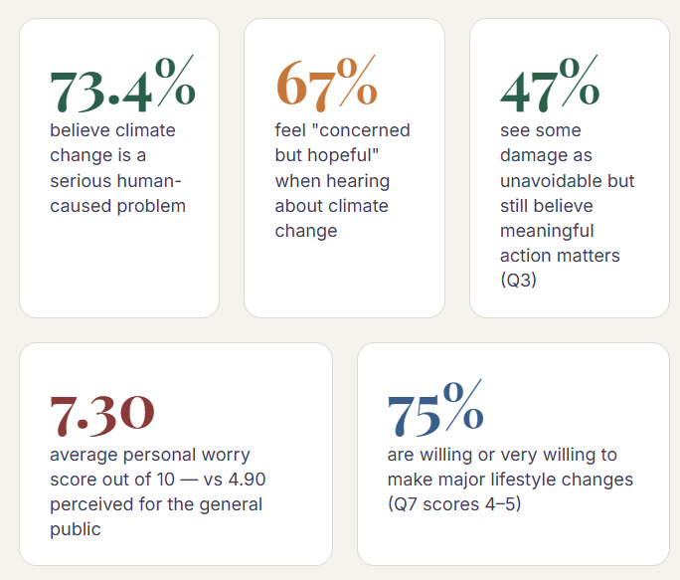
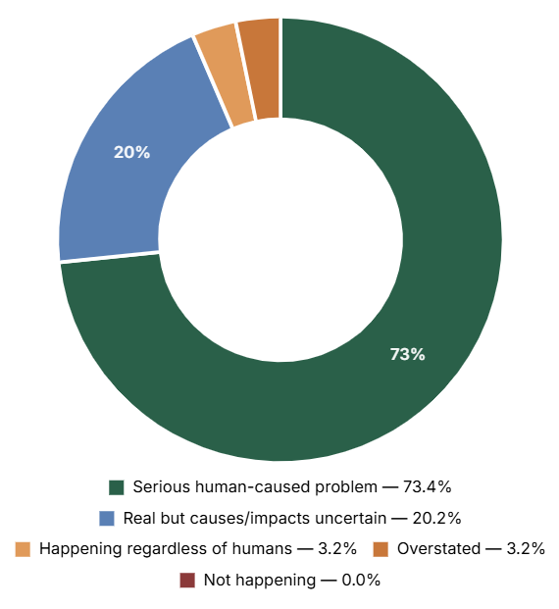
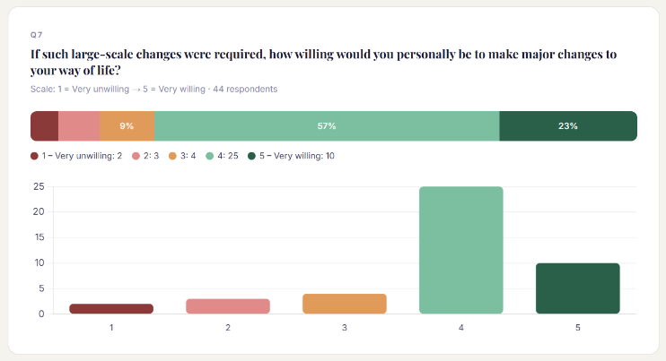
Climate change survey
When you hear about climate change, what best describes your reaction?
How do you feel about climate change?
As an experiment, we conducted a survey of guests' views and feelings on the subject of climate change. In the long run, we hope to gather enough data for a meaningful statistical study within the microcosm of our ship.
Thank you to the 63 participants who completed the survey, representing 50% of all guests on board. On this voyage, 73.4% of respondents consider climate change a serious problem caused by humans. You can view the full results and our interpretation at the link below.
The results will continue to evolve as we collect more data. You can view the results and interpretations on this link.
The results will continue to evolve the more data we collect.
Visit the IPCC website
Climate Change IPCC FAQ
IPCC Summary report

Slide 19
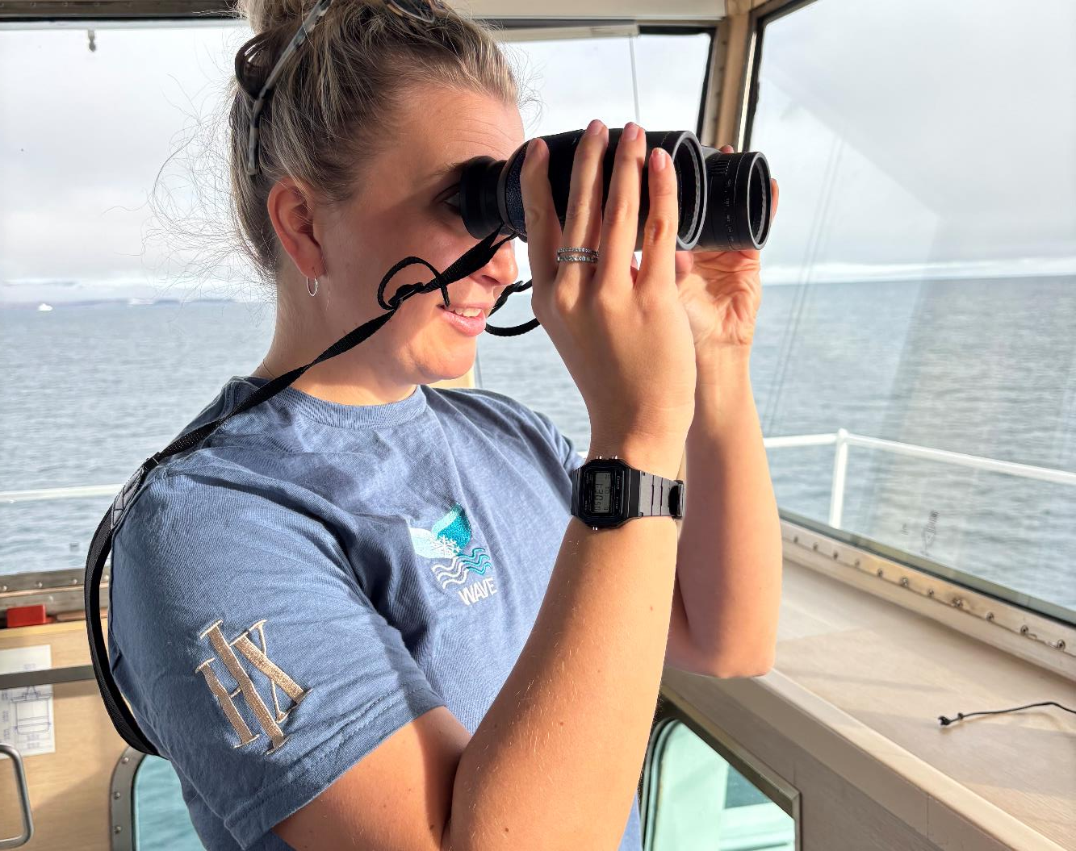


Guest Scientists
WAVE Project
The WAVE Project, run by Heriot-Watt University in Scotland, recently conducted 22 hours of visual surveys aboard MS Fram. By tracking Arctic whale distribution and abundance, the WAVE team's research aims to minimise vessel impacts on marine life.
During this expedition, Alanna Frayne, MSc, recorded three cetacean species in Arctic waters — fin whale, beluga whale, and minke whale — as well as two pinniped species: ringed seal and walrus.
Supported by the HX Foundation and HX Expeditions, the WAVE team thanks you for your contribution to protecting these animals and invites you to follow the project's progress in the years ahead. Scan the QR code to keep up to date.
Credit: Jan Hvizdal /HX
Credit: Yuri Choufour/HX
Credit: Lauren McWhinnie/HX
Notes:
Add info on how many images were submitted to happywhale, new whales were ID, matches etc. as appropriate plus link to ship account on Happywhale – update link to specific voyage

Slide 20
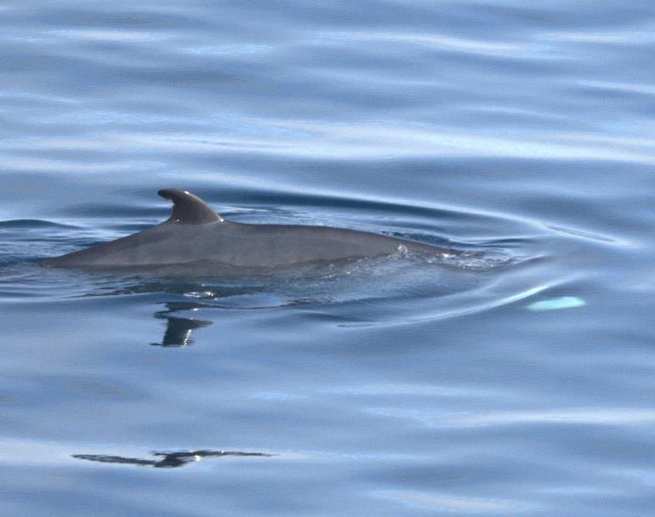
Guest Scientists
WAVE Project
Keep up to date with the project and stay involved: www.wave-arcticwhales.com
DID YOU SEE SOMETHING ON YOUR EXPEDITION? Let us know! Send your photos to:
l.mcwhinnie@hw.ac.uk
Credit: Jan Hvizdal /HX
Credit: Yuri Choufour/HX
Credit: Lauren McWhinnie/HX
Notes:
Add info on how many images were submitted to happywhale, new whales were ID, matches etc. as appropriate plus link to ship account on Happywhale – update link to specific voyage

Slide 21
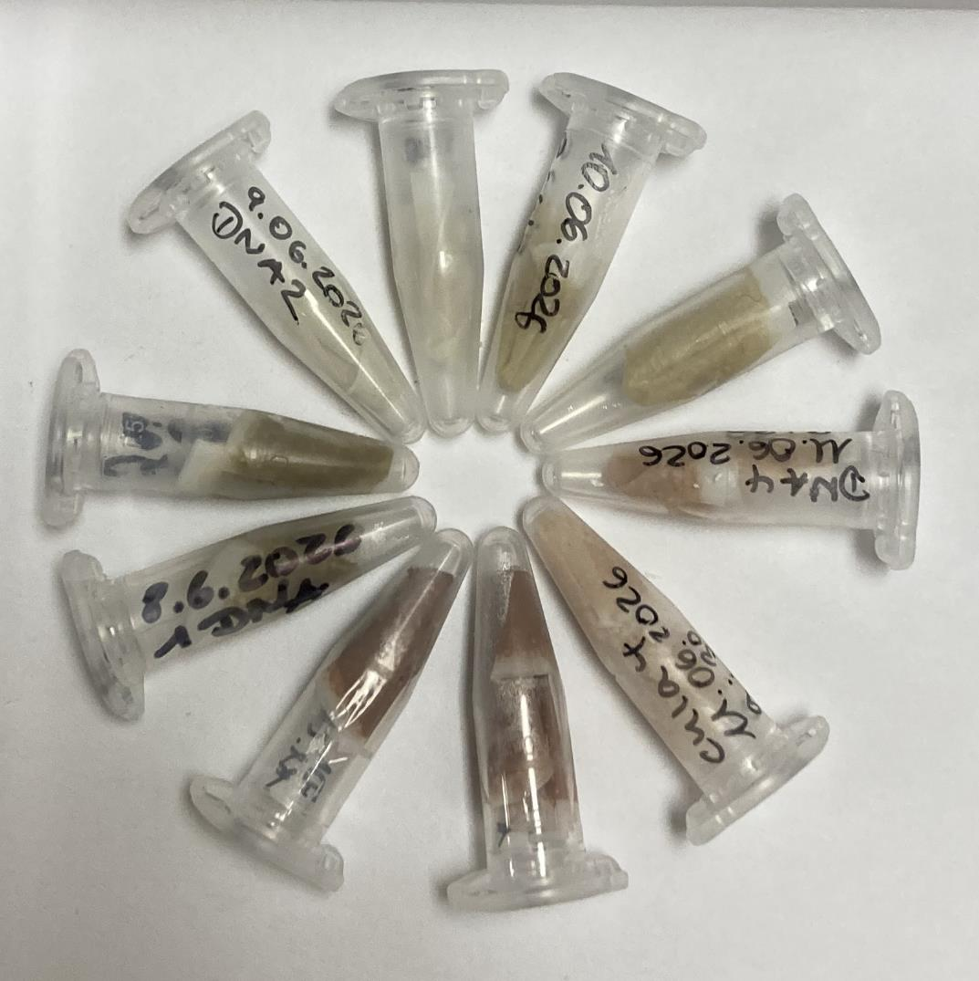
Guest
Scientists Project
FRAM-PLANKTO
The samples we collected across the fjords of Svalbard varied widely in microalgae biomass, depending on the amount of zooplankton in the water — zooplankton feed on microalgae, so low microalgae biomass correlated with high zooplankton abundance.
This variability reflects the diversity of environmental conditions between the fjords, each of which shapes microalgae growth in its own way. Understanding that variability is a cornerstone for understanding the biodiversity and geographic distribution of species in the Arctic. It also provides a baseline for assessing how Arctic ecosystems respond to global change, and for sustainable ocean management.
www.awi.de
Foto: Katja Metfies
Notes:
Add info on how many images were submitted to happywhale, new whales were ID, matches etc. as appropriate plus link to ship account on Happywhale – update link to specific voyage

Slide 22
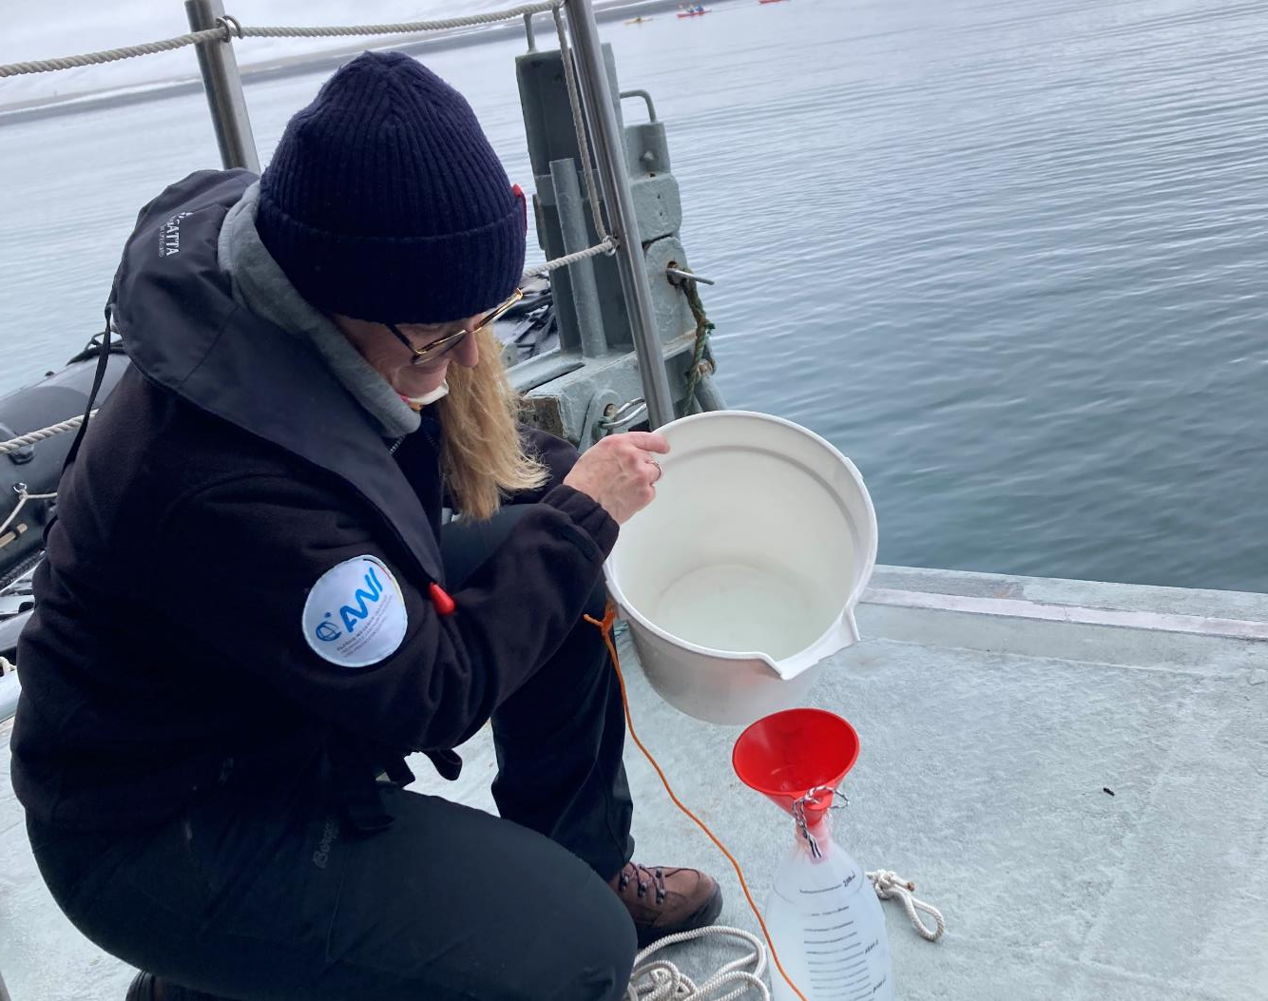


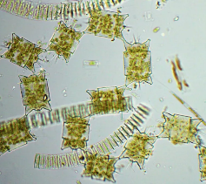
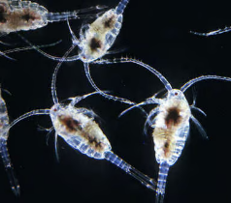
Guest
Scientists Project
FRAM-PLANKTO
The FRAM-PLANKTO project, run by the German Alfred Wegener Institute Helmholtz Centre for Polar Research, collected water samples in each of the fjords MS Fram visited during the voyage. Katja Metfies, polar scientist at AWI, aims to capture the plankton composition that fuels the marine food chain from microalgae all the way up to seals and whales.
These samples, collected in collaboration with HX, complement AWI's long-term observations in the Fram Strait, which track how Arctic marine ecosystems respond to changing environmental conditions.
Phytoplanton
(Microalgae)
Zooplankton
Foto: Katja Metfies
Notes:
Add info on how many images were submitted to happywhale, new whales were ID, matches etc. as appropriate plus link to ship account on Happywhale – update link to specific voyage

Slide 23
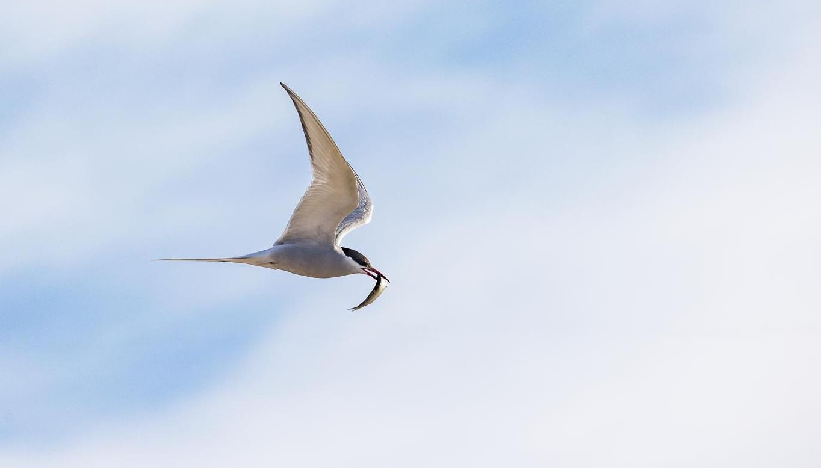
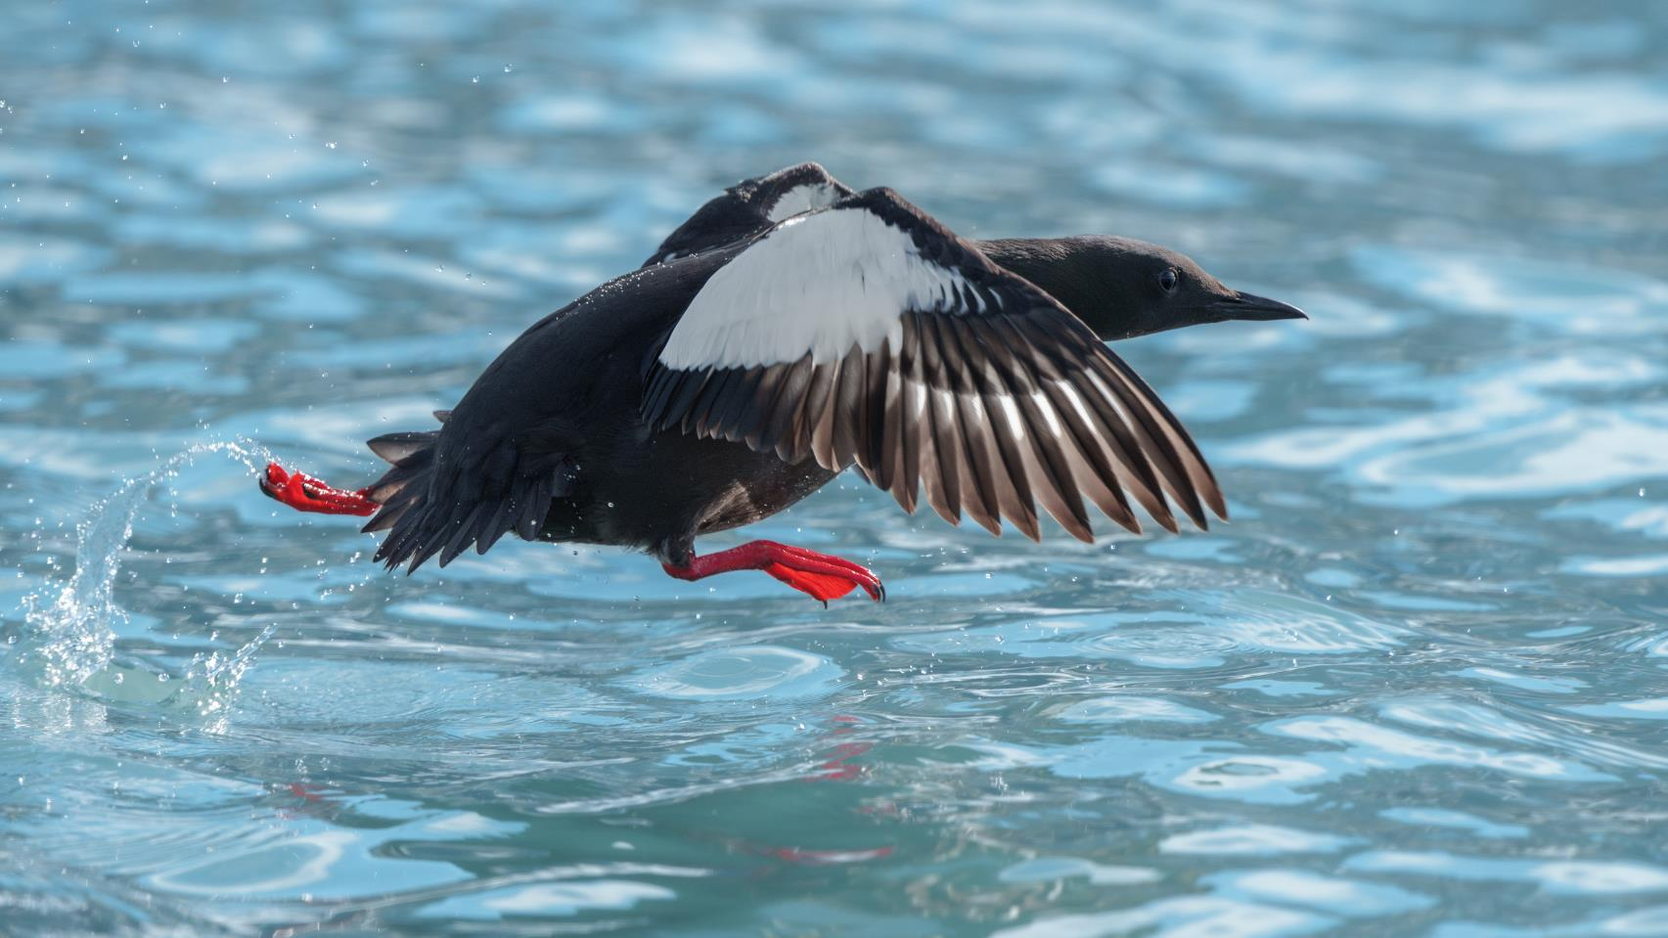
Wildlife List — Birds
Credit: Rosie Barrett/HX
Notes:
Use the following pages to highlight some of the key bird species identified – and/or use the final page of the bird section to highlight the complete bird list on the e-Bird trip report
UPDATE PLEASE

Slide 24

Wildlife List – Seabirds
SCIENTIFIC NAME | ENGLISH | DEUTSCH
Alle alle | little auk / dovekie | Krabbentaucher
Cepphus grylle | black guillemot | Gryllteiste
Fratercula arctica | Atlantic puffin | Papageitaucher
Fulmarus glacialis | northern fulmar | Eissturmvogel
Larus canus | common gull / mew gull | Sturmmöwe
Larus hyperboreus | glaucous gull | Eismöwe
Pagophila eburnea | ivory gull | Elfenbeinmöwe
Rissa tridactyla | black-legged kittiwake | Dreizehenmöwe
Somateria mollissima | common eider | Eiderente
Stercorarius parasiticus | Arctic skua / parasitic jaeger | Schmarotzerraubmöwe
Stercorarius skua | great skua | Skua
Uria lomvia | Brünnich's guillemot / thick-billed murre | Dickschnabellumme
Alle alle | little auk / dovekie | Krabbentaucher
Notes:
Copy and paste water birds observed – make sure scientific name is in italics

Slide 25
Wildlife List – Waterbirds
SCIENTIFIC NAME | ENGLISH | DEUTSCH
Anser brachyrhynchus | pink-footed goose | Kurzschnabelgans
Branta bernicla | brant goose | Ringelgans
Branta leucopsis | barnacle goose | Weißwangengans
Calidris maritima | purple sandpiper | Meerstrandläufer
Phalaropus fulicarius | red (grey) phalarope | Thorshühnchen
Gavia stellata | red-throated diver / loon | Sterntaucher
Somateria mollissima | common eider | Eiderente
Clangula hyemalis | long-tailed duck | Eisente
Notes:
Copy and paste water birds observed – make sure scientific name is in italics

Slide 26
Wildlife List – Landbirds
SCIENTIFIC NAME | ENGLISH | DEUTSCH
Lagopus muta | rock ptarmigan | Alpenschneehuhn
Plectrophenax nivalis | snow bunting | Schneeammer
Notes:
Copy and paste water birds observed – make sure scientific name is in italics
15

Slide 27
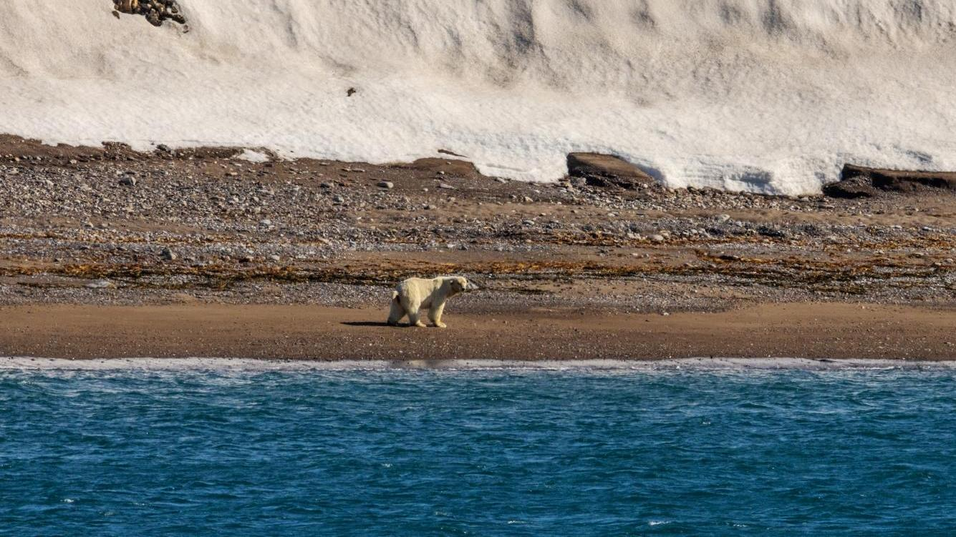
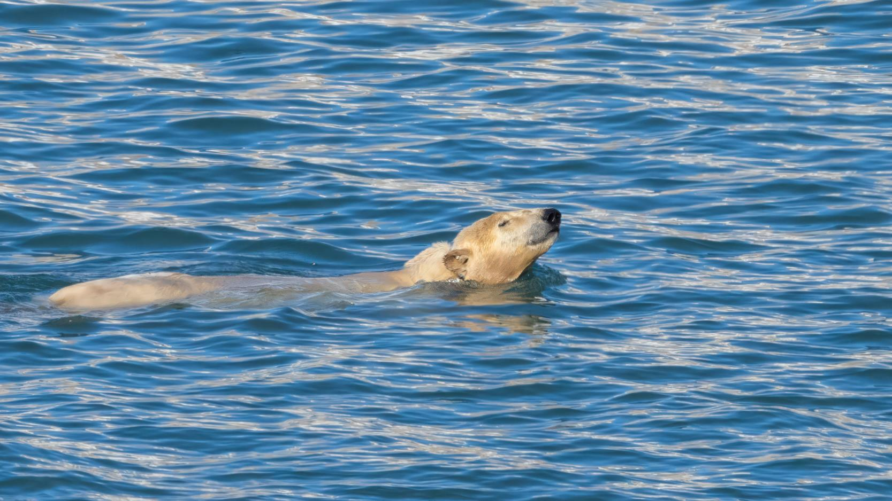
Wildlife List — Marine Mammals
Credit: Rosie Barrett/HX

Slide 28

Wildlife List – Marine Mammals
SCIENTIFIC NAME | ENGLISH | DEUTSCH
Balaenoptera acutorostrata | minke whale | Zwergwal
Delphinapterus leucas | beluga whale | Weißwal
Ursus maritimus | polar bear | Eisbär
Phoca vitulina | harbour seal / common seal | Seehund
Pusa hispida | ringed seal | Ringelrobbe
Odobenus rosmarus | walrus | Walross
Notes:
Copy and paste marine mammals observed – make sure scientific name is in italics

Slide 29
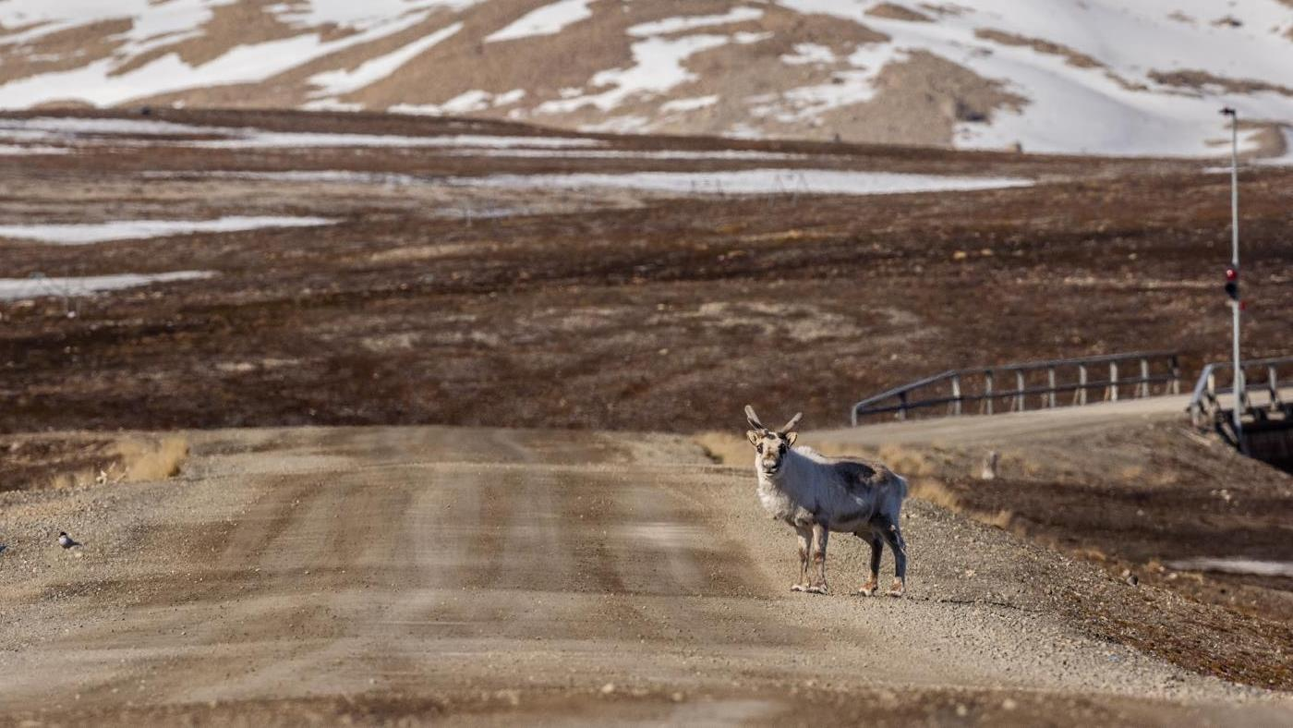
Wildlife List — Land Mammals
Credit: Rosie Barrett/HX

Slide 30
Wildlife List – Land Mammals
SCIENTIFIC NAME | ENGLISH | DEUTSCH
Rangifer tarandus | reindeer | Rentier
Vulpes lagopus | Arctic fox | Polarfuchs
Notes:
Copy and paste marine mammals observed – make sure scientific name is in italics

Slide 31
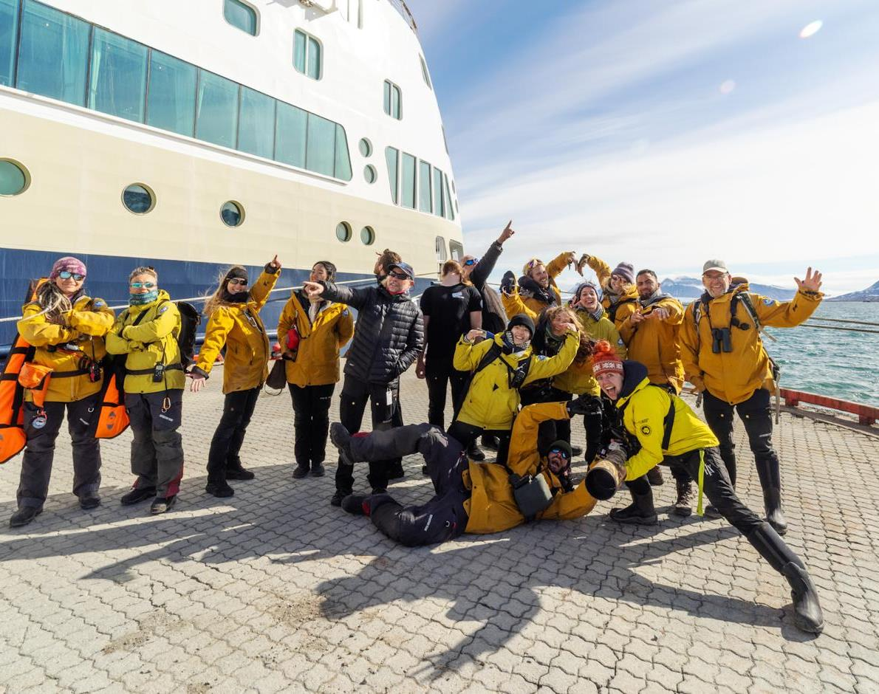
Thank you!
The MS Fram Science and Education Team thanks you for choosing HX Expeditions to explore the western Svalbard archipelago in springtime. Your participation supports the ongoing work of researchers and enables them to join our voyages, carry out meaningful studies, and access logistical resources that are often difficult to secure.
We are grateful for your genuine curiosity and shared enthusiasm for the natural world — from birds and marine mammals to flowers, lichens, mosses, and the microscopic life found in a single drop of water.
It was a real pleasure to exchange ideas, reflect on history over coffee, and marvel together at the diverse ecosystems we encountered along the way. We hope this journey stays with you for a long time to come.
Credit: Rosie Barrett/HX
Credit: Yuri Choufour/HX
Credit: Jan Hvizdal /HX
Yuri Choufour

Slide 32
Thanks for your participation!

