Slide 1
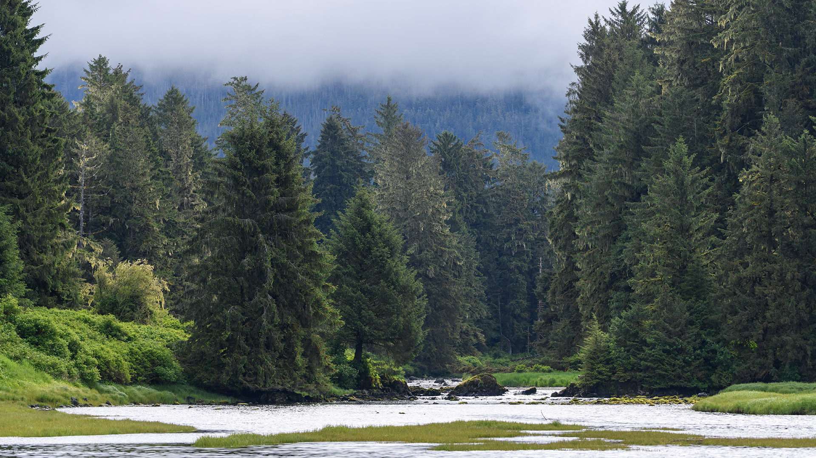
Science & Education Report
Alaska & British Columbia
1 – 13 June 2026

Slide 2
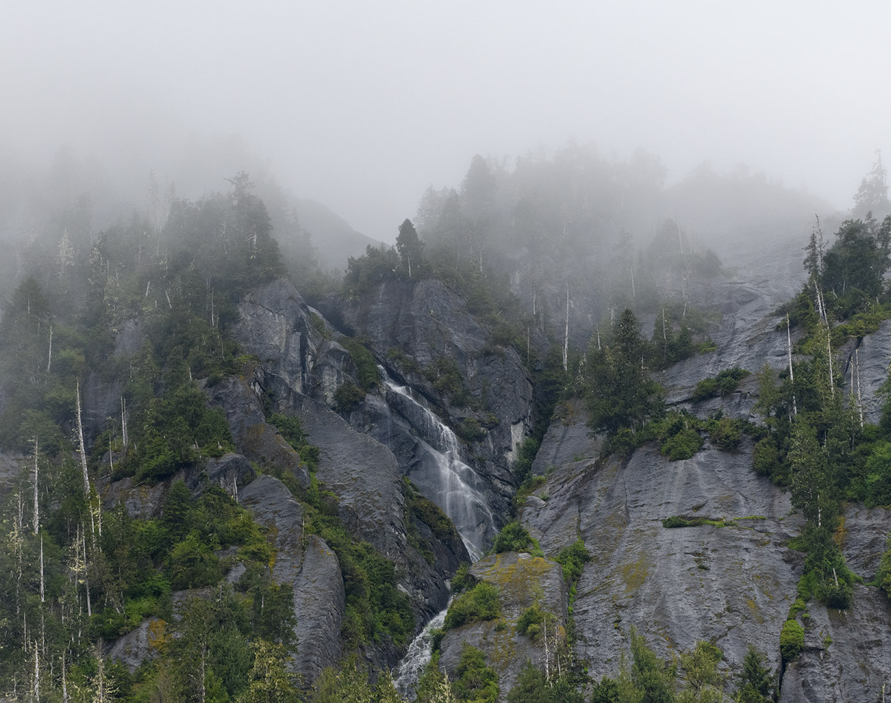
MS Roald Amundsen
1 – 13 June, 2026
Alaska and British Columbia
When you arrived on the MS Roald Amundsen you boarded a research-focused expedition ship fully equipped as a floating laboratory and designed to be a center of learning and discovery. In your time on board, you contributed to scientific studies and expanded your knowledge of the world around you. Let’s take a look back on our journey and what we accomplished while sailing through Alaska and British Columbia
Photo by Holly
Notes:
Add Ship name, dates and voyage name

Slide 3
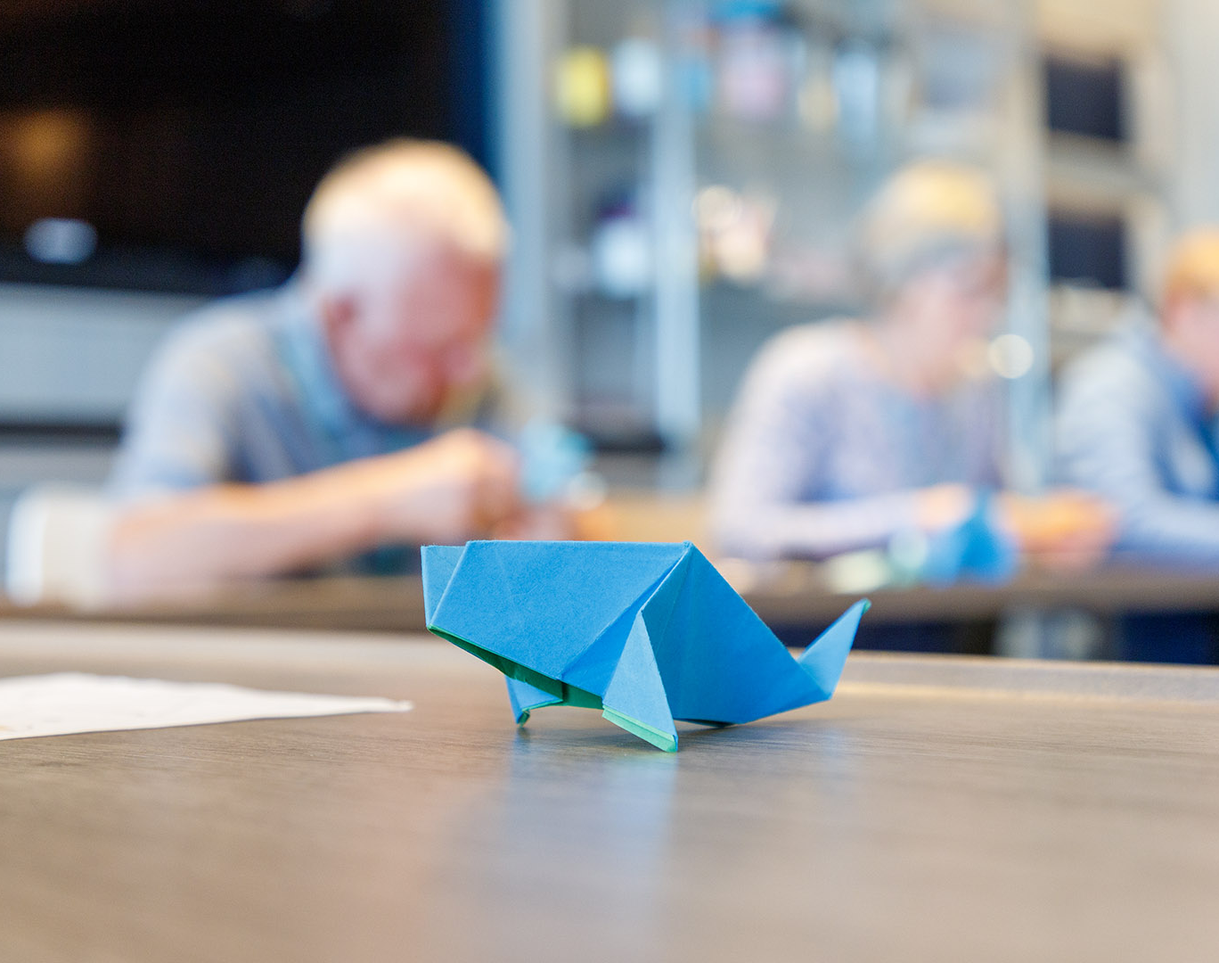
Arts, Crafts & Creativity
We were drawn to the landscapes and culture of Alaska and British Columbia, inspired to create art that reflected our surroundings, including watercolour postcards and origami.
Notes:
UPDATE PHOTO

Slide 4
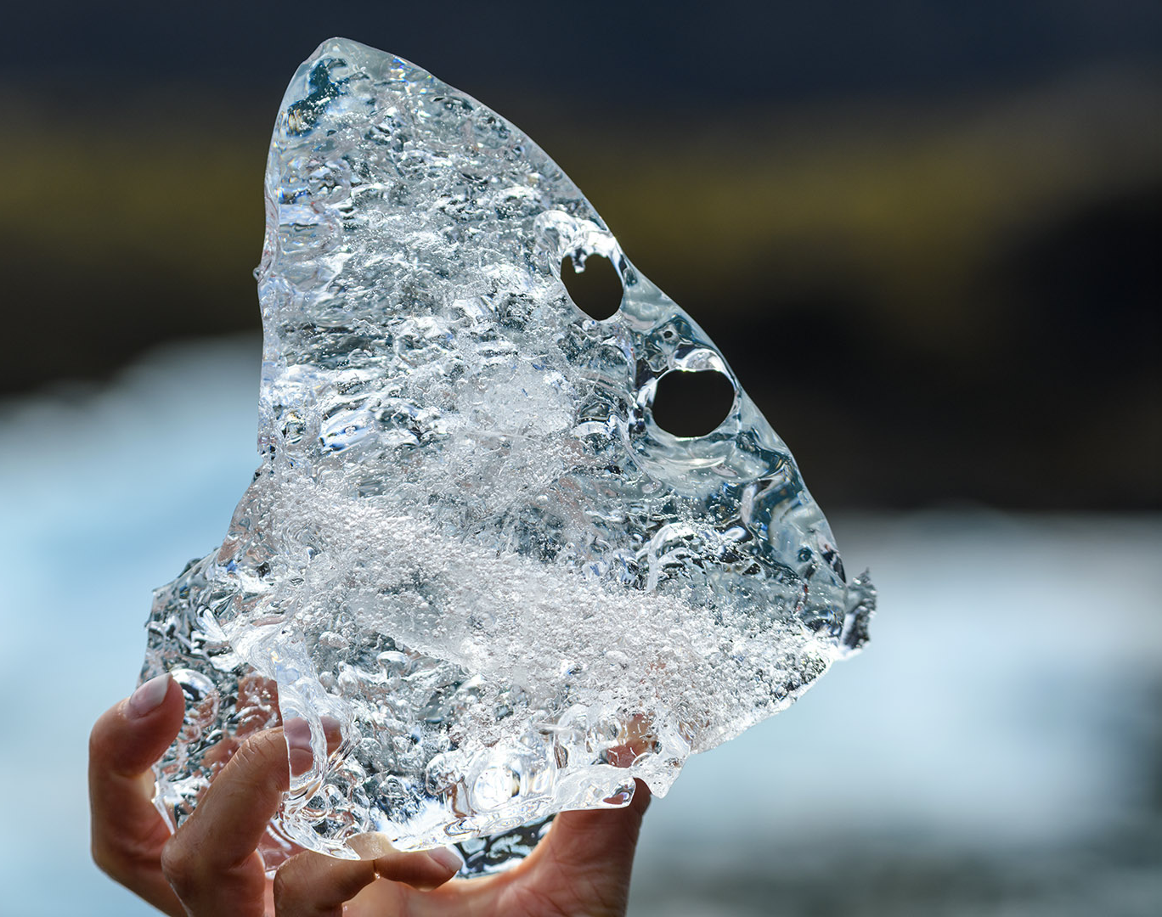
Science & Education Program
Our onboard Naturalists guided you in using scientific tools to investigate the world around us. Through lectures, discovery sessions, expedition boat cruises, and landings ashore, we worked to make every expedition day a memorable and unique learning experience.
Photo by Holly
Notes:
Optional to update photo to trip-specific

Slide 5
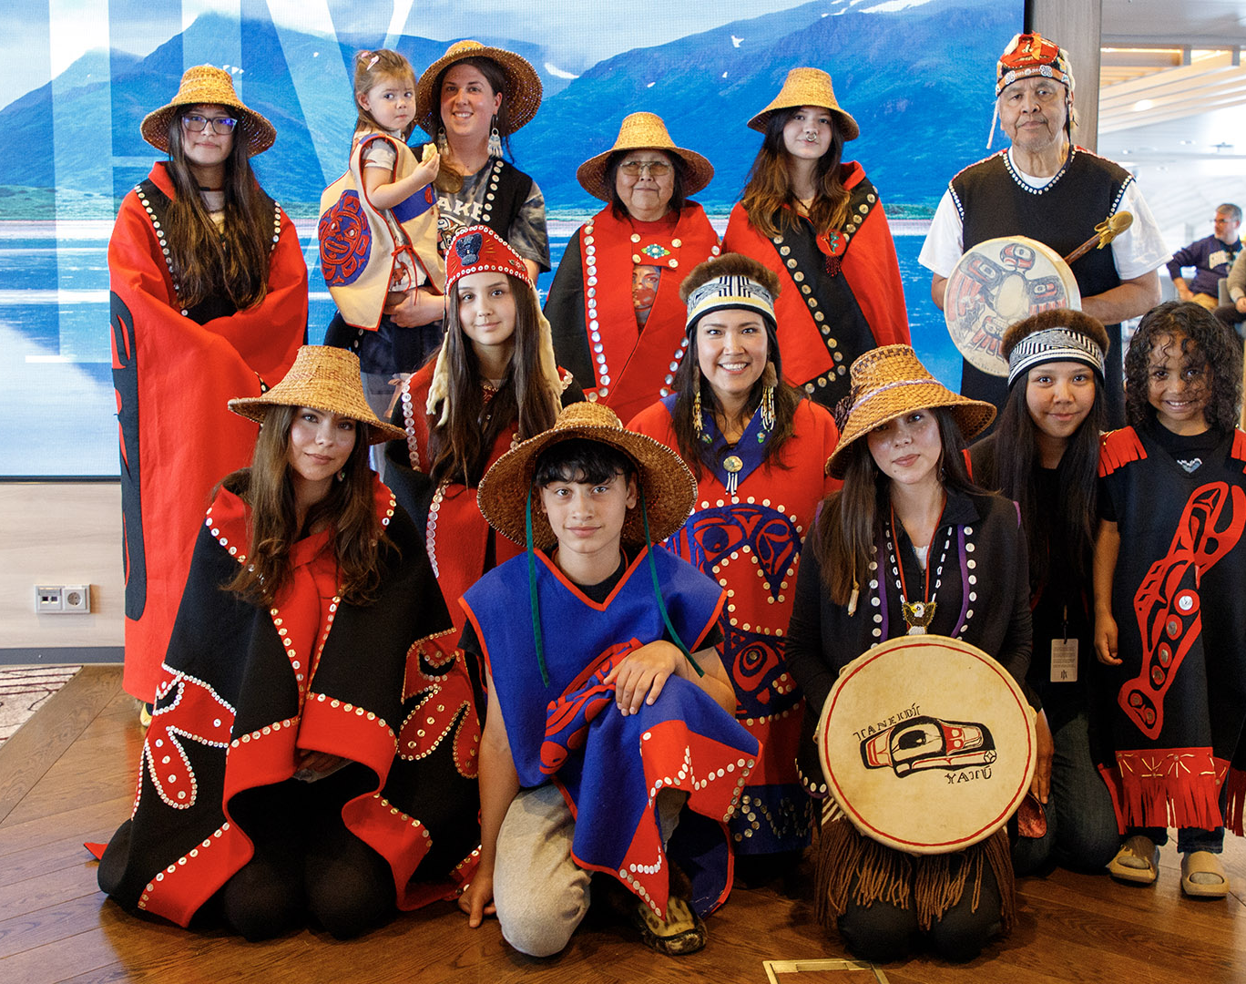
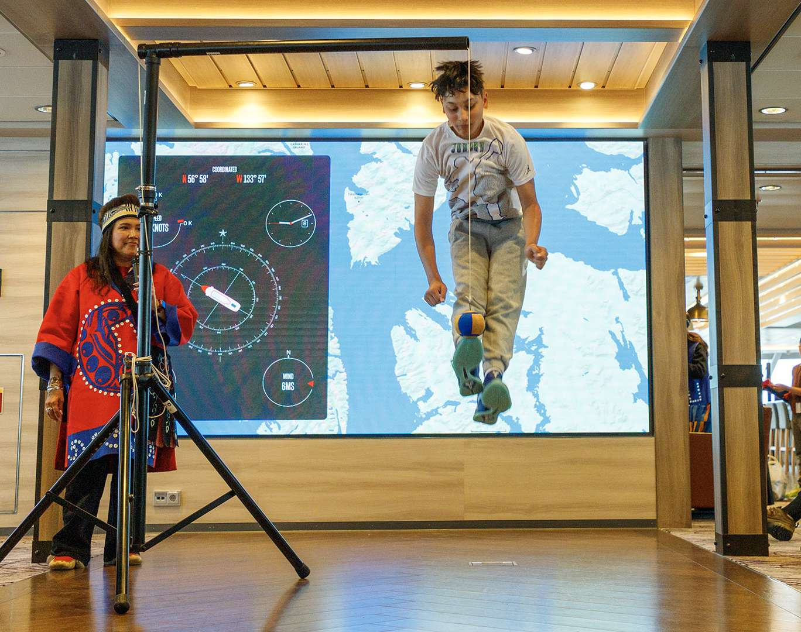
Alaska & British Columbia: Culture
Reading about or watching documentaries on the native cultures of Alaska is one experience. Witnessing that cultural heritage in person is another entirely.
In Kake, the local community welcomed us with a traditional dance ceremony performed alongside local schoolchildren and shared the customs and traditions of the Tlingit people.
They also showed us the regalia worn by different clans and gave us a demonstration of Inuit Olympic Games.

Slide 6
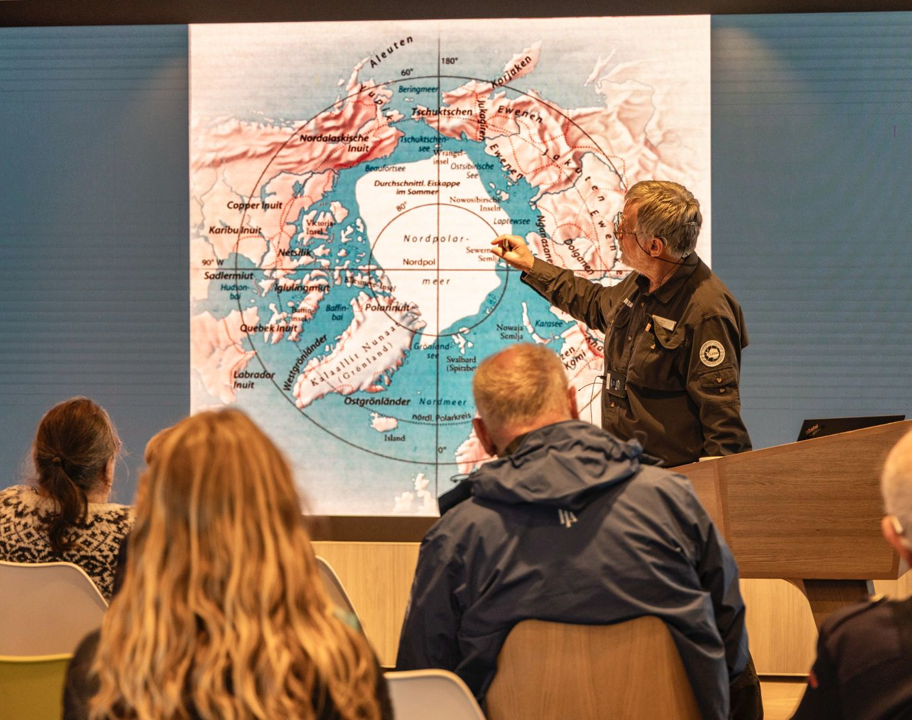
History & Culture
Beyond the native Alaskan cultures, this voyage led us deep into the human history of the region - from the arrival of Russian colonisers and the trade-driven motivations that brought them here, through the height and decline of Russian Alaska, and the lasting impact on the lives of those who had lived here long before.
We also explored the reasons behind the United States purchase of Alaska and how the territory developed in the decades that followed. Closer to the present, we looked at key historical events in South East Alaska, including the Exxon Valdez oil spill.

Slide 7
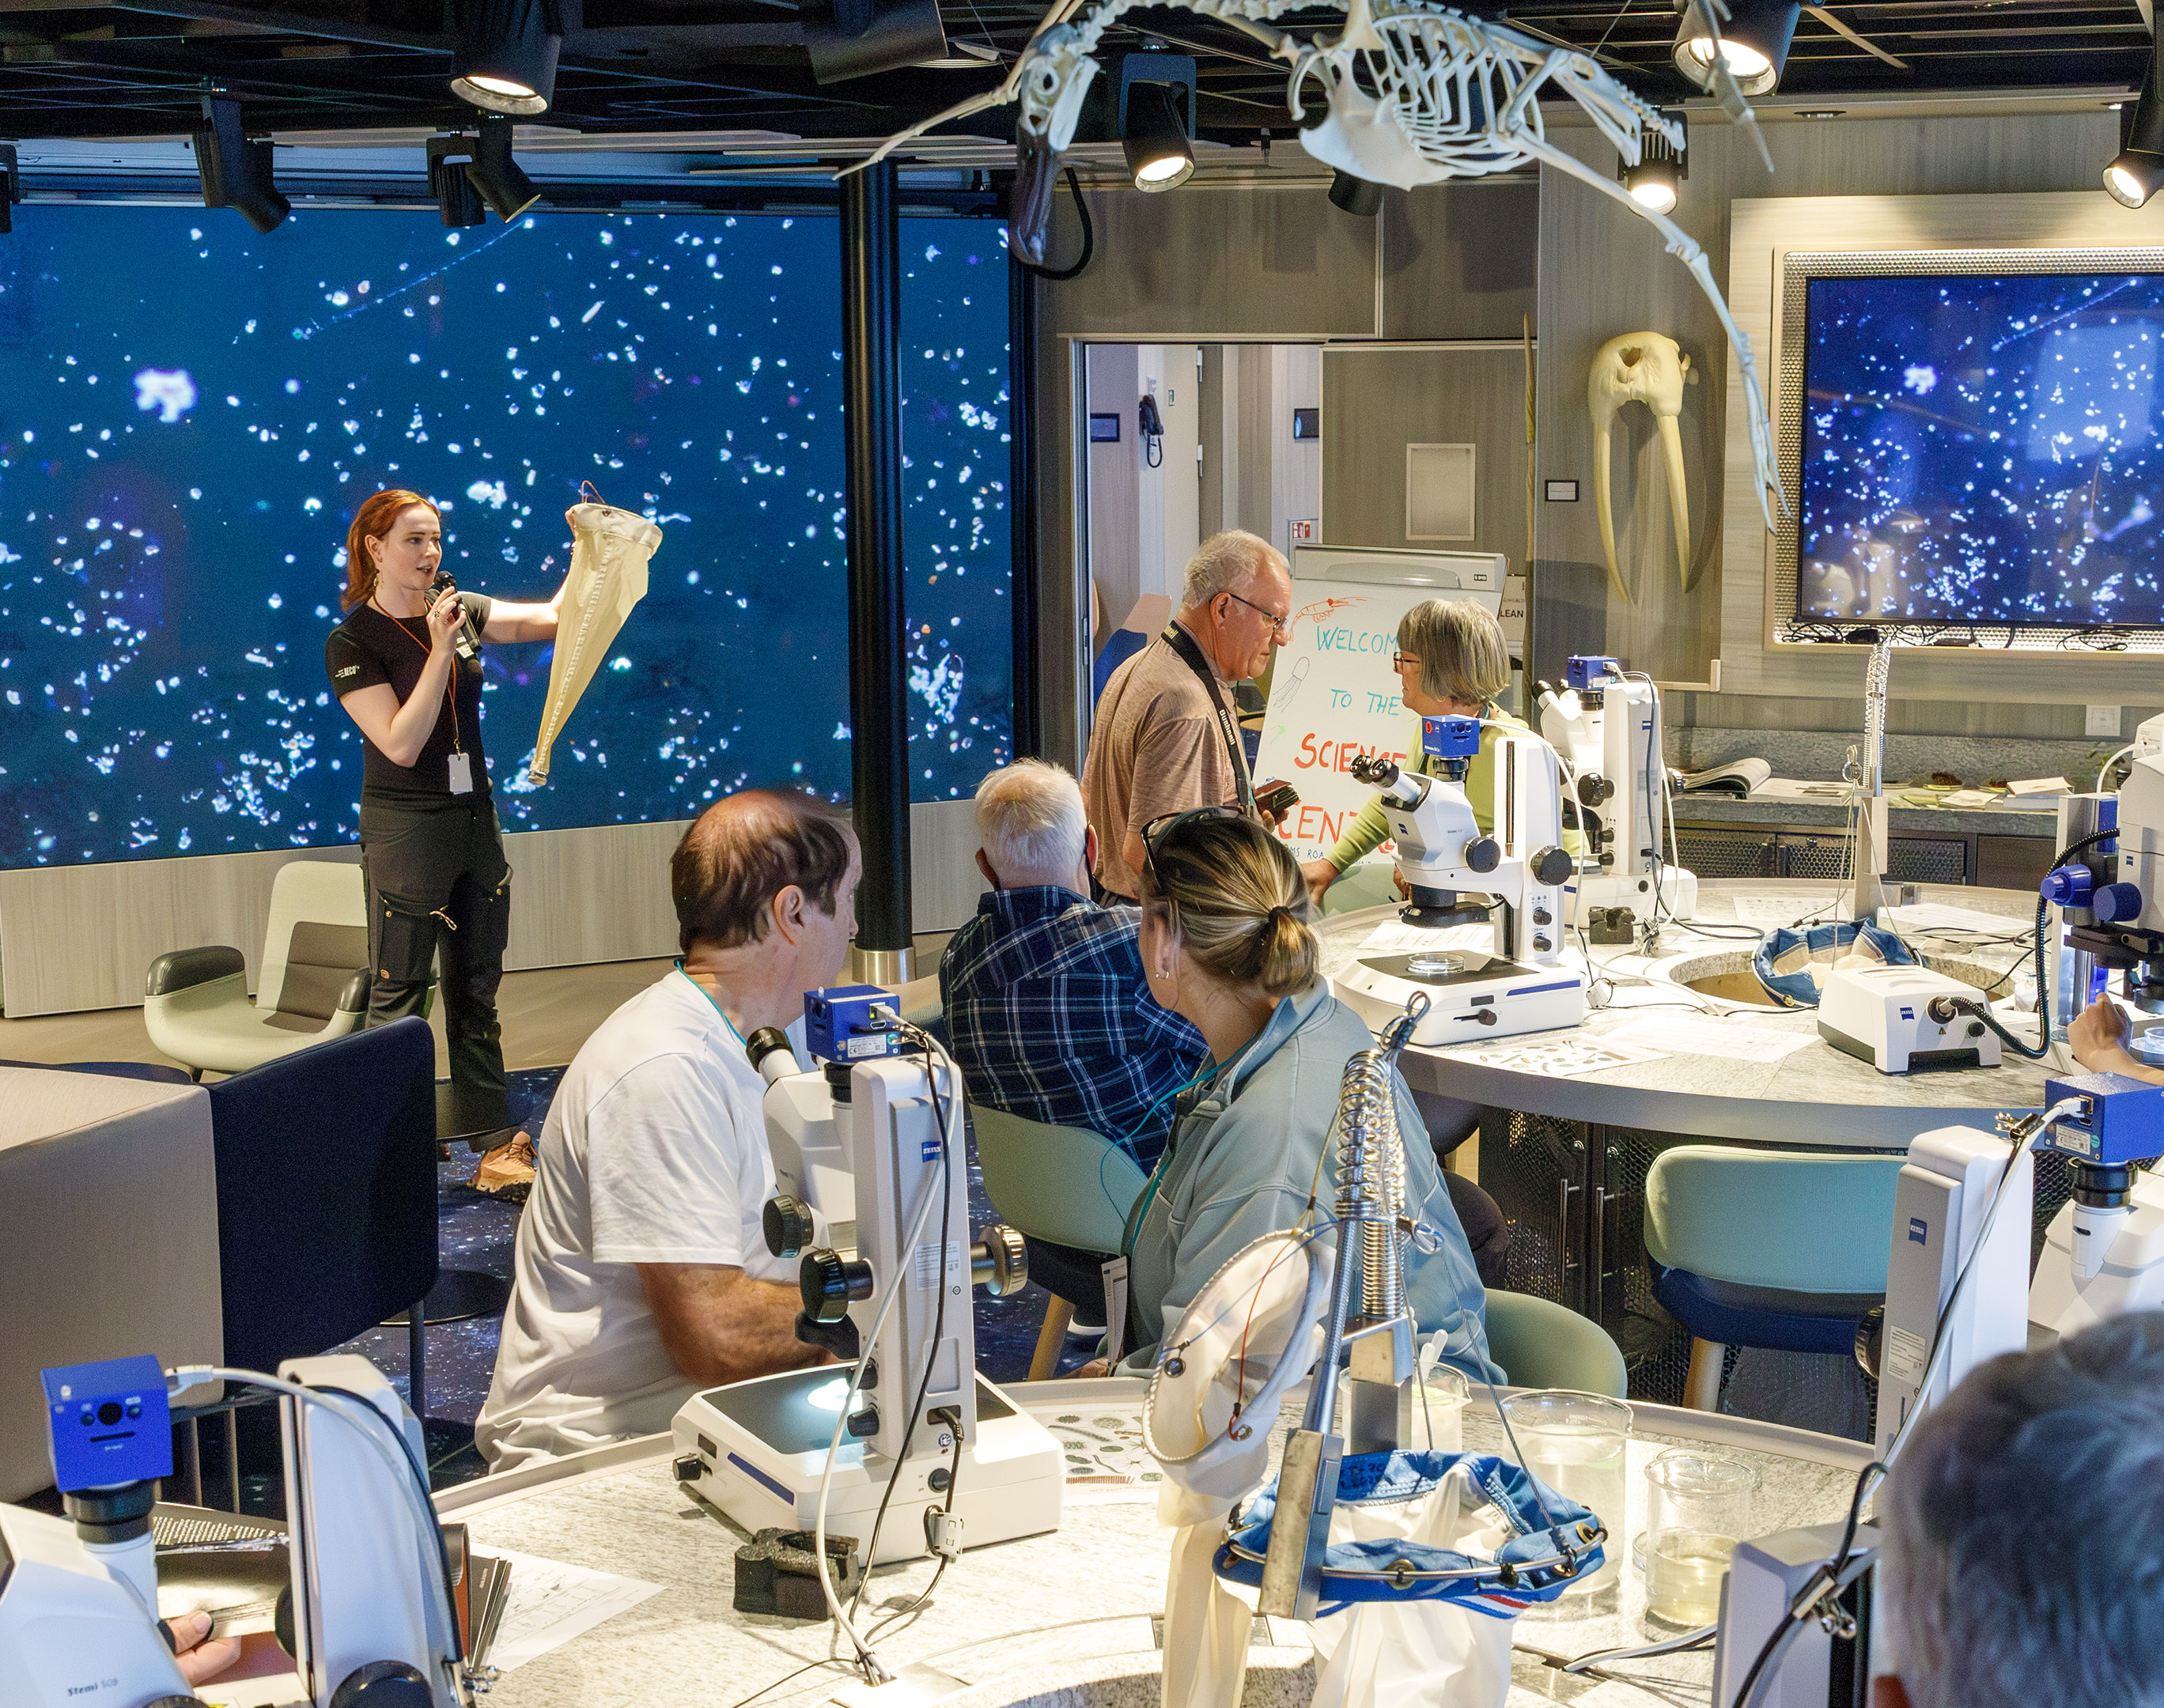
Science Boat
During our voyage we carried out plankton sampling focused on the abundance and species of phytoplankton present in Alaskan waters. The samples and data you helped record provide valuable input to the NOAA-funded Harmful Algal Bloom (HAB) project, which monitors potentially harmful phytoplankton blooms.
On our science boat sessions in Icy Bay, Inian Islands, Hamilton Bay, Endicott Arm, and William Henry Bay, we used a Secchi Disk and a CTD to build a physical profile of the water column, measured turbidity to estimate phytoplankton abundance, then deployed a plankton net to collect phytoplankton and zooplankton samples.
Notes:
UPDATE PHOTO
UPDATE #S, PLACES

Slide 8
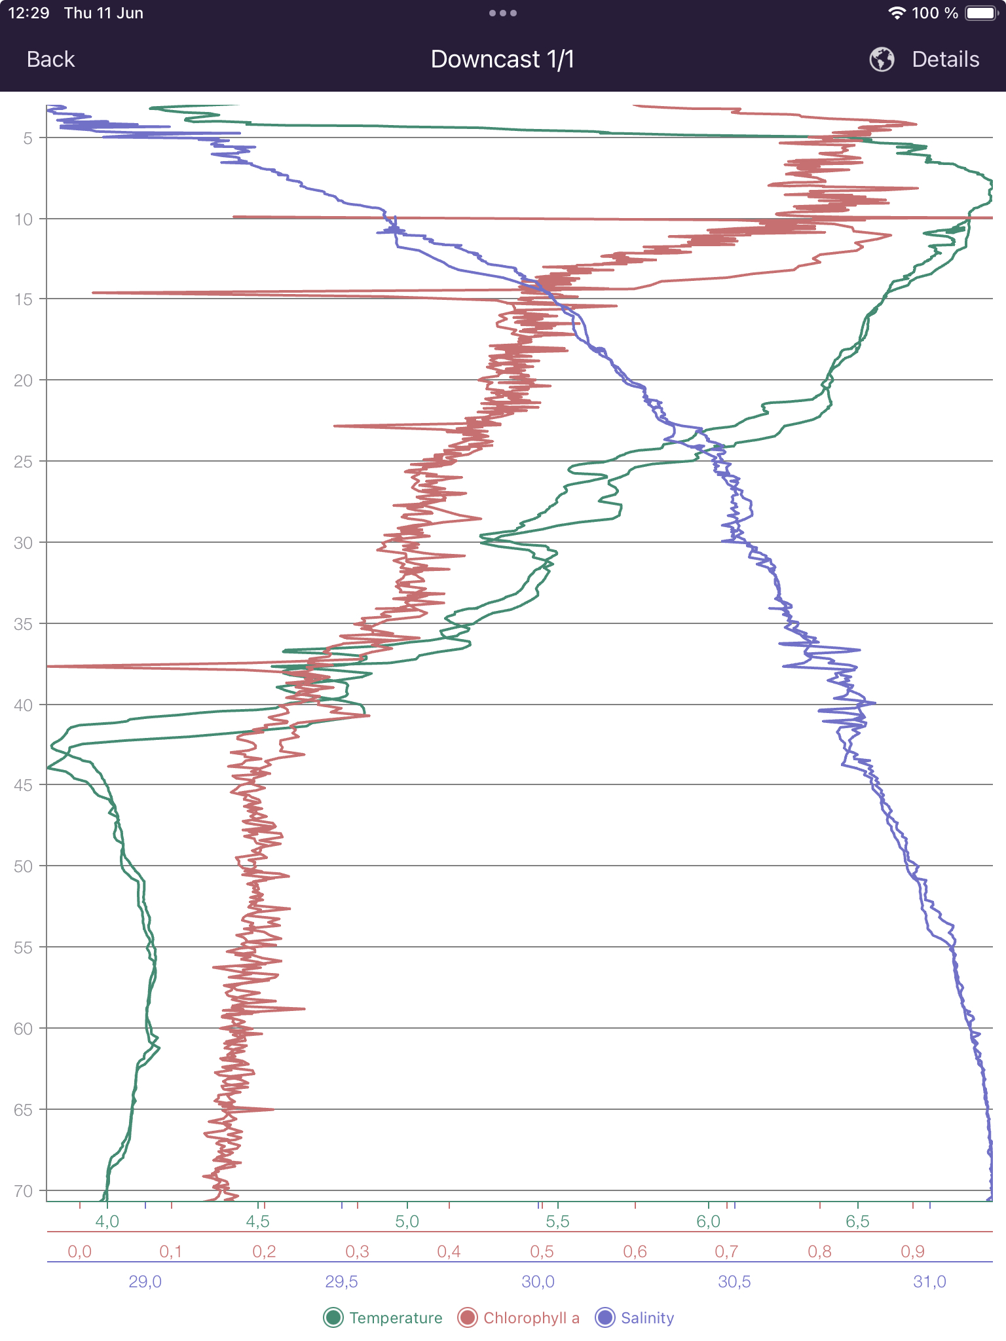
Science Boat: CTD data – Icy Bay
Temperature (green) was coldest near the surface at around 4.3°C in the upper 1–2 m, influenced by glacial meltwater and runoff entering the bay. Temperature then increased to 6.7°C at around 10 m, before decreasing again and remaining stable from around 45 m at 4°C.
Salinity (blue) was lowest at the surface at approximately 28 PSU, reflecting strong freshwater input from melting glaciers and river discharge. Salinity steadily increased with depth, reaching around 31.5 PSU at 70 m, indicating denser marine water beneath the fresher surface layer.
Chlorophyll-a (red) was relatively low, but showed its highest concentrations in the upper ~15 m, with a maximum of 0.8 µg/l. This suggests phytoplankton were concentrated in the sunlit surface layer where enough light is available for photosynthesis. Below 40 m, chlorophyll levels dropped off and remained very low at depth due to reduced light availability.
Overall, this profile reflects a classic glacier-fed Alaskan fjord system: fresh, warm meltwater on top, a strong halocline and thermocline beneath it, and a two-layer chlorophyll structure shaped by stratification and nutrient supply.

Slide 9
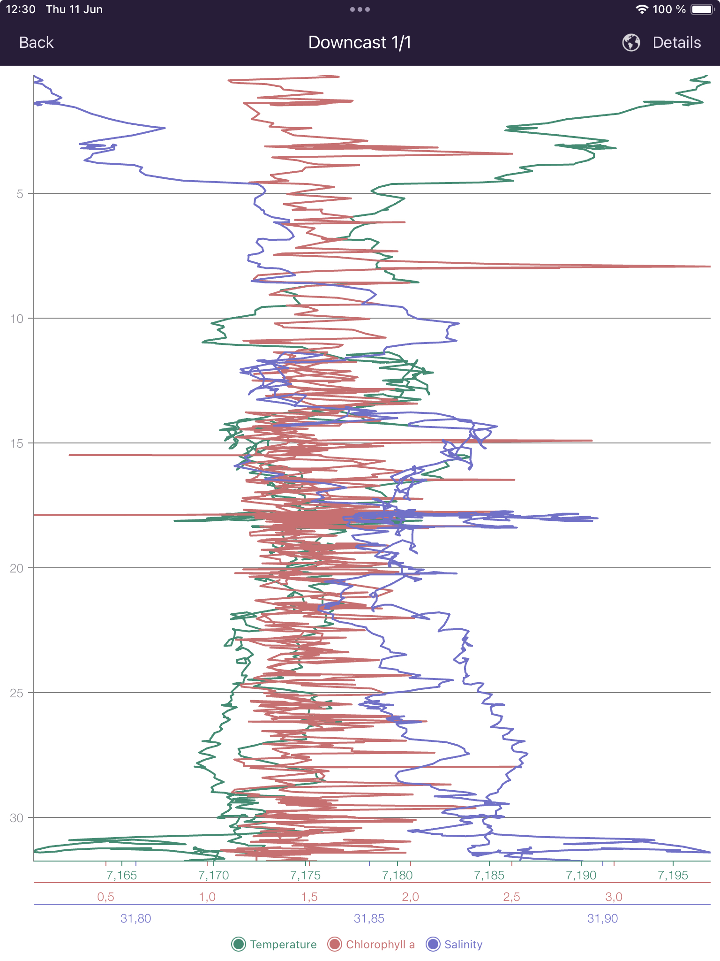
Science Boat: CTD data – Inian Islands
Temperature (green), despite the noisy data, was very stable across the profile when read against the scale, remaining around ~7.19–7.16°C from the surface to ~30 m depth. This suggests the water column was 'well mixed’. This is typical of high-energy tidal environments like the Inian Islands, where strong currents and mixing continually redistribute heat through the water column.
Salinity (blue) remained relatively high and consistent throughout the cast at ~31.75–31.95 PSU, with only minor variation with depth. This indicates a predominantly marine water mass with little freshwater influence compared with glacier-fed fjords like Icy Bay. The lack of a strong halocline again suggests that vigorous tidal mixing and strong currents were preventing the formation of stable surface layers.
Chlorophyll-a (red) again showed little fluctuation, remaining constant down to 30 m at ~1.5–2.0 µg/l.
Overall, this profile reflects a dynamic, well-mixed coastal system strongly influenced by tidal exchange.

Slide 10
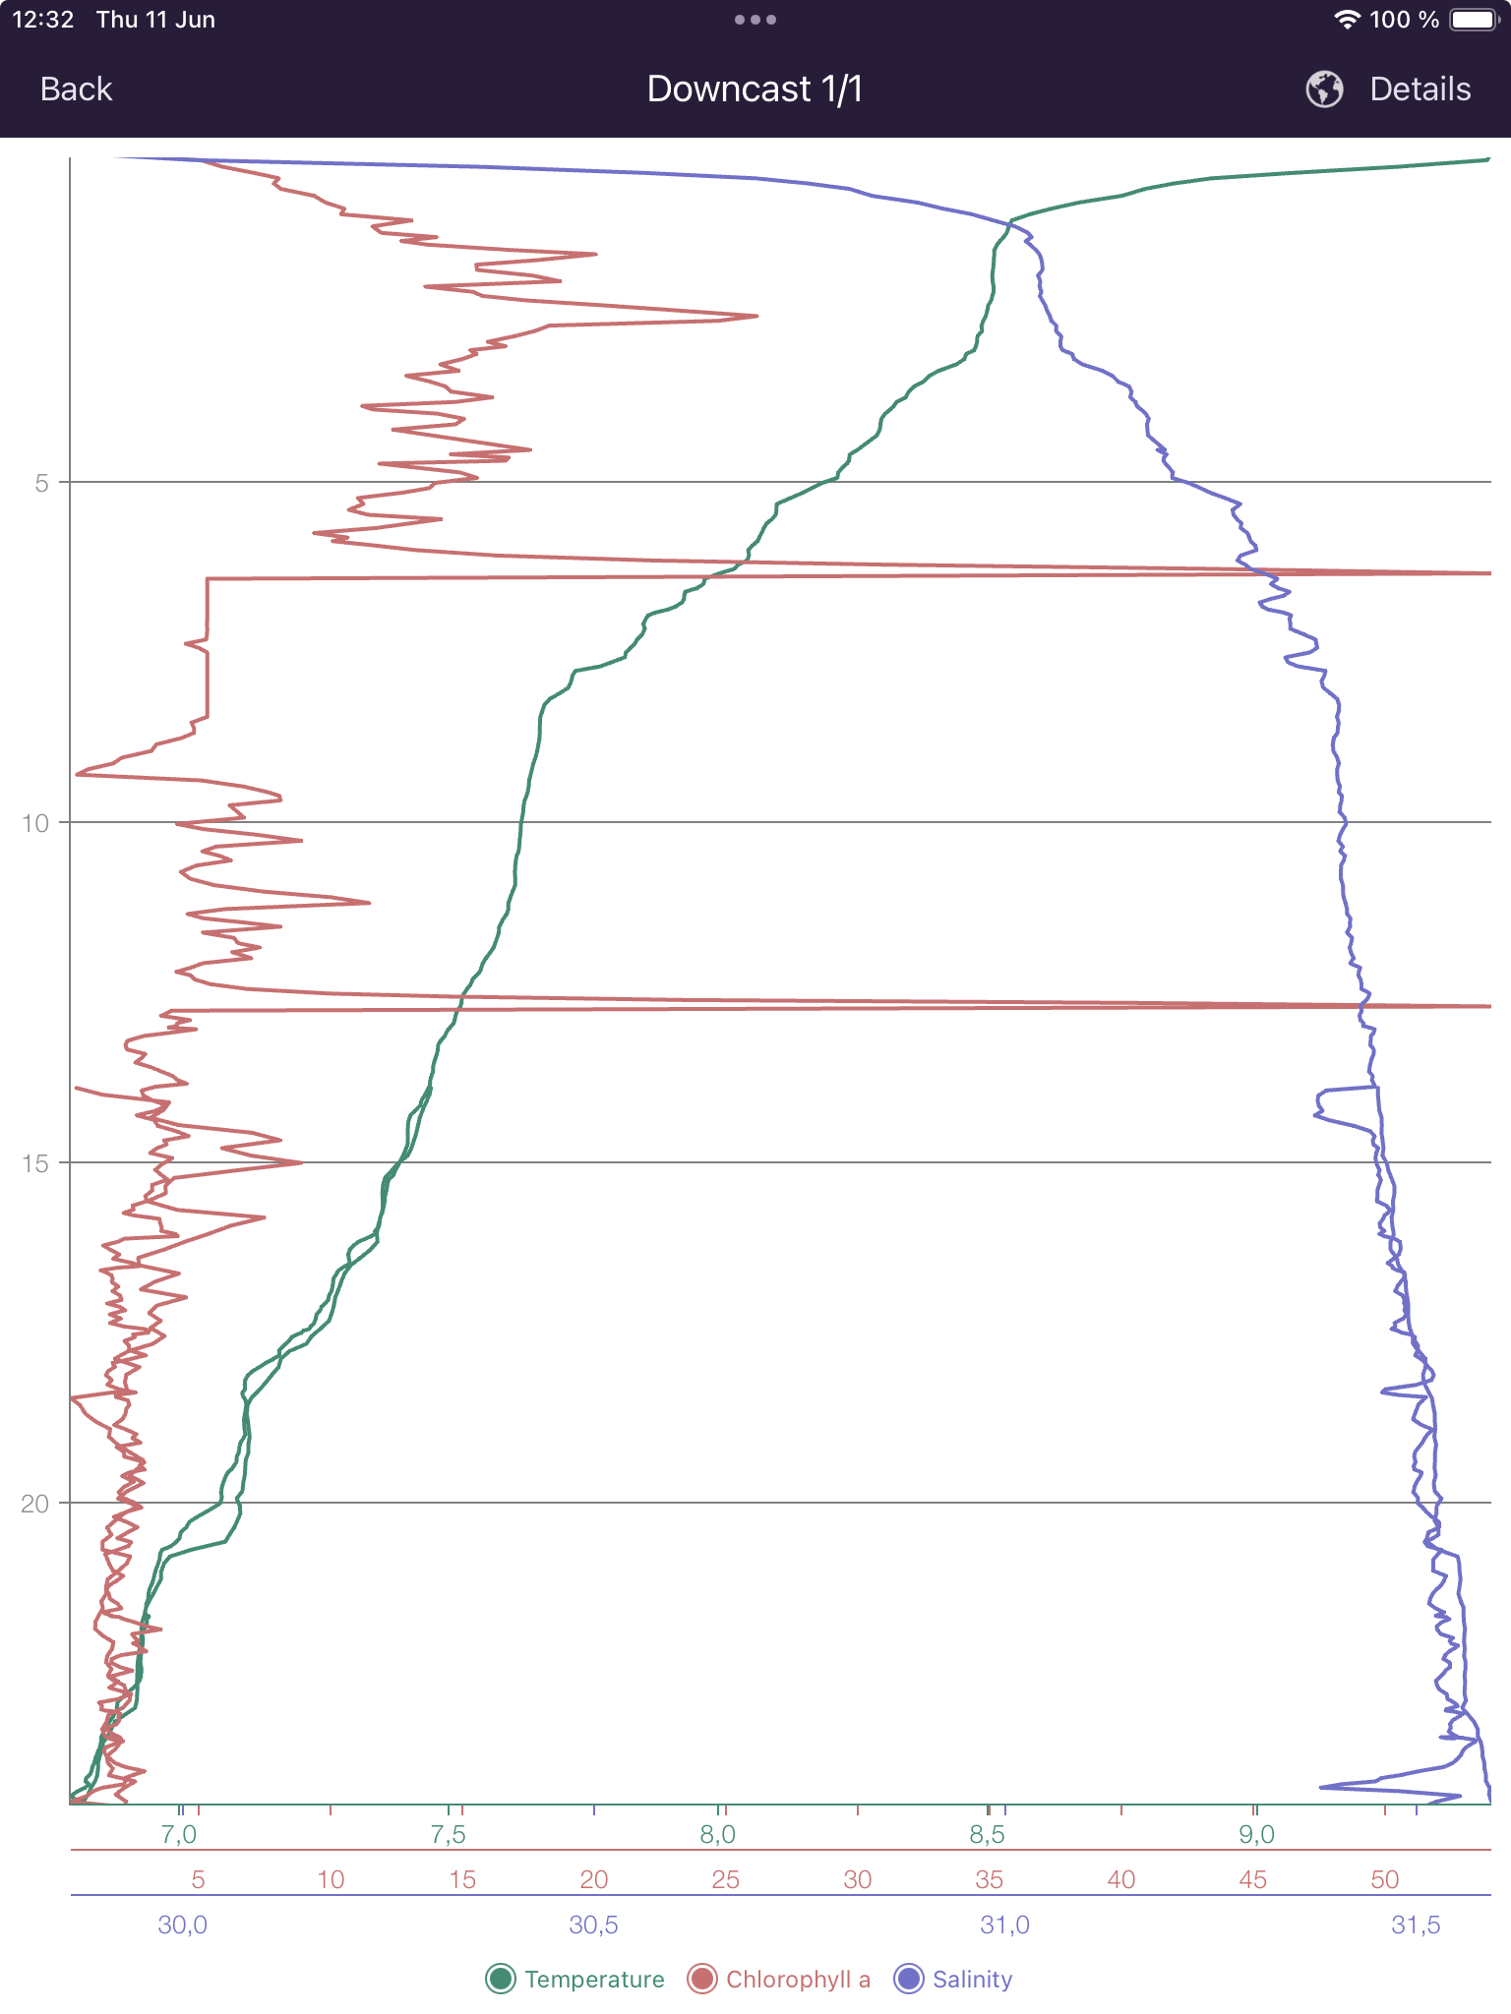
Science Boat: CTD data – Hamilton Bay
Temperature (green) showed a classic profile with warmer water overlying colder, denser water, ranging from 9°C at the surface to ~6.5°C at 25 m depth.
Salinity (blue) was lowest at the surface at ~30 PSU and increased with depth to 31.5 PSU at 25 m. This suggests slightly fresher water from ice melt, river run-off, and rainfall — of which we had plenty that day — overlying saltier, denser, deep water.
Chlorophyll-a (red) revealed very high levels of phytoplankton, suggesting a plankton bloom in this area. Levels were highest between 0–9 m at 20–25 µg/l, indicating optimum nutrients and light availability for a bloom to occur. Beyond 15 m, chlorophyll levels dropped off to <5 µg/l.
Overall, this profile reflects a dynamic and nutrient-rich coastal system with a significant phytoplankton bloom.

Slide 11
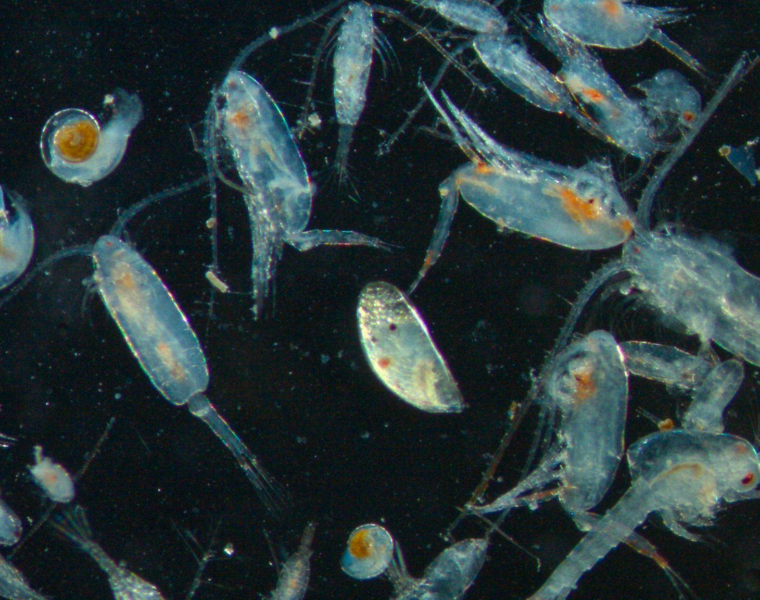
Plankton samples
Plankton are ocean drifters, carried by currents and tides and unable to navigate against these natural forces. Animals (zooplankton) and plant-like algae (phytoplankton) play a key role in supporting the marine food web and the health of our oceans.
The photo on the left shows a sample taken in the Inian Islands, including copepods, sea butterflies, shrimp larvae, and barnacle larvae.
Caprellid amphipod (Castro, Chile)
Notes:
UPATE PHOTOS:
Add any interesting finds in the plankton samples and pictures taken down the microscopes

Slide 12
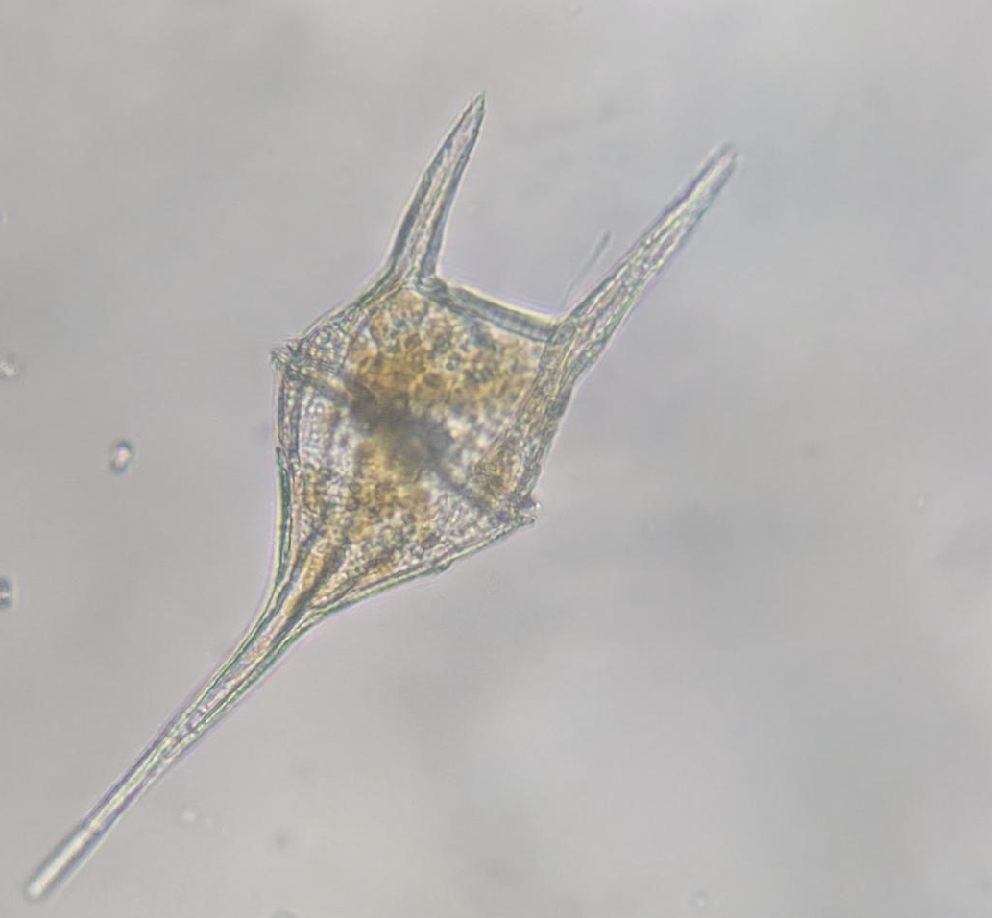
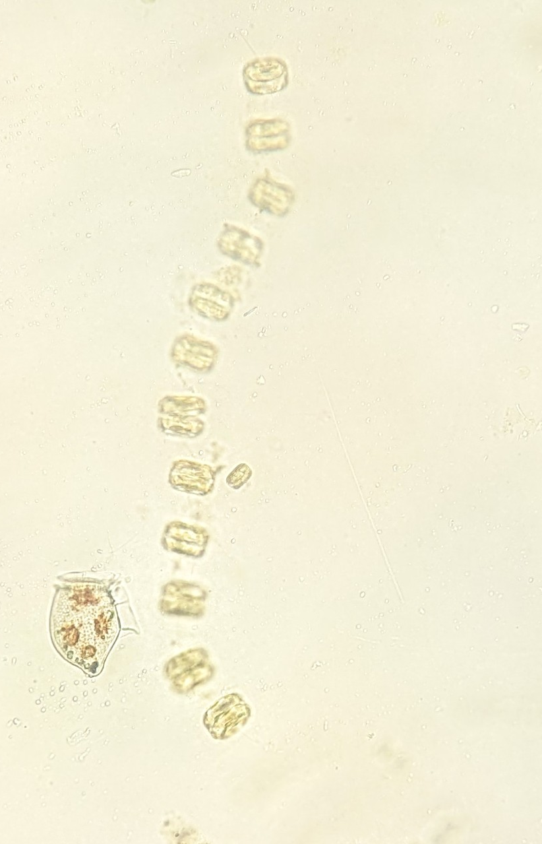
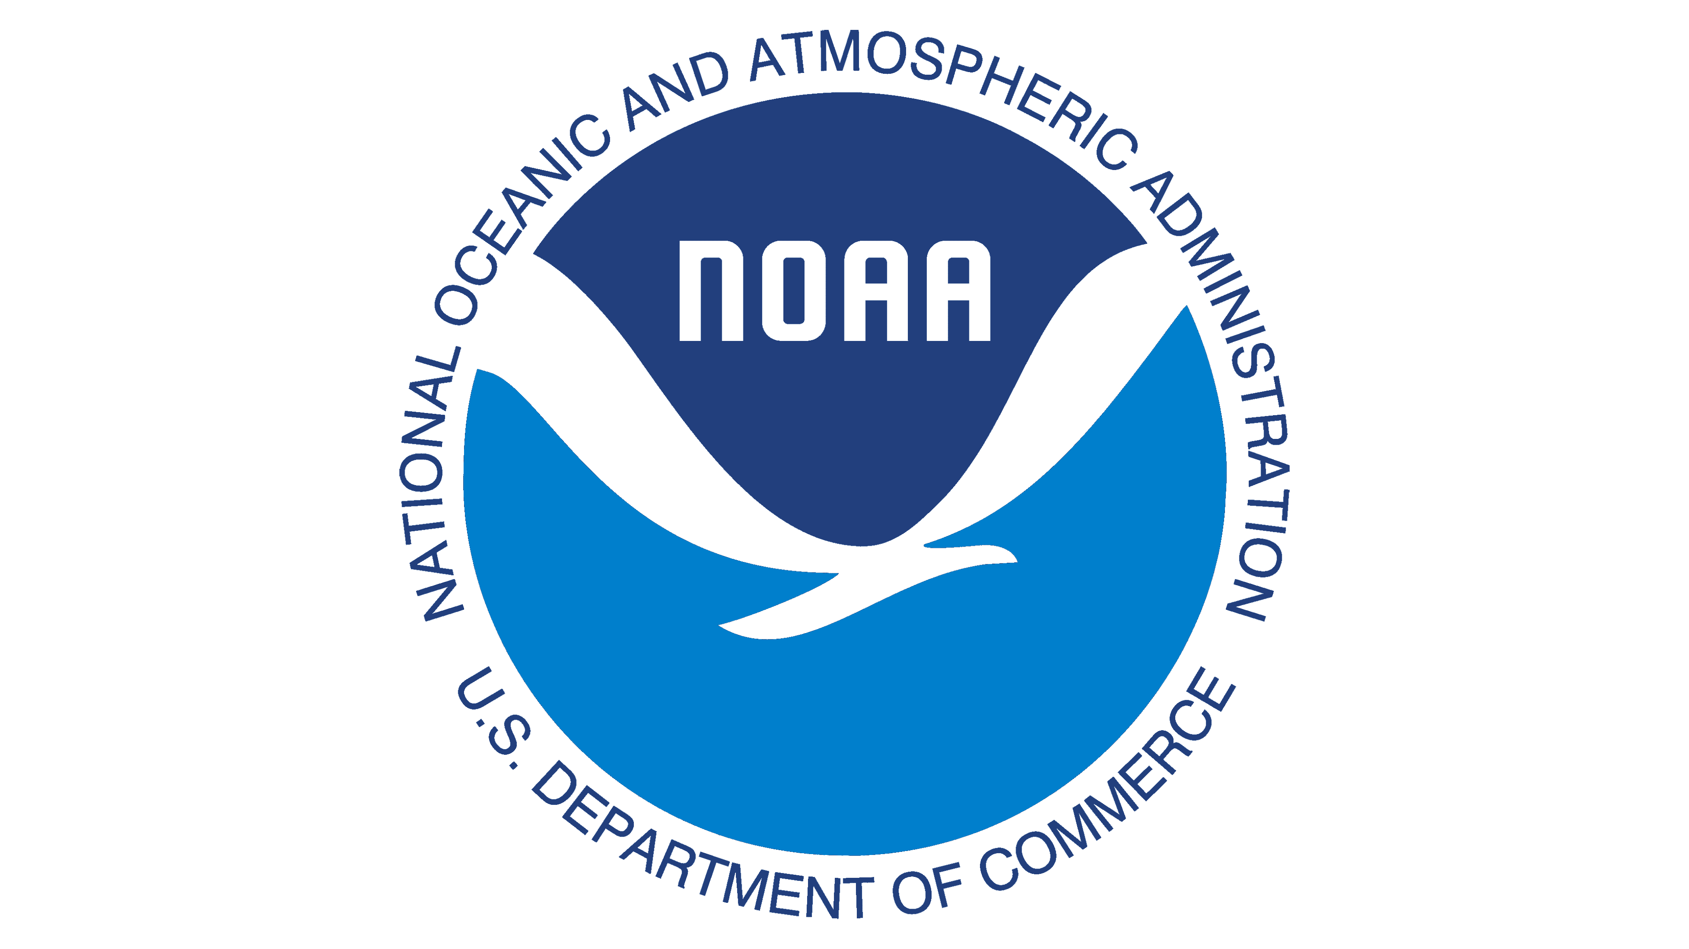
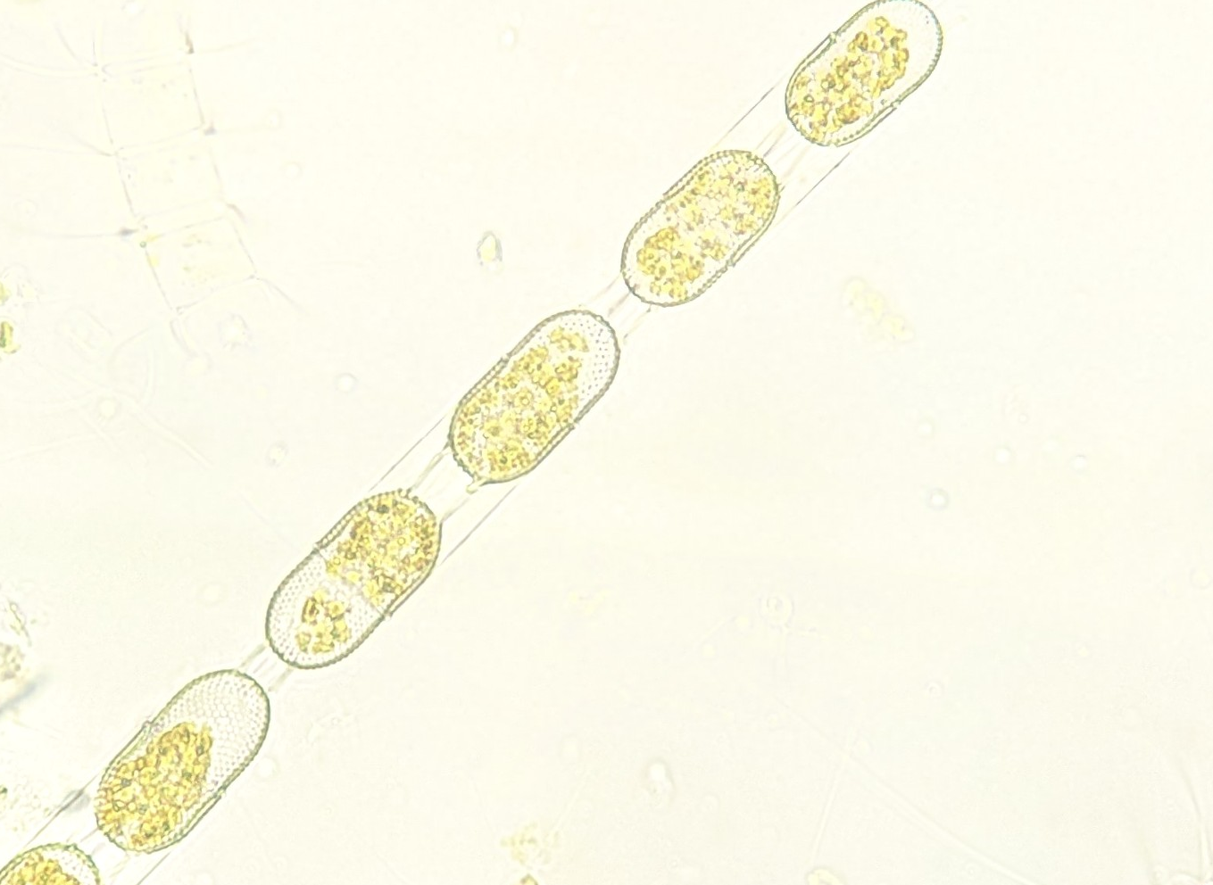
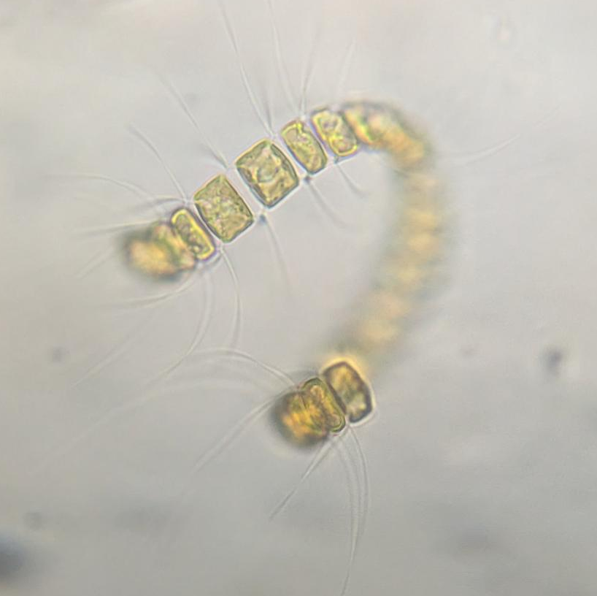
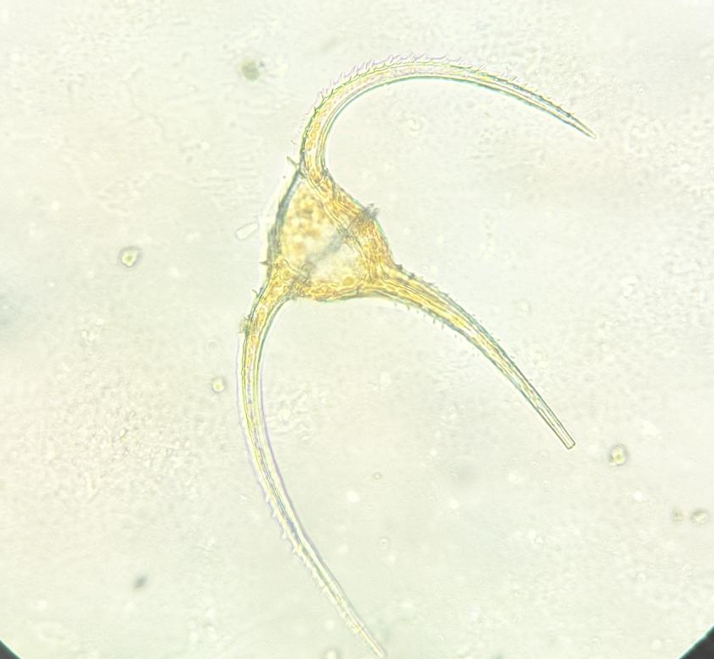
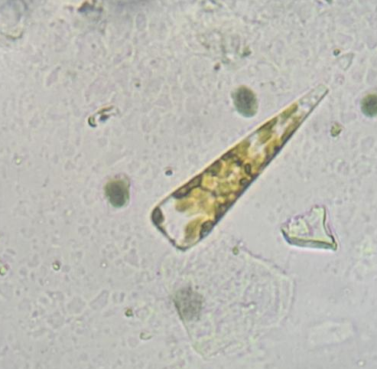
Phytoplankton & Harmful Algal Bloom (HAB) Project
Phytoplankton underpin the marine food web. Like plants on land, they contain photosynthetic pigments (chlorophyll) that convert sunlight into energy and oxygen, and also sequester carbon dioxide.
We collected phytoplankton samples in Icy Bay, Inian Islands, William Henry Bay, Endicott Arm, and Hamilton Bay, and reported the abundance and species present to the HAB project to help detect harmful blooms of microalgae.
These blooms, caused by excessive nutrient pollution and environmental change, can produce toxins that harm aquatic life, disrupt ecosystems, and pose health risks to humans. The HAB project monitors outbreaks, identifies contributing factors, and develops strategies to predict, prevent, and manage HABs through scientific research. We detected high levels of our target species — Dinophysis and Chaetoceros — in samples taken in Hamilton Bay, near Kake, suggesting a HAB event. The sample was preserved and reported to NOAA for further testing and confirmation (see next page).
Tripos furca
Thalassiosira
Stephanopyxis turris
Chaetoceros
Tripos longipes
Licmophora
Notes:
UPATE PHOTOS:
Add any interesting finds in the plankton samples and pictures taken down the microscopes

Slide 13
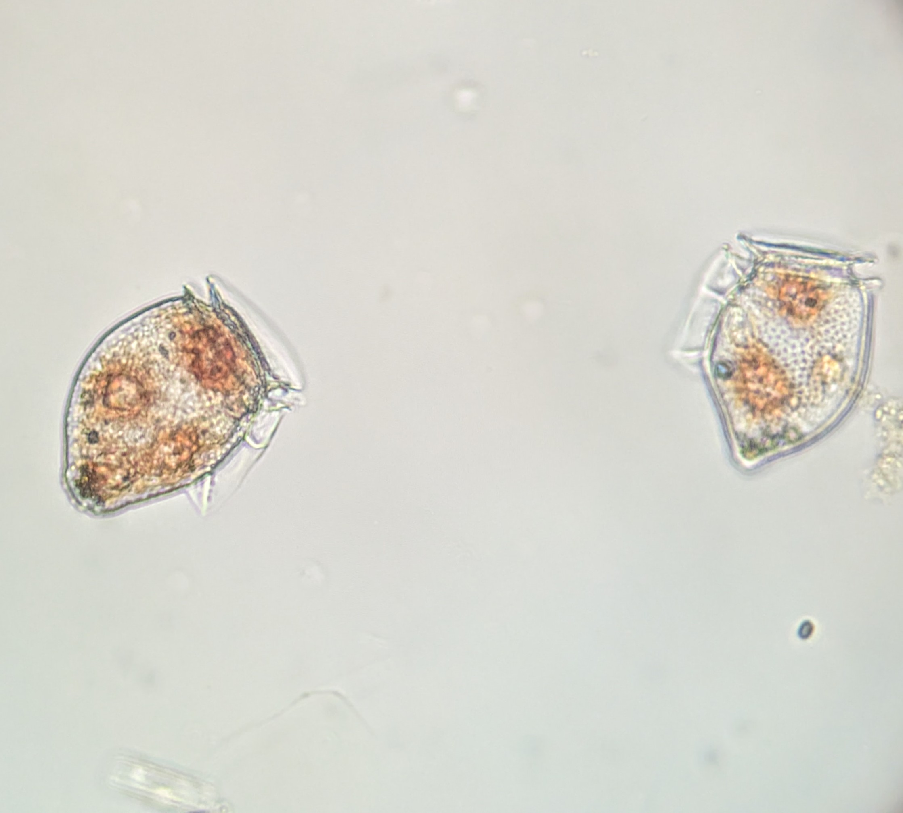
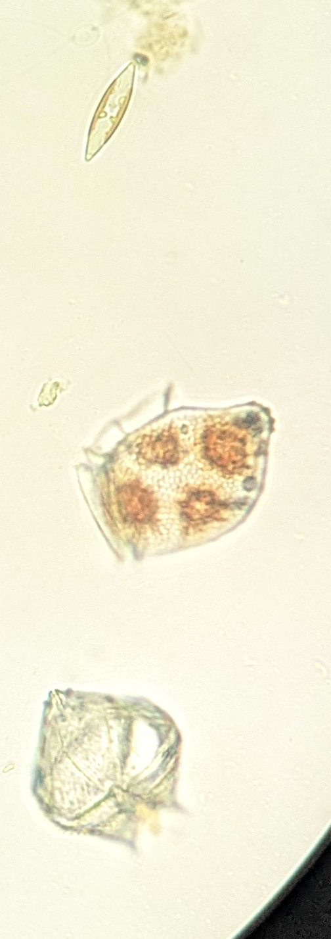
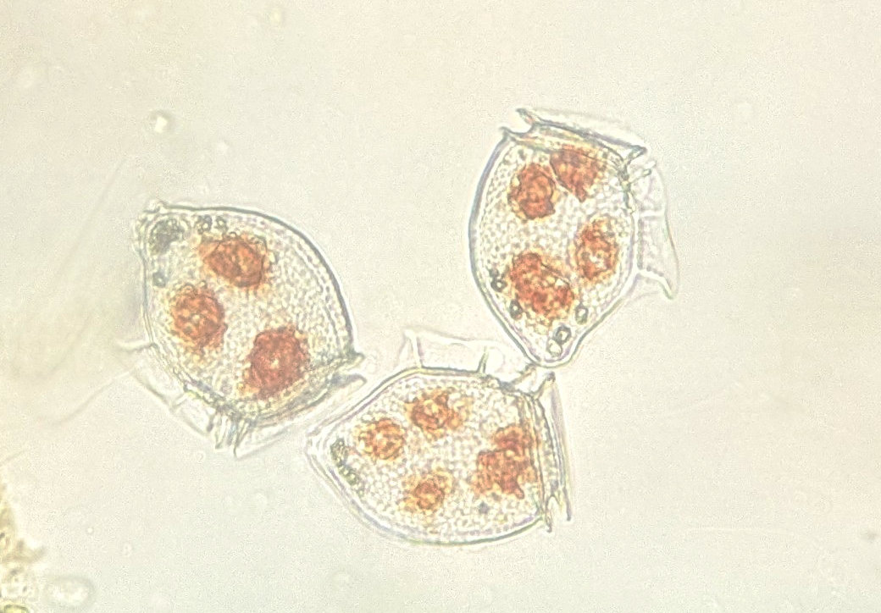
HAB: Hamilton Bay, 8 June 2026
Navicula
As part of our regular science boat sessions, we collected water samples in Hamilton Bay, Kake, and examined them under the microscope. Among the diverse plankton community, we detected elevated levels of Dinophysis norvegica. This microscopic dinoflagellate produces okadaic acid, a toxin that can accumulate in shellfish and cause diarrhetic shellfish poisoning (DSP) in humans.
We reported the findings through NOAA's Phytoplankton Monitoring Network (PMN), which reviewed them and shared the information with the Sitka Tribe of Alaska and the nearby community of Kake. The early warning allowed local partners to increase testing efforts and advise subsistence harvesters to avoid collecting shellfish from the area until the bloom passed.
While harmful algal blooms are a natural phenomenon, their impacts can be significant for coastal communities that depend on shellfish as a food source. Detecting blooms in remote locations is challenging, which makes observations from vessels operating in these regions especially valuable.
This is a clear example of Citizen Science in action. Together, we play a pivotal role in collecting information that directly supports local monitoring networks and community decision-making.
Dinophysis norvegica
Protoperidinium
Dinophysis norvegica
Notes:
UPATE PHOTOS:
Add any interesting finds in the plankton samples and pictures taken down the microscopes

Slide 14
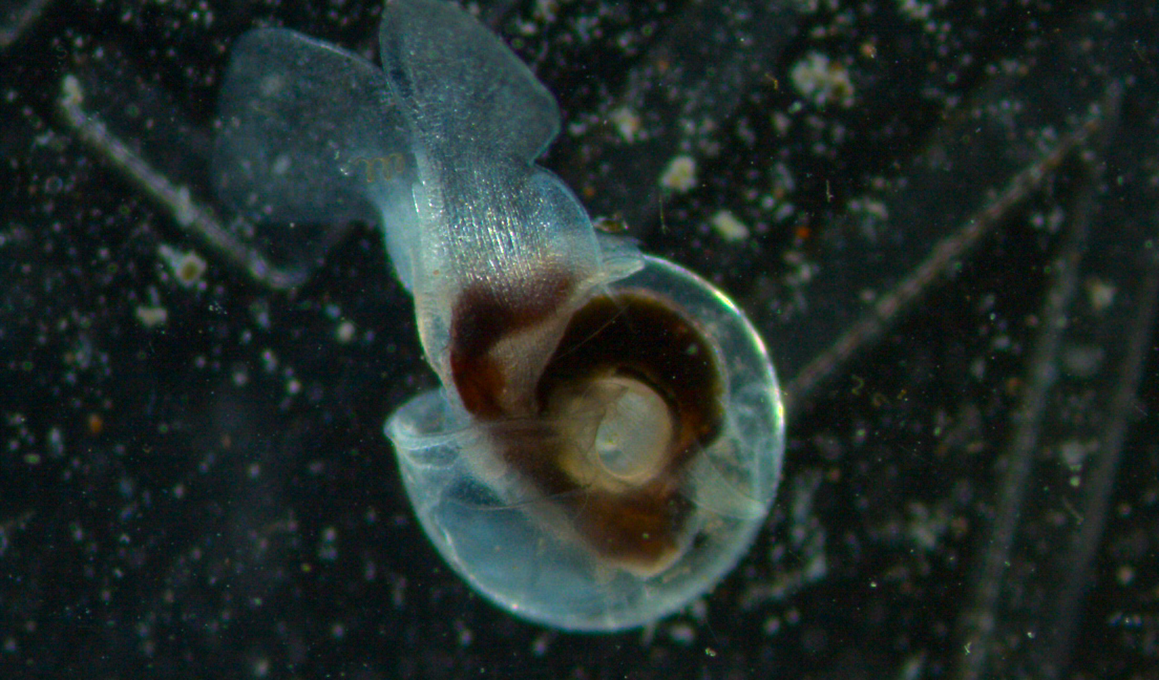
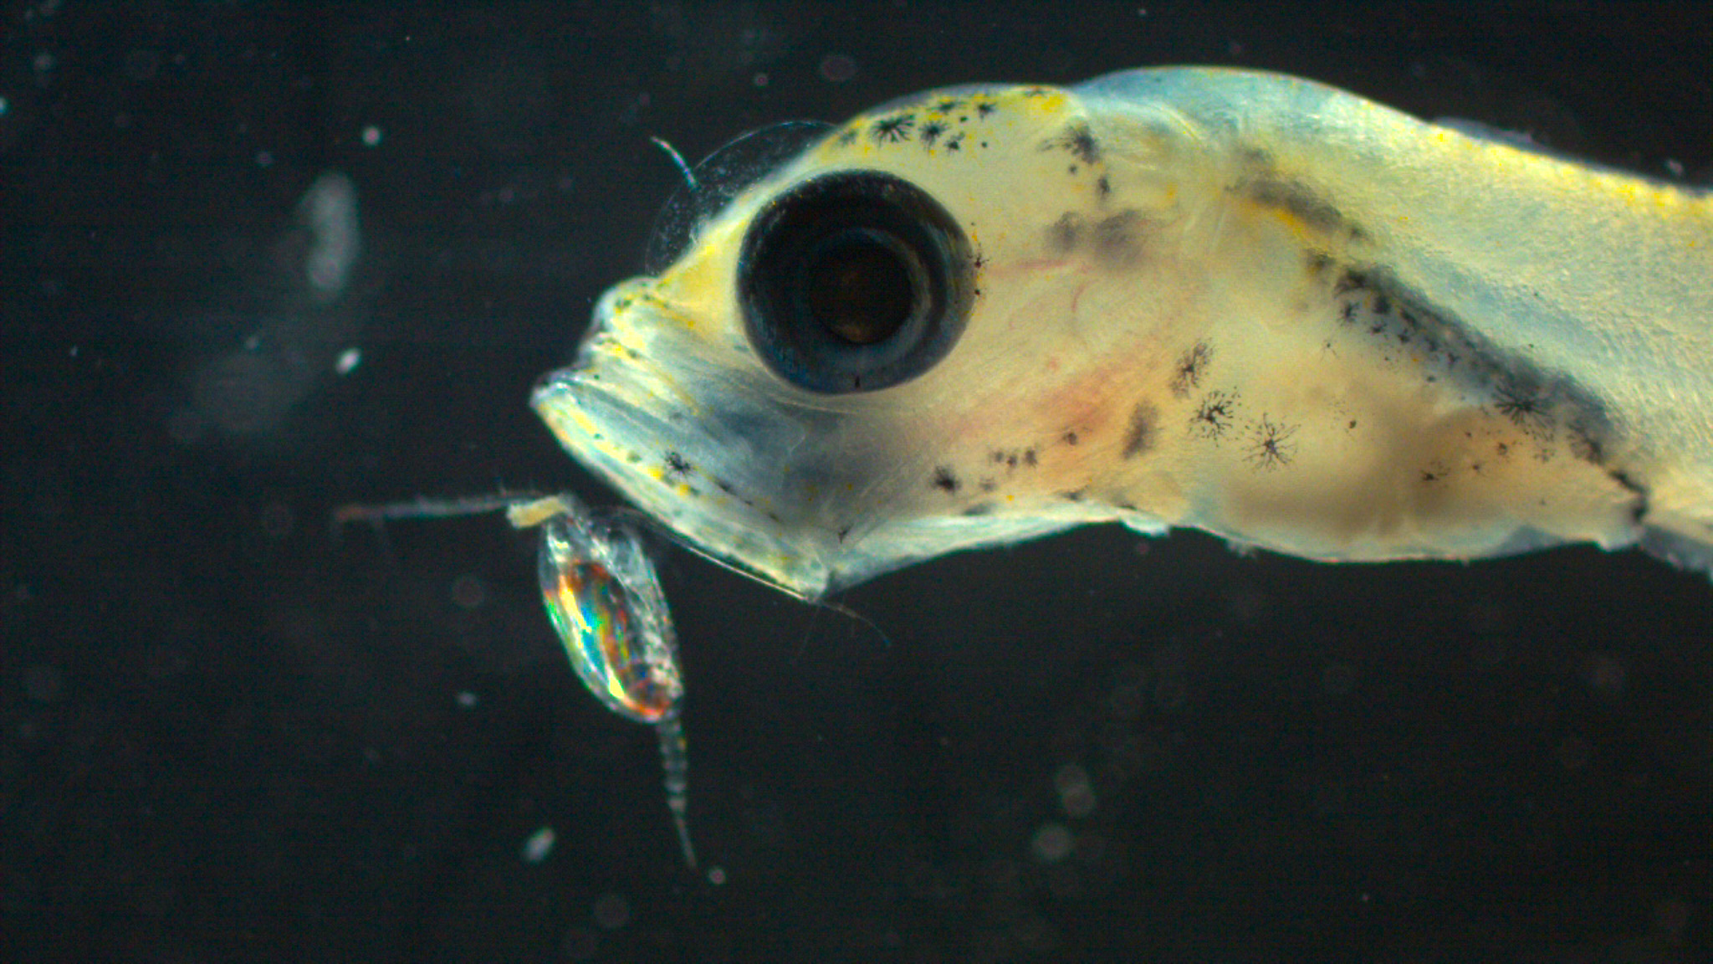
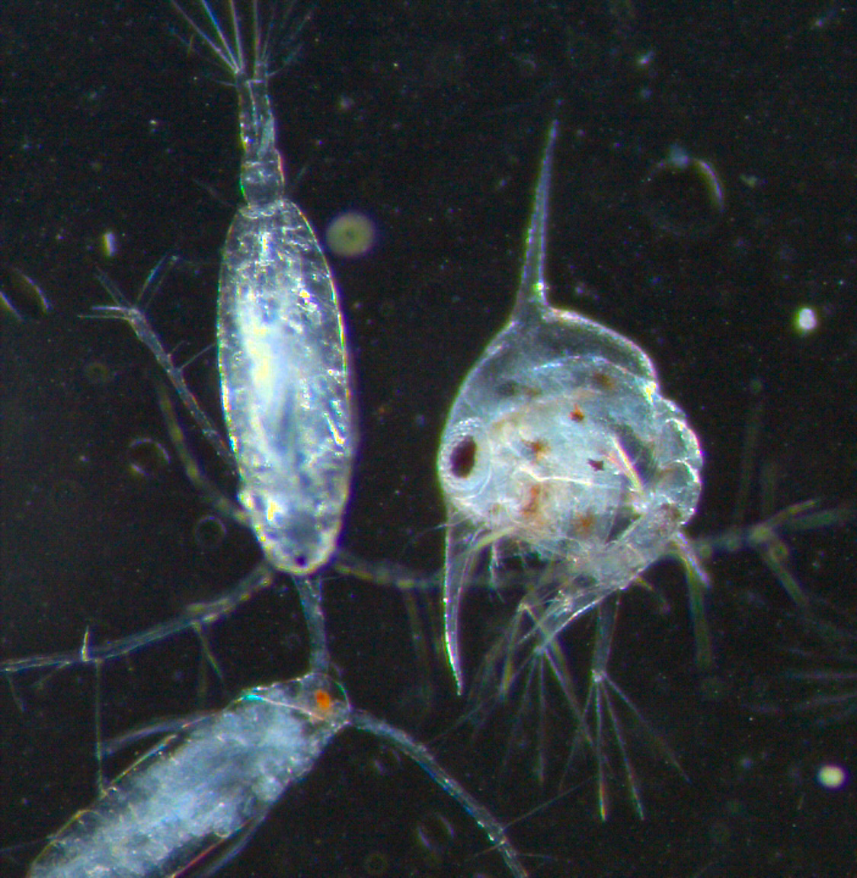
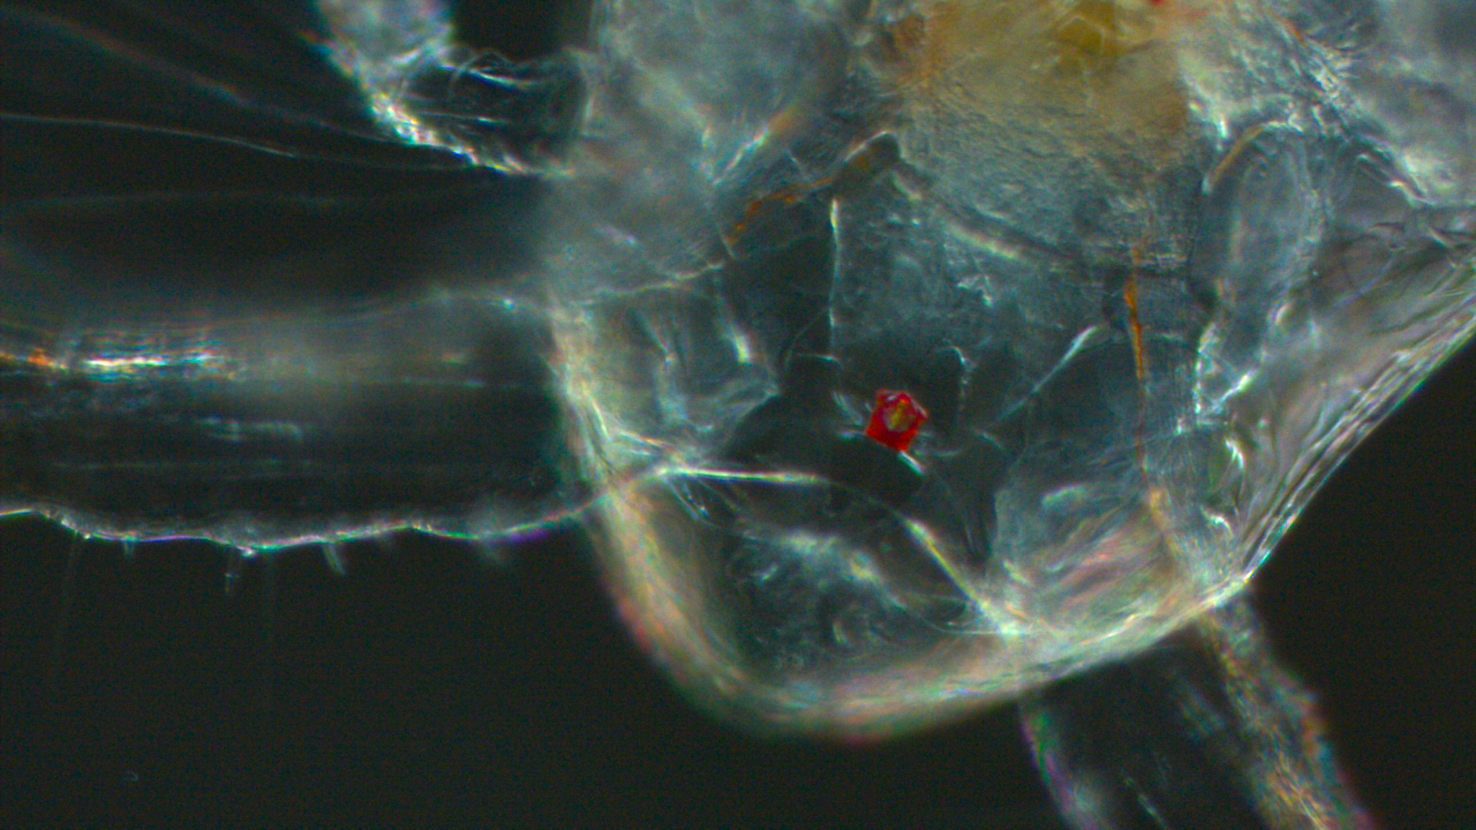
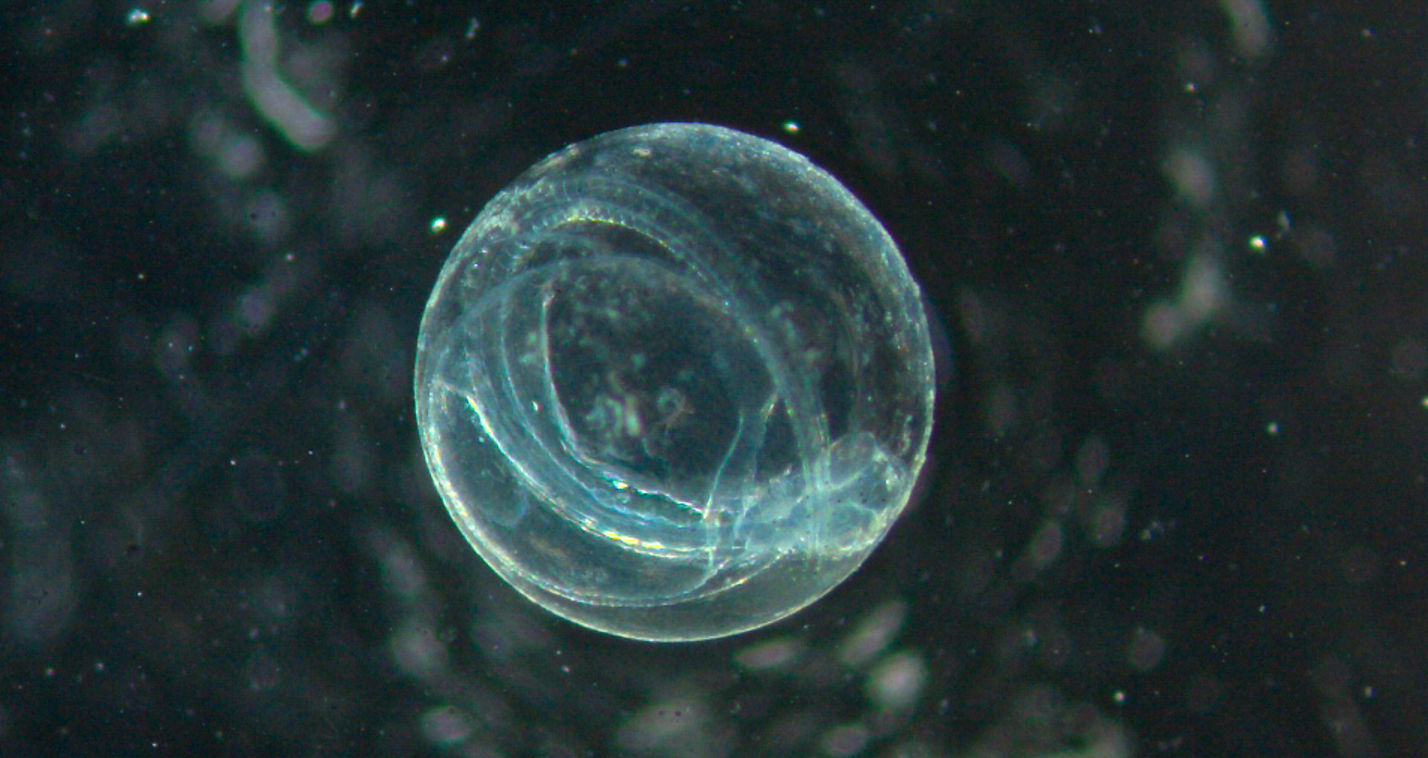
Zooplankton
We also collected zooplankton samples at each of our sampling locations. Samples included 'holoplankton', which remain planktonic for their whole life cycle — such as copepods and arrow worms — and 'meroplankton', which are only planktonic for part of their life cycle, including crab and fish larvae. The photos taken through our microscopes have also been added to our iNaturalist project to help monitor plankton biodiversity.
Sea Butterfly
Possible pollock fish larvae
Fish egg with embryo
Copepods and crab zoea larvae
Copepod eye
Notes:
UPATE PHOTOS:
Add any interesting finds in the plankton samples and pictures taken down the microscopes

Slide 15
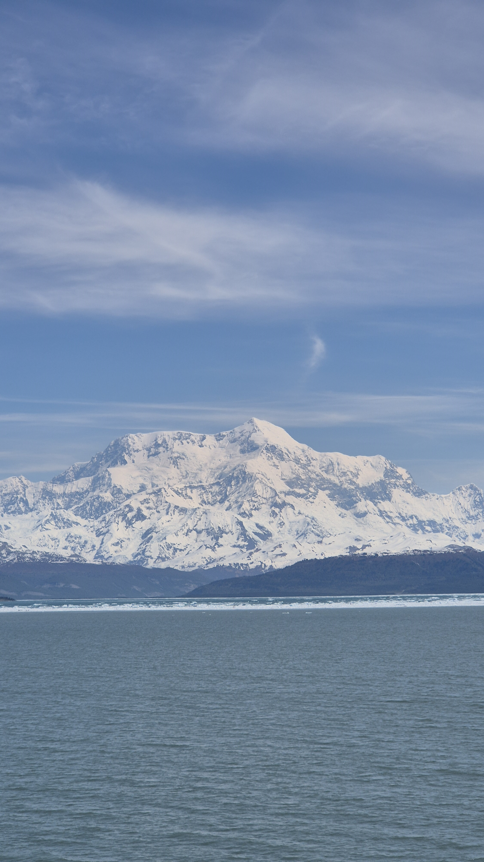
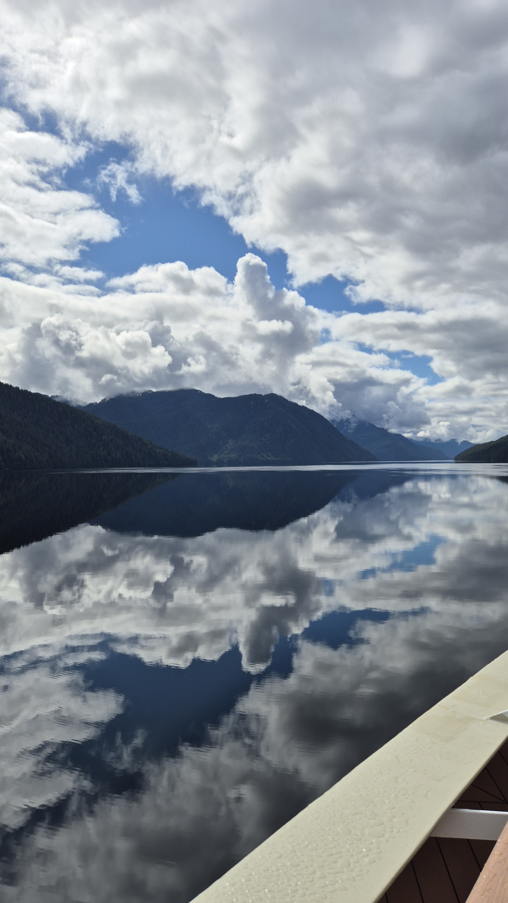
Citizen Science: NASA's GLOBE Cloud Observer
Clouds are not just shapes in the sky; they are an important component of Earth's heat budget and balance. Information about when, where, and what types of clouds are forming helps scientists understand more about Earth's climate and climate change. Through NASA's GLOBE Cloud Observer programme, we contribute to that data.
Our Citizen Scientists submitted five observations across five sessions to the global database run by NASA. So far, our observations have not yet been matched to data from weather satellites. Even without matched satellite data, these observations still contribute to the growing baseline for these remote regions.
If you would like to continue cloud observations at home, you can download the app 'GLOBE Observer'.
View our data on the global map.
Cumulus and stratocumulus clouds over British Columbia 11.06.2026. Photo by Jenna Silk, HX Marine Biologist Expedition Guide
High altitude* 20,000-40,000ft / 6km – 12km) cirrostratus clouds over Mount Saint Elias (18,008ft / 5,489m), Alaska 25.05.2026. Photo by Jenna Silk, HX Marine Biologist Expedition Guide
Notes:
Right image – In the Pacific Northwest, USA, Coastal upwelling causes cold water to rise from deep in the ocean to replace the surface water. The cold water cools the air above it and as the moist marine air cools, low clouds form when the water vapor condenses into water droplets. Hence the iconic cloudy trees of Alaska’s coastline. This also brings nutrients to the forests from the marine water vapour.

Slide 16
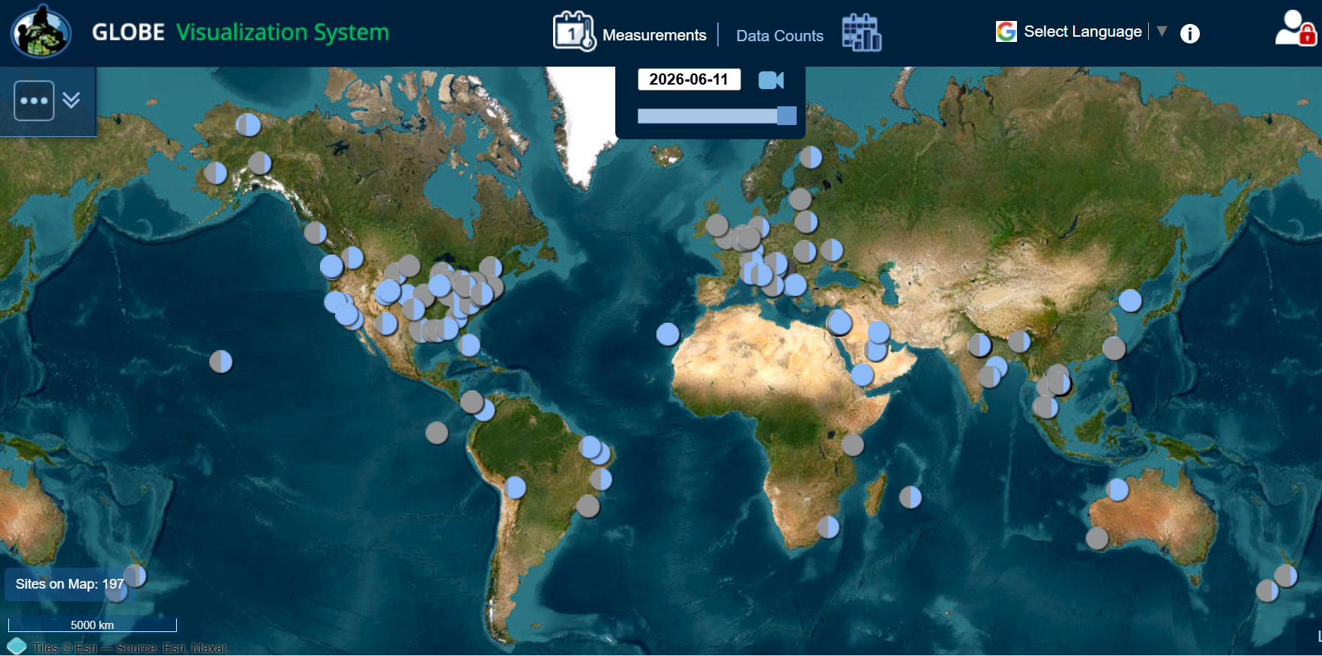
NASA Cloud Observer data worldwide, 11 June 2026
Our observation

Slide 17
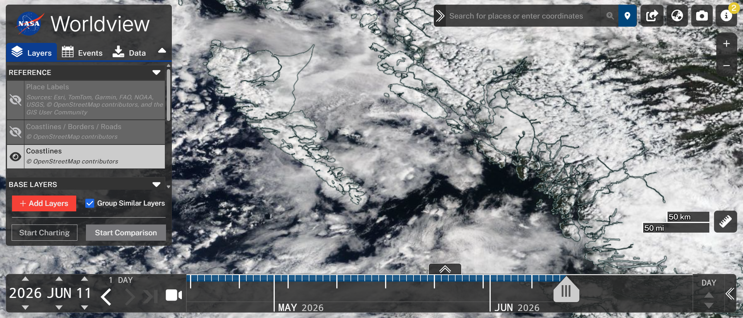
NASA Cloud Observer
View our data on the global map

Slide 18

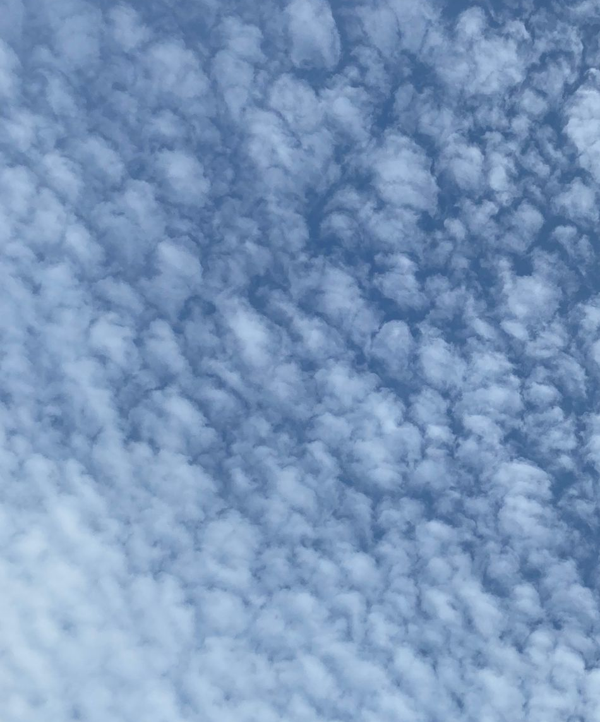
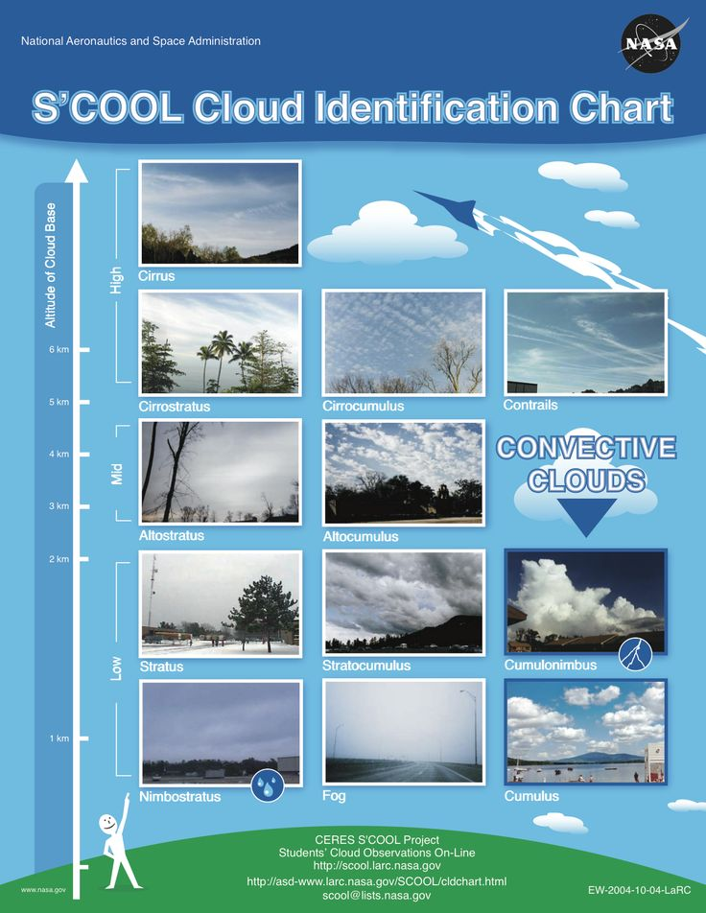
High clouds (base above 6,000 metres):
Cirrus: thin, wispy clouds composed of ice crystals. They often appear as delicate streaks or feathery wisps high in the sky.
Cirrostratus: thin, sheet clouds covering large portions of the sky. They can create a halo around the sun or moon.
Cirrocumulus: small, fluffy clouds resembling fish scales or ripples.
Medium clouds (base between 2,000 and 6,000 metres):
Altocumulus: puffy, greyish-white clouds with rounded edges, often forming parallel rows or patches.
Altostratus: thick, greyish clouds that partially obscure the sun or moon. They lack the distinct features of cirrostratus.
Low clouds (base below 2,000 metres):
Stratus: uniform, grey clouds that cover the sky like a blanket. They can bring drizzle or light rain.
Stratocumulus: low, lumpy clouds with defined edges, often appearing in rows or patches.
Nimbostratus: thick, dark grey clouds associated with steady rain or snow.
If you would like to explore more examples, you can check out NASA's On-Line Cloud Chart. View our data on the global map.
Diagram labels: 1, 2, 3, 4, 5, 6
  If you would like to explore more examples, you can check out NASA’s On-Line Cloud Chart View our data on the global map.
6
5
4
3
2
1
Notes:
Add summary of number of sessions and observations submitted, any special observations and add specific link to NASA Cloud observations if possible

Slide 19
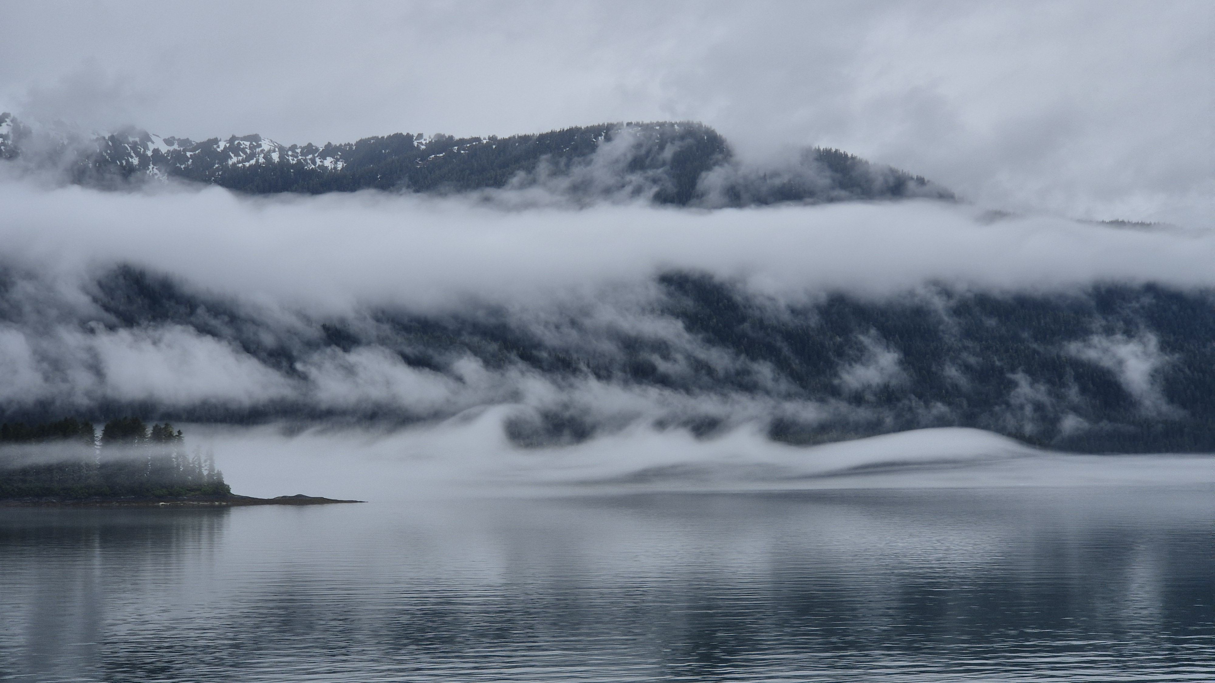
Kelvin-Helmholtz clouds at the top of the lowest fog layer; these form when the air above is moving faster than the layer below, creating wave-like patterns.
Endicott Arm in the Tracy Arm-Fords Terror Wilderness area, Alaska, 7 June 2026. Photo by Jenna Silk, HX Marine Biologist Expedition Guide.

Slide 20
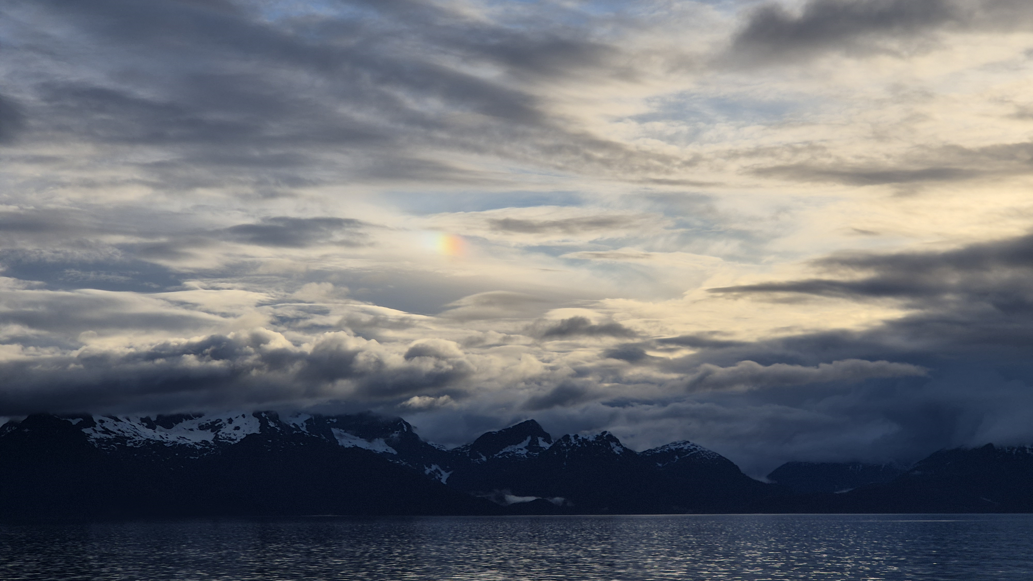
High-altitude cirrostratus clouds, their iridescence created by ice crystals within that cloud type refracting the sunlight. Heavier altostratus and stratocumulus clouds below cast shadows. Evening after departing the Kake and Hamilton Bay area, Alaska, 8 June 2026. Photo by Jenna Silk, HX Marine Biologist Expedition Guide.

Slide 21
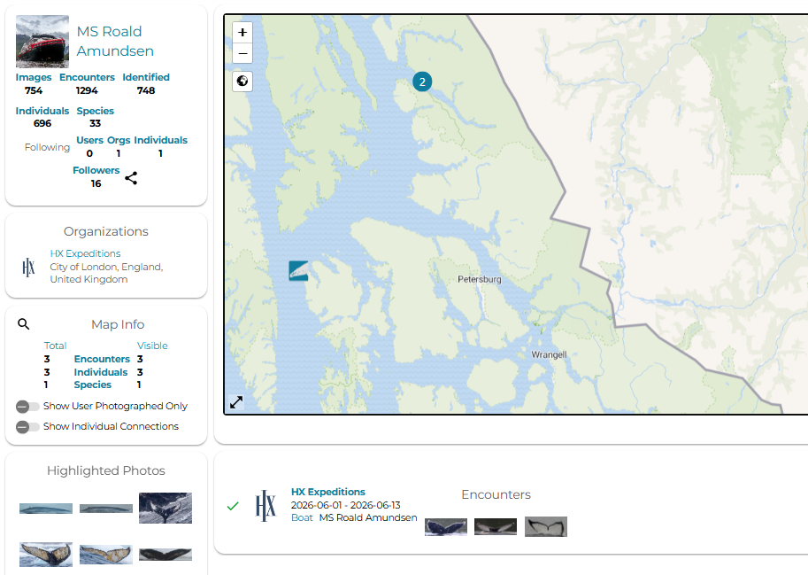
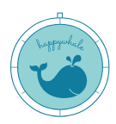
Citizen Science
Happywhale
Cetaceans — whales, dolphins, and porpoises — capture our imagination and our hearts whenever we see them. And something as simple as taking a photograph can help scientists learn more about these animals. That is where Happywhale comes in: by using AI to match images of whales submitted by users, the platform can track individuals as they migrate across the world and through their lives. When you submit a photo of a whale, you will be notified of any past and future matches of that individual.
So far we have five registered submissions of humpback whale tail flukes from the ship by the team and guests during this voyage, three of which have already been matched to known individuals. It is never too late to upload your ID-quality photos of whales — and of seals with spots — from this voyage or from any earlier trips. Older photos are just as valuable: they can confirm whether individuals known from recent encounters were alive before those reports.
View MS Roald Amundsen's submissions to Happywhale during our voyage.
To receive updates whenever these individuals are seen again (there are no spam emails), create a login and add yourself to this voyage by clicking the + sign next to this trip's dates on the MS Roald Amundsen page here.
Notes:
Update

Slide 22
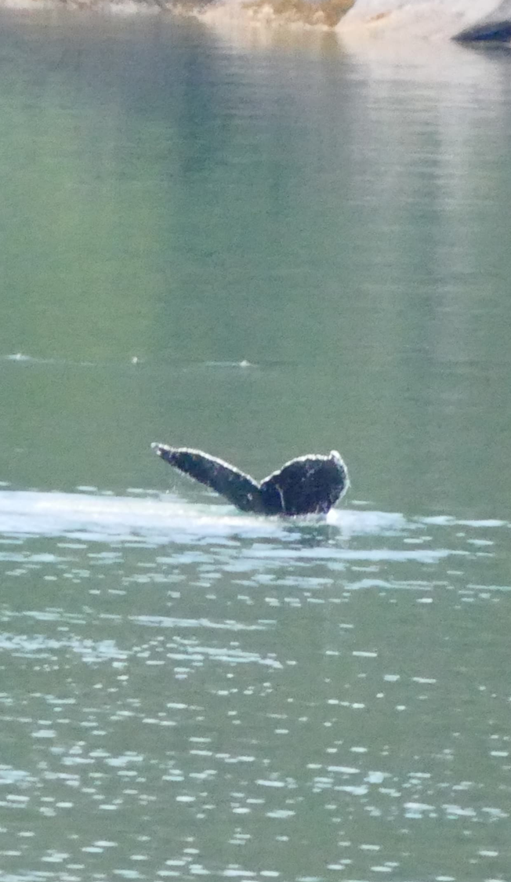
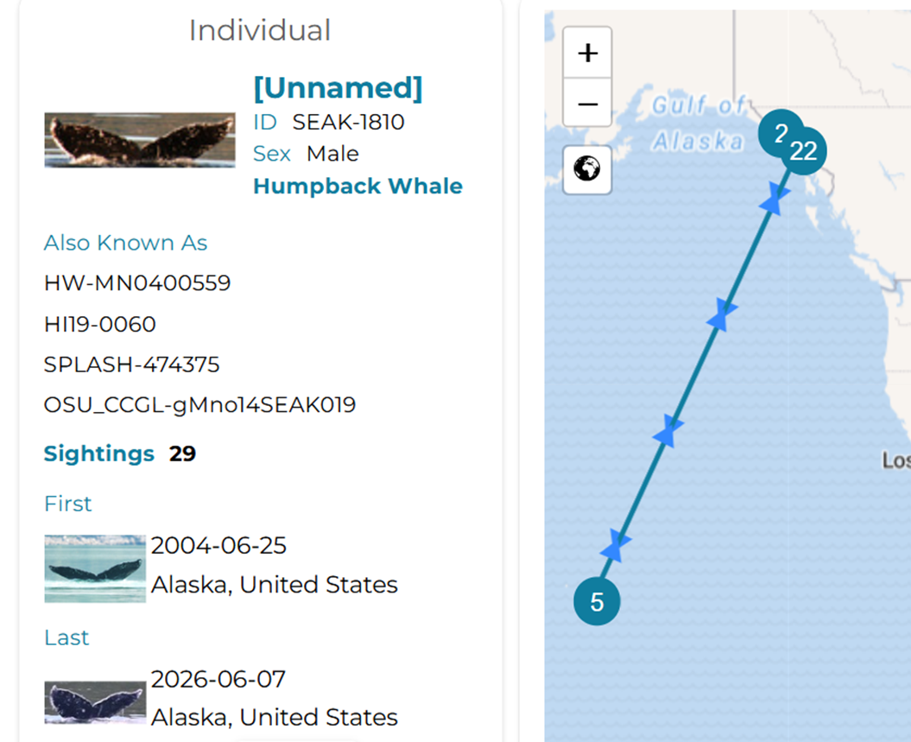
This whale is known as SEAK-1810. After the HX Foundation Auction, a guest donated the €500 required to name a whale through Happywhale, raising important funds for the platform's ongoing research and conservation work. He has previously been spotted and recorded by Ted Cheeseman, the founder of Happywhale. He has now been given the name Gerhard, a name of deep personal meaning to the guest.
This whale was one of two spotted very close to the ship shortly after our close encounter with three brown bears as we made our way out of Endicott Arm on 7 June 2026. Photo by Leonie Zimmermann, ORCA Ocean Conservationist.

Slide 23
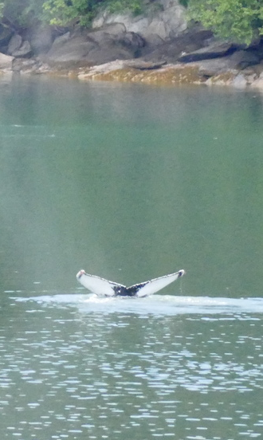
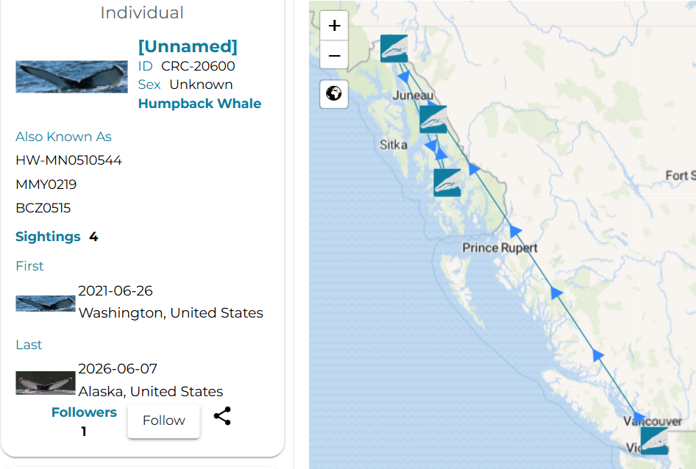
It is not too late to name a whale seen during our voyage. Individual CRC-20600, also seen close to the ship during the same encounter, is still without a name. If you wish to name this whale, you can let Happywhale know here.
Also seen in Endicott Arm on 7 June 2026.
Photo submitted by Leonie Zimmermann.

Slide 24

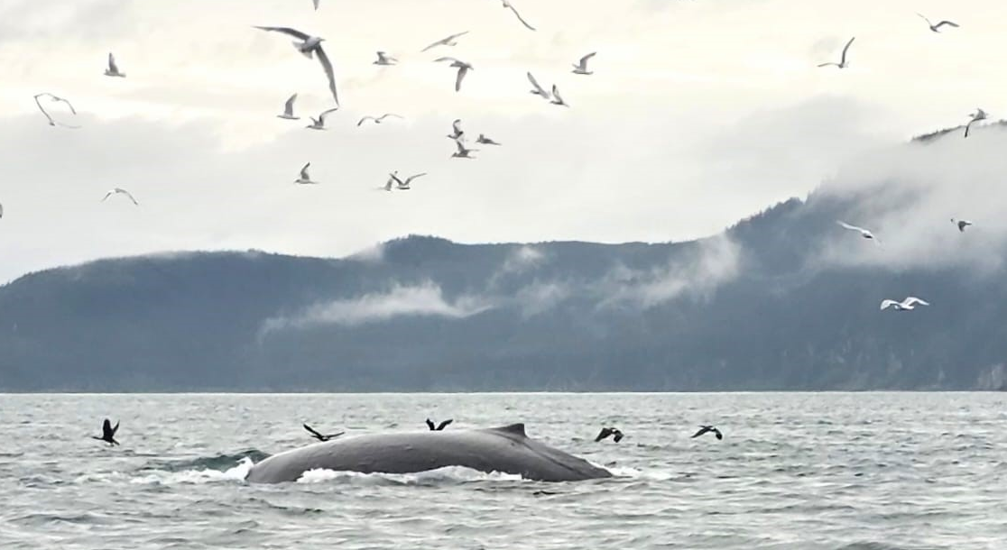
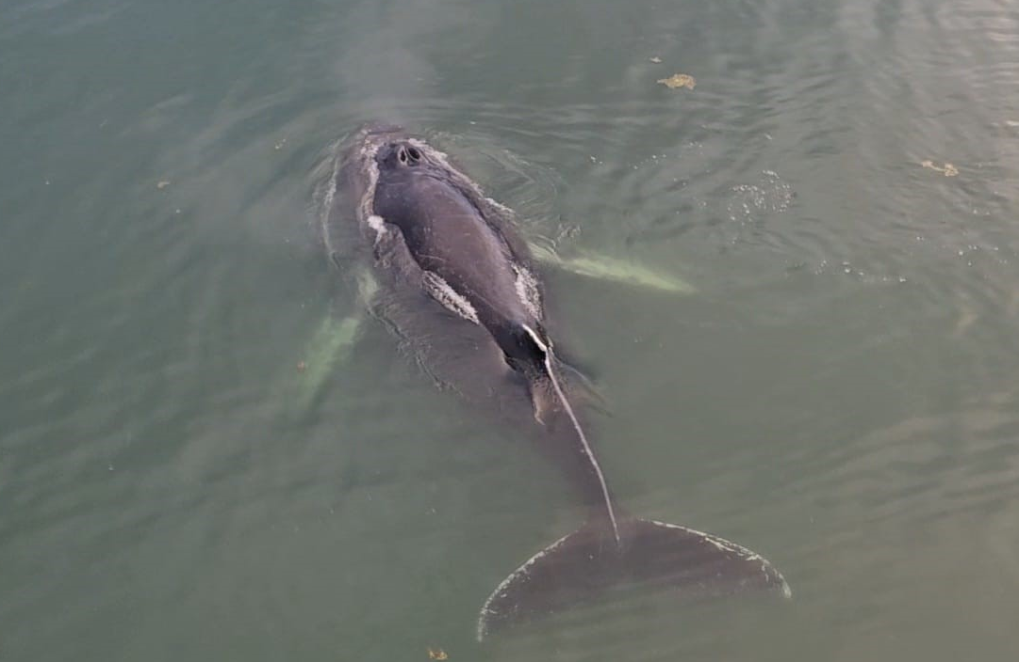
Citizen Science
ORCA
During your journey through Alaska you were joined by ORCA Ocean Conservationist Leo, who collected data during wildlife watches on whales, dolphins, and porpoises. ORCA is a cetacean conservation charity dedicated to the long-term protection of whales, dolphins, and porpoises. The data Leo collected was sent back to ORCA and made available to many organisations working in cetacean conservation.
Visit orca.org.uk for more information.

Slide 25
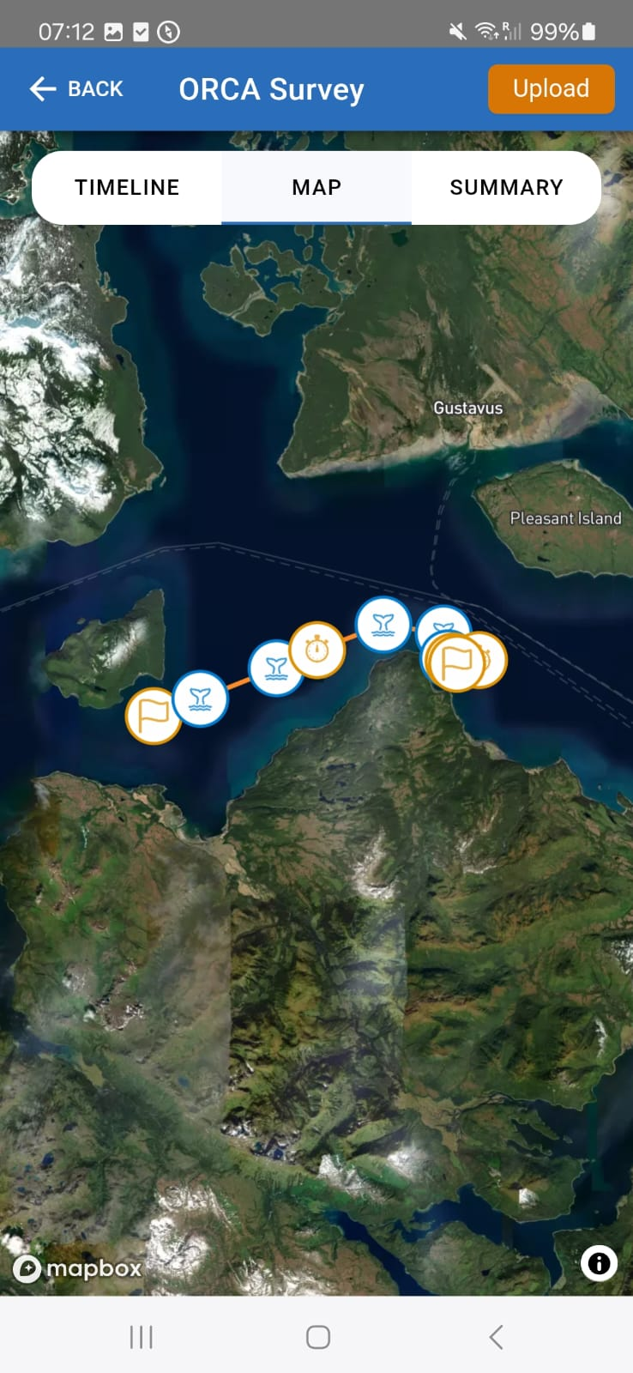
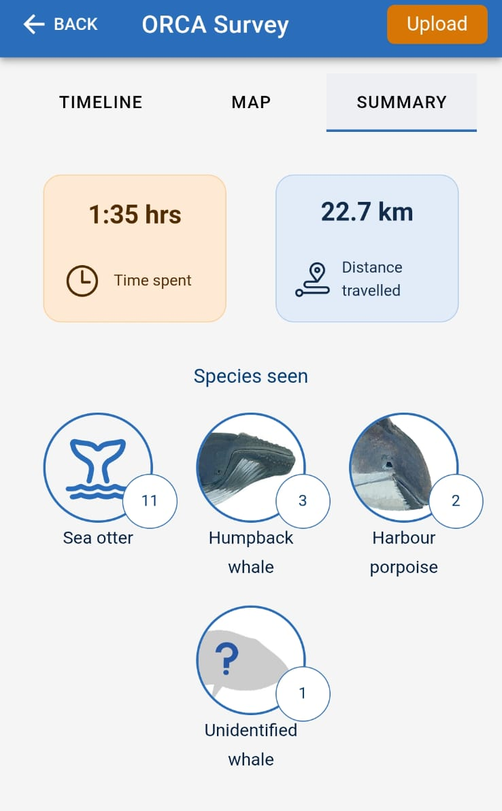
OceanWatchers Survey Effort
A sincere thank you to everyone who joined the Naturalists for the wildlife watches, in all weathers. Sightings were not always guaranteed, but it was a pleasure to get to know you out on deck.
In total, we gathered 35 hours of data spanning more than 632 km.
Every kilometre counts if we are to better understand population dynamics.
Screenshots from the data collection
Notes:
Picture: Day 5 – Icy Arm

Slide 26
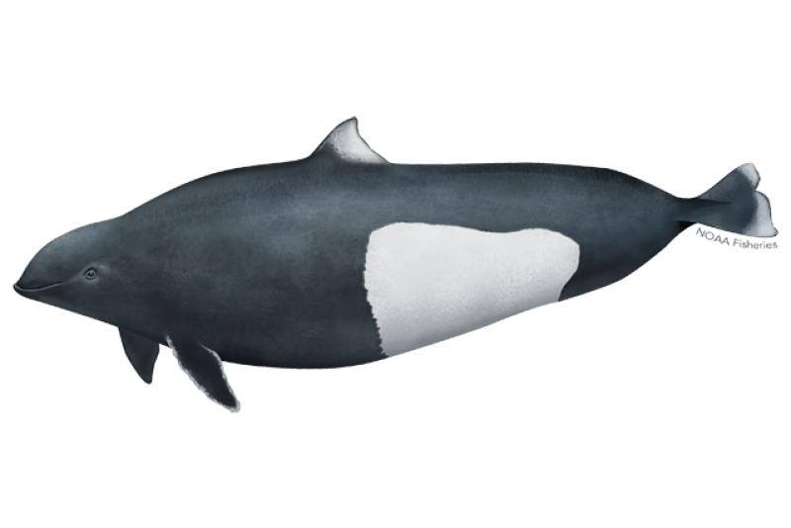
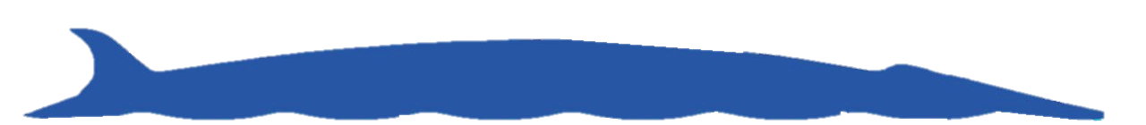
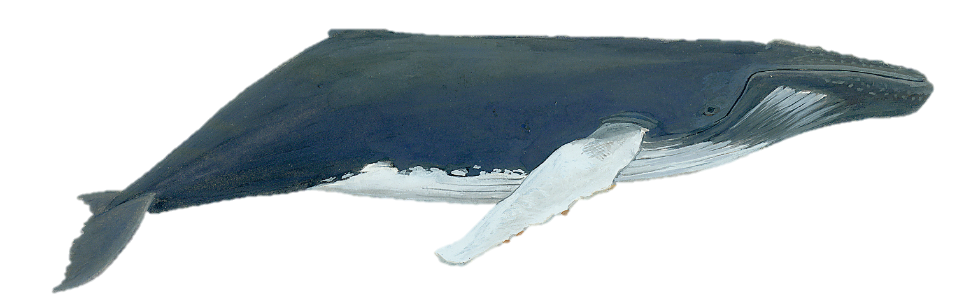
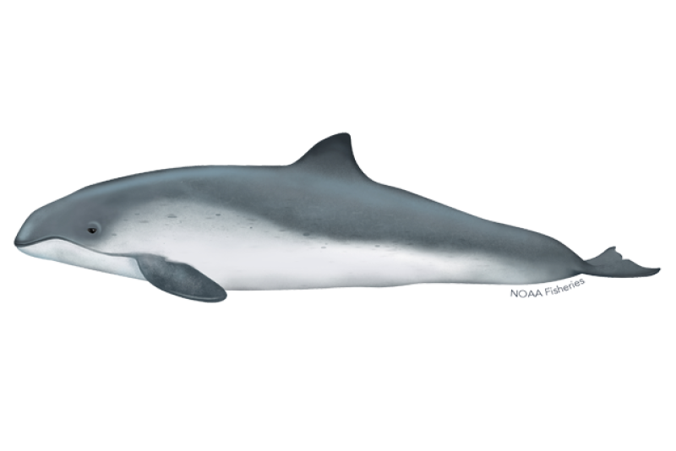
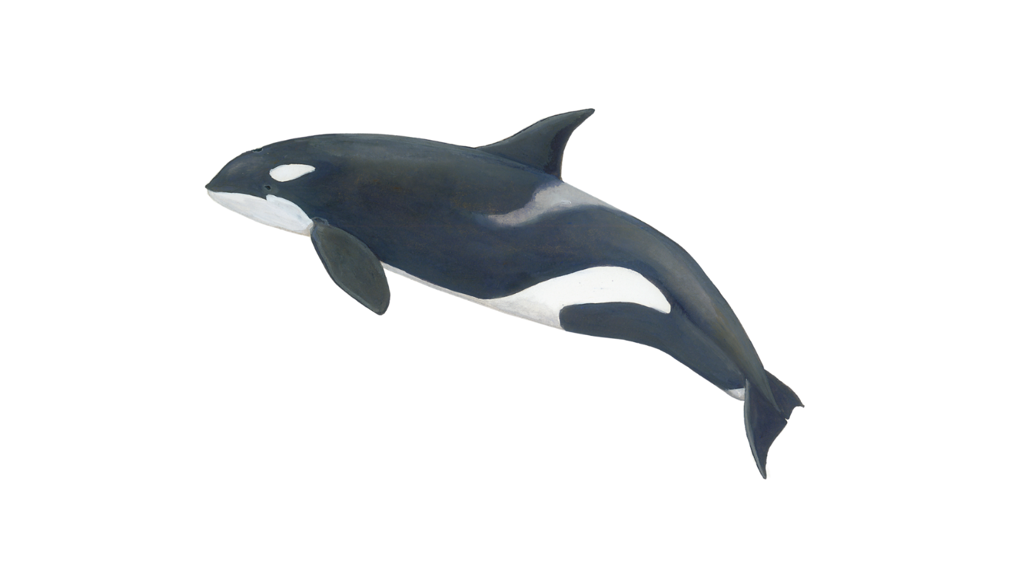


What species did we see?
4
Dall‘s porpoise
Unidentified whales
61
Humpback whale
Killer whale
57
Harbour porpoise
13
10
1
Minke whale
Fin whales
2
Notes:
11.06.2026

Slide 27


Citizen Science iNaturalist
During our voyage we had the chance to explore many different ecosystems: from rainforest to intertidal zone and kelp forest, from rivers and lakes to glaciated fjords. In these habitats we recorded a wide variety of trees, flowers, marine invertebrates, mammals, and birds.
In total we recorded 414 species and 1,448 observations — and counting. As you upload more photos from home, the dataset continues to grow.
Through iNaturalist, these observations can now be used as data in global scientific research. Thank you for joining the project and contributing to this Citizen Science platform.
View our data submitted on our iNaturalist project here:
2026 June 1 - 13: MS Roald Amundsen: Alaska & British Columbia · iNaturalist
Notes:
Add summary of number of observations, number of species etc. and add link to the iNaturalist project for the specific trip

Slide 28



The most observed species
Notes:
Not in logbook

Slide 29




Citizen Science eBird
At sea and on land, our onboard Ornithologist and enthusiastic birder guests surveyed the avifauna we encountered along our route. The diversity of habitats we travelled through brought us an equally diverse array of birds, from the majestic bald eagle to a wide variety of ducks and shorebirds.
Across our onboard wildlife watches and eBird sessions on deck, we recorded 93 bird species across 67 eBird checklists. Through the eBird platform, the data we collected is available to scientists around the world, helping them understand patterns of bird distribution, migration, and habitat use.
View our data for this trip here:
2026 June 1 - 13: MS Roald Amundsen: Alaska & British Columbia, Where the Mountains Meet the Sea - eBird Trip Report
Red-breasted Sapsucker, Sphyrapicus ruber
Photo by Holly
Notes:
Give overview of the number of bird species found, number of observations etc. and add link to the e-Bird trip report

Slide 30

Notes:
Not in logbook

Slide 31


Wildlife Highlight: Tongass National Forest
Tongass National Forest, June 2026
In Kake, we saw the largest traditional pole carved by a Native artist from a single piece of wood. It was once a free-standing 132 ft (40 m) cedar tree from the ancient Tongass Rainforest.
To the left we see a 500-year-old western hemlock, Tsuga heterophylla, in a portion of the old-growth Tongass forest outside Klawock. It was alive before European contact and has stood quietly while entire civilisations rose and fell.

Slide 32



Dr. Thomas (Tom) Hale
Political Geologist & Geographer
For questions, lecture materials, or to connect: thale@udel.edu

Slide 33



Geological Highlight: New Eddystone Rock
On our way out of Misty Fjords National Monument we passed an unusual structure standing tall in the middle of the water, surrounded by a dark grey beach. This 72 m (237 ft) basalt pillar is the remnant of an ancient cinder cone volcano that erupted roughly 15,000 years ago. It is considered the 'volcanic plug' or 'neck' — the core that withstood weathering while the cone around it eroded away. The feature is a direct result of glacial retreat, which caused isostatic rebound of the crust and allowed magma to reach the surface, creating this volcanic event.
The rock contrasts sharply with the 960 m (3,150 ft) granitic walls where our expedition boats cruised that morning, which date back roughly 60–65 million years. What this site showcases is the relationship between glacial melt and volcanic activity, and the active geology that still shapes Alaska today. It is hard to imagine the immense power of glacial forces — strong enough to carve rocks millions of years old in only thousands.

Slide 34


Geological Highlight: Mount Saint Elias
One of the standout moments of this voyage was the clear view of Mount Saint Elias. This 5,489 m peak is the second highest in the United States, and a direct result of rapid tectonic uplift — mountain building — as the Yakutat microplate collides with and subducts beneath the North American plate. The mountain rises on average by 3–4 mm per year, while the Yakutat plate itself subducts at an astonishing rate of roughly 5 cm per year.
During our voyage in this area it was hard to comprehend these deep-time geological events — but we were sailing directly over the Yakutat microplate. Mount Saint Elias is a true testament to Alaska's active geology and the jigsaw of ranges that have formed over millions of years to create the landscape we see today. Unlike its neighbouring peaks, this mountain is not volcanic but metamorphic, built as sedimentary rocks are thrust, folded, baked, and cooked through this intense mountain-building process.
(Boots et al., 2019)

Slide 35



Geology Resources
Geology of Southeast Alaska – Rock and Ice in Motion: an excellent book that covers most of the geology we saw across the voyage. Easy to read, often finished in a single day, and full of stories that make it a fine companion to your photos.
A Geologic Guide to Wrangell-Saint Elias National Park and Preserve, Alaska (USGS): a more detailed look at the geology of Mount Saint Elias from the United States Geological Survey.
Roadside Geology of Alaska (2nd edition): for those interested in the geology of individual American states, this series is a strong way into the subject and covers many sites visible from the road, air, and sea.
Mindat.org: the largest online database of mineral information and mining localities in the world. Search any location — county, state, or country — followed by "Mindat" (for example: "Germany, Mindat") to find lists of minerals and mines in the area, both recent and historical.

Slide 36

Wildlife
List - Birds
Notes:
CHANGE PHOTO APRIL 2025

Slide 37
Wildlife List – Birds
Scientific Name | English | Deutsch | Norsk
Branta canadensis | Canada goose | Kanadagans | Kanadagås
Anas platyrhynchos | Mallard | Stockente | Stokkand
Histrionicus histrionicus | Harlequin duck | Kragenente | Harlekinand
Melanitta perspicillata | Surf scoter | Brillenente | Brilleand
Melanitta deglandi | White-winged scoter | Höckersamtente | Knoppsjøorre
Melanitta americana | Black scoter | Pazifiktrauerente | Amerikasvartand
Bucephala islandica | Barrow's goldeneye | Spatelente | Islandsand
Mergus merganser | Common merganser | Gänsesäger | Laksand
Mergus serrator | Red-breasted merganser | Mittelsäger | Siland
Dendragapus fuliginosus | Sooty grouse | Küstengebirgshuhn | Sotjerpe
Columba livia | Rock pigeon | Felsentaube | Klippedue (bydue)
Patagioenas fasciata | Band-tailed pigeon | Nördliche Bandtaube | Bånddue
Streptopelia decaocto | Eurasian collared dove | Türkentaube | Tyrkerdue
Calypte anna | Anna's hummingbird | Annakolibri | Rødmaskekolibri
Selasphorus rufus | Rufous hummingbird | Rotrücken-Zimtelfe | Rødkolibri
Notes:
Copy and paste water birds observed – make sure scientific name is in italics

Slide 38
Wildlife List – Birds
Scientific Name | English | Deutsch | Norsk
Haematopus bachmani | Black oystercatcher | Klippenausternfischer | Amerikasvarttjeld
Phalaropus lobatus | Red-necked phalarope | Odinshühnchen | Svømmesnipe
Cerorhinca monocerata | Rhinoceros auklet | Nashornalk | Neshornlunde
Fratercula cirrhata | Tufted puffin | Gelbschopflund | Topplunde
Brachyramphus brevirostris | Kittlitz's murrelet | Kurzschnabelalk | Kortnebbdvergteist
Brachyramphus marmoratus | Marbled murrelet | Marmelalk | Marmordvergteist
Cepphus columba | Pigeon guillemot | Taubenteiste | Beringteist
Uria aalge | Common murre | Trottellumme | Lomvi
Synthliboramphus antiquus | Ancient murrelet | Silberalk | Nordstarik
Rissa tridactyla | Black-legged kittiwake | Dreizehenmöwe | Krykkje
Xema sabini | Sabine's gull | Schwalbenmöwe | Sabinemåke
Chroicocephalus philadelphia | Bonaparte's gull | Bonapartemöwe | Kanadahettemåke
Larus brachyrhynchus | Short-billed gull | Kurzschnabel-Sturmmöwe | Kortnebbmåke
Larus smithsonianus | Herring gull | Kanadamöwe | Amerikagråmåke
Larus californicus | California gull | Kaliforniermöwe | Præriegråmåke
Larus glaucescens | Glaucous-winged gull | Beringmöwe | Gråvingemåke
Sterna paradisaea | Arctic tern | Küstenseeschwalbe | Rødnebbterne
Notes:
Copy and paste water birds observed – make sure scientific name is in italics

Slide 39
Wildlife List – Birds
Scientific Name | English | Deutsch | Norsk
Gavia stellata | Red-throated loon | Sterntaucher | Smålom
Gavia pacifica | Pacific loon | Pazifiktaucher | Amerikastorlom
Gavia immer | Common loon | Eistaucher | Islom
Phalacrocorax pelagicus | Pelagic cormorant | Meerscharbe | Beringskarv
Ardea herodias | Great blue heron | Kanadareiher | Herodiashegre
Antigone canadensis | Sandhill crane | Kanadakranich | Kanadatrane
Haliaeetus leucocephalus | Bald eagle | Weißkopf-Seeadler | Hvithodehavørn
Falco columbarius | Merlin | Merlin | Dvergfalk
Megaceryle alcyon | Belted kingfisher | Gürtelfischer | Belteisfugl
Sphyrapicus ruber | Red-breasted sapsucker | Feuerkopf-Saftlecker | Rødbrystsevjespett
Empidonax difficilis | Western flycatcher | Feuchtwald-Schnäppertyrann | Vestempid
Vireo gilvus | Warbling vireo | Sängervireo | Sangvireo
Cyanocitta stelleri | Steller's jay | Diademhäher | Furuskrike
Pica hudsonia | Black-billed magpie | Hudsonelster | Svartnebbskjære
Corvus brachyrhynchos | American crow | Amerikakrähe | Amerikakråke
Corvus corax | Common raven | Kolkrabe | Ravn
Poecile rufescens | Chestnut-backed chickadee | Rotrückenmeise | Kastanjemeis
Notes:
Copy and paste water birds observed – make sure scientific name is in italics

Slide 40
Wildlife List – Birds
Scientific Name | English | Deutsch | Francais
Tachycineta bicolor | Tree swallow | Sumpfschwalbe | Tresvale
Tachycineta thalassina | Violet-green swallow | Veilchenschwalbe | Talassinsvale
Hirundo rustica | Barn swallow | Rauchschwalbe | Låvesvale
Progne subis | Purple martin | Purpurschwalbe | Purpursvale
Corthylio calendula | Ruby-crowned kinglet | Rubingoldhähnchen | Rubinfuglekonge
Regulus satrapa | Golden-crowned kinglet | Indianergoldhähnchen | Ildkronefuglekonge
Certhia americana | Brown creeper | Amerikabaumläufer | Amerikatrekryper
Troglodytes pacificus | Pacific wren | Pazifikzaunkönig | Barsmett
Cinclus mexicanus | American dipper | Grauwasseramsel | Gråfossekall
Sturnus vulgaris | European starling | Star | Stær
Ixoreus naevius | Varied thrush | Halsbanddrossel | Båndtrost
Catharus ustulatus | Swainson's thrush | Zwergmusendrossel | Brunkinnskogtrost
Catharus guttatus | Hermit thrush | Einsiedler-Musendrossel | Eremittskogtrost
Turdus migratorius | American robin | Wanderdrossel | Vandretrost
Bombycilla cedrorum | Cedar waxwing | Zedernseidenschwanz | Einersidensvans
Loxia curvirostra | Red crossbill | Fichtenkreuzschnabel | Grankorsnebb
Spinus pinus | Pine siskin | Fichtenzeisig | Stripesisik
Notes:
Copy and paste water birds observed – make sure scientific name is in italics

Slide 41
Wildlife List – Birds
Scientific Name | English | Deutsch | Francais
Passerella iliaca | Fox sparrow | Fuchsammer | Revespurv
Junco hyemalis | Dark-eyed junco | Winterammer | Vinterjunko
Zonotrichia leucophrys | White-crowned sparrow | Dachsammer | Hvitkronespurv
Melospiza melodia | Song sparrow | Singammer | Sangspurv
Melospiza lincolnii | Lincoln's sparrow | Lincolnammer | Gråbrynspurv
Parkesia noveboracensis | Northern waterthrush | Drosselwaldsänger | Vannparula
Leiothlypis celata | Orange-crowned warbler | Orangefleck-Waldsänger | Oransjekroneparula
Geothlypis trichas | Common yellowthroat | Weidengelbkehlchen | Nordgulstrupe
Setophaga petechia | Yellow warbler | Goldwaldsänger | Gulparula
Setophaga coronata | Yellow-rumped warbler | Kronenwaldsänger | Myrteparula
Setophaga townsendi | Townsend's warbler | Townsendwaldsänger | Granparula
Cardellina pusilla | Wilson's warbler | Mönchswaldsänger | Kalottparula
Sayornis saya | Say's phoebe | Zimtbauch-Phoebetyrann | Brunfibi
Tyrannus verticalis | Western kingbird | Schmalschnabel-Königstyrann | Vestkongetyrann
Stelgidopteryx serripennis | Northern rough-winged swallow | Graukehlschwalbe | Nordtaggsvale
Pipilo maculatus | Spotted towhee | Fleckengrundammer | Flekktovi
Haemorhous mexicanus | House finch | Hausgimpel | Husrosenfink
Notes:
Copy and paste water birds observed – make sure scientific name is in italics

Slide 42

Wildlife
List - Marine Mammals

Slide 43

Wildlife List – marine mammals
SCIENTIFIC NAME | ENGLISH | DEUTSCH | FRANÇAIS | NORSK
Balaenoptera physalus | Fin whale | Finnwal | Rorqual commun | Finhval
Megaptera novaeangliae | Humpback whale | Buckelwal | Baleine à bosse | Knølhval
Balaenoptera acutorostrata | Common minke whale | Zwergwal | Rorqual à museau pointu | Vågehval
Orcinus orca | Killer whale, orca | Schwertwal, Orka | Orque | Spekkhogger
Phocoena phocoena | Harbour porpoise | Schweinswal | Marsouin commun | Nise
Lagenorhynchus obliquidens | Pacific white-sided dolphin | Pazifischer Weißseitendelfin | Lagénorhynque à flancs blancs du Pacifique | Kortsnutedelfin
Phocoenoides dalli | Dall's porpoise | Weißflankenschweinswal | Marsouin de Dall | Dalls nise
Eumetopias jubatus | Steller sea lion | Stellerscher Seelöwe | Lion de mer de Steller | Stellersjøløve
Phoca vitulina | Harbour seal | Seehund | Phoque commun | Steinkobbe
Enhydra lutris | Sea otter | Meerotter | Loutre de mer | Havoter
Notes:
Copy and paste marine mammals observed – make sure scientific name is in italics

Slide 44

Wildlife
List - Land Mammals

Slide 45

Wildlife List – Land mammals
SCIENTIFIC NAME | ENGLISH | DEUTSCH | FRANÇAIS | NORSK
Alces alces gigas | Alaskan Moose | Elch | Élan | Elk
Ursus americanus | American black bear | Amerikanischer Schwarzbär | Ours noir | Amerikansk svartbjørn
Ursus arctos | Brown bear | Braunbär | Ours brun | Isbjørn
Lontra canadensis | North American River Otter | Nord-amerikanischer Fischotter | Loutre de rivière
Tamiasciurus hudsonicus | American Red Squirrel | Gemeines Rothörnchen | Écureuil roux américain | Amerikansk ekorn
Oreamnos americanus | Mountain Goat | Schneeziege | Chèvre des Montagnes Rocheuses | Snøgeit
Neogale vison | Mink | Nerz | Vison
Odocoileus hemionus | Sitka Deer | Maultierhirsch | Cerf à queue noire | Mulhjort
Canis lupus crassodon | Coastal wolf |  | Loup des plaines | Nordamerikansk steppeulv
Erethizon dorsatum | North American Porcupine | Urson | Porc-épic d'Amérique | Nordamerikansk trepiggsvin
Notes:
Copy and paste land mammals observed – make sure scientific name is in italics

Slide 46

Thank you for participating!

