Slide 1
Science & Education Report

Slide 2
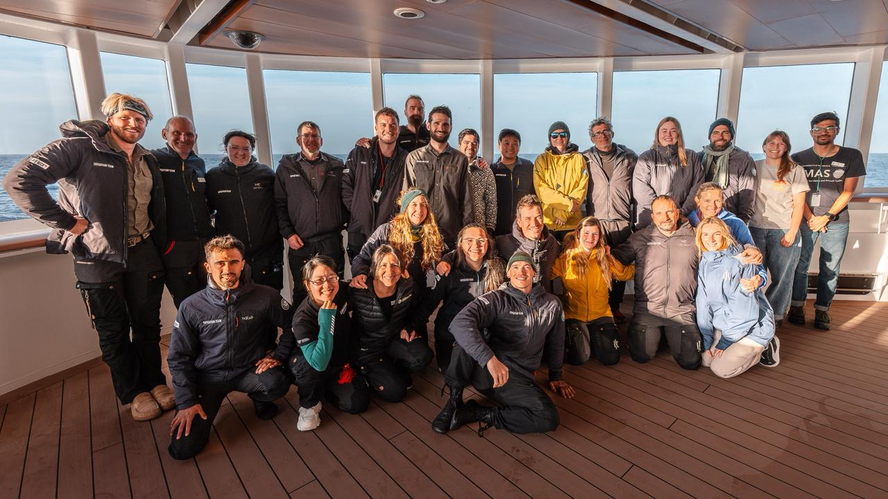
MS Fridtjof Nansen Highlights of Antarctica 8 – 18 February 2026
Photo credit: Marcus Bergström
Notes:
Add Ship name, dates and voyage name

Slide 3
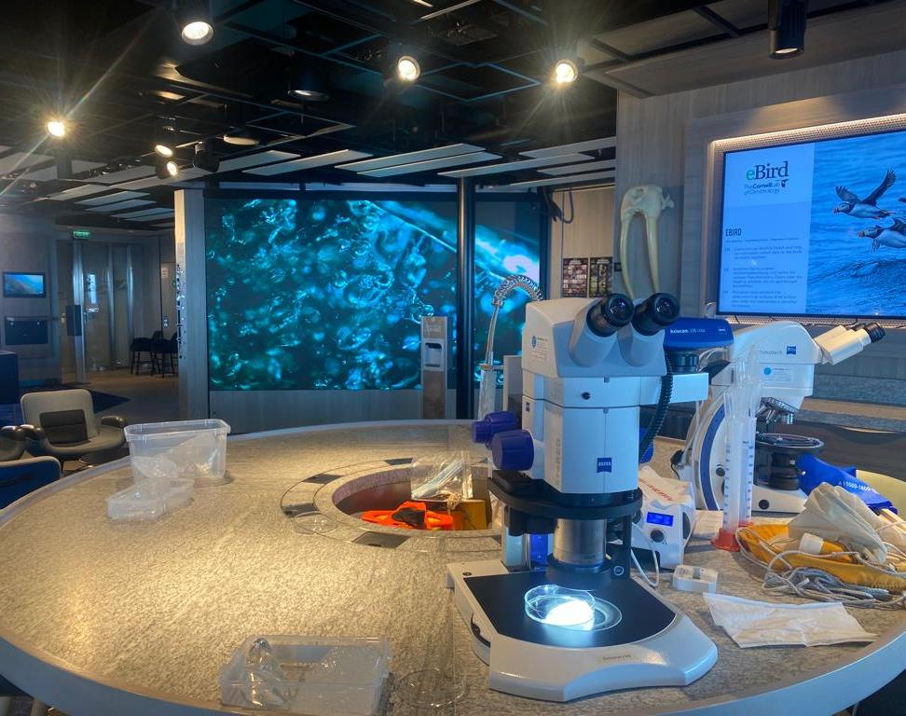
Science & Education Programme
During this voyage, we collected data for 6 Citizen Science projects in total: eBird, Happywhale, iNaturalist, ORCA, NASA’s GLOBE Cloud Observer & the Secchi Disk Project. You were able to enrich your mind with 20 lectures on different topics, from birds to rocks. You also took part in the 15 discovery sessions we put on.
We had Guest Scientists aboard from two different projects collecting data while you were on board. The ORCA Ocean Watchers were collecting data on sightings made during the time the ship was in transit and the Sounds Good! project recorded the sounds of the penguin colonies to analise the respective ages of the chicks.
A lot of you were very interested in the scientific aspect of our voyage and we thank you all for your enthusiasm. Here we provide a summary of our science activities.
© Martin Hain/HX
Notes:
Add brief summary of the Science & Education Program over the whole voyage

Slide 4
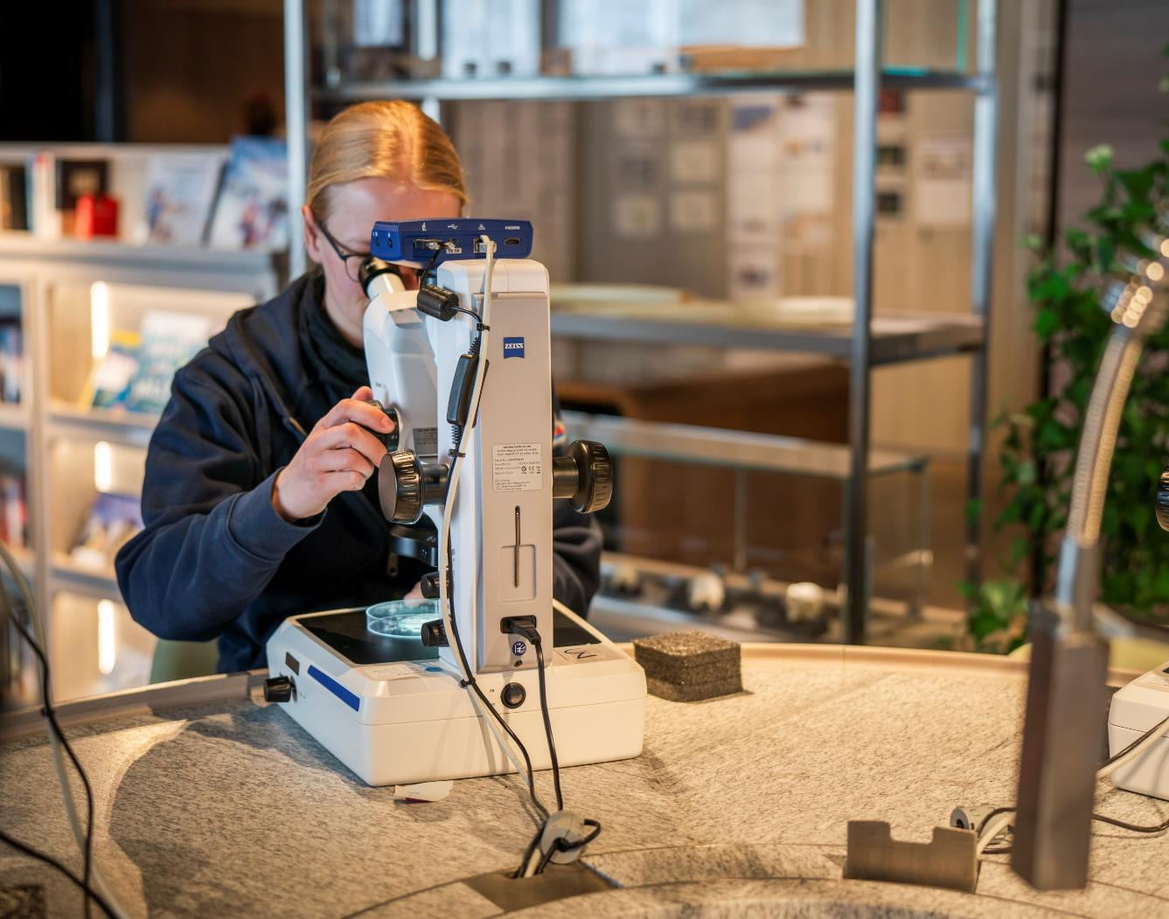
Lectures & Discovery sessions
20 lectures
15 discovery sessions
6 Citizen Science projects
12 science boats outings
2 Guest Scientist projects

Slide 5
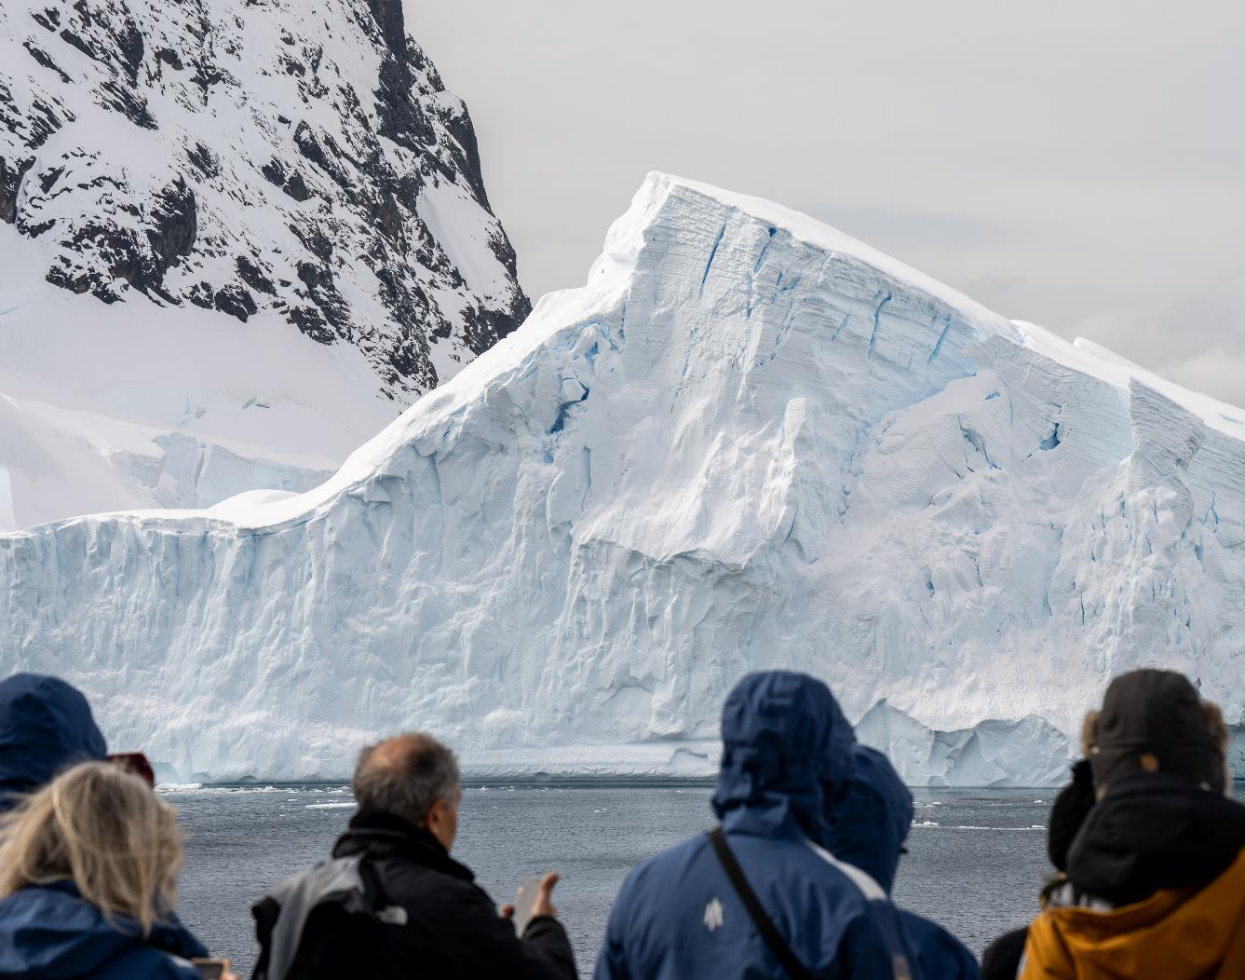
Wildlife Watch
37 Species:
9 mammals
28 birds

Slide 6
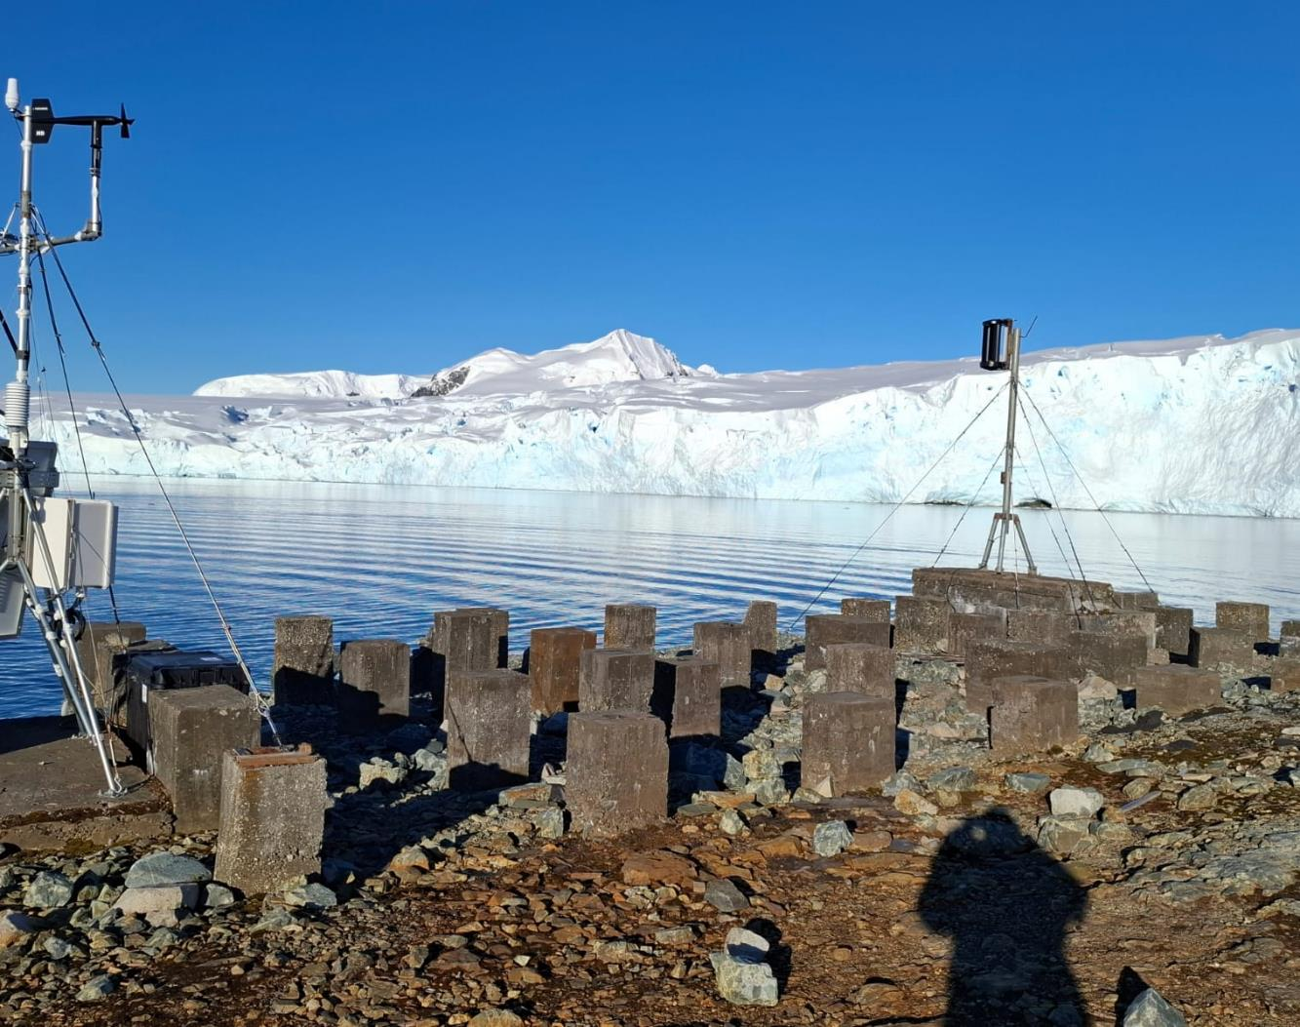
History & Culture
On our voyage we discussed the explorers that charted the part of the Antarctic Peninsula we have been sailing in. We talked about how Charcot and his French expedition overwintered on Port Charco, which we saw from Pleneau Island. When MS Fridtjof Nansen sailed through the Lemaire Channel, we were following the journey of Adrian de Gerlache and his ship the Belgica in 1898.
On Prospect Point and on Danco Island we saw the foundations of two British Stations that were operative in the 1950s but were abandoned and later dismantled in 2004 because they were not declared an historical site and thus the materials could not stay in Antarctica according to the Antarctica Treaty.
Notes:
Add summary of history workshops or hikes undertaken

Slide 7
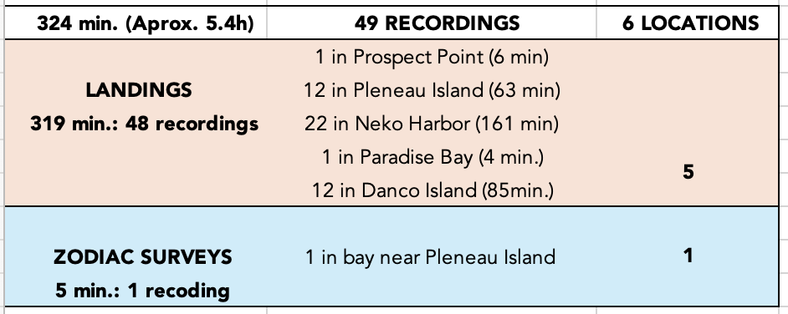
Sounds Good!
HX Expeditions & Universidade de São Paulo
MS Fridtjof Nansen
8 – 18 February 2026
Summarized Results: Season #2; Expedition #3
4 and a half days in Antarctica

Slide 8
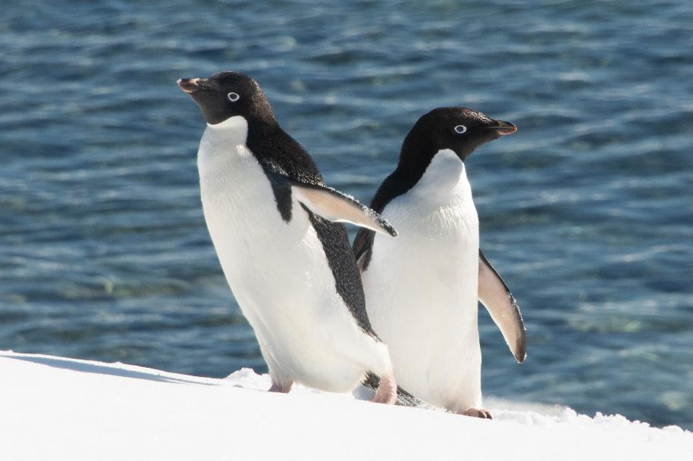
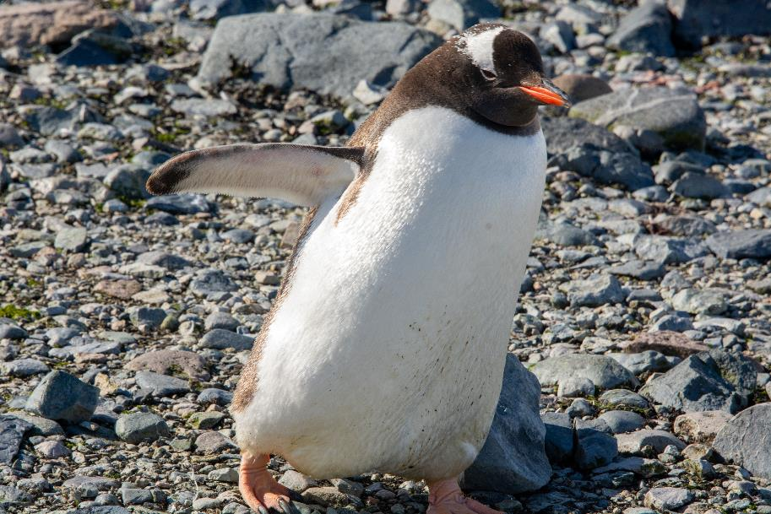
The Main Stars:
Adélie and Gentoo Penguins
Laura Kloepper
Laura Kloepper

Slide 9
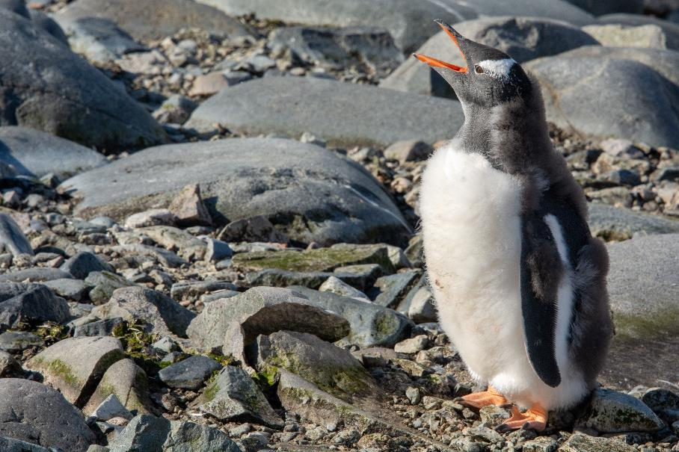
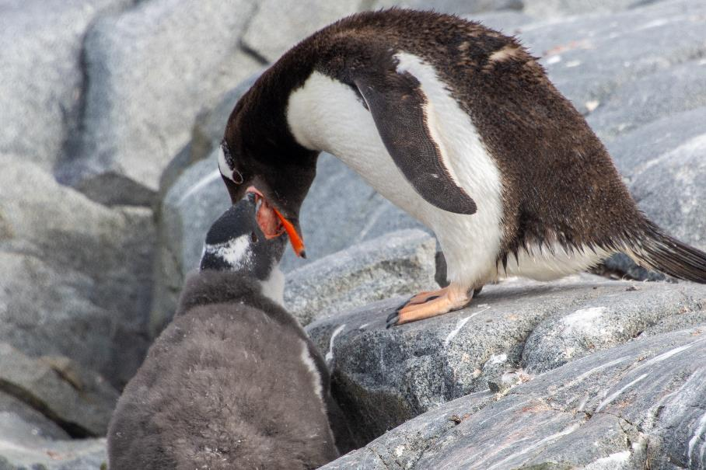
Highlights of Expedition #3
Pleneau Island– February 12, 2026
Recorded many sounds and video of feeding chicks
Laura Kloepper
Laura Kloepper

Slide 10
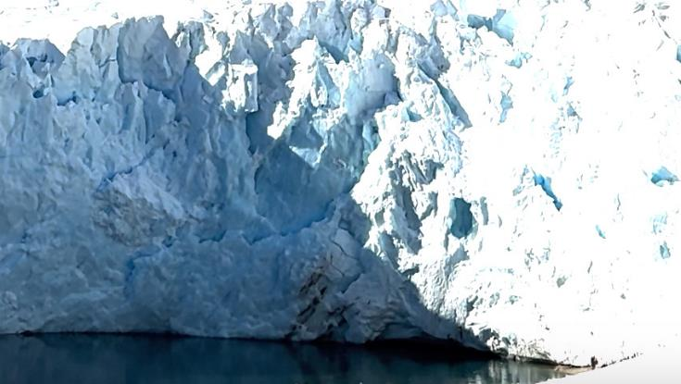
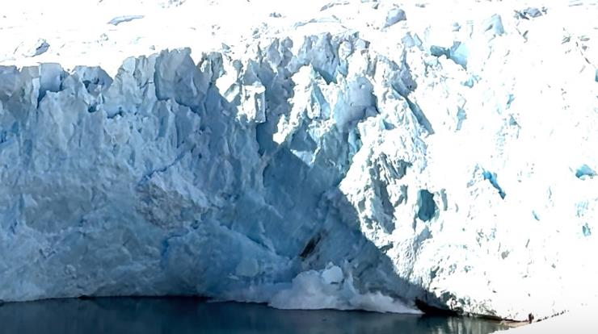
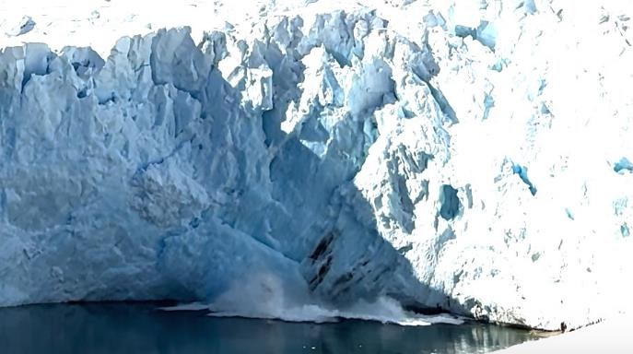
Highlights of Expedition #3
Neko Harbor – 13 February 2026
Recorded sounds and video of glacier calving!
Laura Kloepper
Laura Kloepper
Laura Kloepper

Slide 11
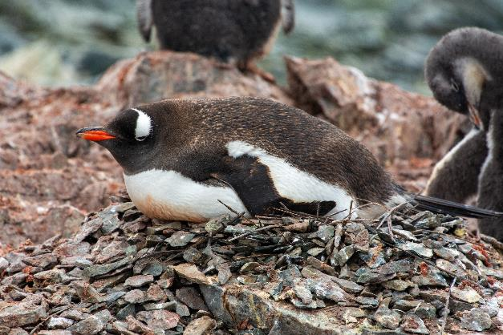
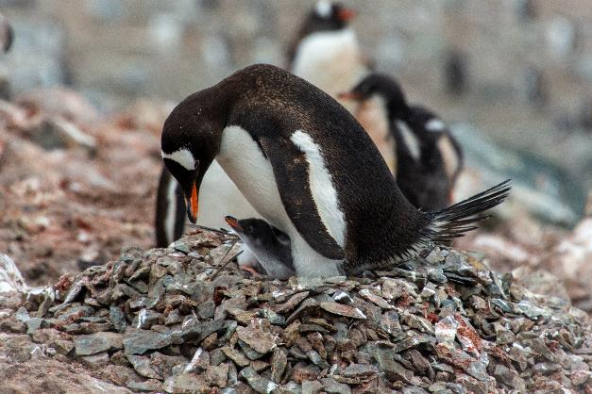
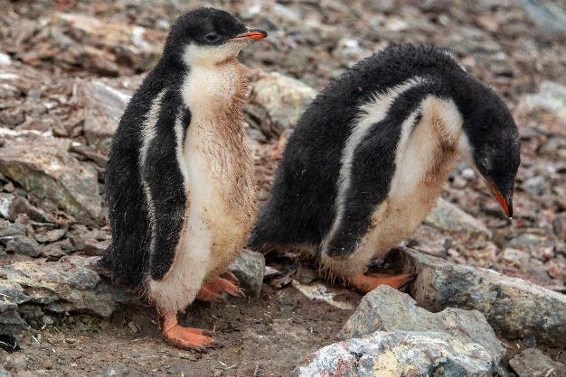
Highlights of Expedition #3
Danco Island – 14 February 2026
Recorded vocalizations at different breeding/age stages
Laura Kloepper
Laura Kloepper
Laura Kloepper

Slide 12
Highlights of Expedition #3
Missions Accomplished!
Expanded operations to all three HX vessels operating in polar and subpolar waters during the austral summer, ensuring broader reach and logistical versatility
Trained and integrated two new collaborators into the Sounds Good! initiative, introducing them to the operational dynamics of HX cruises and strengthening the team’s interdisciplinary capacity
Continued the collection of acoustic recordings in both marine and terrestrial environments, with improved techniques and broader geographic coverage

Slide 13
Highlights of Expedition #2
Missions Accomplished!
Strengthened collaboration between Guest Scientists and Expedition Leaders, as well as other onboard team members, to refine data collection efforts and explore ways to enhance guest engagement
Enhanced and diversifyed onboard educational efforts, sharing knowledge with guests through dynamic and accessible formats, including lectures, sound-based experiences, and informal interactions

Slide 14
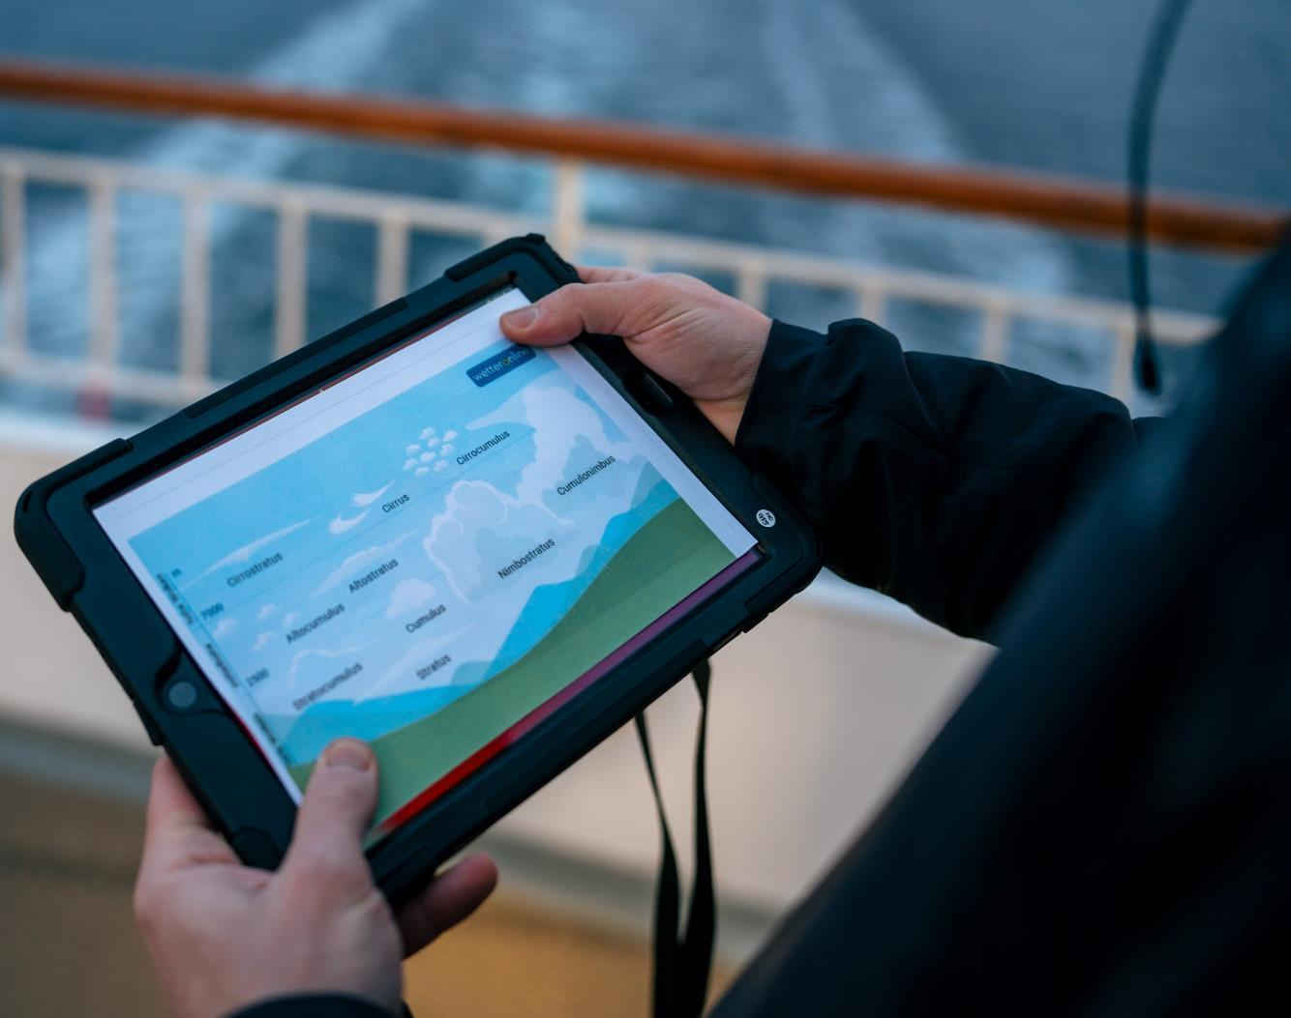

NASA GLOBE Cloud Observer
On this Highlights of Antarctica Expedition we conducted three Cloud Observation sessions and sent our data off to NASA!
Thank you to the 57 Cloud Observers who participated in the program, and remember, you can continue to do this at home!
Observations from the Drake Passage are critical, as they reflect the ocean-atmosphere interface of the Circumpolar Current and Winds.
Thank you for your active participation
View our data on the global map
Notes:
Add summary of number of sessions and observations submitted, any special observations and add specific link to NASA Cloud observations if possible

Slide 15
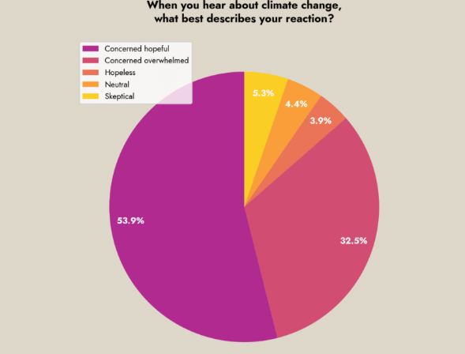
Climate Change Survey
How do you feel about climate change?
As an experiment, we conducted a survey on our guests’ views and feelings on the subject of climate change. In the long run, we would like to gather enough data for a scientific statistical study based on the microcosm of our ship. This cruise has seen the very first instance of such a survey.
Thank you to the 130 participants who answered the survey. You can view and download the results (pdf) on this link.

Slide 16
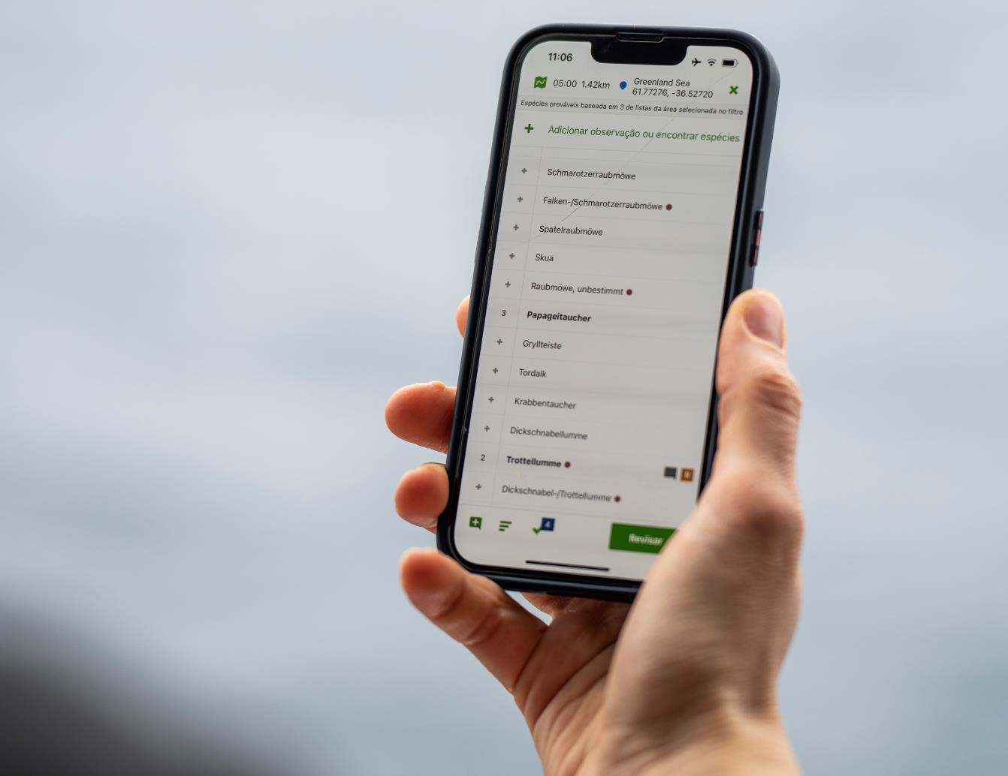

The eBird project
During this voyage, our Ornithologist, conducted 20 surveys. At least 22 species were observed. The most frequently observed species were Wilson’s storm petrels, black-browed albatrosses, south polar skuas, and kelp gulls.
Find the trip report for the voyage and the checklists here:
FNANT2605 Fridtjof Nansen Highlights of Antarctica 8 - 17 February 2026 - eBird Trip Report
Notes:
Add summary of number of observations, number of species etc. and add link to the iNaturalist project for the specific trip

Slide 17
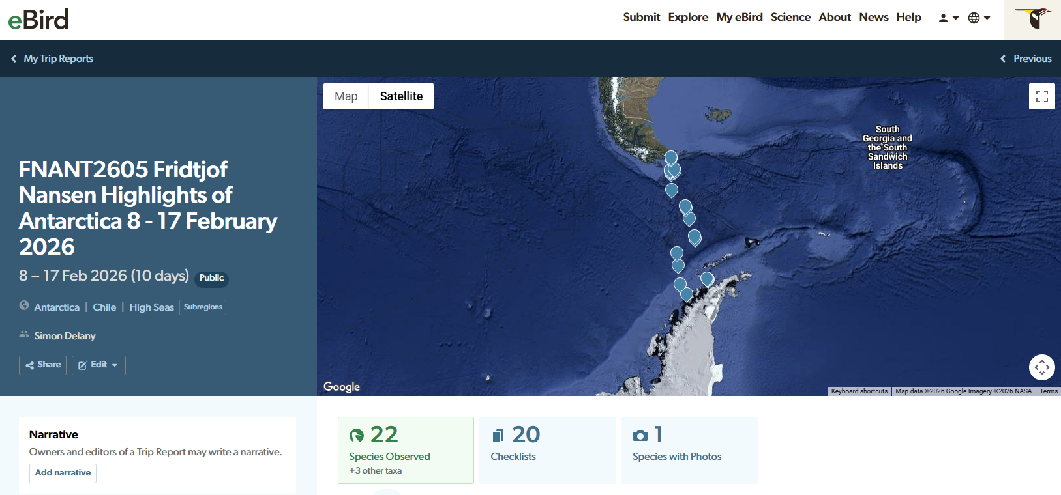
Trip Report on eBird

Slide 18
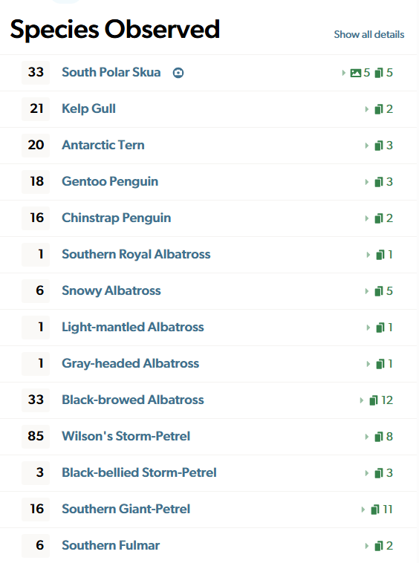
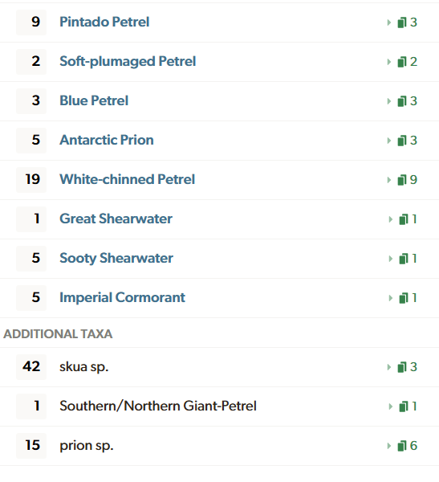

Slide 19
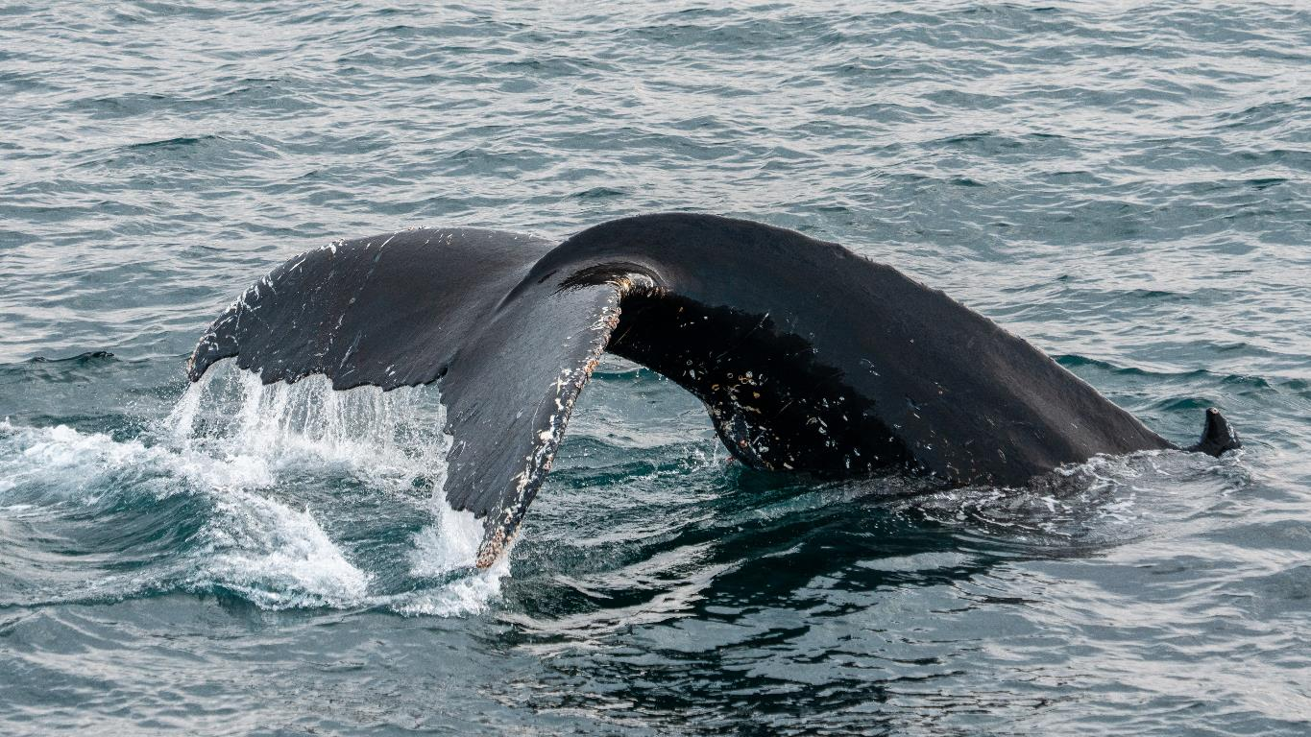
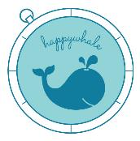

Happywhale
This voyage was a success in terms of whale sightings and our Marine Scientist Daniela, together with the Science Team, submitted 3 fluke photo to the Happwhale platform.
Two have these came back as matches to whales that have been spotted before. Thank you so much for helping us gather amazing pictures and capture profound moments!
View our data on the global map
Humpback whale at Petermann Island, © Timo Heinz/HX
Notes:
Add summary of number of sessions and observations submitted, any special observations and add specific link to NASA Cloud observations if possible

Slide 20
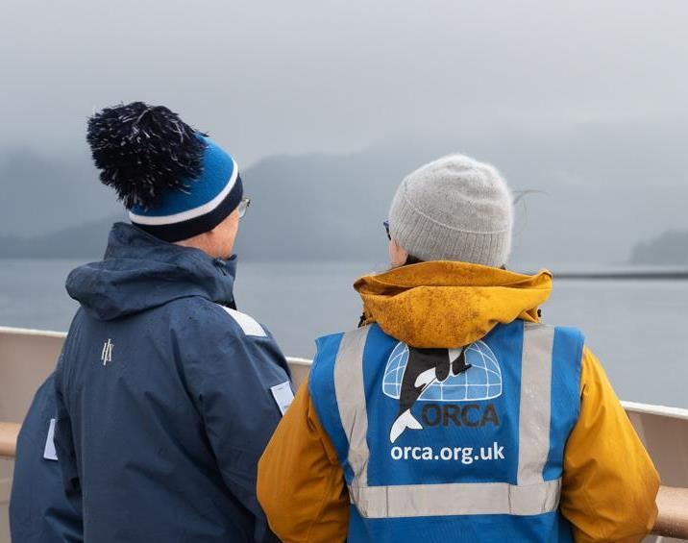

ORCA
Using ORCA’s OceanWatchers App, multiple sightings were registered during our voyage and submitted to IAATO’s Voluntary Cetacean and Pinniped Sightings project (V-CaPS)

Slide 21
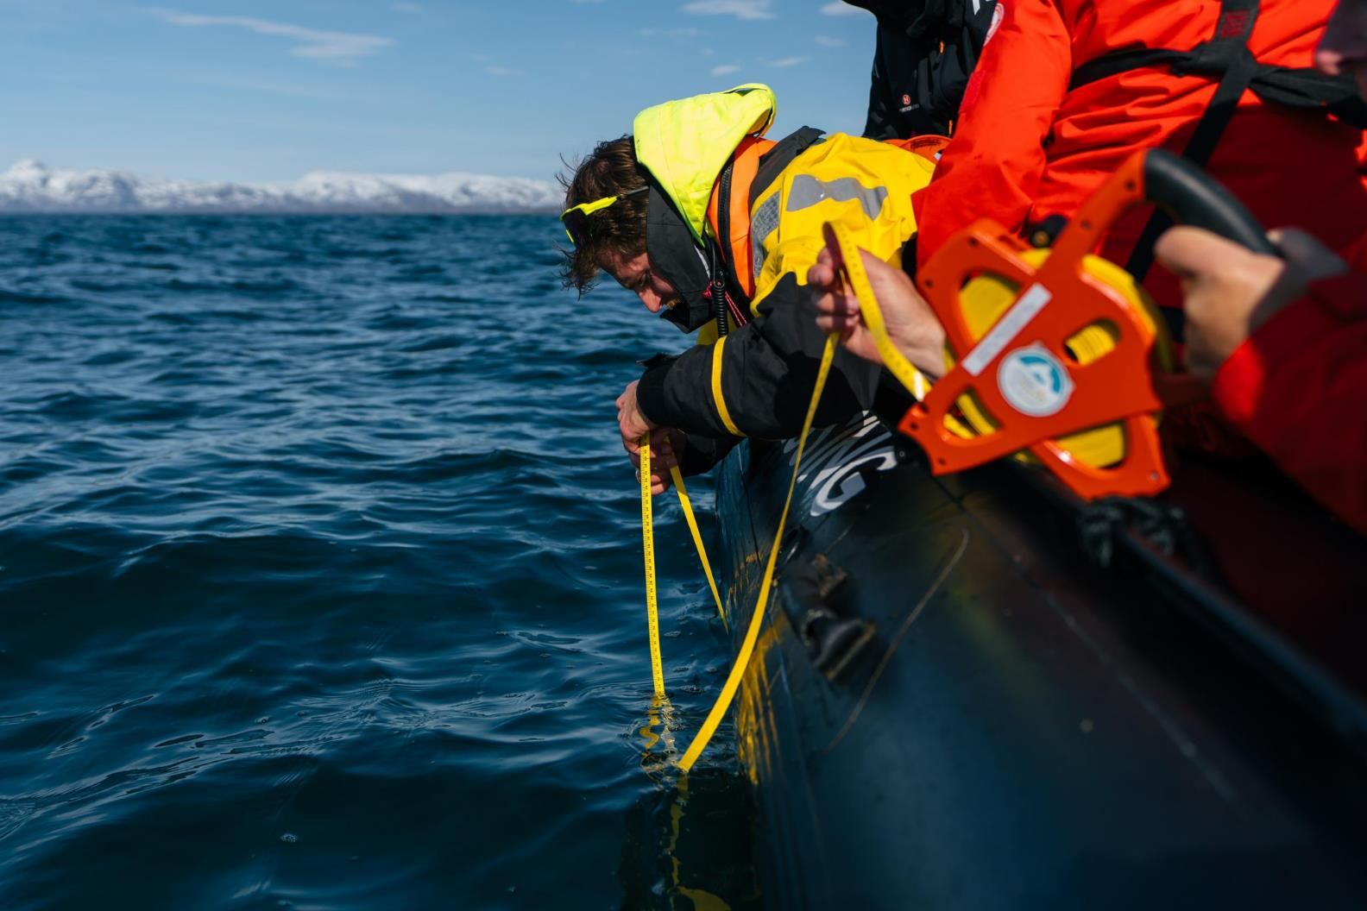
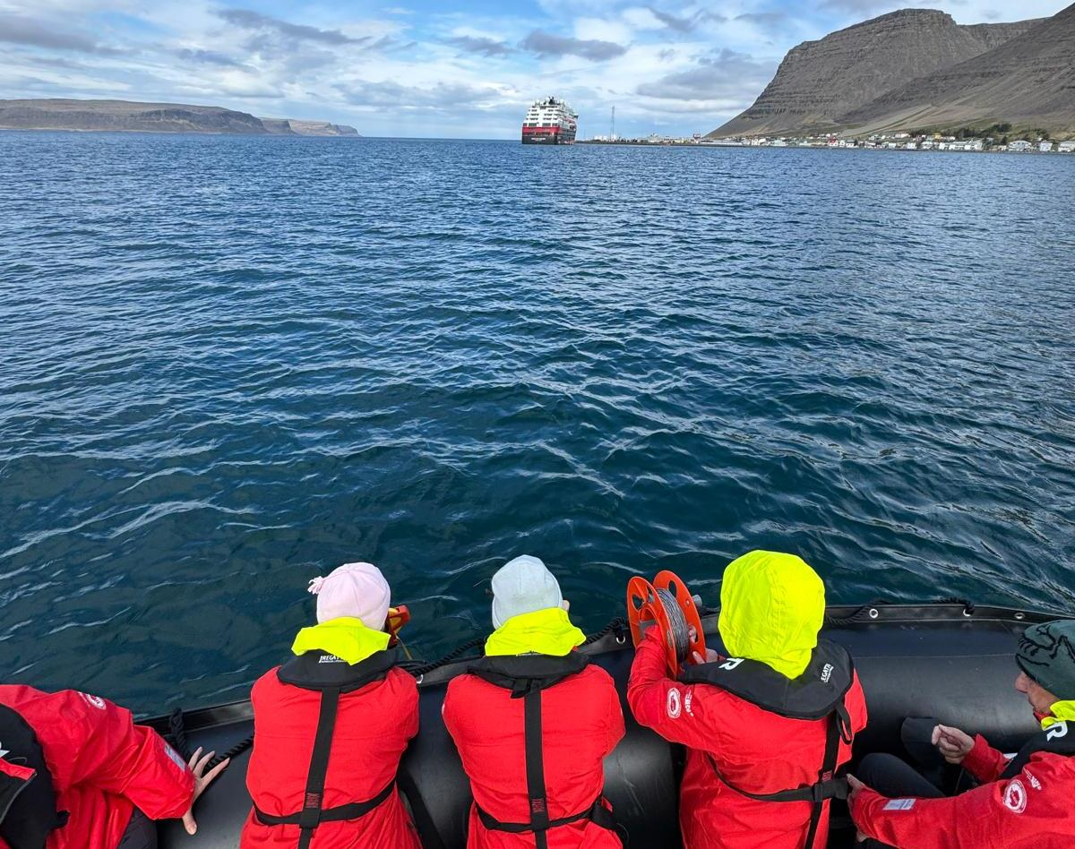
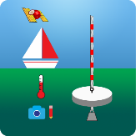
Science Boat
We had 12 science boat sessions during this trip in Pleneau Island, Neko Harbour, and Danco Island. We sampled for different projects. We used the Secchi Disk measurements to document the turbidity/clarity of the water and assess the abundance of phytoplankton.
We towed a plankton net of 20 µm mesh size to gather water samples and deployed our CTD sensor to understand the oceanographical parameters of the water (temperature, salinity, chlorophyll a).
These missions were a success; thank you for your participation!
View our data submitted to the Secchi Disk Project
Notes:
Add highlights of what science boat activities and sampling were undertaken – update secchi link to specific voyage if possible

Slide 22
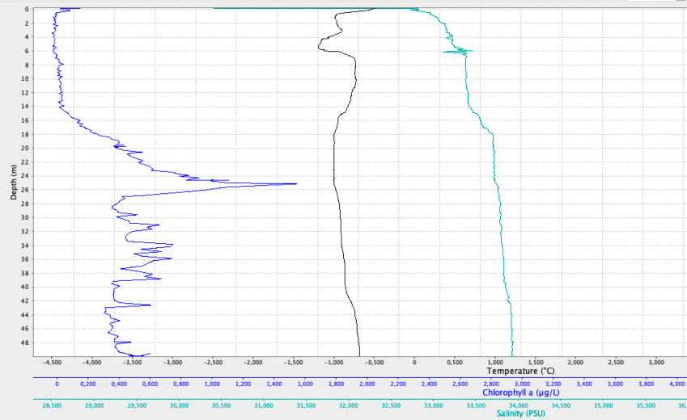
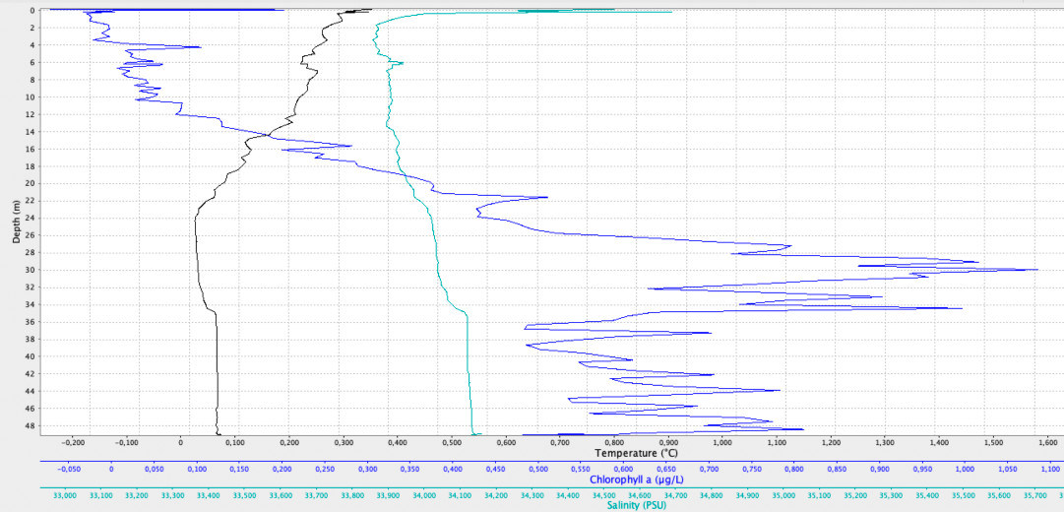
Pleneau Island
Danco

Slide 23
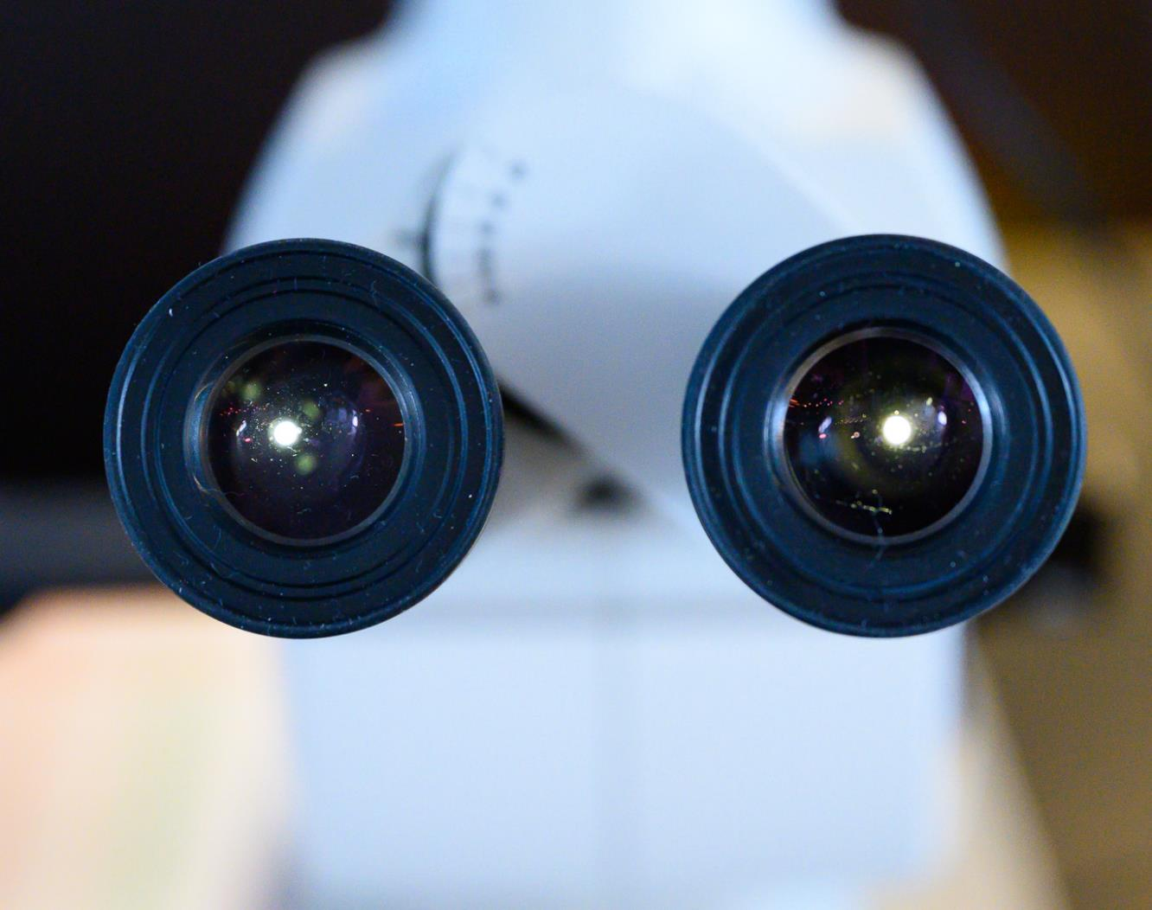
Plankton Samples
©Martin Hain/HX
Notes:
Add any interesting finds in the plankton samples and pictures taken down the microscopes

Slide 24
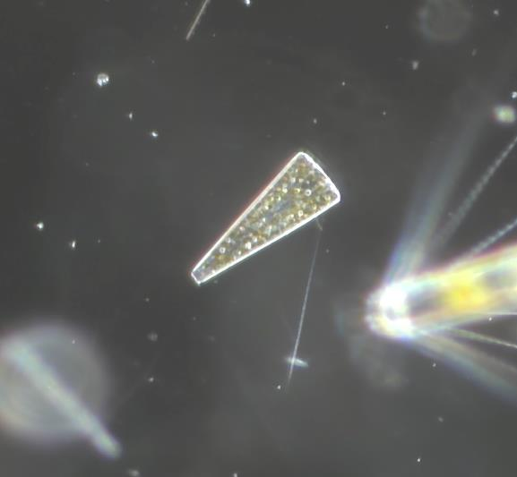
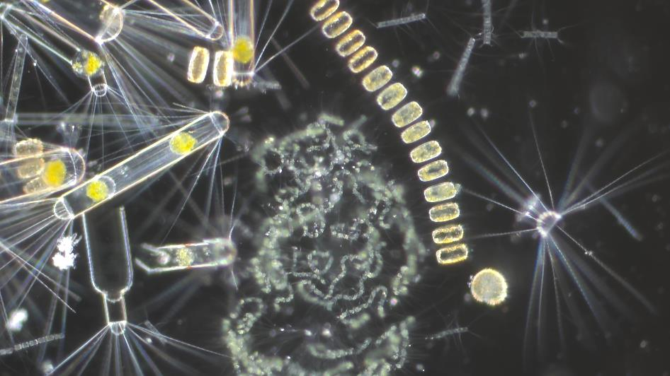
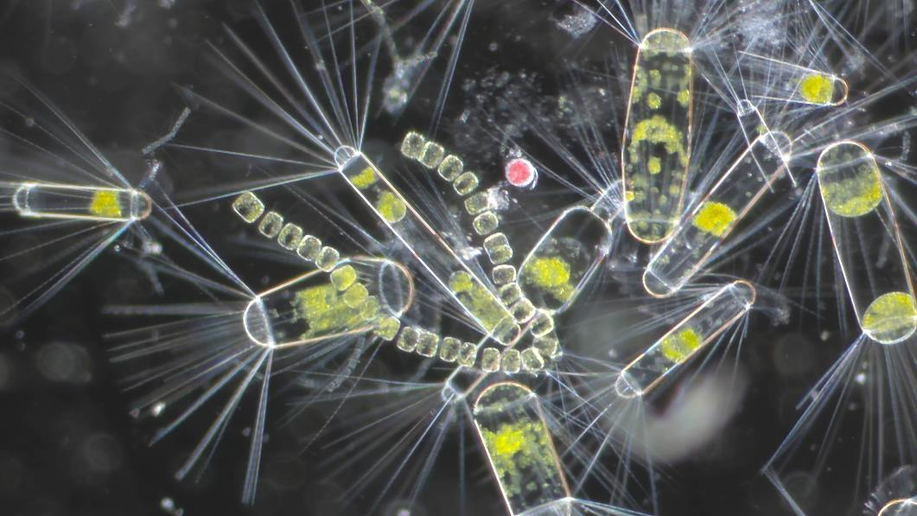

Slide 25
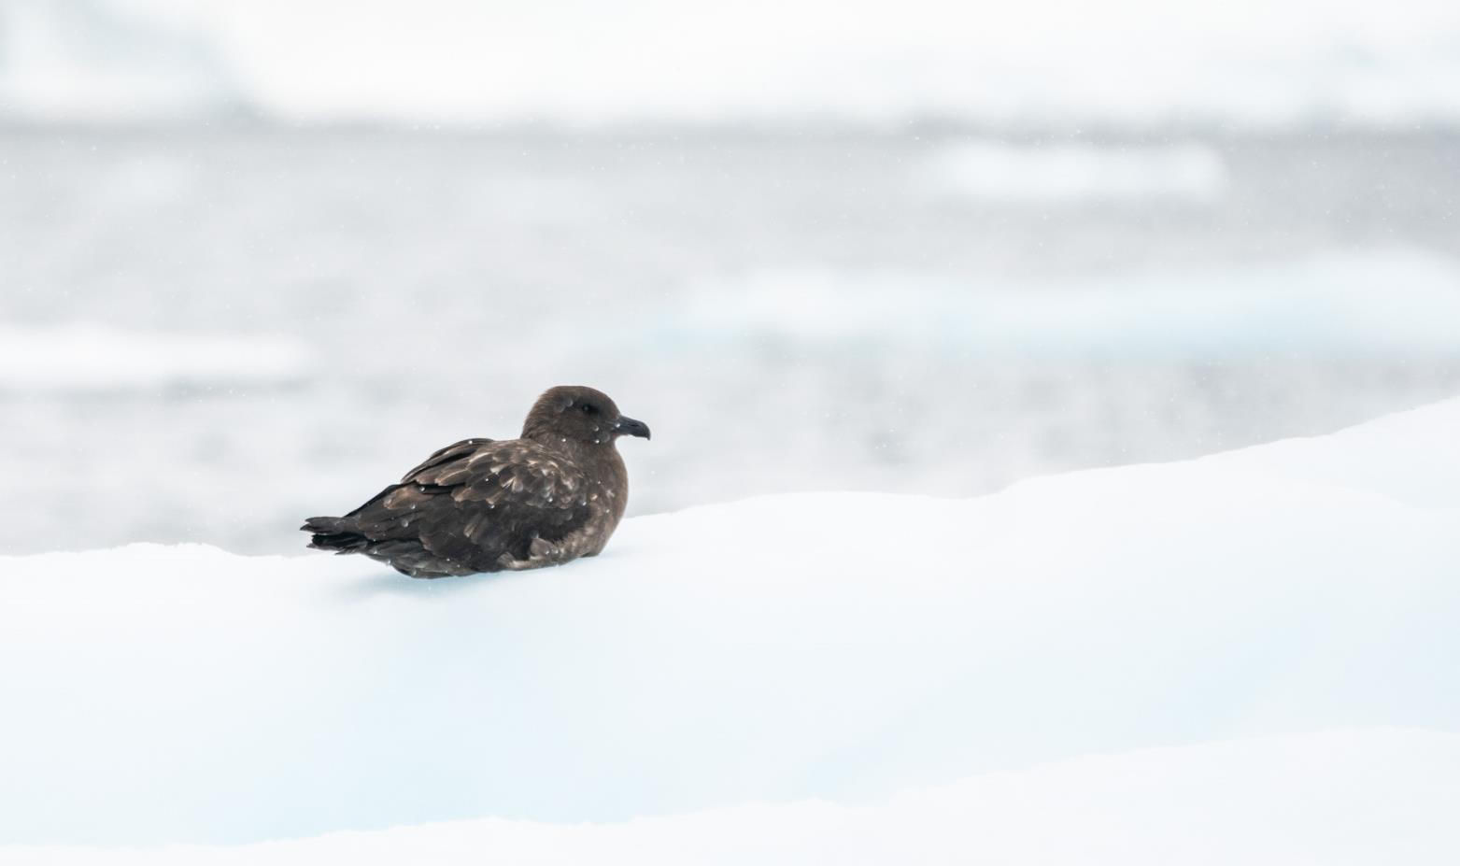
Wildlife
List – Birds
Notes:
Use the following pages to highlight some of the key bird species identified – and/or use the final page of the bird section to highlight the complete bird list on the e-Bird trip report

Slide 26
Birds - Wildlife list |  |  |  | February
Scientific Name | English | Deutsch | Français | 8 | 9 | 10 | 11 | 12 | 13 | 14 | 15 | 16 | 17
Pygoscelis papua | Gentoo Penguin | Eselspinguin | Manchot papou |  |  |  | X | X | X | X | X
Pygoscelis adeliae | Adelie Penguin | Adeliepinguin | Manchot d’Adélie |  |  |  | X | X
Pygoscelis antarcticus | Chinstrap Penguin | Zügelpinguin | Manchot à jugulaire |  |  |  |  |  | X | X | X
Eudyptes chrysolophus | Macaroni Penguin | Goldschopfpinguin | Gorfou doré |  |  | X
Spheniscus magellanicus | Magellanic Penguin | Magellanpinguin | Manchot de Magellan | X
Diomeda exulans | Snowy Albatross (Wandering A.) | Wanderalbatros | Albatros hurleur |  |  | X |  |  |  |  |  |  | X
Diomeda epomophora | Southern Royal Albatross | Königsalbatros | Albatros royal |  |  |  |  |  |  |  |  |  | X
Thalassarche melanophris | Black-browed Albatross | Schwarzbrauenalbatros | Albatros à sourcils noirs | X | X | X |  |  |  |  |  | X | X
Thalassarche chrysostoma | Grey-headed Albatross | Graukopfalbatros | Albatros à tête grise |  |  | X
Phoebetria palpebrata | Light-mantled Albatross | Graumantelalbatros | Albatros fuligineux |  |  | X
Macronectes giganteus | Southern Giant Petrel | Riesensturmvogel | Pétrel géant | X | X | X | X | X |  |  | X | X | X
Procellaria aequinoctialis | White-chinned Petrel | Weißkinn-Sturmvogel | Puffin à menton blanc |  | X | X |  |  |  |  |  | X | X
Pterodroma mollis | Soft-plumaged Petrel | Weichfeder-Sturmvogel | Pétrel soyeux |  |  |  |  |  |  |  |  | X
Fulmarus glacialoides | Southern Fulmar | Silbersturmvogel | Fulmar argenté |  |  | X |  |  | X
Daption capense | Cape Petrel | Kapsturmvogel | Damier du Cap |  |  | X |  |  |  |  |  | X
Thalassoica antarctica | Antarctic Petrel | Antarktissturmvogel | Pétrel antarctique
Pagodroma nivea | Snow Petrel | Schneestormvogel | Pétrel des neiges
Halobalaena caerulea | Blue Petrel | Blausturmvogel | Prion bleu |  | X | X
Pachyptila belcheri | Slender-billed Prion | Dünnschnabel-Sturmvogel | Prion de Belcher
Pachyptila desolata | Antarctic Prion | Taubensturmvogel | Prion de la Désolation |  | X | X
Oceanites oceanicus | Wilson’s Storm-petrel | Buntfuß-Sturmschwalbe | Océanite de Wilson |  |  | X | X | X | X | X | X |  | X
Fregetta tropica | Black-bellied Storm-petrel | Schwarzbauch-Sturmschwalbe | Océanite à ventre noir |  |  | X |  |  |  |  |  | X
Ardenna grisea | Sooty Shearwater | Dunkelsturmtaucher | Puffin fuligineux |  |  |  |  |  |  |  |  |  | X
Ardenna gravis | Great Shearwater | Kappensturmtaucher | Puffin majeur |  |  |  |  |  |  |  |  |  | X
Leucocarbo atriceps | Imperial Cormorant | Kaiserscharbe | Cormoran impérial | X |  |  | X | X |  | X | X
Stercorarius maccormicki | South Polar Skua | Antarktikskua | Labbe de McCormick |  | X | X | X | X | X | X | X
Stercorarius antarcticus | Brown Skua (Subantarctic) | Subantarktikskua | Labbe antarctique
Stercorarius chilensis | Chilean Skua | Chileskua | Labbe du Chili | X
Larus dominicanus | Kelp Gull | Dominikanermöwe | Goéland dominicain | X |  |  |  | X | X | X | X
Leucophaeus scoresbyii | Dolphin Gull | Blutschnabelmöwe | Goéland de Scoresby
Chionis albus | Snowy Sheathbill | Weißgesicht-Scheidenschnabel | Chionis blanc |  |  |  |  | X |  | X
Sterna vittata | Antarctic Tern | Antarktikseeschwalbe | Sterne couronnée |  |  |  | X | X | X | X | X
Sterna hirundinacea | South American Tern | Falklandseeschwalbe | Sterne hirundinacée | X

Slide 27
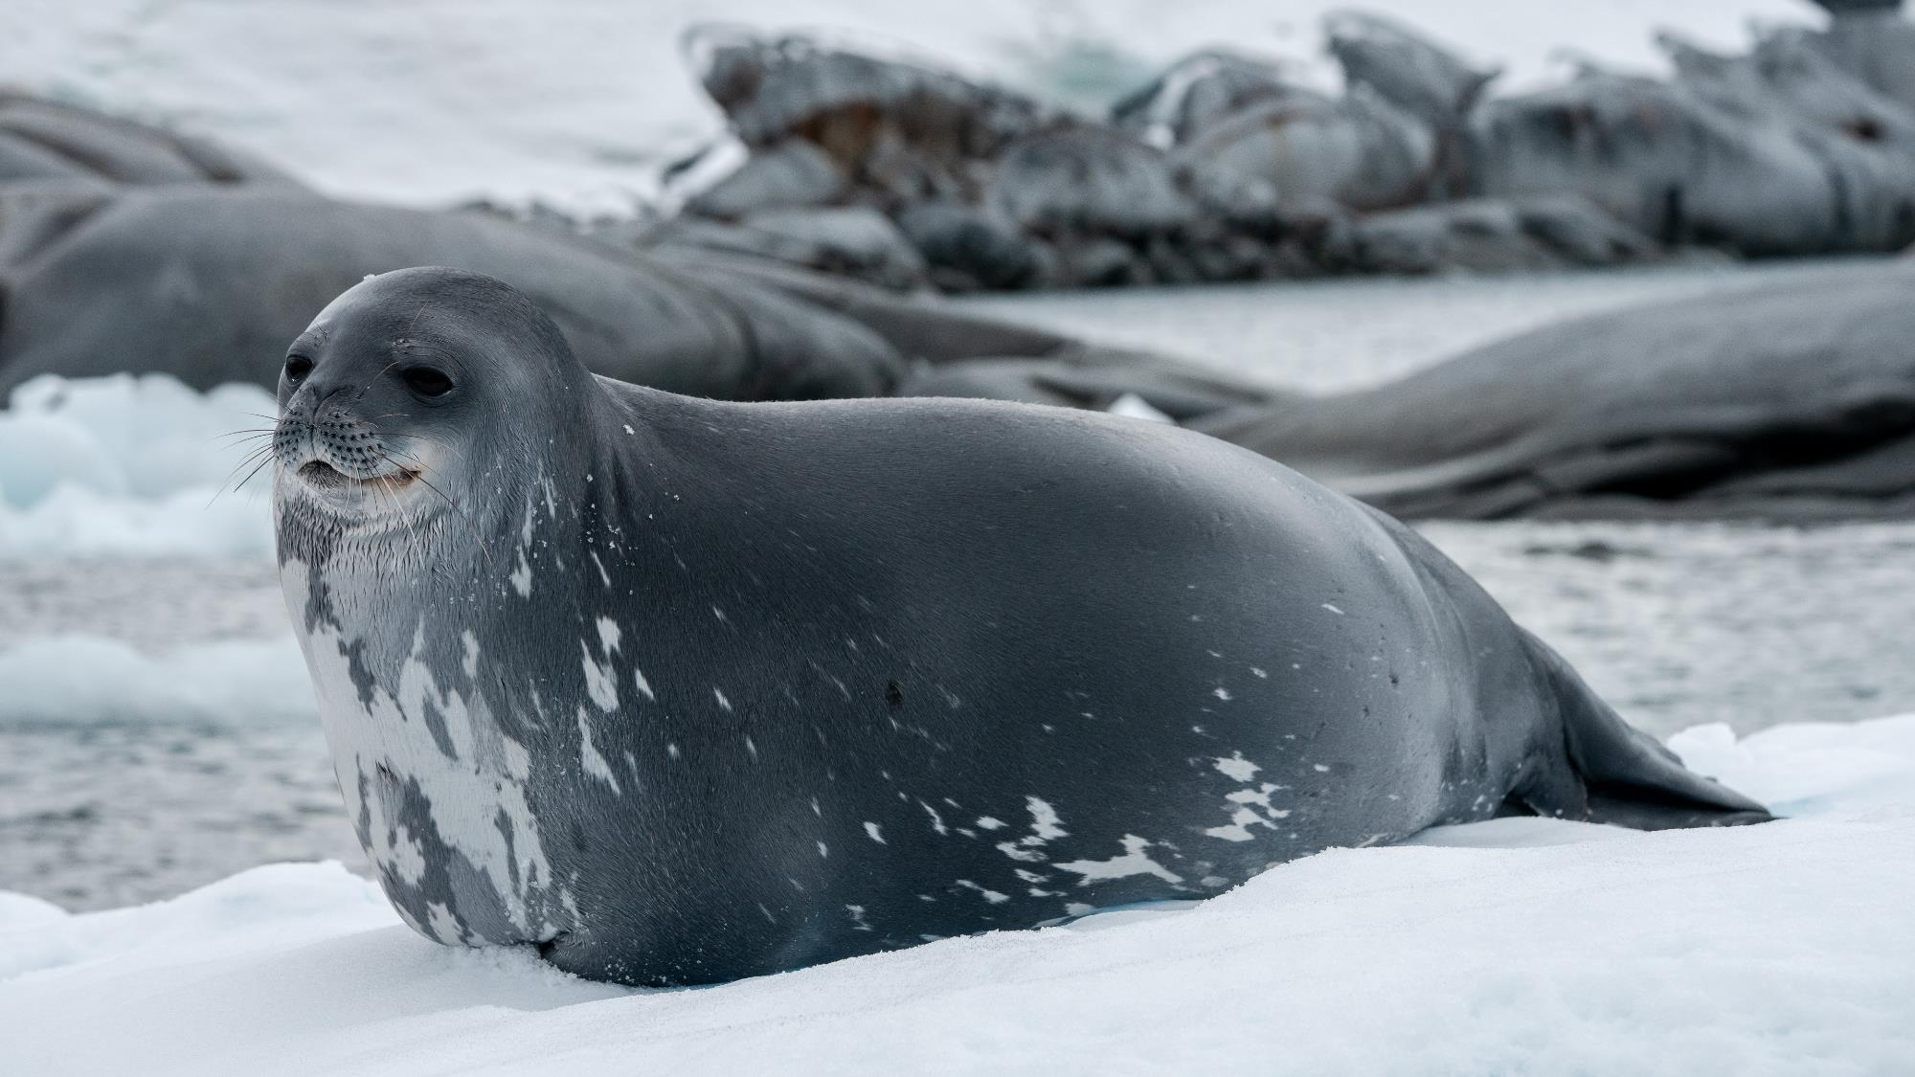
Wildlife
List - Marine Mammals

Slide 28

Wildlife List – Marine Mammals
Notes:
Copy and paste marine mammals observed – make sure scientific name is in italics

Slide 29
Connect with your inner scientist

