Slide 1
Science & Education Report
MS Fridtjof Nansen 2025

Slide 2
MS Fridtjof Nansen
Elemental Iceland – Circular Saga from Reykjavík
17 May 2025 – 24 May 2025
Credit: Timo Heinz/HX

Slide 3
Science & Education Program
From the volcanic beaches of the south to the glacier-carved fjords of the northwest, the Science and Education Team journeyed with you around Iceland’s entire coast, uncovering the wonders of this unique island nation.
Through lectures, hands-on workshops, and cultural experiences ashore—from Heimaey’s lava fields to the cliffs of the Westfjords—we explored Iceland’s resilient wildlife, rich cultural heritage, and the powerful natural forces that continue to shape its landscapes.
We hope these shared moments—spotting whales off the northern coast, listening to the seabirds of Látrabjarg, or walking through centuries of geological history—have deepened your appreciation for Iceland and sparked a lasting curiosity for the natural world.
Credit: Martin Hain/HX

Slide 4
Science & Education Program
Aboard HX vessels, we are guests in Iceland's wild and ever-changing landscapes, but through citizen science, you’ve become part of something bigger. Science is for everyone, happening everywhere, every day, and your participation makes a difference.
By observing wildlife, collecting data, and contributing to global research projects, you’ve forged a deeper connection with Iceland’s ecosystems, from seabird cliffs to volcanic shores.
This journey doesn’t end here. You have the tools to keep exploring, documenting, and protecting nature wherever you go.
Together, we can turn curiosity into action, fostering a future where people and the planet thrive.
Credit: Timo Heinz/HX

Slide 5
History
Your journey through the north of Iceland has taken you into landscapes shaped by fire, ice, and ancient myths. Standing at the edge of Goðafoss—the “Waterfall of the Gods”—you may have imagined the moment when pagan idols were cast into the falls, a powerful story still carried in the roar of the water.
At Lake Mývatn, you walked among craters, lava formations, and steaming geothermal fields that revealed just how alive this land remains. The eerie beauty of Dimmuborgir and the sulfurous terrain of Námaskarð showed the wild creativity of Iceland’s volcanic forces, while the serene waters of the Mývatn Nature Baths offered a quiet moment to take it all in.
In the Diamond Circle, you explored dramatic contrasts—from the thunder of Dettifoss, one of Europe’s most powerful waterfalls, to the silent embrace of Ásbyrgi canyon, where ancient floods carved a lush horseshoe-shaped haven.
These landscapes don’t just tell Iceland’s story—they invite us into it. We hope these sights and moments will stay with you, reminding you of the deep connection between nature, culture, and curiosity.
Credit: Tim Heinz/HX
Notes:
Please update this slide for this voyage

Slide 6
History
.
Your visit to the Snæfellsnes Peninsula offered a taste of Iceland in miniature—from volcanic peaks to black pebble beaches, lava caves, and dramatic coastal cliffs. One of the most iconic sights was Kirkjufell, the steep, solitary mountain rising above Grundarfjörður. Whether admired up close or viewed alongside the photogenic Kirkjufellsfoss waterfall, it’s easy to see why this landscape has captured imaginations for centuries.
As you explored Djúpalónssandur’s lava-strewn shoreline, ventured into the depths of Vatnshellir cave, or walked the cliffs of Arnarstapi, you stepped into a region shaped as much by story as by stone. Some say Kirkjufell resembles the back of a dragon, others believe it’s home to huldufólk—the hidden people of Icelandic folklore. Onboard, Icelandic musician Andri Ivars brought these cultural threads to life through music, humour, and storytelling.
From snow-covered volcanic slopes to tales whispered by the wind, Snæfellsnes continues to blur the line between myth and geology, reminding us that the landscape is never just scenery in Iceland. It’s a story still being told.
Credit: Timo Heinz/HX
Notes:
Please update this slide for this voyage

Slide 7
Geology
Kirkjufell’s striking shape tells a deeper story of Iceland’s ever-changing landscape. Layer by layer, the mountain reveals a history shaped by both fire and ice—built from volcanic rock and ash, then sculpted by powerful glaciers over thousands of years.
Its steep slopes and exposed strata are the result of repeated glacial advances during the Ice Ages of the Pleistocene, carving away softer material and leaving behind the distinctive peak we see today. Kirkjufell stands not only as a beautiful landmark, but as a natural archive of Iceland’s dynamic geological past—a place where the forces of eruption and erosion continue to meet.
Credit: Mario Reichenbach
Notes:
Please update for this voyage

Slide 8
Wildlife Watch
As we sailed around Iceland’s rugged coastlines, you were invited to step out on deck and take in the ever-changing seascape—cliffs, rolling swells, and skies teeming with birdlife. But the most memorable moments often came in stillness, as we scanned the horizon together in quiet anticipation.
Throughout the journey, we encountered an incredible range of seabirds: Northern gannets diving with precision, puffins skimming just above the waves, eider ducks drifting along rocky shores, and countless others adding movement and character to the coastal air. Each sighting brought the shoreline to life, reminding us that even the most remote edges of the world are full of energy, pattern, and purpose.
These encounters are more than passing impressions—they are reminders to stay curious, to look a little longer, and to care for the fragile web of life that depends on these cold northern waters.
Diatoms (St. Matthew, Alaska)
Credit: Tiimo Heinz/HX
Photo: Oscar Farrera
Notes:
Creativity was just one way we engaged with this incredible environment, but another was through direct observation.
Whether standing on deck or out in the zodiacs, we spent time scanning the horizon, watching seabirds glide past, and spotting whales as they surfaced. Every wildlife sighting was a reminder that Antarctica is anything but empty—it’s full of life, adapted to thrive in the harshest conditions.

Slide 9
NASA Cloud Observer
During our voyage, we contributed to NASA’s GLOBE Cloud Observations, collecting data on:
May 19th (Ísafjörður)
By comparing your ground-based observations with satellite measurements, scientists can refine cloud classifications, enhance climate models, and improve weather predictions—advancing our understanding of Earth’s atmosphere and climate.
Curious to continue? You can keep observing and submitting data from home using the GLOBE Observer app, turning everyday cloud-watching into real scientific impact.
View our data on the global map
Credit: Marina Livonius
Credit: Owen Hunt/HX
Photo: Oscar Farrera
Notes:
Slide already updated for this voyage

Slide 10
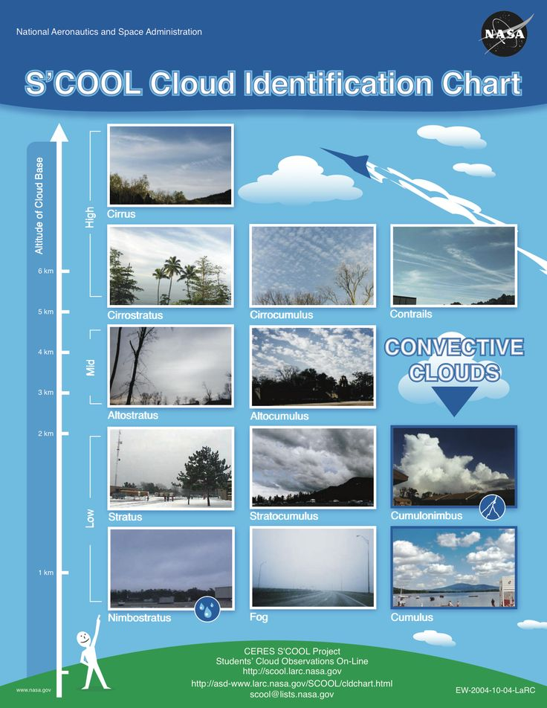
NASA Cloud Observer
High Clouds (Base above 6,000 meters):
Cirrus: Thin, wispy clouds composed of ice crystals. They often appear as delicate streaks or feathery wisps high in the sky.
Cirrostratus: Thin, sheet-like clouds that cover large portions of the sky. They can create a halo around the sun or moon.
Cirrocumulus: Small, fluffy clouds in a regular pattern, resembling fish scales or ripples.
Medium Clouds (Base between 2,000 and 6,000 meters):
Altocumulus: Puffy, grayish-white clouds with rounded edges. They often form parallel rows or patches.
Altostratus: Thick, grayish clouds that partially obscure the sun or moon. They lack the distinct features of cirrostratus.
Low Clouds (Base below 2,000 meters):
Stratus: Uniform, grayish clouds that cover the sky like a blanket. They can bring drizzle or light rain.
Stratocumulus: Low, lumpy clouds with defined edges. They often appear in rows or patches.
Nimbostratus: Thick, dark gray clouds associated with steady rain or snow.
Remember that these cloud types can vary in appearance and behaviour, but this basic classification helps meteorologists understand weather patterns and atmospheric conditions. If you’d like to explore more examples, you can check out NASA’s On-Line Cloud Chart.
6
5
4
3
2
1
View our data on the global map
Notes:
Slide already updated for this voyage

Slide 11
iNaturalist
Western Columbine
Aquilegia formosa
from Cordova, AK
Throughout this voyage, you played a vital role in documenting the incredible biodiversity of Iceland.
By capturing and submitting images of wildlife and plant life, you contributed to a global effort to track species distribution and monitor ecosystems across some of Iceland's most remote and ecologically rich coastlines.
Together, we gathered: 267 Observations 120 Species Identified 11 Observers Participating
Click on the link to view our collective data and see the impact of your contributions:
View our data on the iNaturalist website
Credit: Chiara Giulia Bertulli
Credit: Chiara G Bertulli/HX
Notes:
Just as we’ve collected data on the ocean and the sky, we also played a role in documenting life on land and at sea. Every wildlife sighting, plant identification, and photo taken helped build a bigger picture of biodiversity in Antarctica—contributing to global research on how ecosystems are changing.
To walk us through the iNaturalist project and the data we collected, I’d like to invite Ingvild to the stage

Slide 12
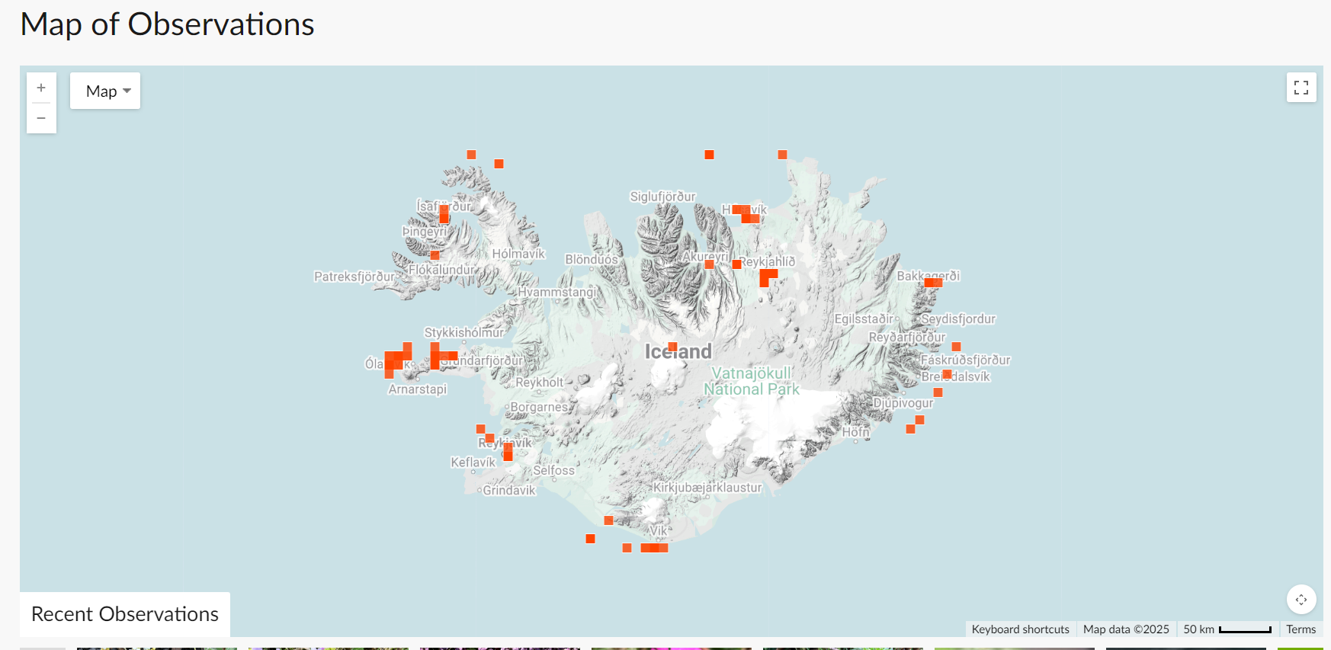
FNICE2505 – MS Fridtjof Nansen 17-24.5.2025
Notes:
Map of observations – to update

Slide 13
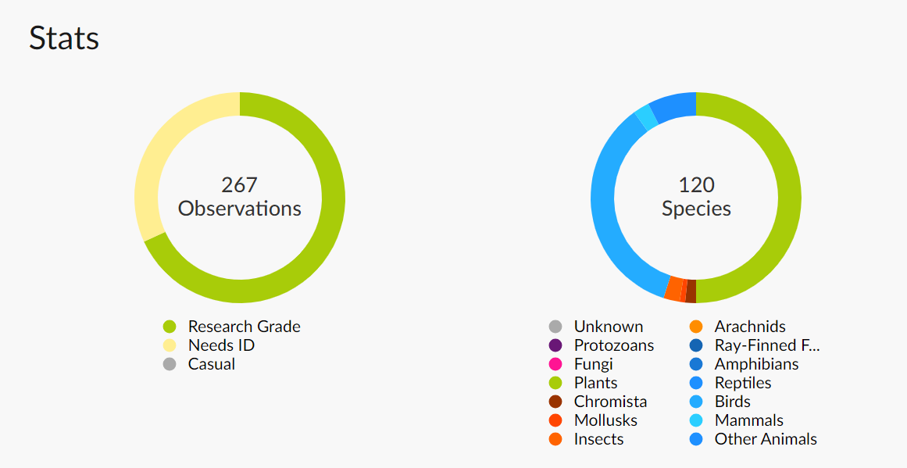
FNICE2505 – MS Fridtjof Nansen 17-24.5.2025
Notes:
Stats and line of submissions – to update

Slide 14
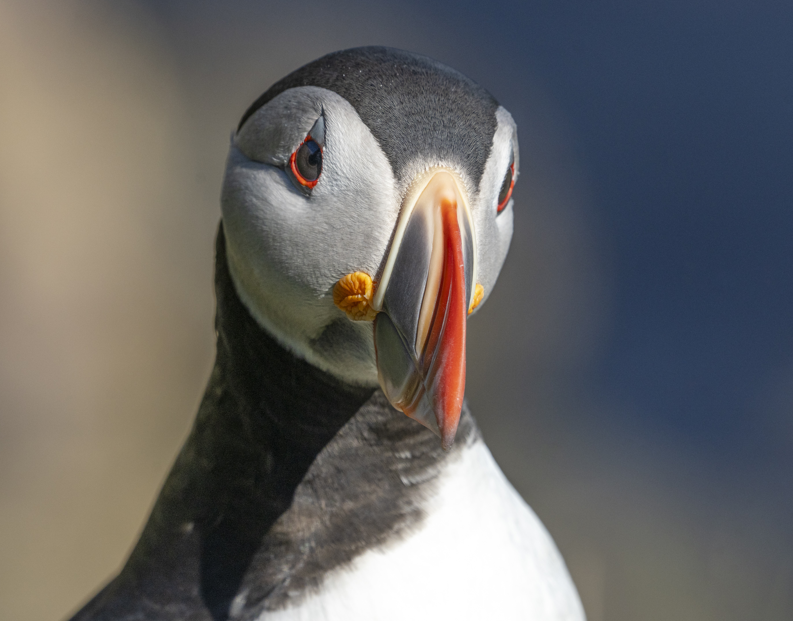
eBird
Bird-watching isn’t just a hobby—it’s a powerful tool for science. eBird, a global citizen science platform, allows bird enthusiasts to record and share sightings, contributing valuable data for research and conservation.
During our voyage, our onboard ornithologists conducted wildlife watches, completing 57 checklists and recording 46 bird species along the way.
Every entry adds to a growing database that helps scientists track migration patterns, monitor populations, and understand bird behaviour in remote regions like Antarctica. Scan the QR code to explore our data and see how your observations contribute to a global effort in avian research:
Credit: Timo Heinz/HX
Notes:
DONE

Slide 15
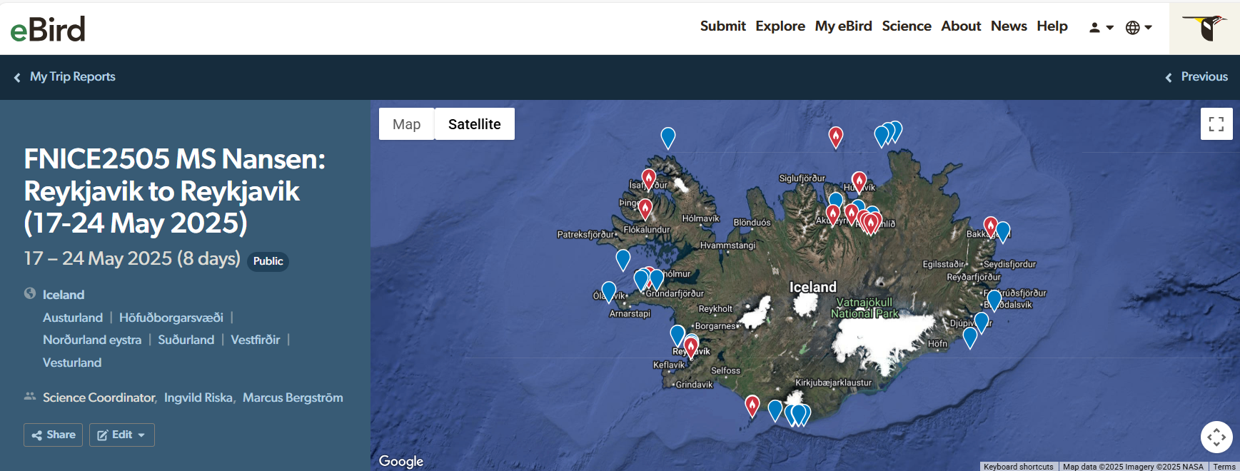

Slide 16
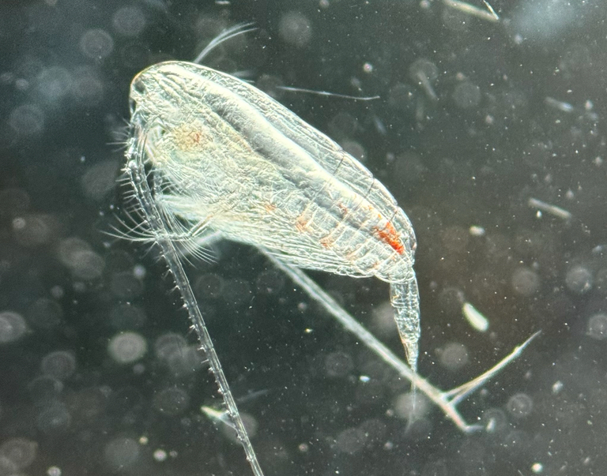
Plankton Samples
Back in the science centre, we brought the ocean into focus—examining our water samples under the microscope to uncover the hidden world of phytoplankton and zooplankton.
Using microscopes, we projected magnified images onto the screen, allowing everyone to see the intricate details of these tiny organisms. Smaller binocular microscopes offered a hands-on experience, inviting you to search for life in each drop of water.
The samples revealed a world dominated by diatoms, a type of phytoplankton that forms the foundation of the marine food web. What seemed invisible to the eye became a vivid reminder that even the smallest life forms shape this vast and wild ecosystem.
Photo: Ingvild Riska
Notes:
Please update photo for this voyage

Slide 17
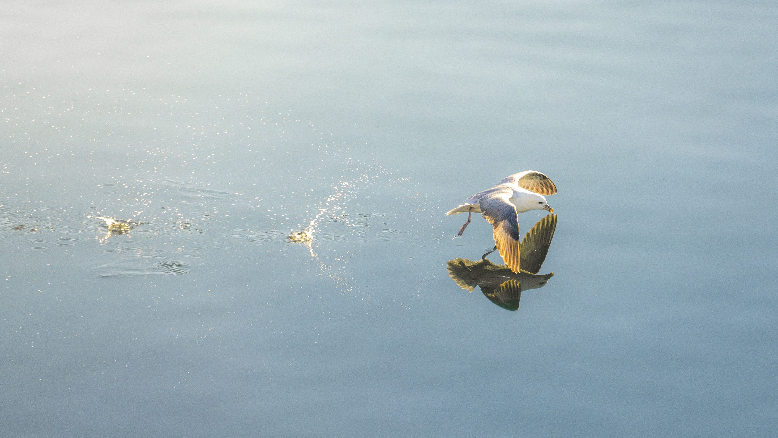
Wildlife
List - Birds
Credit: Timo Heinz

Slide 18
Wildlife List – Seabirds
Scientific Name | English | Deutsch | Français
Fulmarus glacialis | Northern Fulmar | Eissturmvogel | Fulmar boréal
Puffinus puffinus | Manx Shearwater | Atlantiksturmtaucher | Puffin des Anglais
Chroicocephalus ridibundus | Black-headed Gull | Lachmöwe | Mouette rieuse
Morus bassanus | Northern Gannet | Basstölpel | Fou de Bassan
Larus argentatus | Herring Gull | Silbermöwe | Goéland argenté
Larus fuscus | Lesser Black-backed Gull | Heringsmöwe | Goéland brun
Larus glaucoides | Iceland Gull | Polarmöwe | Goéland arctique
Larus hyperboreus | Glaucous Gull | Eismöwe | Goéland bourgmestre
Larus marinus | Great Black-backed Gull | Mantelmöwe | Goéland marin
Rissa tridactyla | Black-legged Kittiwake | Dreizehenmöwe | Mouette tridactyle
Sterna paradisaea | Arctic Tern | Küstenseeschwalbe | Sterne arctique
Phalacrocorax carbo | Great Cormorant | Kormoran | Grand Cormoran
Stercorarius parasiticus | Arctic Skua/ Parasitic Jaeger | Schmarotzerraubmöwe | Labbe parasite
Stercorarius skua | Great Skua | Skua | Grand Labbe
Stercorarius pomarinus | Pomarine Skua/Jaeger | Spatelraubmöwe | Labbe pomarin
Alca torda | Razorbill | Tordalk | Petit Pingouin
Fratercula arctica | Atlantic Puffin | Papageitaucher | Macareux moine
Cepphus grylle | Black Guillemot | Gryllteiste | Guillemot à miroir
Uria aalge | Common Murre | Trottellumme | Guillemot marmette
Uria lomvia | Brünnich’s Guillemot/ Thick-billed Murre | Dickschnabellumme | Guillemot de Brünnich
Notes:
Please update this slide for this voyage. Make sure the scientific name is in italics; English, German and French only

Slide 19
Wildlife List – Waterbirds
Scientific Name | English | Deutsch | Français
Cygnus cygnus | Whooper Swan | Singschwan | Cygne chanteur
Anas crecca | Eurasian Teal | Krickente | Sarcelle d’hiver
Anas platyrhynchos | Mallard | Stockente | Canard colvert
Anser anser | Greylag Goose | Graugans | Oie cendrée
Branta bernicla | Brant Goose | Ringelgans | Bernache cravant
Clangula hyemalis | Long-tailed Duck | Eisente | Harelde kakawi
Histrionicus histrionicus | Harlequin Duck | Kragenente | Arlequin plongeur
Mareca penelope | Eurasian Wigeon | Pfeifente | Canard siffleur
Mergus serrator | Red-breasted Merganser | Mittelsäger | Harle huppé
Somateria mollissima | Common Eider | Eiderente | Eider à duvet
Charadrius hiaticula | Common Ringed Plover | Sandregenpfeifer | Pluvier grand-gravelot
Pluvialis apricaria | European Golden Plover | Goldregenpfeifer | Pluvier doré
Gavia immer | Common Diver/Loon | Eistaucher | Plongeon huard
Gavia stellata | Red-throated Diver/Loon | Sterntaucher | Plongeon catmarin
Haematopus ostralegus | Eurasian Oystercatcher | Austernfischer | Huîtrier pie
Podiceps auritus | Slavonian/Horned Grebe | Ohrentaucher | Grèbe esclavon
Arenaria interpres | Ruddy Turnstone | Steinwälzer | Tournepierre à collier
Notes:
Please update this slide for this voyage. Make sure the scientific name is in italics; English, German and French only

Slide 20
Wildlife List – Waterbirds
Scientific Name | English | Deutsch | Français
Calidris alpina | Dunlin | Alpenstrandläufer | Bécasseau variable
Calidris canutus | Red Knot | Knutt | Bécasseau maubèche
Gallinago gallinago | Common Snipe | Bekassine | Bécassine des marais
Limosa limosa | Black-tailed Godwit | Uferschnepfe | Barge à queue noire
Numenius phaeopus | Whimbrel | Regenbrachvogel | Courlis corlieu
Phalaropus lobatus | Red-necked Phalarope | Odinshühnchen | Phalarope à bec étroit
Aythya fuligula | Tufted Duck | Reiherente | Fuligule morillon
Tringa totanum | Common Redshank | Rotschenkel | Chevalier gambette
Notes:
Please update this slide for this voyage. Make sure the scientific name is in italics; English, German and French only

Slide 21
Wildlife List – Landbirds
Scientific Name | English | Deutsch | Français
Plectrophenax nivalis | Snow Bunting | Schneeammer | Plectrophane des neiges
Columba livia | Rock Dove | Felsentaube | Pigeon biset
Corvus corax | Northern Raven | Kolkrabe | Grand Corbeau
Acanthis flammea | Common Redpoll | Birkenzeisig | Sizerin flammé
Anthus pratensis | Meadow Pipit | Wiesenpieper | Pipit farlouse
Motacilla alba | White Wagtail | Bachstelze | Bergeronnette grise
Oenanthe oenanthe | Northern Wheatear | Steinschmätzer | Traquet motteux
Passer domesticus | House Sparrow | Haussperling | Moineau domestique
Lagopus lagopus | Willow Ptarmigan | Moorschneehuhn | Lagopède des saules
Sturnus vulgaris | European Starling | Star | Étourneau sansonnet
Turdus iliacus | Redwing | Rotdrossel | Grive mauvis
Turdus merula | Common blackbird | Amsel | Merle noir
Regulus regulus | Goldcrest | Wintergoldhänchen | Roitelet huppé
Notes:
Please update this slide for this voyage. Make sure the scientific name is in italics; English, German and French only

Slide 22
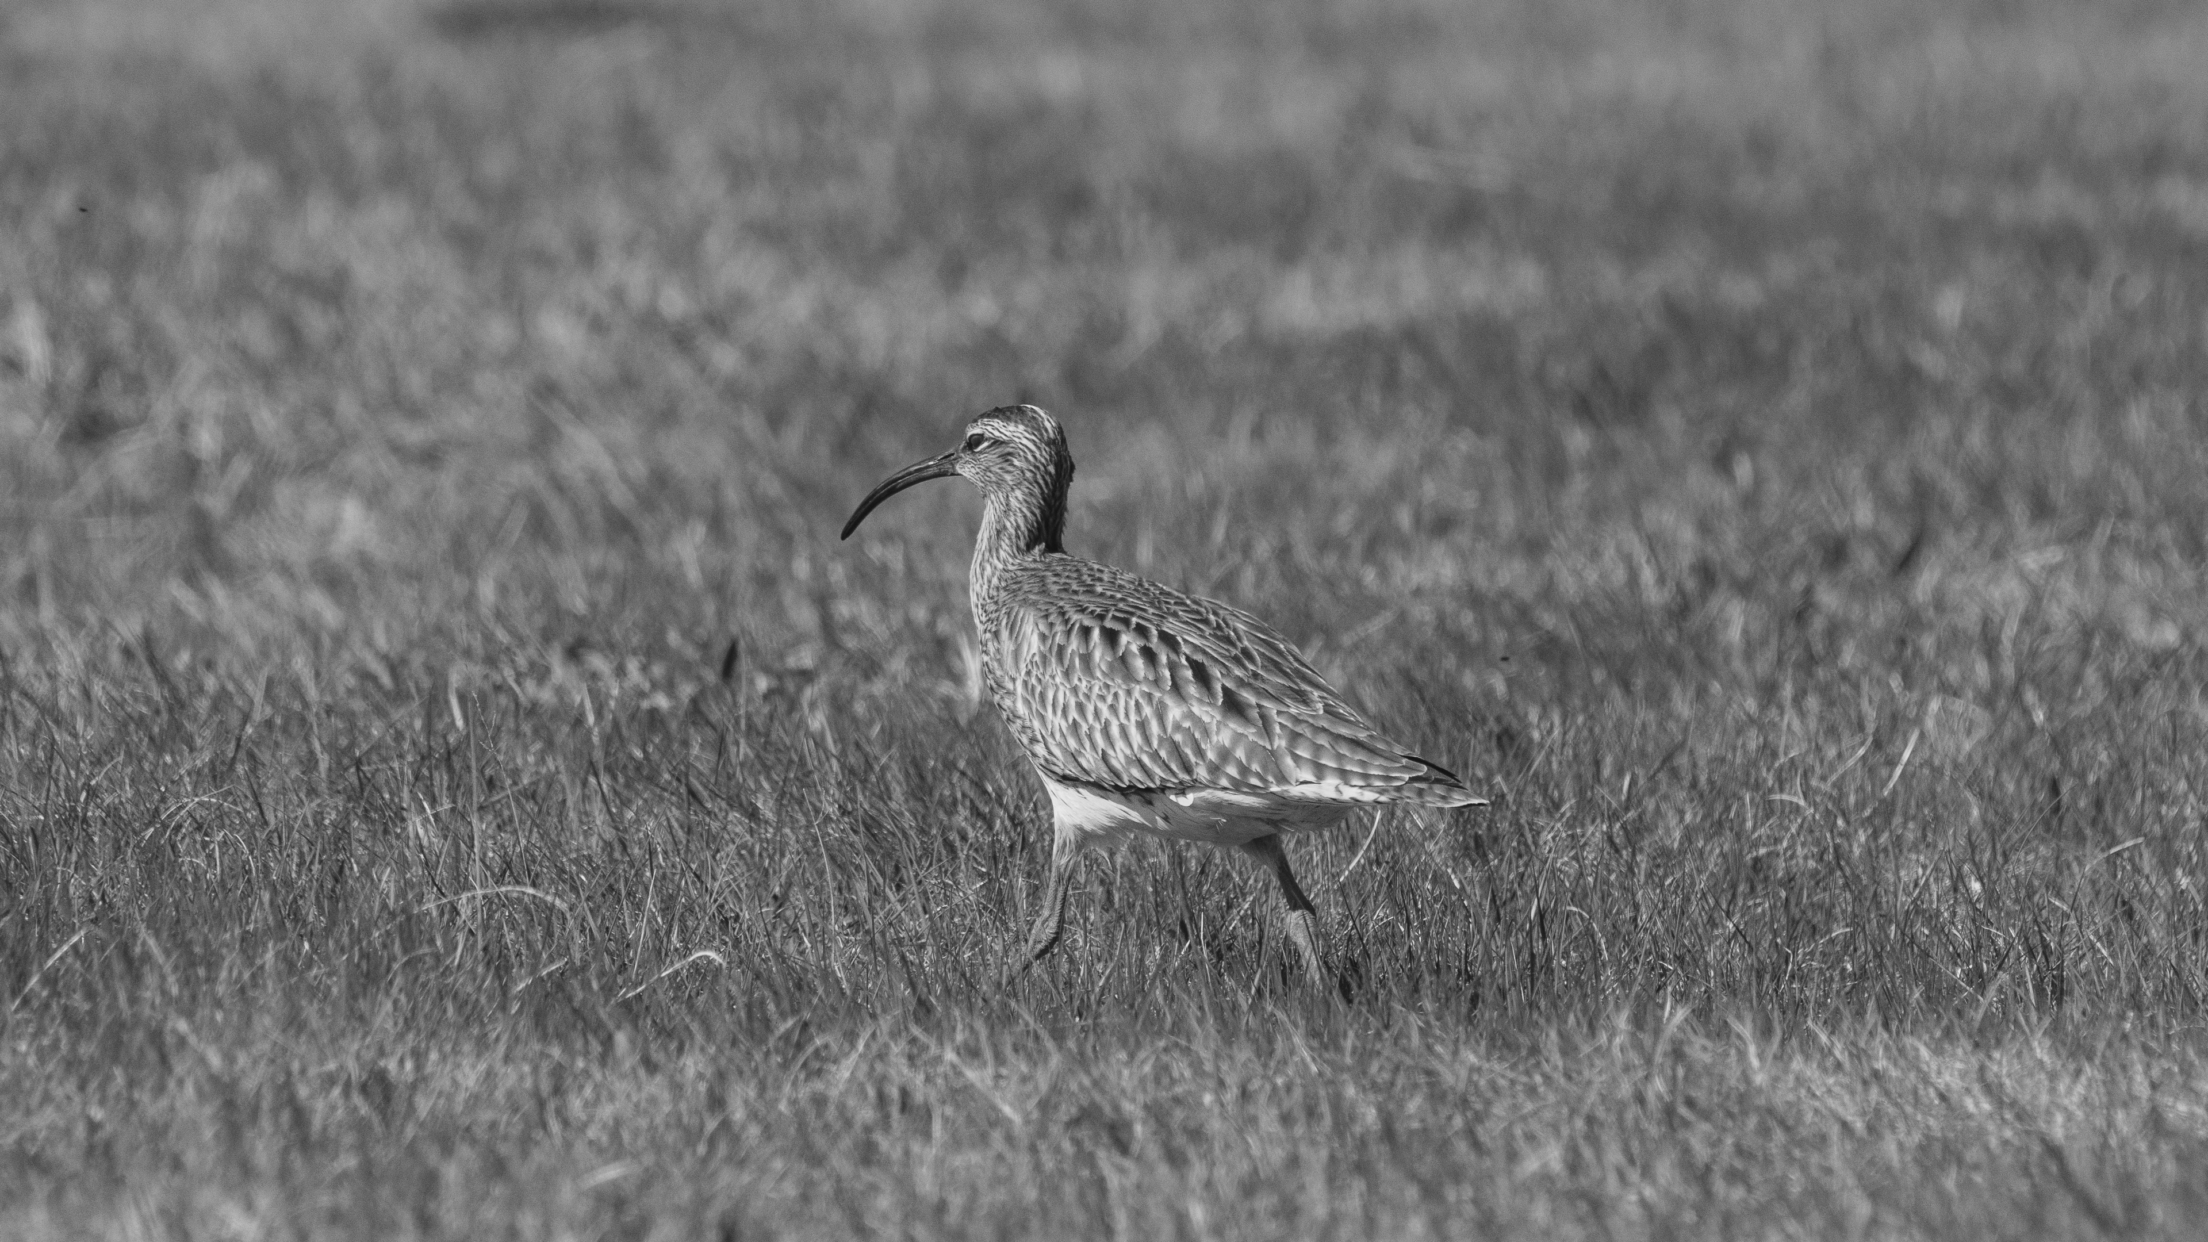
Eurasian Whimbrel (Numenius phaeopus)
Credit: Timo Heinz/HX

Slide 23
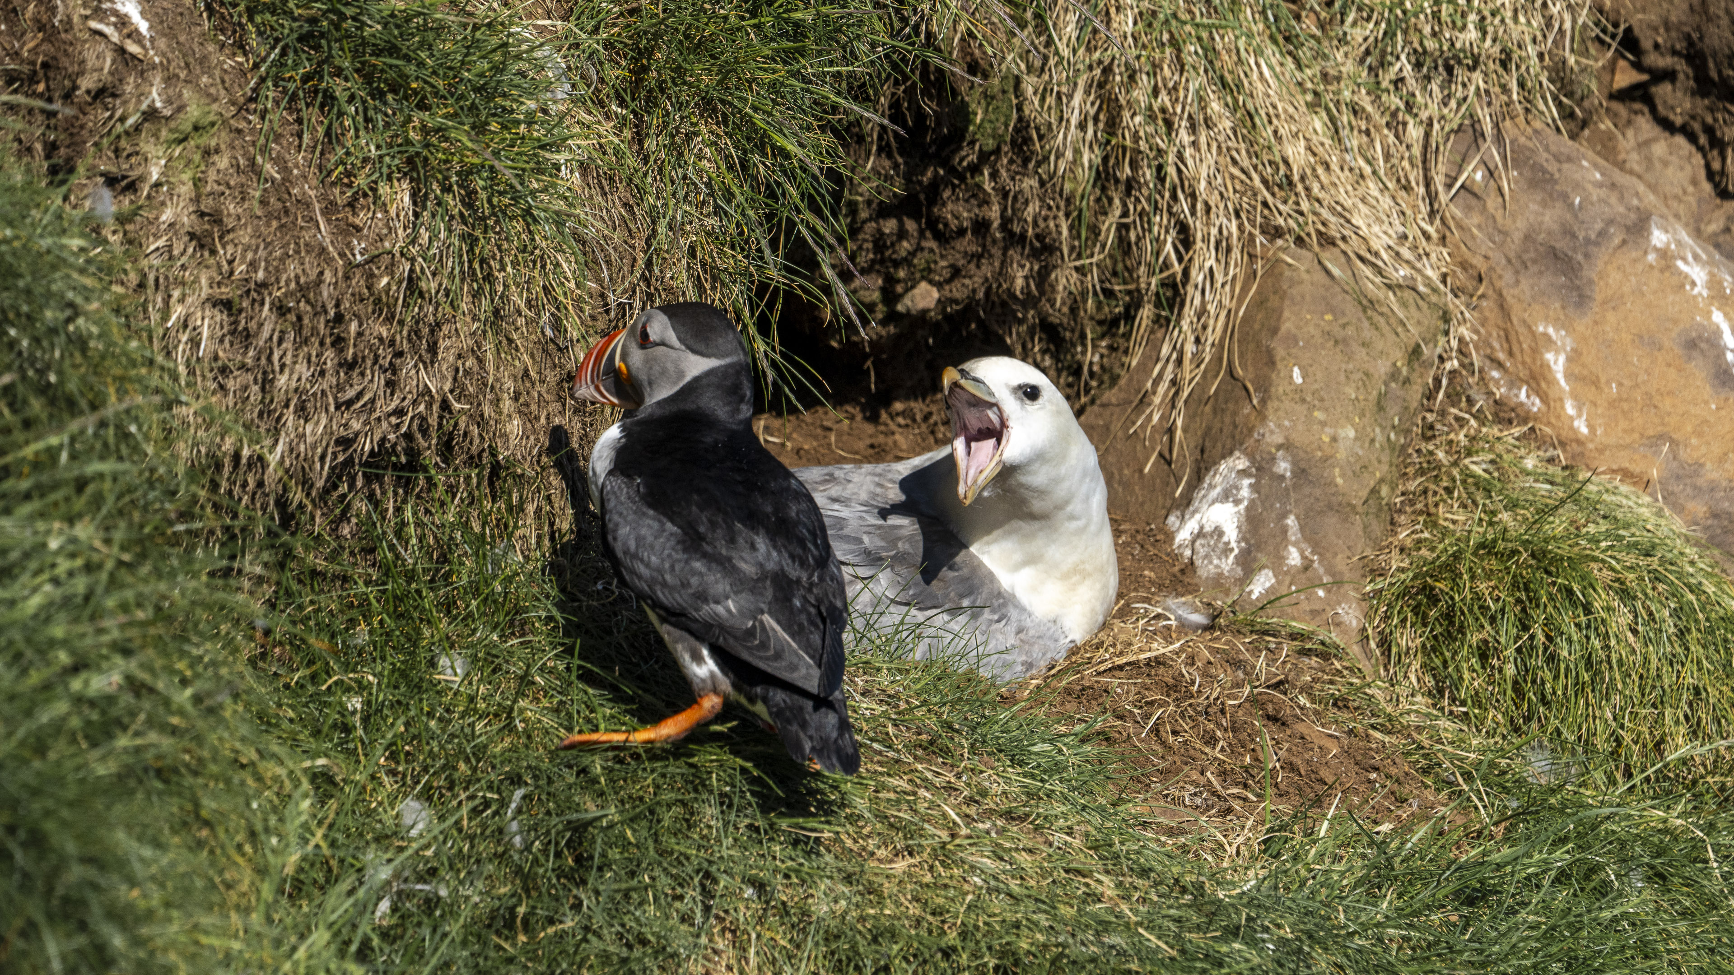
Northern Fulmar (Fulmarus glacialis) and Atlantic Puffin (Fratercula arctica)
Credit: Timo Heinz/HX

Slide 24
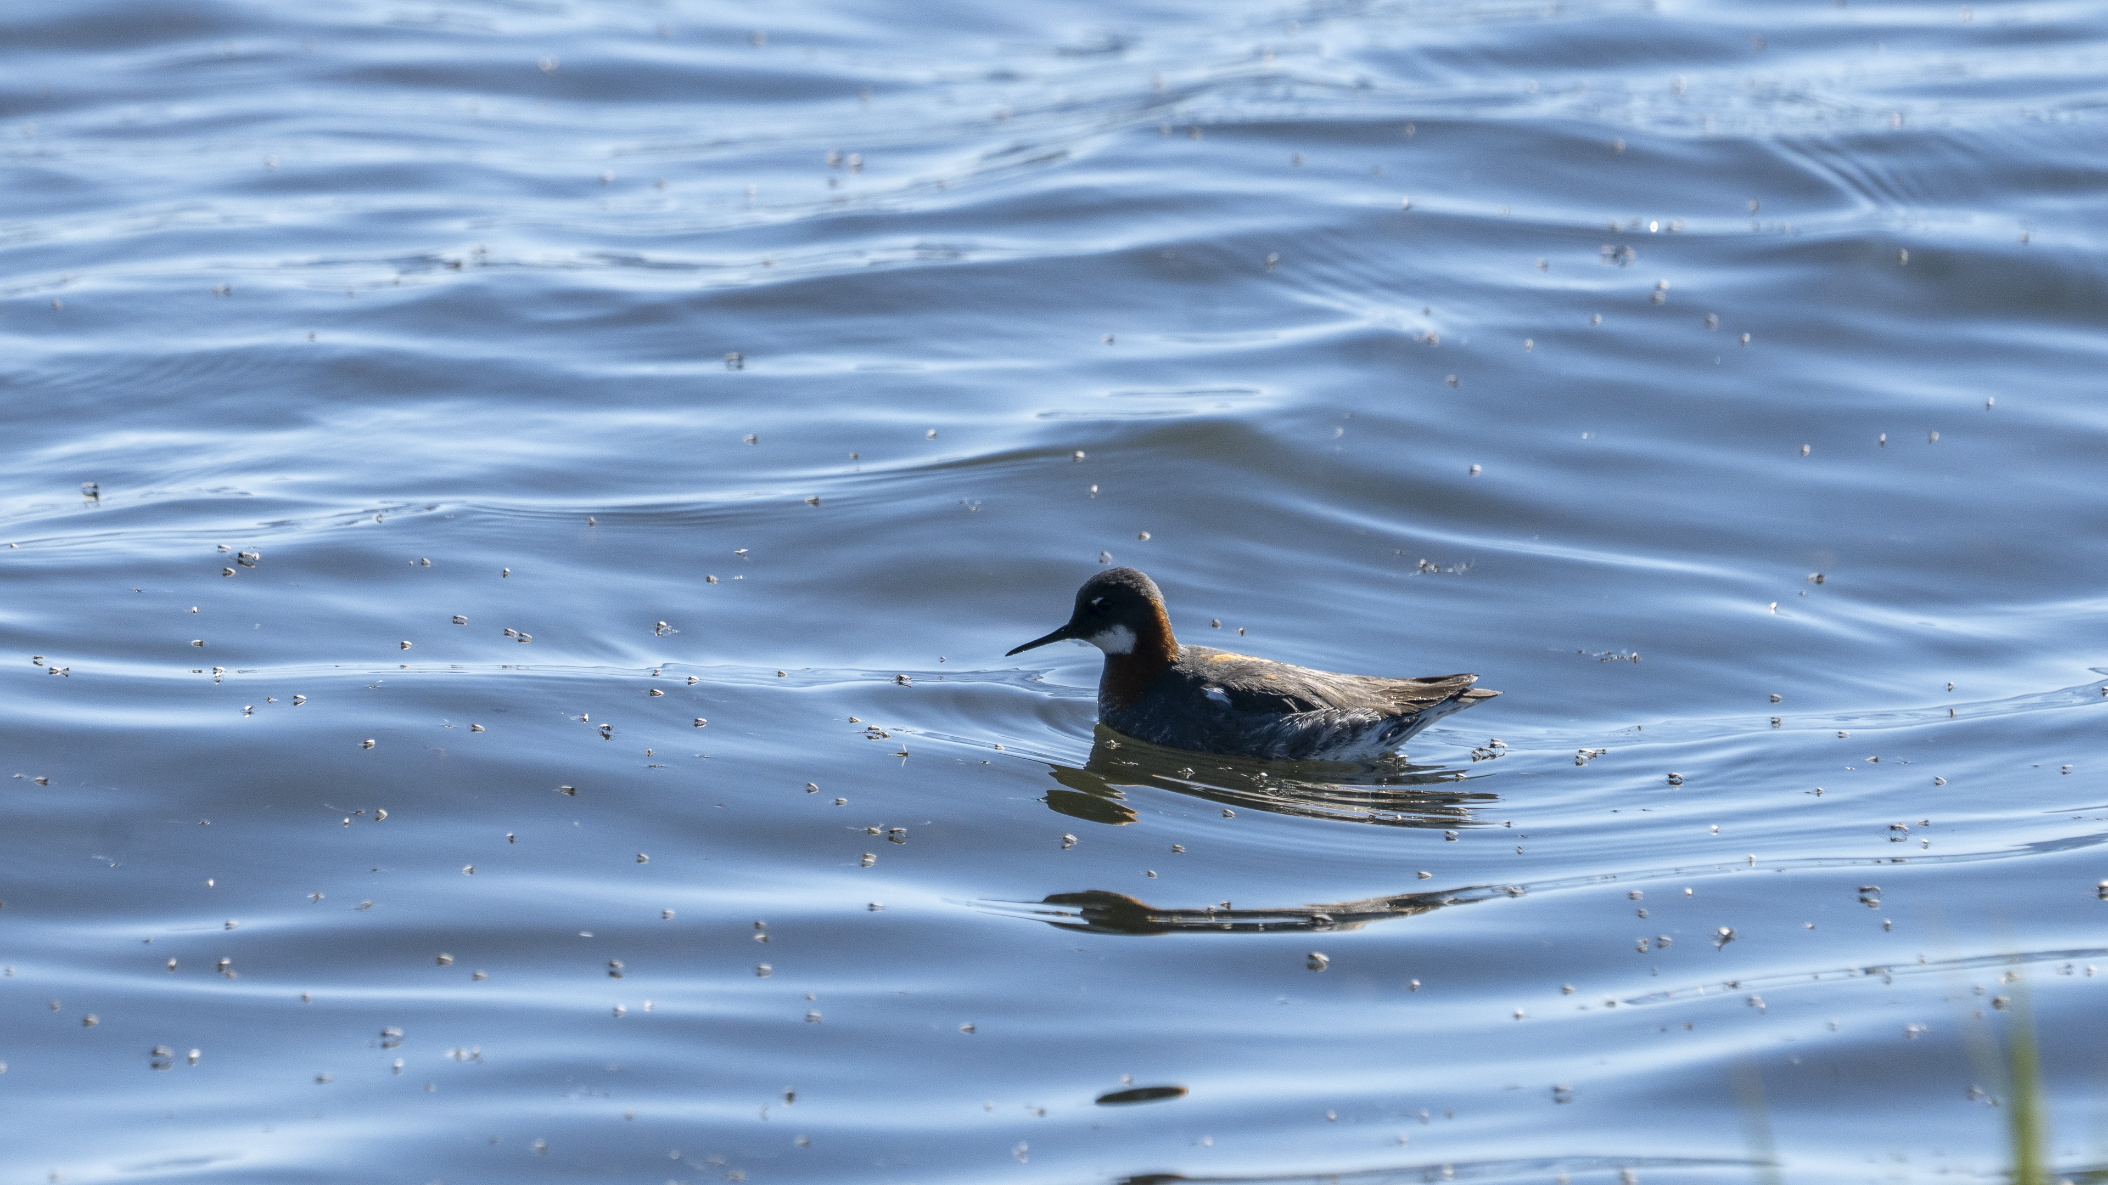
Red-necked Phalarope (Phalaropus lobatus)
Credit: Timo Heinz/HX

Slide 25
Credit: Timo Heinz/HX

Slide 26
Wildlife List – Marine Mammals
Scientific Name | English | Deutsch | Français
Halichoerus grypus | Grey seal | Kegelrobbe | Phoque gris
Phoca vitulina | Harbour seal | Kegelrobbe | Phoque commun
Megaptera novaeangliae | Humpback whale | Buckelwal | Baleine à bosse
Orcinus orca | Killer whale | Schwertwal | Épaulard
Balaenoptera acutorostrata | Minke Whale | Zwergwal | Petit rorqual
Physeter macrocephalus | Sperm Whale | Pottwal | Cachalot
Lagenorhynchus albirostris | White-beaked Dolphin | Weißschnauzendelfin | Dauphin à bec blanc
Notes:
Copy and paste marine mammals observed – make sure scientific name is in italics

Slide 27
Connect With Your Inner Scientist
Photo: Oscar Farrera

